Slide 1
第四章 自顶向下的分析

Slide 2
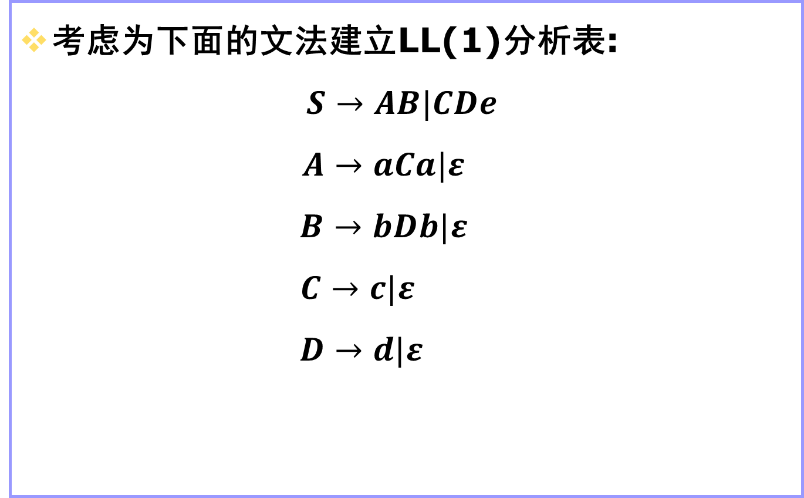
一个例子
考虑为下面的文法建立LL(1)分析表:
$$S→AB|CDe$$
$$A→aCa|ε$$
$$B→bDb|ε$$
$$C→c|ε$$
$$D→d|ε$$

Slide 3
First集和Follow集
当文法比较复杂时，使用前面的规则构造分析表比较麻烦。
因此需要引入First集和Follow集的概念，来辅助构造分析表。
当产生式右侧以非终结符开始时，我们需要计算First集，就是计算产生式右侧可能以哪些终结符开始。
当某个非终结符可以推出空时，我们需要计算Follow集，就是计算当在这个非终结符后面出现哪些终结符时可以使用推出空这个产生式。

Slide 4
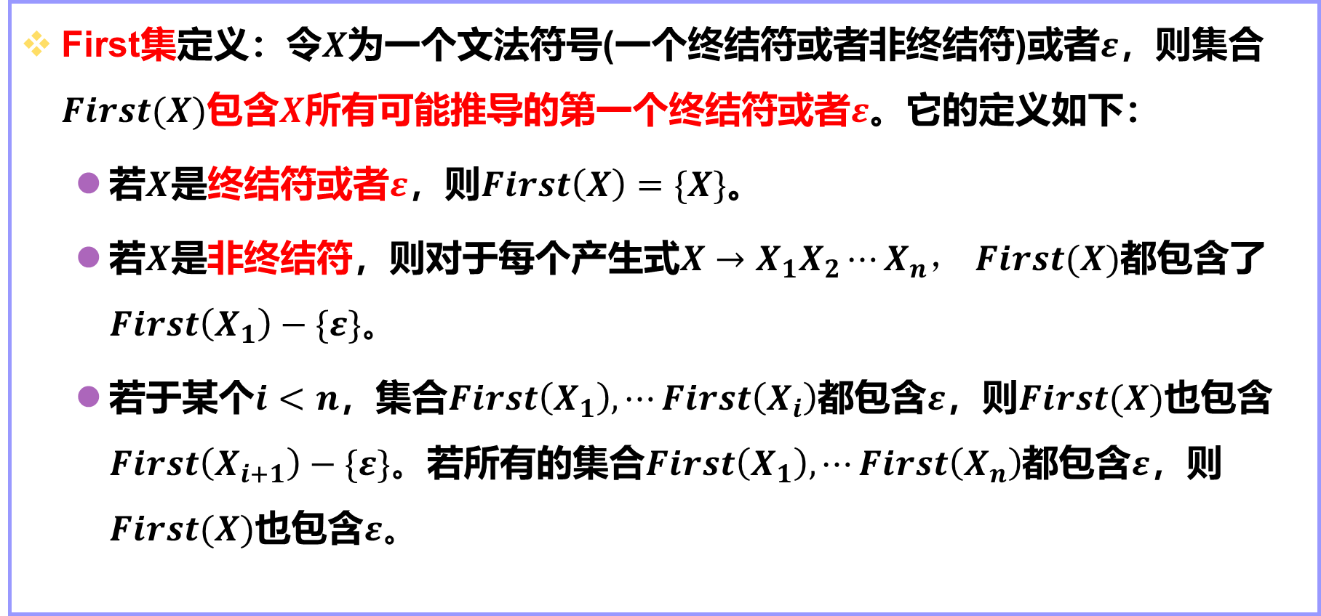
First集
First集定义：令$X$为一个文法符号(一个终结符或者非终结符)或者$ε$，则集合$First(X)$包含$X$所有可能推导的第一个终结符或者$ε$。它的定义如下：
若$X$是终结符或者$ε$，则$First\left(X\right)=\{X\}$。
若$X$是非终结符，则对于每个产生式$X→X_{1}X_{2}⋯X_{n}，$ $First(X)$都包含了$First\left(X_{1}\right)−\{ε\}。$
若于某个$i<n$，集合$First\left(X_{1}\right),⋯First\left(X_{i}\right)$都包含$ε$，则$First(X)$也包含$First\left(X_{i+1}\right)−\{ε\}。$若所有的集合$First\left(X_{1}\right), ⋯First\left(X_{n}\right)$都包含$ε$，则$First(X)$也包含$ε。$

Slide 5
计算First集的方法
for all non-terminal A do First(A):={ };
while there are changes to any First(A) do
for each production choice A→X1X2…Xn do
k:=1;
Continue:=true;
while Continue= true and k<=n do
add First(X_{k})-{ε} to First(A);
if ε is not in First(X_{k}) then Continue:= false;
k:=k+1;
if Continue = true then add ε to First(A);

Slide 6
计算示例
exp → exp addop term∣term
addop → +|-
term → term mulop factor ∣ factor
mulop →*
factor →(exp) ∣ n
(1) exp → exp addop term
(2) exp → term
(3) addop → +
(4) addop → -
(5) term → term mulop factor
(6) term → factor
(7) mulop →*
(8) factor →(exp)
(9) factor →n

Slide 7
示例
Grammar Rule | Pass 1 | Pass 2 | Pass 3
exp → exp addop term
exp→ term | ft(exp)<=ft(term) |  | ft(exp)={(, n}
addop → + | ft(addop)={+}
addop → - | ft(addop)={+,-}
term→term mulop factor
term → factor | ft(term)<=ft(factor) | ft(term)={(, n}
mulop →* | ft(mulop)={*}
factor →(exp) | ft(factor)={(}
factor →n | ft(factor)={(, n}

Slide 8
示例
所以First集如下：
First(exp) = {(,n}
First(term) = {(,n}
First(factor) = {(,n}
First(addop) = {+,-}
First(mulop) = {*}

Slide 9
示例
为if语句文法计算First集。
statement → if-stmt | other
if-stmt → if (exp) statement else-part
else-part → else statement | ε
exp → 0 | 1
展开：
(1) statement → if-stmt
(2) statement → other
(3) if-stmt → if (exp) statement else-part
(4) else-part → else statement
(5) else-part →ε
(6) exp → 0
(7) exp → 1

Slide 10
示例
Grammar Rule | Pass 1 | Pass 2
statement → if-stmt | ft(statement)<=ft(if-stmt) | ft(statement)={if,other}
statement → other | ft(statement)={other}
if-stmt → if (exp) statement else-part | ft(if-stmt)={if}
else-part → else statement | ft(else-part)={else}
else-part →ε | ft(else-part)={else,ε}
exp → 0 | ft(exp)={0}
exp → 1 | ft(exp)={0,1}

Slide 11
示例
所以First集如下：
First(statement) = {if,other}
First(if-stmt) = {if}
First(else-part) = {else,ε}
First(exp) = {0,1}

Slide 12
示例
为语句序列文法计算First集。
stmt-sequence →stmt stmt-seq’
stmt-seq’ →; stmt-sequence|ε
stmt→s
展开：
stmt-sequence →stmt stmt-seq’
stmt-seq’ →; stmt-sequence
stmt-seq’ →ε
stmt→s
First集如下:
First(stmt-sequence)={s}
First(stmt-seq’)={; , ε}
First(stmt)={s}

Slide 13
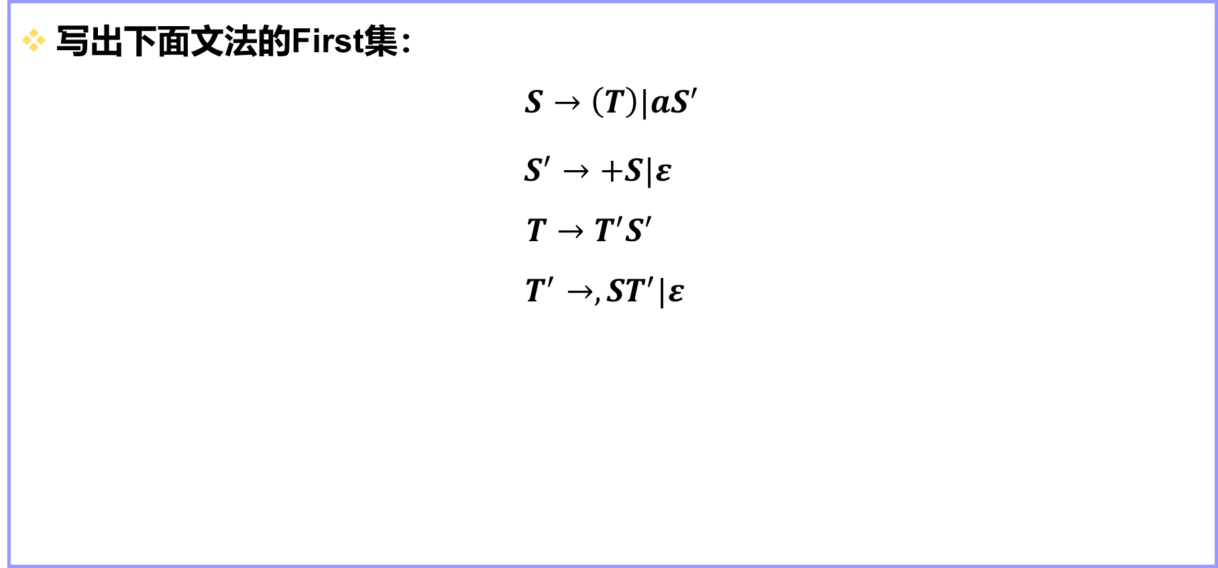
练习
写出下面文法的First集：
$$S→\left(T\right)|aS^{′}$$
$S^{′}→+S|ε$
$$T→T^{′}S^{′}$$
$$T^{′}→,ST^{′}|ε$$

Slide 14
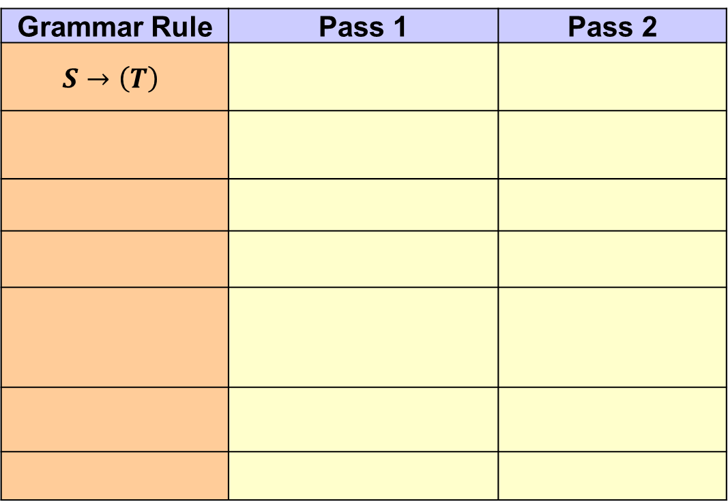
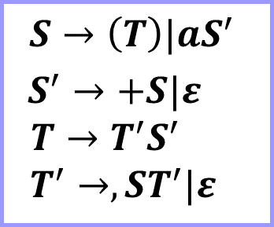
练习
Grammar Rule | Pass 1 | Pass 2
$$S→\left(T\right)$$
$$S→\left(T\right)|aS^{′}$$
$S^{′}→+S|ε$
$$T→T^{′}S^{′}$$
$$T^{′}→,ST^{′}|ε$$

Slide 15
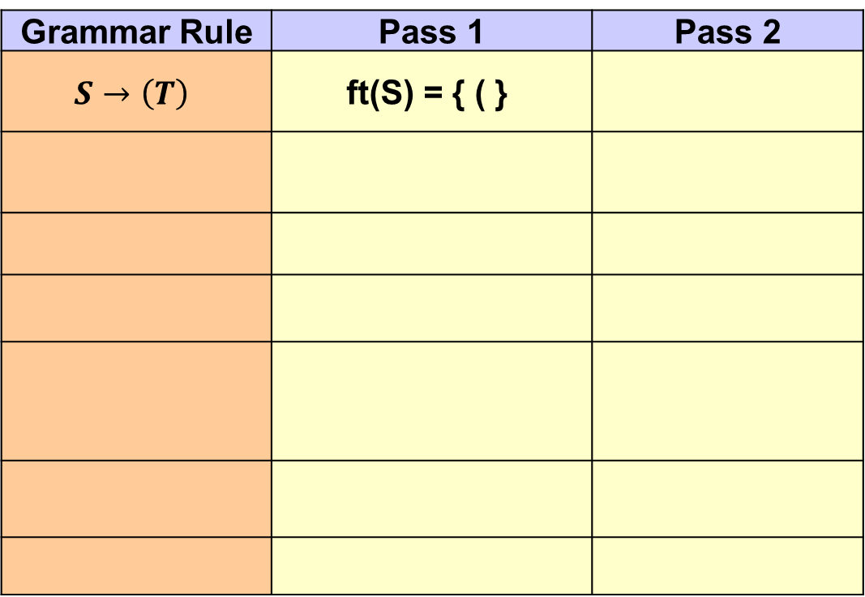
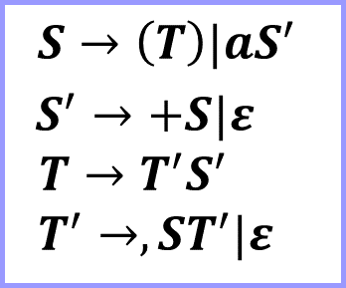
练习
Grammar Rule | Pass 1 | Pass 2
$$S→\left(T\right)$$ | ft(S) = { ( }
$$S→\left(T\right)|aS^{′}$$
$S^{′}→+S|ε$
$$T→T^{′}S^{′}$$
$$T^{′}→,ST^{′}|ε$$

Slide 16
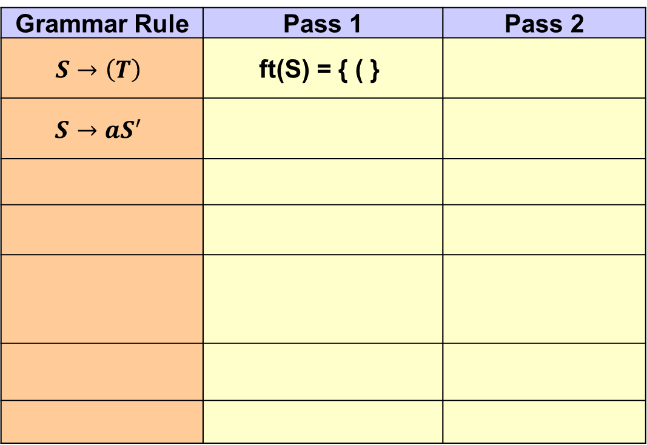
练习
Grammar Rule | Pass 1 | Pass 2
$$S→\left(T\right)$$ | ft(S) = { ( }
$$S→aS^{′}$$
$$S→\left(T\right)|aS^{′}$$
$S^{′}→+S|ε$
$$T→T^{′}S^{′}$$
$$T^{′}→,ST^{′}|ε$$

Slide 17
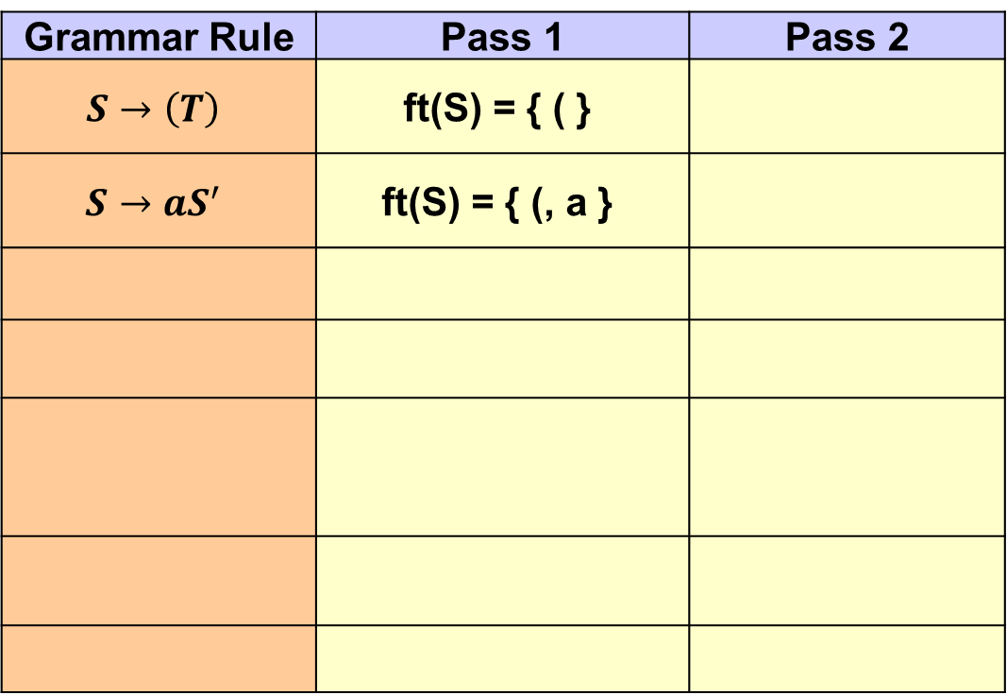
练习
Grammar Rule | Pass 1 | Pass 2
$$S→\left(T\right)$$ | ft(S) = { ( }
$$S→aS^{′}$$ | ft(S) = { (, a }
$$S→\left(T\right)|aS^{′}$$
$S^{′}→+S|ε$
$$T→T^{′}S^{′}$$
$$T^{′}→,ST^{′}|ε$$

Slide 18
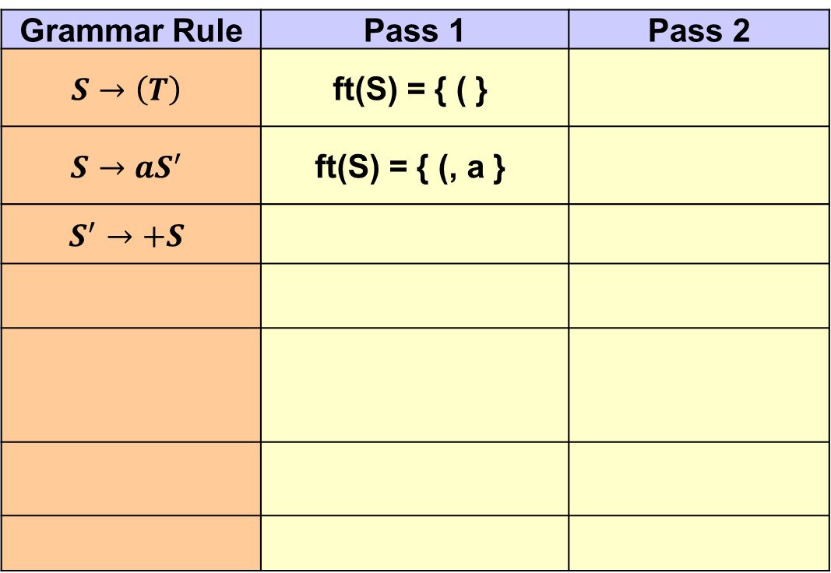
练习
Grammar Rule | Pass 1 | Pass 2
$$S→\left(T\right)$$ | ft(S) = { ( }
$$S→aS^{′}$$ | ft(S) = { (, a }
$$S^{′}→+S$$
$$S→\left(T\right)|aS^{′}$$
$S^{′}→+S|ε$
$$T→T^{′}S^{′}$$
$$T^{′}→,ST^{′}|ε$$

Slide 19
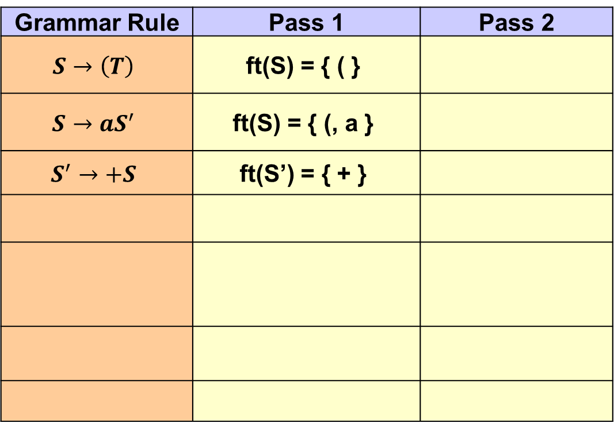
练习
Grammar Rule | Pass 1 | Pass 2
$$S→\left(T\right)$$ | ft(S) = { ( }
$$S→aS^{′}$$ | ft(S) = { (, a }
$$S^{′}→+S$$ | ft(S’) = { + }
$$S→\left(T\right)|aS^{′}$$
$S^{′}→+S|ε$
$$T→T^{′}S^{′}$$
$$T^{′}→,ST^{′}|ε$$

Slide 20
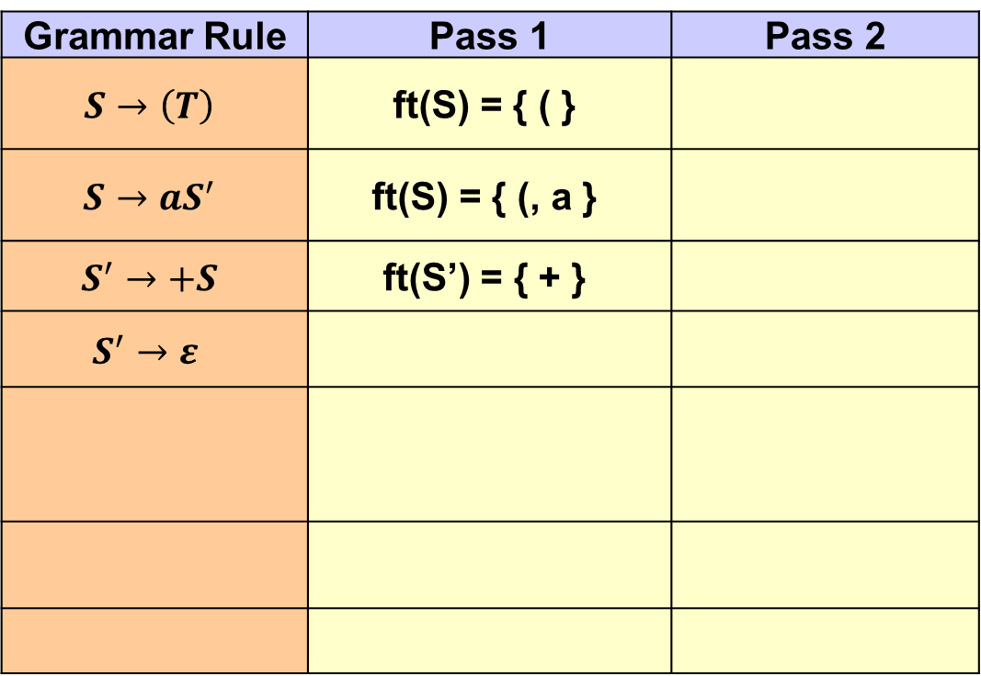
练习
Grammar Rule | Pass 1 | Pass 2
$$S→\left(T\right)$$ | ft(S) = { ( }
$$S→aS^{′}$$ | ft(S) = { (, a }
$$S^{′}→+S$$ | ft(S’) = { + }
$$S^{′}→ε$$
$$S→\left(T\right)|aS^{′}$$
$S^{′}→+S|ε$
$$T→T^{′}S^{′}$$
$$T^{′}→,ST^{′}|ε$$

Slide 21
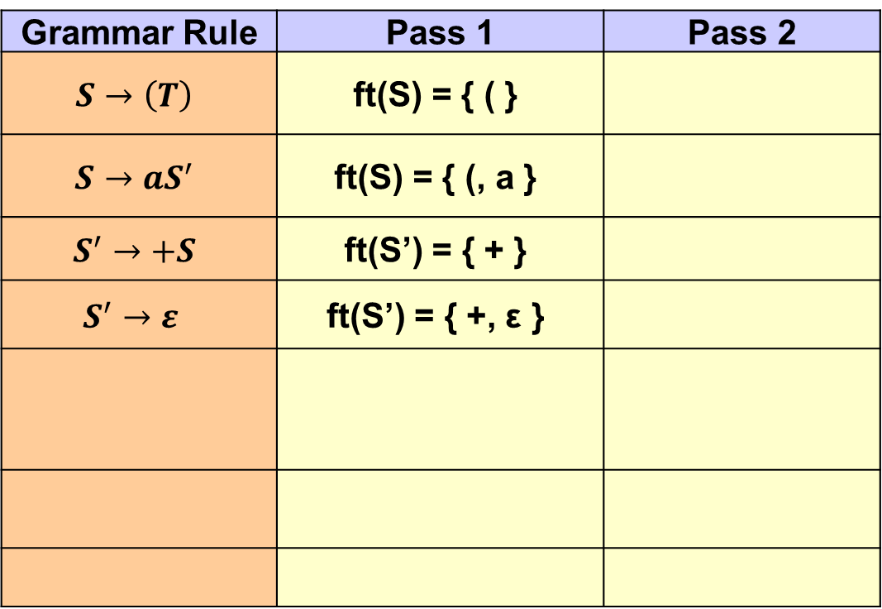
练习
Grammar Rule | Pass 1 | Pass 2
$$S→\left(T\right)$$ | ft(S) = { ( }
$$S→aS^{′}$$ | ft(S) = { (, a }
$$S^{′}→+S$$ | ft(S’) = { + }
$$S^{′}→ε$$ | ft(S’) = { +, ε }
$$S→\left(T\right)|aS^{′}$$
$S^{′}→+S|ε$
$$T→T^{′}S^{′}$$
$$T^{′}→,ST^{′}|ε$$

Slide 22
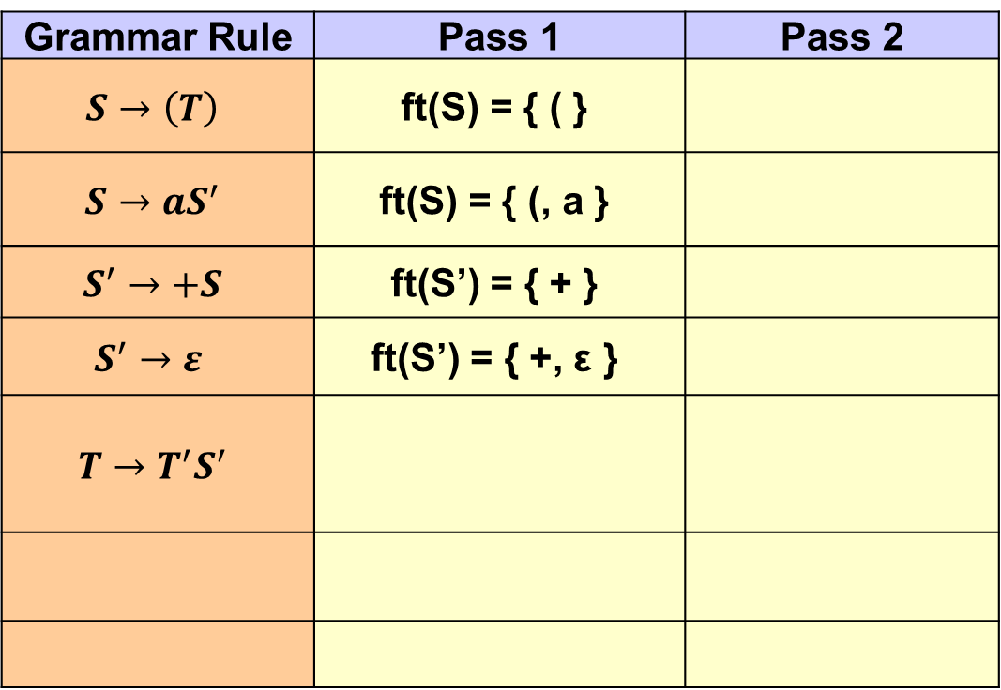
练习
Grammar Rule | Pass 1 | Pass 2
$$S→\left(T\right)$$ | ft(S) = { ( }
$$S→aS^{′}$$ | ft(S) = { (, a }
$$S^{′}→+S$$ | ft(S’) = { + }
$$S^{′}→ε$$ | ft(S’) = { +, ε }
$$T→T^{′}S^{′}$$
$$S→\left(T\right)|aS^{′}$$
$S^{′}→+S|ε$
$$T→T^{′}S^{′}$$
$$T^{′}→,ST^{′}|ε$$

Slide 23
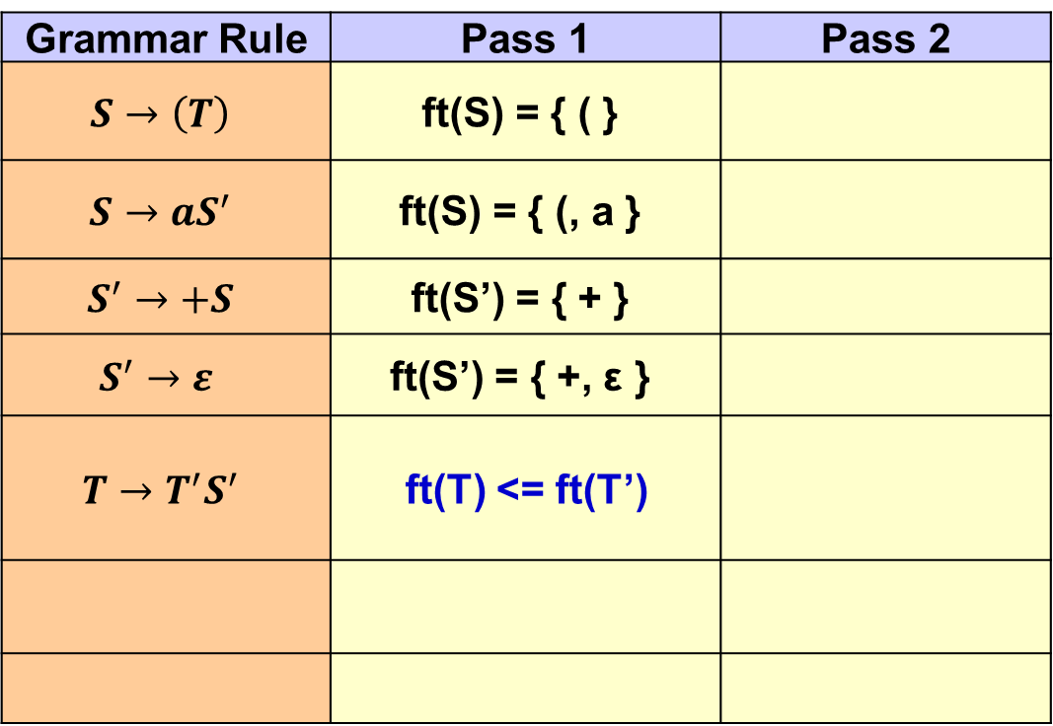
练习
Grammar Rule | Pass 1 | Pass 2
$$S→\left(T\right)$$ | ft(S) = { ( }
$$S→aS^{′}$$ | ft(S) = { (, a }
$$S^{′}→+S$$ | ft(S’) = { + }
$$S^{′}→ε$$ | ft(S’) = { +, ε }
$$T→T^{′}S^{′}$$ | ft(T) <= ft(T’)
$$S→\left(T\right)|aS^{′}$$
$S^{′}→+S|ε$
$$T→T^{′}S^{′}$$
$$T^{′}→,ST^{′}|ε$$

Slide 24
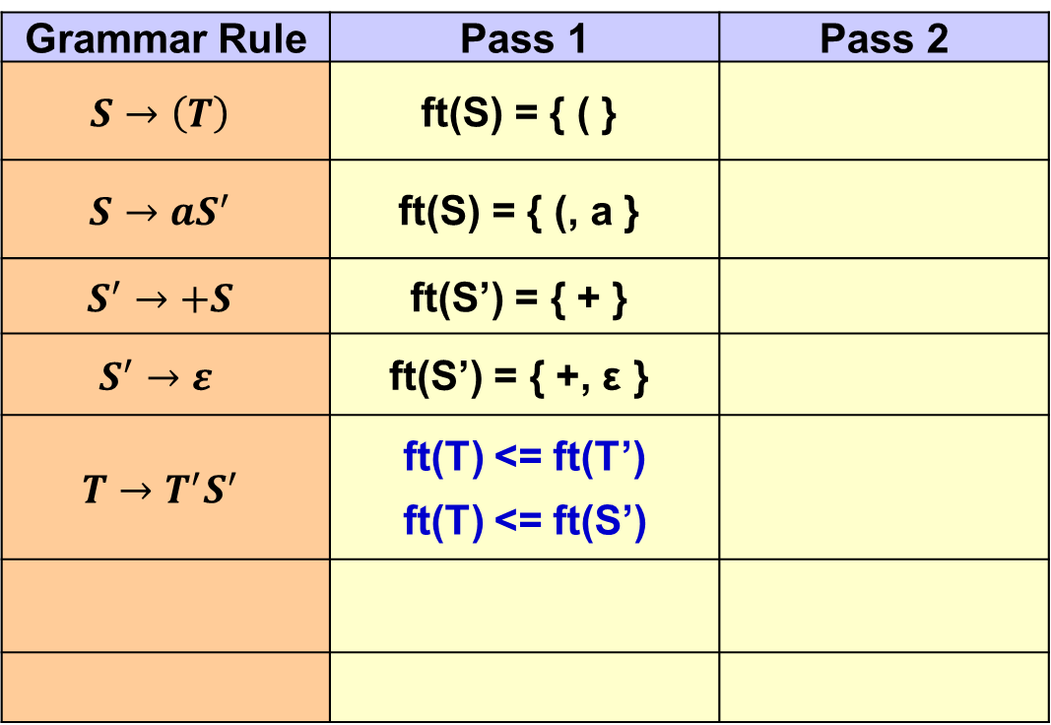
练习
Grammar Rule | Pass 1 | Pass 2
$$S→\left(T\right)$$ | ft(S) = { ( }
$$S→aS^{′}$$ | ft(S) = { (, a }
$$S^{′}→+S$$ | ft(S’) = { + }
$$S^{′}→ε$$ | ft(S’) = { +, ε }
$$T→T^{′}S^{′}$$ | ft(T) <= ft(T’) ft(T) <= ft(S’)
$$S→\left(T\right)|aS^{′}$$
$S^{′}→+S|ε$
$$T→T^{′}S^{′}$$
$$T^{′}→,ST^{′}|ε$$

Slide 25
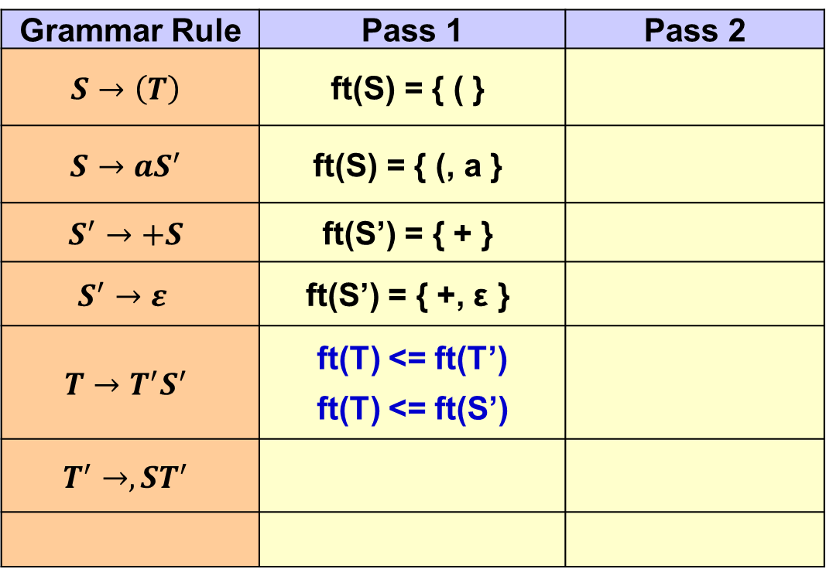
练习
Grammar Rule | Pass 1 | Pass 2
$$S→\left(T\right)$$ | ft(S) = { ( }
$$S→aS^{′}$$ | ft(S) = { (, a }
$$S^{′}→+S$$ | ft(S’) = { + }
$$S^{′}→ε$$ | ft(S’) = { +, ε }
$$T→T^{′}S^{′}$$ | ft(T) <= ft(T’) ft(T) <= ft(S’)
$$T^{′}→,ST^{′}$$
$$S→\left(T\right)|aS^{′}$$
$S^{′}→+S|ε$
$$T→T^{′}S^{′}$$
$$T^{′}→,ST^{′}|ε$$

Slide 26
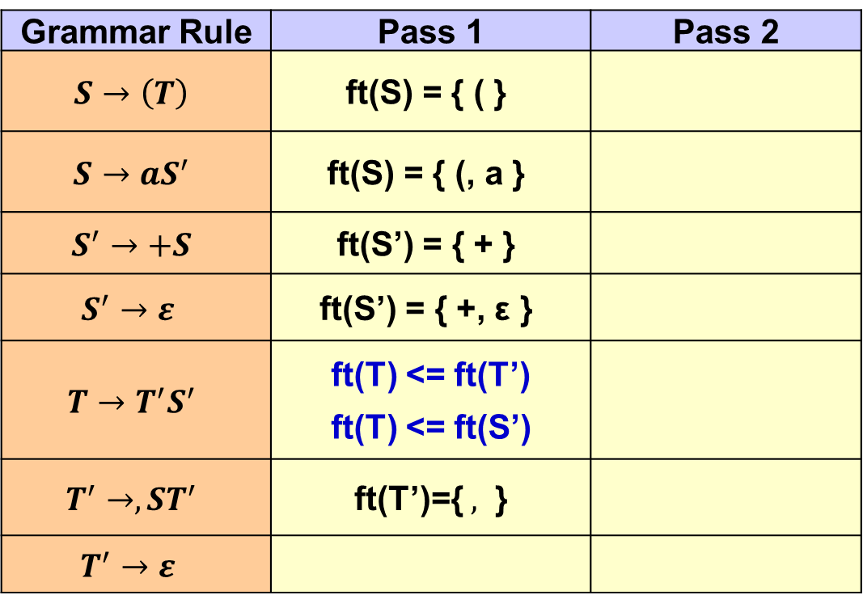
练习
Grammar Rule | Pass 1 | Pass 2
$$S→\left(T\right)$$ | ft(S) = { ( }
$$S→aS^{′}$$ | ft(S) = { (, a }
$$S^{′}→+S$$ | ft(S’) = { + }
$$S^{′}→ε$$ | ft(S’) = { +, ε }
$$T→T^{′}S^{′}$$ | ft(T) <= ft(T’) ft(T) <= ft(S’)
$$T^{′}→,ST^{′}$$ | ft(T’)={ $,$ }
$$T^{′}→ε$$
$$S→\left(T\right)|aS^{′}$$
$S^{′}→+S|ε$
$$T→T^{′}S^{′}$$
$$T^{′}→,ST^{′}|ε$$

Slide 27
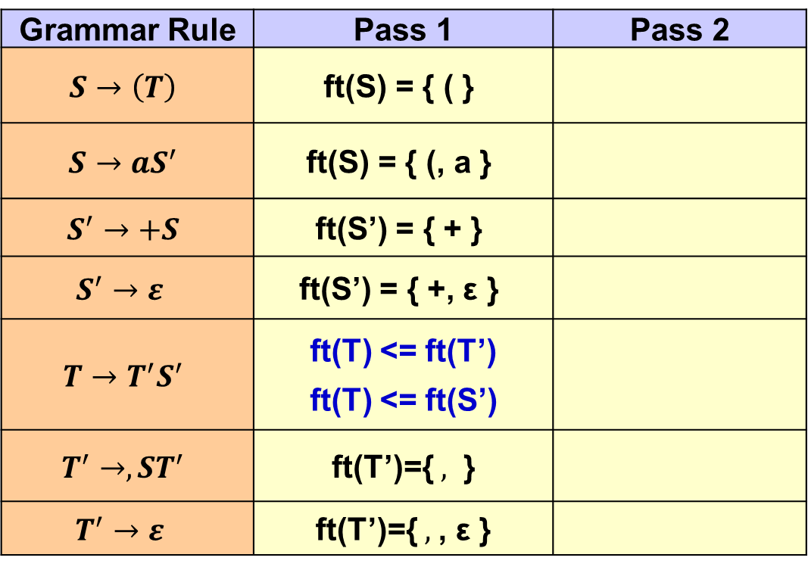
练习
Grammar Rule | Pass 1 | Pass 2
$$S→\left(T\right)$$ | ft(S) = { ( }
$$S→aS^{′}$$ | ft(S) = { (, a }
$$S^{′}→+S$$ | ft(S’) = { + }
$$S^{′}→ε$$ | ft(S’) = { +, ε }
$$T→T^{′}S^{′}$$ | ft(T) <= ft(T’) ft(T) <= ft(S’)
$$T^{′}→,ST^{′}$$ | ft(T’)={ $,$ }
$$T^{′}→ε$$ | ft(T’)={ $,$, ε }
$$S→\left(T\right)|aS^{′}$$
$S^{′}→+S|ε$
$$T→T^{′}S^{′}$$
$$T^{′}→,ST^{′}|ε$$

Slide 28
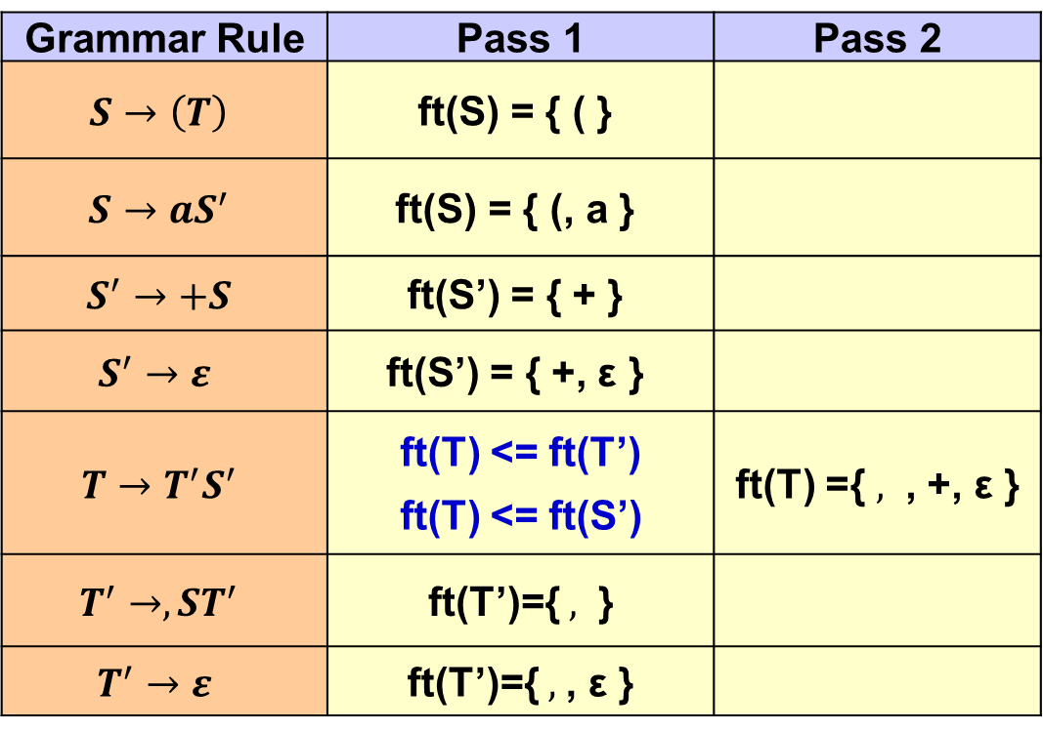
练习
Grammar Rule | Pass 1 | Pass 2
$$S→\left(T\right)$$ | ft(S) = { ( }
$$S→aS^{′}$$ | ft(S) = { (, a }
$$S^{′}→+S$$ | ft(S’) = { + }
$$S^{′}→ε$$ | ft(S’) = { +, ε }
$$T→T^{′}S^{′}$$ | ft(T) <= ft(T’) ft(T) <= ft(S’) | ft(T) ={ $,$ , +, ε }
$$T^{′}→,ST^{′}$$ | ft(T’)={ $,$ }
$$T^{′}→ε$$ | ft(T’)={ $,$, ε }
$$S→\left(T\right)|aS^{′}$$
$S^{′}→+S|ε$
$$T→T^{′}S^{′}$$
$$T^{′}→,ST^{′}|ε$$

Slide 29
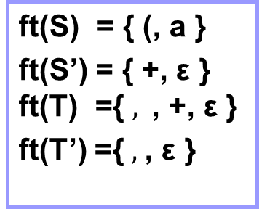
练习
Grammar Rule | Pass 1 | Pass 2
$$S→\left(T\right)$$ | ft(S) = { ( }
$$S→aS^{′}$$ | ft(S) = { (, a }
$$S^{′}→+S$$ | ft(S’) = { + }
$$S^{′}→ε$$ | ft(S’) = { +, ε }
$$T→T^{′}S^{′}$$ | ft(T) <= ft(T’) ft(T) <= ft(S’) | ft(T) ={ $,$ , +, ε }
$$T^{′}→,ST^{′}$$ | ft(T’)={ $,$ }
$$T^{′}→ε$$ | ft(T’)={ $,$, ε }
$$S→\left(T\right)|aS^{′}$$
$S^{′}→+S|ε$
$$T→T^{′}S^{′}$$
$$T^{′}→,ST^{′}|ε$$
$$\text{ft}\text{(}\text{S}\text{) = \{ (, }\text{a}\text{ \} }$$
ft(S’) = { +, ε }
$$\text{ft}\text{(}\text{T}\text{) =\{ },\text{ , +, }\text{ε}\text{ \}}$$
ft(T’) ={ $,$, ε }

Slide 30
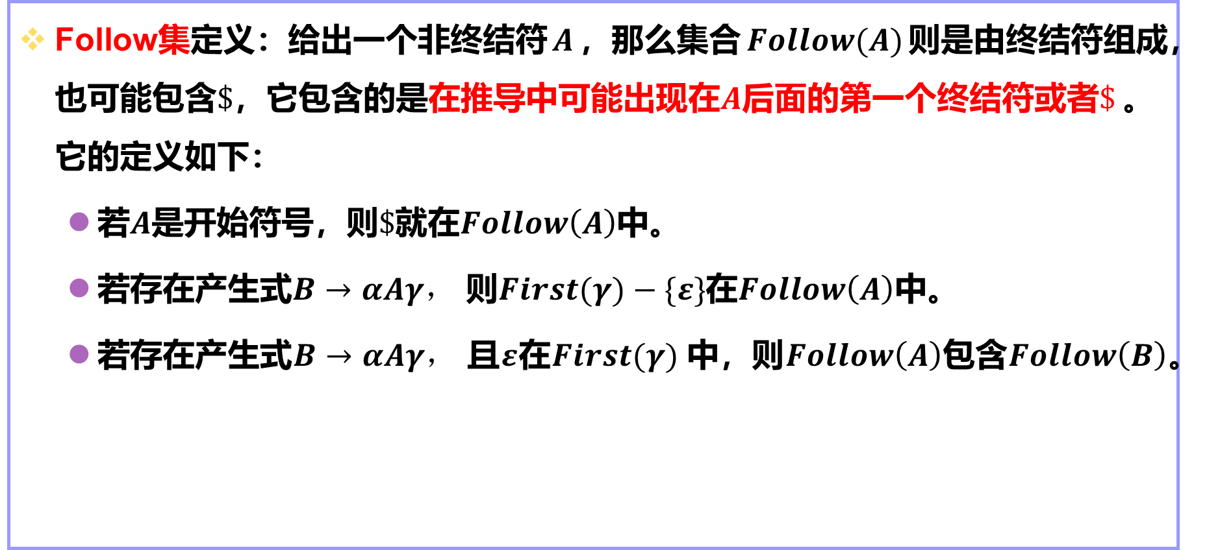
Follow集
Follow集定义：给出一个非终结符$A$，那么集合$Follow(A)$则是由终结符组成，也可能包含$\$$，它包含的是在推导中可能出现在$A$后面的第一个终结符或者$\$$。它的定义如下：
若$A$是开始符号，则$\$$就在$Follow\left(A\right)$中。
若存在产生式$B→αAγ，$ 则$First(γ)−\{ε\}$在$Follow\left(A\right)$中。
若存在产生式$B→αAγ，$ 且$ε$在$First(γ)$中，则$Follow\left(A\right)$包含$Follow\left(B\right)$。

Slide 31
计算Follow集的方法
Follow(start-symbol):={$};
for all non-terminals A≠start-symbol do follow(A):={ };
while there changes to any follow sets do
for each production A→X1X2…Xn do
for each Xi that is a non-terminal do
add First(Xi+1Xi+2…Xn) – {ε} to Follow(Xi)
if ε is in First(Xi+1Xi+2…Xn) then
add Follow(A) to Follow(Xi)

Slide 32
计算示例
(1) exp → exp addop term
(2) exp → term
(3) addop → +
(4) addop → -
(5) term → term mulop factor
(6) term → factor
(7) mulop →*
(8) factor →(exp)
(9) factor →number
First(exp) = {(,number}
First(term) = {(,number}
First(factor) = {(,number}
First(addop) = {+,-}
First(mulop) = {*}

Slide 33
示例
(1) exp → exp addop term
(2) exp → term
(3) addop → +
(4) addop → -
(5) term → term mulop factor
(6) term → factor
(7) mulop →*
(8) factor →(exp)
(9) factor →number
 | First | Follow
exp | (,number | $,+,-, )
term | (,number | $,+,-, *,)
factor | (,number | $,+,-, *,)
addop | +, - | (,number
mulop | * | (,number
Grammar rule | Pass 1 | Pass 2
exp → exp addop term | fw(exp)={$,+,- } fw(addop)={(,number} fw(term)<=fw(exp) | fw(term)={ $,+,-, *,)}
exp → term
term → term mulop factor | fw(term)={ * } fw(mulop)={ (, number} fw(factor)<= fw(term) | fw(factor)={$,+,-, *,)}
term →factor
factor →(exp) | fw(exp)={ $,+,-,) }

Slide 34
示例
所以Follow集如下：
Follow(exp) = {$,+,-, )}
Follow(addop) = {(,number}
Follow(term) = { $,+,-, *, )}
Follow(mulop) = {(,number}
Follow(factor) = { $,+,-, *, )}

Slide 35
计算示例
(1) statement → if-stmt
(2) statement → other
(3) if-stmt → if (exp) statement else-part
(4) else-part → else statement
(5) else-part →ε
(6) exp → 0
(7) exp → 1
First(statement) = {if,other}
First(if-stmt) = {if}
First(else-part) = {else,ε}
First(exp) = {0,1}

Slide 36
(1) statement → if-stmt
(2) statement → other
(3) if-stmt → if (exp) statement else-part
(4) else-part → else statement
(5) else-part →ε
(6) exp → 0
(7) exp → 1
 | First | Follow
statement | if, other | $, else
if-statement | if | $, else
else-part | else, ε | $, else
exp | 0, 1 | )
Grammar rule | Pass 1 | Pass 2
statement→if-stmt | fw(statement)={ $ } fw(if-stmt)<=fw(statement) | fw(statement)={$,else} fw(if-stmt)={$,else}
statement→other
if-stmt →if (exp) statement else-part | fw(exp)={ ) } fw(statement)={ $, else } fw(else-part)<=fw(if-stmt) fw(statement)<=fw(if-stmt) | fw(else-part)={$,else}
else-part → else statement | fw(statement)<=fw(else-part)
else-part →ε
exp → 0
exp → 1

Slide 37
示例
所以Follow集如下：
Follow(statement)={$,else}
Follow(if-statement)={$,else}
Follow(else-part)={$,else}
Follow(exp)={)}

Slide 38
stmt-sequence →stmt stmt-seq’
stmt-seq’ →; stmt-sequence
stmt-seq’ →ε
stmt→s
 | First | Follow
stmt-sequence | s | $
stmt | s | $, ;
stmt-seq’ | ; , ε | $
Grammar rule | Pass 1 | Pass 2
stmt-sequence →stmt stmt-seq’ | fw(stmt-sequence)={ $ } fw(stmt)={;} fw(stmt-seq’)<=fw(stmt-sequence) fw(stmt)<=fw(stmt-sequence) | fw(statement)={$} fw(stmt-seq’ )={$} fw(stmt) = {; , $}
stmt-seq’ →; stmt-sequence | fw(stmt-sequence)<=fw(stmt-seq’)
stmt-seq’ →ε
stmt→s

Slide 39
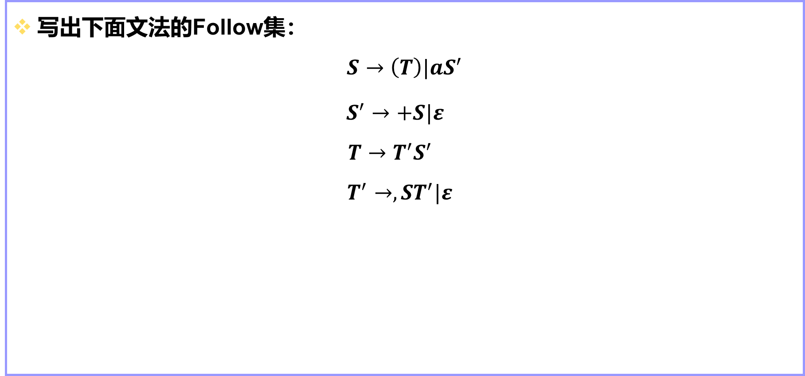
练习
写出下面文法的Follow集：
$$S→\left(T\right)|aS^{′}$$
$S^{′}→+S|ε$
$$T→T^{′}S^{′}$$
$$T^{′}→,ST^{′}|ε$$

Slide 40
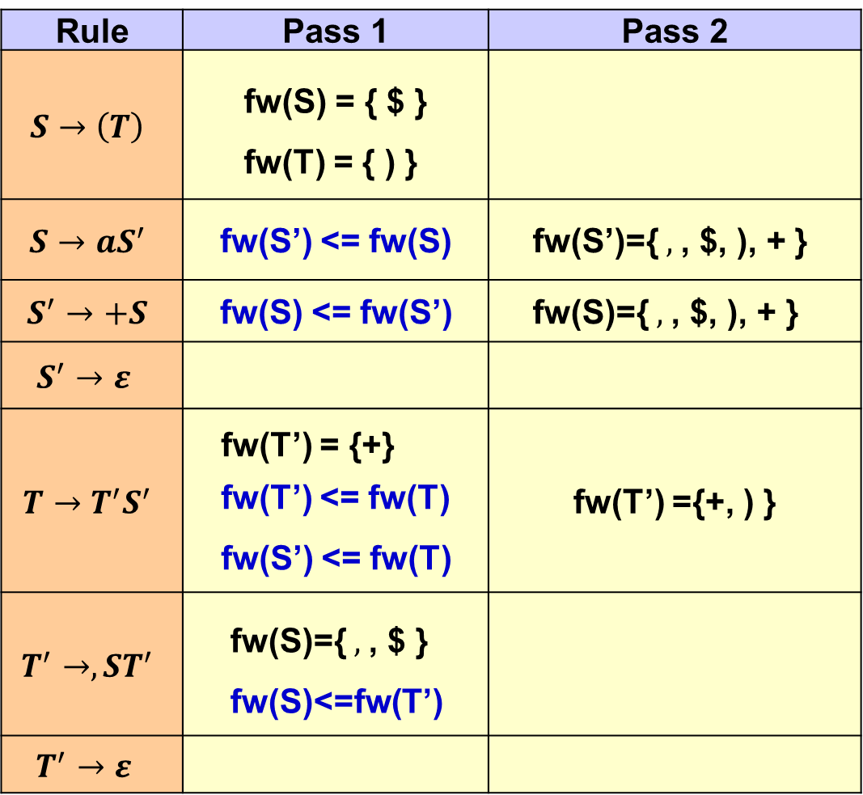
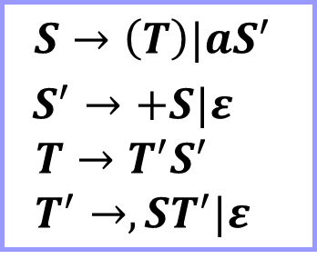
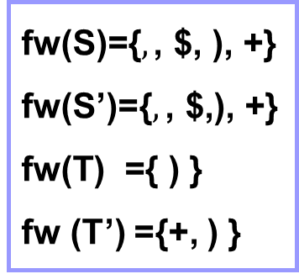
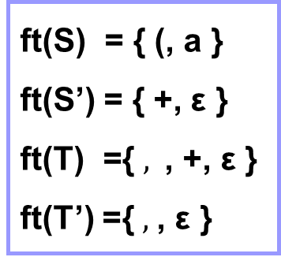
$$S→\left(T\right)|aS^{′}$$
$S^{′}→+S|ε$
$$T→T^{′}S^{′}$$
$$T^{′}→,ST^{′}|ε$$
Rule | Pass 1 | Pass 2
$$S→\left(T\right)$$ | fw(S) = { $ } fw(T) = { ) }
$$S→aS^{′}$$ | fw(S’) <= fw(S) | fw(S’)={ $,$, $, ), + }
$$S^{′}→+S$$ | fw(S) <= fw(S’) | fw(S)={ $,$, $, ), + }
$$S^{′}→ε$$
$$T→T^{′}S^{′}$$ | fw(T’) = {+} fw(T’) <= fw(T) fw(S’) <= fw(T) | fw(T’) ={+, ) }
$$T^{′}→,ST^{′}$$ | fw(S)={ $,$, $ } fw(S)<=fw(T’)
$$T^{′}→ε$$
$$\text{ft}\text{(}\text{S}\text{) = \{ (, }\text{a}\text{ \} }$$
ft(S’) = { +, ε }
$$\text{ft}\text{(}\text{T}\text{) =\{ },\text{ , +, }\text{ε}\text{ \}}$$
ft(T’) ={ $,$, ε }
$$\text{fw}\text{(}\text{S}\text{)=\{}, \text{, \$, )}\text{, +\}}$$
fw(S’$\text{)=\{}, \text{, \$,), +\}}$
$$\text{fw}\text{(}\text{T}\text{) =\{ ) \}}$$
fw (T’) ={+, ) }

Slide 41
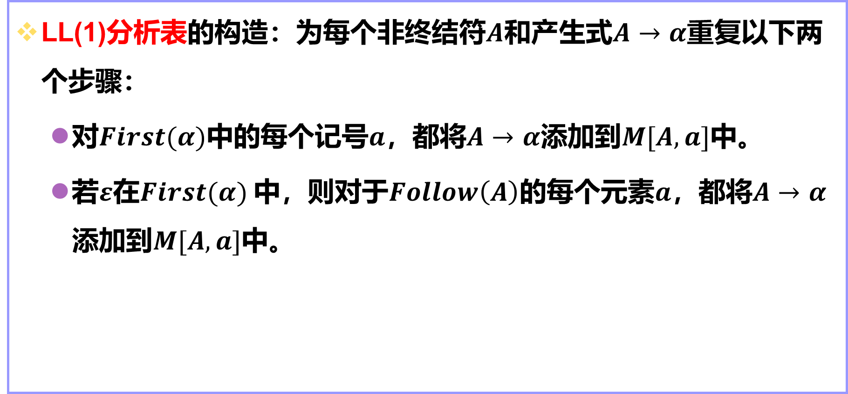
使用First集和Follow集构造分析表
LL(1)分析表的构造：为每个非终结符$A$和产生式$A→α$重复以下两个步骤：
对$First(α)$中的每个记号$a$，都将$A→α$添加到$M[A,a]$中。
若$ε$在$First(α)$中，则对于$Follow\left(A\right)$的每个元素$a$，都将$A→α$添加到$M[A,a]$中。

Slide 42
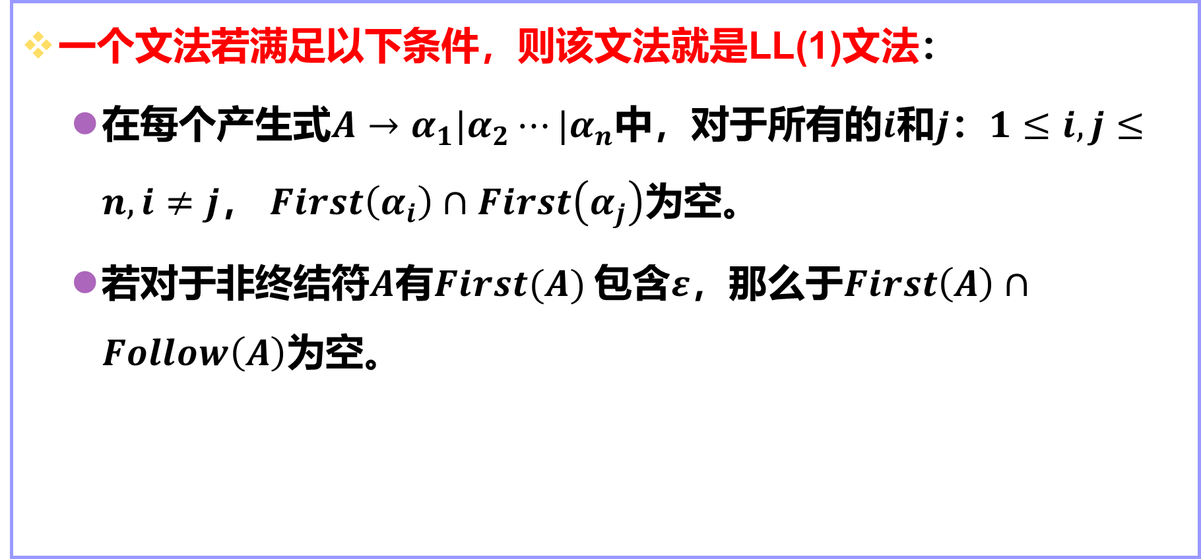
定理
一个文法若满足以下条件，则该文法就是LL(1)文法：
在每个产生式$A→α_{1}|α_{2}⋯|α_{n}$中，对于所有的$i$和$j$：$1≤i, j≤n, i≠j$， $First\left(α_{i}\right)∩First\left(α_{j}\right)$为空。
若对于非终结符$A$有$First(A)$包含$ε$，那么于$First\left(A\right)∩Follow\left(A\right)$为空。

Slide 43
exp→exp addop term
exp →term
addop→+
addop→-
term→term mulop factor
term → factor
mulop →*
factor →(expr)
factor → number
 | First | Follow
exp | (,number | $,+,-, )
term | (,number | $,+,-, *,)
factor | (,number | $,+,-, *,)
addop | +, - | (,number
mulop | * | (,number
M[N,T] | ( | number | ) | + | - | * | $
exp | exp→exp addop term exp →term | exp →exp addop term exp →term
addop |  |  |  | addop→+ | addop→-
term | term→term mulop factor term → factor | term → term mulop factor term → factor
mulop |  |  |  |  |  | mulop →*
factor | factor →(exp) | factor → number

Slide 44
(1) statement → if-stmt
(2) statement → other
(3) if-stmt → if (exp) statement else-part
(4) else-part → else statement
(5) else-part →ε
(6) exp → 0
(7) exp → 1
 | First | Follow
statement | if, other | $, else
if-statement | if | $, else
else-part | else, ε | $, else
exp | 0, 1 | )
M[N,T] | if | other | else | 0 | 1 | $
statement | statement → if-stmt | statement → other
if-stmt | if-stmt → if (exp) statement else-part
else-part |  |  | else-part → else statement else-part →ε |  |  | else-part →ε
exp |  |  |  | exp → 0 | exp → 1

Slide 45
stmt-sequence →stmt stmt-seq’
stmt-seq’ →; stmt-sequence
stmt-seq’ →ε
stmt→s
 | First | Follow
stmt-sequence | s | $
stmt | s | $, ;
stmt-seq’ | ; , ε | $
M[N,T] | S | ; | $
stmt-sequence | stmt-sequence →stmt stmt-seq’
stmt | stmt→s
stmt-seq’ |  | stmt-seq’ →; stmt-sequence | stmt-seq’ →ε

Slide 46
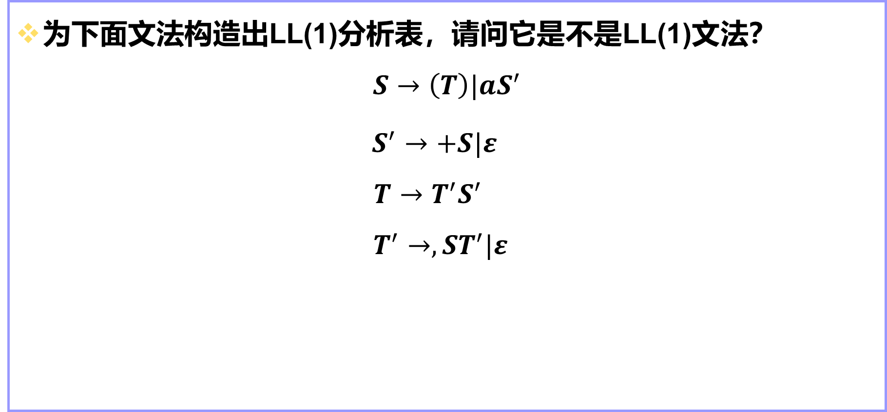
练习
为下面文法构造出LL(1)分析表，请问它是不是LL(1)文法？
$$S→\left(T\right)|aS^{′}$$
$S^{′}→+S|ε$
$$T→T^{′}S^{′}$$
$$T^{′}→,ST^{′}|ε$$

Slide 47
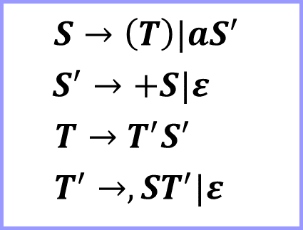
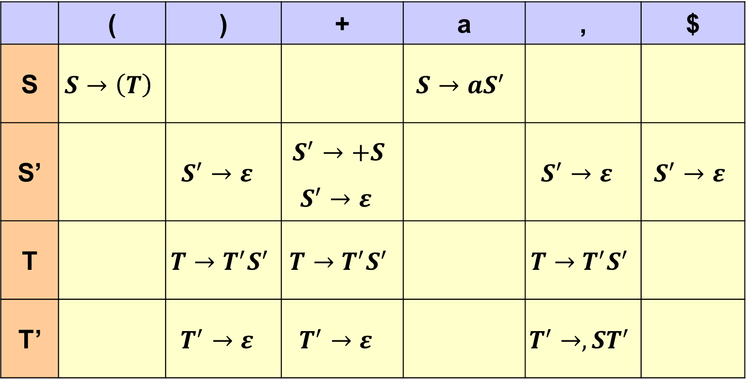
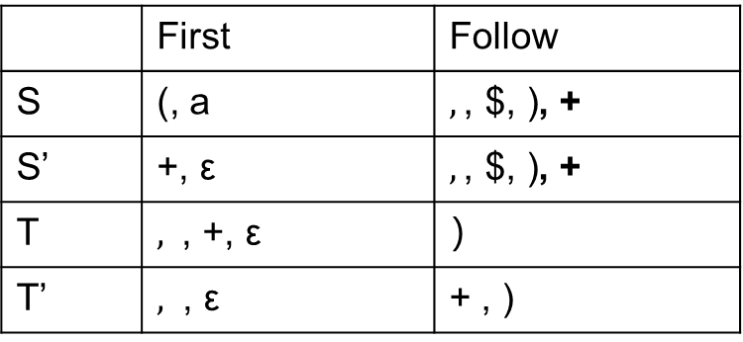
$$S→\left(T\right)|aS^{′}$$
$S^{′}→+S|ε$
$$T→T^{′}S^{′}$$
$$T^{′}→,ST^{′}|ε$$
 | First | Follow
S | (, a | $$, \text{, \$, )}\text{, +}$$
S’ | +, ε | $$, \text{, \$, )}\text{, +}$$
T | $$,\text{ , +, }\text{ε}$$ | ）
T’ | $,$ , ε | + , )
 | ( | ) | + | a | , | $
S | $$S→\left(T\right)$$ |  |  | $$S→aS^{′}$$
S’ |  | $S^{′}→ε$ | $$S^{′}→+S$$ $$S^{′}→ε$$ |  | $S^{′}→ε$ | $$S^{′}→ε$$
T |  | $$T→T^{′}S^{′}$$ | $$T→T^{′}S^{′}$$ |  | $$T→T^{′}S^{′}$$
T’ |  | $$T^{′}→ε$$ | $$T^{′}→ε$$ |  | $$T^{′}→,ST^{′}$$

Slide 48
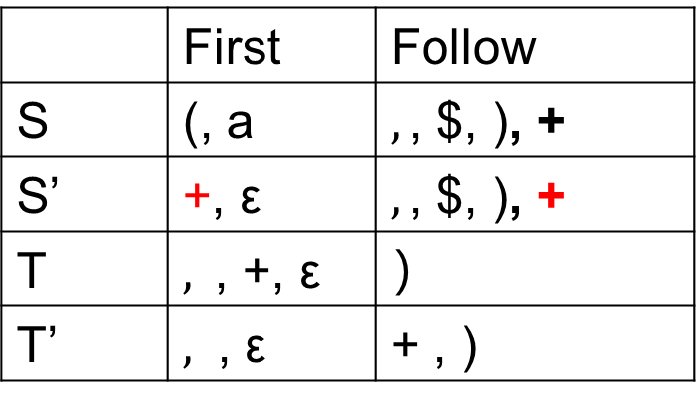

 | First | Follow
S | (, a | $$, \text{, \$, )}\text{, +}$$
S’ | +, ε | $$, \text{, \$, )}\text{, }\text{+}$$
T | $$,\text{ , +, }\text{ε}$$ | ）
T’ | $,$ , ε | + , )
由于分析表中这个格子里含2条产生式，因此该文法不是LL(1)文法。
 | ( | ) | + | a | , | $
S | $$S→\left(T\right)$$ |  |  | $$S→aS^{′}$$
S’ |  | $S^{′}→ε$ | $$S^{′}→+S$$ $$S^{′}→ε$$ |  | $S^{′}→ε$ | $$S^{′}→ε$$
T |  | $$T→T^{′}S^{′}$$ | $$T→T^{′}S^{′}$$ |  | $$T→T^{′}S^{′}$$
T’ |  | $$T^{′}→ε$$ | $$T^{′}→ε$$ |  | $$T^{′}→,ST^{′}$$

Slide 49
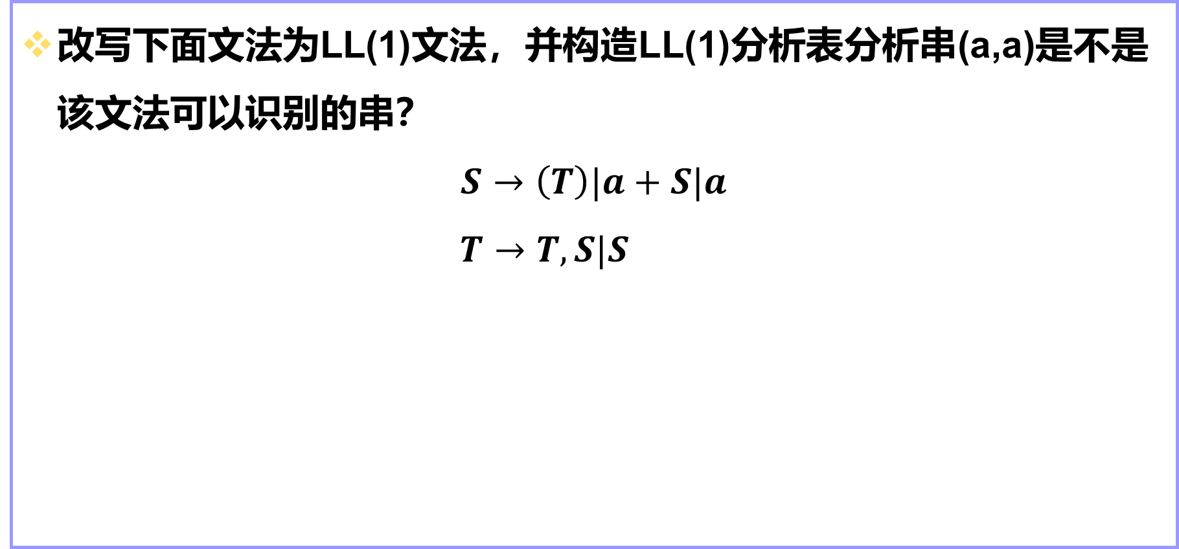
综合练习1
改写下面文法为LL(1)文法，并构造LL(1)分析表分析串(a,a)是不是该文法可以识别的串？
$$S→\left(T\right)|a+S|a$$
$$T→T,S|S$$

Slide 50
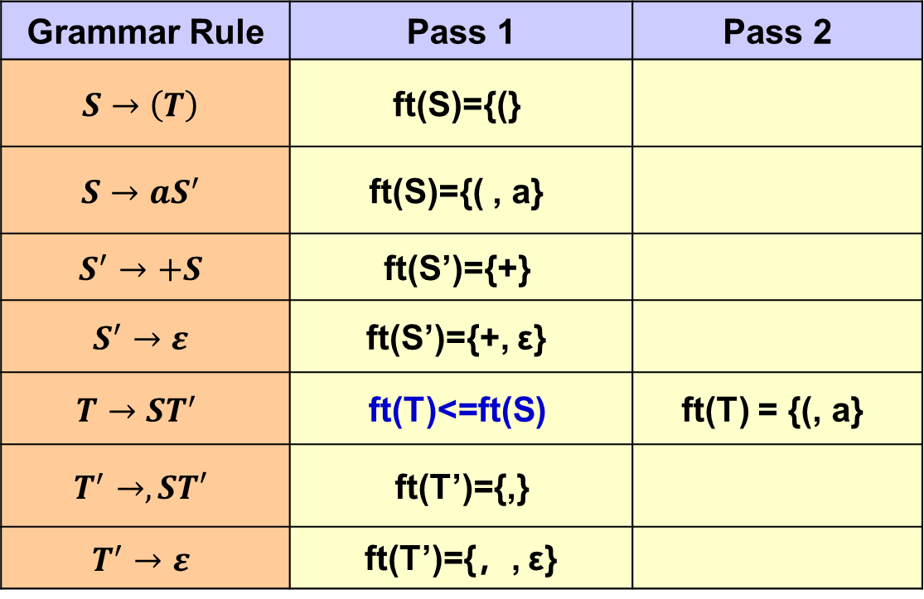

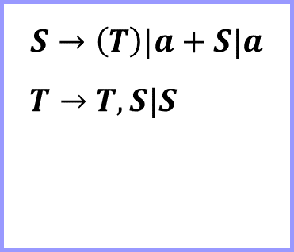
$$S→\left(T\right)|a+S|a$$
$$T→T,S|S$$
$$S→\left(T\right)|aS^{′}$$
$S^{′}→+S|ε$ $T→ST^{′}$ $T^{′}→,ST′|ε$
 | First
S | (, a
S’ | +, ε
T | (, a
T’ | ，, ε
Grammar Rule | Pass 1 | Pass 2
$$S→\left(T\right)$$ | ft(S)={(}
$$S→aS^{′}$$ | ft(S)={( , a}
$$S^{′}→+S$$ | ft(S’)={+}
$$S^{′}→ε$$ | ft(S’)={+, ε}
$$T→ST^{′}$$ | ft(T)<=ft(S) | ft(T) = {(, a}
$$T^{′}→,ST′$$ | ft(T’)={,}
$$T^{′}→ε$$ | ft(T’)={，, ε}

Slide 51
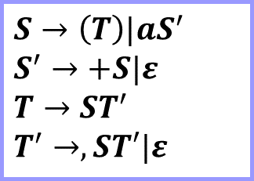
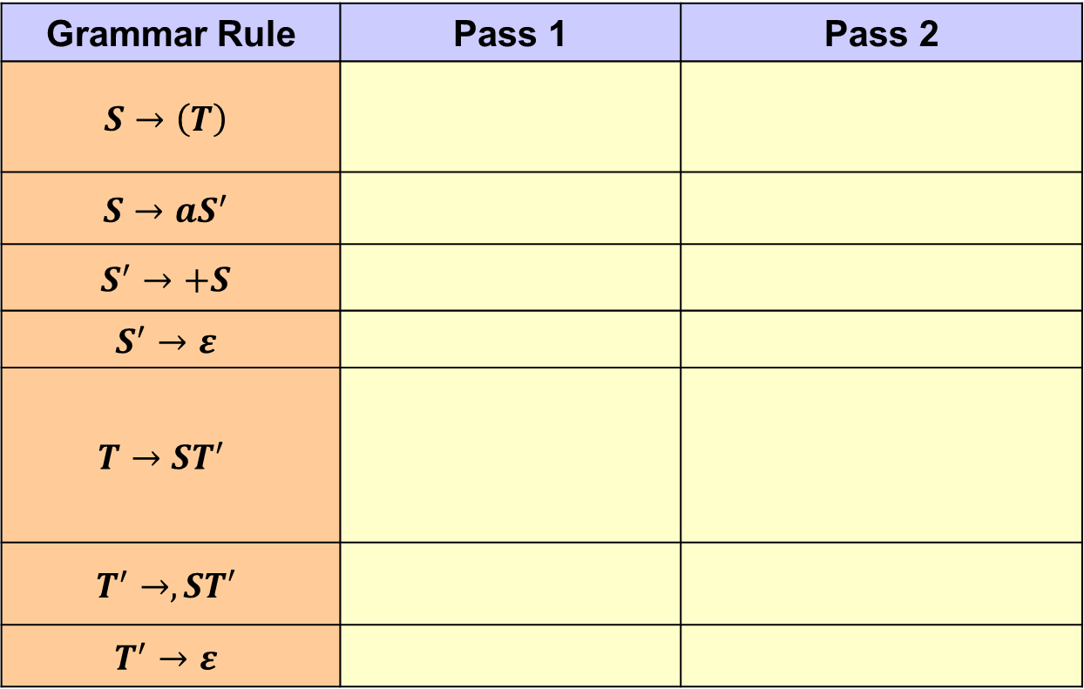
 | First | Follow
S | (, a | $, ，, )
S’ | +, ε | $, ，, )
T | (, a | )
T’ | ，, ε | )
$$S→\left(T\right)|aS^{′}$$
$S^{′}→+S|ε$ $T→ST^{′}$ $T^{′}→,ST′|ε$
Grammar Rule | Pass 1 | Pass 2
$$S→\left(T\right)$$
$$S→aS^{′}$$
$$S^{′}→+S$$
$$S^{′}→ε$$
$$T→ST^{′}$$
$$T^{′}→,ST′$$
$$T^{′}→ε$$
fw(S)={$}
fw(S)={$, ，, )}
fw(T)={)}
fw(S’)<=fw(S)
fw(S’)={$, ，, )}
fw(S)<=fw(S’)
fw(S)={$, ，}
fw(T’)<=fw(T)
fw(T’)={)}
fw(S)<=fw(T)
fw(S)<=fw(T’)

Slide 52


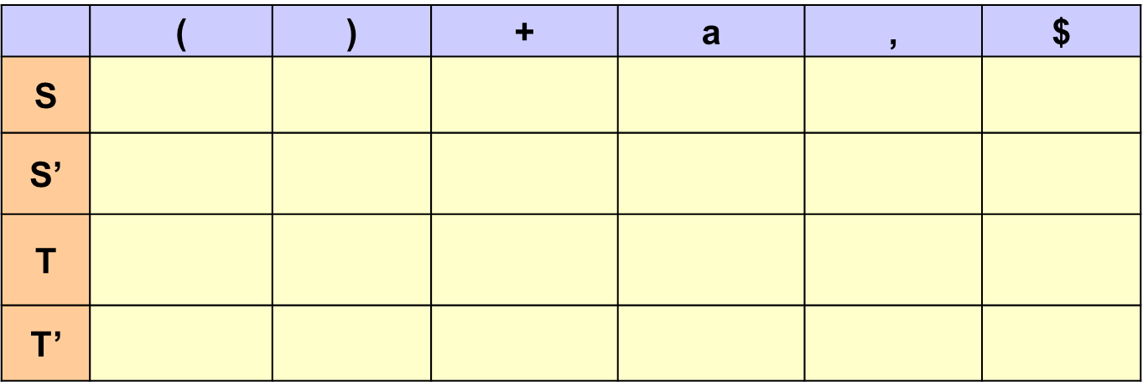









 | First | Follow
S | (, a | $, ，, )
S’ | +, ε | $, ，, )
T | (, a | )
T’ | ，, ε | )
$$S→\left(T\right)|aS^{′}$$
$S^{′}→+S|ε$ $T→ST^{′}$
$$T^{′}→,ST′|ε$$
 | ( | ) | + | a | , | $
S
S’
T
T’
$$S→\left(T\right)$$
$$S→aS^{′}$$
$$S^{′}→ε$$
$$S^{′}→+S$$
$$S^{′}→ε$$
$$S^{′}→ε$$
$$T→ST^{′}$$
$$T→ST^{′}$$
$$T^{′}→ε$$
$$T^{′}→,ST^{′}$$

Slide 53

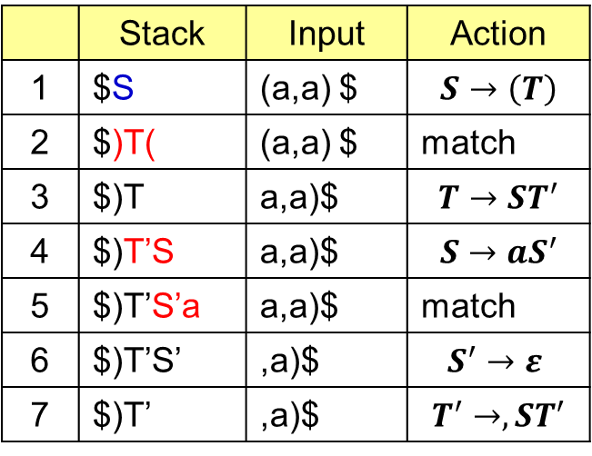



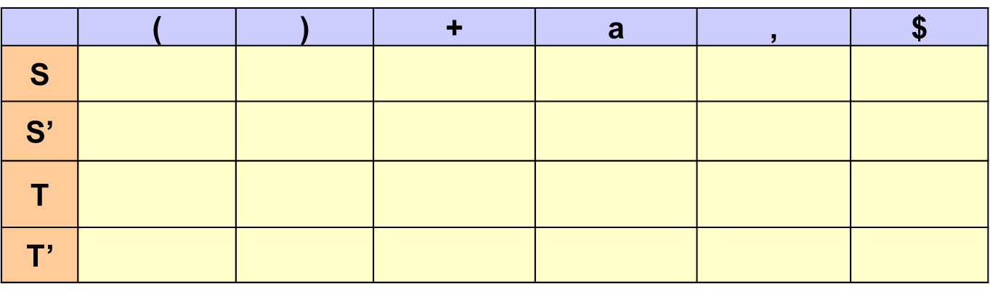






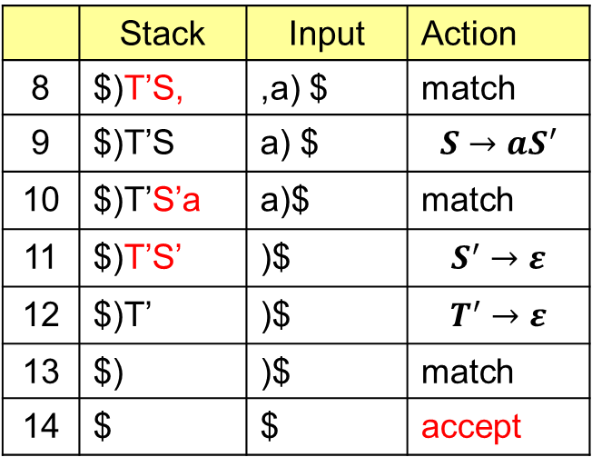
 | ( | ) | + | a | , | $
S
S’
T
T’
$$S→\left(T\right)$$
$$S→aS^{′}$$
$$S^{′}→ε$$
$$S^{′}→+S$$
$$S^{′}→ε$$
$$S^{′}→ε$$
$$T→ST^{′}$$
$$T→ST^{′}$$
$$T^{′}→ε$$
$$T^{′}→,ST^{′}$$
 | Stack | Input | Action
1 | $S | (a,a) $ | $$S→\left(T\right)$$
2 | $)T( | (a,a) $ | match
3 | $)T | a,a)$ | $$T→ST^{′}$$
4 | $)T’S | a,a)$ | $$S→aS^{′}$$
5 | $)T’S’a | a,a)$ | match
6 | $)T’S’ | ,a)$ | $$S^{′}→ε$$
7 | $)T’ | ,a)$ | $$T^{′}→,ST^{′}$$
 | Stack | Input | Action
8 | $)T’S, | ,a) $ | match
9 | $)T’S | a) $ | $$S→aS^{′}$$
10 | $)T’S’a | a)$ | $$\text{match}$$
11 | $)T’S’ | )$ | $$S^{′}→ε$$
12 | $)T’ | )$ | $$T^{′}→ε$$
13 | $) | )$ | $$\text{match}$$
14 | $ | $ | accept

Slide 54
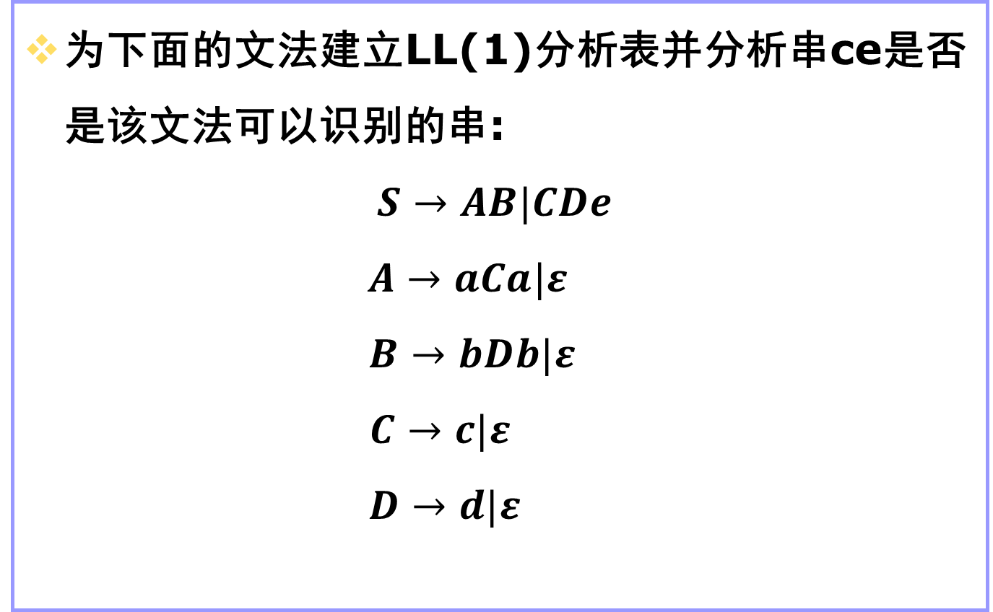
综合练习2
为下面的文法建立LL(1)分析表并分析串ce是否是该文法可以识别的串:
$$S→AB|CDe$$
$$A→aCa|ε$$
$$B→bDb|ε$$
$$C→c|ε$$
$$D→d|ε$$

Slide 55
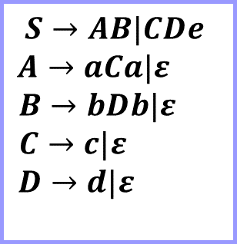
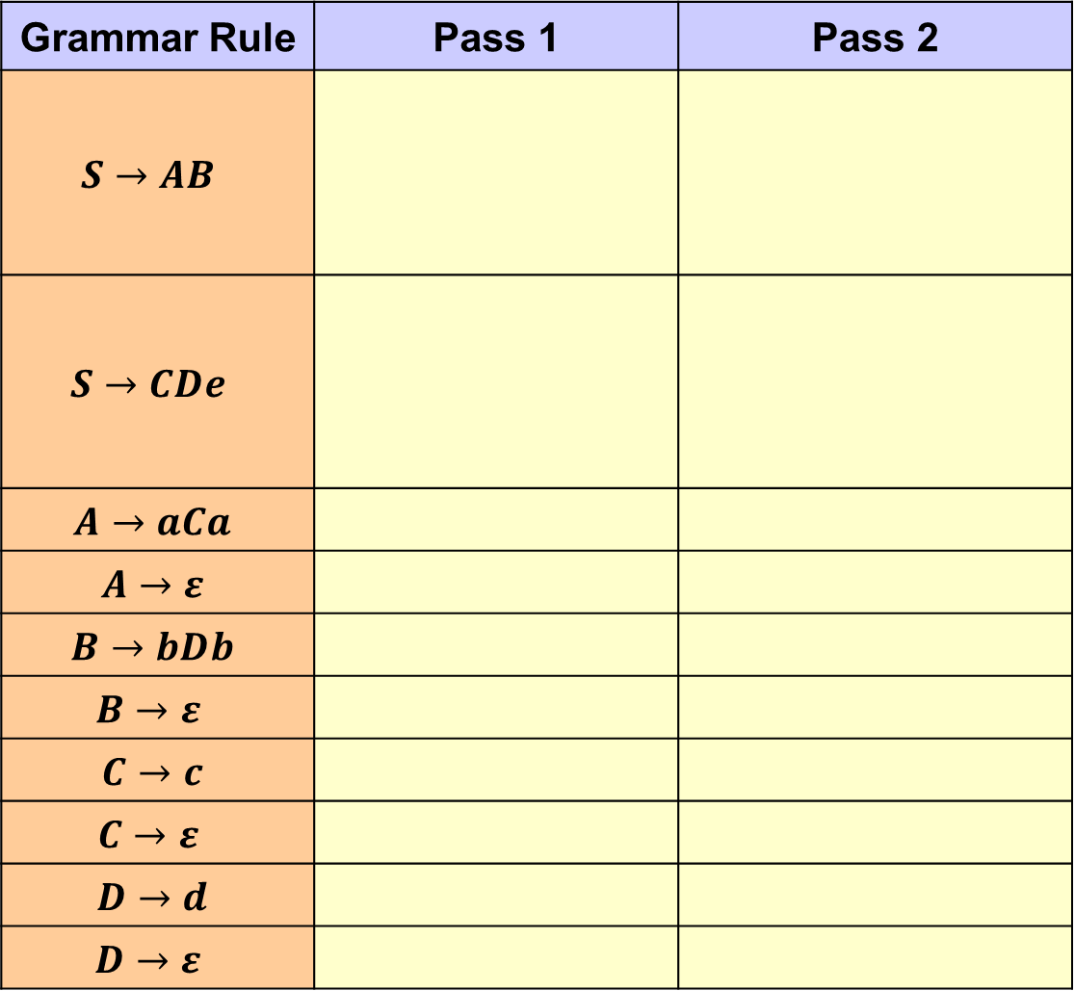
Grammar Rule | Pass 1 | Pass 2
$$S→AB$$
$$S→CDe$$
$$A→aCa$$
$$A→ε$$
$$B→bDb$$
$$B→ε$$
$$C→c$$
$$C→ε$$
$$D→d$$
$$D→ε$$
$$S→AB|CDe$$
$$A→aCa|ε$$
$$B→bDb|ε$$
$$C→c|ε$$
$$D→d|ε$$
ft(S)<=ft(A)
ft(S)<=ft(B)
ft(S)={ε}
ft(S)<=ft(C)
ft(S)<=ft(D)
ft(S)={ε,a,b,c,d,e}
 | First
S | ε,a,b,c,d,e
A | a, ε
B | b, ε
C | c, ε
D | d, ε
ft(S)={ε , e}
ft(A)={a}
ft(A)={a, ε}
ft(B)={b}
ft(B)={b, ε}
ft(C)={c}
ft(C)={c, ε}
ft(D)={d}
ft(D)={d, ε}

Slide 56

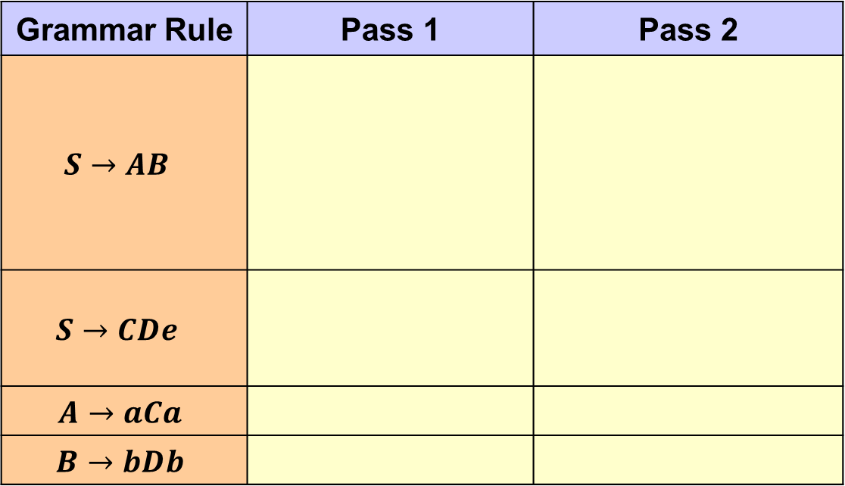
 | First | Follow
S | ε,a,b,c,d,e | $
A | a, ε | b, $
B | b, ε | $
C | c, ε | d, e, a
D | d, ε | e, b
$$S→AB|CDe$$
$$A→aCa|ε$$
$$B→bDb|ε$$
$$C→c|ε$$
$$D→d|ε$$
Grammar Rule | Pass 1 | Pass 2
$$S→AB$$
$$S→CDe$$
$$A→aCa$$
$$B→bDb$$
fw(S)={$}
fw(A)={b}
fw(A)={b,$}
fw(B)<=fw(S)
fw(B)={$}
fw(A)<=fw(S)
fw(C)={d, e}
fw(D)={e}
fw(C)={d, e, a}
fw(D)={e, b}

Slide 57




















$$S→AB|CDe$$
$$A→aCa|ε$$
$$B→bDb|ε$$
$$C→c|ε$$
$$D→d|ε$$
 | First | Follow
S | ε,a,b,c,d,e | $
A | a, ε | b, $
B | b, ε | $
C | c, ε | d, e, a
D | d, ε | e, b
 | a | b | c | d | e | $
S
A
B
C
D
$$S→AB$$
$$S→AB$$
$$S→CDe$$
$$S→CDe$$
$$S→CDe$$
$$S →AB$$
$$A→aCa$$
$$A→ε$$
$$A→ε$$
$$B→bDb$$
$$B→ε$$
$$C→ε$$
$$C→c$$
$$C→ε$$
$$C→ε$$
$$D→ε$$
$$D→d$$
$$D→ε$$

Slide 58




















 | a | b | c | d | e | $
S
A
B
C
D
$$S→AB$$
$$S→AB$$
$$S→CDe$$
$$S→CDe$$
$$S→CDe$$
$$S →AB$$
$$A→aCa$$
$$A→ε$$
$$A→ε$$
$$B→bDb$$
$$B→ε$$
$$C→ε$$
$$C→c$$
$$C→ε$$
$$C→ε$$
$$D→ε$$
$$D→d$$
$$D→ε$$
 | Stack | Input | Action
1 | $S | ce$ | $$S→CDe$$
2 | $eDC | ce$ | $$C→c$$
3 | $eDc | ce$ | match
4 | $eD | e$ | $$D→ε$$
5 | $e | e$ | match
6 | $ | $ | accept

