Slide 1

MIPS指令集 (2)

Slide 2
机器语言表达
指令在计算机中用二进制数据表示
内存中存储程序
冯诺伊曼结构
二进制数据以不同的方式解释
哈佛结构
二进制兼容 (向下)

Slide 3
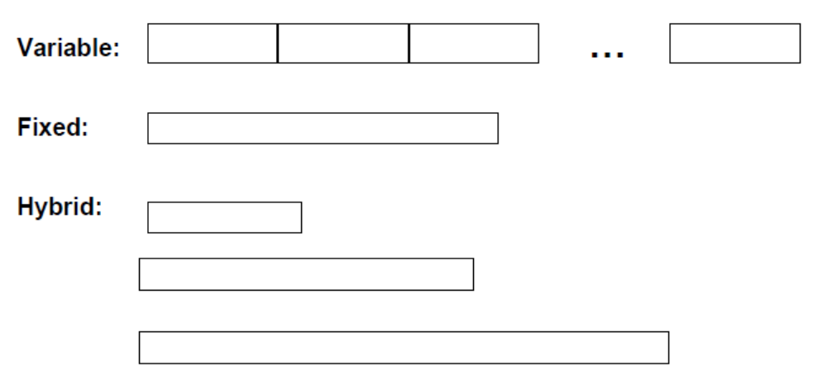
指令长度
变长指令(Intel 80x86, VAX) 的取指令和指令译码需要多个步骤，但更具灵活性.
定长指令更容易取指令和指令译码，更利于流水线和并行执行.

Slide 4
操作数数量?
多数运算指令需要3个操作数 (e.g., z = x + y).
多数ISA在指令中指定0-3 个操作数(显式).
操作数可以显式或隐式指定.

Slide 5
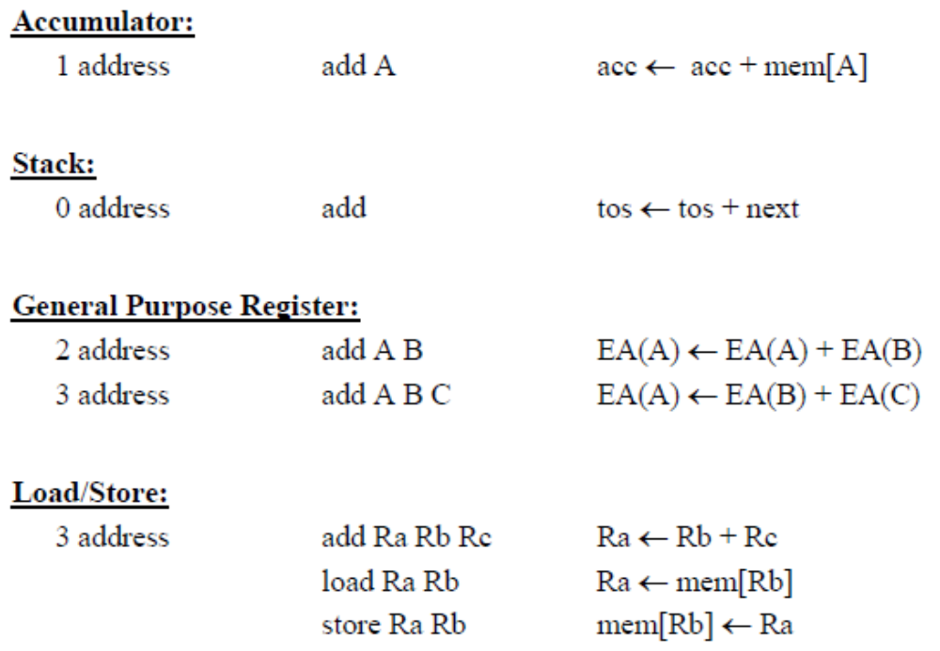
操作数数量?

Slide 6
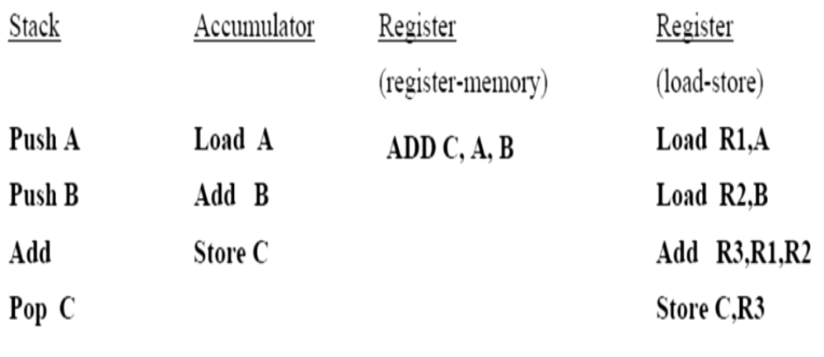
操作数数量
C = A + B

Slide 7
寻址模式- 怎样指定操作数
-Register direct R3
-Immediate (literal)#25
-Direct (absolute)M[10000]
-Register indirect M[R3]
-Base+Displacement M[R3 + 10000]
if register is the program counter, this is PC-relative
-Base+Index M[R3 + R4]
-Scaled Index M[R3 + R4*d + 10000]
-Autoincrement M[R3++]
-Autodecrement M[R3 --]
-Memory Indirect M[ M[R3] ]

Slide 8
够用吗?
通过对VAX ISA的研究表明，程序中88%的指令使用了简单的寻址模式(immediate, direct, register indirect, and base+displacement).
同时，80%的立即数足以用16bits表示.
基址寻址使用16bits的偏移量能满足99%的需要.

Slide 9
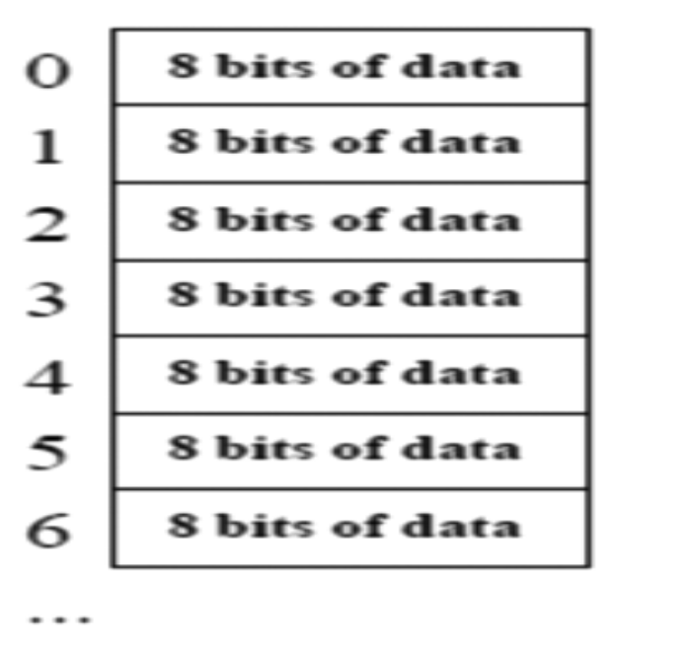
存储器组织
看作巨大的1维数组.
存储器地址即为数组的索引
字节地址（Byte addressing）意味着字节数组的索引.

Slide 10
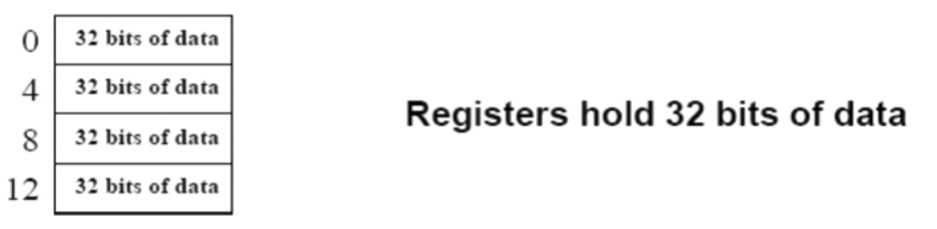
存储器组织
以不同尺度访问存储器
word 为32 bits 或4 bytes.
2³²字节按字节地址寻址 0 to 2³²-1
2³⁰字按字节地址寻址 0, 4, 8, ... 2³²-4
字按4字节对齐

Slide 11
MIPS ISA
32-bit 定长指令
3 种指令格式
3 操作数，load-store 架构
32 个通用寄存器 (integer, floating point)
2 个特殊寄存器 HI 和 LO, 用于乘法和除法
寄存器为32-bits wide (word)
采用寄存器寻址, 立即数寻址, 基址寻址

Slide 12
指令类型
算数运算
add, sub, mul, div
逻辑运算
and, or, sll, srl
访存
lw, sw
条件分支
beq, bne
无条件转移
j, jr, jal

Slide 13
条件分支
如何指定分支地址?
研究表明，绝大多数条件分支的转移目标相对于程序当前位置(PC)都很近 (loops, if-then-else).
  使用相对地址(PC)比使用绝对地址更方便
  e.g., beq $1, $2, 100 => if ($1 == $2) PC = PC + 100 * 4

Slide 14
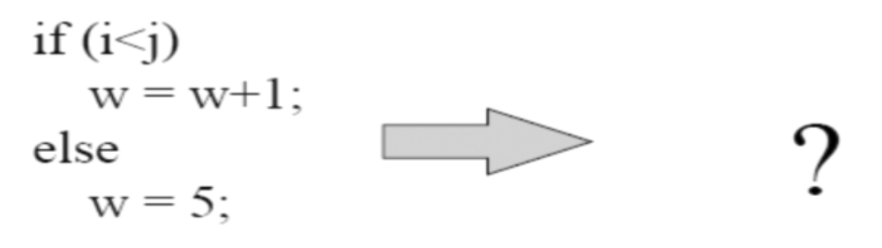
MIPS 条件分支
beq, bne
  beq r1, r2, addr => if (r1 == r2) goto addr
slt $1, $2, $3 => if ($2 < $3) $1 = 1; else $1 = 0
结合 $0, 能实现所有基础的条件分支
Always, never, !=, = =, >, <=, >=, <, >(unsigned), <= (unsigned), ...

Slide 15
MIPS 指令编码
MIPS 指令格式（定长32bit）
  R-format, I-format, J-format
高6 bit 为操作码

Slide 16
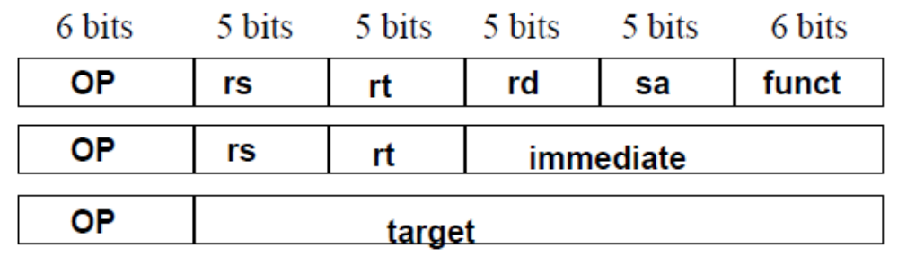
MIPS 指令格式
由操作码决定指令格式类型
add r1, r2, r3
  opcode=0, funct=32, rs=2, rt=3, rd=1, sa=0
  000000 00010 00011 00001 00000 100000

Slide 17
MIPS R-format 指令
op
rs
rt
rd
shamt
funct
6 bits
5 bits
5 bits
5 bits
5 bits
6 bits
Instruction fields
  op: operation code (opcode)
  rs: first source register number
  rt: second source register number
  rd: destination register number
  shamt: shift amount
  funct: function code (extends opcode)
Notes:
The University of Adelaide, School of Computer Science
September 28, 2022
Chapter 2 — Instructions: Language of the Computer

Slide 18
R-format
op
rs
rt
rd
shamt
funct
6 bits
5 bits
5 bits
5 bits
5 bits
6 bits
add $t0, $s1, $s2
special
$s1
$s2
$t0
0
add
0
17
18
8
0
32
000000
10001
10010
01000
00000
100000
00000010001100100100000000100000₂ = 02324020₁₆
Notes:
The University of Adelaide, School of Computer Science
September 28, 2022
Chapter 2 — Instructions: Language of the Computer

Slide 19
访问操作数
操作数位于:
  寄存器registers (32 int, 32 fp)
  存储器memory (2³² locations)
寄存器访问
  容易寻址（地址短）
  速度快
使用load-store 架构访问存储器.
  运算指令仅访问寄存器

Slide 20
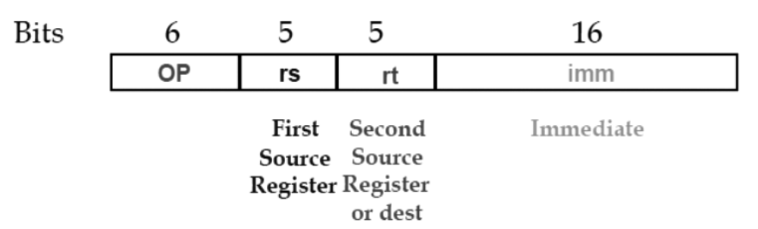
I-Format 指令
立即数（immediate）指令格式
  不同的I指令由不同的操作码区分
  立即数为16位有符号数(positive/negative constants)
  lw , sw , addi , beq …...

Slide 21
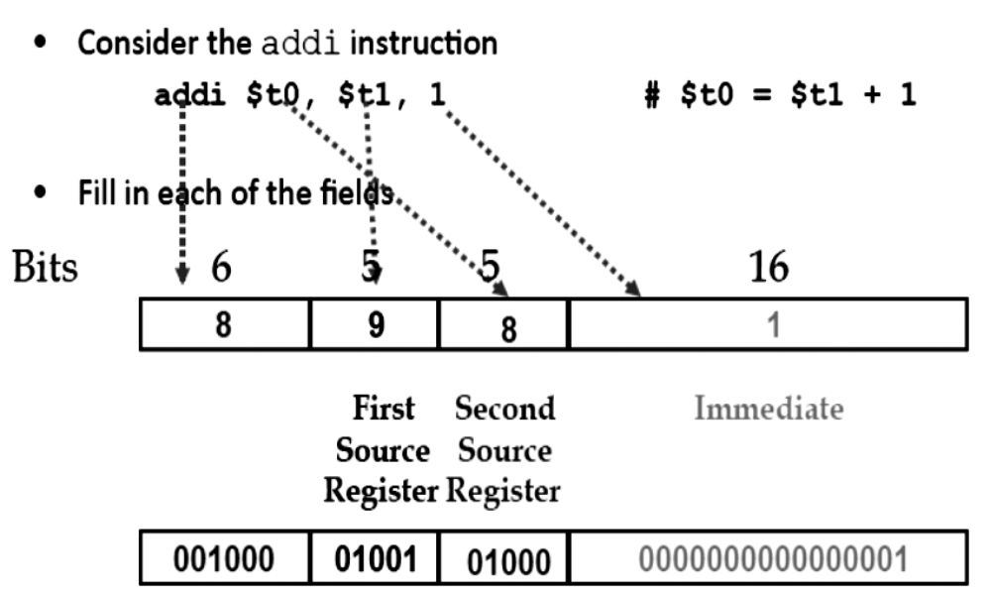
I-Format

Slide 22
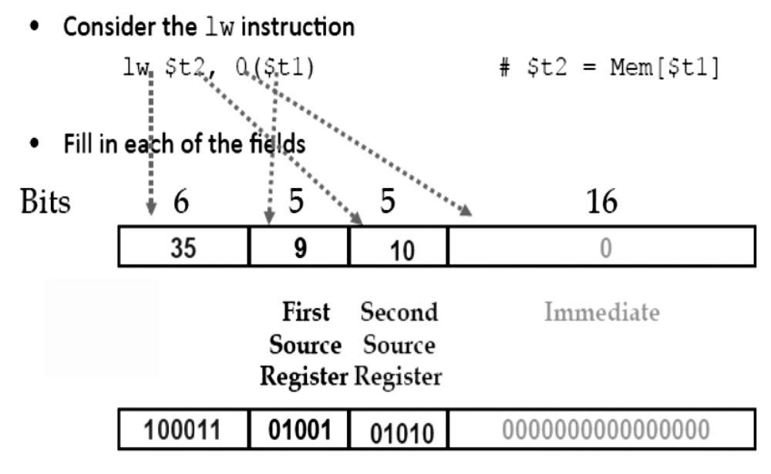
I-Format : Load/Store

Slide 23
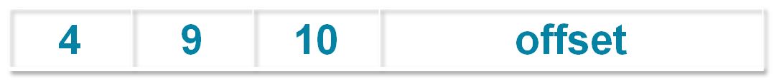
I-Format : branches
beq $t1, $t2, Label

Slide 24
PC 相对寻址 （Relative Addressing）
指令长度为32bits，且按4字节对齐存储
因此，实际转移地址为
  PC + 4* immediate

Slide 25
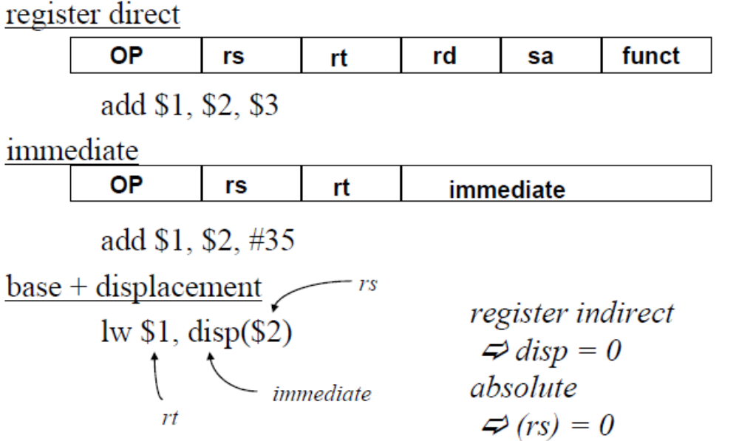
MIPS 寻址模式

Slide 26
J-Format 指令
6 bits
26 bits
As usual, each field has a name:
opcode
target address
由操作码与 R-format 和 I-format 区分
剩余26bits为转移地址

Slide 27
J-Format 指令
New PC = { PC[31..28], target address, 00 }
{ 4 bits , 26 bits , 2 bits } = 32 bit address
  { 1010, 11111111111111111111111111, 00 } = 10101111111111111111111111111100

Slide 28
指令格式
I-format: 含有立即数的指令, lw,sw,beq,bne
  (shift 指令不是I-format)
J-format: j , jal
R-format: 其他指令为R

Slide 29
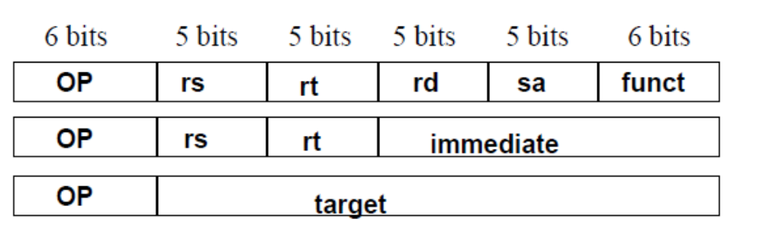
MIPS ISA
其他选择?
  64 registers
  20-bit immediates
  4 operand instruction (e.g. Y = AX + B)

Slide 30
R-Format
MIPS Instruction:
  add $8,$9,$10
  Decimal number per field representation:
0
9
10
8
0
32
  Binary number per field representation:
000000
01001
01010
01000
00000
100000
_{hex}
  hex representation: 0 1 2 A 4 0 2 0 _{hex}
  decimal representation: 19,546,144_{ten}

Slide 31
MIPS ISA
算数逻辑运算:
  Add, AddU, Sub, SubU, And, Or, Xor, Nor, SLT, SLTU
  AddI, AddIU, SLTI, SLTIU, AndI, OrI, XorI, LUI
  SLL, SRL, SRA, SLLV, SRLV, SRAV
访存:
  LB, LBU, LH, LHU, LW, LWL,LWR
  SB, SH, SW, SWL, SWR

Slide 32
MIPS 逻辑运算指令
Instruction Example Meaning Comment
and and $1,$2,$3 $1 = $2 & $3 3 reg. operands; Logical AND
or or $1,$2,$3 $1 = $2 | $3 3 reg. operands; Logical OR
xor xor $1,$2,$3 $1 = $2 ^ $3 3 reg. operands; Logical XOR
nor nor $1,$2,$3 $1 = ~($2 |$3) 3 reg. operands; Logical NOR
and immediate andi $1,$2,10 $1 = $2 & 10 Logical AND reg, constant
or immediate ori $1,$2,10 $1 = $2 | 10 Logical OR reg, constant
xor immediate xori $1, $2,10 $1 = ~$2 &~10 Logical XOR reg, constant
shift left logical sll $1,$2,10 $1 = $2 << 10 Shift left by constant
shift right logical srl $1,$2,10 $1 = $2 >> 10 Shift right by constant
shift right arithm. sra $1,$2,10 $1 = $2 >> 10 Shift right (sign extend)
shift left logical sllv $1,$2,$3 $1 = $2 << $3 Shift left by variable
shift right logical srlv $1,$2, $3 $1 = $2 >> $3 Shift right by variable
shift right arithm. srav $1,$2, $3 $1 = $2 >> $3 Shift right arith. by variable

Slide 33
移位(Shift)指令
op
rs
rt
rd
shamt
funct
6 bits
5 bits
5 bits
5 bits
5 bits
6 bits
shamt: how many positions to shift
Shift left logical
  Shift left and fill with 0 bits
  sll by i bits multiplies by 2^{i}
Shift right logical
  Shift right and fill with 0 bits
  srl by i bits divides by 2^{i} (unsigned only)
Notes:
The University of Adelaide, School of Computer Science
September 28, 2022
Chapter 2 — Instructions: Language of the Computer

Slide 34
AND 运算
常用于掩码操作
  清除选择位之外的部分
and $t0, $t1, $t2
$t2
0000 0000 0000 0000 0000 1101 1100 0000
$t1
0000 0000 0000 0000 0011 1100 0000 0000
$t0
0000 0000 0000 0000 0000 1100 0000 0000
Notes:
The University of Adelaide, School of Computer Science
September 28, 2022
Chapter 2 — Instructions: Language of the Computer

Slide 35
OR 运算
常用于掩码操作
设置选择位
or $t0, $t1, $t2
$t2
0000 0000 0000 0000 0000 1101 1100 0000
$t1
0000 0000 0000 0000 0011 1100 0000 0000
$t0
0000 0000 0000 0000 0011 1101 1100 0000
Notes:
The University of Adelaide, School of Computer Science
September 28, 2022
Chapter 2 — Instructions: Language of the Computer

Slide 36
NOT 运算
反转比特位
MIPS 使用NOR 指令实现NOT运算
  a NOR b == NOT ( a OR b )
nor $t0, $t1, $zero
Register 0: always read as zero
$t1
0000 0000 0000 0000 0011 1100 0000 0000
$t0
1111 1111 1111 1111 1100 0011 1111 1111
Notes:
The University of Adelaide, School of Computer Science
September 28, 2022
Chapter 2 — Instructions: Language of the Computer

Slide 37
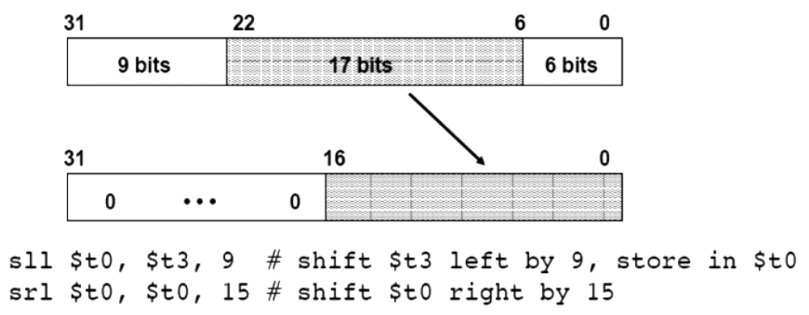
Logic 运算
比特操作

Slide 38
MIPS 访存指令
Instruction Comment
sw $3，500($4) Store word
sh $3，502($2) Store half
sb $2，300($3) Store byte
lw $1, 30($2) Load word
lh $1, 40($3) Load halfword
lhu $1, 40($3) Load halfword unsigned
lb $1, 40($3) Load byte
lbu $1, 40($3) Load byte unsigned
lui $1, 40 Load Upper Immediate (16 bits shifted left by 16)
Q: Why need lui?
LUI R5
R5
0000 … 0000

Slide 39
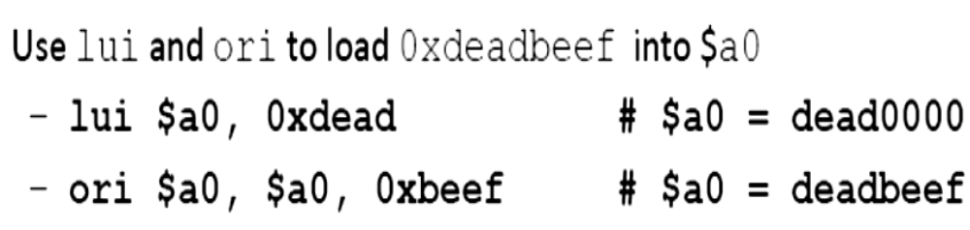
读入32 bit 常数
MIPS 只有16 bits 立即数
可以从存储器读入常数，但速度较慢

Slide 40
Multiply / Divide
乘法，除法
  MULT rs, rt
  MULTU rs, rt
  DIV rs, rt
  DIVU rs, rt
获得结果
  MFHI rd
  MFLO rd
Registers
HI
LO

Slide 41
MIPS 算数运算指令
Instruction Example Meaning Comments
add add $1,$2,$3 $1 = $2 + $3 3 operands; exception possible
subtract sub $1,$2,$3 $1 = $2 – $3 3 operands; exception possible
add immediate addi $1,$2,100 $1 = $2 + 100 + constant; exception possible
add unsigned addu $1,$2,$3 $1 = $2 + $3 3 operands; no exceptions
subtract unsigned subu $1,$2,$3 $1 = $2 – $3 3 operands; no exceptions
add imm. unsign. addiu $1,$2,100 $1 = $2 + 100 + constant; no exceptions
multiply mult $2,$3 Hi, Lo = $2 x $3 64-bit signed product
multiply unsigned multu$2,$3 Hi, Lo = $2 x $3 64-bit unsigned product
divide div $2,$3 Lo = $2 ÷ $3, Lo = quotient, Hi = remainder
Hi = $2 mod $3
divide unsigned divu $2,$3 Lo = $2 ÷ $3, Unsigned quotient & remainder
Hi = $2 mod $3
Move from Hi mfhi $1 $1 = Hi Used to get copy of Hi
Move from Lo mflo $1 $1 = Lo Used to get copy of Lo

Slide 42
符号位扩展
使用有符号数的符号位，填充扩展位:
Examples of sign extending 8 bits to 16 bits:
00001010 ⇒ 00000000 00001010
10001100 ⇒ 11111111 10001100
立即数的扩展?
  算数运算 (add, sub, etc.) 总是进行符号位扩展（包括无符号运算指令）!
  逻辑运算总是0扩展
  Load/Store 地址计算总是符号位扩展
Multiply/Divide 无立即数操作数:
lb , lh :
  lbu, lhu 0扩展
  lb, lh 符号位扩展

Slide 43
MIPS 比较和分支
比较和分支
  BEQ rs, rt, offset if R[rs] == R[rt] then PC-relative branch
  BNE rs, rt, offset <>
与0比较和分支
  BLEZ rs, offset if R[rs] <= 0 then PC-relative branch
  BGTZ rs, offset >0
  BLT <0
  BGEZ >=0
  BLTZAL rs, offset if R[rs] < 0 then branch and link (into R 31)
  BGEZAL >=0
其它比较和分支用两条指令实现

Slide 44
MIPS jump, branch, compare 指令
Instruction Example Meaning
branch on equal beq $1,$2,100 if ($1 == $2) go to PC+4+100 Equal test; PC relative branch
branch on not eq. bne $1,$2,100 if ($1!= $2) go to PC+4+100 Not equal test; PC relative
set on less than slt $1,$2,$3 if ($2 < $3) $1=1; else $1=0 Compare less than; 2’s comp.
set less than imm. slti $1,$2,100 if ($2 < 100) $1=1; else $1=0 Compare < constant; 2’s comp.
set less than uns. sltu $1,$2,$3 if ($2 < $3) $1=1; else $1=0 Compare less than; natural numbers
set l. t. imm. uns. sltiu $1,$2,100 if ($2 < 100) $1=1; else $1=0 Compare < constant; natural numbers
jump j 10000 go to 10000 Jump to target address
jump register jr $31 go to $31 For switch, procedure return
jump and link jal 10000 $31 = PC + 4; For procedure call

Slide 45
数的比较
$1= 0…00 0000 0000 0000 0001
$2= 0…00 0000 0000 0000 0010
$3= 1…11 1111 1111 1111 1111
slt $4,$2,$1 ; if ($2 < $1) $4=1; else $4=0
slt $5,$3,$1 ; if ($3 < $1) $5=1; else $5=0
sltu $6,$2,$1 ; if ($2 < $1) $6=1; else $6=0
sltu $7,$3,$1 ; if ($3 < $1) $7=1; else $7=0
寄存器$4 - $7的值是?
$4 = ; $5 = ; $6 = ; $7 = ;

Slide 46
假设 $s3=i, $s4=j, $s5=@A
Loop: addiu $s4,$s4,1 # j = j + 1
sll $t1,$s3,2 # $t1 = 4 * i
addu $t1,$t1,$s5 # $t1 = @ A[i]
lw $t0,0($t1) # $t0 = A[i]
addiu $s3,$s3,1 # i = i + 1
slti $t1,$t0,10 # $t1 = $t0 < 10
beq $t1,$0, Loop # goto Loop
slti $t1,$t0, 0 # $t1 = $t0 < 0
bne $t1,$0, Loop # goto Loop
do j = j + 1
while (______);
What C code properly fills in the blank in loop on right?
1: A[i++] >= 10
2: A[i++] >= 10 | A[i] < 0
3: A[i] >= 10 || A[i++] < 0
4: A[i++] >= 10 || A[i] < 0
5: A[i] >= 10 && A[i++] < 0
6: None of the above

Slide 47
假设 $s3=i, $s4=j, $s5=@A
Loop: addiu $s4,$s4,1 # j = j + 1
sll $t1,$s3,2 # $t1 = 4 * i
addu $t1,$t1,$s5 # $t1 = @ A[i]
lw $t0,0($t1) # $t0 = A[i]
addiu $s3,$s3,1 # i = i + 1
slti $t1,$t0,10 # $t1 = $t0 < 10
beq $t1,$0, Loop # goto Loop if $t1 == 0 ($t0 >= 10)
slti $t1,$t0, 0 # $t1 = $t0 < 0
bne $t1,$0, Loop # goto Loop if $t1 != 0 ($t0 < 0)
do j = j + 1
while (______);
What C code properly fills in the blank in loop on right?
1: A[i++] >= 10
2: A[i++] >= 10 | A[i] < 0
3: A[i] >= 10 || A[i++] < 0
4: A[i++] >= 10 || A[i] < 0
5: A[i] >= 10 && A[i++] < 0
6: None of the above

Slide 48
问题：
哪条指令的编码为 35_{ten}?
  A. add $0, $0, $0
  B. subu $s0,$s0,$s0
  C. lw $0, 0($0)
  D. addi $0, $0, 35
  E. subu $0, $0, $0
  F.
  寄存器编码:
  0: $0, 8: $t0, 9:$t1, ..15: $t7, 16: $s0, 17: $s1, .. 23: $s7
  操作码
  add: opcode = 0, funct = 32
  subu: opcode = 0, funct = 35
  addi: opcode = 8
  lw: opcode = 35
opcode
rs
rt
rd
shamt
funct
opcode
rs
rt
rd
shamt
funct
opcode
rs
rt
offset
opcode
rs
rt
immediate
opcode
rs
rt
rd
shamt
funct
Notes:
1 PERSON VOTE: Pink: 40%, Reed: 30%, Yellow: 20%, Blue: 20%
Afterwards: Pink 90%

Slide 49
问题：
哪条指令的编码为 35_{ten}?
  A. add $0, $0, $0
  B. subu $s0,$s0,$s0
  C. lw $0, 0($0)
  D. addi $0, $0, 35
  E. subu $0, $0, $0
寄存器编码:
0: $0, 8: $t0, 9:$t1, ..15: $t7, 16: $s0, 17: $s1, .. 23: $s7
操作码
  add: opcode = 0, funct = 32
  subu: opcode = 0, funct = 35
  addi: opcode = 8
  lw: opcode = 35
0
0
0
0
0
32
0
16
16
16
0
35
35
0
0
0
8
0
0
35
0
0
0
0
0
35

Slide 50
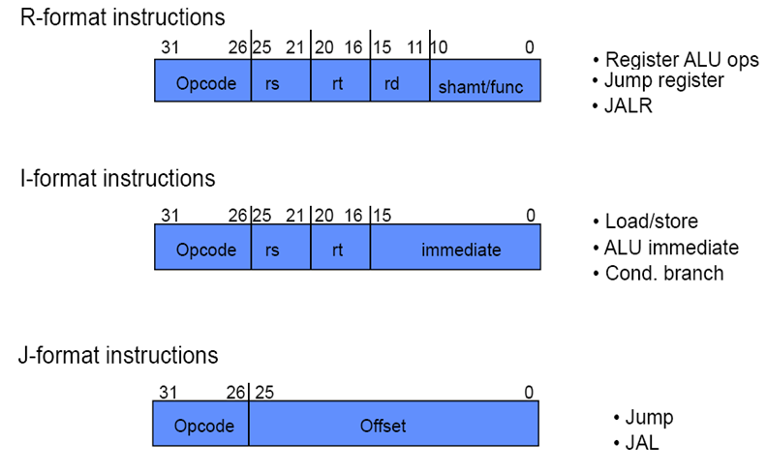
指令格式总结

Slide 51
寻址模式总结
寄存器寻址
  操作数为寄存器(e.g. ALU)
基址寻址 (ex. load/store)
  操作数在存储器中，其地址为
  基地址寄存器 + 常数
立即寻址 (e.g. constants)
  操作数为常数，包含在指令中
PC-相对寻址 (e.g. branch)
  地址为PC + 指令中的常数 (e.g. branch)
伪直接寻址(e.g. jump)
  目标地址为PC连接指令地址域

Slide 52
寻址模式总结
Immediate Addressing
Op⁶
Rs⁵
Rt⁵
immediate¹⁶
Operand is a constant
Register Addressing
Op⁶
Rs⁵
Rt⁵
Rd⁵
sa⁵
funct⁶
Operand is in a register
Register
Base or Displacement Addressing
Operand is in memory (load/store)
Op⁶
Rs⁵
Rt⁵
immediate¹⁶
Word
+
Halfword
Byte
Register = Base address

Slide 53
Addressing Modes Summary
Used for branching (beq, bne, …)
PC-Relative Addressing
Op⁶
Rs⁵
Rt⁵
immediate¹⁶
+1
Word = Target Instruction
PC³⁰
00
Target Instruction Address
PC = PC + 4 × (1 + immediate¹⁶)
PC³⁰ + immediate¹⁶ + 1
00
Used by jump instruction
Pseudo-direct Addressing
Op⁶
immediate²⁶
:
Word = Target Instruction
PC⁴
PC²⁶
00
Target Instruction Address
PC⁴
immediate²⁶
00

Slide 54
汇编例子
  Assume Loop at location 80000
Loop: sll $t1, $s3, 4 | 80000 | 0 | 0 | 19 | 9 | 4 | 0
add $t1, $t1, $s6 | 80004 | 0 | 9 | 22 | 9 | 0 | 32
lw $t0, 0($t1) | 80008 | 35 | 9 | 8 | 0
bne $t0, $s5, Exit | 80012 | 5 | 8 | 21 | 2
addi $s3, $s3, 1 | 80016 | 8 | 19 | 19 | 1
j Loop | 80020 | 2 | 20000
Exit: … | 80024

Slide 55
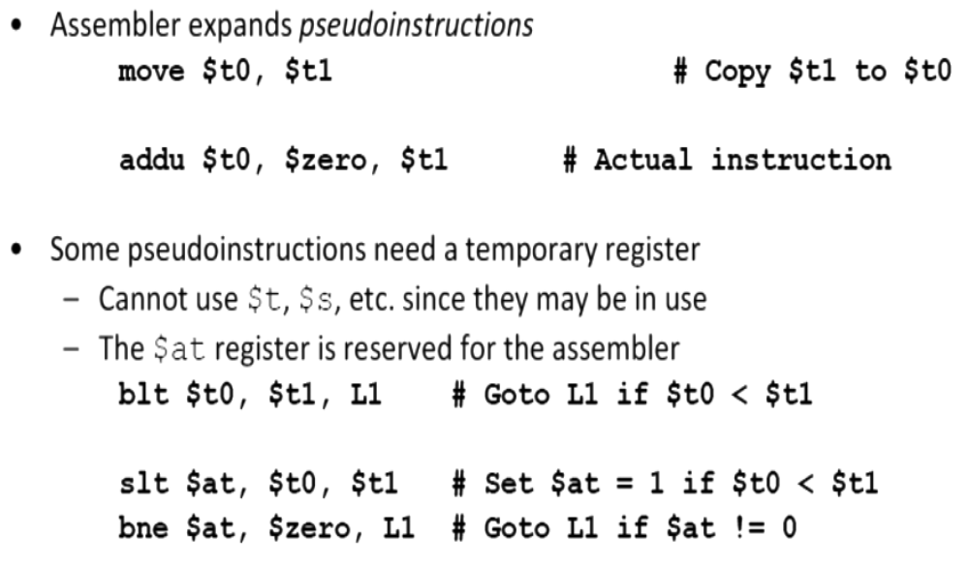
伪指令

Slide 56
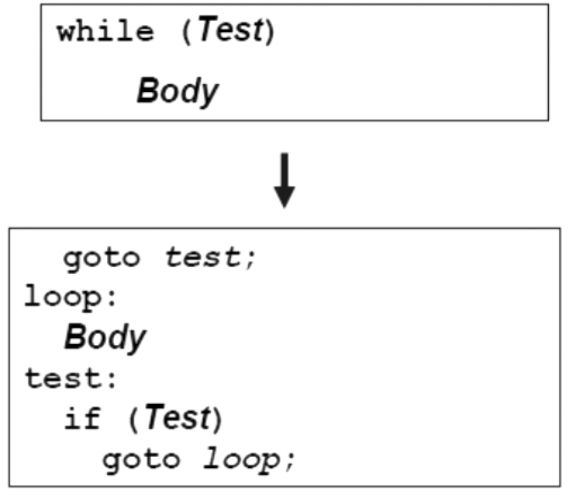
While 循环
While loop review

Slide 57
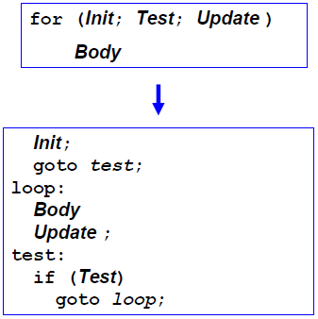
For 循环
Similar to while loop

Slide 58
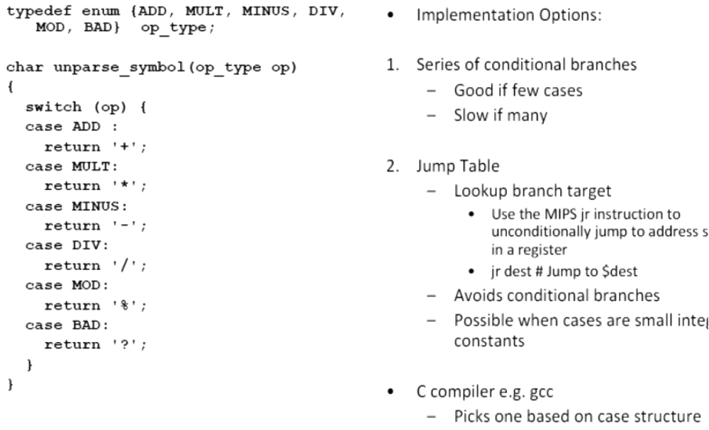
Switch Statements

Slide 59
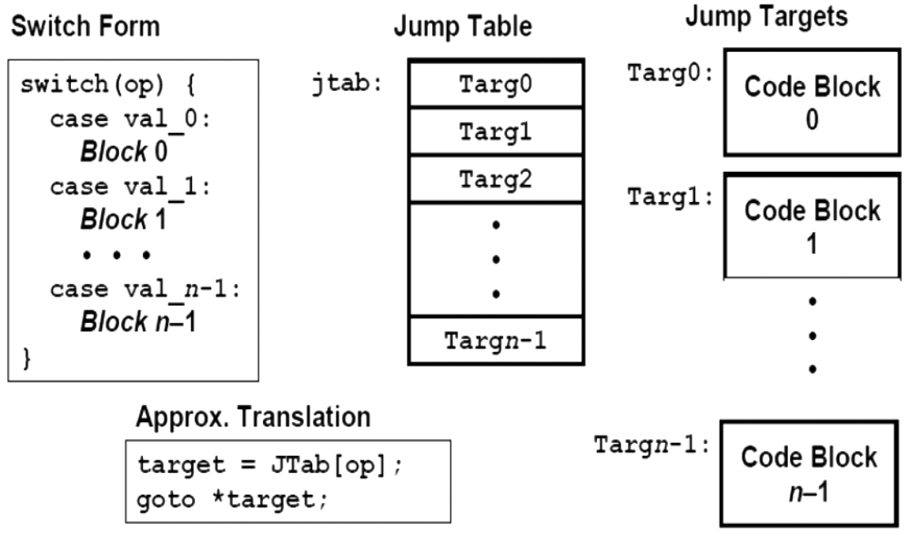
Jump Table Structure

