Slide 1
Chapter 5
大容量和高速度:
开发存储器层次结构

Slide 2
存储器设计的问题
用户需要：又快又大的存储器
存储技术 | 典型访问时间 | GB价格 (2020)
SRAM | 0.5-2.5ns | $500-$1,000
DRAM | 50-70ns | $3-$6
Magnetic disk | 5,000,000-20,000,000ns | $0.01- $0.02

Slide 3
局部性
1. 时间局部性:
如果某数据项被访问，那么在不久的将来它还可能再次被访问。
2. 空间局部性:
如果某数据项被访问，与它地址相邻的数据项可能很快被访问。
大多数程序都展现出上述特征。

Slide 4
解决方案
建立存储器层次结构
S
p
e
e
d
C
P
U
S
i
z
e
C
o
s
t
(
$
/
b
i
t
)
processor
upper
F
a
s
t
e
s
t
M
e
m
o
r
y
S
m
a
l
l
e
s
t
H
i
g
h
e
s
t
Data are transferred
M
e
m
o
r
y
S
l
o
w
e
s
t
M
e
m
o
r
y
B
i
g
g
e
s
t
L
o
w
e
s
t

Slide 5
重要概念
命中(Hit): CPU 访问高层存储成功
缺失(Miss): CPU 访问高层存储失败
命中时间(Hit time): 访问高层存储所需要的时间（包括判断当前访问命中或缺失的时间）
缺失代价(Miss penalty): 将相应数据块从低层存储替换到高层存储的时间，以及将数据传递给CPU的时间

Slide 6
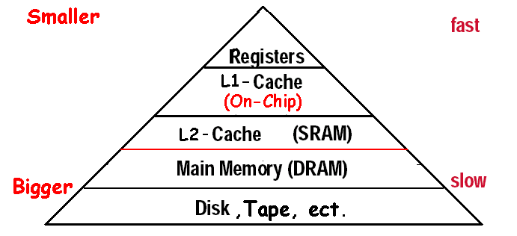
开发存储层次结构
  基于不同的速度和规模
Levels in the memory hierarchy
Increasing distance form the CPU in access time
Size of the memory at each level

Slide 7
开发存储层次结构
1. 高速缓存（Cache）:解决主存速度问题
2. 虚拟存储（Virtual Memory）: 解决主存大小问题

Slide 8
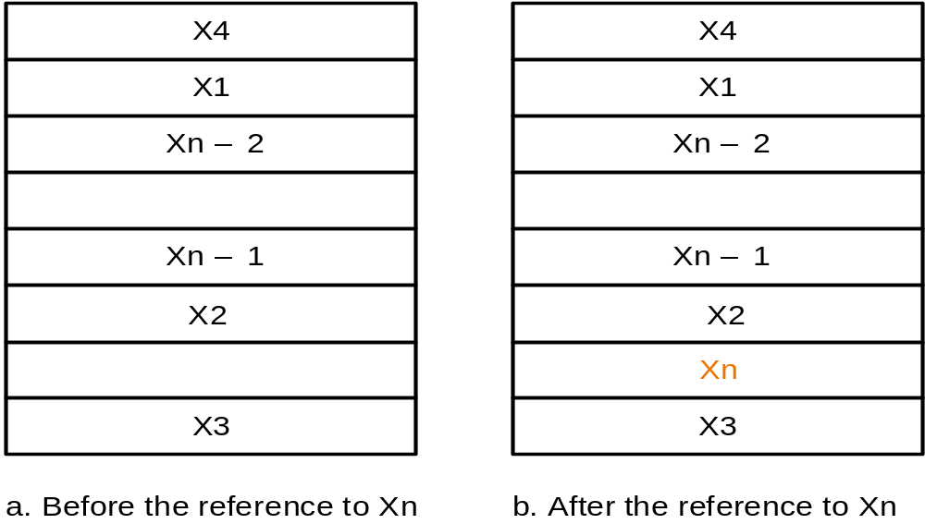
Cache基本原理
简单实现
问题:
  如何知道数据是否在缓存中?
  如果在，如何找到它?
解决: 直接映射
对于低层存储的每块数据，换入缓存时将换入到缓存的唯一确定位置.
多个低层存储数据块共享一个缓存位置

Slide 9
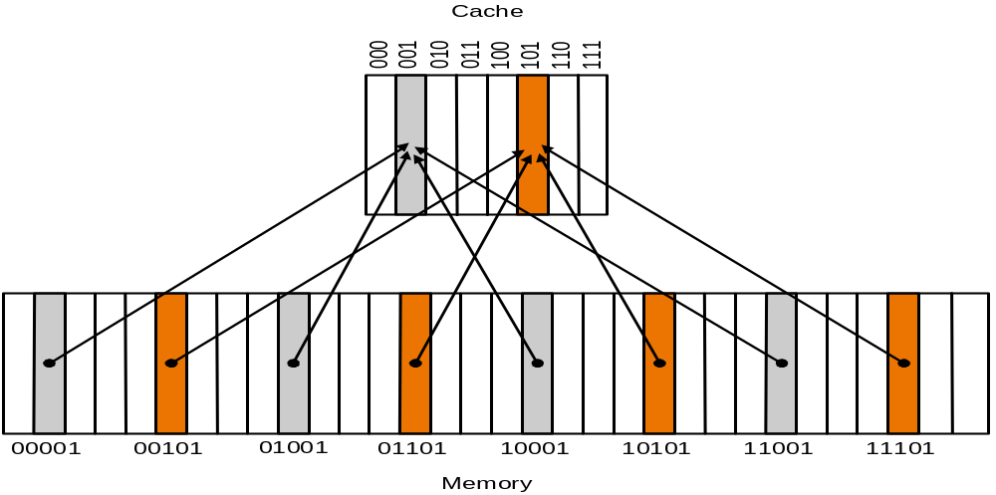
直接映射 Cache
index
Cache 8 Block
32 Block

Slide 10
访问cache --- 如何找到数据?
主存块地址比cache块地址大
TAG
Index
Byte offset
Block address MOD Numbers of Cache Block
Index | V | Tag | Data
000 | N
001 | N
010 | N
011 | N
100 | N
101 | N
110 | N
111 | N
a. The initial state of the cache after power-on
Valid bit

Slide 11
访问序列
10110,11010,10110,11010,10000,00011,10000,10010
Index | V | Tag | Data
000 | N
001 | N
010 | N
011 | N
100 | N
101 | N
110 | Y | (10)₂ | Memory(10110)
111 | N
b. After handling a miss of address(10110)
Index | V | Tag | Data
000 | N
001 | N
010 | Y | (11)₂ | Memory(11010)
011 | N
100 | N
101 | N
110 | Y | (10)₂ | Memory(10110)
111 | N
c. After handling a miss of address(11010)
Index | V | Tag | Data
000 | N
001 | N
010 | Y | (11)₂ | Memory(11010)
011 | N
100 | N
101 | N
110 | Y | (10)₂ | Memory(10110)
111 | N
d. After handling a hit of address(10110)
Index | V | Tag | Data
000 | N
001 | N
010 | Y | (11)₂ | Memory(11010)
011 | N
100 | N
101 | N
110 | Y | (10)₂ | Memory(10110)
111 | N
e. After handling a hit of address(11010)

Slide 12
访问序列-2
10110,11010,10110,11010,10000,00011,10000,10010
Index | V | Tag | Data
000 | Y | (10)₂ | Memory(10000)
001 | N
010 | Y | (11)₂ | Memory(11010)
011 | N
100 | N
101 | N
110 | Y | (10)₂ | Memory(10110)
111 | N
f. After handling a miss of address(10000)
Index | V | Tag | Data
000 | Y | (10)₂ | Memory(10000)
001 | N
010 | Y | (11)₂ | Memory(11010)
011 | Y | (00)₂ | Memory(00011)
100 | N
101 | N
110 | Y | (10)₂ | Memory(10110)
111 | N
g. After handling a miss of address(00011)
Index | V | Tag | Data
000 | Y | (10)₂ | Memory(10000)
001 | N
010 | Y | (11)₂ | Memory(11010)
011 | Y | (00)₂ | Memory(00011)
100 | N
101 | N
110 | Y | (10)₂ | Memory(10110)
111 | N
h. After handling a hit of address(10000)
Index | V | Tag | Data
000 | Y | (10)₂ | Memory(10000)
001 | N
010 | Y | (11)→ (10)₂ | Memory(10010)
011 | Y | (00)₂ | Memory(00011)
100 | N
101 | N
110 | Y | (10)₂ | Memory(10110)
111 | N
i. After handling a miss of address(10010)

Slide 13
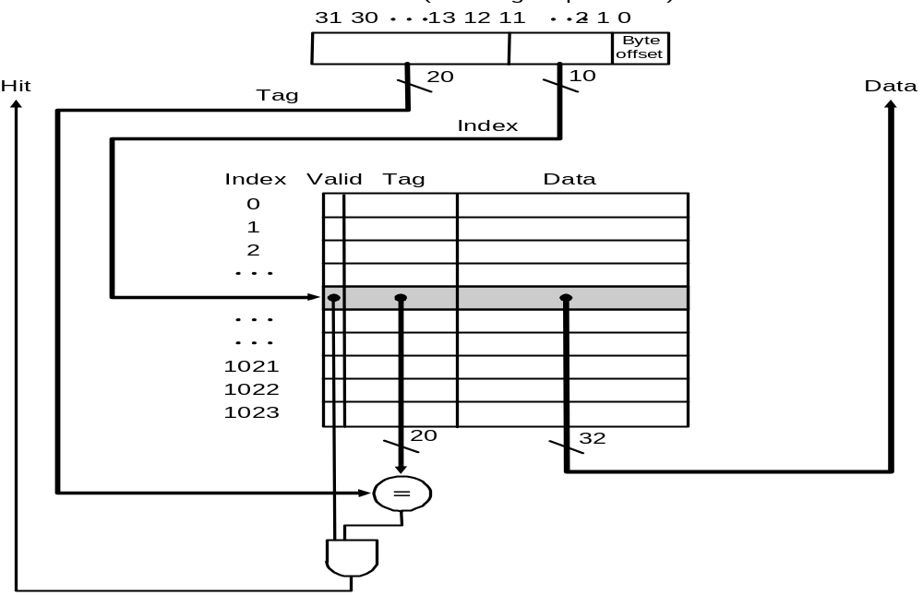
直接映射结构
For MIPS:

Slide 14
Cache例子
例子
How many total bits are required for a direct-mapped cache 16KB of data and 4-word blocks, assuming a 32-bit address?
Answer
16KB=4KWord=2¹² words
One block=4 words = 2² words
Number of blocks (index bit) = 2¹² ÷ 2² = 2¹⁰ blocks
Data bits of block =4×32=128 bits
Tag bits = address – index-block size =32-10–2-2 =18 bits
Valid bit = 1 bit
Total Cache size = 2¹⁰ × (128+18+1)= 2¹⁰×147= 147 Kbits
        = 18.4KB
It is about 1.15 times as many as needed just for the data

Slide 15
映射地址
例子
Consider a cache with 64 blocks and a block size of 16 bytes.
What block number does byte address 1200 map to?
Answer
(Block address) mod (Number of cache blocks)
Where the address of the block is
75 mod 64 =11
First: get BLOCK Address
Byte address
1200
=
= 75
Bytes per block
16
Then: get INDEX
Byte address
×Byte per block
Byte address
+( Byte per block-1)
Bytes per block
Bytes per block
×Byte per block
Here:
1200 1215

Slide 16
直接映射地址选择 higher-order vs. lower-order address bits
Tag
Index
Block
Offset
k
t
b
V
Tag
Data Block
2^{k}
lines
t
=
HIT
Data Word or Byte

Slide 17
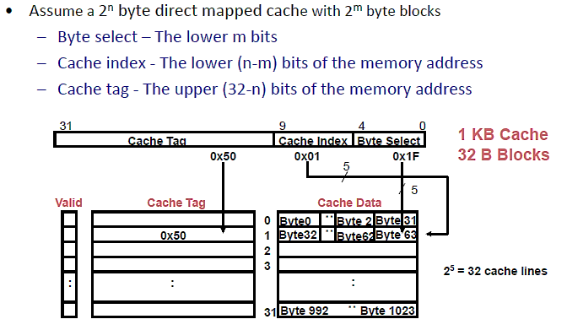
缓存块

Slide 18
块大小和空间局部性
Block is unit of transfer between the cache and memory
4 Byte block, b=2
Tag
Byte0
Byte1
Byte2
Byte3
Split CPU address
block address offset_{b}
32-b bits
b bits
2^{b} = block size a.k.a line size (in bytes)
Larger block size has distinct hardware advantages
  less tag overhead
  exploit fast burst transfers from DRAM
  exploit fast burst transfers over wide busses
What are the disadvantages of increasing block size?
Fewer blocks => more conflicts. Can waste bandwidth.

Slide 19
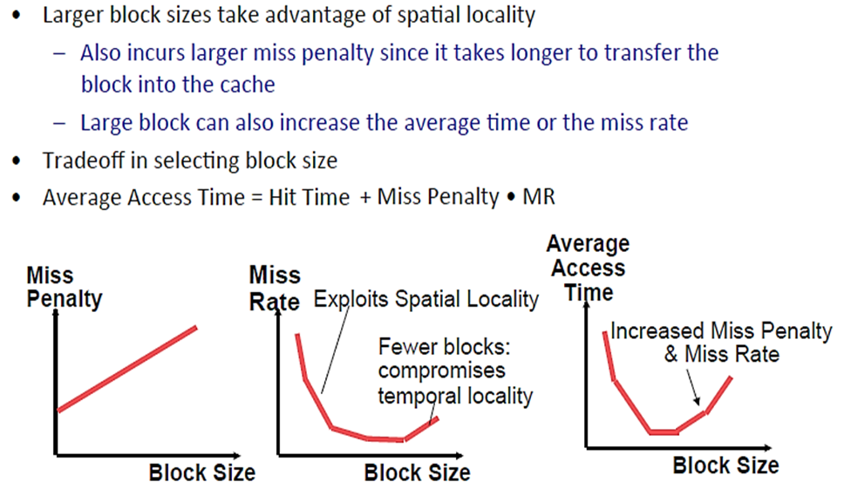
块尺寸

Slide 20
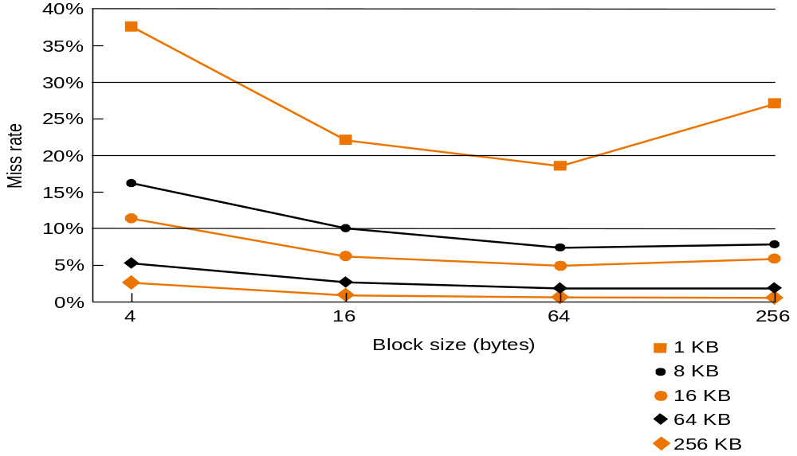
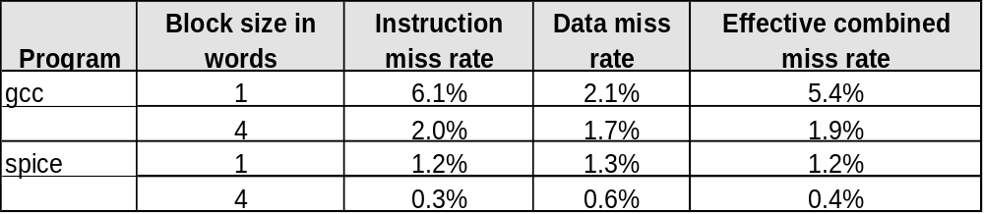
不同块尺寸的性能
Increasing the block size tends to decrease miss rate:
Use split caches because there is more spatial locality in code:

Slide 21
处理Cache读命中和缺失
Read hits
  this is what we want!
Read misses—two kinds of misses
  instruction cache miss
  data cache miss
let’s see main steps taken on an instruction cache miss
  Stall the CPU, fetch block from memory, deliver to cache, restart CPU read
1. Send the original PC value (current PC-4) to the memory.
2. Instruct main memory to perform a read and wait for the memory to complete its access.
3. Write the cache entry, putting the data from memory in the data portion of the entry, writing the upper bits of the address into the tag field, and turning the valid bit on.
4. Restart the instruction execution at the first step, which will refetch the instruction again, this time finding it in the cache.

Slide 22
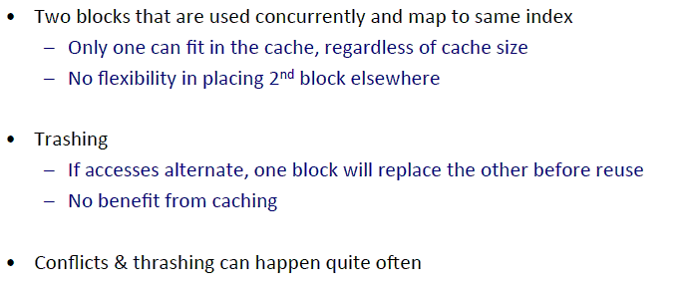
直接映射问题: 冲突缺失

Slide 23
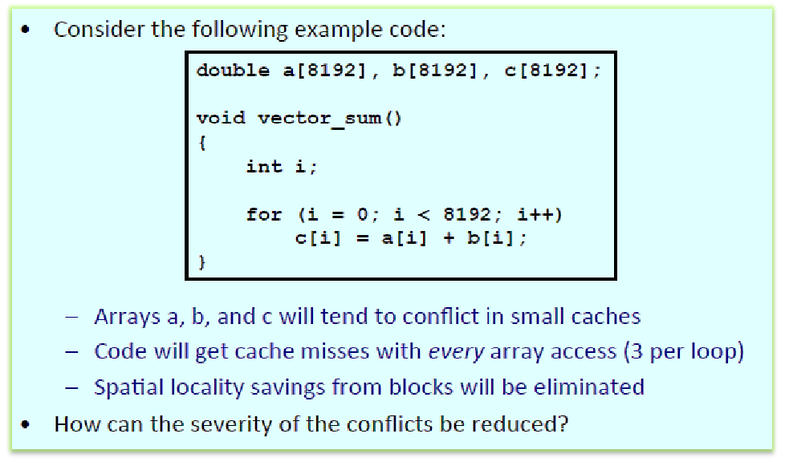
冲突例子:

Slide 24
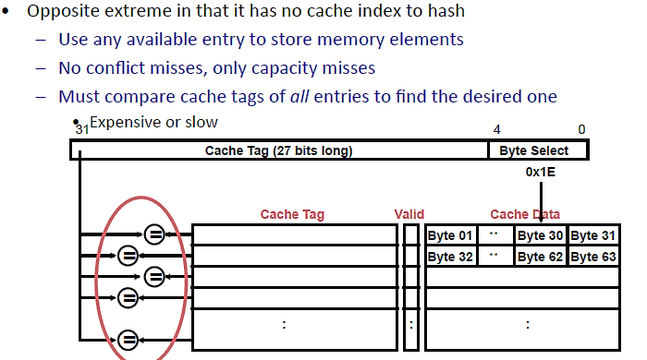
全相联Cache

Slide 25
全相联 Cache
V
Tag
Data Block
t
=
Tag
t
=
HIT
Block
Offset
Data
Word
or Byte
=
b

Slide 26
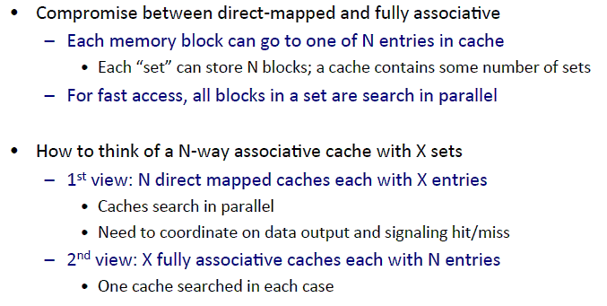
N-way 组相联

Slide 27
2-Way 组相联
Tag
Index
Block
Offset
b
t
k
V
Tag
Data Block
V
Tag
Data Block
t
=
=
Data
Word
or Byte
HIT

Slide 28
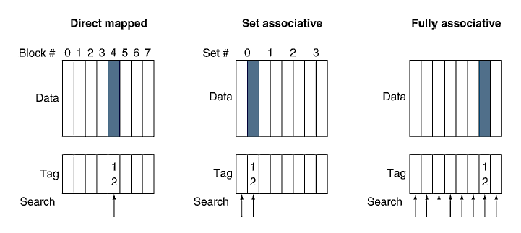
相联 Cache

Slide 29
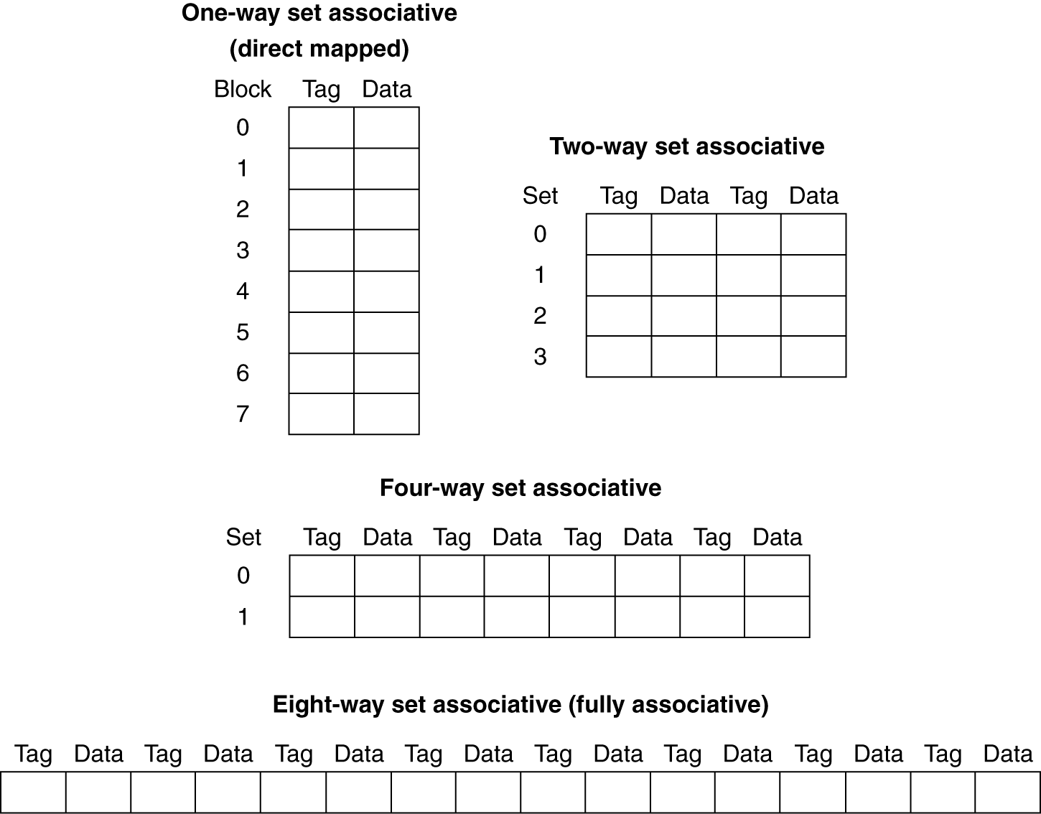
组相联
For a cache with 8 entries

Slide 30
组相联 Example
Compare 4-block caches
  Direct mapped, 2-way set associative,
  fully associative
  Block access sequence: 0, 8, 0, 6, 8
Direct mapped
Block address | Cache index | Hit/miss | Cache content after access
 |  |  | 0 | 1 | 2 | 3
0 | 0 | miss | Mem[0]
8 | 0 | miss | Mem[8]
0 | 0 | miss | Mem[0]
6 | 2 | miss | Mem[0] |  | Mem[6]
8 | 0 | miss | Mem[8] |  | Mem[6]

Slide 31
组相联 Example
2-way set associative
Block address | Cache index | Hit/miss | Cache content after access
 |  |  | Set 0 |  | Set 1
0 | 0 | miss | Mem[0]
8 | 0 | miss | Mem[0] | Mem[8]
0 | 0 | hit | Mem[0] | Mem[8]
6 | 0 | miss | Mem[0] | Mem[6]
8 | 0 | miss | Mem[8] | Mem[6]
Fully associative
Block address |  | Hit/miss | Cache content after access
0 |  | miss | Mem[0]
8 |  | miss | Mem[0] | Mem[8]
0 |  | hit | Mem[0] | Mem[8]
6 |  | miss | Mem[0] | Mem[8] | Mem[6]
8 |  | hit | Mem[0] | Mem[8] | Mem[6]

Slide 32

组相联 Cache 组织

Slide 33
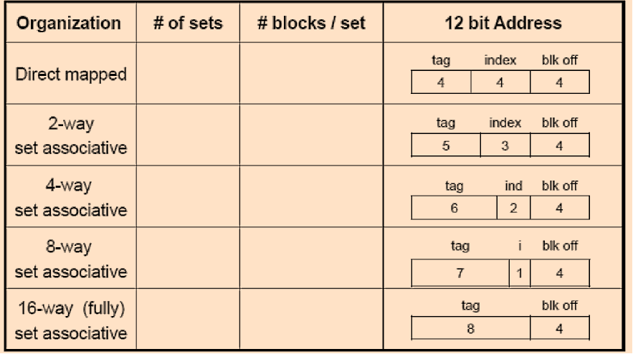
Cache 组织
256 bytes, 16 byte block, 16 blocks

Slide 34
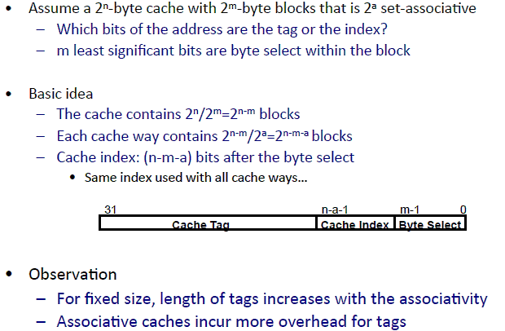
组相联Tag & Index

Slide 35
相联度
Increased associativity decreases miss rate
  But with diminishing returns
  Simulation of a system with 64KB
  D-cache, 16-word blocks, SPEC2000
  1-way: 10.3%
  2-way: 8.6%
  4-way: 8.3%
  8-way: 8.1%

Slide 36
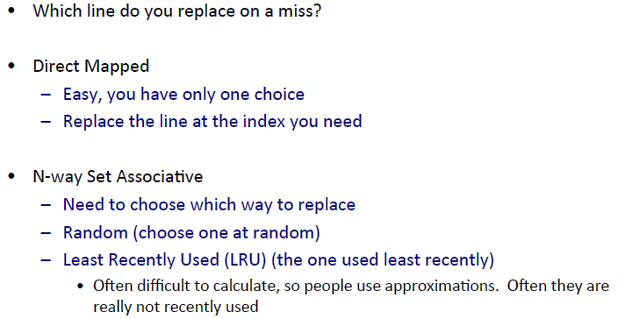
替换策略

Slide 37
替换策略
Several different replacement policies can be used
  Random replacement - randomly pick any block
    Easy to implement in hardware, just requires a random number generator
  Least-recently used (LRU) - pick the block in the set which was least recently accessed
    Assumed more recently accessed blocks more likely to be referenced again
    This requires extra bits in the cache to keep track of accesses.
  First in,first out(FIFO)-Choose a block from the set which was first came into the cache

Slide 38
CPU-Cache 交互 (5-stage pipeline)
0x4
Add
E
Decode,
Register
Fetch
M
A
we
Y
addr
nop
ALU
Y
IR
B
Primary
Data
Cache
rdata
PC
addr
inst
D
R
wdata
hit?
hit?
wdata
  PCen
Primary
Instruction
Cache
MD1
MD2
Stall entire CPU on data cache miss
To Memory Control
Cache Refill Data from Lower Levels of Memory Hierarchy

Slide 39
改进Cache性能
Average memory access time =
Hit time + Miss rate x Miss penalty
To improve performance:
  reduce the hit time
  reduce the miss rate
  reduce the miss penalty
What is the simplest design strategy?

Slide 40
串行vs并行
α is HIT RATIO: Fraction of references in cache
1 - α is MISS RATIO: Remaining references
Addr
Addr
CACHE
Main
Memory
Processor
Data
Data
Average access time for serial search: t_{cache} + (1 - α) t_{mem}
Addr
CACHE
Main
Memory
Processor
Data
Data
Average access time for parallel search: α t_{cache} + (1 - α) t_{mem}
Savings are usually small, t_{mem} >> t_{cache}, hit ratio α high
High bandwidth required for memory path
Complexity of handling parallel paths can slow t_{cache}

Slide 41
Cache 缺失原因
强制缺失Compulsory: first-reference to a block （a.k.a. cold start）
- misses that would occur even with infinite cache
容量缺失Capacity: cache is too small to hold all data needed by the program
- misses that would occur even under perfect
replacement policy
冲突缺失Conflict: misses that occur because of collisions
due to block-placement strategy
    - misses that would not occur with full associativity

Slide 42
Cache 参数对性能的影响
Larger cache size
  reduces capacity and conflict misses
  hit time will increase
Higher associativity
  reduces conflict misses
  may increase hit time
Larger block size
  reduces compulsory and capacity (reload) misses
  increases conflict misses and miss penalty

Slide 43
多级 Caches
Primary cache attached to CPU
  Small, but fast
Level-2 cache services misses from primary cache
  Larger, slower, but still faster than main memory
Main memory services L-2 cache misses
Some high-end systems include L-3 cache

Slide 44
多级 Cache 例子
Given
  CPU base CPI = 1, clock rate = 4GHz
  Miss rate/instruction = 2%
  Main memory access time = 100ns
With just primary cache
  Miss penalty = 100ns/0.25ns = 400 cycles
  Effective CPI = 1 + 0.02 × 400 = 9

Slide 45
多级 Cache 例子 (cont.)
Now add L-2 cache
  Access time = 5ns
  Global miss rate to main memory = 0.5%
Primary miss with L-2 hit
  Penalty = 5ns/0.25ns = 20 cycles
Primary miss with L-2 miss
  Extra penalty = 400 cycles
CPI = 1 + 0.02 × 20 + 0.005 × 400 = 3.4
Performance ratio = 9/3.4 = 2.6

Slide 46
多级 Cache
Primary cache
  Focus on minimal hit time
L-2 cache
  Focus on low miss rate to avoid main memory access
  Hit time has less overall impact
Results
  L-1 cache usually smaller than a single cache
  L-1 block size smaller than L-2 block size

Slide 47
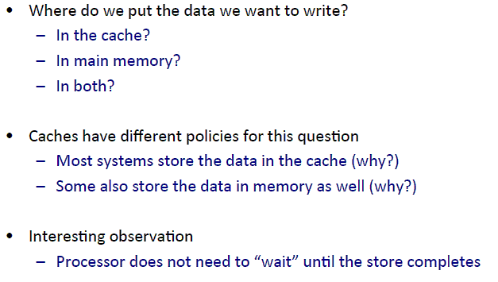
写策略

Slide 48
写策略选择
Cache hit:
  write through: write both cache & memory
    Generally higher traffic but simpler pipeline & cache design
  write back: write cache only, memory is written only when the entry is evicted
    A dirty bit per block further reduces write-back traffic
Cache miss:
  no write allocate: only write to main memory
  write allocate (aka fetch on write): fetch into cache
Common combinations:
  write through and no write allocate（memory centric）
  write back with write allocate（cache centric）

Slide 49
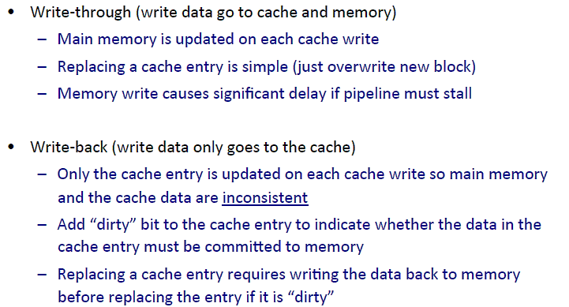
写策略选择

Slide 50
写策略选择
Write-through
  Misses are simpler and cheaper(no write-back to memory)
  Easier to implement
  Uses a lot of bandwidth to the next level of meory
Write-back
  Writes are fast on a hit
  Multiple writes within a block require only one “writeback” later
  Efficient block transfer on write back to memory at eviction

Slide 51
写Cache
Tag
Index
Block
Offset
b
t
k
V
Tag
Data
2^{k}
lines
t
=
WE
HIT
Data Word or Byte

Slide 52
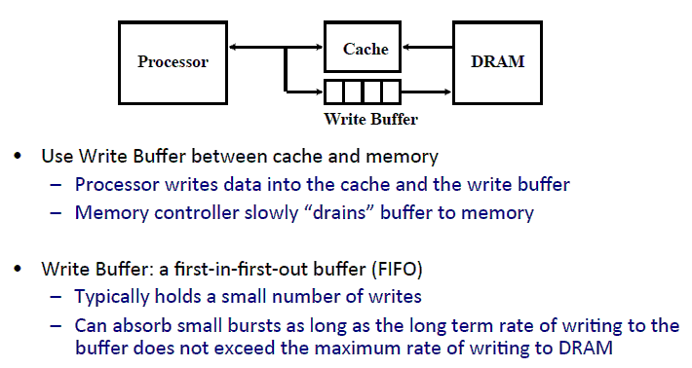
Write-Through 避免等待

Slide 53
写缓冲-减少读缺失代价
Unified L2 Cache
Data Cache
CPU
RF
Write
buffer
Evicted dirty lines for writeback cache
All writes in writethrough cache
Processor is not stalled on writes, and read misses can go ahead of write to main memory
Problem: Write buffer may hold updated value of location needed by a read miss
Simple scheme: on a read miss, wait for the write buffer to go empty
Faster scheme: Check write buffer addresses against read miss addresses, if no match, allow read miss to go ahead of writes, else, return value in write buffer

Slide 54
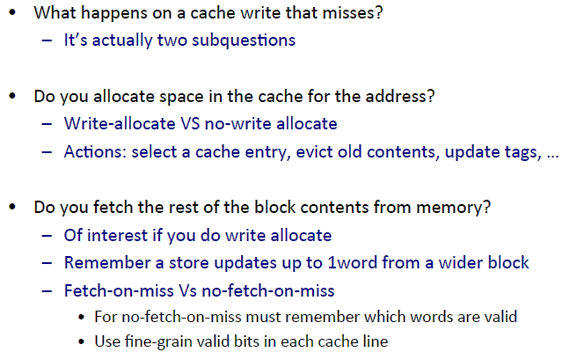
Cache 写策略: 写分配？

Slide 55
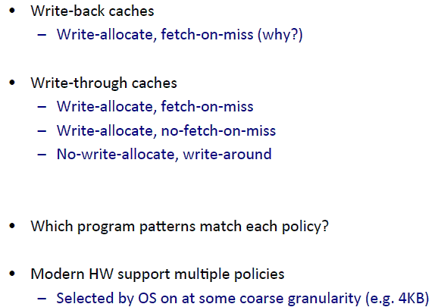
典型选择

Slide 56
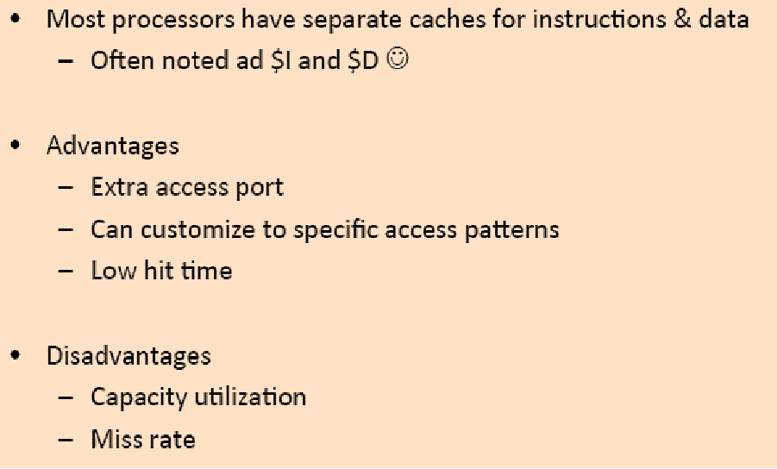
指令&数据 Caches

Slide 57
Cache 控制
Example cache characteristics
  Direct-mapped, write-back, write allocate
  Block size: 4 words (16 bytes)
  Cache size: 16 KB (1024 blocks)
  32-bit byte addresses
  Valid bit and dirty bit per block
  Blocking cache
    CPU waits until access is complete
31
10
9
4
3
0
Tag
Index
Offset
18 bits
10 bits
4 bits

Slide 58
接口信号
CPU
Cache
Memory
Read/Write
Read/Write
Valid
Valid
Address
32
Address
32
Write Data
32
Write Data
128
Read Data
32
Read Data
128
Ready
Ready
Multiple cycles per access

Slide 59

状态机
Use an FSM to sequence control steps
Set of states, transition on each clock edge
  State values are binary encoded
  Current state stored in a register
  Next state
  = f_{n} (current state,
  current inputs)
Control output signals
= f_{o} (current state)

Slide 60

Cache 控制器状态机
Could partition into separate states to reduce clock cycle time

Slide 61
软件优化
Restructuring code affects the data block access sequence
  Group data accesses together to improve spatial locality
  Re-order data accesses to improve temporal locality
Prevent data from entering the cache
  Useful for variables that will only be accessed once before being replaced
  Needs mechanism for software to tell hardware not to cache data (“no-allocate” instruction hints or page table bits)
Kill data that will never be used again
  Streaming data exploits spatial locality but not temporal locality
  Replace into dead cache locations

Slide 62
Loop Interchange
  for(j=0; j < N; j++) {
  for(i=0; i < M; i++) {
  x[i][j] = 2 * x[i][j];
  }
  }
  for(i=0; i < M; i++) {
  for(j=0; j < N; j++) {
  x[i][j] = 2 * x[i][j];
  }
  }
What type of locality does this improve?

Slide 63
Loop Fusion
  for(i=0; i < N; i++)
  a[i] = b[i] * c[i];
  for(i=0; i < N; i++)
  d[i] = a[i] * c[i];
  for(i=0; i < N; i++)
  {
  a[i] = b[i] * c[i];
  d[i] = a[i] * c[i];
  }
What type of locality does this improve?

Slide 64
Matrix Multiply
z
j
  for(i=0; i < N; i++)
  for(j=0; j < N; j++) {
  r = 0;
  for(k=0; k < N; k++)
  r = r + y[i][k] * z[k][j];
  x[i][j] = r;
  }
k
y
k
x
j
i
i
Not touched
Old access
New access

Slide 65
Matrix Multiply with Cache Tiling
  for(jj=0; jj < N; jj=jj+B)
  for(kk=0; kk < N; kk=kk+B)
  for(i=0; i < N; i++)
  for(j=jj; j < min(jj+B,N); j++) {
  r = 0;
  for(k=kk; k < min(kk+B,N); k++)
  r = r + y[i][k] * z[k][j];
  x[i][j] = x[i][j] + r;
  }
z
j
k
y
k
x
j
i
i
What type of locality does this improve?
Not touched
Old access
New access

Slide 66
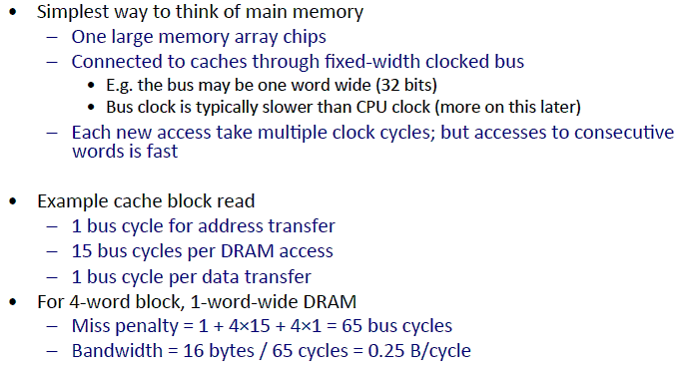
主存: DRAM

Slide 67
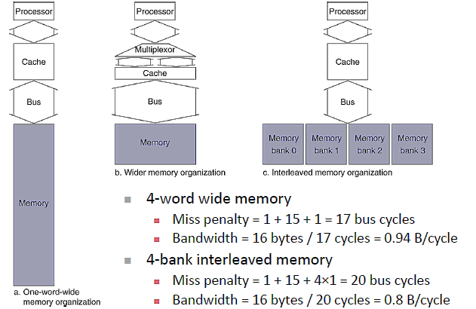
增加带宽

Slide 68
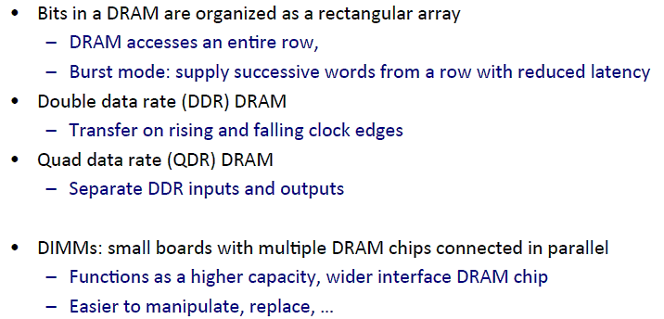
DRAM 组织

Slide 69
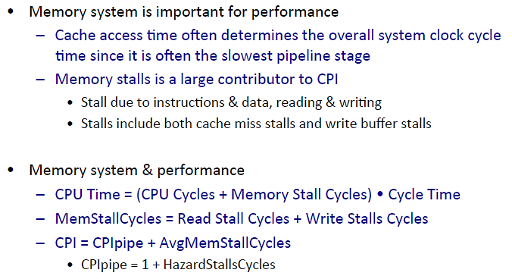
性能度量

Slide 70
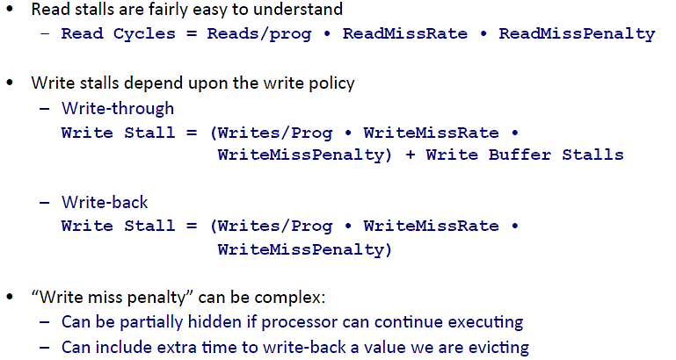
性能度量

Slide 71
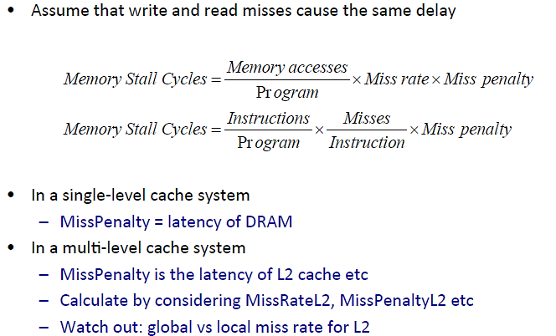
Worst-Case Simplicity

Slide 72
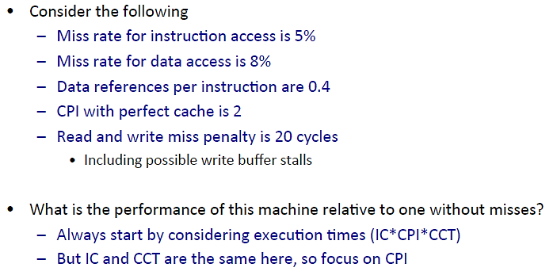
Simple Cache Performance Example

Slide 73
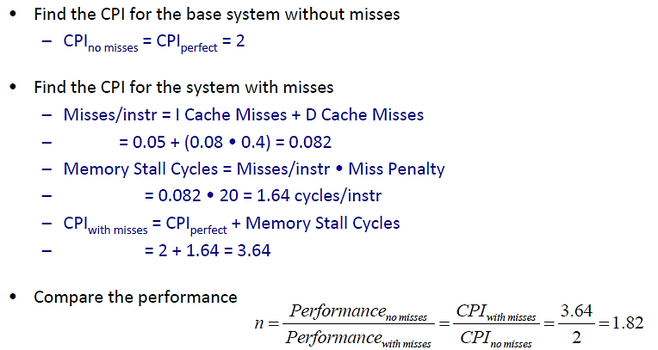
Performance Solution

Slide 74
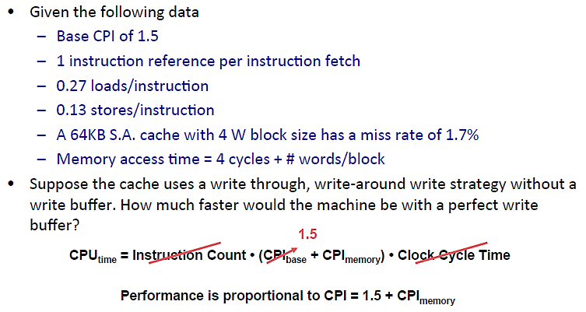
Another Cache Problem

Slide 75
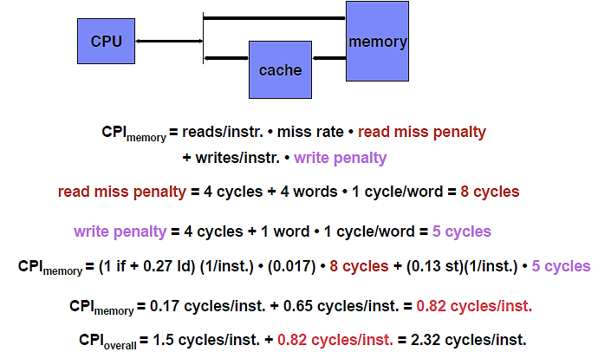
No Write Buffer

Slide 76
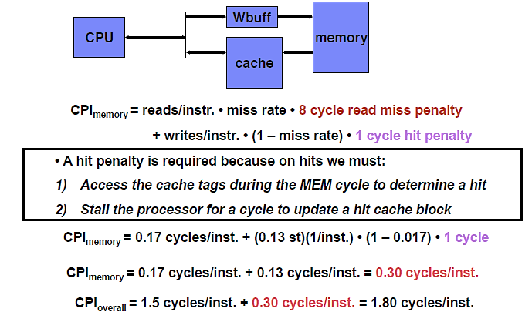
Perfect Write Buffer

Slide 77
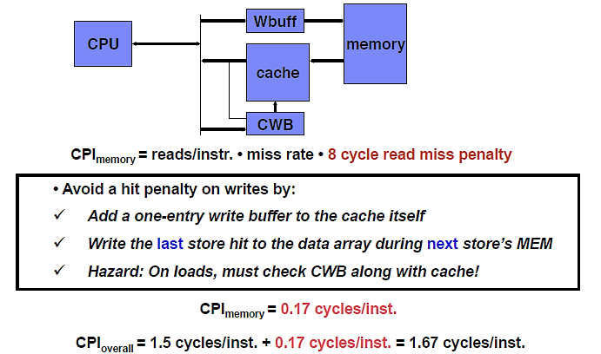
Perfect Write Buffer + Cache Write Buffer

Slide 78
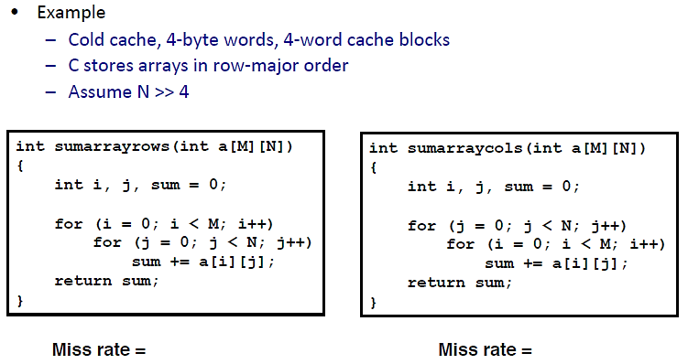
Fallacy: Caches are Transparent to Programmers

Slide 79
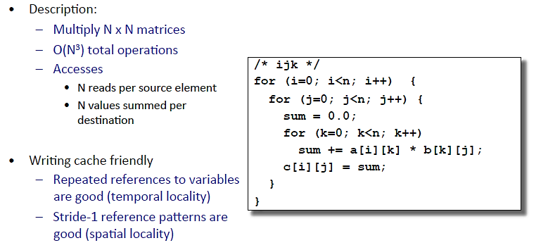
Matrix Multiplication Example

