Slide 1
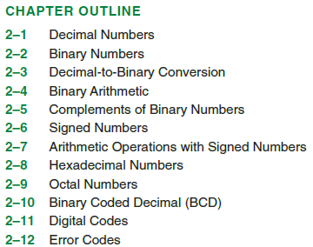
CHAPTER 2: Number Systems Operations, and Codes

Slide 2
2.1 Introduction to Number System 数制系统简介
Digital systems represented information in a discrete form, and Number systems provide the means of quantifying information for processing by digital system. (数字系统以离散方式表示信息，数制系统提供了由数字系统处理量化信息的一种方法)
Positional Number Systems
Number system conversion
Binary Codes
Arithmetic

Slide 3
Number Systems - Decimal
“base” 10 (radix is 10)
10 digits: 0...9
536.159₁₀=(5×10²)+(3×10¹)+(6×10⁰)+(1×10⁻¹)+(5×10⁻²)+(9×10⁻³)
Radix or Base
Weight

Slide 4
Number Systems – Decimal (cont.)
In general, a decimal number with n digits to the left of the decimal point, and m digits to the right of the decimal point is written as:
A_{n-1} A_{n-2} … A₁ A₀ . A₋₁ A₋₂ … A_{-m+1} A_{-m}
where A_{i} is a coefficient between 0..9,
and i denotes the weight (=10^{i}) of A_{i}.

Slide 5
Number Systems – General
“base” r (radix r)
r digits
N = A_{n-1} ×r ^{n-1} + A_{n-2} × r ^{n-2} +… + A₁ × r + A₀ +
A₋₁ × r ⁻¹ + A₋₂ × r ⁻² +… + A_{-m} × r ^{-m}
Most
Significant
Bit (MSB)
Least
Significant
Bit (LSB)

Slide 6
Positional Number Systems
Let r=radix or base of a number system; 数制的基或基数
Let c=character from the character set of the radix; 该基的字符集合中的字符
Let N=number to be represented in radix; 要用r进制表示的数
Let n=the number of digits in the integer portion of N； n整数部分的位数
Let m=the number of digits in the fractional portion of N；小数部分的位数
(N)_{r}=(c_{n-1}r^{n-1}+c_{n-2}r^{n-2}+…+c₁r¹+c₀r⁰+c₋₁r⁻¹+c₋₂r⁻²+…+c_{-m}r^{-m})
(N)r= c_{i}r^{i}

Slide 7
Number Systems – General (cont.)
e.g. let r = 6
(312.4)₆ = 3 × 6² + 1 × 6¹ + 2 × 6⁰ + 4 × 6⁻¹
= (116.66)₁₀
Conversion from n-radix (any system with radix n) to decimal follows similar process as above

Slide 8
Number Systems (cont.)
Most common number systems for computers:
Binary (r = 2)
Octal (r = 8)
Hexadecimal (r = 16)

Slide 9
Binary Numbers--Base 2
Computers represent all data as “strings of bits”, each bit being either 0 or 1
“base” 2, with 2 digits: 0 and 1
e.g.
(101101.10)₂ = 1×2⁵ + 0×2⁴ + 1×2³ + 1×2² + 0×2¹ + 1×2⁰ + 1×2⁻¹ + 0×2⁻²
(in decimal) = 32 + 0 + 8 + 4 + 0 + 1 + ½ + 0
= (45.5)₁₀

Slide 10
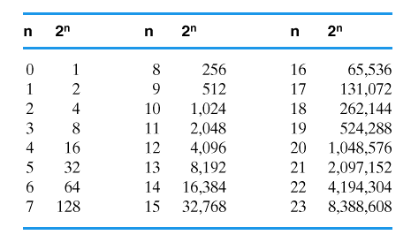
Powers of two
Memorize at least through 2¹⁶

Slide 11
Octal Numbers--Base 8
“base” 8
with 8 digits: 0..7
Eg.
231.25₈=2×8² + 3×8¹+1×8⁰+2×8⁻¹+5×8⁻²
(in decimal) =153.328125₁₀

Slide 12
Hexadecimal Numbers--Base 16
r = 16
Digits (convention): 0..9, A, B, C, D, E, F
A=10, B=11, … , F = 15

Slide 13
e.g1.
(3FB)₁₆ = 3×16² + 15×16¹ + 11×16⁰
(in decimal) = 768 + 240 + 11
= (1019)₁₀
e.g2.
A59C.3A₁₆ = (A×16³)+(5×16²)+(9×16¹)+(C×16⁰)+(3×16⁻¹) +(A×16⁻²)

Slide 14
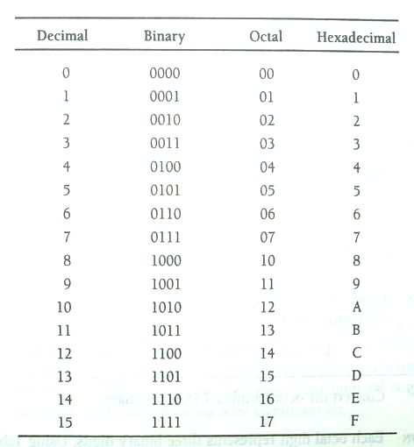
2.3 Number System Conversion
Decimal, binary, octal, and hexadecimal number

Slide 15
Binary ↔ Octal
(011 010 101 000 . 111 101 011 100)₂
( 3 2 5 0 . 7 5 3 4 )₈
E.g. Convert the binary number
010011110111.110101010₂ to octal
Solution 010,011,110,111.110,101,010₂=2367.652₈

Slide 16
Binary ↔ Hex
( 0110 1010 1000 . 1111 0101 1100 )₂
( 6 A 8 . F 5 C )₁₆
E.g. Convert the binary number
010011110111.110101010₂ to hexadecimal
Solution 0100,1111,0111.1101,0101,0000₂
=4F7.D50₁₆

Slide 17
2.3 Number System Conversion
hexadecimal and octal to Binary Conversion
E.g. Convert the numbers F37A.B2₁₆, 735.5₈ to binary
Solution F37A.B2=1111,0011,0111,1010.1011,0010₂
735.5₈ =111,011,101.101₂
Practice problem: convert 367.236₈to binary then hexadecimal
Solution
367.236₈=011,110,111.010,011,110₂
011,110,111.010,011,110₂=0,1111,0111.0100,1111,0₂=F7.4F₁₆

Slide 18
2.3 Number System Conversion
Binary to decimal Conversion
11001.011₂ =(1×2⁴)+(1×2³)+(0×2²)+(0×2¹)+(1×2⁰) +(0× 2⁻¹)+(1×2⁻²)+(1×2⁻³)
=16+8+0+0+1+0+0.25+0.125
=25.375₁₀

Slide 19
2.3 Number System Conversion
Decimal to Binary Conversion
Successive Division Radix Conversion(逐次除法基转换)
(每次除法的余数成为新基下的数符，不断重复直到产生最低位数值)
E.g. Convert 119₁₀ to binary
（LSB）
Solution
119₁₀=1110111₂
（MSB）

Slide 20
2.3 Number System Conversion
Decimal to Binary Conversion
Fractional Radix Conversion, Successive Multiplication
(小数基转换，逐次乘法) [乘积中的整数部分成为新基下的数，乘积中的小数部分再乘以新基，如此持续下去。停止条件：？]
E.g. Convert .75₁₀ to binary
Solution
Multiply .75 by 2 (.75)2=1.5 1(MSB)
Multiply .5 by 2 (.5)2=1.0 1
Multiply 0 by 2 (0)2=0.0 0(LSB)
.75₁₀=.110=(1)2⁻¹+(1)2⁻²

Slide 21
2 Number System Conversion
E.g. Convert 95.0625₁₀ to binary（con.）
Solution First, convert the integer part of the decimal number by successive division
1.Devide 95 by 2
5.Devide 5 by 2
(LSB)
2.Devide 47 by 2
6.Devide 2 by 2
3.Devide 23 by 2
7.Devide 1 by 2
(MSB)
4.Devide 11 by 2
95₁₀=1·2⁶+0·2⁵+1·2⁴+1·2³+1·2²+1·2¹+1·2⁰

Slide 22
2 Number System Conversion
E.g. Convert 95.0625₁₀ to binary（con.）
Second, convert the fraction
(.0625)2=0.125 0 (MSB)
(.125)2=0.25 0
(.25)2=0.5 0
(.5)2=1.0 1 (LSB)
.0625₁₀=.0001₂
95.0625₁₀=1011111.0001₂

Slide 23
2 Number System Conversion
Decimal to Any Radix
The conversion of decimal numbers to any other radix applies the successive division and successive multiplication algorithms
e.g. Convert 23.625₁₀ to octal (base 8)
Solution
Convert the integer portion by successive division
Convert te fraction portion by successive multiplication
1.Divide 23 by 8
(.625)8=5.00 5
(MSB)
(LSB)
2.Divide 2 by 8
.625₁₀=.5₈
(MSB)
23.625₁₀=27.5₈
23₁₀=27₈

Slide 24
2 Number System Conversion
Any Radix to Decimal
e.g. Convert 324.2₅ to decimal
Solution 3·5²+2·5¹+4·5⁰+2·5⁻¹
=3· (25)+2· (5)+4· (1)+2· (1/5)
=75+10+4+2/5
=89.4₁₀

Slide 25
2 Number System Conversion
Practice problem:
1. Convert 345.2₆ to decimal
2. Convert 34.8₁₀ to base 5
Solution:
1. 137.333……₁₀
2. 114.4₅

Slide 26
Binary Code(二进制编码)
A binary code represents text, computer processor instructions, or other data using any two-symbol system, but often the binary number system‘s 0 and 1.
Some codes are suitable for arithmetic operations; some are good at the delivery of information to the system's digital sensors. Binary code can also be used to represent signed numbers.

Slide 27
Binary Codes
Code 是代表某事物的一个或一组符号。
二进制位常常成组地用来表示十进制数字或字母字符。用二进制编码的十进制数，缩写为BCD (Binary Coded Decimal)。用二进制表示的十进制数，在驱动可视化显示时十分有用。
某些二进制编码适合算数运算，其他的编码有利于将信息传送到系统的数字传感器。
二进制编码还可用于表示符号的数

Slide 28
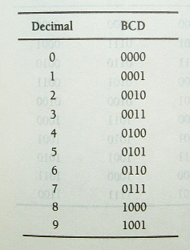
Binary Codes
1 Natural Binary Coded Decimal (自然二进制编码的十进制)
在与数字系统交互作用的许多应用中，人们需要将二进制信息用一种容易转换为十进制信息的方式编码。与用一排灯直接表示二进制信息的形式相比，人们更容易阅读十进制显示。
四个二进制位表示一个十进制位
e.g. Convert 9275.6₁₀ into BCD
Decimal to natural BCD
Solution:
9=1001
2=0010
7=0111
5=0101
6=0110
9275.6₁₀=1001，0010，0111，0101.0110 in BCD
BCD码比直接二进制码需要更多位。

Slide 29
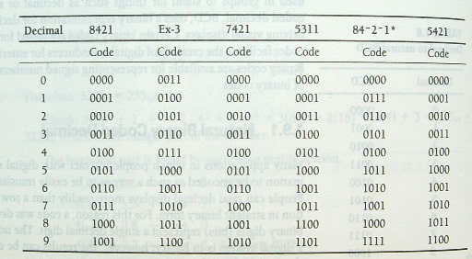
Binary Codes
. Binary Codes (Weighted) [(加权)二进制编码]
存在许多二进制编码十进制(BCD码)方案。都有６种未分配的二进制组合。
加权二进制编码，为二进制的位置分配不同的权，产生不同的编码。在实际的数字系统应用中，采用某些特定编码会比其他编码产生更少的逻辑。
映像特征
Notes:
加权二进制编码，为二进制的位置分配不同的权，产生不同的编码，在实际的数字系统应用中，采用某些特定编码会比其他编码产生更少的逻辑

Slide 30
Binary Codes
余3码(Ex-3) 将自然BCD码的值+3
加权二进制编码，为二进制的位置分配不同的权，产生不同的编码，在实际的数字系统应用中，采用某些特定编码会比其他编码产生更少的逻辑
Notes:
加权二进制编码，为二进制的位置分配不同的权，产生不同的编码，在实际的数字系统应用中，采用某些特定编码会比其他编码产生更少的逻辑

Slide 31
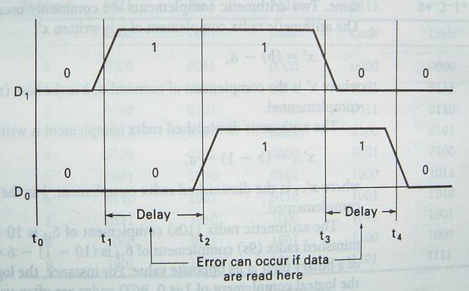
Binary Codes
Unit Distance Code: Gray code (间隔位编码：格雷码)
二进制编码通常用于将数据从测量物参数的传感器输送到数字系统。人们希望这些编码在两个连续值之间只有一位发生变化，这种所期待的特性可减少可能发生的由同时两个数发生变化所导致的测量错误。对于一种编码而言，区分不同值的能力是十分重要的。如果发生短暂时延，数字系统也许会接收错误数据
Timing diagram illustrating potential error when two bits change sat the same time

Slide 32
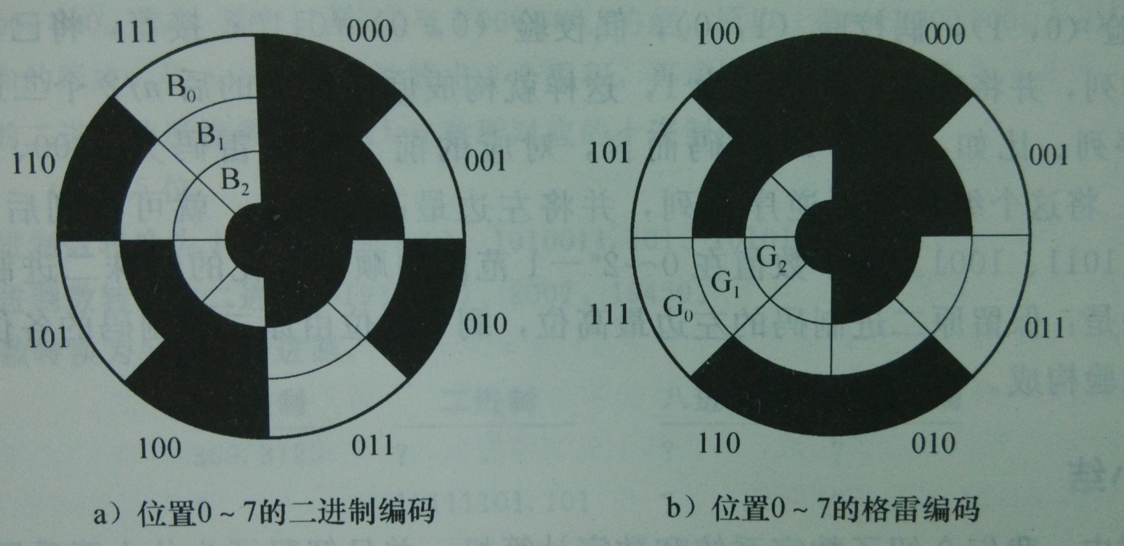
Binary Codes
Unit Distance Code: Gray code (间隔位编码：格雷码)
二进制编码通常用于将数据从测量物参数的传感器输送到数字系统。人们希望这些编码在两个连续值之间只有一位发生变化，这种所期待的特性可减少可能发生的由同时两个数发生变化所导致的测量错误。对于一种编码而言，区分不同值的能力是十分重要的。如果发生短暂时延，数字系统也许会接收错误数据

Slide 33
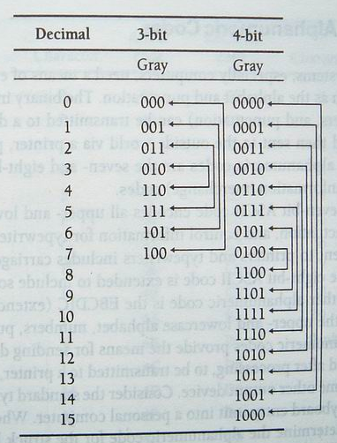
Binary Codes
. Unit Distance Code: Gray code
使用格雷码，则在相邻两位之间只有一位发生变换，这将消除从一个码值到另一个码值转换时产生位置错误的可能
Three-bit and Four-bit Gray code

Slide 34
Binary → Gray code
Let >> means shift right(右移), ⊕ means exclusive or(异或), then the follow step change N from Binary to Gray code.
N ⊕ (N >> 1 )
Example: change 10110₂ to gray code.
Answer:
1 0 1 1 0
1 0 1 1
1 1 1 0 1
0⊕1=1 1⊕0=1
0⊕0=0 1⊕1=0

Slide 35
Binary → Gray code
The most significant bit (left-most) in the Gray code is the same as the corresponding MSB in the binary number.
Going from left to right, add each adjacent pair of binary code bits to get the next Gray code bit. Discard carries.
For example, the conversion of the binary number 10110 to Gray code is as follows:

Slide 36
Gray-to-Binary Code Conversion
To convert from Gray code to binary, use a similar method; however, there are some differences.
The most significant bit (left-most) in the binary code is the same as the corresponding bit in the Gray code. For example, the conversion of the Gray code word 11011 to binary is as follows:

Slide 37
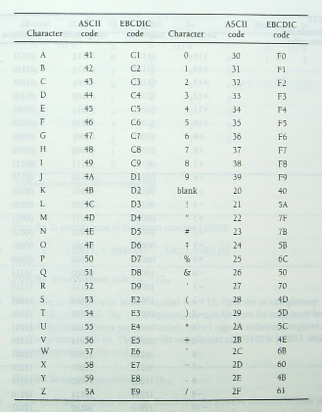
Binary Codes
Alphanumeric codes
字母数字编码
数字系统，尤其是计算机，更需要将数据(如字母表、标点符号等)进行编码的方法。
二进制信息(表示数字、字母和标点符号)可被输入到系统存储、处理、最后通过在打印机或显示器送外外部世界
ASCII (American standard code for information interchange)
EBCDIC (extended BCD interchange code 扩展的BCD交换码)
Partial listing of seven-bit ASCII and eight-bit EBCDIC codes in hexadecimal

Slide 38
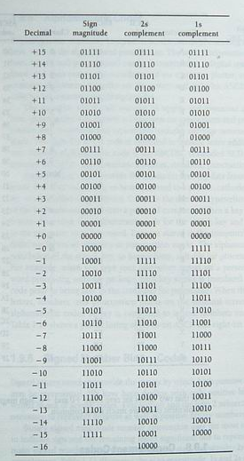
Binary Codes
6、Signed Number Binary
Sign magnitude and complement
Binary signed magnitude number convention uses the most significant bit position to indicate sign and the remaining lesser significant bits to represent magnitude
Sign magnitude 符号数编码
2s complement
1s complement
Notes:
2进制带符号数规定使用最高位表示符号而其他较低位表示数量，我们要关注3种带符号的2进制编码：带符号数量码，以2为基的补码，以1为基的补码（原码、补码、反码）

Slide 39
2.6 Signed Number Representation
Signed Magnitude Method
N = (s,a_{n-1} ... a₀.a₋₁ ... a_{-m})_{rsm},
where s = 0 if N is positive and s = r -1 otherwise.
E.g. N = -(15)₁₀
In binary: N = -(15)₁₀ = -(1111)₂ = (1, 1111)_{2sm}
In decimal: N = -(15)₁₀ = (9, 15)_{10sm}
Complementary Number Systems
Radix complements (r's complements)
[N]_{r} = r^{n} - (N)_{r}
where n is the number of digits in (N)_{r}.
Diminished radix complements (r-1’s complements)
[N]_{r-1} = r^{n} - (N) _{r} - 1
Notes:
带符号数的表示，约定数码序列中的最高位为符号位，符号位为0表示正数，当为负数的时候符号位为r-1，其余有效数值部分则用绝对值表示。
带符号数原码性质：
1、对于2进制，数值0在原码表示中可以有两种形式，可称为+0或-0，以整数为例它们的代码分别为00…00,与10…00，但含义相同。
2、符号位不是数值的一部分，它们是人为约定”0正1负”，所以符号位在运算过程中需要单独处理，不能当作数值的一部分直接参与运算。
原码中用绝对值表示数值比较直观，但对于应用得更多的加减运算，原码加减不太方便
为了克服原码加减的缺点，让符号为业作为数值的一部分参与运算，简化加减运算方法，化“减”为“加“，计算机广泛采用补码表示作为运算基础。
补码表示方法为：如果数为正，则整数的补码与原码表示形式相同；如果数为负，则将负数原码除符号位外其余各位取反，末位再加1。这是以有模运算为前提的。
众所周知，时钟以12为计数循环，即以12为模，13点钟在舍去模12后，即为1点钟。从0点出发反时针拨一格即-1点钟，也可以看成是从0点出发顺时针拨11格，即11点，换句话说，在模12前提下，-1可以映射为+11。
计算机的运算部件与寄存器都有一定字长限制，因此它的运算也是一种有模运算。例如一定位数的计数器，在计满后会产生溢出，又从头开始计数，产生溢出的量就是计数器的模，相当于时钟的12。
补码的定义：
确定模以后，我们将某数X对该模的补数称为其补码。定义为：[X]补=M+X。若x〉0，则模M作为正常的溢出量可以舍去，同时钟一例一样，13点舍去12成1点，因而正数的补码就是它本身，形式上与原码相同。若x<0，则X补=M-|X|，因而负数的补码等于模M减去该数的绝对值，如同时钟一例中，-1的补码是12-1=11一样。
2.由真值、原码转换成补码
根据补码定义可以直接求得补码，但是比较原码与补码在形式上的差异，可以找到更简便的实用转换规律，由原码求补码。这里给出两种方法
1、正数的补码表示与正数的原码表示相同，有负数原码表示转换为负数补码表示时，符号位不变，将尾数各位先变反，然后末位加一
例： X原=0.1010 X补=0.1010
X原=1.1010 变反 1.1010
1.0101 末位加1 1
X补 1.0110
2、正数的补码表示与正数的原码表示相同，由负数原码表示转换为负数补码表示时，符号位不变，尾数自低位向高位，第一个1及其以前的各位0保持不变，以后各位按位变反
例： X原=1.1010
X补=1.0110
*****补码的性质******
1、在补码表示中，最高位表示数的正负，在形式上与原码相同，即0正1负。但补码的符号位是数值的一部分，由补码定义式计算而得
2、在补码表示中，数0只有一种表示，即00000…..
3、负数补码的表示范围比原码稍宽。
******补码的加法*****
计算机基本采用补码加减法，因为它比较简单。补码加减是指：操作数用补码表示，连同符号位一道运算，结果也用补码表示，依据的基本关系是：
（X+Y）补=X补+Y补
（X-Y）补=X补+（-Y）补
******补码加减法运算规则*******
1、参加运算的操作数用补码表示，符号位作为数的一部分直接参与运算，所得即为补码表示的运算结果
2、若操作码为加，则两数直接相加
3、若操作码为减，则将减数变补后再与被减数相加
9+3=12 （-9）+（-1）=-12
01001 10111 （-9补码）
+ 00011 + 11101 （-3补码）
01100 1 10100 （-12补码）
9-3=6 9-（-3）=12
01001 01001
+ 11101 + 00011
1 00110 01100
3-9=-6
00011
+ 10111
11010

Slide 40
Radix Complement Number Systems
2's complement of (N)₂ = (101001)₂
[N]₂ = 2⁶ - (101001)₂ = (1000000)₂ - (101001)₂ = (010111)₂
(N)₂ + [N]₂ = (101001)₂ + (010111)₂ = (1000000)₂
If we discard the carry, (N)₂ + [N]₂ = 0.
Hence, [N]₂ can be used to represent -(N)₂.
[ [N]₂ ]₂ = [(010111)₂]₂ = (1000000)₂ - (010111)₂ = (101001)₂ = (N)₂.
2's complement of (N)₂ = (1010)₂ for n = 6
[N]₂ = (1000000)₂ - (1010)₂ = (110110)₂.
10's complement of (N)₁₀ = (72092)₁₀
[N]₁₀ = (100000)₁₀ - (72092)₁₀ = (27908)₁₀.

Slide 41
Radix Complement Number Systems
Algorithm1： Find [N]_{r} given (N)_{r} .
1.Copy the digits of N, beginning with the LSB and proceeding toward the MSB until the first nonzero digit, a_{j}, has been reached
2.Replace a_{j} with r - a_{j}.
3.Replace each remaining digit a_{j} , of N by (r - 1) - a_{j} until the MSB has been replaced.
Example: 10's complement of (56 700)₁₀ is (43300)₁₀
Example: 2's complement of (10100)₂ is (01100)₂.
Example: 2’s complement of N = (10110)₂ for n = 8.
Put three zeros in the MSB position and apply algorithm
N = 00010110
[N]₂ = (11101010)₂

Slide 42
Radix Complement Number Systems
Algorithm2： Find [N]_{r} given (N)_{r} .
First replace each digit, a_{k} , of (N)_{r} by (r - 1) - a_{k} and then add 1 to the resultant.
Example: Find 2’s complement of N = (01100101)₂ .
N = 01100101
10011010 Complement the bits
+1 Add 1
[N]₂ = (10011011)₂
Example: Find 10’s complement of N = (40960)₁₀
N = 40960
59039 Complement the bits
+1 Add 1
[N]₁₀ = (59040)₁₀

Slide 43
Radix Complement Number Systems
2's complement number system
Positive number :
N = +(a_{n-2}, ..., a₀)₂ = (0, a_{n-2}, ..., a₀)_{2cns},
where .
Negative number:
N = (a_{n-1}, a_{n-2}, ..., a₀)₂
-N = [a_{n-1}, a_{n-2}, ..., a₀]₂ (two's complement of N),
where .
Example: Two's complement number system representation of ± (N)₂
when (N)₂ = (1011001)₂ for n = 8:
+(N)₂ = (0, 1011001)_{2cns}
-(N)₂ = [+(N)₂]₂ = [0, 1011001]₂ = (1, 0100111)_{2cns}

Slide 44
Diminished Radix Complement Number systems
Diminished radix complement [N]_{r-1} of a number (N)_{r} is:
[N]_{r-1} = r^{n} - (N)_{r} - 1
One’s complement (r = 2):
[N]₂₋₁ = 2^{n} - (N)₂ - 1
Example: One’s complement of (01100101)₂
[N]₂₋₁ = 2⁸ - (01100101)₂ - 1
= (100000000)₂ - (01100101)₂ - (00000001)₂
= (10011011)₂ - (00000001)₂
= (10011010)₂
Notes:
反码

Slide 45
Signed numbers（有符号数）
signed magnitude codes (符号数编码 — 原码)
This approach is directly comparable to the common way of showing a sign (placing a "+" or "−" next to the number's magnitude).
1’s complement codes (以1为基的补码 — 反码)
A system known as ones' complement can be used to represent negative numbers.
2’s complement codes (以2为基的补码 — 补码)
The 2's complement of an n-bit number is defined as the complement with respect to 2^{n};

Slide 46
1’s complement (反码)
The 1’s complement of a binary number is just the inverse of the digits. To form the 1’s complement, change all 0’s to 1’s and all 1’s to 0’s.
[N]₂₋₁ = 2^{n} - (N)₂ - 1 (n is the number of digits in (N)₂)
In digital circuits, the 1’s complement is formed by using inverters
1 1 0 0 1 0 1 0
0 0 1 1 0 1 0 1

Slide 47
2’s complement(补码)
The 2’s complement of a binary number is found by adding 1 to the LSB of the 1’s complement
[N]₂ = 2^{n} - (N)₂
n is the number of digits in (N)₂.
1 1 0 0 1 0 1 0
Another way to convert it is working from LSB towards MSB
0 0 1 1 0 1 1 0
Flip all the remaining bits.
Find the first 1 and copy the right part

Slide 48
Examples
(N)₂ = (101001)₂ (hint: n=6)
1's complement: [010110]₂₋₁
2's complement: [010111]₂
(N)₂=(1010)₂. If n = 6 ?
1’s complement: [N]₂₋₁ = 2⁶ - (1010)₂ = (110101)₂
2's complement: [N]₂ = (1000000)₂ - (1010)₂ = (110110)₂

Slide 49
Signed magnitude codes
There are several ways to represent signed binary numbers. In all cases, the MSB in a signed number is the sign bit, that tells you if the number is positive or negative.
|N|
0/1 | x | x | x | x | x | x | x
Sign bit
符号位
Magnitude bit(n)
数值位
0: +
1: -

Slide 50
Signed magnitude codes
Example: N = 1101₂
(+N)₂=01101
(-N)₂=2⁴ - (-1101)=11101
How about 0?
+000…00=0 000…00
- 000…00=1 000…00

Slide 51
Complement form(补码形式)
1’s complement
Positive: remain the same as signed magnitude codes.
Negative: the 1’s complement of the corresponding positive number.
2’s complement
Positive: remain the same as signed magnitude codes.
Negative: the 1’s complement of the corresponding positive number+1.

Slide 52
1’s complement form
Example: N = 1101₂
[+N]₂₋₁=01101
[-N]₂₋₁=10010
How about 0?
+000…00=0 000…00
- 000…00=1 111…11

Slide 53
2’s complement form
Example: N = 1101₂
[+N]₂=01101
[-N]₂= 10011
How about 0?
[±000…00]₂=0 000…00
N=1010₂, calculate 2's complement of –N with 1 sign bit and 7 magnitude bit?
(N)₂=(00001010)₂
[-N]₂ = [11110110]₂
Attention: (N)₂ + [-N]₂ = 2⁸ .

Slide 54
Radix Complement Number Systems
Quzi：
Find the 2s complement of the binary number 110011
Find the 1s complement code for -12₁₀
Find the 2s complement code for -18₁₀
Answer: 001101
10011
101110

Slide 55
2.7 Binary Arithmetic Using Complement Codes
Subtract
Operation
Add
X>Y
X<Y
X=Y
(+X)+(+Y)
(+X)+(-Y)
(-X)+(+Y)
(-X)+(-Y)
(+X)-(+Y)
(+X)-(-Y)
(-X)-(+Y)
(-X)-(-Y)
+(X+Y)
-(X+Y)
+(X+Y)
-(X+Y)
+(X-Y)
-(X-Y)
+(X-Y)
-(X-Y)
-(X-Y)
+(X-Y)
-(X-Y)
+(X-Y)
+(X-Y)
+(X-Y)
+(X-Y)
+(X-Y)
Addition and subtraction of signed numbers

Slide 56
Arithmetic with 2’s complement form
N₁+N₂：[N₁]₂+[N₂]₂=[N₁+N₂]₂
N₁-N₂：[N₁]₂+[-N₂]₂=[N₁-N₂]₂
Rules for it: Add the two signed numbers. Discard any final carries. The result is in signed form.
Examples:
00011110 = +30
00001111 = +15
00001110 = +14
11101111 = −17
11111111 = −1
11111000 = −8
00101101
= +45
11111101
= −3
1
11110111
= −9
Discard carry

Slide 57
2.7 Binary Arithmetic Using Complement Codes
e.g.
9+3=12 （-9）+（-3）=-12
0^1001 1^0111 （-9）
+ 0^0011 + 1^1101 （-3）
0^1100 1 1^0100 （-12）
9-3=6 9-（-3）=12
0^1001 0^1001
+ 1^1101 + 0^0011
1 0^ 0110 0^1100
3-9=-6
0^0011
+ 1^0111
1^1010

Slide 58
2.7 Binary Arithmetic Using Complement Codes
e.g. 0^1101.1+0^1011.0
0^1101.1
+ 0^1011.0
1^1000.1
0^01101.1
+ 0^01011.0
0^11000.1
The error occurred due to insufficient bit positions to hold the answer
Notes:
虽然两个操作数都只需要使用5位就可以表达，但是它们使用了6位目的是为了使结果有足够的位置来装

Slide 59
2.7 Binary Arithmetic Using Complement Codes
e.g. Add X and Y . Let X=-8₁₀ and Y=-10₁₀, both in 2s complement
1^1000
+ 1^0110
(1)0^1110
1^11000
+ 1^10110
(1)1^01110
-8₁₀+(-10₁₀)=-18₁₀ , 0^1110 is not -18₁₀
and 1^01110 is the Complement of -18₁₀ ?
57
Notes:
当位数不足以表示结果时就会产生溢出

Slide 60
Arithmetic with 2’s complement form
Note that if the number of bits required for the answer is exceeded, overflow will occur. This occurs only if both numbers have the same sign. The overflow will be indicated by an incorrect sign bit.
Two examples are:
01000000 = +128
01000001 = +129
10000001 = −127
10000001 = −127
10000001
= −126
Discard carry
100000010
= +2
Wrong! The answer is incorrect and the sign bit has changed.

Slide 61
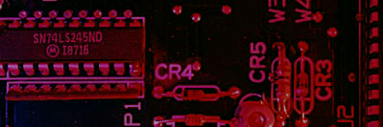
2.6.7
Floating Point Numbers
Floating point notation is capable of representing very large or small numbers by using a form of scientific notation. A 32-bit single precision number is illustrated.
S E (8 bits) F (23 bits)
Sign bit
Biased exponent (+127)
Magnitude with MSB dropped
Example
Express the speed of light, c, in single precision floating point notation. (c = 0.2998 x 10⁹)
Solution
In binary, c = 0001 0001 1101 1110 1001 0101 1100 0000₂.
In scientific notation, c = 1.0001 1101 1110 1001 0101 1100 0000 x 2²⁸.
S = 0 because the number is positive. E = 28 + 127 = 155₁₀ = 1001 1011₂. F is the next 23 bits after the first 1 is dropped.
In floating point notation, c =
0 10011011 000 1110 1111 0100 1010 1110

Slide 62
2–12 Error Codes
In this section, three methods for adding bits to codes to detect a single-bit error are discussed.
The parity method of error detection is introduced
the cyclic redundancy check is discussed.
Describe the Hamming code

Slide 63
Parity Method（奇偶校验法）
The parity method is a method of error detection for simple transmission errors involving one bit (or an odd number of bits). A parity bit is an “extra” bit attached to a group of bits to force the number of 1’s to be either even (even parity偶校验) or odd (odd parity奇校验).
Example: The ASCII character for “a” is 1100001 and for “A” is 1000001. What is the correct bit to append to make both of these have odd parity?
The ASCII “a” has an odd number of bits that are equal to 1; therefore the parity bit is 0. The ASCII “A” has an even number of bits that are equal to 1; therefore the parity bit is 1.

Slide 64
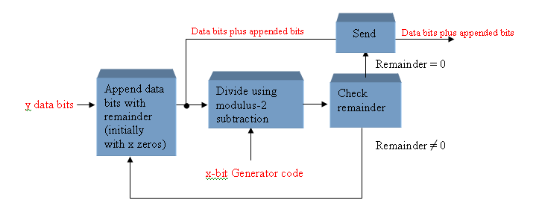
Cyclic Redundancy Check （循环冗余校验码）
The cyclic redundancy check (CRC) is an error detection method that can detect multiple errors in larger blocks of data. At the sending end, a checksum(校验和) is appended to a block of data. At the receiving end, the check sum is generated and compared to the sent checksum. If the check sums are the same, no error is detected.

Slide 65
Hamming Code
The Hamming code is used to detect and correct a single-bit error in a transmitted code. To accomplish this, four redundancy bits are introduced in a 7-bit group of data bits. These redundancy bits are interspersed at bit positions 2^{n} (n = 0, 1, 2, 3) within the original data bits. At the end of the transmission, the redundancy bits have to be removed from the data bits. A recent version of the Hamming code places all the redundancy bits at the end of the data bits, making their removal easier than that of the interspersed bits. A coverage of the classic Hamming code is available on the website.
Notes:
海明码，小名汉明码（Hamming Code），以发明者理查德·卫斯里·汉明的名字命名。海明码具有检错和纠错双功能，它基于奇偶校验原理，只能检查出某一位错码的位置。当有多位错码时，它就不适用了。
海明码的检错、纠错基本思想是将有效信息按某种规律分成若干组，每组安排一个校验位进行奇偶性测试，然后产生多位检测信息，并从中得出具体的出错位置，最后通过对错误位取反（也是原来是1就变成0，原来是0就变成1）来将其纠正。

Slide 66
Homework
判断题、自测题：(自愿完成)
2.1-2.2节：2、4、6、8
2.3-2.4节：11、14、15、16
2.5-2.6节：21、22、24、25
2.7-2.8节：31、34、38
2.9-2.12节：46、52、56、58、60
每一题选2小题完成(a、b)

Slide 67
TO BE CONTINUED

