Slide 1
Chapter 4 Boolean Algebra and Logic Simplification

Slide 2
Boolean Algebra(布尔代数)
In Boolean algebra（布尔代数）, a variable（变量） is a symbol used to represent an action, a condition, or data. A single variable can only have a value of 1 or 0. (逻辑值0和1是用来表征矛盾的双方和判断事件真伪的形式符号，无大小、正负之分。)
The complement（反变量） represents the inverse of a variable and is indicated with an overbar. Thus, the complement of A is A or A’.

Slide 3
Boolean Addition(布尔加法)
Boolean addition(布尔加法) is equivalent to the OR operation.
The sum term(和项) is a sum of literals.
Eg. A+B、A+B+C+D
The sum term is 1 if one or more of the literals are 1. The sum term is zero only if each literal is 0.
Determine the values of A, B, and C that make the sum term of the expression A + B + C = 0?
Example
Solution
Each literal must = 0; therefore A = 1, B = 0 and C = 1.

Slide 4
Boolean Multiplication(布尔乘法)
In Boolean algebra, multiplication is equivalent to the AND operation.
The product of literals forms a product term（乘积项）.
Eg. AB、ABCD
The product term will be 1 only if all of the literals are 1.
Example
What are the values of the A, B and C if the product term of A.B.C = 1?
Solution
Each literal must = 1; therefore A = 1, B = 0 and C = 0.

Slide 5
相等（Equivalent）：对于逻辑变量的任何一组取值，两个逻辑表达式A和B的输出都相等，则认为A=B。
例：A=xy+x，B=x(x+y)，A和B是否相等？
x | y | A | B
0 | 0 | 0 | 0
0 | 1 | 0 | 0
1 | 0 | 1 | 1
1 | 1 | 1 | 1
A=B

Slide 6
Commutative Laws(交换律)
The commutative laws(交换律) are applied to addition and multiplication.
For addition, the commutative law states
In terms of the result, the order in which variables are ORed makes no difference.
A + B = B + A
For multiplication, the commutative law states
In terms of the result, the order in which variables are ANDed makes no difference.
AB = BA

Slide 7
Associative Laws（结合律）
The associative laws（结合律） are also applied to addition and multiplication.
For addition, the associative law states
When ORing more than two variables, the result is the same regardless of the grouping of the variables.
A + (B +C) = (A + B) + C
For multiplication, the associative law states
When ANDing more than two variables, the result is the same regardless of the grouping of the variables.
A(BC) = (AB)C

Slide 8
Distributive Law（分配律）
The distributive law（分配律） is the factoring law. A common variable can be factored from an expression just as in ordinary algebra. That is
AB + AC = A(B+ C)
The distributive law can be illustrated with equivalent circuits:
A(B+ C)
AB + AC

Slide 9
Rules of Boolean Algebra（布尔代数的法则）
1. A + 0 = A
7. A . A = A
2. A + 1 = 1
8. A . A = 0
=
3. A . 0 = 0
9. A = A
4. A . 1 = A
10. A + AB = A
5. A + A = A
11. A + AB = A + B
6. A + A = 1
12. (A + B)(A + C) = A + BC

Slide 10
Rules 10 A+AB = A（吸收律）
Rules of Boolean algebra can be illustrated with Venn diagrams. The variable A is shown as an area.
The rule A + AB = A can be illustrated easily with a diagram. Add an overlapping area to represent the variable B.
The overlap region between A and B represents AB.
=
The diagram visually shows that A + AB = A. Other rules can be illustrated with the diagrams as well.

Slide 11
请证明 A+A*B=A
A*(A+B)=A
真值表证明：
A | B | A+A*B
0 | 0 | 0
0 | 1 | 0
1 | 0 | 1
1 | 1 | 1
A | B | A*(A+B)
0 | 0 | 0
0 | 1 | 0
1 | 0 | 1
1 | 1 | 1
代数证明:
证明：A+A*B=A*1+A*B
=A*(1+B)
=A*1
=A
思考：AB’+ACB’(D+C’F)=AB’成立吗？

Slide 12
Rules 11 （消去律）
Example
Illustrate the rule with a Venn diagram.
A + AB = A + B
Solution
This time, A is represented by the blue area and B again by the red circle.
The intersection represents
Notice that A + AB = A + B
AB.
A

Slide 13
请证明 A + A’B = A + B
证明：A + A’B = A + AB + A’B
= A + B
思考：AB’+A’BCD=AB’+CD成立吗？

Slide 14
Rules 12 (分配律)
Rule 12, which states that (A + B)(A + C) = A + BC, can be proven by applying earlier rules as follows:
(A + B)(A + C) = AA + AC + AB + BC
= A + AC + AB + BC
= A(1 + C + B) + BC
= A . 1 + BC
= A + BC
This rule is a little more complicated, but it can also be shown with a Venn diagram, as given on the following slide…

Slide 15
Three areas represent the variables A, B, and C.
The area representing A + B is shown in yellow.
The area representing A + C is shown in red.
The overlap of red and yellow is shown in orange.
The overlapping area between B and C represents BC.
ORing with A gives the same area as before.
(A + B)(A + C)
=
A + BC

Slide 16
DeMorgan’s Theorem（德摩根定理）
The complement of a product of variables is equal to the sum of the complemented variables.（积项的反变量等于反变量的和）
AB = A + B
Applying DeMorgan’s first theorem to gates:

Slide 17
DeMorgan’s Theorem
The complement of a sum of variables is equal to the product of the complemented variables.（和项的反变量等于反变量的积）
A + B = A . B
Applying DeMorgan’s second theorem to gates:

Slide 18
DeMorgan’s Theorem
Example
Apply DeMorgan’s theorem to remove the overbar covering both terms from the expression X = C + D.
Solution
To apply DeMorgan’s theorem to the expression, you can break the overbar covering both terms and change the sign between the terms. This results in X = C . D. Deleting the double bar gives X = C . D.
=

Slide 19
DeMorgan’s Theorem
摩根定理可以推广到任意个变量的情况：

Slide 20
Exercise 4-1 Apply DeMorgan’s theorem to remove the overbar covering more than one literal 。

Slide 21
Functionally Complete Operation Sets（功能完全操作集）
FC₁={AND、OR、NOT}
FC₂={NOR}
FC₃={NAND}
FC₄={XOR、AND}

Slide 22
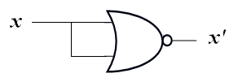
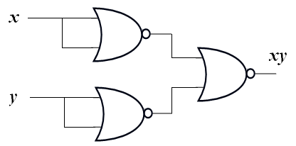
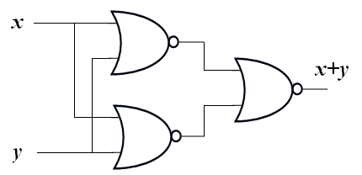
FC₂={NOR}
NOT
AND
OR

Slide 23

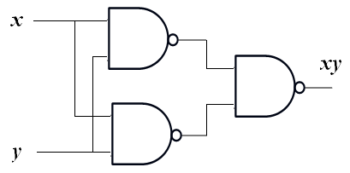
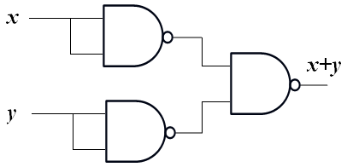
FC₃={NAND}
NOT
AND
OR

Slide 24
FC₄={XOR、AND}
NOT
AND
OR

Slide 25

Exercise 4-2: Apply DeMorgan’s theorem to make the expressions with only NOT and NAND。
$$F1=A\overline{B}+AC$$
$$F2=A\overline{B+C}+A(B+C)$$

Slide 26
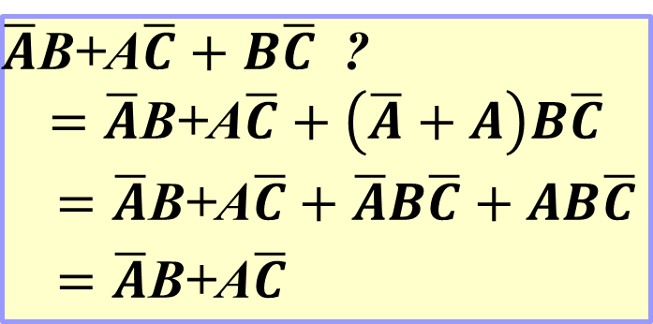
Simplification using Boolean algebra（布尔化简）
A simplified Boolean expression uses fewer gates to implement a given expression.
$\overline{A}$B+A$\overline{C}+B\overline{C}$ ?
$$=\overline{A}\text{B}\text{+}\text{A}\overline{C}+\left(\overline{A}+A\right)B\overline{C}$$
$=\overline{A}\text{B}\text{+}\text{A}\overline{C}+\overline{A}B\overline{C}+AB\overline{C}$
$=\overline{A}\text{B}\text{+}\text{A}\overline{C}$
并项法
吸收法
消去法
配项法

Slide 27
Simplification using Boolean algebra
Using Boolean algebra techniques, simplify this expression:

Slide 28
Simplification using Boolean algebra

Slide 29
Exercise 4-3: Using Boolean algebra techniques, simplify this expression:
$$F=\left(A\overline{B}\left(C+BD\right)+\overline{A}\overline{B}\right)C$$

Slide 30
SOP and POS forms(积之和与和之积形式)
Boolean expressions can be written in the sum-of-products form (SOP, 积之和, 与或式) or in the product-of-sums form (POS, 和之积, 或与式).
These forms can simplify the implementation of combinational logic.
In both forms, an overbar cannot extend over more than one variable（不能有长非号）.

Slide 31
SOP and POS forms(积之和与和之积形式)
An expression is in SOP form when two or more product terms are summed as in the following examples:
A B C + A B A B C + C D C D + E
An expression is in POS form when two or more sum terms are multiplied as in the following examples:
(A + B)(A + C) (A + B + C)(B + D) (A + B)C
注意：逻辑函数的基本形式并不是唯一的。例如：

Slide 32
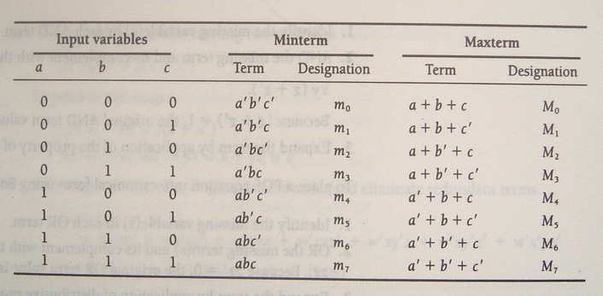
Minterm and Maxterm(最小项与最大项)

Slide 33
最小项：包含所有输入变量（每个变量都以原变量或者反变量的形式出现且仅出现一次）的乘积项，用m_{i}表示。n个变量可以构成2^{n}个最小项。
下标i的取值规则是：按照变量顺序将最小项中的原变量用1表示，反变量用0表示，由此得到一个二进制数，与该二进制数对应的十进制数即下标i的值。
例如：3变量A、B、C构成的最小项AB’C可以用m₅表示。
任意一个最小项，其相应变量有且仅有一种取值使这个最小项的值为1。并且，最小项不同，使其值为1的变量取值不同。

Slide 34
相同变量构成的两个不同最小项相“与” 为0。因为任何一种变量取值都不可能使两个不同最小项同时为1，故相“与”为0。即
m_{i} · m_{j} = 0
n个变量的全部最小项相“或”为1。通常借用数学中的累加符号“Σ”，将其记为
n个变量构成的最小项有n个相邻最小项。
相邻最小项：是指除一个变量互为相反外，其余部分均相同的最小项。例如 ，三变量最小项A B C和AB’C相邻 。

Slide 35
最大项：包含所有输入变量（每个变量都以原变量或者反变量的形式出现且仅出现一次）的和项，用M_{i}表示。 n个变量可以构成2^{n}个最大项。
下标i的取值规则是：将最大项中的原变量用0表示，反变量用1表示，由此得到一个二进制数，与该二进制数对应的十进制数即下标 i 的值。
例如：3变量A、B、C构成的最大项A’+B+C’可以用M₅表示。
任意一个最大项，其相应变量有且仅有一种取值使这个最大项的值为0。并且，最大项不同，使其值为0的变量取值不同。

Slide 36
相同变量构成的两个不同最大项相“或”为1。因为任何一种变量取值都不可能使两个不同最大项同时为0，故相“或”为1。
M _{i} + M _{j} = 1
n个变量的全部最大项相“与”为0。通常借用数学中的累乘符号“Π”将其记为
n个变量构成的最大项有n个相邻最大项。相邻最大项是指除一个变量互为相反外，其余变量均相同的最大项。

Slide 37
m₃=?
M₃=?
m₃=a’bc
M₃=a+b’+c’
m₃=M₃’
M₃=m₃’
m₃’=?
M₃’=?
m₃’=(a’bc)’=a+b’+c’
M₃’=(a+b’+c’)=a’bc

Slide 38
SOP Standard form(标准与或式)
In SOP standard form, every variable in the domain must appear in each term.
This form is useful for constructing truth tables.
最小项之和：当输出变量为逻辑1的所有最小项的和。也称为标准与-或表达式。F=∑m_{i}

Slide 39
You can expand a nonstandard term to standard form by multiplying the term by a term consisting of the sum of the missing variable and its complement.
Convert expression to standard SOP form.

Slide 40
POS Standard form（标准或与式）
In POS standard form, every variable in the domain must appear in each sum term of the expression.
最大项之积：当输出变量为逻辑0的所有最大项的乘积。也称为标准或-与表达式。 F=∏M_{i}

Slide 41
You can expand a nonstandard POS expression to standard form by adding the product of the missing variable and its complement and applying rule 12, which states that (A + B)(A + C) = A + BC.
Convert expression to standard POS form.

Slide 42
Exercise: Convert expression to standard form.

Slide 43
Convert the truth table to standard forms
x | y | z | F | F’
0 | 0 | 0 | 0 | 1
0 | 0 | 1 | 0 | 1
0 | 1 | 0 | 1 | 0
0 | 1 | 1 | 0 | 1
1 | 0 | 0 | 1 | 0
1 | 0 | 1 | 1 | 0
1 | 1 | 0 | 0 | 1
1 | 1 | 1 | 0 | 1

Slide 44
思考
？

Slide 45
任意一个逻辑关系对应的真值表是唯一的
真值表与逻辑方程的两种标准形式之间存在一一对应关系
任意一个逻辑关系对应的逻辑方程的两种标准形式是唯一的

Slide 46
Karnaugh maps（卡诺图）
The Karnaugh map (K-map) is a tool for simplifying combinational logic（化简工具）.
Each cell represents one possible product term.
Each cell differs from an adjacent cell by only one variable.
Cells are usually labeled using 0’s and 1’s to represent the variable and its complement.

Slide 47
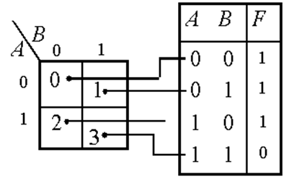
2-variable map
0
1
B
A
1
1
0
K-maps can simplify combinational logic by grouping cells and eliminating variables that change.
1
0
1

Slide 48
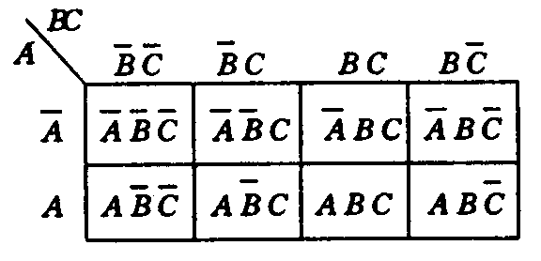
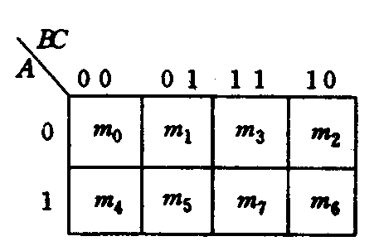
3-variable map
AB
C
00
01
11
10
0
0
0
1
1
1
0
1
0
0
Gray Code

Slide 49
4-variable map
AB
AB
CD
00
01
11
10
CD
00
01
11
10
Gray Code
00
m₀
m₄
m₁₂
m₈
00
0
1
0
0
01
0
0
1
1
01
m₁
m₅
m₁₃
m₉
11
0
1
1
0
11
m₃
m₇
m₁₅
m₁₁
10
1
1
1
0
10
m₂
m₆
m₁₄
m₁₀

Slide 50
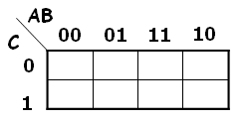
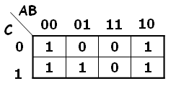
Draw the Karnaugh maps for the expression.

Slide 51
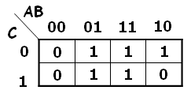
Draw the Karnaugh maps for the expression.

Slide 52
Exercise: Draw the Karnaugh maps for the expression.

Slide 53
也可根据“与”的公共性和“或”的叠加性根据一般与或式作出相应卡诺图。
AB
CD
00
01
11
10
00
0
0
1
0
01
0
0
1
0
11
1
1
1
1
10
1
0
1
0

Slide 54
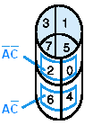
Simplify by 3-variable map

Slide 55
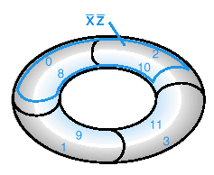
Simplify by 4-variable map
AB
CD
00
01
11
10
00
m₀
m₄
m₁₂
m₈
01
m₁
m₅
m₁₃
m₉
11
m₃
m₇
m₁₅
m₁₁
10
m₂
m₆
m₁₄
m₁₀

Slide 56
卡诺图化简的一般原则
在卡诺图中寻找卡诺圈，对卡诺圈内的最小项进行合并。
卡诺圈内的方格个数为2^{m}个
卡诺圈内的输出必须全部是1
卡诺圈是一个广义上的“矩形”
化简时的原则
每个卡诺圈越大越好
卡诺圈越少越好
卡诺圈必须覆盖所有的输出为1的方格
卡诺圈之间不存在包含关系
1
1
1
1
1
1
1
1
1
1
1

Slide 57
Example
F(A,B,C,D) = ∑(0,1,2,3,4,5,6,7,8,10,13)
AB
A’
00
01
11
10
B’D’
CD
00
1
1
1
1
1
1
01
1
1
1
1
1
1
1
1
1
1
BC’D
11
10
1
1
1
1
1
1
F(A,B,C,D) = A’+B’D’+BC’D

Slide 58

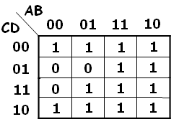
Example
思考：还有别的画法吗？
最简结果有时并不唯一

Slide 59
Example
每个圈内必须有仅有自己才包含的项
f(a,b,c,d) = ∑(0,3,4,5,7,11,13,15)
ab
ab
cd
00
01
11
10
cd
00
01
11
10
00
1
1
00
1
1
01
1
1
01
1
1
11
1
1
1
1
11
1
1
1
1
10
10
f(a,b,c,d) =a’c’d’+cd+bc

Slide 60
Example
f(a,b,c,d) = ∑(0,1,4,5,8,11,12,13,15)
ab
ab
cd
00
01
11
10
cd
00
01
11
10
00
1
1
1
1
00
1
1
1
1
01
1
1
1
01
1
1
1
11
1
1
11
1
1
10
10
f(a,b,c,d) = c’d’ + a’c’ + bc’ + acd

Slide 61
Exercise
F(a,b,c,d)=∑(0,1,2,4,5,6,8,9,12,13,14)
F(a,b,c,d)=∑(1,3,4,5,7,8,9,11,15)

Slide 62
F(a,b,c,d)=∑(0,1,2,4,5,6,8,9,12,13,14)
ab
cd
00
01
11
10
00
1
1
1
1
F(a,b,c,d)=c’+a’d’+bd’
01
1
1
1
1
11
10
1
1
1

Slide 63
F(a,b,c,d)=∑(1,3,4,5,7,8,9,11,15)
ab
cd
00
01
11
10
00
1
1
1
1
1
F(a,b,c,d)=cd+a’d+a’bc’+ab’c’
01
11
1
1
1
1
10

Slide 64
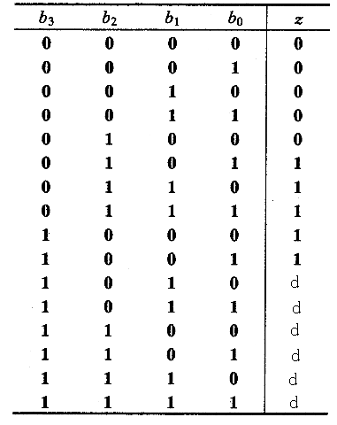
Don’t Care Conditions(无关项)
There may be a combination of input values which
will never occur
if they do occur, the output is of no concern.
The function value for such combinations is called a don't care.

Slide 65
b₁b₀
b₃b₂
00
01
11
10
00
0
0
0
0
01
0
1
1
1
11
d
d
d
d
10
1
1
d
d
b₁b₀
b₃b₂
00
01
11
10
00
0
0
0
0
01
0
1
1
1
11
d
d
d
d
10
1
1
d
d

Slide 66
Exercise
cd
ab
00
01
11
10
00
0
1
0
1
01
1
1
0
1
11
0
0
d
d
10
1
1
d
d

Slide 67
Selected Key Terms
Variable
Complement
Sum term
Product term
A symbol used to represent a logical quantity that can have a value of 1 or 0, usually designated by an italic letter.
The inverse or opposite of a number. In Boolean algebra, the inverse function, expressed with a bar over the variable.
The Boolean sum of two or more literals equivalent to an OR operation.
The Boolean product of two or more literals equivalent to an AND operation.

Slide 68
Selected Key Terms
Sum-of-products (SOP)
Product of sums (POS)
Karnaugh map
A form of Boolean expression that is basically the ORing of ANDed terms.
A form of Boolean expression that is basically the ANDing of ORed terms.
An arrangement of cells representing combinations of literals in a Boolean expression and used for systematic simplification of the expression.

Slide 69

Quiz
1. The associative law for addition is normally written as
a. A + B = B + A
b. (A + B) + C = A + (B + C)
c. AB = BA
d. A + AB = A

Slide 70
Quiz
2. The Boolean equation AB + AC = A(B+ C) illustrates
a. the distribution law
b. the commutative law
c. the associative law
d. DeMorgan’s theorem

Slide 71
Quiz
3. The Boolean expression A . 1 is equal to
a. A
b. B
c. 0
d. 1

Slide 72
Quiz
4. The Boolean expression A + 1 is equal to
a. A
b. B
c. 0
d. 1

Slide 73
Quiz
6. A Boolean expression that is in standard SOP form is
a. the minimum logic expression
b. contains only one product term
c. has every variable in the domain in every term
d. none of the above

Slide 74
Quiz
7. Adjacent cells on a Karnaugh map differ from each other by
a. one variable
b. two variables
c. three variables
d. answer depends on the size of the map

Slide 75
Quiz
8. The minimum expression that can be read from the Karnaugh map shown is
a. X = A
b. X = A
c. X = B
d. X = B

Slide 76
Quiz
9. The minimum expression that can be read from the Karnaugh map shown is
a. X = A
b. X = A
c. X = B
d. X = B

Slide 77
Homework
P140 Self-Test 1-16
P141 10 d e
P142 20 c e 22
P144 44 b c 46

