Slide 1
Chapter 6 Functions of Combinational Logic

Slide 2
Half-Adder 半加器
Basic rules of binary addition are performed by a half adder, which has two binary inputs (A and B) and two binary outputs (Carry out and Sum).
The logic symbol and equivalent circuit are:
Σ
Σ
∑= AB’ + A’B = A⊕B
C_{out}=AB
A
Σ
A
B
C_{out}
C_{out}
B

Slide 3
n-bit Addition ?
The addition of two n-bit binary numbers generates a n-bit sum and a carry out.
Example: let n = 4
C_{out} | C₃ | C₂ | C₁ | C₀
 | A₃ | A₂ | A₁ | A₀
+ | B₃ | B₂ | B₁ | B₀
 | S₃ | S₂ | S₁ | S₀
1 | 1 | 0 | 1 | 0
 | 1 | 1 | 0 | 1
+ | 1 | 1 | 0 | 1
 | 1 | 0 | 1 | 0

Slide 4
Full-Adder(全加器)
By contrast, a full adder has three binary inputs (A, B, and Carry in) and two binary outputs (Carry out and Sum).
The truth table summarizes the operation.
C_{out} = AB + A’BC_{in} + AB’C_{in}
= AB + (A⊕B)C_{in}
∑ = AB’ C_{in}’ + A’B’C_{in} + A’BC_{in}’ +ABC_{in} = A⊕B⊕C_{in}
00
01
11
10
00
01
11
10
AB
AB
C_{in}
C_{in}
0
0
0
0
1
0
0
1
0
1
1
1
0
1
1
1
1
0
1
0
Notes:
Cout没有化到最简是为了后续方便。

Slide 5
Full-Adder
C_{out} = AB + (A⊕B)C_{in}
∑ = A⊕B⊕C_{in}
A full-adder can be constructed from two half adders as shown:
Σ
Σ
Σ
Σ
A
A
A
Sum
Σ
A
Σ
B
B
C_{out}
B
C_{out}
B
C_{out}
C_{in}
C_{in}
C_{out}
Symbol

Slide 6
Full-Adder
Example
For the given inputs, determine the intermediate and final outputs of the full adder.
Solution
The first half-adder has inputs of 1 and 0; therefore the Sum =1 and the Carry out = 0.
Σ
Σ
1
Σ
Σ
0
Sum
1
A
A
The second half-adder has inputs of 1 and 1; therefore the Sum = 0 and the Carry out = 1.
0
B
C_{out}
0
B
C_{out}
1
The OR gate has inputs of 1 and 0, therefore the final carry out = 1.
1
1
C_{out}

Slide 7
n-bit Combinational Adders（n位加法器）
Perform parallel multi-bit addition
Parallel Adders (并行加法器，also called Ripple Carry Adder，脉动进位加法器 )
Simple design
Time consuming.
Carry Look ahead Adder (先行进位加法器)
More complex than Parallel Adders
Reduces circuit delay

Slide 8
Parallel Adders 并行加法器
Full adders are combined into parallel adders that can add binary numbers with multiple bits. A 4-bit adder is shown.
A₄ B₄
A₃ B₃
A₂ B₂
A₁ B₁
C₀
A
B
C_{in}
A
B
C_{in}
A
B
C_{in}
A
B
C_{in}
C_{out}
Σ
C_{out}
Σ
C_{out}
Σ
C_{out}
Σ
C₄
C₃
C₂
C₁
Σ₄
Σ₃
Σ₂
Σ₁
The carry (C₄) is not ready until it propagates through all of the full adders. This is called ripple carry, delaying the addition process.
Notes:
进位信号由低位向高位逐级传递，所以这种加法称为行波进位传递。
串行加法器的延时主要受进位传递延时影响，如果一个1位FA的延时为△，则n位串行加法器的延时为n △ 。

Slide 9
Carry Look ahead Adder(超前进位加法器)
One method of speeding up the addition process by eliminating this ripple carry delay is called look-ahead carry addition(超前进位加法).
Consider：C_{i+1} = A_{i}B_{i} + (A_{i} ⊕ B_{i}) C_{i}
Carry generation(进位产生)：
Let G_{i} = A_{i}B_{i}= 1，if G_{i}=1，then C_{i+1}=1
Carry propagation(进位传递)：
Let P_{i} = A_{i} ⊕ B_{i} ，if P_{i}=1，then C_{i+1}=C_{i}
Notes:
n位加法器的逻辑电路的替代设计
以硬件成本增加为代价，使得延时减少。
方式：把FA的进位产生与进位的传递分开
此处的Gi也即书上的Cgi，Pi是书上的Cpi

Slide 10
Carry Look ahead Adder(先行进位加法器)
HA
PARTIAL FULL ADDER(PFA)
HA
Can this connection eliminate the ripple carry delay ？
Notes:
这个连接方式能不能解决进位传递延时问题？
否。进位方式仍然是行波进位。
解决方案：让C_{i}只依赖于C₀和A_{i}，B_{i}

Slide 11
A 4-bit Carry Look ahead Adder
C_{i+1} = G_{i} + P_{i}C_{i}
Base on this ayalysis:
C₁ = G₀+P₀ C₀
C₂ = G₁+P₁C₁ = G₁+P₁(G₀+P₀C₀) = G₁+P₁G₀+P₁P₀C₀
C₃ = G₂ + P₂C₂ = G₂+P₂G₁+P₂P₁G₀+P₂P₁P₀C₀
C₄ = G₃+P₃G₂+P₃P₂G₁+P₃P₂P₁G₀ + P₃P₂P₁P₀ C₀
Now the ripple problem is solved.
Carry generation(进位产生)
Carry propagation(进位传递)
Notes:
传递延时此时是常数，不依赖于行波进位，只依赖于门电路的延时。

Slide 12
A 4-bit Carry Look ahead Adder
C_{i}：2 gate delays.

Slide 13
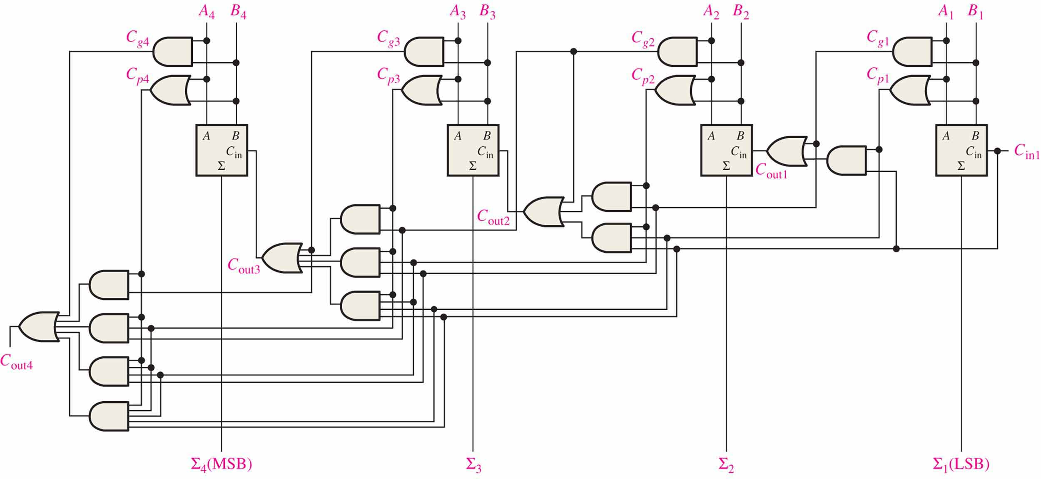
Logic diagram for a 4-stage look-ahead carry adder

Slide 14
A 4-bit Adders(4位加法器)
The logic symbol for a 4-bit parallel adder is shown. This 4-bit adder includes a carry in (labeled (C₀) and a Carry out (labeled C₄).
Σ
1
2
3
4
1
2
3
4
The 74LS283 is an example. It features look-ahead carry, which adds logic to minimize the output carry delay. For the 74LS283, the maximum delay to the output carry is 17 ns.
Binary number A
4-bit sum
1
2
3
4
Binary number B
Input carry
Output carry
C₀
C₄

Slide 15
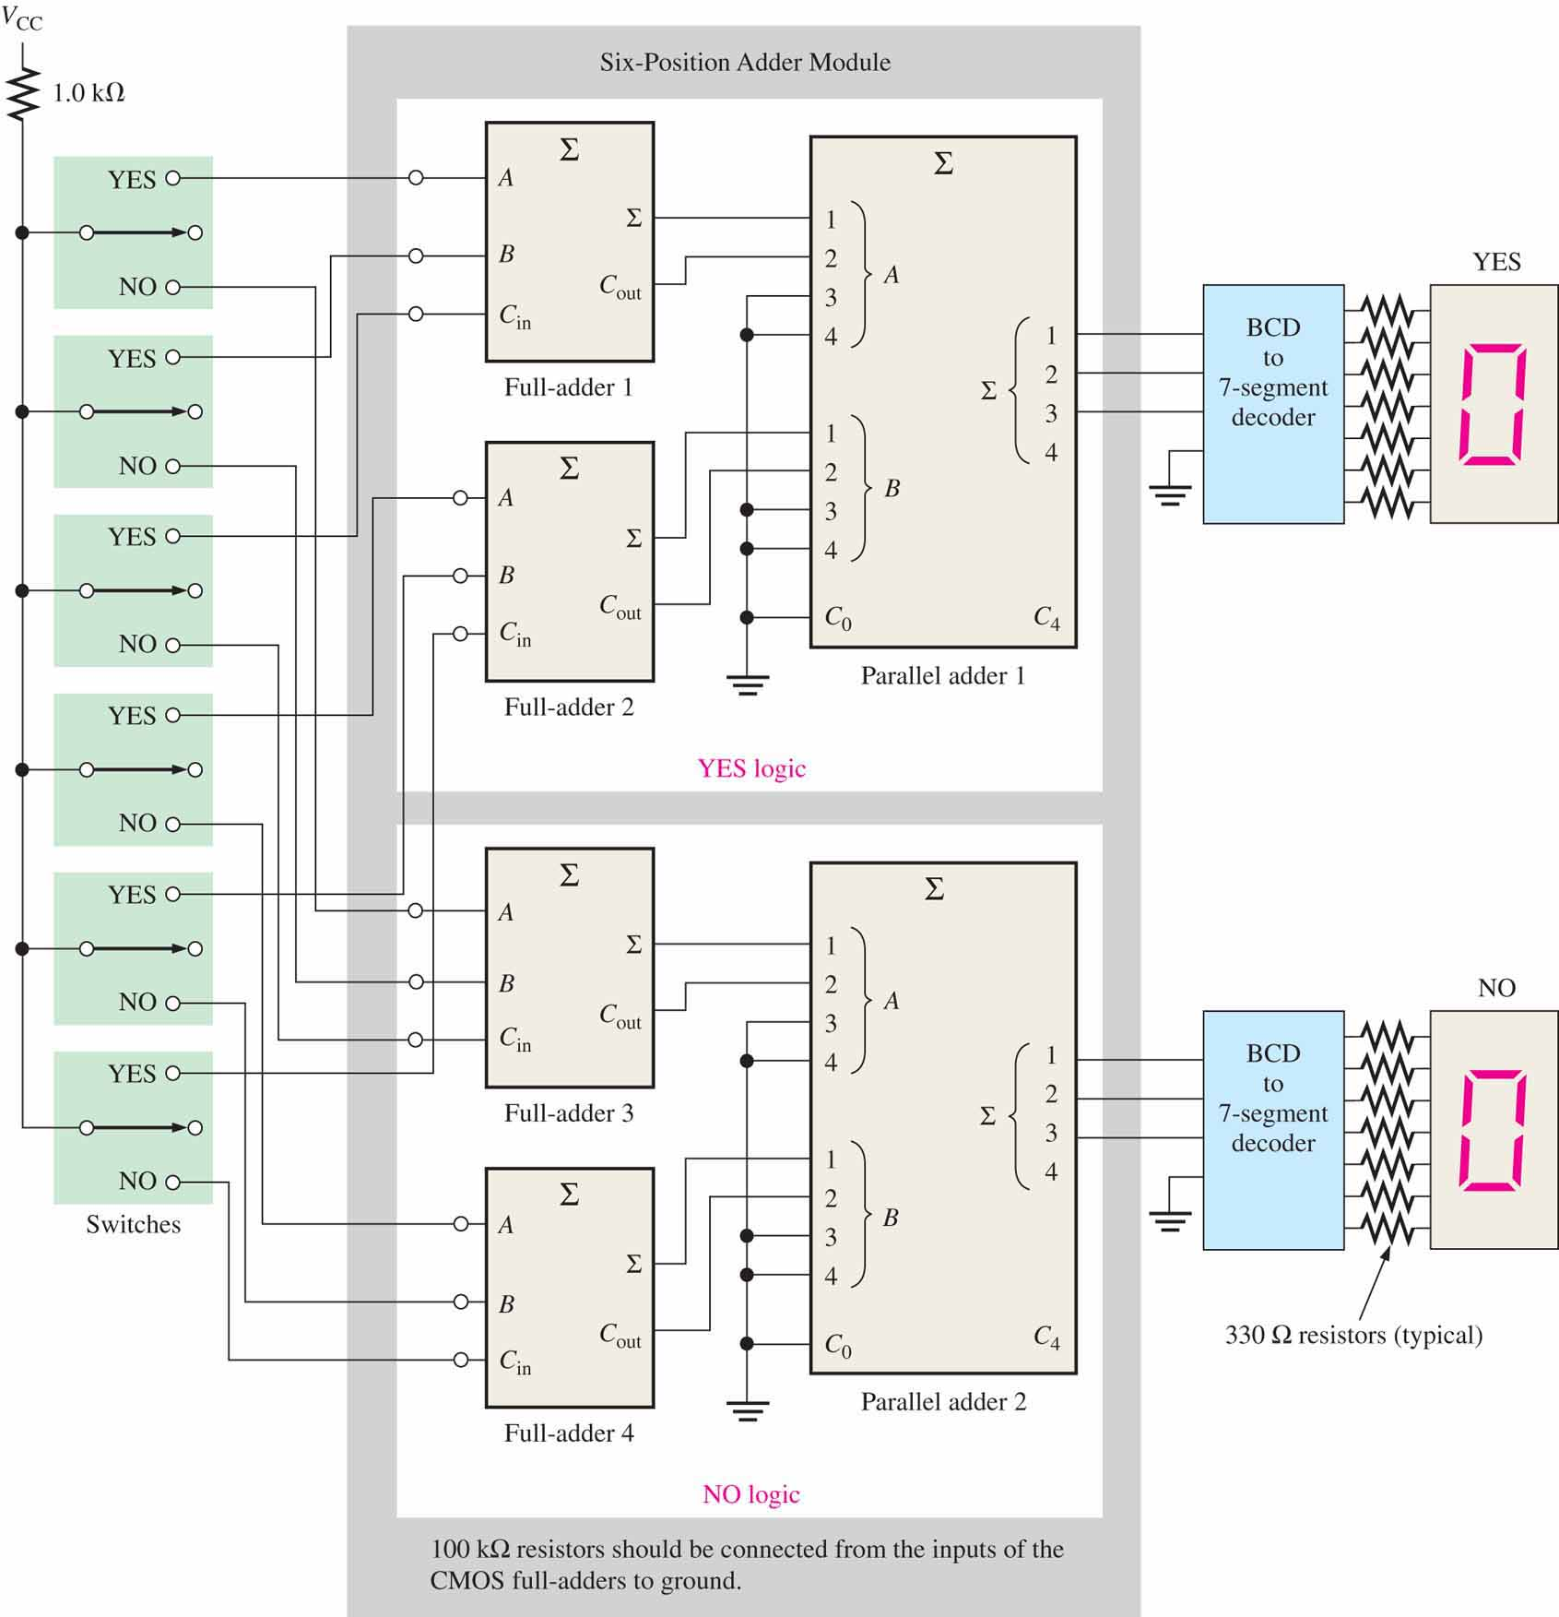
An application:
a voting system

Slide 16
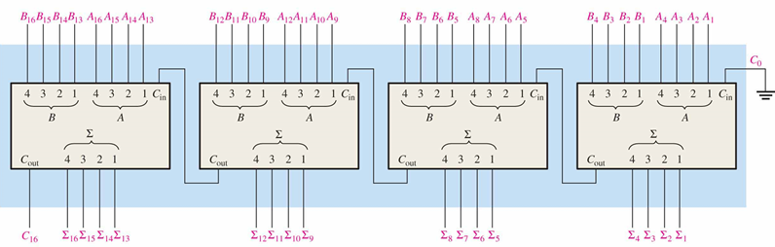
An application: Cascading(级联) four 74LS283 four-bit adders to form 1 16bit adder
Notes:
注意：此时芯片内部为先行进位方式，但是芯片之间仍是行波传递方式。

Slide 17
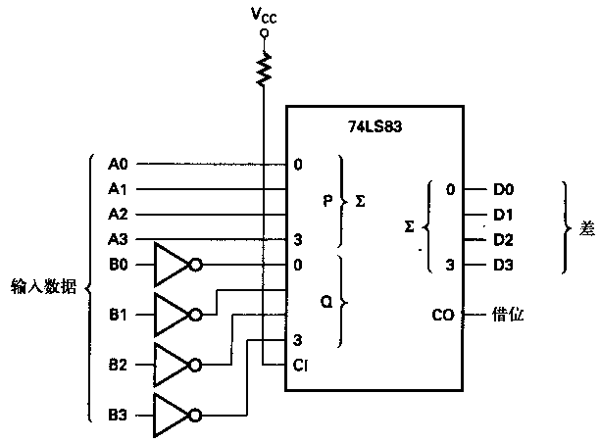
An application：Subtractor
Using 2’s complement to realize subtraction
Difference
Input data
Why c-in always be 1？
Notes:
两个二进制数A、B相减，可以转为补码操作A_{补}+(-B)_{补}
进位C-in恒置1，等价于把被减数按位取反+1。

Slide 18
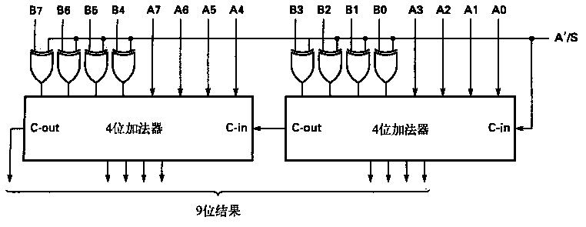
An application：an adder/subtractor circuit.
A’/S is the mode control. How does it work?
When the A’/S mode control input is a 0 the EX-OR gates do not invert, so the input data are added unchanged. The carry-in bit is forced to logic 0.
Notes:
A’/S控制决定了做加法还是减法操作
A’/S为0时，异或门不进行取反操作，进位为逻辑0，为加法器
A’/S为1时，异或门进行取反操作，进位为逻辑1，为减法器

Slide 19
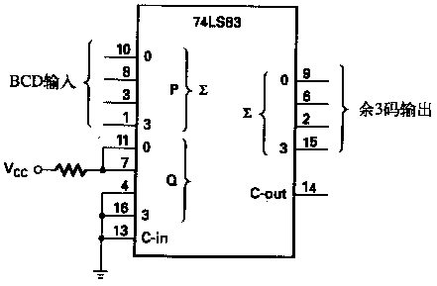
An application：a BCD to Excess-3 code converter

Slide 20
An application：BCD Adder
BCD Decimal Adder:
Requires 8 inputs (4 bits per decimal number)
5 outputs indicate the decimal sum and the carry
Remember BCD addition rules: Add 0110 to the sum if it is greater than 1010 to correct the carry bit
e.g.：Let A=1000，B=0111。The BCD sum of A+B is (1)0101
 | 1 | 0 | 0 | 0
+ | 0 | 1 | 1 | 1
 | 1 | 1 | 1 | 1
 |  | 1 | 1 | 1 | 1
+ |  | 0 | 1 | 1 | 0
 | 1 | 0 | 1 | 0 | 1
Notes:
进位关系不同，故需+6修正

Slide 21
错误产生原因：两者进位关系不同
1、
0111（8421 BCD）=7, 正确。
2、
1101是非法码。需加 6 修正。
产生进位，本位和正确。
3、
0001,错误。需加 6 修正。
产生进位，本位和正确。

Slide 22
结论：两个BCD码相加
当和大于9或进位为1的时候，需要将结果加6进行修正；
当和小于9则不修正。
修正信号应在有进位信号C_{out}产生、或两个8421BCD码相加之和为10~15的情况下产生。

Slide 24
1
&
Σ
Σ
&
&
Σ
Σ
加6修正

Slide 25
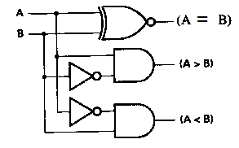
Comparators 比较器
The function of a comparator is to compare the magnitudes of two binary numbers to determine the relationship between them.
Single bit comparator
A EQ B = A’B’ + AB
A > B = AB’
A< B = A’B
A | B | A=B | A>B | A<B
0 | 0 | 1 | 0 | 0
0 | 1 | 0 | 0 | 1
1 | 0 | 0 | 1 | 0
1 | 1 | 1 | 0 | 0
How about Two-bit comparator?

Slide 26
Comparators
A₃ B₃ A₂ B₂ A₁ B₁ A₀ B₀ | F_{A＞B} F_{A＜B} F_{A＝B}
A₃＞B₃ × × × A₃＜B₃ × × × A₃＝B₃ A₂＞B₂ × × A₃＝B₃ A₂＜B₂ × × A₃＝B₃ A₂＝B₂ A₁＞B₁ × A₃＝B₃ A₂＝B₂ A₁＜B₁ × A₃＝B₃ A₂＝B₂ A₁＝B₁ A₀＞B₀ A₃＝B₃ A₂＝B₂ A₁＝B₁ A₀＜B₀ A₃＝B₃ A₂＝B₂ A₁＝B₁ A₀＝B₀ | 1 0 0 0 1 0 1 0 0 0 1 0 1 0 0 0 1 0 1 0 0 0 1 0 0 0 1
Notes:
对于多位比较，可以先比较最高位，高位相等的条件下，再查看低位比较结果

Slide 27
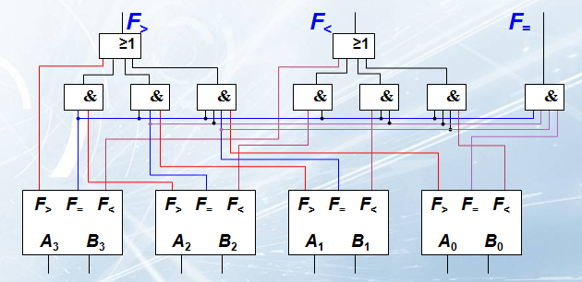
F> = F_{3>} + F₃₌F_{2>} + F₃₌F₂₌F_{1>} + F₃₌F₂₌F₁₌F_{0>}
F< = F_{3<} + F₃₌F_{2<} + F₃₌F₂₌F_{1<} + F₃₌F₂₌F₁₌F_{0<}
F₌ = F₃₌F₂₌F₁₌F₀₌

Slide 28
Comparators
IC comparators provide outputs to indicate which of the numbers is larger or if they are equal.
Cascading inputs are provided to expand the comparator to larger numbers.
COMP
A₀
0
A₁
A
A₂
A₃
3
A > B
A > B
Cascading
inputs
Outputs
A = B
A = B
A < B
A < B
B₀
0
B₁
A
B₂
B₃
3
The IC shown is the 4-bit 74LS85.

Slide 29
Comparators
IC comparators can be expanded using the cascading inputs as shown.
The lowest order comparator has a HIGH on the A = B input.
LSBs
MSBs
A₀
COMP
A₄
COMP
A₁
0
A₅
0
A₂
A
A₆
A
A₃
A₇
3
3
A > B
A > B
A > B
A > B
+5.0 V
A = B
A = B
A = B
A = B
Outputs
A < B
A < B
A < B
A < B
B₀
0
B₄
0
B₁
A
B₅
A
B₂
B₆
B₃
3
B₇
3

Slide 30
Decoders 译码器
A decoder is a logic circuit that detects the presence of a specific combination of bits at its input.
Two simple decoders that detect the presence of the binary code 0011 are shown. The first has an active HIGH output; the second has an active LOW output.
A₀
A₀
A₁
X
A₁
X
A₂
A₂
A₃
A₃
Active HIGH decoder for 0011
Active LOW decoder for 0011

Slide 31
Decoders
Question
Assume the output of the decoder shown is a logic 1. What are the inputs to the decoder?

Slide 32
Decoders
IC decoders have multiple outputs to decode any combination of inputs.
For example the binary-to-decimal decoder shown here has 16 outputs – one for each combination of binary inputs.

Slide 33
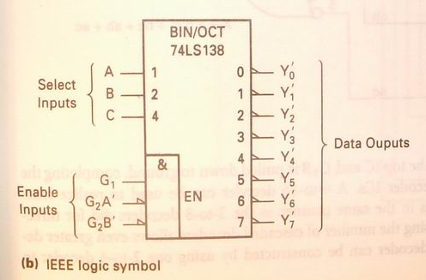
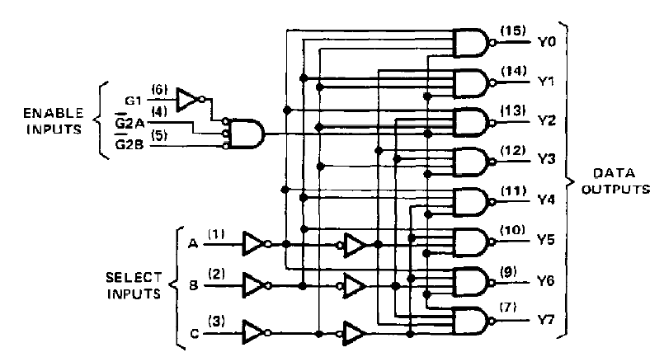
74LS138
The 74LS138 is a 3-to-8 decoder(1-of-8) with three chip select inputs (two active LOW, one active HIGH).

Slide 34
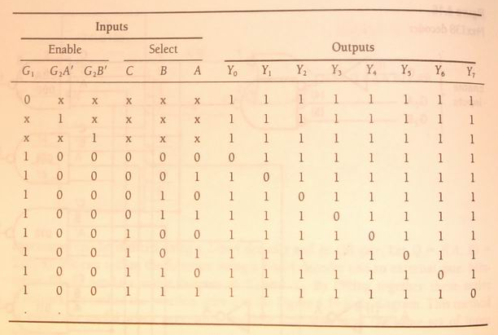
74LS138 and minterms
Y₀’=(C’B’A’)’
Y₁’=(C’B’A)’
Y₂’=(C’BA’)’
Y₃’=(C’BA)’
Y₄’=(CB’A’)’
Y₅’=(CB’A)’
Y₆’=(CBA’)’
Y₇’=(CBA)’
=m₀’
=m₁’
=m₂’
=m₃’
=m₄’
=m₅’
=m₆’
=m₇’

Slide 35
Application of binary decoder
A binary decoder can be used to develop some logic expressions.
Eg: Implement the following logic expressions with 74LS138:
Y1=A’B’+AC+A’C’
Y2=A’C+AC’
Y3=B’C+BC’

Slide 36
Step1:Convert the expressions to standard SOP form
Y1 =A’B’+AC+A’C’
=A’B’C+A’B’C’+ABC+AB’C+A’BC’+A’B’C’
=m1+m0+m7+m5+m2+m0
= (m0’m1’m2’m5’m7’)’
Y2 =A’C+AC’
=A’BC+A’B’C+ABC’+AB’C’
= m3+m1+m6+m4
= (m1’m3’m4’m6’)’
Y3 =B’C+BC’
=AB’C+A’B’C+ABC’+A’BC’
=m5+m1+m6+m2
= (m1’m2’m5’m6’)’

Slide 37
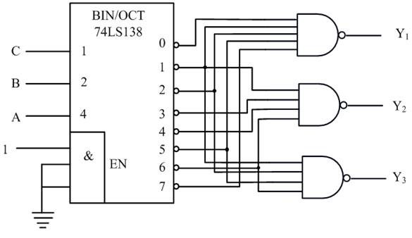
Step2: Draw the logic circuits with 74LS138 and basic gates
Is there any other solution?
Y₁= (m₀’m₁’m₂’m₅’m₇’)’
Y₂= (m₁’m₃’m₄’m₆’)’
Y₃= (m₁’m₂’m₅’m₆’)’

Slide 38
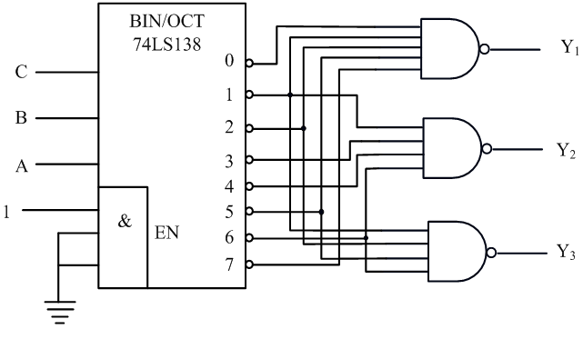
Y₁= (m₀’m₁’m₂’m₅’m₇’)’
Y₂= (m₁’m₃’m₄’m₆’)’
Y₃= (m₁’m₂’m₅’m₆’)’
Y₁=A’B’+AC+A’C
=∑(0,1,2,5,7) = m₃’m₄’m₆’
Y₂=A’C+AC’
= ∑(1,3,4,6) = m₀’m₂’m₅’m₇’
Y₃=B’C+BC’
=∑(1,2,5,6) = m₀’m₃’m₄’m₇’

Slide 39
Exercise
Implement the following logic expressions with 74LS138
X = f(a,b,c) = ∑(0,3,5,6,7)

Slide 40
Decoders
X/Y
A specific integrated circuit decoder is the 74HC154 (shown as a 4-to-16 decoder).
It includes two active LOW chip select lines which must be at the active level to enable the outputs. These lines can be used to expand the decoder to larger inputs.
A₀
A₁
A₂
A₃
CS₁
CS₂
EN
74HC154

Slide 41
Implementing Boolean functions using decoders
use 74HC154 to implement F(A, B, C, D) = Σm(1,2,5,7)
F

Slide 42
Cascading two 74LS138 to implement one 4-to-16 decoder
Chip1
Chip2
Select signal
=>Enable
_{W}
x y z
D₀～D₇
D₈～D₁₅
0
0 0 0
0 0 0 0
1 1 1
0 1 1 1
1
0 0 0
1 0 0 0
1 1 1
1 1 1 1
Select chip 1:
Select chip 2:

Slide 43
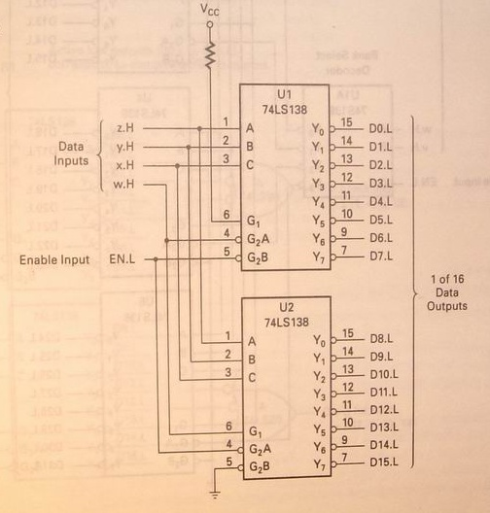

Slide 44
Decoders
BCD-to-decimal decoders accept a binary coded decimal input and activate one of ten possible decimal digit indications.
A₀
Assume the inputs to the 74HC42 decoder are the sequence 0101, 0110, 0011, and 0010. Describe the output.
A₁
Example
A₂
A₃
Solution
All lines are HIGH except for one active output, which is LOW. The active outputs are 5, 6, 3, and 2 in that order.

Slide 45
BCD Decoder/Driver
Another useful decoder is the 74LS47. This is a BCD-to-seven segment display with active LOW outputs.
V_{CC}
BCD/7-seg
BI/RBO
BI/RBO
灭零输入/异步灭零输出
BCD inputs
Outputs to seven segment device
灯测试
LT
LT
异步灭零输入
RBI
RBI
74LS47
GND

Slide 46
BCD Decoder/Driver
The 74LS47 features leading zero suppression, which blanks unnecessary leading zeros but keeps significant zeros as illustrated here. The BI/RBO output is connected to the RBI input of the next decoder.
Blanked
Blanked

Slide 47
BCD Decoder/Driver
Trailing zero suppression blanks unnecessary trailing zeros to the right of the decimal point as illustrated here. The RBI input is connected to the BI/RBO output of the following decoder.
Decimal point
Blanked
Blanked

Slide 48
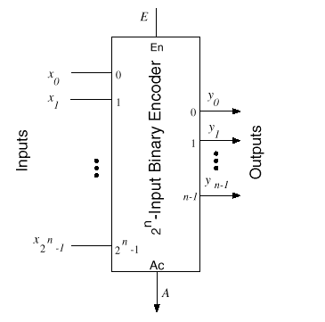
Encoders编码器
An encoder accepts an active logic level on one of its inputs and converts it to a coded output, such as BCD or binary.

Slide 49
Encoders
The decimal to BCD is an encoder with an input for each of the ten decimal digits and four outputs that represent the BCD code for the active digit.
The basic logic diagram is shown. There is no zero input because the outputs are all LOW when the input is zero.
1
A₀
2
3
A₁
4
5
A₂
6
7
8
A₃
9

Slide 50
Encoders
Example
Solution
1
0
1
Show how the decimal-to-BCD encoder converts the decimal number 3 into a BCD 0011.
A₀
The top two OR gates have ones as indicated with the red lines. Thus the output is 0111.
2
0
1
3
1
A₁
4
0
5
0
0
A₂
6
0
0
7
8
0
0
0
A₃
9

Slide 51
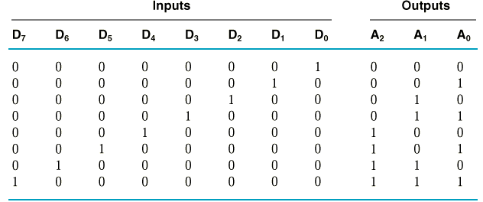
A₀ = D₁ + D₃ + D₅ + D₇
A₁ = D₂ + D₃ + D₆ + D₇
A₂ = D₄ + D₅ + D₆ + D₇
8-3 binary encoders

Slide 52
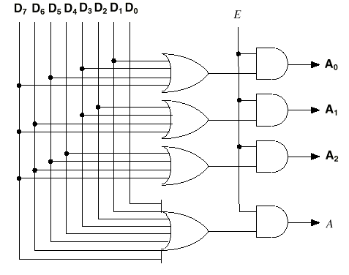

Slide 53
Encoders
V_{CC}
The 74HC147（十进制-BCD编码器） is an example of an IC encoder. It is has ten active-LOW inputs and converts the active input to an active-LOW BCD output.
It is a priority encoder(优先编码器). This means that if more than one input is active, the one with the highest order decimal digit will be active.
HPRI/BCD
Decimal input
BCD output
74HC147
GND

Slide 54
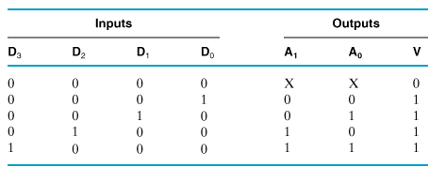
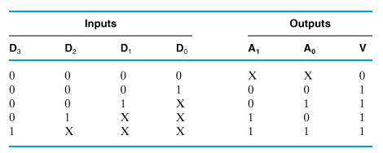
priority encoder 优先编码器
non-priority encoder
priority encoder
highest priority

Slide 55
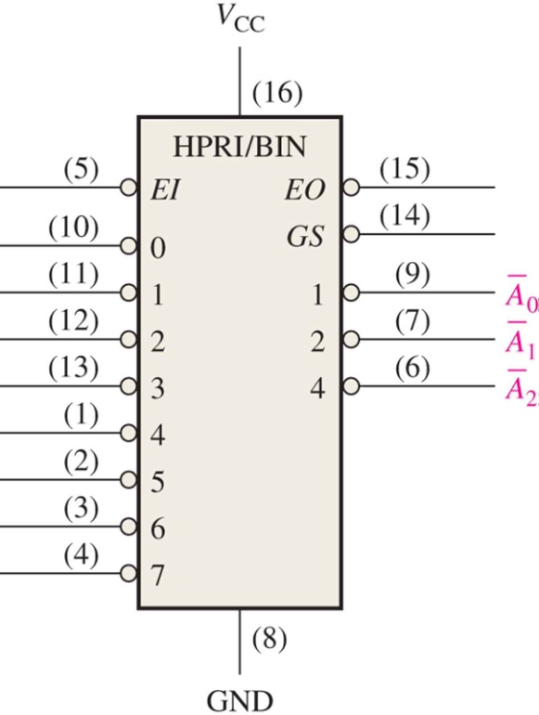
74LS148 8-3 priority encoder

Slide 56
Application : priority encoder
Fire
priority
encoder
Theft
proc
119
Gas leakage
110
TV
call user
AC
other
other

Slide 57
Code converters代码转换器
There are various code converters that change one code to another. Two examples are the four bit binary-to-Gray converter and the Gray-to-binary converter.
Example
Show the conversion of binary 0111 to Gray and back.
0
1
LSB
Solution
1
0
LSB
0
1
1
0
1
1
1
1
0
0
0
MSB
0
MSB
Binary-to-Gray Gray-to-Binary

Slide 58
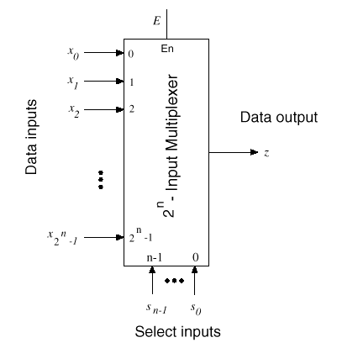
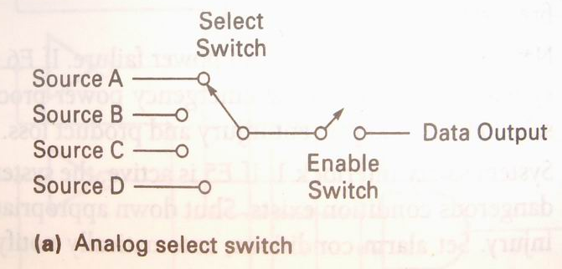
Multiplexers数字多路器
A multiplexer (MUX) selects one data line from two or more input lines and routes data from the selected line to the output.
The particular data line that is selected is determined by the select inputs.

Slide 59
Multiplexers
For a 2^{n}-to-1 multiplexer, there are 2^{n} data input lines and n selection lines whose bit combination determines which input is selected.
4-to-1 Multiplexer needs 2 selection lines.
8-to-1 Multiplexer needs 3 selection lines.

Slide 60
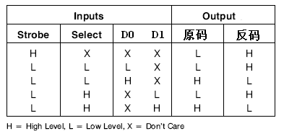
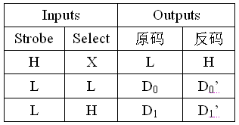
2-1 demultiplexer
Truth table
Input（2lines）
0
1
Select
D₀
D₁

Slide 61
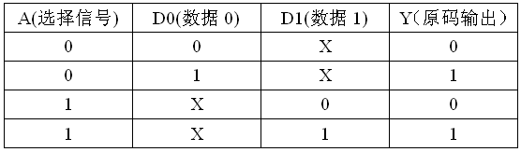
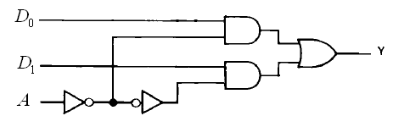
2-1 demultiplexer
Input
Y
=
D
A
'
+
D
A
0
1
Select

Slide 62
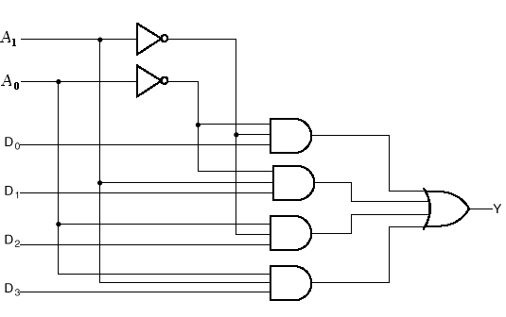
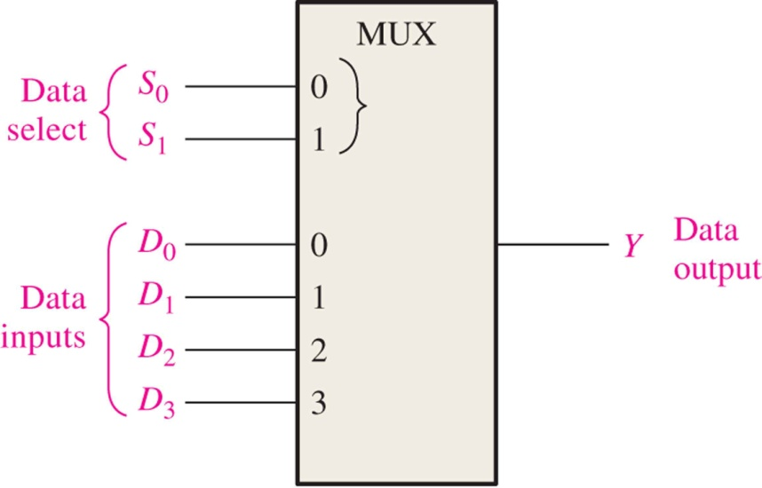
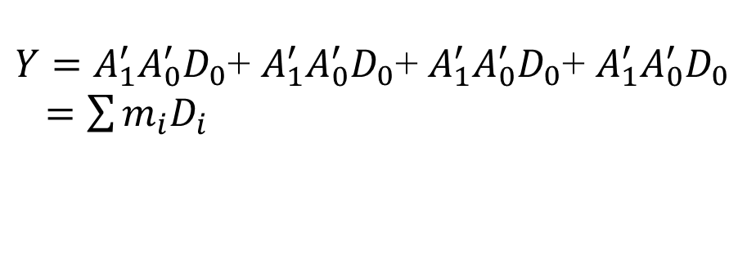
4-1 demultiplexer
$Y=A_{1}^{′}A_{0}^{′}D_{0}$+ $A_{1}^{′}A_{0}^{′}D_{0}$+ $A_{1}^{′}A_{0}^{′}D_{0}$+ $A_{1}^{′}A_{0}^{′}D_{0}$
$=\sum{m_{i}D_{i}}$
Select signal
A₁
A₁
A₀
Y
0
1
A₀
0
0
D₀
0
D0
D2
0
1
D₁
1
0
D₂
1
D1
D3
1
1
D₃

Slide 63
Multiplexers
Two select lines are shown here to choose any of the four data inputs.
D₂
Question
Which data line is selected if S₁S₀ = 10?
S₀
0
Data select
1
S₁
D₀
Data output
Data inputs
D₁
D₂
D₃

Slide 64
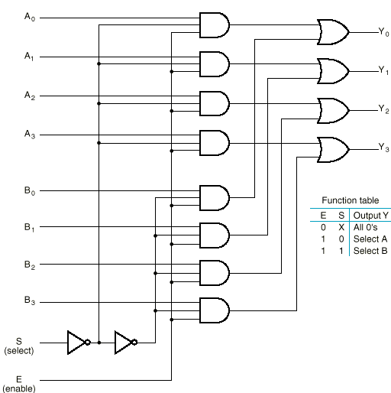
Example: Quad 2-to-1 MUX
Uses four 2-to-1 MUXs with common select (S) and enable (E).
Select line chooses between A_{i}’s and B_{i}’s. The selected four-wire digital signal is sent to the Y_{i}’s
Enable line turns MUX on and off (E=1 is on).
Notes:
使用4个2-1选择器，共享使能和选择信号。
S选择线决定把A_{i}还是B_{i}送往Y_{i}
使能信号E打开或关闭多路器。

Slide 65
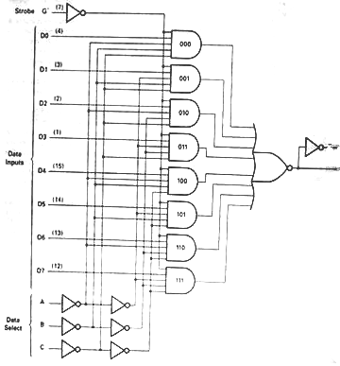
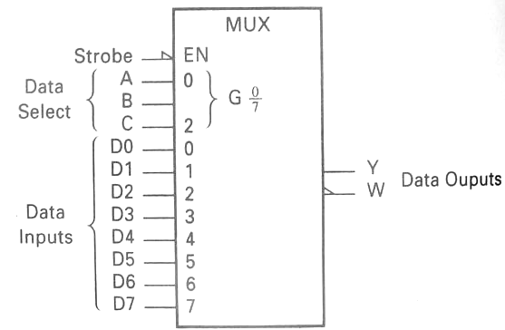
8-1 Multiplexer 74LS151

Slide 66
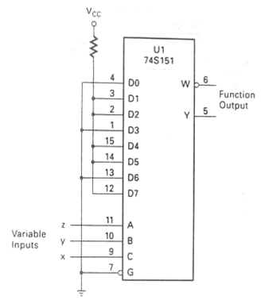

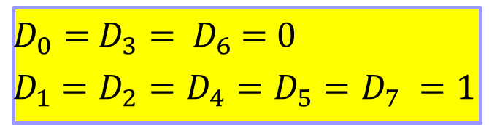
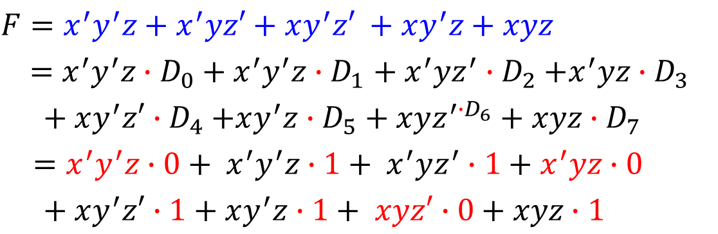
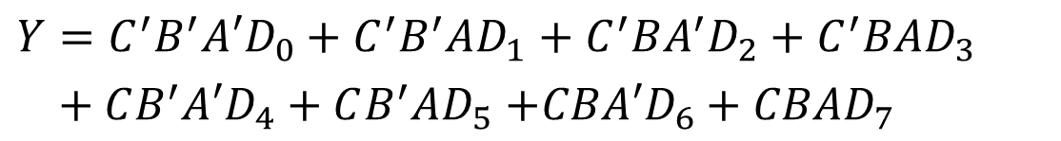
Implementing Boolean functions with Multiplexers
Using an 8-to-1 multiplexer to realize the Boolean function F=f(x,y,z)=∑(1,2,4,5,7)
$D_{0}=$ $D_{3}=$ $D_{6}$ = 0
$D_{1}$ $=D_{2}=D_{4}=D_{5}$ $=D_{7} =1$
$Y=C^{′}B^{′}A′D_{0}+C^{′}B^{′}AD_{1}$ $+ C^{′}BA^{′}D_{2}+C^{′}BAD_{3}$
$+ CB^{′}A′D_{4}+CB^{′}AD_{5}$ $+CBA′D_{6}+CBAD_{7}$
令$C=x B=y A=z$
$$F=x^{′}y^{′}z+x^{′}yz′+xy^{′}z′ +xy^{′}z+xyz$$
$=x^{′}y^{′}z{∙D}_{0}+ x^{′}y^{′}z{∙D}_{1}$ $+ x^{′}yz^{′}{∙D}_{2}+x^{′}yz∙D_{3}$
$+ xy^{′}z′{∙D}_{4}+xy^{′}z{∙D}_{5}$ $+ xyz^{′{∙D}_{6}}+xyz∙D_{7}$
$=x^{′}y^{′}z∙0+ x^{′}y^{′}z∙1+ x^{′}yz^{′}∙1+x^{′}yz∙0$
$$+ xy^{′}z′∙1+xy^{′}z∙1+ xyz′∙0+xyz∙1$$

Slide 67
Exercise
Using an 8-to-1 multiplexer to realize the Boolean function
F=f(x,y,z)=∑(0,3,5,6,7)

Slide 68
How can implement a 3-input function with a 4-1 multiplexer?
AB
CD
00
01
11
10
A
AB
1
00
00
01
11
10
0
C
B
01
0
0
CD
D
11
1
1
C+D
C+D
10
4-input
3-input
2-input

Slide 69
A
0
1
0
1
B
CD
A
0
D
1
C+D
C+D
1-input

Slide 70
E.g. Using an 4-1 multiplexer to realize the Boolean function F=f(x,y,z)=∑(1,2,4,5,7)
XY
00
01
11
10
z
z’
1
z
D₀
Z
D₁
4-1
MUX
F
0
1
1
D₂
D₃
1
1
1
1
Y
A0
X
A1
X
D₀=z
D₁=z’
D₂=1
D₃=z
Y
0
1
EN
0
z
1
F=X’Y’D₀+X’YD₁+XY’D₂+XYD₃
=X’Y’Z+X’YZ’+XY’+XYZ
1
z'
z

Slide 71
Exercise: Using an 4-1 multiplexer to realize the Boolean function
F = f(x,y,z) = ∑(1,2,6,7)

Slide 72
Demultiplexers（多路分配器）
A demultiplexer (DEMUX) performs the opposite function from a MUX. It switches data from one input line to two or more data lines depending on the select inputs.
The 74LS138 was introduced previously as a decoder but can also serve as a DEMUX.
When connected as a DEMUX, data is applied to one of the enable inputs, and routed to the selected output line depending on the select variables.
Note that the outputs are active-LOW .
Data select lines
Data outputs
Enable
inputs
74LS138
Notes:
定义：把数字数据以特定的时序从一个输入传送到不同输出中的一条输出线上的一种数字电路。

Slide 73
Demultiplexers
A
0
A
1
A
Example
Determine the outputs, given the inputs shown.
2
G
1
G
LOW
2A
Solution
G
LOW
2B
Y
0
Data select lines
Y
Data outputs
1
Y
2
Y
Enable inputs
3
Y
4
Y
5
Y
6
Y
74LS138
7

Slide 74
Parity Generators/Checkers奇偶发生器/校验器
Parity is an error detection method that uses an extra bit appended to a group of bits to force them to be either odd or even. In even parity(偶校验), the total number of ones is even; in odd parity(奇校验) the total number of ones is odd.
Example
The ASCII letter S is 1010011. Show the parity bit for the letter S with odd and even parity.
Solution
S with odd parity =
11010011
S with even parity =
01010011

Slide 75
Parity Generators/Checkers
Checker: The 74LS280 can test codes with up to 9 bits. The even output will normally be HIGH if the data lines have even parity; otherwise it will be LOW. Likewise, the odd output will normally be HIGH if the data lines have odd parity; otherwise it will be LOW.
Data inputs
Σ Even
Σ Odd
Generator: To generate even parity, the parity bit is taken from the odd parity output. To generate odd parity, the output is taken from the even parity output.
74LS280

Slide 76
Selected Key Terms
Full-adder
Cascading
Ripple carry
Look-ahead carry
A digital circuit that adds two bits and an input carry bit to produce a sum and an output carry.
Connecting two or more similar devices in a manner that expands the capability of one device.
A method of binary addition in which the output carry from each adder becomes the input carry of the next higher order adder.
A method of binary addition whereby carries from the preceding adder stages are anticipated, thus eliminating carry propagation delays.

Slide 77
Selected Key Terms
Decoder
Encoder
Priority encoder
Multiplexer (MUX)
Demultiplexer (DEMUX)
A digital circuit that converts coded information into a familiar or noncoded form.
A digital circuit that converts information into a coded form.
An encoder in which only the highest value input digit is encoded and any other active input is ignored.
A circuit that switches digital data from several input lines onto a single output line in a specified time sequence.
A circuit that switches digital data from one input line onto a several output lines in a specified time sequence.

Slide 78

Quiz
1. For the full-adder shown, assume the input bits are as shown with A = 0, B = 0, C_{in} = 1. The Sum and C_{out} will be
a. Sum = 0 C_{out} = 0
b. Sum = 0 C_{out} = 1
c. Sum = 1 C_{out} = 0
d. Sum = 1 C_{out} = 1
Σ
Σ
Σ
Σ
Sum
0
A
A
0
B
C_{out}
B
C_{out}
1
C_{out}

Slide 79
Quiz
2. The output will be LOW if
a. A < B
b. A > B
c. both a and b are
correct
d. A = B
A₁
B₁
A₂
B₂
Output
A₃
B₃
A₄
B₄

Slide 80
Quiz
3. If you expand two 4-bit comparators to accept two 8-bit numbers, the output of the least significant comparator is
a. equal to the final output
b. connected to the cascading inputs of the most
significant comparator
c. connected to the output of the most significant
comparator
d. not used

Slide 81
Quiz
4. Assume you want to decode the binary number 0011 with an active-LOW decoder. The missing gate should be
a. an AND gate
b. an OR gate
c. a NAND gate
d. a NOR gate
A₀
A₁
?
X
A₂
A₃

Slide 82
Quiz
5. Assume you want to decode the binary number 0011 with an active-HIGH decoder. The missing gate should be
a. an AND gate
b. an OR gate
c. a NAND gate
d. a NOR gate
A₀
A₁
?
X
A₂
A₃

Slide 83
Quiz
6. The 74138 is a 3-to-8 decoder. Together, two of these ICs can be used to form one 4-to-16 decoder. To do this, connect
a. one decoder to the LSBs of the input; the other decoder to the MSBs of the input
b. all chip select lines to ground
c. all chip select lines to their active levels
d. one chip select line on each decoder to the input MSB

Slide 84
Quiz
7. The decimal-to-binary encoder shown does not have a zero input. This is because
a. when zero is the input,
all lines should be LOW
b. zero is not important
c. zero will produce
illegal logic levels
d. another encoder is used
for zero
1
A₀
2
3
A₁
4
5
A₂
6
7
8
A₃
9

Slide 85
Quiz
8. If the data select lines of the MUX are S₁S₀ = 11, the output will be
a. LOW
b. HIGH
c. equal to D₀
d. equal to D₃
Data
select
S₀
S₁
D₀
Data
output
Data
inputs
D₁
D₂
D₃

Slide 86
Quiz
9. The 74138 decoder can also be used as
a. an encoder
b. a DEMUX
c. a MUX
d. none of the above

Slide 87
Quiz
10. The 74LS280 can generate even or odd parity. It can also be used as
a. an adder
b. a parity tester
c. a MUX
d. an encoder

Slide 88
Quiz
Answers:
1. c
2. c
3. b
4. c
5. a
6. d
7. a
8. d
9. b
10. b

Slide 89
Homework
self-test
8
14
16
20
24
32

