Slide 1
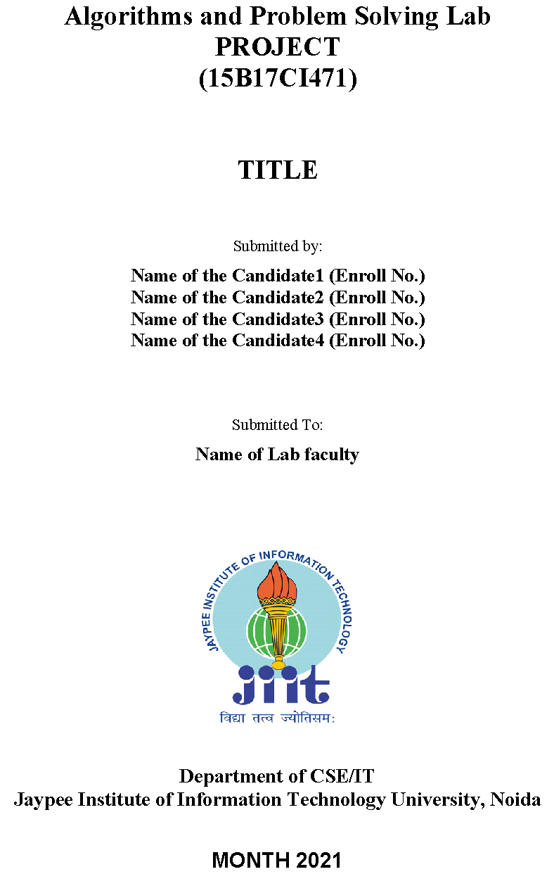
Detecting Phishing Websites Using Machine Learning Algorithms
Minor Project - II
Team Members:
Kartikeya Consul (9919103183)
Manan Chaudhary (9919103178)
Megha Jain (9919103188)

Slide 2
PROBLEM STATEMENT
Phishing can steal credentials, launch viruses and lock up your data and hold it for ransom. Even antivirus software can't stop attacks it cannot see coming. So we intend to develop a website using ML techniques which will detect Phishing URLs.

Slide 3
STATE-OF-THE-ART
M. Amaad et al^{.[1]} presented a hybrid model for classification of phishing website. In this paper, proposed model carried out in two phase. They achieved 97.75% accuracy on testing dataset. There limitation was that this model requires more time to build hybrid model.
Ahmad et al^{.[2]} proposed three new features to improve accuracy rate for phishing website detection. In this paper, author has concluded this work can be enhanced by using this novel features with decision tree machine learning classifiers.

Slide 4
Ankit Kumar Jain & B. B. Gupta^{-[3]} presented a machine learning based novel anti-phishing approach that extracts the features from client side only. We have examined the various attributes of the phishing and legitimate websites in depth and identified nineteen outstanding features to distinguish phishing websites from legitimate ones.

Slide 5
OBJECTIVES
To analyze the best approach to detect malicious URL and alert users.
To apply the best ML model in the proposed approach in order to analyze the real time URLs and produce effective results.
Accuracy of different ML models is compared and the best one is selected to detect phishing websites.
To prevent the users from getting their personal information like user name, passwords and online banking transactions stolen.
As it is said…
What is a hacker’s weekend getaway?
They go phishing!

Slide 6
Proposed Design
We have collected the data of legitimate and phishing URL’s.
Then, we performed feature extraction on those URL’s
Then, we have trained them using different Machine Learning Models and compared the accuracy we got for all these models
Then, we chose the best one, which in this case is XG Boost Classifier with 97.47% accuracy.
Then we integrated this model with a website which will tell that the inputted URL is a legitimate or a phished URL.

Slide 7
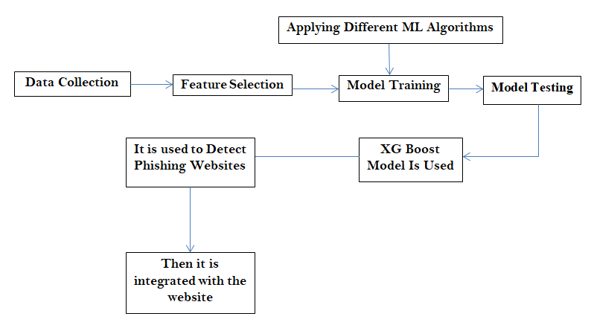
Work Flow

Slide 8
Data Analysis Plan
We collected various URL’s from PhishTank ^{.[4]} website which are labeled as:
Phished-URL’s ^{.[5]}
Non-Phished-URL’s ^{.[6]}
Then, we extracted various important features from the above mentioned URL’s which are discussed in the Implementation slide.
Then, we used the dataset provided by UCI Machine Learning repository collated by Mohammad et al. The dataset has 11055 data-points with 6157 legitimate URLs and 4898 phishing URLs.

Slide 9
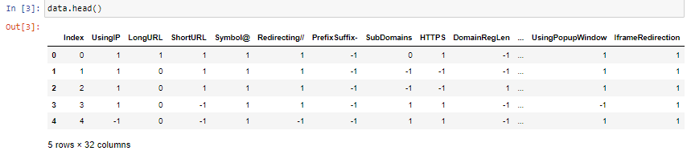
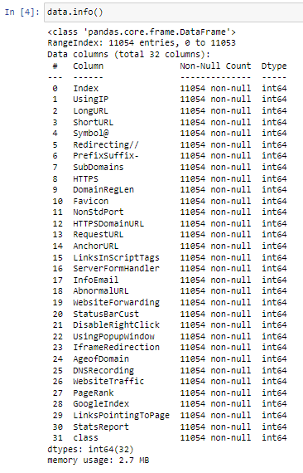
Dataset Collection
Dataset by Mohammad et al:
See Here

Slide 10
IMPLEMENTATION
Feature Selection: The following category of features are selected:
Address Bar Based Features
Abnormal Based Features
HTML and JavaScript Based Features
Domain Based Features
Address Bar Based Features considered are:
IP Address in URL Sub-Domain and Multi-Sub Domain Length of URL HTTPS Domain URL
URL Shortening Services Domain Registration Length
URL’s having “@” Symbol Favicon
Redirecting using “//” Non Standard Port
Prefix or Suffix “-” in Domain

Slide 11
Abnormal Based Features considered are:
Request URL URL of Anchor
Links in Script Tags Server from Handler
Information to Email Abnormal URL
HTML and JavaScript Based Features considered are:
Website Forwarding Status Bar Customization
Disabling Right Click Using Pop-Up Window
I-Frame Redirection
Domain Based Features considered are:
Age of Domain DNS Record
Website Traffic Page Rank
Google Index Number of Links Pointing to a Page
Statistical Reports

Slide 12
Machine Learning Models
This is a supervised Machine Learning task. There are two major types of supervised machine learning problems, called Classification and Regression.
This dataset comes under Classification problem, as the input URL is classified as Phishing(-1) or Legitimate(1). There are various machine learning models considered here to train the dataset but we selected the best model out of the all i.e.
XG Boost Classifier

Slide 13
RESULTS & ANALYSIS
Machine Learning Model | Accuracy Score (%)
Gradient Boosting Classifier | 97.33
Random Forest Classifier | 97.06
Decision Tree Classifier | 96.79
Support Vector Classifier | 93.21
Logistic Regression | 93.03
KNN Classifier | 94.21
ADA Boost Classifier | 93.80
XG Boost Classifier | 97.47
Clearly, XG Boost Classifier gives the best accuracy score i.e. 97.47%, hence, we used this model to predict Phishing Websites

Slide 14
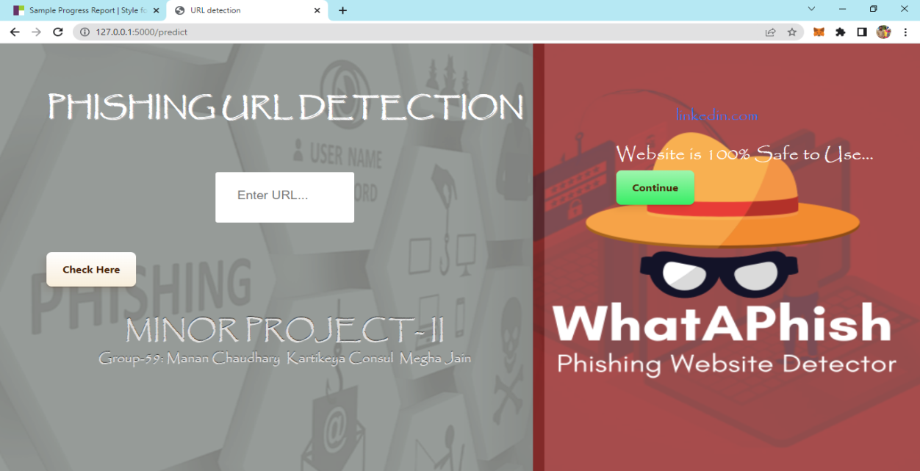
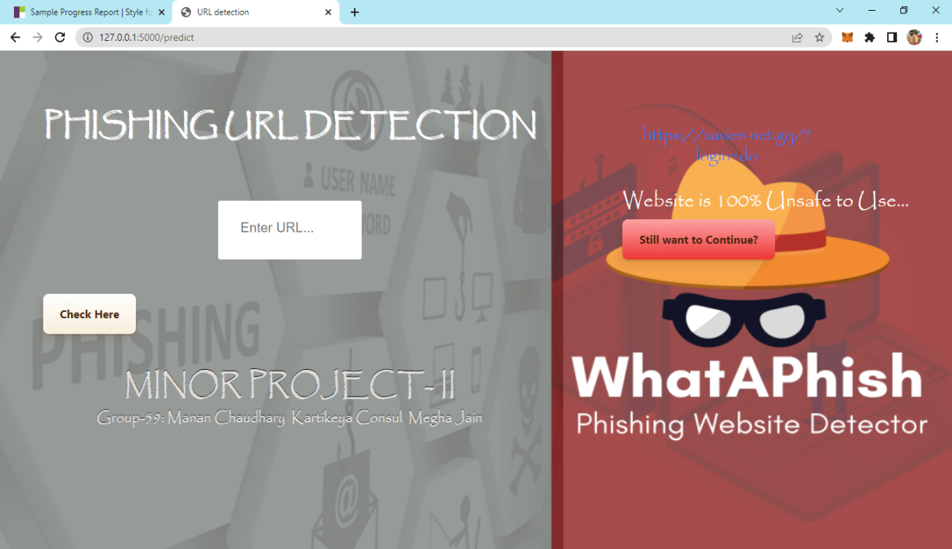
Integrating our model to Website
We integrated our model with the website:
Testing a Legit Website:
linkedin.com
Testing a Phished Website:
https://xavier-net.gq/?login=do

Slide 15
Conclusion
Our project’s aim was to compare pre-defined different Machine Learning Classifiers and then select the best algorithm based on their performance.
Then, we built a Chrome extension for detecting phishing web pages.
The extension allows easy deployment of our phishing detection model to end users.
We have detected phishing websites using XG Boost Classifier with the accuracy of 97.47%.

Slide 16
Future Scope
For future enhancements, we intend to build the phishing detection system as a scalable web service which will incorporate online learning so that new phishing attack patterns can easily be learned and improve the accuracy of our models with better feature extraction.

Slide 17
References
[1] https://www.researchgate.net/publication/315472902_A_Hybrid_Model_to_Detect_Phishing-Sites_Using_Supervised_Learning_Algorithms
[2] https://www.mirlabs.net/jias/secured/Volume9Issue4/Paper24.pdf
[3] https://ideas.repec.org/a/spr/telsys/v68y2018i4d10.1007_s11235-017-0414-0.html
[4] https://phishtank.org/index.php
[5] https://phishtank.org/phish_search.php?valid=y&active=All&Search=Search
[6] https://phishtank.org/phish_search.php?valid=n&active=All&Search=Search

Slide 18


