Slide 1
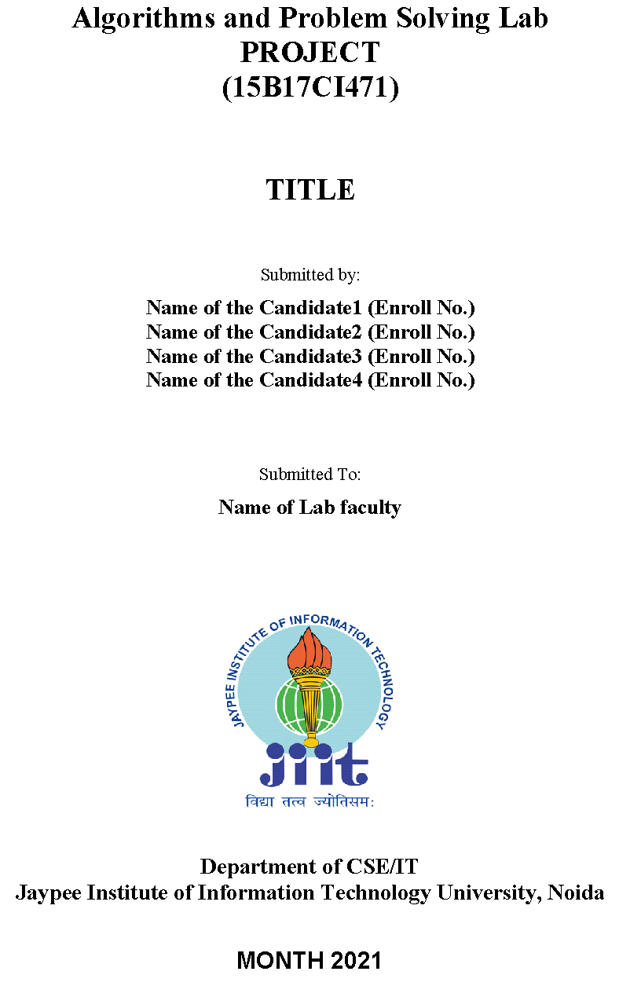
Real-Time Face Mask Detection
Minor Project
Team Members:
Kartikeya Consul (9919103183)
Manan Chaudhary (9919103178)
Megha Jain (9919103188)

Slide 2
PROBLEM STATEMENT
The COVID-19 coronavirus pandemic is wreaking havoc on the world's health. The healthcare sector is in a state of disaster. Many precautionary steps have been taken to prevent the spread of this disease, including the usage of a mask, which is strongly recommended by the World Health Organization (WHO).
But, not wearing a mask is a huge problem and a barrier to prevent COVID-19 crisis. It is not an easy task to aware people about this pandemic. In many countries, COVID-19 cases are still rising in a rapid way. Before availability of vaccine, it was so difficult to stop this virus to rise. It is said that “Prevention is better than Cure”. To prevent this virus, we need to be aware, wear mask and sanitize ourselves on a regular basis.

Slide 3
STATE-OF-THE-ART
In a model they have proposed a pre-trained MobileNet with a global pooling block for face mask detection. The pre-prepared MobileNet takes a shading picture and creates a multi-dimensional component map. The worldwide pooling block that has been used in the proposed model changes the element map into an element vector of 64 highlights. At long last, the softmax layer performs paired order utilizing the 64 highlights. We have assessed our proposed model on two openly accessible datasets. Their proposed model has accomplished 99% and 100% exactness on DS1 and DS2 separately. The worldwide pooling block that has been utilized in the proposed model dodges over-fitting the model. Further, the proposed model beats existing models in the quantity of boundaries just as preparing time. But this model cannot detect face mask for multiple faces at a time.
Another paper utilizes a proficient and strong item location calculation to naturally identify the appearances with veils or without covers, making the plague avoidance work more clever.

Slide 4
STATE-OF-THE-ART (Contd.)
And in another model, they gathered a broad data set of 9886 pictures of individuals with and without face covers and physically named them, at that point use multi-scale preparing and picture mistake techniques to improve YOLOv3, an article recognition calculation, to consequently distinguish whether a face is wearing a veil. Their analysis results show that the mean Average Precision (mAP) of the improved YOLOv3 calculation model came to 86.3%. This work can viably and naturally distinguish whether individuals are wearing veils, which decreases the pressing factor of conveying HR for checking covers openly puts and has high functional application esteem.

Slide 5
LIMITATIONS:
The developed system can detect the live video streams but does not keep a record. Unlike the CCTV camera footage the admin can not rewind, play or pause it. As whenever a strict system is imposed people always try to break it. Hence when a person is detected with no mask, the head of the organization can be notified via mail that so and so person entered without mask. The proposed system can be integrated with databases of respective organizations to keep a record of the person who entered without mask. With more complex functions a screenshot of the person’s face can also be attached to keep it as a proof.

Slide 6
OBJECTIVES
To make a face mask detector proto type.
To monitor people in public places that they are following prevention protocol.
To check if a person is wearing mask or not
To make the face mask detection process from manual to automatic.
To lower costs and human effort.
To maximize the effectiveness of the process.
To learn about deep learning methods through the research work.
To develop our knowledge and experience by working on this project.

Slide 7
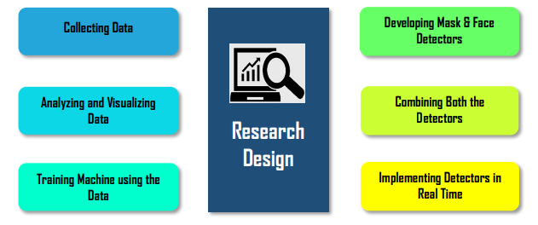
PROPOSED DESIGN
This project is actually a quantitative research. Because we had to collect data, analyse and visualize them with python programming language, train model using the python tools and finally get an output from a raw input, which can detect a mask on a human face. All the characteristics show that our project is actually a result of quantitative research. In addition, this project is descriptive research as the aim of the project is to develop model with higher accuracy and precision. We can also call this research as an experimental as well as an action research. Preparation of this project can be described shortly through the following figure:

Slide 8
IMPLEMENTATION
The model proposed here is designed and modeled using python libraries namely Tensorflow, Keras and OpenCV. The model we used is the MobileNetV2 of Convolutional Neural Network. The method of using MobileNetV2 is called using Transfer Learning. Transfer learning is using some pre trained model to train your present model and get the prediction which saves time and makes using training the different models easy. We tune the model with the hyper parameters : learning rate, number of epochs and batch size. The model is trained with a dataset of images with two class, with mask and without mask. The dataset has 1915 images of with mask class and 1918 images of without mask class.
Training the model with the taken dataset.
Deploying the model
In this project we have developed a model using the above mentioned libraries. We have tested the model for different conditions with different hyper parameters, for which the results are mentioned in the next section.

Slide 9
First we feed the dataset in the model, run the training program, which trains the model on the given dataset. Then we run the detection program, which turns on the video stream, captures the frames continuously from the video stream with an anchor box using object detection process. This is passed through the MobileNetV2 model layers which classifies the image as with or without mask. If the person is wearing a mask, a green anchor box is displayed and red if not wearing a mask with the accuracy for the same tagged on the anchor box.
Summarizing the steps to create the model:
Installing the Dependencies
Loading the Dataset
Data Pre-processing
Mask Detector Model
Training Model
Using models in Real-Time Camera
Detecting Mask using Open-CV Model

Slide 10
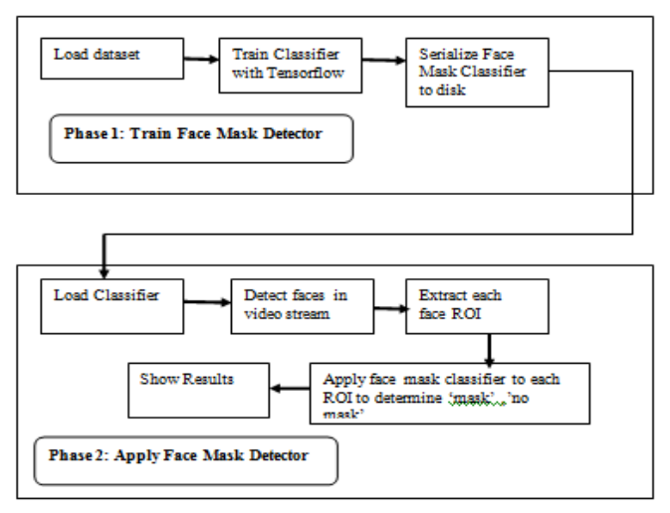
FLOW DIAGRAM

Slide 11
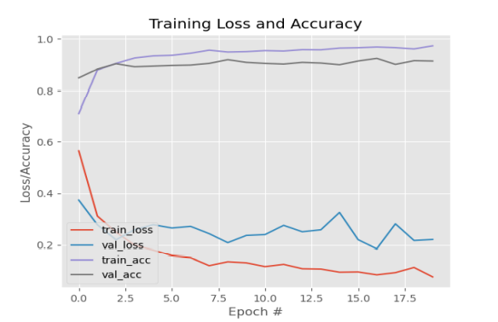
RESULTS & ANALYSIS
The plot of the best model from our research is shown below. It shows the plot for training loss, validation loss, training accuracy and validation accuracy for Number of epochs versus loss or accuracy. It is evident from the plot that as the number of epochs increases the training and validation accuracy increases and the training and validation loss decreases. And also the validation accuracy is higher than the training accuracy which proves that the model is not suffering through over-fitting.

Slide 12
DATA ANALYSIS PLAN
Dataset has been divided as the training and the testing datasets. To train efficiently and effectively, we have considered 80% of total images as training dataset and the 20% of total images as testing data set to test the prediction accuracy. For simplicity, the images in our training data collection are classified into two categories as “with mask” and “without mask”. used a lightweight image classifier, MobileNetV2, which gives high accuracy and is well suited for mobile devices. In pre-processing steps, resized image to 224 × 224 pixels to maintain consistency.
Trained model is deployed using OpenCV, many deep learning frameworks TensorFlow, Caffe and Torch use OpenCV for deployment. Model is applied on the real time video frames captured using webcam to detect people in the frame wearing mask or not.

Slide 13
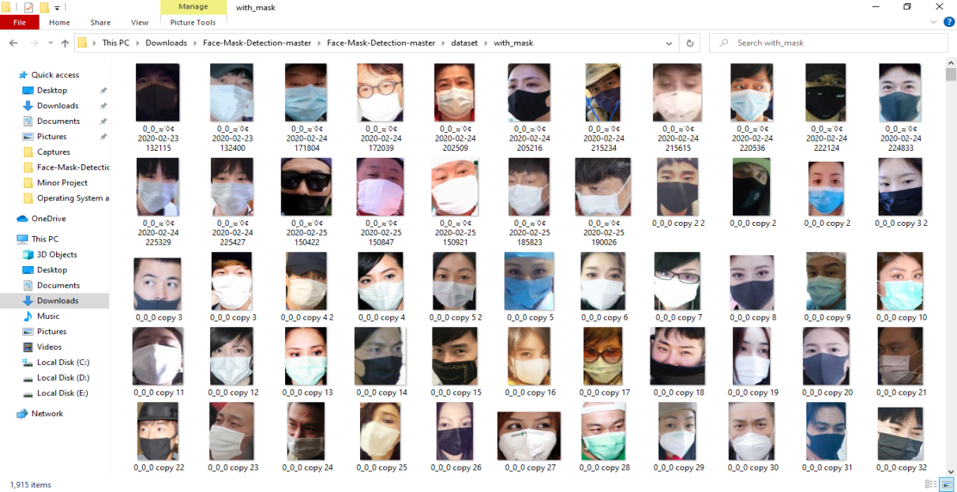
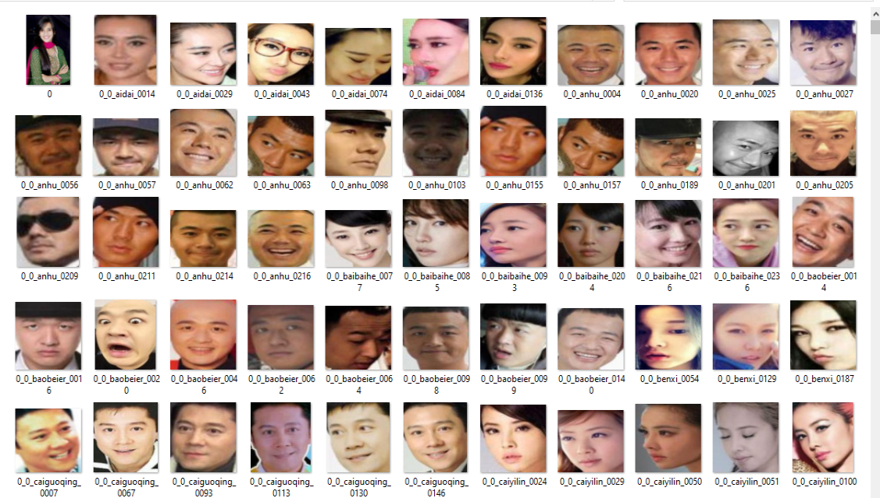
DATASET COLLECTION
With-Mask Dataset
Without-Mask Dataset

Slide 14
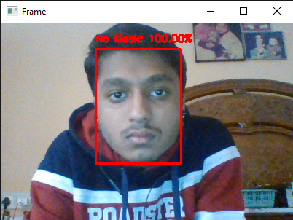
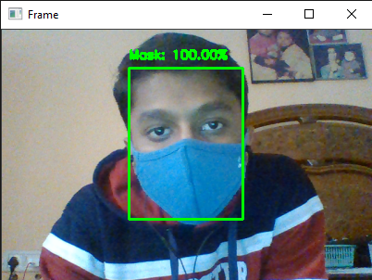
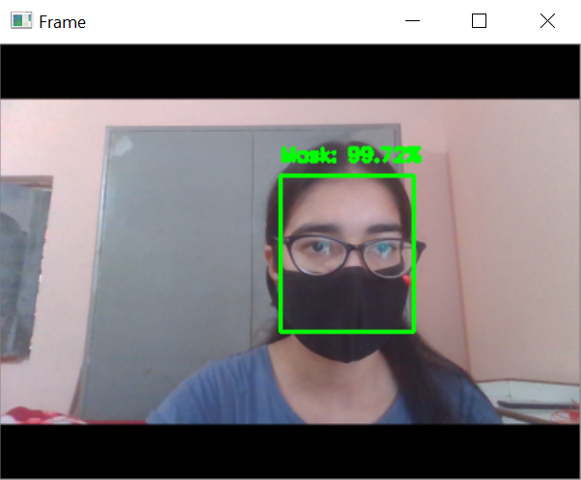
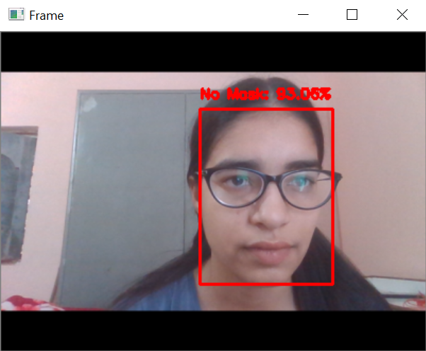
SCREENSHOT OF REAL-TIME VIDEO CAPTURE

Slide 15
CONCLUSION
To moderate the spread of the COVID-19 pandemic, measures should be taken. We have demonstrated a facemask detector using Convolutional Neural Network and move learning techniques in neural organizations. To train, validate and test the model, we utilized the dataset that consisted of 1915 masked faces pictures and 1918 exposed faces pictures. The model was induced on pictures and live video transfers. To choose a base model, we assessed the measurements like precision, accuracy, and recall and chose MobileNetV2 architecture with the best exhibition having 99% precision and 99% recall. It is additionally computationally efficient using MobileNetV2 which makes it simpler to introduce the model to inserted frameworks. This face mask detector can be sent in numerous regions like shopping centers, air terminals and other substantial traffic places to screen people in general and to dodge the spread of the infection by checking who is following essential rules and who isn't.

Slide 16
FUTURE SCOPE
The present model proposed gives great accuracy for single face with and without mask. For multiple faces also it gives quite good accuracy. It works easily on any mobile device just by switching on the video stream, with no external hardware requirement.
Future scope that can be worked on are:
Improving the accuracy for multiple face mask detection, to classify the faces into three categories that is, With mask, without mask, Improper mask instead of just the two with and without mask class by adding datasets with images of people wearing masks not covering their noses properly and
To detect the masked face using the FaceNet model of Convolutional Neural Network so as to further improve our model and add marking attendance feature in it by detecting the face even when the mask is on.

Slide 17


