Slide 1


Digital Auto Report 2023
What consumers really want
VOLUME 1

Slide 2

This report: Volume 1
Understanding consumer preferences and implications
Digital Auto Report 2023 – Volume 1
Consumer view – changing mobility preferences
Implications for auto players – interface, subscription and charging
Coming up next: Volume 2
Assessing global mobility market
dynamics
Eleventh annual Digital Auto Report,
developed by Strategy& and PwC
Global consumer survey with a focus on the US, EU and China (n = 3,000)
Quantitative market outlook up to 2035,
based on regional structural analysis
Interviews with industry executives at OEMs and suppliers, and with leading academics and industry analysts
Market outlook – penetration of technologies and mobility types
Technology – shifting gears in connected, electric, automated
Regulation – slowdown or acceleration of key policies?
Digital Auto Report 2023 Strategy&
2

Slide 3
Addressing changing consumer preferences requires auto players to gear up their user interfaces and business models
Executive summary – Volume 1
1. Consumer preferences | Our consumer survey (n = 3,000 in Germany, US, China) captures current preferences in auto & mobility and is contrasted with expert opinions In respect of connected services, consumers first want to get the basics right – the highest priority is safety + navigation, phone mirroring is gaining importance, on-demand car functions as well; experts rate the importance of infotainment and lifestyle higher than consumers do; willingness to pay for full set of connected services stands at ~€20 / months in GER and the US, and at ~€40 in China – experts give more conservative estimates Germans still hesitant about BEV cars – only 35% would consider getting one; more openness in the US ~50%; China very open to BEVs with >90% Low trust towards L4 automated vehicles in GER and US with 60-70% feeling uncomfortable vs. 15% in China; but on the other hand, Germans who want to use L4 have a higher willingness to pay to use robo-taxis than to use driver-driven taxis; in the US and China willingness to pay is lower Purchasing a new/used car preferred; subscription models gain traction; online car purchase scores highest in China (36% vs.10% in Germany) Consumers intend to use public transport more often than last year, but show similar intentions for own car; less interest in sharing / hailing
2. Automotive implications | Auto players face strategic challenges with regard to connected, electric, automated & smart mobility. Volume 1 focuses on three key aspects: A Getting the user interface right As software-defined vehicles open the door to many new markets, OEMs need to be clear in which consumer life areas they want to play, which experience differentiators to focus on (luxury vs. convenience), and how to build a corresponding service portfolio. Investment decisions should be based on value creation beyond direct user revenues, with a balanced view on build vs. buddy vs. buy for tech components B Rethinking vehicle sales OEMs benefit from a rising demand for car subscriptions - expected to grow from 0.3m to 2-4m units by 2035 in Europe. To reach profitability. OEMs need to balance consumer needs (model flexibility, transparent pricing) with smart asset lifecycle management for maximum residual value C Going beyond the vehicle New business models emerge around batteries and bi-directional charging. With ~5m bi-di cars in Germany by 2035, market potential is €160-220m for vehicle-to-home / microgrid and €470-550m for vehicle-to-grid solutions – assuming successful orchestration of ecosystem players
Digital Auto Report 2023 Strategy&
Note: Please refer to respective section for detailed assumptions and sources behind stated propositions
3

Slide 4

Contents
Consumer preferences – connected, electric, automated and smart
Implications for auto players – interface, subscription and charging
Digital Auto Report 2023
Strategy& 4

Slide 5




Latest consumer attitudes within CASE are reflected in a survey of 3,000 respondents in Germany, US and China
Consumer – Overview
Overview of consumer survey
3
regions
15
questions
3,000
respondents
50
experts
Key results
Safety + navigation remain the most important connected services features – on-demand functions gaining popularity
Willingness to pay at ~20€ per month in Germany and the US, while at ~40€ in China – experts more cautious
n = 1,000
n = 1,000
n = 1,000
Germans still sceptical about BEV cars – only 35% would
consider getting one, but more openness in the US ~50%
In China, overwhelming preference for BEV with >90% considering such option – vs. only 80% considering ICE
Gender
(%)
51
49
50
50
44
56
Age*
(%)
32
35
33
27
36
37
39
43
18
German / US respondents sceptical about L4 automated cars – 60-70% uncomfortable vs. 15% in China
Willingness to pay for robo-taxis vs. driver-driven taxis is
lower in the US and China than in Germany
18-34
35-54
55+
Household income** (%, gross monthly)
8 | 24 | 43 | 9 | 7
10 | 24 | 30 | 9 | 18
8 | 21 | 31 | 13 | 27
Low income
Rather low income
Medium income
Rather high income
High income
Purchasing a new or used car still preferred option, but car
subscription models are gaining traction
Consumers want to reduce CO₂ mainly through more walking/cycling, switching to electric car, and using more public transport
Employer type of experts (%)
63
16 21
44
38
18
14
53
33
OEM
Supplier
Operator
Digital Auto Report 2023 Strategy&
*Age brackets harmonized; **Low income (<1,6T EUR, <2T USD, <12T YUAN), Rather low income (1,6-3,3T EUR, 2-4T USD, 12-25T YUAN), Medium income
(3,3-6,6T EUR, 4-8T USD, 25-51T YUAN), Rather high income (6,6-8,3T EUR, 8-10T USD, 52-64T YUAN), High income (>8,3T EUR, >10T USD, >64T YUAN)
5

Slide 6



Safety and navigation remain as most important connected services features – on-demand car functions on the rise
Connected services – Share of participants rating feature as important
Consumer – Connected
Question: “Which connected service categories are particularly important to you?”
80%
78%
93%
Navigation
78%
82%
96%
Safety
On-demand car functions
69%
71%
92%
Mirror smart-phone in car
60%
61%
85%
Safety and navigation still most important feature for respondents across all regions.
Infotainment/ Entertainment
45%
55%
76%
Significant increase in the number of participants in Germany who rate smartphone mirroring as important”
Vehicle management
39%
62%
92%
Lifestyle and
comfort
27%
59%
89%
+
Infotainment/entertainment more
important for younger consumers
2023
2021
2020
Digital Auto Report 2023 Strategy&
Source: PwC Strategy& consumer research
6

Slide 7

Experts rate infotainment higher than consumers do –in China, they underestimate relevance of on-demand functions
Connected services – Share of experts rating feature as important
Expert – Connected
Question: “Which connected service categories are particularly important to you?”
Navigation
94
69
80
Safety
89
94
93
On-demand car functions
89
69
67
-27%
Mirror smart-phone in car
31
69
80
Safety, navigation and entertainment are considered the most important by experts.
-48%
Infotainment/ Entertainment
73
+63%
75
+35%
87
+14%
Experts in Germany are rather less enthusiastic when assessing the importance of mirroring smart-phones
Vehicle management
68
81
73
Lifestyle and
comfort
63
+130%
75
+28%
67
-25%
Experts in China are comparatively less upbeat when assessing the importance of on-demand functions and lifestyle & comfort services.”
2023 – Experts
2023 – Consumer
Digital Auto Report 2023 Strategy&
Source: PwC Strategy& expert survey
7

Slide 8

Smartphone mirroring to the car has highest rating; Auto OEM apps for service access are less popular
Connected services and media/entertainment in the car
Consumer – Connected
Question: “How would you prefer to enjoy connected services and media/ entertainment in your car?”
On my smartphone directly | 53% |  |  | 59% |  |  | 59%
On a screen mirroring from a smartphone into the vehicle |  |  | 69% |  |  | 69% |  |  | 63%
On an app of content provider installed in your car | 45% |  |  | 37% |  |  | 45%
Auto OEM app accessing content
 |  | 32% |  |  | 35% |  |  | 33%
Highest preference across all countries is for smartphone mirroring.
Media/entertainment via an auto OEM application is less popular.”
1st and 2nd rank
Digital Auto Report 2023 Strategy&
Source: PwC Strategy& consumer research; Difference to 100%: no/low likelihood
8

Slide 9








Willingness to pay for connected services around 20€/month in Germany and the US but twice as much in China (40€)
Connected services – Median willingness to pay¹⁾
Consumer – Connected
Willingness to pay¹⁾
(monthly in €)
Question: “At what price would you consider a full set of relevant connected services
…for a full set of connected services in the vehicle that “perfectly fit your needs”
By nationality
Too cheap?”
A good value for money?”
Starting to get expensive?”
Too expensive?”
70
Maximum price
60
50
40
High spread of willingness to pay in China indicates strong polarisation of luxury vs. budget customers ➔ differentiated service packaging needed
X Optimal price
30
Minimum price
Higher optimal price in China indicates that consumers envision more benefits from the “perfect connected service bundle” than in the US/GER – expert view more conservative on prices.”
20
X
X
10
Expert estimate
0
Digital Auto Report 2023 Strategy&
Notes: 1) Calculation of price points based on van-Westendorp-methodology
Source: PwC Strategy& consumer research; Exchange rates: USD/EUR 0.93, YUAN/EUR 0.14 (15.02.2023); PwC Strategy& expert survey research 2023; n=50
9

Slide 10




Among on-demand functions, automated driving features such as traffic jam pilot / parking pilot are attracting more interest
On-demand car functions – Share of participants rating function as important
Consumer – Connected
Question: “How important would be on-demand car function [...] to you?”
Air condition activation
69%
77%
85%
Advanced headlight
63%
62%
87%
functions/performance
Seat heating activation
63%
53%
78%
Automated driving functions – traffic jam pilot or parking pilot – attract considerably more interest vs. previous year.
Traffic jam pilot
53%
52%
90%
Parking pilot
48%
41%
87%
Extension of battery range (e.g. +80 km)
49%
65%
95%
Air condition activation is still viewed as the most important on-demand car function.”
Increase of engine power (e.g. +50 hp)
44%
60%
86%
+
2023
2021
Traffic jam pilot more important for older consumers
Digital Auto Report 2023 Strategy&
Source: PwC Strategy& consumer research
10

Slide 11


Experts in Germany / US attach even more importance than consumers to automated driving function attractiveness
On-demand car functions – Share of experts rating function as important
Expert – Connected
Question: “How important would be on-demand car function [...] to you?”
Air condition activation
84%
63%
73%
Advanced headlight
74%
69%
80%
functions/performance
Seat heating 58%
activation
81%
73%
Extension of battery range and traffic jam pilot are considered the most important functions among experts
Traffic jam pilot
89%
94%
+81%
87%
Parking pilot
84%
81%
+108%
73%
Extension of battery range (e.g. +80 km)
95%
94%
87%
When compared with consumers, experts are particularly bullish about on-demand engine power.”
Experts in US & China are more
+94%
Increase of engine power (e.g. +50 hp)
100%
+129%
81%
87%
+
conservative in assessing the importance of air conditioning activation
2023 – Experts
2023 – Consumer
Digital Auto Report 2023 Strategy&
Source: PwC Strategy& expert survey
11

Slide 12






Looking at powertrain preferences, German and US consumers stick with gasoline, while Chinese prefer BEV
Share of participants rating engine types as likely for next purchase (%)
Consumer – Electric
Question: “Assuming you wanted to buy/lease/subscribe to a passenger car, how likely are you to consider the following types of engines?”
80%
87%
89%
85%
84%
Gasoline
73%
69%
79%
77%
Gasoline is most popular engine type in USA and Germany, followed by PHEV engines, which are slightly more popular than BEVs.
44%
44%
57%
90%
PHEV
51%
93%
39%
41%
82%
Chinese consumers exhibit opposite preferences with BEVs being most popular, ahead of hybrid and ICE engines.”
 |  | 35% |  | 53% |  |  | 93%
BEV |  | 35% |  | 52% |  |  | 95%
–
+
^{H}2 ^{O}2
35%
42%
81%
+
Gasoline engine surprisingly more attractive for younger consumers
Age bracket
18-34yo
35-54yo
55+yo
Digital Auto Report 2023 Strategy&
Source: PwC Strategy& consumer research
12

Slide 13
Consumer acceptance of automated driving remains low in Germany and the US – more openness in China
Consumer – Automated
Automated driving – Consumer attitudes
Level 4 Level 5
9%
16%
47%
100%
Vs. 14% in
2021
6%
12%
100%
17%
10%
Vs. 18% in
2021
23%
18%
17%
51%
24%
Vs. 39% in
2021
19%
18%
50%
38%
43%
Very comfortable Rather comfortable Rather not comfortable Not comfortable at all
66%
30%
53%
11%
13%
4%
6%
Question: “How comfortable would you feel using an autonomous vehicle (Level 4¹⁾)”
Question: “How comfortable would you feel using a fully autonomous vehicle (Level 5²⁾)”
In general, willingness to use automated cars has recovered in comparison with relatively low 2020 figures, which resulted from negative headlines at the time e.g. following accidents and cybersecurity threats. Scepticism towards “fully automated” vehicles (Level 5) still stronger than for Level 4.
Digital Auto Report 2023 Strategy&
There is still a steering wheel and pedals, but no human action or supervision is required, except in more complex cases such as inclement weather or an unusual environment
Can operate fully automatically on any road and under any conditions that a human could negotiate. There is no steering wheel or pedals. All you have to do is specify a destination to the vehicle
Source: PwC Strategy& consumer research
13

Slide 14
On an robo-ride, people want to be entertained or relax – in GER / US they also want to work, but in China prefer to socialize
Consumer – Automated
Automated driving – Top 3 preferences for usage of time gained
2022
2021
52
51
55
57
62
62
57
41
45
45
53
49
39
41
40
39
33
30
Media and | Relaxation | Work and | Media and | Relaxation | Work and | Relaxation | Media and | Social
entertainment | and recovery | productivity | entertainment | and recovery | productivity | and recovery | entertainment | exchange
(e.g. video | (e.g. sleep) | (e.g. email) | (e.g. video | (e.g. sleep) | (e.g. email) | (e.g. sleep) | (e.g. video | (e.g. video-
streaming) |  |  | streaming) |  |  |  | streaming) | conferencing)
Question: “For which activities would you use the time gained while driving in a fully autonomous vehicle?”
The intention to use time gained from not driving went down compared to 2021 – the reduction was significant in Germany and the US. Media & Entertainment as well as relaxation are still the main intended activities.”
Digital Auto Report 2023 Strategy&
Source: PwC Strategy& consumer research
14

Slide 15






~60% of US citizens want to pay less for a robo-taxi vs. a driver-driven taxi; only ~5% want to pay more vs. ~30% in Germany
Automated driving – Willingness to pay
Consumer – Automated
Question: “When considering an average taxi ride and its price, what would be your willingness to pay for an autonomous ride compared to this taxi ride?”
27%
37%
12%
7%
6%
3%
12%
9%
6%
100%
44%
37%
30%
30%
53%
53%
37%
44%
67%
39%
64%
45%
28%
56%
57%
24%
36% 37%
18-34y
35-54y
55+y
18-34y
35-54y
55+y
18-34y
35-54y
55+y
While younger German respondents are willing to pay more for an autonomous ride, older Germans are less inclined to do so.
.
US and Chinese respondents overwhelmingly intend to pay less for an automated ride
– among those who want to pay less, a 40-50% price cut from driver-driven taxis is the norm.”
I’m willing to pay more
I’m willing to pay the same I’m willing to pay less
Digital Auto Report 2023 Strategy&
Source: PwC Strategy& consumer research
15

Slide 16

Majority of respondents prefer to purchase a new or used car; but car subscription models are attracting interest
Ranking of buying/leasing/subscribing to a car
Consumer – Smart Mobility
Question: “How would you rank the following ways of acquiring a car if you needed to purchase, lease, or subscribe to a passenger car in the next one to two years?”
Purchase of a new car | 70% |  |  | 76% |  |  | 82%
Purchase of a used car
 |  |  | 87% |  |  | 78% |  | 29%
Leasing of a new car Leasing of a used car | 47% 33% |  |  | 31% 19% |  |  | 56% 7%
Subscription of a car
 |  | 27% |  |  | 19% |  |  |  | 43%
The intention to purchase a used car is growing, especially in Germany and the US.
Subscription is gaining in popularity – especially in China. The preference for subscription increased strongly in Germany and the US in 2023 (27% vs. 14% in Germany and 19% vs. 15% in US).”
1st and 2nd rank
Digital Auto Report 2023 Strategy&
Source: PwC Strategy& consumer research | Difference to 100%: no/low likelihood
16

Slide 17
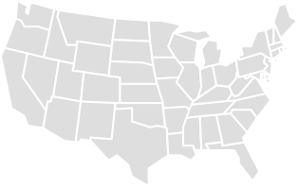


Readiness for online car purchases very high in China, while rather low in Germany – the US falls in between
Willingness to make car purchases online
Consumer – Smart Mobility
Question: “Would you buy your next car online?
41%
37%
36%
32%
31%
27%
22%
18%
15%
19%
The willingness to buy a car online varies significantly across countries.
12%
10%
In China, people are particularly open to completing certain steps or even the entire buying process online.
Low
2023
High
Low
2023
High
Low
2023
High
Willingness Willingness
I would rather do everything at the store
I would configure it online, but sign and test drive it at the store
Yes, I feel comfortable configuring and signing online, but I would prefer to do a test drive at the store Yes, I feel comfortable with doing all steps online
Willingness
In contrast, the majority in Germany feel more comfortable with store processes.”
Digital Auto Report 2023 Strategy&
Source: PwC Strategy& consumer research
17

Slide 18


Even as immediate COVID-19 risks decline, using one’s own
car remains popular; increasing use of shared modes in China
Consumer – Smart Mobility
Mobility pattern after COVID-19 restrictions (%)
Question: “COVID-19 has temporarily changed our mobility behavior in many aspects. How do you plan to use modes […] of transport once we have left the pandemic behind us?”
Own bike
2021
2023
2021
By foot
2023
2021
Own car
2023
Using one’s own car is still seen as the most convenient means of transportation – with highest increase in demand in Germany and the US.
Public transport
2021
2023
Shared micro-mobility
2021
2023
In China, consumers plan to use
shared modes more.
Car-sharing
2021
2023
Across all regions, the number of people planning to use public transport more has increased.”
Ride-hailing
2021
2023
More
Same
Less/not at all
Digital Auto Report 2023 Strategy&
Source: PwC Strategy& consumer research
18

Slide 19

Price and availability are by far the top drivers for encouraging consumers to use sustainable transport
Factors encouraging sustainable transportation modes
Consumer – Smart Mobility
Question: “What would encourage you to use sustainable transportation (e.g. bike sharing, car sharing, public transportation) more frequently?”
59%
54%
60%
60%
40%
40%
45%
36%
In Germany, there has been a sharp increase in the number of consumers who say that better availability is an important factor in persuading them to use sustainable transport.
25%
28%
29%
24% _{23%}
10%
13%
2021
2023 2021
Incentives by the employer (e.g. job bike, car sharing benefit package, ...)
User-friendly access
(e.g. cashless payment via app, ...)
2023
2021
2023
US respondents focus strongly on cheaper prices, whereas user-friendly access is most likely to encourage respondents to use sustainable transport in China.”
Cheaper price
Family offers
(e.g. 4 bikes for the price of 2, ...)
Better availability
(e.g. more bikes)
Digital Auto Report 2023 Strategy&
Source: PwC Strategy& consumer research
19

Slide 20
Every country has different priorities to reduce CO2: In GER more walking, in the US switch to BEV, in CN public transport
Consumer – Smart Mobility
Top-3 contributions to CO₂ reduction
Use public transport more frequently
Question: “What major personal changes would you like to do to contribute to a reduction in CO₂ emissions?”
Short distances more often on foot / by bicycle
Short distances more often on foot / by bicycle
54%
Completely cut out short-haul flights
25%
51%
Switch to an electric car
49%
43%
29%
Use public transport more frequently
_{37%} Short distances more often on foot / by bicycle
48%
24%
Use public transport more frequently
Switch to an electric car
High willingness to contribute to CO₂ reduction, especially in China (98%) – strong increase in the US (79% vs. 52% last year)
Do nothing
21%
2%
25%
Main contributions will be completing short-distance journeys more often on foot / by bicycle, switching to an
electric car, or using public
transport more frequently.”
79%
75%
Change behavior
98%
Digital Auto Report 2023 Strategy&
Source: PwC Strategy& consumer research
20

Slide 21

Contents
Consumer preferences – connected, electric, automated and smart
Implications for auto players – interface, subscription and charging
Digital Auto Report 2023
Strategy& 21

Slide 22

Getting the user interface right
Digital Auto Report 2023
Strategy& 22

Slide 23
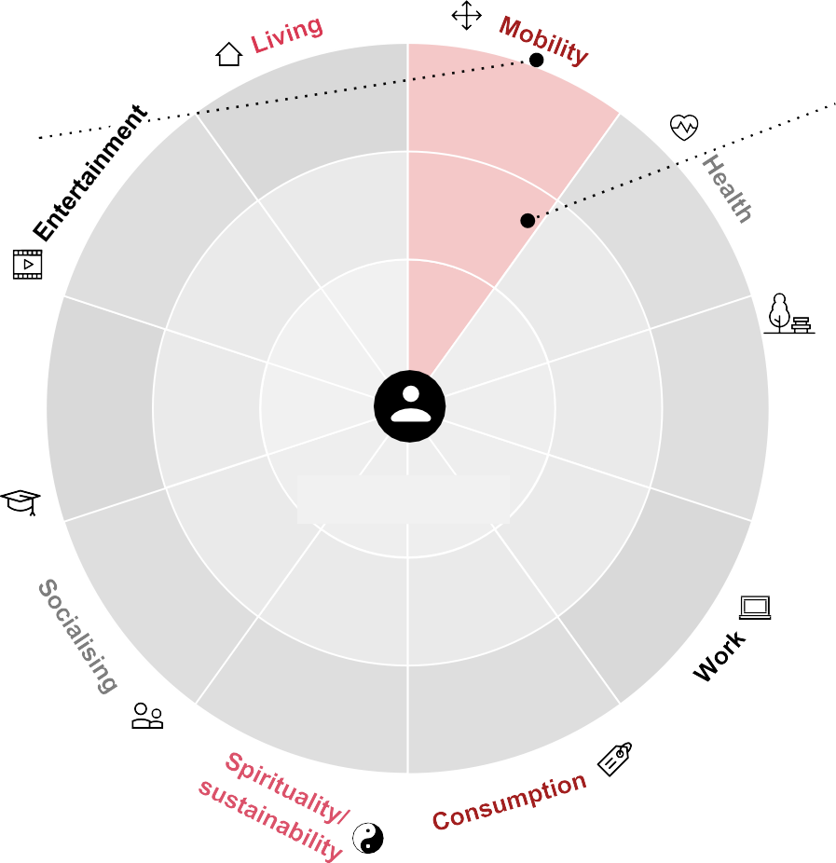

The relevant market for automotive players is expanding beyond the car itself – maintaining user access is crucial
Redefining business models to meet human-centric mobility needs
Mobility demand Mobility solutions
Human needs in mobility Life Areas
determine customer requirements
Successful mobility ecosystem players are clear on four key topics:
E.g.
Supplier
Mobility demand is influenced by long-term economic, political and social trends as well as generational changes
The individual user is located at the center of the ecosystem approach (business to human)
Consumer needs can be grouped
into ten distinct Life Areas
Within these Life Areas, ecosystems emerge in the form of business-to-business and business-to-consumer relationships around specific customer needs
E.g.
OEM
Experience differentiators
E.g.
Aggregator
E.g. luxury, convenience, …
Recreation
Digital portfolio scope
Orchestrator
E.g. life area coverage, niche positioning, …
Value levers
Realiser
E.g. top-line, bottom-line optimization, …
Enabler
Value chain integration
E.g. vertical/horizontal integration, partnering, …
Digital Auto Report 2023 Strategy&
Source: Strategy&, PwC Ecosystemizer
23

Slide 24



Getting the digital interface right means creating a differentiated experience for diverse customer needs
Experience differentiators – Examples
Digital opulence
Rolls Royce cements the credentials of its bold new brand identity for its website with mood videos similar to perfume ads
Efficient interactions
Mercedes me app lets users manage their vehicles on the go, from scheduling service, to making payments, to getting assistance at the push of a button
Bespoke services
Bentley allows their buyers to customize every part of the car, including paint, finishes, materials and even light-projected logos
At your fingertips
FINN manages to provide customers with their
vehicle of choice around seven days after booking
7
Proactive offerings
BMW 7 Series actively welcomes riders into the car by extending a carpet made of light
Differentiated experience:
Luxury
Differentiated experience: Convenience
Hassle-free service
Genesis picks up and returns the car for aftersales services at a place of choice, managed through a personal assistant
Crafted touchpoint
NIO broadens their services with the EP House, a space where owners can come together and celebrate the brand
Seamlessly integrated offerings Uber integrates multi-modal mobility options with related services such as food delivery, health or transit on one platform
Trading scarcity
Lamborghini has created only 5 digital NFT’s based on physical keys made from carbon fiber from the international space station
Full flexibility
Sixt offers various vehicle ownership models (renting, subscription, sharing) with flexible run times and payment schemes in one app
Digital Auto Report 2023 Strategy&
Source: Strategy& analysis
24

Slide 25
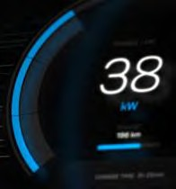



A value-creating digital service portfolio requires automotive players to balance multiple trade-offs
Digital portfolio scope – Examples
Mobility
Entertainment
Work
Health
Portfolio Trade-offs
Vehicle
Function
-as-a-Service
Access
– Tesla virtual bluetooth keys
Sound
– BMW e-engine sound pack
Differentiation vs.
revenue potential
Light
BMW high beam assist
Camera
Tesla sentry mode
Intelligent car assistant
– Alibaba, Volvo/Daimler
AI Avatar
– Fetch.ai autonomous agents
Autonomous driving
– Tesla autopilot upgrade
Reach vs.
profitability
Gaming
– Tesla arcade, Racing
Crypto Car Wallet
Passenger safety
Consumer
onboard
services
Advanced navigation
– MB live traffic
– Various pilots
– NIO fatigue warning
Entertainment
– Tesla caraoke
Mood-based lightening
– Mercedes-Benz ambient
Music streaming
– BMW Spotify, NIO Radio
Meditation
In-car AR gaming
– Audi/holoride partnership
– Porsche Feel-Good-Coach
Synergy focus
vs. risk hedging
Consumer offboard services
Parking search and pay
– VW we park
In-car Office
– Mercedes me connect
NFT Collections
– Roll Royce Phantom
Emergency assistant
– GM OnStar guardian
P2P car/ride sharing
– Sono motors app
Web3 Loyalty Program
– BMW/Coinweb
Plug and charge
– VW/Ionity
Smart Office Connection
– BMW IFTTT
Automated park and charge
Touchpoint control
vs. open partners
B2B/data services
– Bosch Autom. Valet Parking
Predictive maintenance
– BOSCH, Carmen
Fleet mgmt./diagnostics – Daimler connect business | Roadside assistant support – Urgently/Otonomo
Driver’s log/GPS tracking – Daimler connect business | Safer traffic planning – Mercedes Data/London
Last Mile Logistics – NIO delivery in trunk
Car data based insurance
– BMW CarData
Digital first vs. BEV/
AD availability
Car data marketplace
– Caruso, Otonomo, High M.
Digital Auto Report 2023 Strategy&
Source: Strategy& analysis
25

Slide 26






Along the value chain and vehicle life cycle, digital services unlock value beyond direct user monetization
Value levers of digital services – Examples
Implications
Services monetization
Connected services activation fees and/or recurring revenues related to monthly subscriptions | 60-70% are willing to pay 180$/year for connectivity service set
Upselling effect during the ownership cycle by unlocking personalization features or activating built-in hardware | 35-50% are interested in post-purchase activations
Higher satisfaction with on-board experience and creation of ‘stickiness’ through subscription services | 45-55% are more loyal to brands to which they have a subscription
Higher revenues for dealers from original parts sale and workshops traffic triggered by predictive maintenance | 30-40% switch to paid subscription after free trial
Direct revenues from granting third parties access to own platform or monetizing (anonymized) data/insights | 50-60% of companies indicate that they do sell data to third parties
Leverage of real time data on customer preferences/behaviors for timely adjustment of vehicle specifications and features | 30-40% additional revenue potential based on customer insights
Reduction of the number of model-specific variants by activating on-demand vehicle features | 20-30% cost reduction potential through variant reduction
Optimized inventory management through advanced planning of upcoming repairs enabled by predictive maintenance | 20-30% inventory decrease due to demand forecasting
Prevention of recall campaigns by leveraging OTA updates to fix potential technical issues within the circulating fleet | 30-40% of incidents can partly/fully be prevented by OTA
Ecosystem business cases should extend beyond vehicle-centric business cases
Post-purchase activations
Top-line: Direct revenue and customer lifetime value
Brand loyalty
Direct and indirect revenue potential, and opportunities beyond vehicle offerings, should be considered along the customer life cycle
After-sales Loyalty
Platform access/ data sales
B2B offerings offer significant direct monetization potential
R&D optimization
Variant management
In addition to external opportunities, a significant amount of internal opportunities exist, e.g. to increase efficiency in processes & portfolio
Bottom-line: OpEx/CapEx Optimization
Parts inventory management
Recall campaigns
Digital Auto Report 2023 Strategy&
Source: Strategy& analysis + expert discussion
26

Slide 27
OEMs are forced to partner with technology players to deliver compelling digital services – risking a loss of control
Value chain integration – Range of partnership options
OEM
Control
Tech player involvement
V Next ?
I
II
III
IV
No tech player involvement
Operating system and all applications are developed by the OEM
Operating system supply
Standardized tech stack is provided by supplier,
e.g. Android Automotive OS
Content mirroring
Apple/Google content is displayed by using apps within the vehicle, e.g. Android Auto
Tech player content using vehicle data
Usage of car data to enrich 3rd party in-vehicle apps, e.g. for usage based insurance or location based commerce
External development of the digital experience
Entire automotive software is developed by tech supplier
Full control for OEM, no standardization, slower development, reduced offering compared to market leaders
Faster development, easier integration of external applications (e.g. Spotify), standardized setting cannot be adjusted by OEM
Common mobile apps (e.g. Google Maps) are immediately available in-vehicle; less use of OEM native apps / content
Compelling user experience on par with mobile app UX, but OEM apps loose advantage of specific driver / vehicle insights
Data governance between involved stakeholders crucial to avoid downgrading of OEM to pure hardware provisioning
A winning digital experience requires customer proximity, tech capabilities and effective data governance
Digital Auto Report 2023 Strategy&
Source: Strategy& analysis
27

Slide 28

Rethinking vehicle sales
Digital Auto Report 2023
Strategy& 28

Slide 29




Subscription fills the gap between leasing and rental offerings
– resulting overall in four major vehicle ownership archetypes
Vehicle ownership archetypes
Leasing Subscription Rental Sharing
Relative price per month
Low, due to fewer services and longer duration
High, due to high convenience
High, due to high amount of included mileage
Highest, due to highest convenience and most services included
Exact model selection/some configuration
✔
~
🗶
✔
Up-front down payment
✔
🗶
Risk-dependent fee (driver history)
✔
🗶
~
Insurance, tax and registration
Scheduled service, repairs/wear and tear
🗶 |  | ✔
🗶 |  | ✔
~ |  | ✔ |  | ~
🗶 |  | ~ |  |  |  | ✔
🗶 |  | ~ |  | ✔
🗶 |  | ✔ |  | ~ |  | ✔
🗶 |  | ✔
🗶 |  | ✔
Included
services
Additional driver allowed
Flexible cancellation
Switching models Delivery and collection Residual value coverage
Fully digitized customer journey
Duration (average figures for Germany)
2
years
trend
Ø
1)
5-9 1
years²⁾ month
Ø
1)
2-6
years
1
day
Ø
7 days¹⁾
1
year
10
min.
trend
Ø
30 min¹⁾
1
week
3 years
1 year
✔/ ~ / 🗶 = Usually included / Depends on provider / Usually not included
Digital Auto Report 2023 Strategy&
1) Based Strategy& analysis; 2) Depending on specific regulatory environment allowing “prolonged lease”
Source: Strategy& analysis
29

Slide 30

















As alternative ownership models such as subscription emerge, OEMs need to sharpen their vehicle lifecycle mgmt. skills
Subscription customer and asset journey – Example
1. New car leasing
2. Subscription
3. New subscription
4. Used car leasing
5. Car sharing and rental
Customer signs contract
Subscription model suggested to customer
Family plans: subscription renewal with
Due to increased price consciousness, customer decides to lease a used car
Move into city: end of lease and switch to sporadic sharing and rental cars
to lease new car
Customer journey
bigger car
Car rental
Customer occasionally uses car sharing
during vacation
Car handover
After the lease, the car is returned
Residual value optimal: customer offered to trade cars
For their vacation, the customer temporarily adds a second driver
Customer
increases
the annual
km
1. Lifecycle: New car leasing
2. Lifecycle: Used car leasing (different customer(s))
3. Lifecycle: Car sharing (different customers)
Scheduled maintenance
Repairs following accident
Interior refurbish
Vehicle journey
Scheduled
maintenance
Scheduled
maintenance
Scheduled
maintenance
Maintenance
and minor fixes
After the lease, the car is returned
Refurbish battery and ADAS in preparation for next lifecycle
New car is in-fleeted
Car enters used leasing contract with a new customer
In the last lifecycle,
At the end of its
the car moves into the sharing fleet
useful life, the car is
recycled or sold B2B
Year 0
1
2
3
4
5
6
7
8
9
Digital Auto Report 2023 Strategy&
Source: Strategy& analysis
30

Slide 31

















Holistic vehicle lifecycle management aims to increase revenue and utilization, especially during 2nd and 3rd phase
Subscription “3x3” asset lifecycle
Asset potential
1st Lifecycle phase (years 1-3)
2nd Lifecycle phase (years 4-6)
3rd Lifecycle phase (years 7-9)
Residual value
Depending on vehicle utilization in respective ownership model
Maintenance and refurbishment¹⁾
Regular maintenance costs
Sporadic refurbishment costs
Potential repair costs
Revenue and utilization potential
In accordance with residual value
Additional revenue from e.g., contract extras or repair charges
Contract add-on
Recycle
Suitable ownership models
✔
✔
✔
✔
✔
✔
🗶
✔
✔
2)
Sequence of ownership models as well as external market conditions have influence on most suitable selection for each lifecycle phase
For certain ownership models, assets that are viewed as too old may not be favored
The younger the asset, the shorter the duration - especially if utilization is high
Leasing
Subscription
(✔) ³⁾
🗶
Rental
Car sharing
✔
Repurpose vehicle Refurbish vehicle Maintain/repair vehicle Add contract extras Recycle components
Digital Auto Report 2023 Strategy&
Annual OEM-prescribed maintenance/service intervals and use-based repairs – sporadic refurbishment;
Depending on specific regulatory environment allowing “prolonged lease”; 3) As low-budget option
Source: Strategy& analysis
31

Slide 32



Alternative ownership models are on the rise and offer profit potential for OEMs – if the asset life cycle is managed well
Vehicle ownership model split and profitability – Indicative
Ownership model split 2023 [m units] Profitability of ownership models²⁾
Region Europe, 40 countries
1.4
0.2 13.4
Traditional car ownership
Alternative ownership
0.3
10%
1%
100%
6.0
Subscription
has potential to grow to 2-4m units
by 2035 in Europe¹⁾
Ownership models
45%
2%
Purchase
Leasing
Subscription
Rental
Sharing
LCP 1
year 1-3
7%
-115%
-91%
10-15%
<5%
LCP 2
year 4-6
9%
83%
78%
–
<5%
5.6
LCP 3
year 7-9
11%
76%
71%
–
<5%
42%
Leasing
has potential to grow
to 7-8m units
by 2035 in Europe¹⁾
Total
5-7%
10-15%
10-15%
10-15%
<5%
Overall profitability potential higher for leasing, subscription and rental
than for purchase
Purchase
Leasing
Subscription
Rental
Sharing
Profitability across LCPs varies – from relatively constant to a sharp
increase. With rental, there is only one LCP.
It is not individual consideration but a merged portfolio view that is crucial for OEMs
Digital Auto Report 2023 Strategy&
Estimate of share development for ownership model depends on shares of competing models; LCP: Life cycle phase;
Profitability estimate based on individual consideration of ownership model for average middle class passenger EV (price 53.5k EUR)
Source: Strategy& analysis
32

Slide 33




More flexible ownership models offer benefits and risks for OEMs and customers – a win-win solution is required
Vehicle subscription benefit and risk perspective
Key takeaways
Alternative ownership models need to create a win-win situation for customers and OEMs
Currently, they mostly play into the strategic agenda of OEMs
Strong customer centricity and efficient asset management of used cars are needed to reach profitability
Customer
Flexibility of car ownership in case of changing life circumstance
Residual value and admin process (insurance, maintenance, etc.) peace of mind
Opaque pricing and difficulty of comparing offerings
Perception of ownership is absent
OEM
Keeping track of battery lifecycle/recycling requirements according to regulations
Product piloting and learning from data insights into longer-term car usage
Customers willingness to pay and price
pressure for alt. ownership offering
Residual value risk at end of lifetime and need for strong operational excellence
OEMs may leverage their existing retail network and preferential vehicle acquisition conditions to differentiate themselves from start-up competitors
Digital Auto Report 2023 Strategy&
Source: Strategy& analysis
33

Slide 34
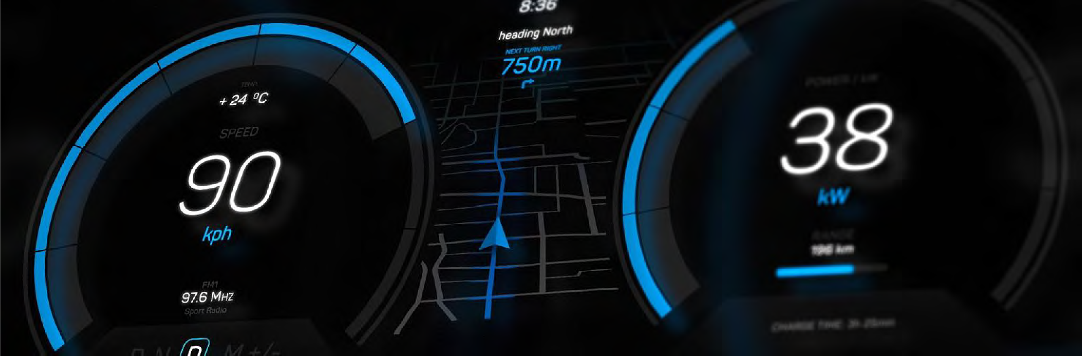
Going beyond the vehicle
Digital Auto Report 2023
Strategy& 34

Slide 35
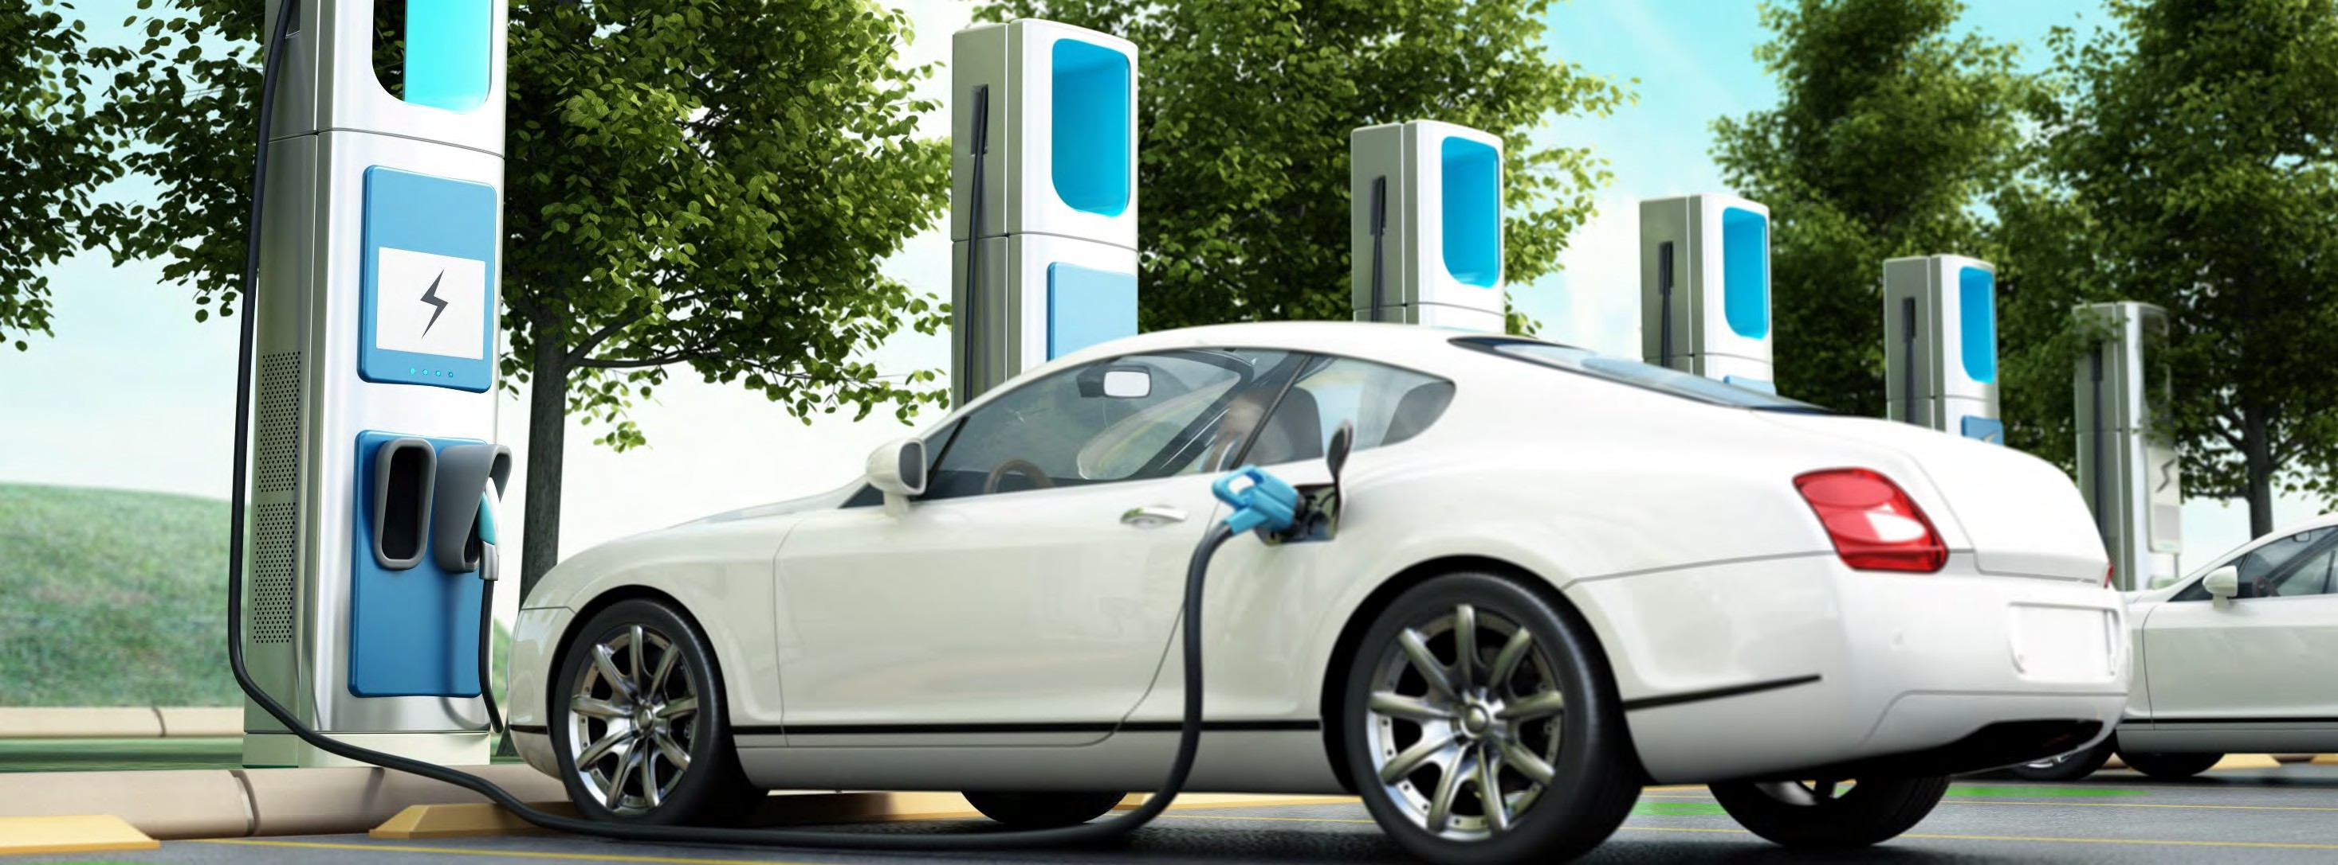


Rise of e-mobility provides ample opportunities to capture value beyond the vehicle – e.g. with batteries and charging
Value pools beyond the vehicle – Focus e-mobility
Battery production
Battery value chain
Battery in car assembly
Last mile services
Location-based commerce
Charging value chain
Car/battery usage
Energy provisioning
Site and asset ownership
Charging equipment manufacturing
Installation and maintenance
Charge point operation
Bi-directional Charging
Energy system integration
eMSP
1)
Onboard entertainment
Battery
exchange
Fleet mgmt. services
Battery second life
Adjacent ecosystem services
Battery recycling
Digital Auto Report 2023 Strategy&
Source: Strategy& analysis
35

Slide 36



Infrastructure and vehicle penetration are key requirements for successful realization of bi-directional charging use cases
Bi-directional charging – Market simulation Germany
Bi-directional sockets by 2030 Bi-directional charging-capable vehicle fleet (#)
Bi-directional charging capable vehicle fleet in Germany (as share of total EV fleet)
1.8m
0.7m
Private
2.5m
Home and apartment buildings
Office
_{58%} 61% 62% 63%
_{48%} 54%
0.16m
0.03m
_{36%} 42%
22%
15%
29%
Public
0.19m
11%
6%
Parking
Charging hubs
2023
2024
2025
2026
2027
2028
2029
2030
2031
2032
2033
2034
2035
Total 2030: 2.7 million bi-directional sockets
Total 2030: ~5 million bi-directional vehicles
Digital Auto Report 2023 Strategy&
Source: PwC Strategy& Study (2022): “Der E-Mobility-Check: Wie bereit ist Deutschland?”; Strategy& analysis
36

Slide 37

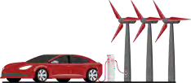



Front-of-meter prosumer use cases depend on a multitude of external factors that limit mainstream adoption in short term
Prosumer charging business model comparison – Germany
Behind the meter Front of meter
Application Area | V2L V2H/B | V2G / VGI
Use Cases | Self-supply optimization Consumption optimization | Load shifting Power market trading
Enabler Revenues | Potential for software enablers: €160-220m¹⁾ in 2030 | Potential for software enablers: €470-550m²⁾ in 2030
Customer
Demand
Short-term: Growing EV user demand to use vehicle e.g. as additional storage for home PV or emergency power bank (in the US)
Mid-term: EV user demand driven by incentive to earn/save money, but depending on available solutions & attractive pricing
Enablers & Limitations
Energy Tech
Need for penetration of bi-directional capable vehicles and infrastructure (i.e. EV charger) to reach “critical mass”
Need for development of standard protocols (interconnection, communication, vehicle and charging station safety & functionality)
Regulation
Fully supportive behind-the-meter regulation expected by 2024 due to limited complexity of “closed” micro-ecosystem
Fully supportive regulation not expected before 2028 at EU level due to high stakeholder complexity (smart meter as reference)
Economics
Tech cost reduction (vehicle / infrastructure) required for scale up
Availability of comprehensive ancillary services as important enabler
Need for flexible V2G tariffs: Time-of-Use or Time-of-Day pricing
Minimum number of kwh must be available at a certain point in time for utility providers to rely upon when managing the grid
While front of meter still requires more regulatory alignment at European level, behind the meter already has a high market readiness in the short term
Digital Auto Report 2023 Strategy&
V2L: Vehicle-to-load (e.g. e-bike, another EV, etc.) V2H/B: Vehicle-to-home / building V2G/VGI: Vehicle-to-grid / vehicle-grid-integration PV: Photovoltaic
1) Includes software for grid optimization of households (V2H) and public charge point operators only; 2) Includes software for power market trading for households and public charge point operators only
Source: Strategy& analysis
37

Slide 38









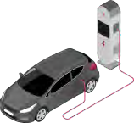

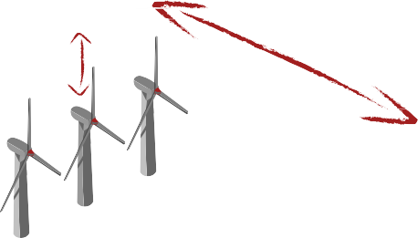
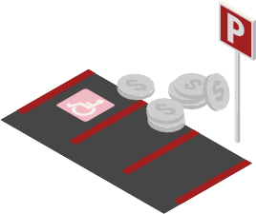
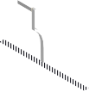





Realization and scale-up of prosumer use cases require efficient charging and battery stakeholder coordination
Charging & battery ecosystem stakeholder activation
Main scale-up challenges
V2H
Stakeholder fear of losing control points to a central, dominant player (e.g. OEMs see USP in unique charging experience)
Relatively high transactions costs for clearing and billing (given comparatively low value of single transactions)
Different interests and priorities across parties (e.g. CPOs want to maximize utilization, whereas OEMs want to maximize charging availability)
Can a decentralized coordination approach help to solve these challenges?
Services
White label Software
End user
Connect to charger
Service provider
Software supplier
Charging data
Services
Charging data
Charging data
EV/Battery
Charge and discharge
Data exchange
Charging
data
CPO
Bi-directional energy provision
Charging data
Integration
EV data
Utility sector
Parking provider
Vehicle manufacturer
Battery manufacturer
Digital Auto Report 2023 Strategy&
Charging stakeholders
Source: Strategy& analysis
Enabling ecosystem partners
38

Slide 39
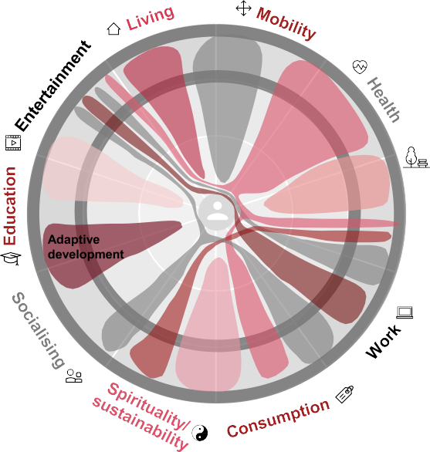


Implication for automotive players: Holistic ecosystem approach beyond core business is key to future success
Ecosystems…
Smart environ-ment
Green and seamless mobility
On the one hand…
Holistic wellbeing
On the other hand…
Ecosystems can create lock-in effects based on differentiated offerings
Customer lifetime value can be increased through holistic journey coverage
Faster growth and higher earning potential can be achieved when compared with traditional approaches to value creation
Personalized pleasure
Rest and relaxation
Building & managing ecosystems is
complex
Theoretically, unlimited number of potential offerings complicates the selection process
Product-centric view carries risk of missing market/customer needs (particularly for more advanced topics)
Recreation
New Work
Personal wealth and legal
Customized and fast demand fulfillment
Relation-
_{ships} Believe and
mindfulness
Success factors
✔ Be clear about own ecosystem role – whether orchestrator, realizer or enabler
✔ Build offering portfolio and allocate resources accordingly
✔ Maintain a holistic and iterative approach in the selection of suitable offerings
✔ Actively manage the portfolio and prioritize clearly according to a coherent, consistent and multi-layered ecosystem logic
Digital Auto Report 2023 Strategy&
Source: Strategy&, PwC Ecosystemizer
39

Slide 40










Network contacts
Jörg Krings
joerg.krings@
strategyand.de.pwc.com
Automotive Europe
Dr. Andreas Gissler
andreas.gissler@
strategyand.de.pwc.com
Digital Transformation
Jonas Seyfferth
jonas.seyfferth@
strategyand.de.pwc.com
Connected and Smart Mobility
Hartmut Güthner
hartmut.guethner@
strategyand.de.pwc.com
Automated Driving
Dr. Jörn Neuhausen
joern.neuhausen@
strategyand.de.pwc.com
Alternative Powertrains
Thilo Bühnen
thilo.buehnen@
pwc.ch
Mobility Venturing
Contributors
Steven van Arsdale Sebastian Hauk Carl Heselschwerdt Tobias Karl
Tobias Killmeier Tobias Seemann Patrick Schwenke Malien Zehnpfenning
Akshay Singh
akshay.singh@ pwc.com
Automotive US
Steven Jiang
steven.jiang@ strategyand.cn.pwc.com
Automotive China
Kentaro Abe
kentaro.abe@ pwc.com
Automotive Japan
Milos Bartosek
milos.bartosek@ pwc.com
Infrastructure Deals
© 2023 PwC. All rights reserved. PwC refers to the PwC network and/or one or more of its member firms, each of which is a separate legal entity. Please see www.pwc.com/structure for further details. Mentions of Strategy& refer to the global team of practical strategists that is integrated within the PwC network of firms. For more about Strategy&, see www.strategyand.pwc.com. No reproduction is permitted in whole or part without written permission of PwC. Disclaimer: This content is for general purposes only, and should not be used as a substitute for consultation with professional advisors.
Digital Auto Report 2023
Strategy& 40

