Slide 1



Nigeria (Bi-monthly) Economic Outlook
Impact of global economic trends on Nigeria's foreign exchange and the way forward
October 2023
PwC

Slide 2


Content
1
Macroeconomic Context
2
Economic Outlook
3
Impact of Global Economic Trends on Nigeria FX Market and Way Forward
4
PwC Economics Services
Internal PwC

Slide 3




Macroeconomic dashboard
GDP Growth Rate
Exchange Rate- Official ₦
$
Exchange rate- Parallel
₦ $
Monetary Policy Rate
2.5%
Period Q-o-Q%
Q2 8.7%
₦769.3/$
Period M-o-M% Previous*
Sept 29 -0.35% ₦772/$
₦1,008/$
18.75%
Previous
2.3%
Period
Sept 29
M-o-M% Previous*
9.5% ₦920/$
Period
July
M-o-M%
1.4%
Previous*
18.5%
Oil Production
FX Reserves
Market Capitalisation
₦
$
Inflation
1.4mbpd
$33.2bn
Period M-o-M%
Sept 29 -1.5%
₦36.3tn
Period M-o-M%
Sept 29 2.2%
25.8%
Period
Aug
M-o-M%
7.7%
Previous 1.3mbpd
Previous*
$33.7bn
Previous
₦36.4tn
Period
Aug
M-o-M%
7.1%
Previous
24.1%
Source: NBS, CBN, FMDQ, NGX, Aboki FX, PwCAnalysis
NB: The cut off date is as of September 29, 2023

Slide 4

Setting the context (1/2)
Macro dynamics
The marginal growth in GDP by 2.5% in Q2 2023 from 2.3% in Q1 2023 was caused by the lingering effect of the cash crunch. PwC projects 2.8% growth rate for Nigeria in 2023 and 3% in 2024. This marginal growth projection may be due to the emerging effects of the implementation domestic fiscal reforms by the ministerial and economic management team of the country
The fastest growing sectors were utilities (31.8%), financial services (26.8%), information & communication ( 8.6%), and construction (3.4%). The growth in the activities of the utility sector may be partly attributed to the increase in the number of metered customers by 3.1% to 5.47 million people while increase in interest income, digital transactions and forex revaluation gains may be responsible for the growth in financial services
Inflation rose to 25.8% in August from 24.1% in July fueled by both food (29.3%) and transportation inflation rates (27.1%). We expect that the full effect of the PMS subsidy removal will continue to be a key driver of inflation in the short to medium term
FTSE Russell downgrade of Nigeria from frontline to unclassified market due to low FX liquidity, triggered sell-offs which drove the decline in the All Share Index (ASI) by 1.2% or $1.4 billion (N463.7billion) in market capitalisation on September 13th. Further downgrades may continue to weigh negatively on investor sentiment
To reduce food inflation, wheat import bill and enhance improve food security, the Federal Government secured $163m AfDB loan for domestic wheat production
Prices and markets
development
Real income still under pressure as inflation (25.8% as of August 2023) continues to rise and national minimum wage remains unchanged in the short-term. In addition, input costs (including the Y-o-Y increase of 216% in PMS from January to September) will continue to pass through to consumer prices further worsening the affordability of goods and services in the economy in the short to medium term
Provisional increase in wages of N35,000 to all Federal workers for a period of 6 months. The temporary increase is aimed at alleviating the impact of subsidy removal in the short-term
Consumer and demand
Regulatory and policy development (1)
Meter prices reviewed upwards by the National Electricity Regulatory Commission (NERC). The price of single-phase and three-phase meters were raised by 39.7% and 31.1% respectively. The increase is aimed at ensuring balance between reasonable cost recovery for Meter Asset Providers (MAPs) and affordable pricing for consumers, ensuring sustainable meter provision
Implementation of the Finance Act 2023 from September 1st, 2023. The Act introduces key reforms for expansion of the tax base:
VAT withholding and collection: VAT must be remitted by appointed persons to the FIRS no later than the 14th of the month following collection (e.g., VAT collected in August 2023 should be remitted by September 14, 2023)
Revised building definition: Certain structures like masts, transmission lines, caravans, and trailers are no longer exempt and are now subject to VAT
starting from September 1, 2023
Source: NBS, CBN, PwC Analysis

Slide 5

Setting the context (2/2)
Regulatory and policy development (2)
Increased Tertiary Education Tax (TET) rate: The TET rate has been raised from 2.5% to 3% of a company's assessable profits for accounting
periods ending on or after September 1, 2023
Repealed tax benefits: The Companies Income Tax Act (CITA) no longer provides benefits for investment allowances, rural investment allowances, and tax exemptions on income earned in convertible currencies by hotels from September 1, 2023 onwards
Imposition of a 0.5% levy on goods imported into Nigeria from outside Africa
₦
Fiscal dynamics
Public debt rose by 4.6% Q-o-Q to $113bn in Q2 2023 from $108bn in Q1 2023. The rise in public debt is attributed to the securitisation of ways
and means (N22.7tn), a 67% depreciation of the naira which resulted in the increase of total debt by $5bn (see Page 6)
Manufacturing, finance & insurance activities and information and communication accounted for 45% of total collection of CIT & VAT. It implies that revenue collection is not well diversified across the 21 sectors of the economy. This may have implications for reaching the targeted tax to GDP of 18% by 2026 and government revenue generation capacity in the short to medium term
₦
Monetary dynamics
Foreign suppliers may not accept letters of credit amid unsettled $7 billion FX obligations to domestic lenders. This may lead to less imports of the much-needed inputs and goods for manufacturing and retail/wholesale trade which may heighten inflationary pressures and negatively impact GDP growth
CBN Introduced new directives:
Directives to banks to cease from utilising their FX revaluation gains for dividends and operational expenditures. This is to enable banks to set aside FX revaluation gains for counter-cyclical buffers to mitigate potential unfavourable fluctuations in FX rates
Directives to all International Money Transfer Operators (IMTOs) operating within the country to strictly follow the allowable limit of -2.5% to
+2.5% foreign exchange guideline. This enables the IMTOs to sell forex above the 2.5% of the preceding day’s NAFEX rates. However, there are still compliance concerns on the ability of the CBN to enforce the directive. Enforcing this directive may help narrow the gap between the official exchange rate and the parallel exchange rate, therefore fostering stability within the foreign exchange (FX) market (see Page 27 for recommendations on closing the gap)
CBN introduces new policies:
The reintroduction of Bureau De Change to increase the supply of foreign exchange, reduce the divergence between the forex markets and strengthen the Naira in the medium to long-term. This raises concerns over the absence of long-term planning by the monetary policy authority.
The launch of a Foreign Exchange (FX) Price Verification System (PVS) to enable importers gain access to forex. This may help regularise and
standardise the prices of goods and services that people wish to import, potentially reducing the demand for the dollar within the economy
Source: NBS, CBN, NGX, Proshare, PwCAnalysis

Slide 6
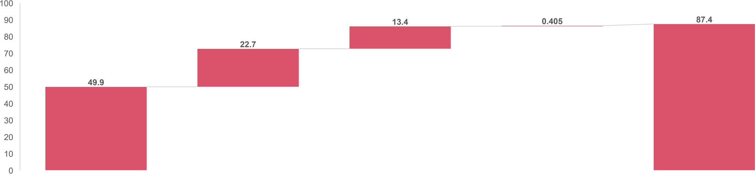
The rise in Nigeria’s public debt to N87.4trillion in Q2 2023 could be attributed to the impact of securitisation of ways & means, and the naira devaluation
The Dynamics of Nigeria’s Public Debt (N’trillion)
Q1 total debt
Impact of securitised ways and means
*Impact of devaluation
*Others
Q2 total debt
*External debt as of Q2 2023 was $43.2billion at an exchange rate of N770.38/$ while the exchange rate as of Q1 2023 was 460.35
*The impact of devaluation was calculated using the difference in official exchange rates in Q1 and Q2 2023 multiplied by the external debt in Q2 2023 to obtain the revaluation gain
*Others are estimated and may include new borrowings
Source: DMO, PwC Analysis
Insights
The securitisation of ways and means, and the impact of the devaluation of the naira accounted for 59.1% and 34.9% respectively of the rise in public debt in Q2 2023.
A sustained rise in public debt may negatively affect the country's credit ratings, subsequently increasing the cost of borrowing

Slide 7
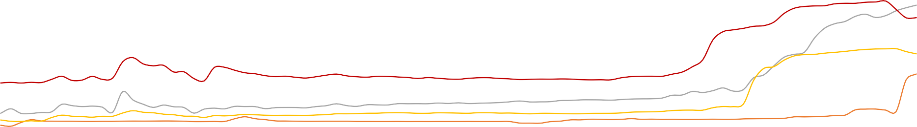
The rise in all energy pressure points may further squeeze consumer’s purchasing power
Energy Pressure Points (Naira)
Brent crude oil price recorded an eight-year high of USD140 per barrel in March 2022, which was exclusively due to the Russia–Ukraine war which disrupted global supply chains
The fuel subsidy removal led to a jump in PMS prices by more than 200%
1400
5000
4500
1200
 |  |  |  |  |  |  |  |  |  |  |  |  |  |  |  |  |  |  |  |  |  |  | 4000
1000 |  |  |  |  |  |  |  |  |  |  |  |  |  |  |  |  |  |  |  |  |  |  | 3500
800 |  |  |  |  |  |  |  |  |  |  |  |  |  |  |  |  |  |  |  |  |  |  | 3000 2500
600 |  |  |  |  |  |  |  |  |  |  |  |  |  |  |  |  |  |  |  |  |  |  | 2000
400 |  |  |  |  |  |  |  |  |  |  |  |  |  |  |  |  |  |  |  |  |  |  | 1500
 |  |  |  |  |  |  |  |  |  |  |  |  |  |  |  |  |  |  |  |  |  |  | 1000
200 |  |  |  |  |  |  |  |  |  |  |  |  |  |  |  |  |  |  |  |  |  |  | 500
0 |  |  |  |  |  |  |  |  |  |  |  |  |  |  |  |  |  |  |  |  |  |  | 0
Kerosene per litre (LHA)
PMS per litre (LHA)
Automotive Gas Oil (Diesel) per litre (LHA)
Liquefied Petroleum Gas (5KG) (RHA)
LHS – Left Hand Side, RHS – Right Hand Side
Source: NBS, PwC Analysis
Insights
All identified energy pressure points which include kerosene, PMS, Automotive Gas Oil, and Liquified Petroleum Gas have been deregulated by the government. This implies that they may likely move in the same direction with the trends in the international oil price.
The rise in energy pressure points due to increases in international oil price will further squeeze consumer’s purchasing power
Although the prices of petroleum products may possibly be moving in the same direction, the price of PMS may not be on par with the other products due to the likelihood of partial subsidy being reintroduced to cushion the effect of a rise in PMS price, in the absence of increase in the minimum wage for the labour force and palliative measures for the poor

Slide 8
Slowdown of GDP growth in Q2 2023 to 2.5% was attributed to continued effect of naira redesign policy
The Dynamics of Nigeria’s GDP Growth Rate
The CBN’s policy on naira redesign and withdrawal limits caused a slowdown in economic activities
The economic recession in 2016 was caused by a decline in oil prices and oil production shocks
Covid-19 disruptions which caused massive breakdown of economic activities caused the economy to contract to its lowest level in over 10 years.
6
4
2
0
-2
-4
-6
-8
Q1 Q2 Q3 Q4 Q1 Q2 Q3 Q4 Q1 Q2 Q3 Q4 Q1 Q2 Q3 Q4 Q1 Q2 Q3 Q4 Q1 Q2 Q3 Q4 Q1 Q2 Q3 Q4 Q1 Q2
2016
2017
2018
2019
2020
2021
2022
2023
Source: NBS, PwC Analysis
Insights
The marginal growth in GDP by 2.5% in Q2 2023 from 2.3% in Q1 2023 was caused by the lingering effect of the cash crunch and the emerging effect of domestic reforms
(subsidy removal and FX liberalisation)
GDP is expected to grow marginally in Q3 2023 due to slowdown of economic activities occasioned by prevailing macroeconomic headwinds. PwC projects 2.8% growth rate for Nigeria in 2023 and 3% in 2024
Transportation (-50.6%) and Mining & quarrying (-12.2%) sectors recorded growth contractions while agriculture (1.5%), real estate (1.9%), and manufacturing (2.2%) recorded slow growth. The negative growth in the mining and quarrying sector is due to business contractions in the oil and gas sector, while the increase in PMS prices accounts for the contraction in the transportation sector

Slide 9

Information & communication sector is the only fast growing dominant sector
Dominant sectors
Fast growing
Slow growing
Key insights
The information and communication sector is the only dominant sector with a fast growth of 8.6%. The growth in the sector may be attributed to the increase in consumption of data services and subscriber number
Financial and insurance sector growth of 26.8% may be attributed to the rise in interest income, digital transactions and forex revaluation gains
The transportation and storage sector in Nigeria experienced a significant contraction primarily due to the Federal Government's removal of the PMS subsidy. This decision resulted in higher PMS prices, prompting many private car owners to opt for public transportation especially those with lower income to reduce their travel. As a result, transportation fares for both local and inter-state journeys have risen, deterring many from commuting and impacting their personal and business activities
Information & communication – 8.6%
Trade – 2.4%
Manufacturing – 2.2%
Agriculture – 1.5%
01
02
03 04
Financial & insurance – 26.8%
Construction – 3.4%
Accommodation & food services – 3.4%
Transportation & storage – (-50.6%)
Mining & quarrying – (-12.1%)
Arts, entertainment & recreation – 2.5%
Professional, scientific & technical
services – 2.9%
Fast growing
Slow and contracting
Small sectors
*Assumptions
Sectors with more than or equal to N1trillion activity are classified as dominant economy while sectors below N1trillion are small sectors
Fast growing sectors are sectors with growth rate more than 3% while slow growth rate are below 3%

Slide 10



Economic context and outlook
Key Assumption Drivers
Likely Impacts
Inflation is expected to rise in the short to medium-term on the basis of increased petroleum prices and a devalued naira on food, transport and non-food prices
Petroleum products expected to rise on the back of the rise in the international oil price. This will impact the food, transport and core inflation
Growth
Continued inflationary growth and rise in the cost of living may lead to marginal real economic growth in the medium term
PwC projects 2.8% growth rate for Nigeria in 2023 and 3% in 2024
Prices and markets development
Investment
Capital reallocation from the Nigeria’s economy may continue to impact foreign investment
flows in the short to medium term
Investors may adopt a wait and see approach due to lack of forward guidance on FX policy
(see Page 21-25)
The unsettled FX backlogs may lead to scarcity of goods and inputs for manufacturing and trade leading to further increase in prices
Consumers are expected to be pressured by higher prices causing demand to slow down
Wage adjustments unlikely to be on par with inflation simultaneously and proportionately
Consumer and
demand
Government Spending
Government spending will rise but continue to be constrained by debt servicing obligations and huge fiscal deficit
Newly installed ministerial cabinet to drive economic
direction and fiscal policy management
Implementation of the Finance Act 2023 from September 1st. The Act introduces key reforms for expansion of the tax base
Brent crude oil price rose to $94/b on September 13, the highest since November 2022. Goldman Sachs predicts that oil prices will reach $107/b by end of 2024
Consumer Demand
₦
Rise in energy, food, transportation and import costs may dampen consumer spending on non-discretionary items
S&P projects 2.8% growth in consumption demand in 2023 and 2.9% in 2024
Fiscal dynamics
Production
High FX rates may drive up cost of goods & services and impact negatively on firm performance
Businesses may likely incur losses due to the impact of increased interest rates, devaluation losses, among other challenges
The reintroduction of BDCs and adoption of the FX Price Verification System to improve accessibility and accountability in the long term. In the short-term we expect that FX will still be in short supply
S&P projects -1.6% in industrial production in 2023 and growth of 6.7% in 2024
Lack of forward guidance on FX policy and unsettled backlog of FX obligations may continue to impact investor sentiment
Reintroduction of BDCs to provide relief from the continued devaluation of the naira in the short to medium term
The appointment of a new CBN governor and management team will shape the direction of the monetary policy
₦
Monetary dynamics
Net Exports
Net exports will continue to be pressured given FX unavailability
Source: S&P, PwC Analysis

Slide 11




Framing the relationships between global trends and Nigeria FX market
Five global trends
FX Market
Local trends
Supply dynamics Net flows
Demand dynamics
Tightening monetary environment to curtail inflation
Fiscal policy + development (fiscal balance, debt)
Cost of funding
Capital reallocation
Trade balance
Remittances
Confidence
Concerns on debt sustainability
Local economy growth/ performance
(exports and Imports, inflation
etc.)
Investors + market confidence
Heightened geopolitical risk
Weakening global trade
Market Mechanisms and Governance: Access, Friction, Transparency, Market Debt and Financial Instruments, Price Discovery
Financial and capital market activities
Slowing GDP growth
Monetary+ FX Market Strategy + Policy
FX Outcomes
Stability + volatility
Price evolution
Flexibility to shocks

Slide 12

Key global trends
Tightening monetary environment to curtail inflation
Monetary policy tightening to curtail inflation led to the US Fed and ECB raising rates 11 and 10 consecutive times respectively. The ECB raised policy interest rate by 25 basis points to 4% in September. On the other hand, the Federal Reserve and BoE held the interest rate steady in September. But the Federal reserve stiffened its hawkish stance by projecting further rate increase by the end of the year
As the fight to bring inflation back to target continues, the IMF expects global interest rates to remain high for quite some time
Concerns on debt sustainability
In 2022, global public debt – comprising general government domestic and external debt – reached a record $92 trillion. Developing countries owe almost 30% of the total, of which roughly 70% is attributable to China, India and Brazil
Economies already susceptible to weaknesses may encounter additional rises in borrowing expenses. Several nations, including Zambia,
Sri Lanka, Ghana, Pakistan, and Tunisia, face mounting challenges in servicing their debts
Elevated levels of global energy and commodity (oil, uranium and grain) supply risks from political tensions in Gabon, Niger and the Russia-Ukraine conflict. These geopolitical challenges is coupled with the coalition of voluntary supply cuts led by Saudi and Russia
Fueled by the pandemic and Russia’s war in Ukraine, the IMF foresees an increasingly fragmented world For instance, FDI is now increasingly driven by geopolitical preference
Heightened geopolitical risk
China's trade performance showed a 8.8% (y/y) decrease in exports and a 7.3% drop in imports in August. While the United State’ recorded a slow growth in import and export (y/y) by 1.7% and 1.6% respectively
Due to supply chain disruptions and national security concerns trade restrictions by countries have increased significantly. These trade policy actions could pose a serious threat to global prosperity
Weakening global trade
Global GDP growth is expected to slow down with economic projections falling short of historical growth
IMF projects that GDP growth in the United States, the EU and the UK is expected to decline to 1.8%, 0.9% and 0.4%
respectively in 2023
Slowing GDP growth

Slide 13
The impact of the global transmission mechanisms on price discovery, liquidity, and friction in forex access in Nigeria
Transmission Mechanism |  | Assessing the transmission mechanism on price discovery, liquidity, and friction in forex access
1 | Cost of funding | Increase in debt concerns which has led to lowering of credit ratings may lead to increase in the cost of international fund. This may increase the demand pressure on forex to meet future FX debt service obligations. This is evident in the decline in capital importation from $24 billion in 2018 to $5.3 billion in 2022
2 | Capital reallocation | The increase in global Central Bank’s policy rate may lead to capital reallocation away from Nigeria financial market to other markets with more attractive yields on investment. This may reduce FX flows to the economy The Nigeria MSCI index recorded a significant decline of 113%, from 23.5% in 2020 to -3.02% in 2022, reflecting capital reallocation to other economies
3 | Trade balance | A marginal trade surplus may lead to an increased pressure on FX threatening liquidity in the forex market. In Q2 2023, Nigeria recorded a positive balance of trade of $2.3 billion. The positive trade balance could be attributed to the growth of total export by 9% (y/y) to $12.5 billion
4 | Remittances | A weak global economic growth may negatively affect remittance flows into the economy. The decline in remittance flows may reduce FX flows to the economy. Though remittances to Nigeria accounted for 38% of the total flows to the region, it increased by only 3.3% to $20.1 billion
5 | Confidence | Lower credit ratings due to Nigeria’s widening fiscal deficit, debt service to revenue ratio may reduce confidence in the Nigeria economy. This may lead to reallocation of funds from the Nigerian economy and reduction in FX flows

Slide 14
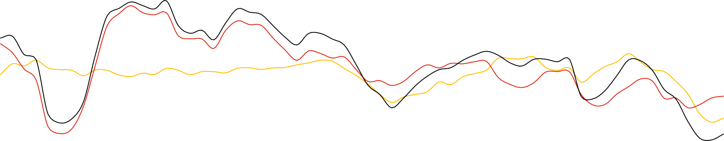
The global financial landscape is more challenging (1/2)
Emerging Market (EM) Net Portfolio Flows (% of GDP, 4 quarter
rolling sum)
8
6
4
2
0
-2
-4
-6
Inflows
Outflows
China Other EM Total
Sources: IMF, 2023 External Sector Report and IMF staff calculations
Insights
Since the U.S. began its tightening cycle 18 months ago, EM dollar bond yields rose by roughly 200 basis points, foreign currency bond issuance fell significantly, and portfolio flows to major EMs sharply declined

Slide 15
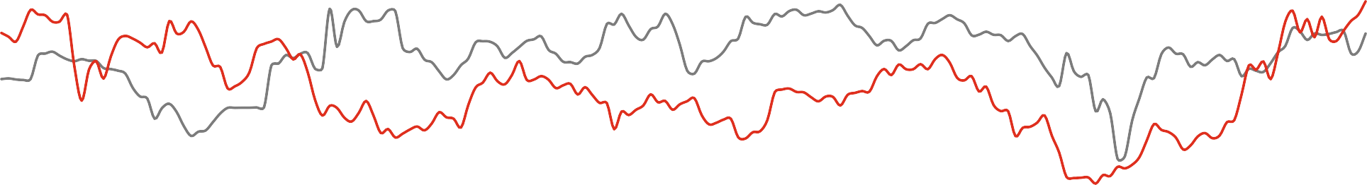
The global financial landscape is more challenging (2/2)
Sovereign Bond Yields
(%, US$ denominated)
20
5.0
4.5
4.0
3.5
3.0
2.5
2.0
1.5
1.0
0.5
0.0
15
10
5
0
January-08
April-08 July-08 October-08 January-09
April-09 July-09 October-09
January-10
April-10 July-10
October-10 January-11
April-11 July-11 October-11 January-12
April-12
July-12 October-12 January-13
April-13 July-13 October-13 January-14
April-14 July-14 October-14 January-15
April-15
July-15 October-15 January-16
April-16
July-16 October-16 January-17
April-17 July-17 October-17 January-18
April-18 July-18 October-18 January-19
April-19 July-19 October-19
January-20
April-20 July-20 October-20 January-21
April-21 July-21 October-21 January-22
April-22 July-22 October-22
January-23
April-23
July-23
Nigeria 10-Year Bond Yield
USA 10-Year Bond Yield
Source: DMO, Investing.com, PwC Analysis
Insights
The nominal yields on 10-year US Treasury bonds have risen above 4%, reaching their highest point since the Global Financial Crisis

Slide 16
Increase in interest rates may lead to reallocation of capital from frontier markets
Federal Funds Rate vs MSCI* Index
The ECB, BOE, and Federal reserve raised rates to curtail the rise in inflation. This led to capital reallocation from frontier and emerging markets to advanced markets
3,500
6
3,000
5
2,500
4
2,000
3
1,500
1,000
2
500
1
0
Q1 Q2 Q3 Q4 2013 | Q1 Q2 Q3 Q4 2014 | Q1 Q2 Q3 Q4 2015 | Q1 Q2 Q3 Q4 2016 | Q1 Q2 Q3 Q4 2017 | Q1 Q2 Q3 Q4 2018 | Q1 Q2 Q3 Q4 2019 | Q1 Q2 Q3 Q4 2020 | Q1 Q2 Q3 Q4 2021 | Q1 Q2 Q3 Q4 2022 | Q1 Q2 2023
0
Frontier Market
Emerging Market
World Market Federal funds rate (%)
Source: NBS, MSCI, PwC Analysis
ECB Interest rate
BOE interest rate (%)
Insights
Following the increase in the fed funds rate to a target range of 5.25%-5.5%, there has been a rise the MSCI index of the developed markets as investors move
capital from the frontier markets to take advantage of higher attractive yields
The Nigeria MSCI index outperformed both the MSCI frontier index (23.52% vs. 1.43%) and the ACWI index (23.52% vs. 16.25%). However, between 2020 and 2022, the Nigeria MSCI index experienced a significant decline of 113% to -3.02% in 2022. This suggests a notable capital flight from Nigeria during that period
Frontier Markets countries include: Bahrain, Bangladesh, Burkina Faso, Benin, Croatia, Estonia, Guinea-Bissau, Iceland, Ivory Coast, Jordan, Kenya, Lithuania, Kazakhstan, Mauritius, Mali, Morocco, Niger, Nigeria, Oman, Pakistan, Romania, Serbia, Senegal, Slovenia, Sri Lanka, Togo, Tunisia and Vietnam.
MSCI is an acronym for Morgan Stanley Capital International*

Slide 17
Rising debt service to revenue ratio has led to the reallocation of capital away from the economy
Nigeria’s Debt Dynamics vs Capital Importation
120
100
80
60
40
20
0
2012
2013
2014 2015
Capital importation ($'billion)
2016 2017
Debt service as a (%) of revenue
2018
2019 2020
Fiscal deficit as a percentage of GDP (%)
2021
2022
Source: NBS, World Bank, PwC Analysis
Insights
Nigeria debt service to revenue ratio increased to 96% in 2022 raising concerns about its widening fiscal deficit, high debt servicing to revenue and rising debt to GDP ratios. This led to low credit rating (Moody, Fitch) which implies access to international funding will be costly and investors are likely to reallocate funds to other attractive and stable markets
This is evident in the decline in capital importation from $24 billion in 2018 to $5.3 billion in 2022

Slide 18
The prevalence of geoeconomic disintegration is on the rise
Trade Tension Increasing
(Number of harmful trade restriction measures imposed)
2,500
2,000
1,500
1,000
500
0
2009
2010
2011
2012
2013
2014
2015
2016
2017
2018
2019
2020
2021
2022
Goods Services Investment
Sources: Global Trade Alert; IMF World Economic Outlook (April 2023)
Insights
Around 3,000 trade restrictions were imposed last year—nearly 3 times the number imposed in 2019. The pandemic and Russia-Ukraine war has led to the rise in trade restriction because of the supply chain disruptions and national security concerns it caused
For example, Nigeria currently produces only 10% of the wheat it consumes, making it highly dependent on imports (import stood at $2.1 billion in 2022, 4% of total import). Therefore, Russia’s exit from the Black Sea grain deal is affecting Nigeria’s effort to become self-reliant in industries that rely on wheat as a key input in local production. The country was already facing challenges in growing wheat because of climate change and insecurity

Slide 19
Decline in global trade growth may adversely affect Nigeria’s trade balance and FX inflows
Nigeria’s Trade Balance vs Global Trade Growth
4,000
The pandemic induced lockdown led to the contraction in global trade. Nigeria recorded a deficit trade balance of N178billion in the same period attributed to the contraction in global trade
30
3,000
25
20
2,000
15
1,000
10
5
0
0
-1,000
-5
-2,000
-10
-15
-3,000
Q1 Q2 Q3 Q4 Q1 Q2 Q3 Q4 2013 2014
Q1 Q2 Q3 Q4 Q1 Q2 Q3 Q4 2015 2016
Q1 Q2 Q3 Q4 Q1 Q2 Q3 Q4 2017 2018
Q1 Q2 Q3 Q4 Q1 Q2 Q3 Q4 Q1 Q2 Q3 Q4 2019 2020
Q1 Q2 Q3 Q4 Q1 2022 2023
-20
2021
Nigeria trade balance (N'billion) (LHA) Global trade growth (%) (RHA)
Source: NBS, World Bank, PwC Analysis
Insights
After two quarters of decline, global trade improved in Q1 2023 by about 2% compared to Q1 2022. This was due to China's economic resurgence after lifting lockdown measures. However, UNCTAD predicts weak growth in Q2 2023 due to persistent inflation, financial vulnerabilities, the Ukraine conflict, and geopolitical tensions, all negatively impacting global trade. Overall, the outlook for global trade in the latter half of 2023 is pessimistic due to these prevailing negative factors
In line with the above trade projections, China’s July exports dropped by double digits. According to the Country’s customs data, exports fell to $281.8 billion. Demand for Chinese exports cooled after the Federal Reserve and Central Banks in Europe and Asia started raising interest rates last year to cool inflation that was at multi-decade highs

Slide 20
Weakening global growth may decelerate remittance flows to the country
Nigeria’s Total Direct Remittances vs Global GDP Growth Rate
The COVID-19
pandemic caused a contraction in GDP growth rate by
-3.1%. The
slowdown in global activities led to the decline in remittance flow to Nigeria by 28%
30
8
25
The financial crisis induced contraction of -1.3% in 2009 led to the decline in remittance flow by 5% in 2009
6
20
4
15
2
10
0
5
-2
0
2006
2007
2008
2009
2010
2011
2012
2013
2014
2015 2016 2017
Global GDP growth rate (%) _{(RHA)}
2018
2019
2020
2021
2022
-4
Total direct remittances ($'billion) (LHA)
Source: CBN, World Bank, PwC Analysis
Insights
Remittance flows to low and middle-income countries is expected to remain resilient but slow to $656 billion (2022: $647 billion), which represents growth of
1.4% by 2023 compared to 8% growth in 2022
The slow growth is due to the softening of economic activity in remittance source countries, limiting employment and wage gains for migrants. Remittance flows to Sub-Saharan Africa in 2022 was largely driven by strong remittance growth in Tanzania (25%), Rwanda (21%), Uganda (17%), Ghana (12%), and Kenya (8.5%). Though remittances to Nigeria accounted for 38% of the total flows to the region, it increased by only 3.3% to $20.1billion
In 2023, growth in remittances to SSA is expected to ease to 1.3%. Sending $200 to the region cost on average 8% in the fourth quarter of 2022, up from 7.8% a year ago (World Bank)

Slide 21
WDAS/RDAS utilisation and FX intervention accounted for 70% of FX outflows between 2004 and 2021
Forex Outflows (US$' Million)
70,000
60,000
50,000
40,000
30,000
20,000
10,000
0
2004
2005
2006
2007
2008
2009
2010
2011
2012 2013
2014
2015
2016
2017
2018
2019
2020
2021
WDAS/RDAS Utilisation/FX Intervention National Indpt Priority Projects (NIPP) Funds Returned to Remitters
Drawings on L/C
Other Official Payments 3RD Party MDA Transfer
External Debt Service Bank Charges
Through Autonomous Sources
Source: CBN, PwC Analysis
Insights
WDAS/RDAS utilisation and FX Intervention accounted for 70% of all FX outflows between 2004 and 2021. This was closely followed by other official payments which accounted for 15% of the total outflows within the same period
External debt service has been on a rise as a result of an imbalance in dollar supply. External debt grew from 1% in 2015 to 37% in 2021

Slide 22
59% of annual FX inflows were from autonomous sources in 2022
USD Inflows to the Nigerian Economy
160
100%
146
142
120
123
80%
119
116
107
105
105
100
91
94
60%
80
88
74
67
72
59
63
40%
51
40
35
20%
0
0%
2004
2005
2006
2007
2008
2009 2010 2011 2012
CBN inflows ($'billion) (LHA)
2013 2014 2015 2016
Non-CBN inflows ($'billion) (LHA)
2017 2018 2019 2020
Annual inflows ($'billion) (RHA)
2021
2022
Source: CBN, PwC Analysis
Insights
Over time, there has been a rise in the inflows of FX from autonomous or non-CBN sources, which has led to the widening divergence between the official and parallel market rates. Since 2007, the FX inflows from autonomous sources exceeded inflows from the CBN
The implication official interventions may not accurately reflect the market demand and supply dynamics as annual inflows is skewed towards unofficial sources

Slide 23
Parallel market premium widened in 2023 with the rise in import bills and the decline in crude oil exports
Parallel Market Premiums
60%
49%
52%
50%
40%
30%
25%
28%
20%
15%
16%
13%
10%
6%
8%
7%
9%
8%
1%
2%
2%
4%
2%
3%
0%
0%
-1%
2018 2019 2020 2021
Note: The data for 2023 is as of September 25
-10%
2004 2005
2006
2007
2008
2009
2010
2011
2012
2013
2014
2015
2016
2017
2022
2023
Source: CBN, PwC Analysis
Insights
The Central Bank of Nigeria (CBN) maintained control over the official foreign exchange (FX) market by offering a more favourable exchange rate and using the threat of sanctions. This allowed them to finance over 60% of USD import demand from 2005 to 2013, giving them significant influence over FX rates for goods and services.
However, Nigeria's external accounts were changing due to an artificially strong exchange rate. Non-tradable services in the import basket grew, driven by increased consumption of foreign transportation, education, health, and financial assets. The other big shift in dollar demand composition was in oil imports which rose from 10-15% in 2005 to 20-22% of total imports at end of 2022
The rise in Nigeria’s import basket and the decline in crude oil exports relative to autonomous flows widened the gap between the parallel market and the official rate

Slide 24
Total net flows through the CBN and autonomous sources has been declining
USD Net Flows to the Nigerian Economy (USD’ billion)
140
120
100
80
60
40
20
0
-20
-40
2004
2005
2006
2007
2008 2009
2010 2011
2012
2013
2014 2015
2016
2017
2018
2019
2020
2021
Netflow through the CBN
Netflow through Autonomous Sources
Total Netflow
Insights
Net flow through the CBN is negative, indicative of the decline in both oil sector receipts and non-oil sector inflows from autonomous sources. Since 2007 more USD came into the market via autonomous sources peaking at $103 billion in 2013
The gap between the official and parallel market rate widened abnormally in 2016Q1 as a result of a fall in oil price to $35/barrel toward the end of February 2016
accompanied by a depreciation of the naira in 2016

Slide 25
Trade-offs in exchange rate policy trilemma
Capital Mobility
Floating exchange Rate & Monetary autonomy
Pegged exchange rate & Capital mobility
Financial Autonomy
Pegged Exchange rate
Pegged exchange rate &
Monetary autonomy
Source: The Brookings Institution
Insights
More exchange-rate flexibility is associated with greater monetary-policy autonomy, so there is some rounding of that corner of the policy trilemma; but temporary,
narrowly targeted capital controls do not enable a country with a fixed exchange rate to have greater monetary-policy autonomy than it has under full capital mobility
Widely applied, longstanding capital controls break the link between domestic and foreign interest rates under a fixed exchange-rate system

Slide 26
Framing the relationships between global trends and Nigeria FX market
preliminary, not exhaustive
Five global trends
3
FX Market
Local trends
Tightening monetary environment
to curtail inflation
Supply dynamics
Fiscal policy + development (fiscal balance, debt)
2
5
Net flows
4
Cost of funding
Capital reallocation
Trade balance
Remittances
Confidence
Demand dynamics
Concerns on debt sustainability
Local economy growth/ performance
(exports and Imports, inflation etc.)
1
Investors + market
confidence
4
Heightened geopolitical risk
Weakening global trade
Market Mechanisms and Governance: Access, Friction, Transparency, Market Debt and Financial Instruments, Price Discovery
Financial and capital market activities
2
Slowing GDP growth
Monetary+ FX Market Strategy + Policy
FX Outcomes
Stability + volatility
Price evolution
Flexibility to shocks
X
See next slide

Slide 27
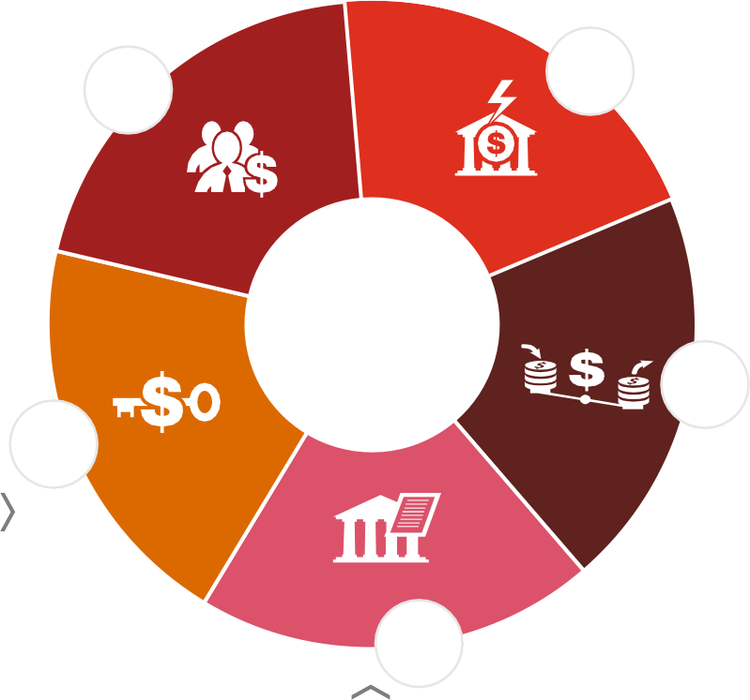
Manage for flexibility and shocks – withstand external shocks with a
pocket of sequenced policy execution
Way forward
2
Boosting of Investors’ Confidence - Clear Nigeria FX Management
Story.
1
3
5
Short-term fix to enhance foreign exchange liquidity
.
Deepening of financial markets
4
Longer term sectorial policy to maximise exports or deepen domestic consumption

Slide 28
PwC Economics team proposition
Measure and assess our client’s impact on the economy, competition and markets
01
Economic Impact Assessment (EIA)/Socio-Economic Impact Assessment
(SEIA)
Regulatory Impact Analysis (RIA)
Competition economics
Policy analysis and development
01
Macroeconomic and political research
Market entry and sectoral analysis
Country and industry risk assessments
02
Help our client make decision on investment and risk
02
Help our client plan for future macroeconomic, mega trend and sustainability scenarios
03
ESG scenario planning
Economic and political scenario planning
Industry and macroeconomic modelling
03

Slide 29




Contact Us
Olusegun Zacchaeus
Partner and West Africa Lead, Strategy&
olusegun.zaccheaus@pwc.com
Omomia Omosomi
Lead Economist & Researcher
omomia.omosomi@pwc.com
Adesola Borokini
Senior economist & Researcher
Adesola.borokini@pwc.com
Nigeria's economic outlook
PwC
Impact of Global Economic Trends on Nigeria’s Foreign Exchange Market
July 2023
16
October 2023 29

