Slide 1

Calibration of Monitors
Same grey level on circles?
Trusting what you see?
Answer: Same grey !!

Slide 2
Why adjust Monitor to correct Colours ?
The sole instrument used for picture evaluation
Signal evaluation may be done by WFM and VECT
The most unstable element in the production chain
Use of material from different sources
Improve competition by quality
Higher quality demand for commercials

Slide 3
What to adjust on the Colour Monitors ?
The colour of grey
The brightness (cut off = black-level)
The contrast (gain, peak white)
The Saturation (chroma gain) & hue (NTSC only)
Adjust to the world standard White D equal to D 6500

Slide 4
Routine Calibrations Summary
Check Purity using full field Red
Check convergence using CROSS-HATCH
Adjust black level using PLUGE
Adjust low level colour using 15% WINDOW
Adjust Contrast level using 100% WINDOW
Adjust high level using 100% WINDOW
Check black and white level for interaction (repeat?)
Adjust saturation (& hue in NTSC) using SPLIT FIELD COLOURBAR (SMPTE Bar in USA)
Check overall function with STAIRCASE
Check Contrast with NEEDLE PULSE and PLUGE STAIR

Slide 5
Colour References
Pre-programmed colour references
D6500
  The most used daylight reference in the professional TV industry. D6500 is defined by CIE
9300K correlated:
  A correlated colour temperature mainly used in Japan and on BW monitors and computer monitors.
3200 K correlated:
  A correlated colour temperature mainly used as an indoor “temperature” for photographic purposes
Notes:
PM 5639/80 Display Unit
Graphic and numeric display, handheld, battery powered
PM 5639/90 CRT Colour Sensor
Handheld colour sensor with suction disc for attachment to the CRT screen. The colour sensor is fitted with high grade dichroic (interference) filter with Standard observer response
Further accessories
Charger, rechargeable battery, carrying case, operating manual, calibration certificate, connection cable, 1.8m
Space in the case for PM 5638/82 generator

Slide 6
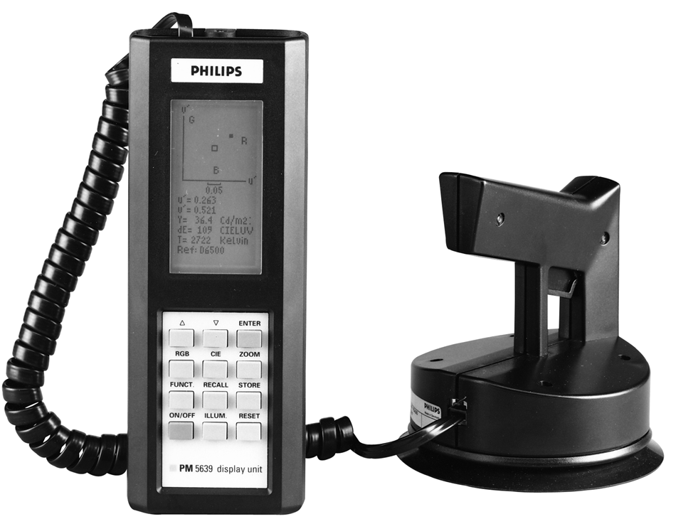
PM 5639/00 Colour Analyser
PM 5639/80 Display Unit
  Handheld, battery powered
PM 5639/90 CRT Colour Sensor
  Handheld colour sensor with suction disc
  Fitted with high grade dichroic) filter with Standard observer response
Further accessories
  Charger, battery, carrying case, manual, cable, 1.8m
  Space in the case for PM 5638/82 generator

Slide 7
PM 5639/01 CRT Colour Analyser, PC
Standard PM 5639/90 CRT colour sensor
  Hand-held colour sensor with suction disc for attachment to the CRT screen. Uses high grade dichroic (interference) filters with Standard Observer response
Software
  Complete stand alone display system and modules for integration in automatic systems
Interface
  Uses standard PC with RS232 port
Accessories
  Operating manual, interface cables, power supply

Slide 8
PM 5639/20 /21 Industrial CRT CA’s
PM 5639/20: One sensor version
PM 5639/21: Two sensor version
PM 5639/92 Industrial colour sensor
  Fast ruggedized colour sensor with high grade dichroic (interference) filters. Bracket for easy attachment.
Software
  Complete stand alone display system and modules (with source code) for integration in automatic systems
Interface
  Uses standard PC with RS232 port(s)
Accessories
  Operating manual, interface cables, power supply

Slide 9
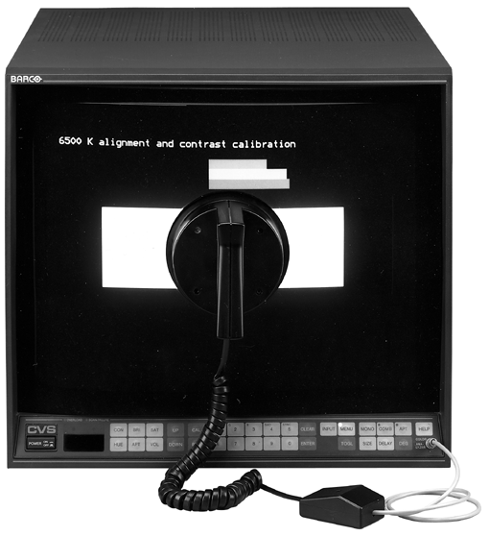
Analysers for automatic Alignment
PM 5639/02 & PM5639/03
Auto Colour Alignment for BARCO & SONY Monitors
  100% automatic alignment
  Uses standard PM 5639/90 CRT Colour Sensor
  Operates with: monitors with menu control
  Adjusts: 6500, 3200 and
  9300 °K
  Cut-off/bias, contrast, colour balance, saturation and hue
Upgrades for use with /00:
  PM 5639/63: BARCO
  PM 5639/64: SONY
Billed side 133 i katalog

Slide 10
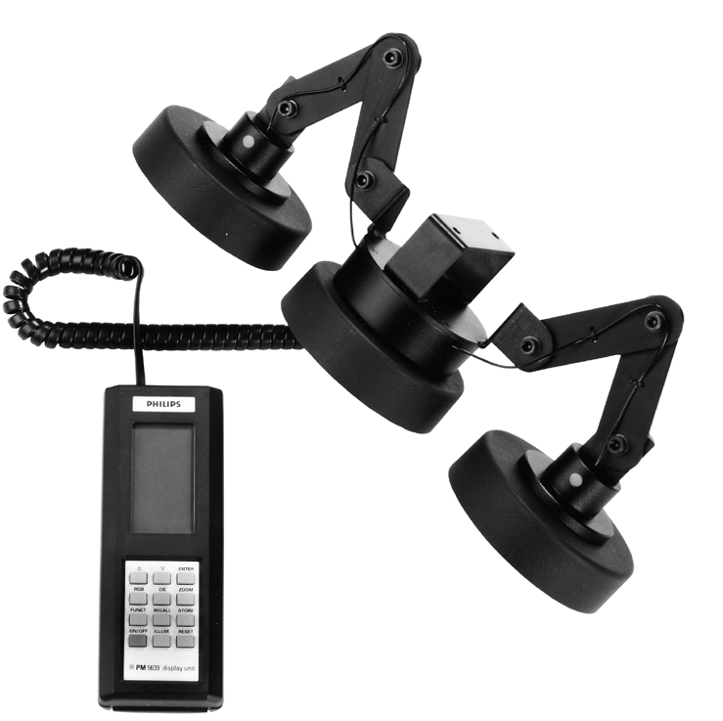
Analyser for Alignment of Projectors.
RGB bar graph display
  The PM 5639/10 includes the popular relative RGB display.
Use
  The triple light sensor has to be mounted on the lenses of the projector. The sensor measures the total light output from the three lenses and compares to a predefined white reference.
Conversion factors
  The PM 5639/10 is a relative measuring device.
Notes:
RGB bar graph display
The PM 5639/10 includes the popular relative RGB display.
Use
The triple light sensor has to be mounted on the lenses of the projector. The sensor measures the total light output from the three lenses and compares to a predefined white reference.
Conversion factors
The PM 5639/10 is a relative measuring device. The absolute light level and colour reference have to be programmed into the instrument. The user may select any light level to equal any reference value with user specified unit of measure.

Slide 11
PM 5639/10 Projector Color Balance Meter
Accessories PM 5639/10
  Standard PM 5639/80 Display Unit
  PM 5639/92 Projector triple light sensor
  One set of bowls according to order
Used with
  All brands of projectors with 3 lenses
  Different bowl size for different projectors
  Automatic operation with the PM 5639/82 and PM 5639/83 Color alignment generators

Slide 12
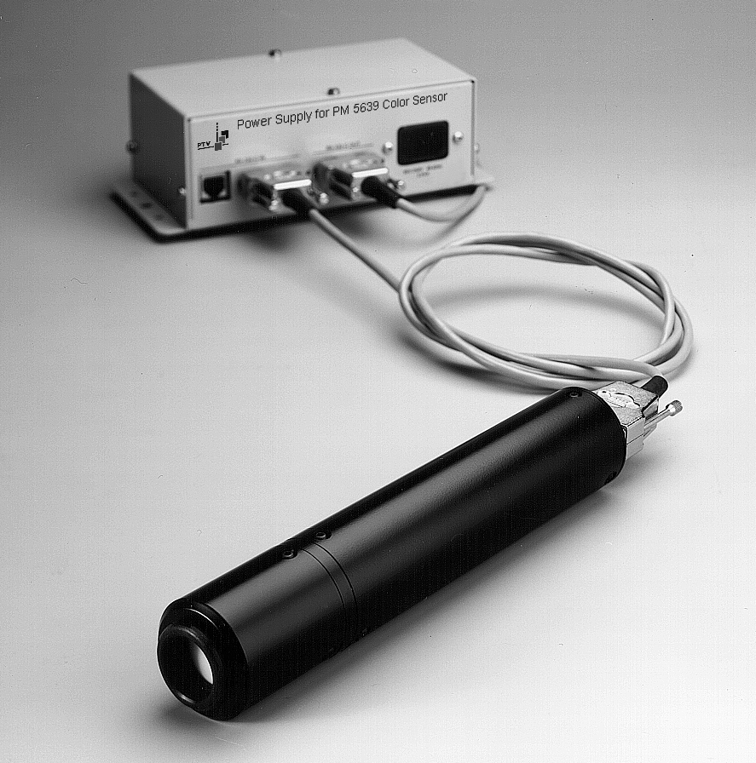
PM5639/25 - small Sensor
PM 5639/95 Miniature industrial colour sensor
  Very fast ruggedized colour sensor with high grade dichroic filter.
  Size allows use of 25 sensors on 17” CRT
Software
  Complete stand alone display system and modules for integration in automatic systems
Interface
  Uses standard PC with RS232
Accessories
  Manual, interface cables, power supply

Slide 13
NEW !!! To come
PM5639/94 LCD version
LCD versus CRT:
  CRT has a spherical emission diagram
  LCD optimised for perpendicular viewing (same is valid for projection screens)
Optics in front of a PM5639/93 Small Sensor Head
Measures light in a small angle
  Angle approx. 10°
  Measurement distance approx. 150mm
Specification not yet settled

Slide 14
The xy Chromaticity Display
Displays the absolute CIE 1931 xy chromaticity co-ordinates
The xy graph shows:
  Reference, measurement and the direction for the adjustment
  The luminance value in either NIT, Cd/m2, or FtL
  The “colour error, dE”, the perceived colour difference between the measurement and the reference
  The name of the used white reference

Slide 15
Light Differences
JND just noticeable difference
  a measure for what the Standard Observer just can see as a difference, not only colour difference
MPCD minimum perceptible colour difference
  a measure for what the Standard Observer just can see as a colour difference
CIELUV
  a measure for light difference in the u’v’ uniform colour space

Slide 16
Display Formats
xyY chromaticity display
  The absolute colour system defined by CIE in 1931.
u’v’Y display
  Absolute colour system defined by CIE in 1976.
  Display is more uniform, meaning that presentation is closer to how humans perceive colours
CCT, Correlated colour temperature
  Temperature in Kelvin of a Plankian radiator perceived by human as being the closest approximation to the actual light
RGB Bar graph display
  Relative measurement depending on phosphor type

Slide 17
Dichroic Filters
Air
Dielectrica
Substrate
Sketch of light transmission through a two layer dichroic filter
A stack of thin dielectric layers with high and low refractive index.
Features:
  No bleaching
  High peak transmission
  No self heating, low temperature dependency

Slide 18
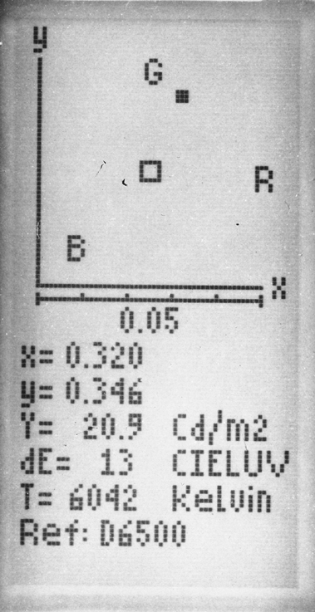
The xy Display.
Displays the absolute CIE xy chromaticity co-ordinate.
The Luminance value in either NIT, cd/m2 or ftl.
dE = the perceived colour difference between the measured value and the reference.
T= Actual colour temp in °Kelvin.

Slide 19
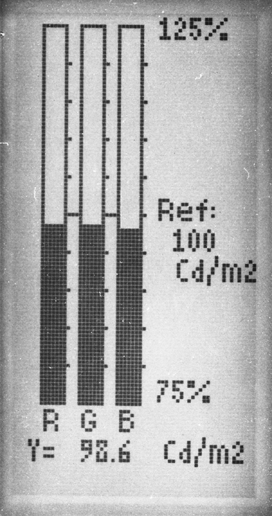
The RGB Display.
Displays the RGB values relative to the white Reference.
The balance is relative to the selected display reference
Select the right phosphors to prevent cross-talk
Use a stored phosphor or perform a LEARN phosphor.

Slide 20
RGB Mode: Learn Phosphor
Only relevant in RGB mode !!
Learn phosphor
  Generates a compensation matrix which is used to remove the interaction between the red gun and the green and blue bar and visa versa
Phosphor compensation
  Introduces the possibility for errors when used on phosphors others than the selected
Interaction control
  An interaction between e.g. the RED gun and the GREEN bar should bring in mind that the phosphor may not be optimised

Slide 21
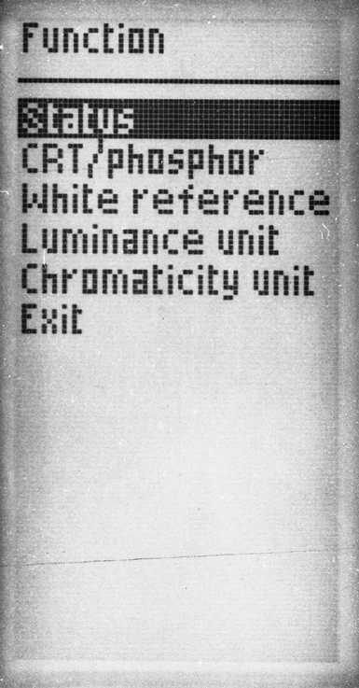
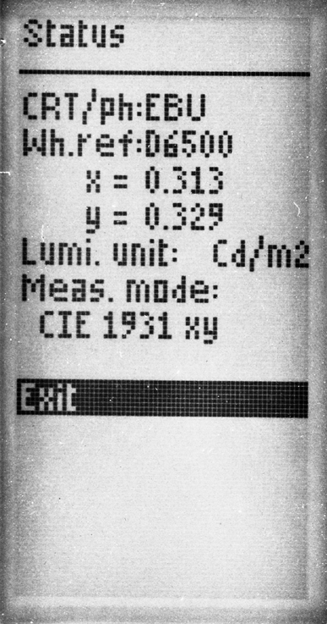
The Function and the Status Display.

Slide 22
PM 5639/20, /21, /25, /01 Software Modules
Communication software modules
  Communication software modules allow easy integration in automatic systems. The modules are supplied with full documentation including source code.
Software modules
  Pascal 7.0, Basic and C++ (all Borland TURBO)
Demo program
  A demonstration program is included. This shows how to use the software modules and the functions included in these
Runs under Windows 95 and 98

Slide 23
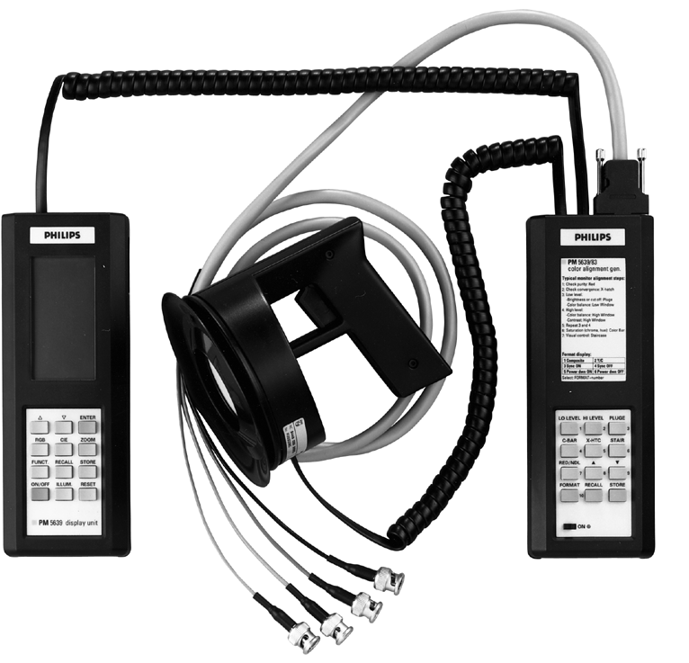
PM 5639 Analyser & Generator System

Slide 24
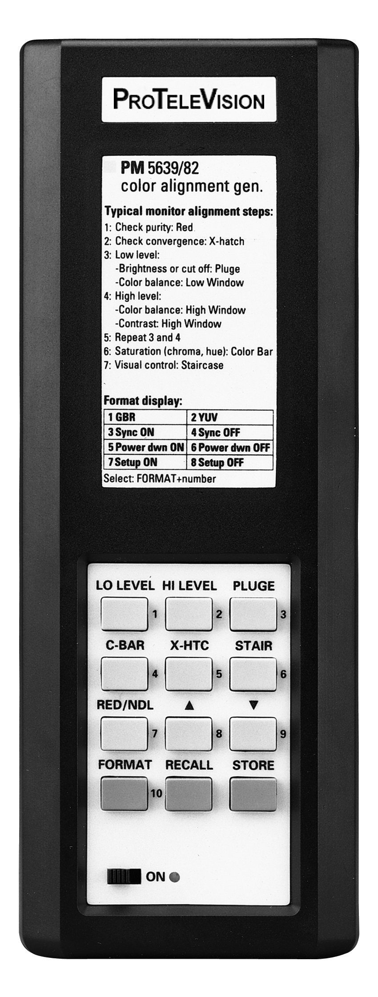
Generators: PM 5639/82 & /83
Hand held, battery operated
Instrument for every version, simple operation
All versions covered: 525/625, PAL or NTSC, RGB/YUV
Composite sync output
Automatic controlled from PM 5639/00 and PM 5639/10
The only dedicated colour alignment generator

Slide 25
PM 5639/82 /83 - Operation
Operates in direct immediate signal mode
Slide on/off switch means no accidental turn on
Auto power down mode preserves battery
Configure mode selects: RGB/YUV
Configure mode selects: NTSC set-up on/off
Configure mode selects: Composite/S-VHS
7 signals accessible by single key operation
10 pre-set signals accessible by two key operation
Pre-set stored by two key operation
Window/flat field level changed by up/down keys

Slide 26
PM 5639/82 /83 - Signals
PLUGE: Brightness adjustment
Window 0-100%: Colour/contrast adjustment
Flat field 0-100%: Colour/contrast adjustment videowalls
Split field colour bar: Chroma gain adjustment (PAL)
SMPTE blue bar: Chroma gain and hue adjustment (NTSC)
Cross hatch: Convergence control (adjustment)
Diagonal cross hatch: Videowall timing adjustment
Needle pulse: High tension monitor control
Red signal: Purity control (adjustment)

Slide 27
PM 8550 Calibration Software
User calibration of PM 5639/90, /92 and /93
Used with established in-house reference
Calibrates the sensor to give desired result on user reference monitor
Additional overlay calibration to factory calibration
Does not obsolete factory calibration
The factory calibration can always be recalled

Slide 28
Traceability
Permits a guarantee for consistent colour analyser calibration
The equipment used for the calibration of the colour analyser is traceable
The reference equipment is calibrated at the Swedish National Testing and Research Institute, Borås, Sweden
Spectral calibration traceable to NIST USA
Luminance calibration traceable to BIPM France

Slide 29
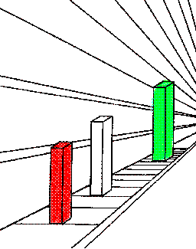
How to do in easy Steps !
Newer trust what you see !!!
The bars do have the same length !!!

Slide 30
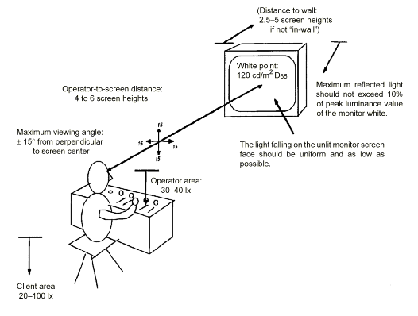
Monitor Environment
Distance to wall: 2.5-5 screen heights if not “in-wall”
White point 120 cd/m² D65
Operator-to-screen distance 4 to 6 screen heights
Maximum reflected light should not exceed 10% of peak luminance value of the monitor white
Maximum viewing angle:
±15º from perpendicular
to screen center
15
15
15
The light falling on the unlit monitor screen face should be uniform and as low as possible
15
Operator area
30-40 lx
Client area
20-100 lx

Slide 31
Routine Calibration Summary 1
Check purity using full field RED
Check convergence using CROSS-HATCH
Adjust black level using PLUGE
Adjust low level colour using 15% (US 20%) WINDOW
Adjust contrast level using 100% WINDOW
Adjust high level colour using 100% WINDOW

Slide 32
Routine Calibration Summary 2
Check black and white level for interaction between brightness, contrast and the colour balance (repeat ?)
Adjust saturation as well as hue in NTSC using SPLIT FIELD COLOURBAR or SMPTE COLORBAR
Check overall function with STAIRCASE
Check contrast with NEEDLE PULSE and PLUGE/STAIR

Slide 33
Hands on PM 5639
The RGB display
  To use the RGB display the phosphors has to be known or LEARN PHOSPOR has to be performed
  Perform LEARN PHOSPOR:
    press ENTER and ON/OFF at same time
  Use STATUS to check that the phosphors is selected.
  Control that the monitor reflects its own reference
  Change white ref. To D6500
  Use the RGB display to adjust to the correct D6500 white reference

Slide 34
Application, Monitor Alignment
Purity, TEST
Test signal: Red 75%
  The display should be completely red. Errors typically give different red tint

Slide 35
Application, Monitor Alignment
Convergence, TEST
Test signal: Cross hatch
  Check that the lines are straight and white
  Convergence errors give bent lines and/or coloured lines

Slide 36
Application, Monitor Alignment
Black level/Brightness, ADJUSTMENT
Test signal: PLUGE signal
  Adjust brightness so that the blacker than black bar disappears and the lighter than black bar is visible

Slide 37
Application, Monitor Alignment
Grey scale, ADJUSTMENT
Test signal: Window 15%/20% and 100%
  Adjust “bias” or “cut-off” for low light grey (black)
  Adjust “gain” or “white” for high light grey (white)

Slide 38
Adjustment of CRT
Starting point
Adjustment ”Cut Off”
Adjustment Low Level
Adjustment High Level

Slide 39
Application, Monitor Alignment
Contrast, ADJUSTMENT
Test signal: Window 100%
  Adjust contrast to correct level. EBU: 80 Cd/m2 or
  SMPTE: 35 ftL

Slide 40
Application, Monitor Alignment
Grey scale tracking, VISUAL TEST
Test signal: Stair Case
  The grey scale response must give equal colour from low to high level
  The red, green and blue guns should give same amount of light from low to high
  Errors give colour tint in either end (or in the middle)

Slide 41
Application, Monitor Alignment
Chroma Gain, ADJUSTMENT
Test signal: Colour Bar with 75% grey
  Select blue only on the monitor (blue gun only)
  Adjust “blue” bar equal to “grey”blue
  Not applicable with component format signal

Slide 42
Application, Monitor Alignment
High Tension Supply, TEST
Test signal: Needle pulse
  Control the shape of the needle pulse. Deviation from straight line indicate high tension problems and reduction in resolution. Reduce the contrast or find a better monitor. This is typically a problem with consumer monitors

Slide 43
Application, Monitor Alignment
CRT overload, TEST
Test signal: PLUGE
  If the staircase looks like a trumpet the phosphors are overloaded (blooming) and resolution reduced. Turn the contrast down or find a better monitor

Slide 44
Special applications

Slide 45
White uniformity Alignment
Remote alignment interface
5 times
PM 5639/93
Controller, PC or other computer
I²C, RS 232 or
another TV-set
Compatible
remote
COM ports
Power
Power
RS 232
Power
Power
RS 232
Power

Slide 46
Automatic Two Sensor System
PM 5639/21 Application
Remote alignment interface
Controller, PC or other computer
PM 3639
Communication Modules
Hardware Expansion boards
may be requiered
Adjustment sofware
Specific for the
TV-set or monitor
TV-set / monitor
Hardware communication
interface: I²C, RS 232 or ..
COM
ports
I²C, RS 232 or
another TV-set
Compatible
remote
Power
RS 232
110/230 V

