Slide 1
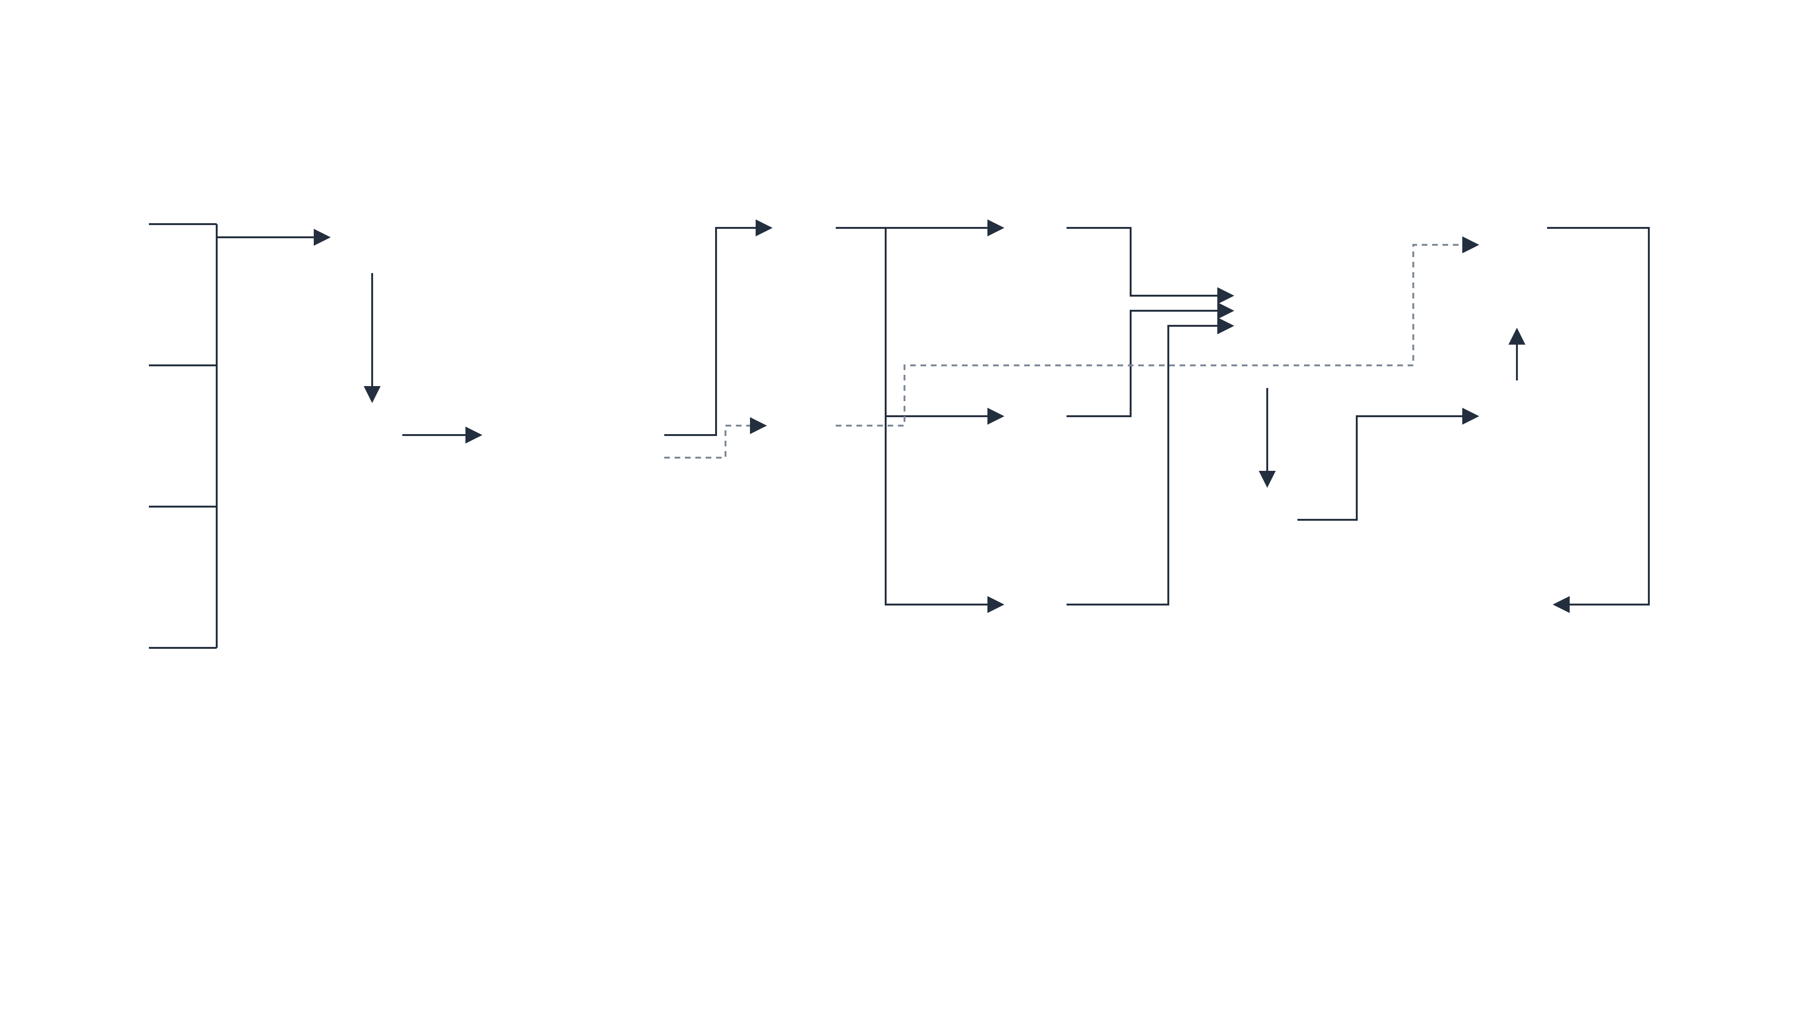

















PRODUCTION MAPPING · L14 INFRASTRUCTURE SPEC
AWS deployment architecture — lineage collection platform
External producers
AWS Cloud
1
SQS priority lanes + DLQs
API
GitHub
AWS Step Functions
4
AWS Fargate
5
Amazon Neptune
push → events lane pr.updated → interactive
Amazon API Gateway
interactive
4 workflows · stage redrive
SCA engine — deterministic
versioned namespaces · active pointer
webhook ingress → normalizer λ (verify · dedupe)
pr.updated — never starved
3
pointer swap (fenced)
Amazon S3 · Object Lock
7
OUTSIDE WORKFLOWS
AI
immutable evidence · manifests · CRR
Jenkins
2
λ
6
8
deploy events (signed) → events lane
events
Amazon EventBridge
push · deploy
Promotion λ
LLM Gateway
Review UI — human gate
TAS
deploy-triggered · 3-step pointer swap
via Bedrock — guardrailed, never gates
SPA: approve · reject · correct — before publish
rules · dedupe · archive + replay
System inventory (TAS)
Amazon DynamoDB
edge ledger · LLM cache · publish lock
API
who owns which repo/system — deltas → bulk lane
bulk
baseline · nightly · LLM batch
Amazon DynamoDB
Stream
Amazon API Gateway
Catalog
dedupe · run ledger · determinants
Kinesis → Firehose · prod hard-denied
lineage · impact APIs · review SPA
URN authority — hourly snapshot pull (schedule)
Security & operations (L12)
IAM
KMS
CloudTrail
CloudWatch
least-privilege per stage · production hard-deny ×2 (IAM + validator) · every pointer swap CloudTrail-audited · correlation contract on every artifact
1
Signed intake: signature verify per producer; dedupe by eventId (DynamoDB, TTL 14d); EventBridge archive makes replay safe.
2
Three multi-AZ SQS lanes + DLQs with redrive runbooks; 10,000-event burst absorbed with zero loss; interactive lane never starved.
3
Step Functions runs 4 workflows; run ledger + determinants in DynamoDB; failed runs redrive from the failed stage, idempotently.
4
Three engines: Fargate SCA (deterministic), Bedrock LLM (guardrail chain, never gates a PR), Kinesis→Firehose runtime (metadata only).
5
S3 Object Lock truth layer: checksummed, write-once; cross-Region replication; RPO 15 min / RTO 4 h for truth classes.
6
DynamoDB edge ledger: idempotent URN merge, confidence bands; ledger and projections rebuild from S3 alone (quarterly drill).
7
Human gate: reviewers verify proposals in the SPA (approve / reject / correct, audited) → fenced publication: monotonic token; stage → verify → atomic pointer swap.
8
Version-pinned queries via the active pointer; bounded traversal ≤ 2 s p95; OpenSearch projection (P1) exposes its lag watermark.
Notes:
Production mapping per L14 in AWS reference-architecture style: API Gateway and EventBridge intake, three SQS lanes with DLQs, Step Functions orchestration, Fargate/Bedrock/Kinesis engines, S3 Object Lock truth, DynamoDB control tables, fenced publication to versioned Neptune namespaces, version-pinned queries. Resiliency: archive replay, DLQ redrive, CRR, rebuild-from-S3, RPO 15 min / RTO 4 h.

Slide 2
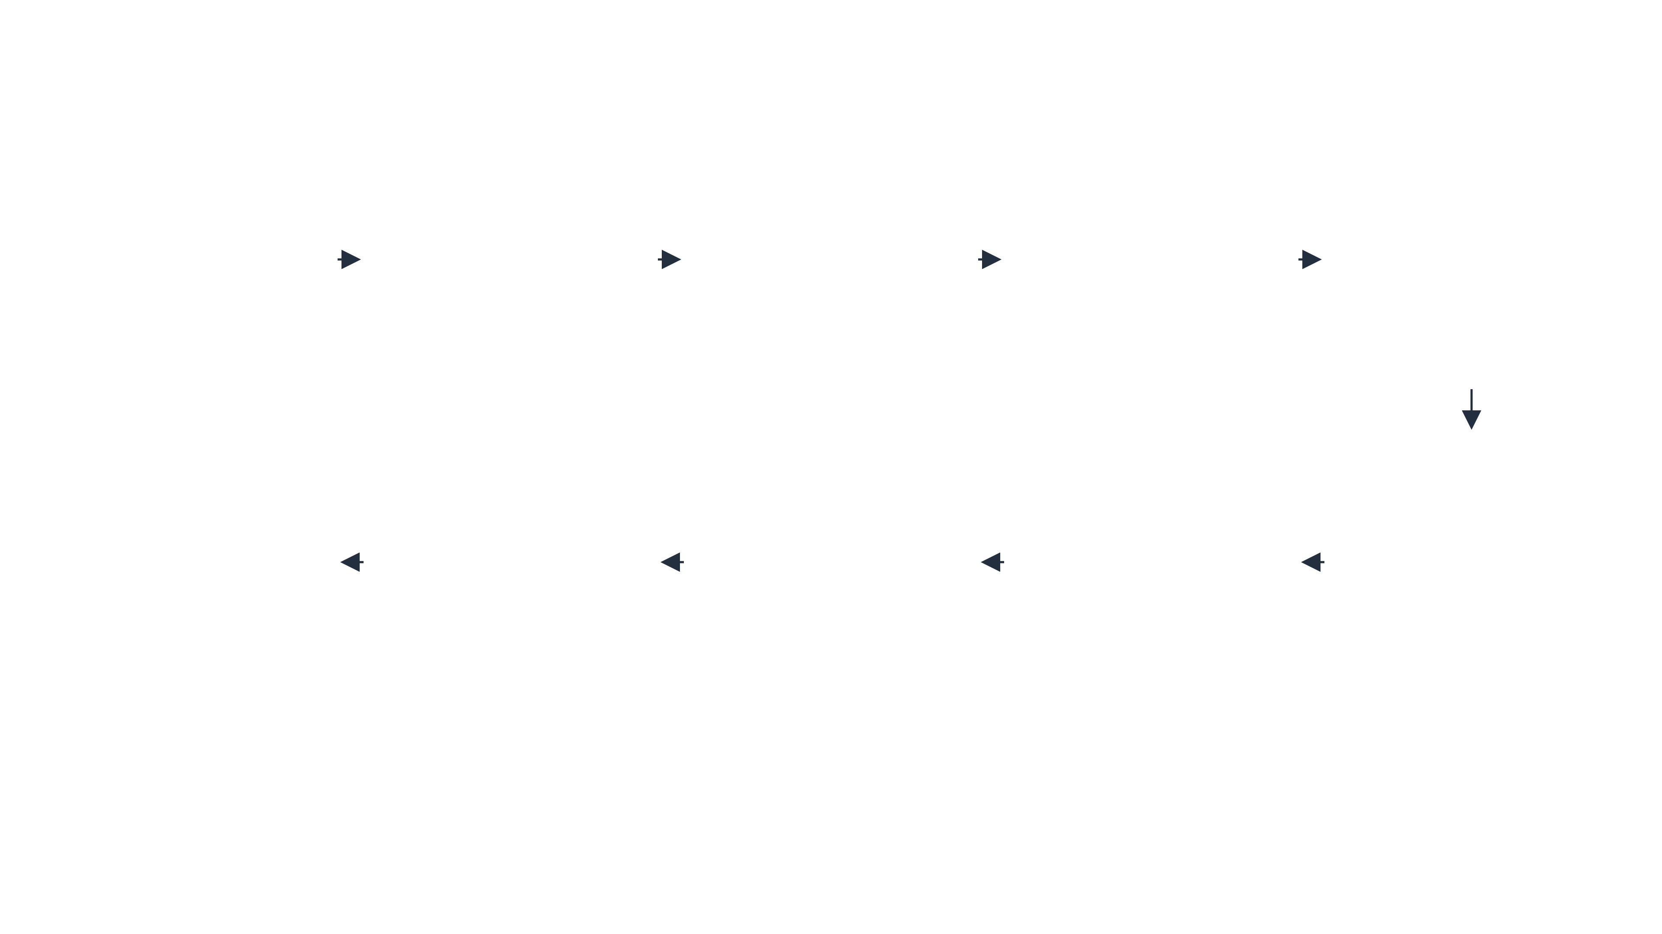








M1 WALKING SKELETON · PUSH → PUBLISH → QUERY
Process flow — signed push to version-pinned query
1
Signed push intake
2
Classification
3
Incremental workflow
4
</>
Static analysis
5
#
URN resolution
Evaluate evidence in 7-level precedence order → seeded repo resolves to DATA_PIPELINE.
Walk Python AST + embedded SQL in changed scope — file, line, AST path, transform, mechanism.
Normalize raw names against the run-pinned catalog snapshot — single match emits a catalog-backed URN.
Verify signature · record delivery ID · build canonical envelope · route to events lane.
Every stage transition written to the run ledger with shared correlation ID.
replay → DUPLICATE · no second run
conflict → UNKNOWN · blocks analysis
QUEUED → … → IN_REVIEW · redrivable
dynamic names → explicit residue
0 or >1 matches → quarantine
10
Lineage & impact query
9
Fenced publication
8
Human review
7
Consolidation
6
Immutable evidence
Proposal diff vs active graph version — approve, reject, or create a corrected successor.
Idempotent merge by edge key · ordinal band from distinct mechanisms · conflicts retained, never averaged.
Resolve through the active pointer · downstream traversal depth ≤ 5.
Checksummed manifest · monotonic fencing token · stage → verify → atomic active-pointer swap.
Deterministic serialization · SHA-256 checksum · write-once object store.
stale writer can never advance the pointer
server-enforced transitions · audited
corroboration is separate · never raises band
re-write accepted only if checksum identical
verdicts: BLOCK / WARN / INFO
Confidence bands — ordinal, derived from distinct mechanisms (L07)
LOWEST
SINGLE
MEDIUM
HIGH
HIGHEST
LLM alone
one non-LLM mechanism
SCA+LLM or runtime+LLM
SCA + runtime
SCA + LLM + runtime
corroboration = NONE | DATASET | ELEMENT — tracked separately, never changes the band
Notes:
M1 walking skeleton: one signed push travels the full trust boundary — intake, classification, orchestration, static analysis, URN resolution, immutable evidence, consolidation, human review, fenced publication, version-pinned query.

