Slide 1

SMART INDIA HACKATHON 2026
TITLE PAGE
Problem Statement ID – SIH26205
Problem Statement Title- AI-Powered Skill Gap Analysis and Career Guidance System
Theme- Smart Education
PS Category- Software
Team ID-
Team Name (Registered on portal)- InfoSnatcher

Slide 2
INNOVATION & UNIQUENESS OF THE SOLUTION
InfoSnatcher
USP: “Right Skill → Right Student → Right Job”
Proposed Solution
AI Skill Profiling
Smart Job Matching
Skill-Gap Analysis
Hidden Talent Detection
Identifies real strengths & abilities.
Matches students with industry needs.
Finds missing skills for each role
Personalized Learning
Recommends skills to improve.
Identifies potential beyond marks.

Slide 3
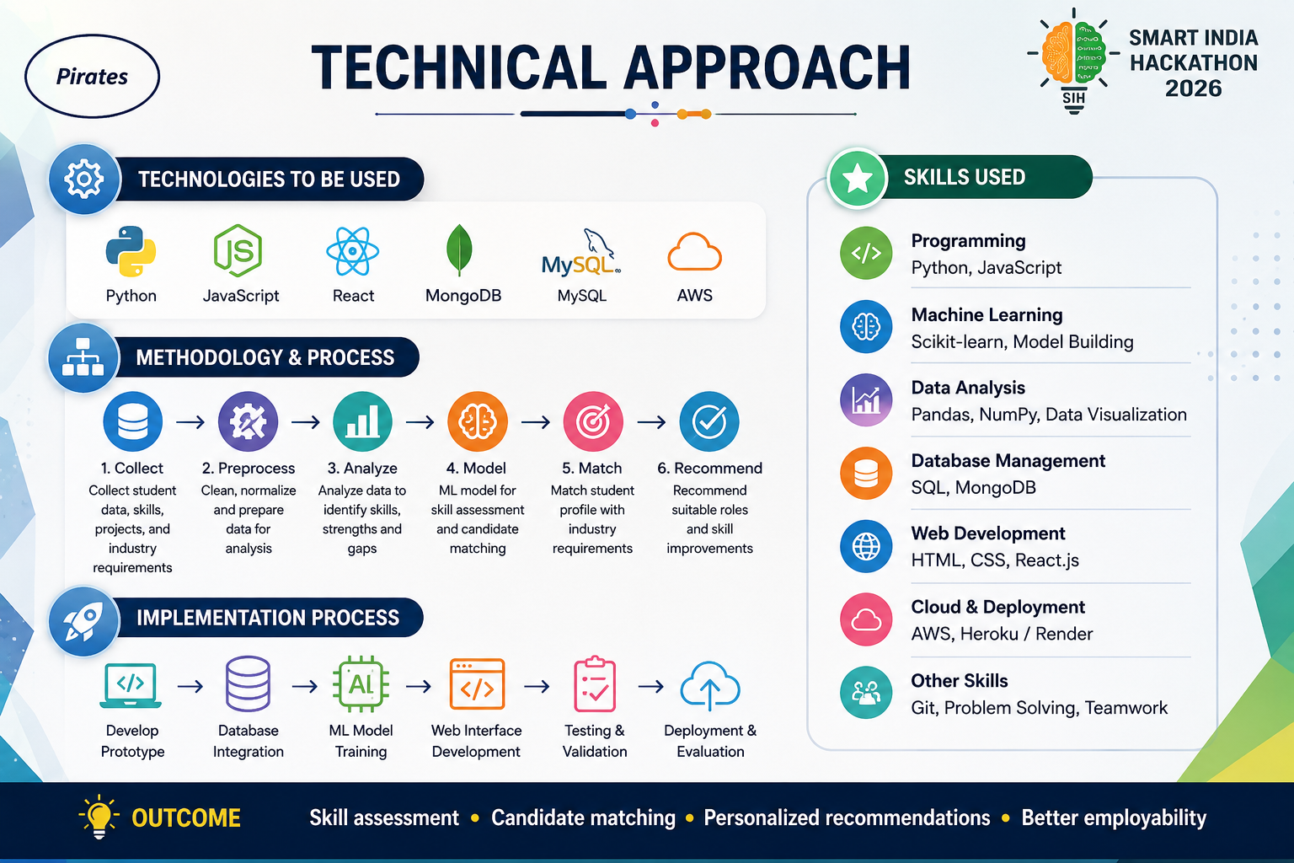
TECHNICAL APPROACH
InfoSnatcher
Technologies to be used (e.g. programming languages, frameworks, hardware)
Methodology and process for implementation (Flow Charts/Images/ working prototype)

Slide 4
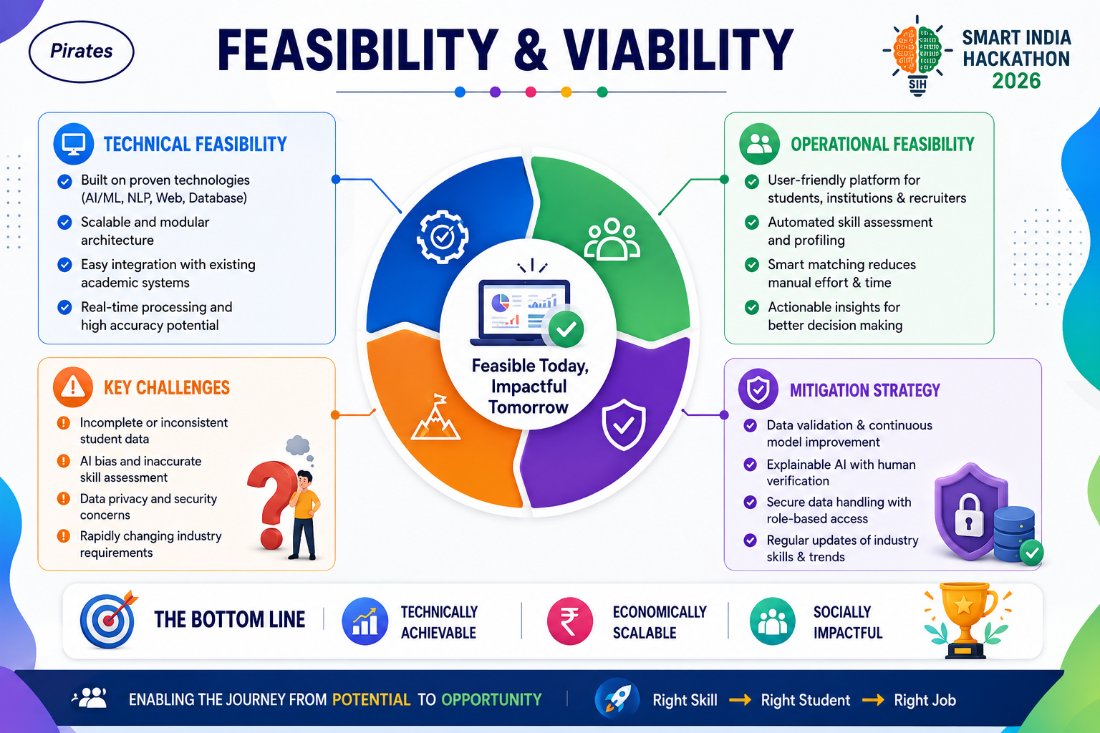
FEASIBILITY AND VIABILITY
InfoSnatcher
Analysis of the feasibility of the idea
Potential challenges and risks
Strategies for overcoming these challenges

Slide 5
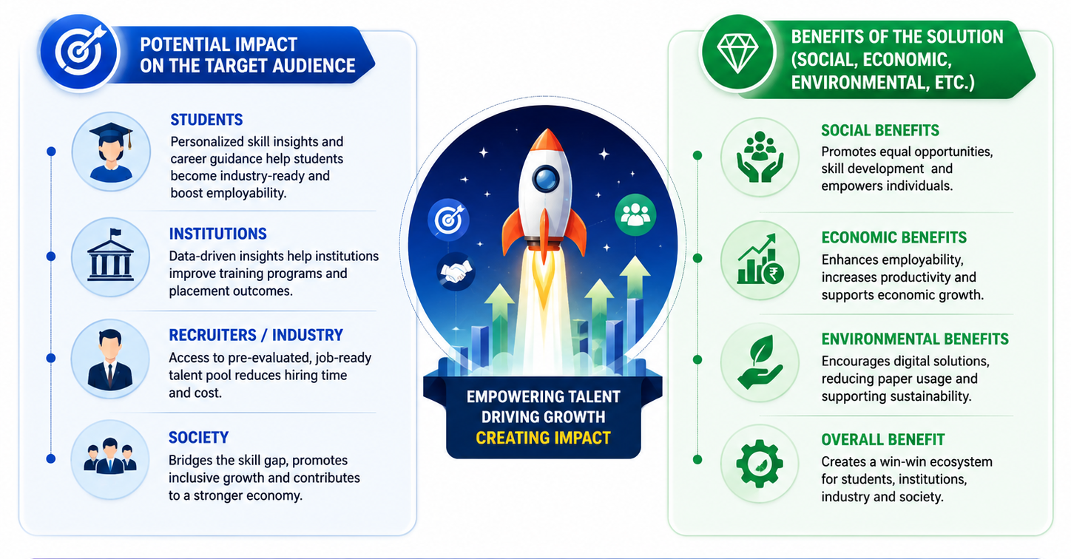
IMPACTS AND BENEFITS
InfoSnatcher

Slide 6
RESEARCH AND REFERENCES
InfoSnatcher
Details / Links of the reference and research work

