Slide 1
Airbnb London Pricing Analysis
What Drives Nightly Rates?

Slide 2
The £127 Question
A 2-bedroom flat in Camden sleeps 4 guests. Should the host charge £85 or £127 per night?
This analysis answers that question with data.

Slide 3
One Slide Summary
If you remember nothing else…
Room type is king: Entire homes command 52-75% premiums over private/shared spaces
Size scales linearly: Each guest capacity = +12% price, each bedroom = +18%
Model accuracy: 73% of predictions within one price tier
R² = 0.50: Half the story told by 6 variables; the other half needs amenities, reviews, exact location

Slide 4
Team
Name | Role
Abel Murad | Data Loading & EDA
Kartavya Jharwal | Model Development
Muazzamkhon Mirdjamalova | Technical Documentation
Rakhila Sayemkozhina | Literature Review
Abdul Rafay Malik | Business Interpretation
Puck Schulten | Visualization

Slide 5
Course: BAN-0200 • Professor: Glen Joseph • Institution: Hult International Business School

Slide 6
The Data at a Glance
Metric | Value
Listings analyzed | 6,319
Source | Inside Airbnb (public data)
Geography | All 33 London boroughs
Price range | £10 – £9,999 / night
Median price | £75 / night

Slide 7
Sampling: Stratified by neighbourhood and room type to preserve market representation.

Slide 8
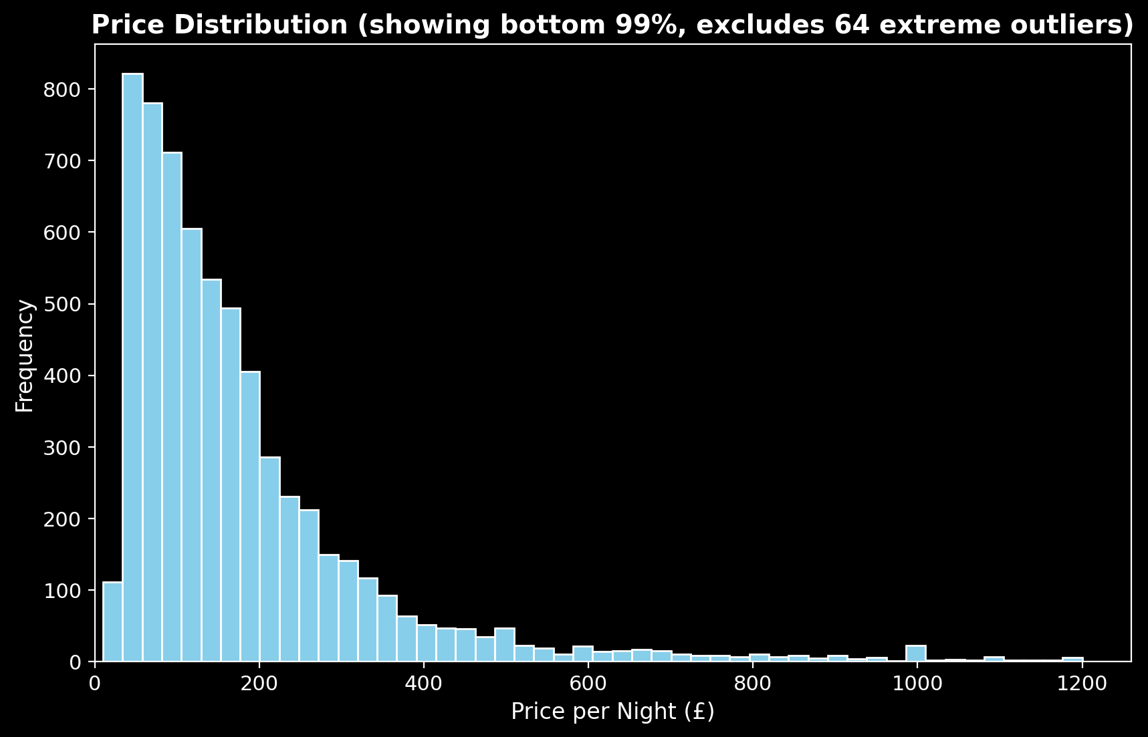
The Problem: Price is Messy
What the histogram shows: - Extreme right skew (long tail of luxury listings) - Median (£75) << Mean (£102) - Top 1% above £500/night
Our response: Log-transform the target variable to stabilize variance.
“When the data screams skewness, the analyst whispers logarithms.”
Price Distribution

Slide 9
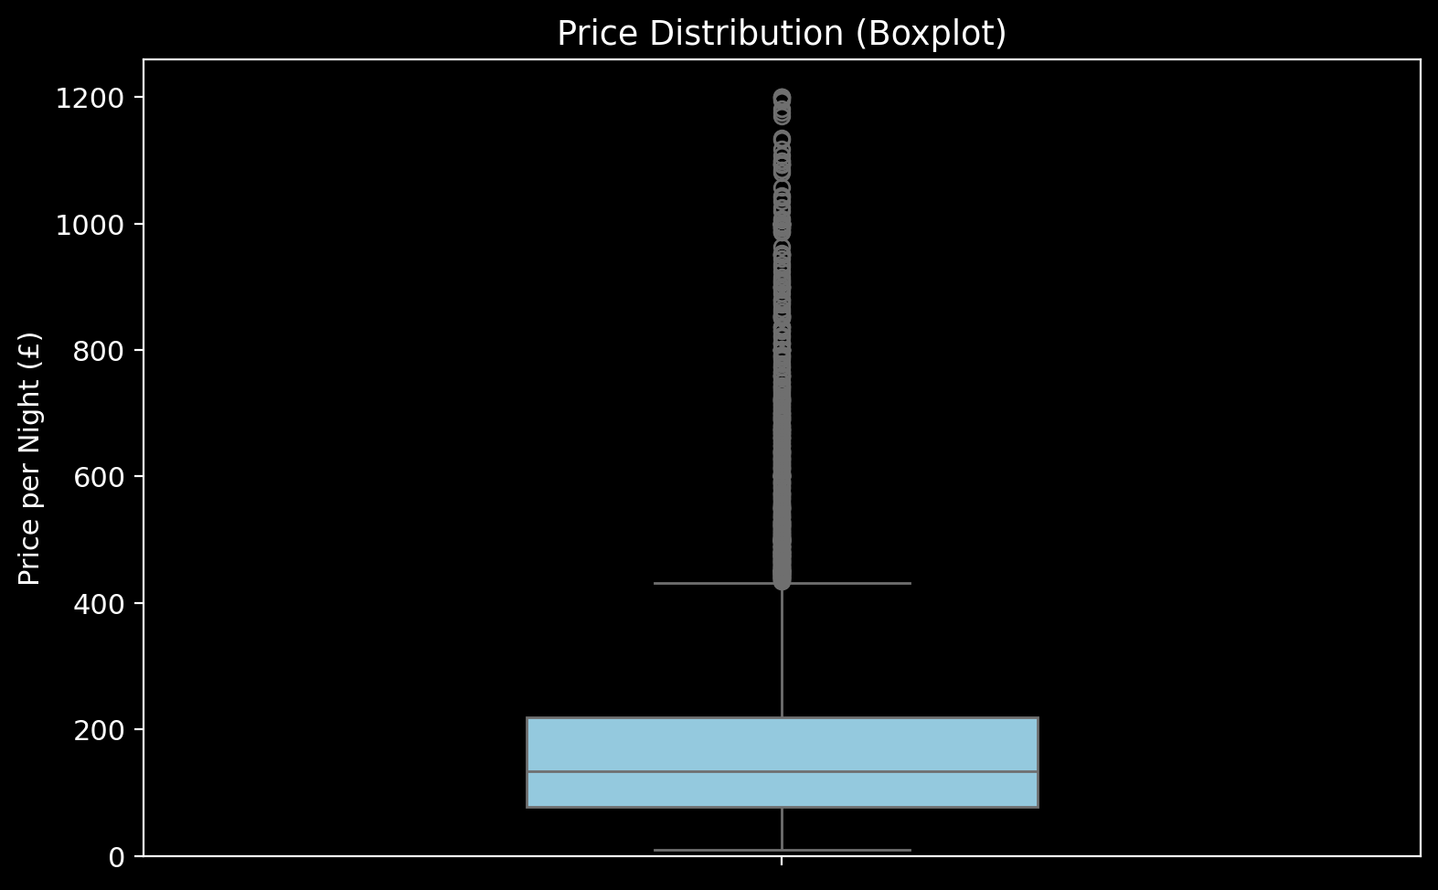
Outlier Detection: The Boxplot View
Key observations: - IQR: £50–£125 (where 50% of listings fall) - Upper fence: ~£200 (outliers above this) - Extreme outliers: £500+ luxury listings
Action taken: Capped at £1,000/night for modeling stability.
Price Boxplot

Slide 10
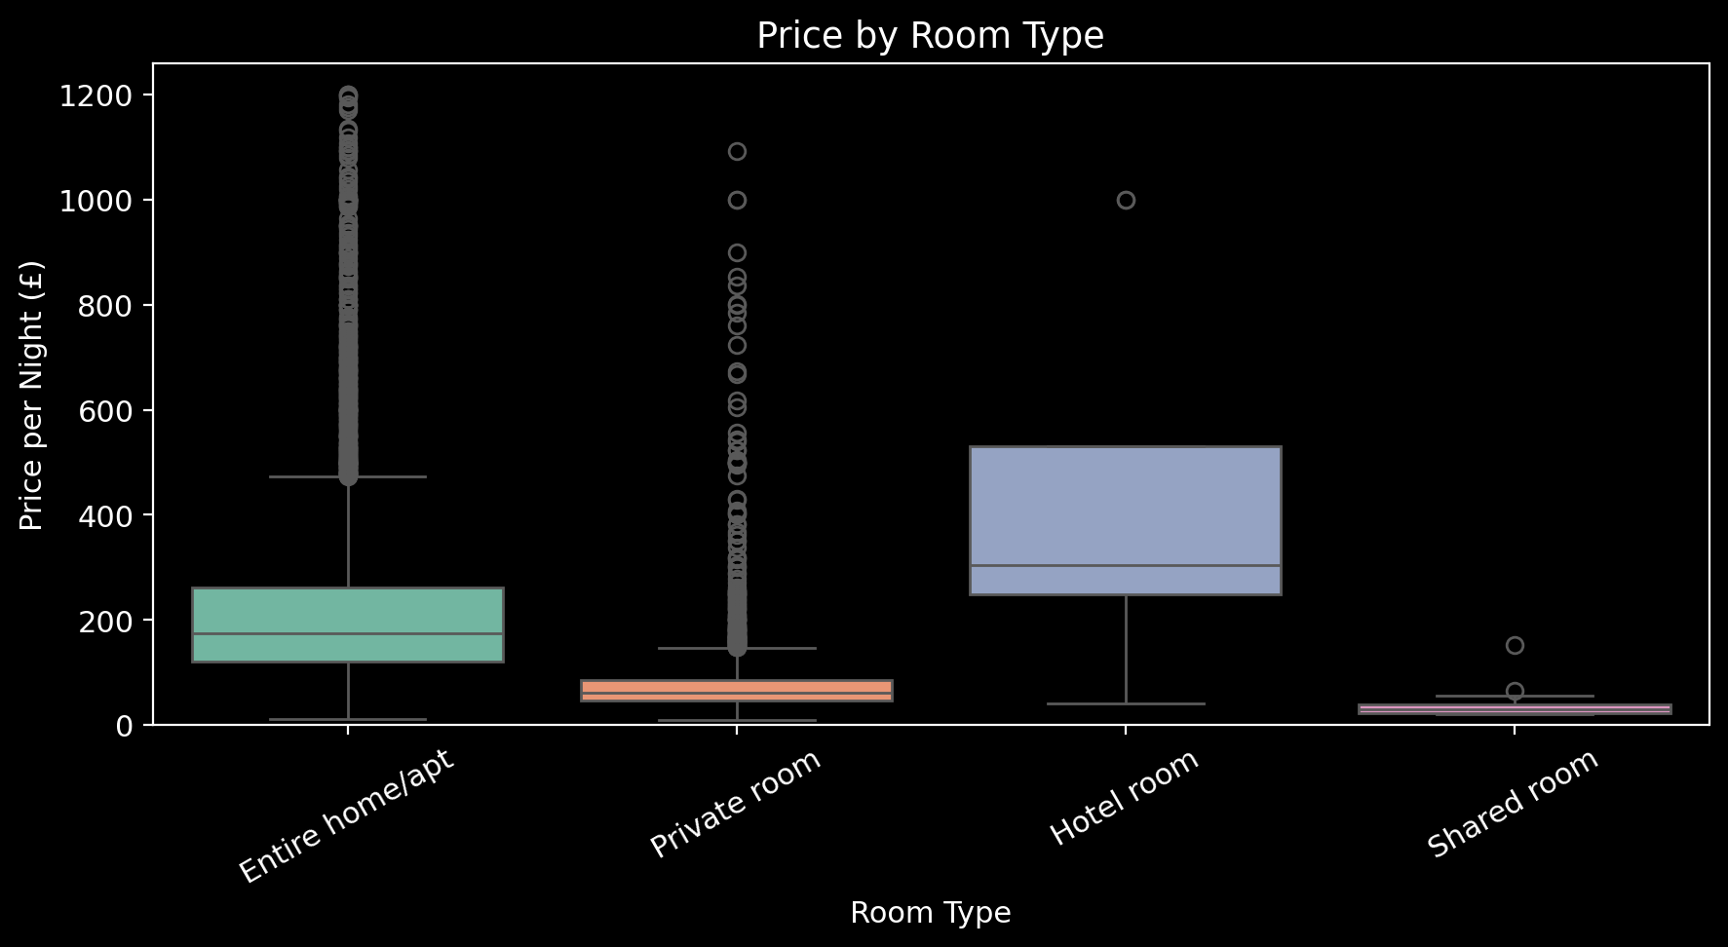
Room Type: The Dominant Signal
Price by Room Type

Slide 11
Room Type | Avg. Price | vs. Entire Home
Entire home/apt | £139 | —
Private room | £67 | −52%
Shared room | £56 | −60%

Slide 12
Business insight: Privacy is worth more than any amenity. Hosts offering entire homes operate in a fundamentally different market than room-sharers.

Slide 13
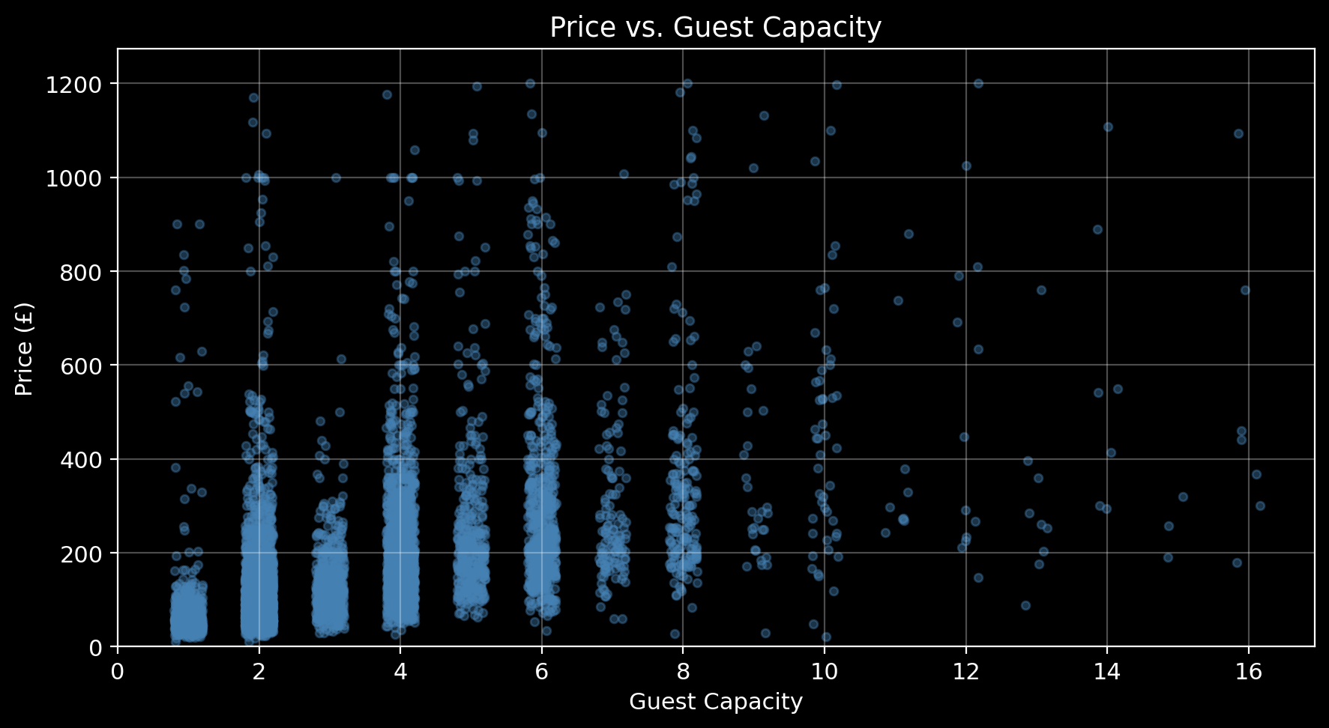
Size Matters (Linearly)
The pattern: - 2 guests → £75/night - 4 guests → £115/night (+53%) - 6 guests → £185/night (+147%)
Rule of thumb: Each additional guest capacity = +12% price premium
This is remarkably consistent across the dataset.
Price vs Capacity

Slide 14
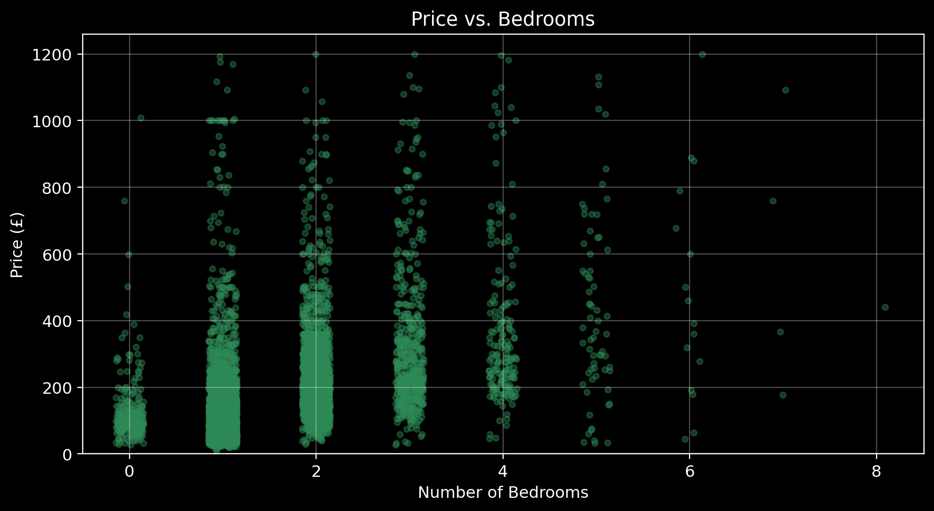
Bedrooms: The Privacy Premium
The pattern: - 1 bedroom → £85/night (base) - 2 bedrooms → £125/night (+47%) - 3+ bedrooms → £175/night (+106%)
Insight: Bedrooms represent privacy, not just space. Families and groups pay more for separation.
Price vs Bedrooms

Slide 15
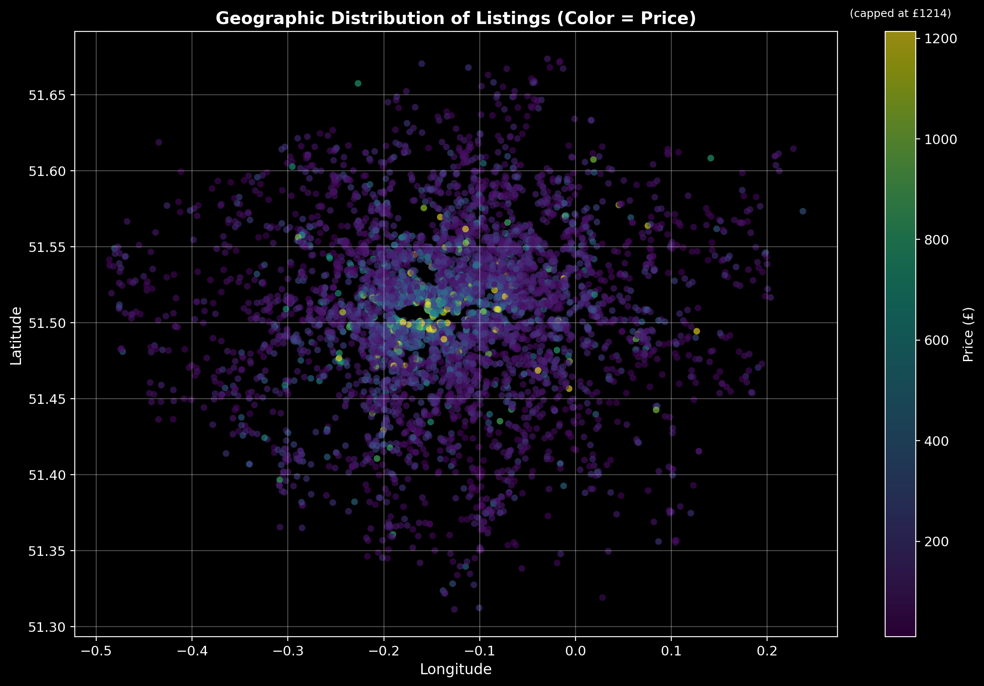
Location: The Geographic Premium
Central London effect: - Westminster, Kensington & Chelsea, City of London = highest medians - Price decays ~5% per mile from center - Tube accessibility adds 10-15% premium
Implication: A Zone 1 listing can charge 30-50% more than an identical property in Zone 4.
Geographic Heatmap

Slide 16
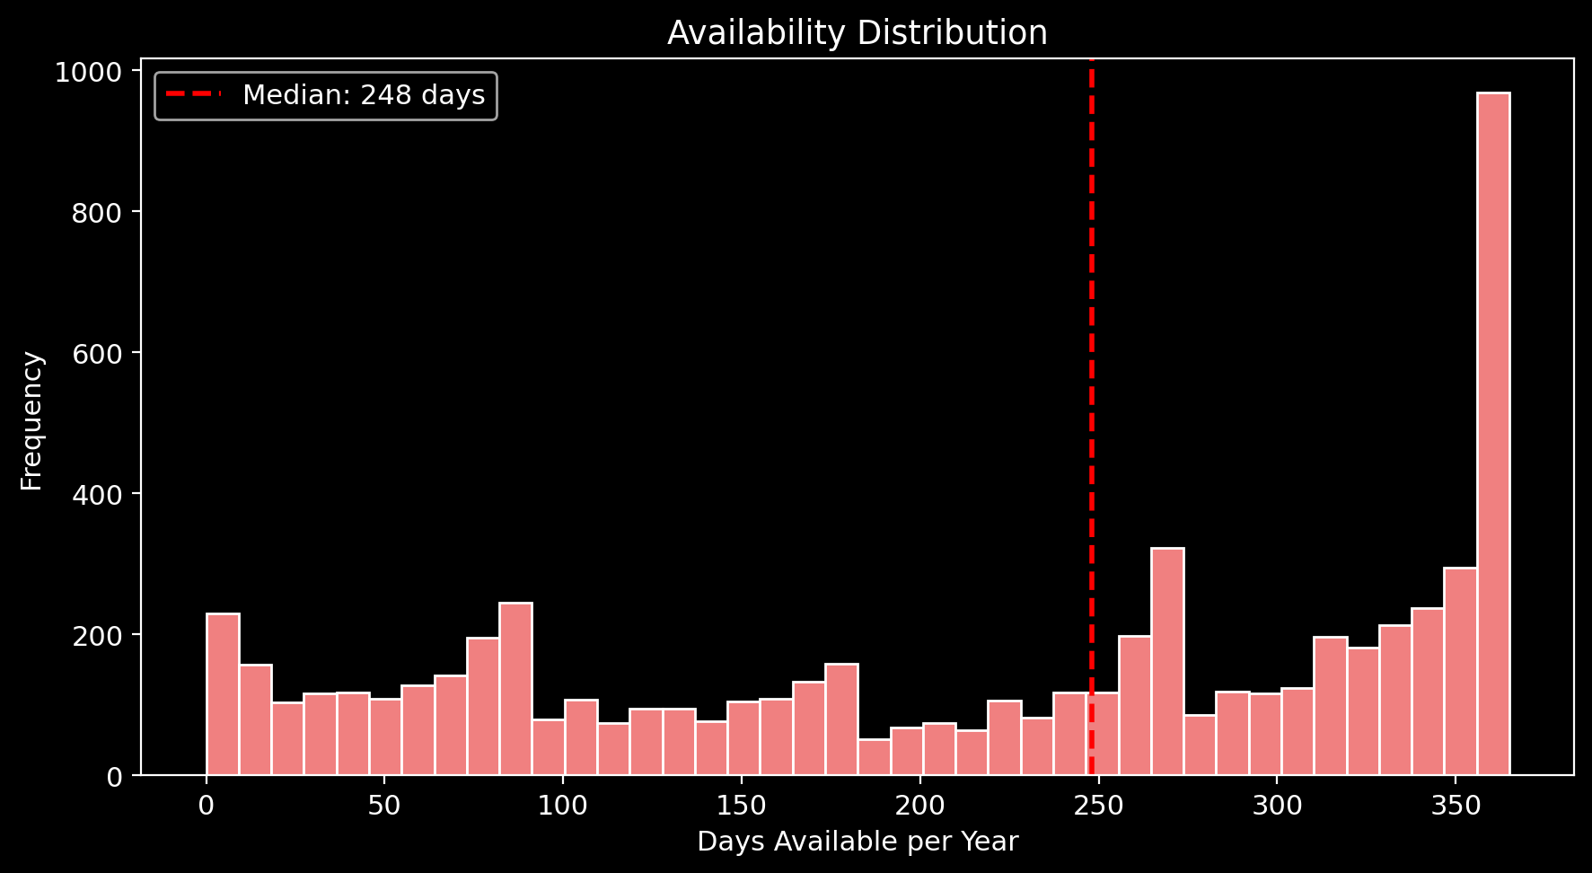
Availability Patterns
What we see: - Bimodal distribution: either rarely available or always available - ~25% of listings have <30 days availability (high demand or hobbyist hosts) - ~20% have 365 days (professional/dedicated rentals)
Availability Distribution

Slide 17
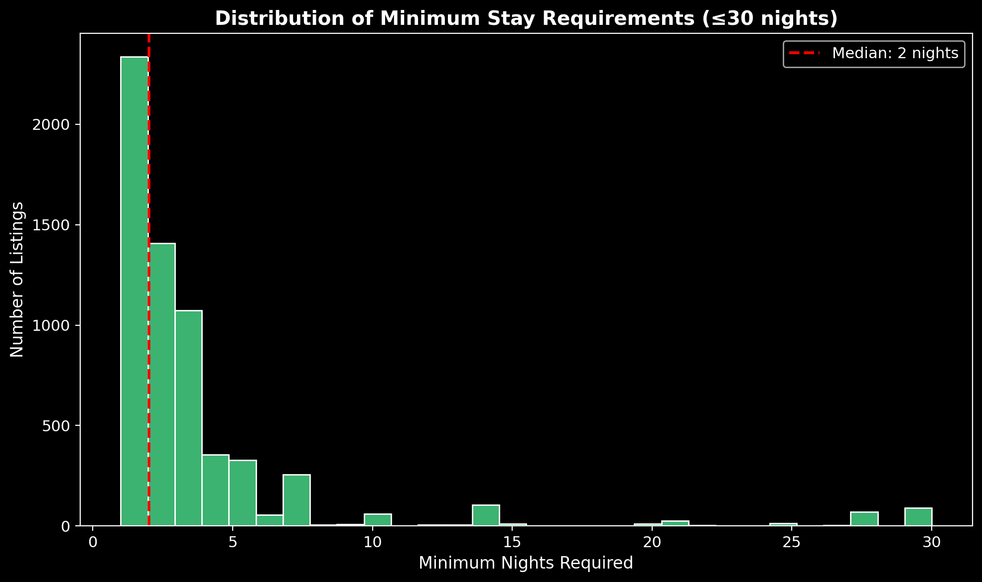
Availability vs Price
Weak relationship (r ≈ 0.05): - High availability ≠ lower prices - Suggests availability is a host choice, not market signal
Excluded from model: Not a significant price predictor.
Availability vs Price

Slide 18
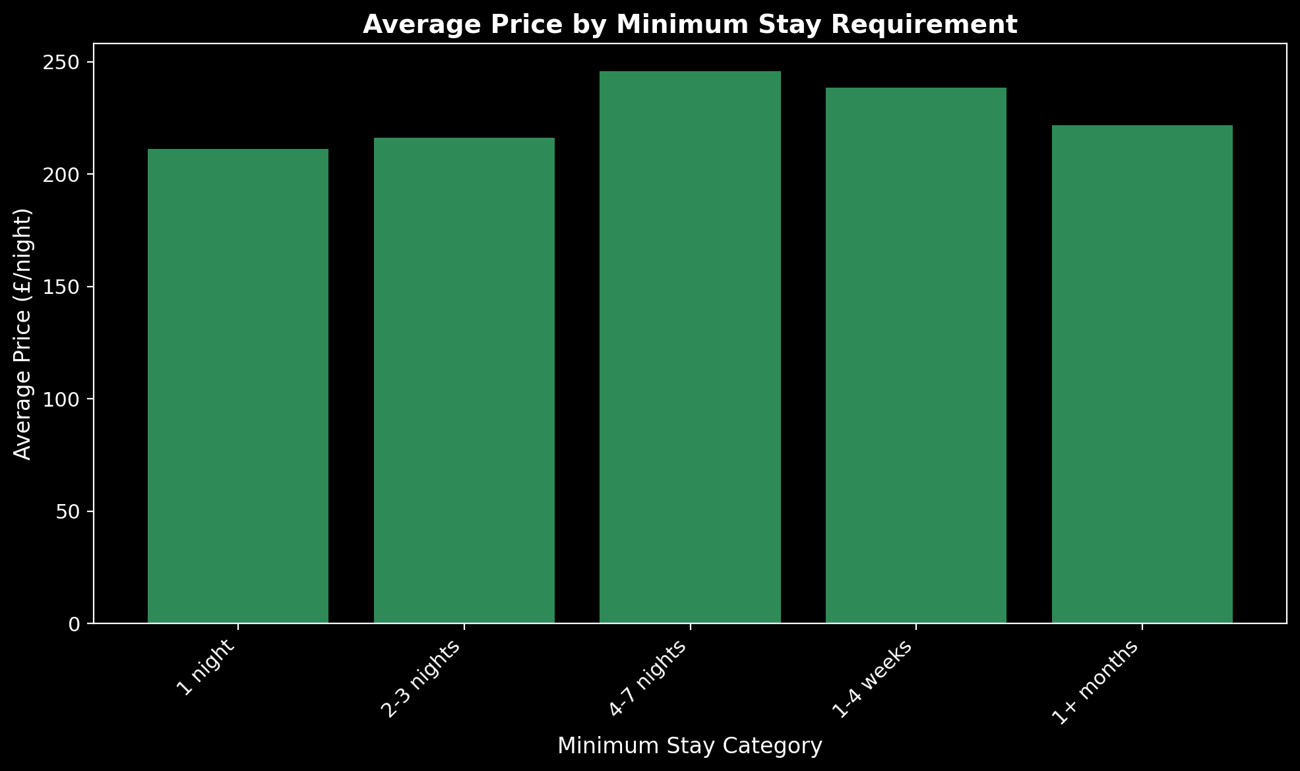
Minimum Nights: Host Strategy
Distribution insights: - Mode at 1-2 nights (tourist-friendly) - Secondary peak at 30+ nights (long-term rentals, regulatory compliance) - London 90-day rule creates clustering
Minimum Nights Distribution

Slide 19
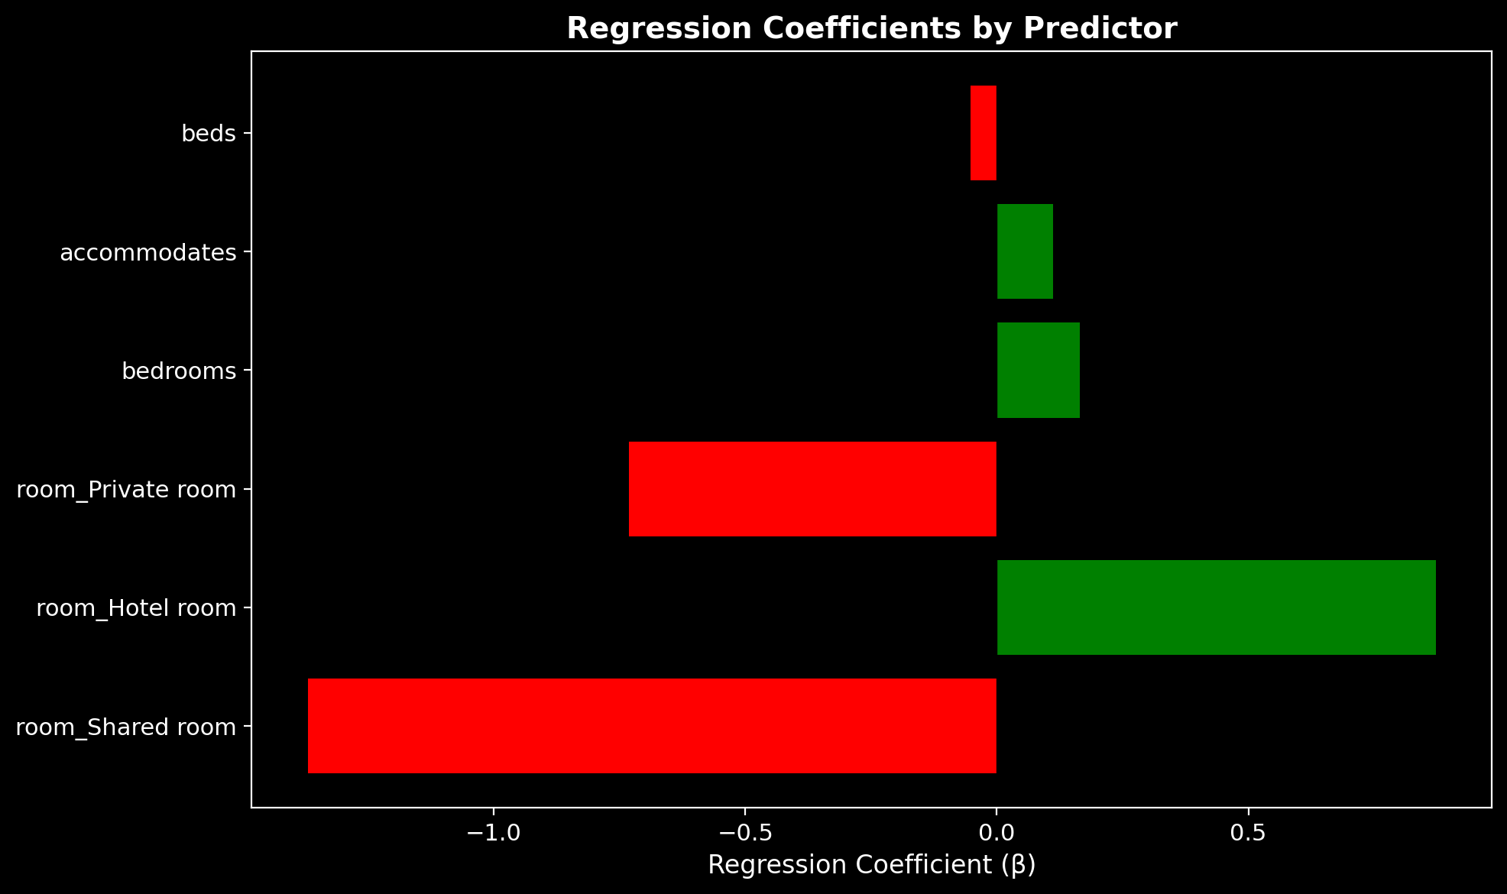
Minimum Nights by Category
Business interpretation: - Short-stay (<7 nights): Tourist market, higher turnover - Medium-stay (7-30): Business travelers, relocations - Long-stay (30+): Corporate housing, regulatory workaround
Excluded from final model: Reflects host strategy, not price driver.
Minimum Nights Categories

Slide 20
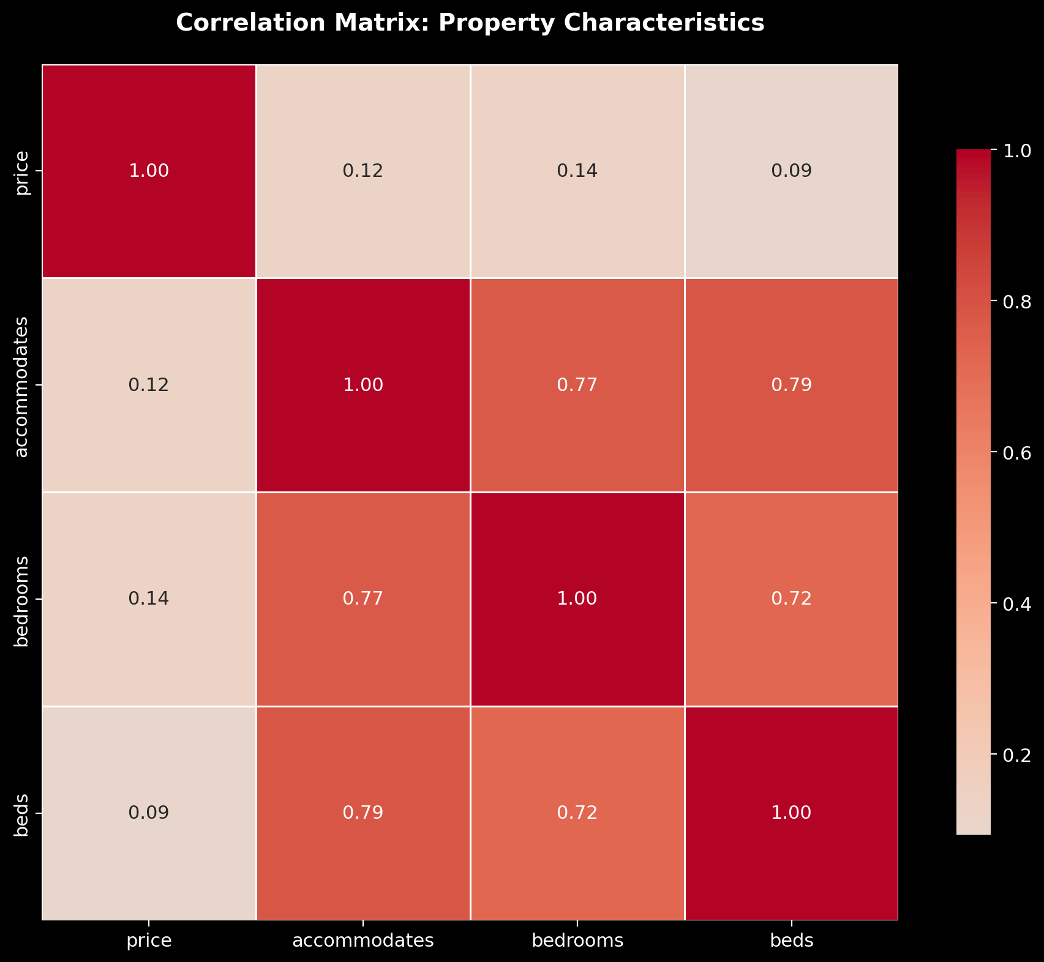
Correlation Reality Check
Correlation Matrix

Slide 21
Variable Pair | r
Accommodates ↔ Bedrooms | 0.82
Bedrooms ↔ Beds | 0.76
Accommodates ↔ Price | 0.54

Slide 22
The multicollinearity question: - VIF for accommodates = 11.6 (above threshold) - Decision: Retained all three—they measure different hospitality concepts (legal capacity vs. privacy units vs. sleeping surfaces)
Statistical purity < Business validity

Slide 23
The Model Specification
$$ln(\text{Price})=β_{0}+β_{1}(\text{accommodates})+β_{2}(\text{bedrooms})+β_{3}(\text{beds})+β_{4}(\text{Hotel})+β_{5}(\text{Private})+β_{6}(\text{Shared})+ε$$
Hypotheses: - H₀: All β = 0 (characteristics don’t matter) - H₁: ∃ β ≠ 0 (at least one matters)
Result: F-statistic > 1,000, p < 0.001 → Reject H₀

Slide 24
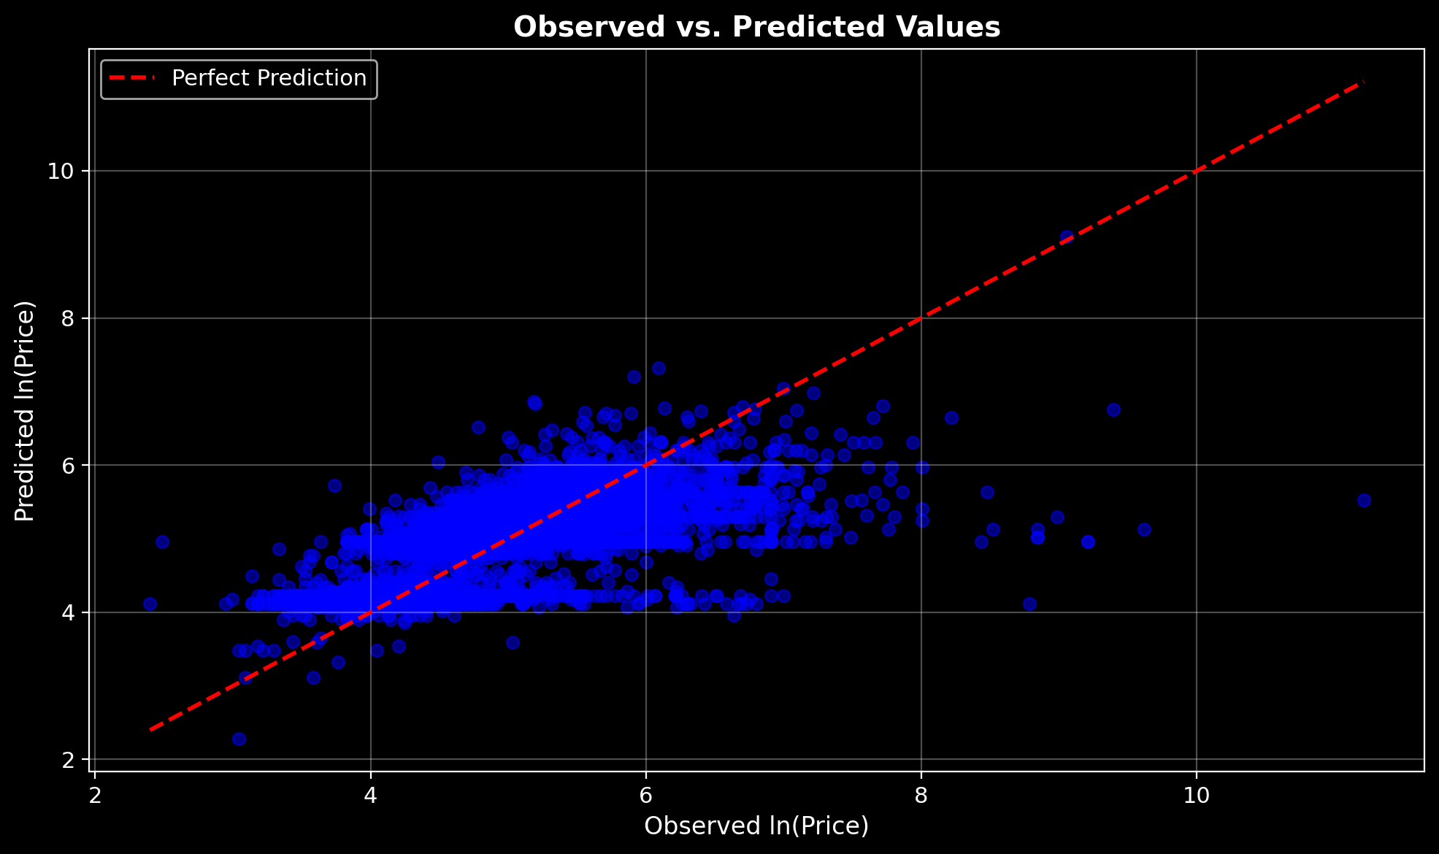
Coefficient Visualization
Visual takeaway: - Green bars (positive): accommodates, bedrooms, Hotel room add value - Red bars (negative): beds, Private room, Shared room reduce price - Magnitude: Room type effect dwarfs capacity effects
Coefficient Bar Chart

Slide 25
Coefficient Translation
Variable | β | Price Impact | Plain English
Accommodates | +0.11 | +12% per guest | More capacity = higher price
Bedrooms | +0.16 | +18% per bedroom | Separate rooms highly valued
Beds | −0.05 | −5% per bed | Negative when controlling for capacity
Hotel room | +0.87 | +139% vs entire home | Luxury/service premium
Private room | −0.73 | −52% vs entire home | Privacy premium is massive
Shared room | −1.37 | −75% vs entire home | Budget tier confirmed

Slide 26
Interpretation: Going from private room to entire home adds 52% to price—equivalent to adding 3 bedrooms.

Slide 27
Model Performance
Metric | Value | What It Means
R² | 0.50 | 50% of price variance explained
Adjusted R² | 0.50 | No overfitting penalty (n >> k)
RMSE (log) | 0.57 | ±57% typical prediction error
F-statistic | >1,000 | Model is highly significant

Slide 28
Benchmark: Literature reports R² = 0.45-0.60 for parsimonious hedonic models. We’re in range.

Slide 29
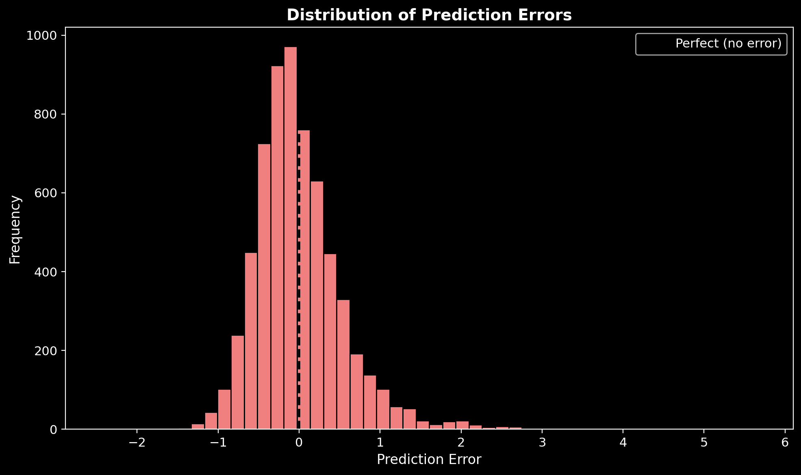
Prediction Accuracy by Tier
Observed vs Predicted

Slide 30
 | Budget | Mid | Premium | Luxury
Exact match | High | High | Moderate | Low
Within 1 tier | 94% | 93% | 85% | 62%

Slide 31
Insight: Model excels at Budget/Mid-range; struggles with Luxury (missing: amenities, reviews, professional photos).

Slide 32
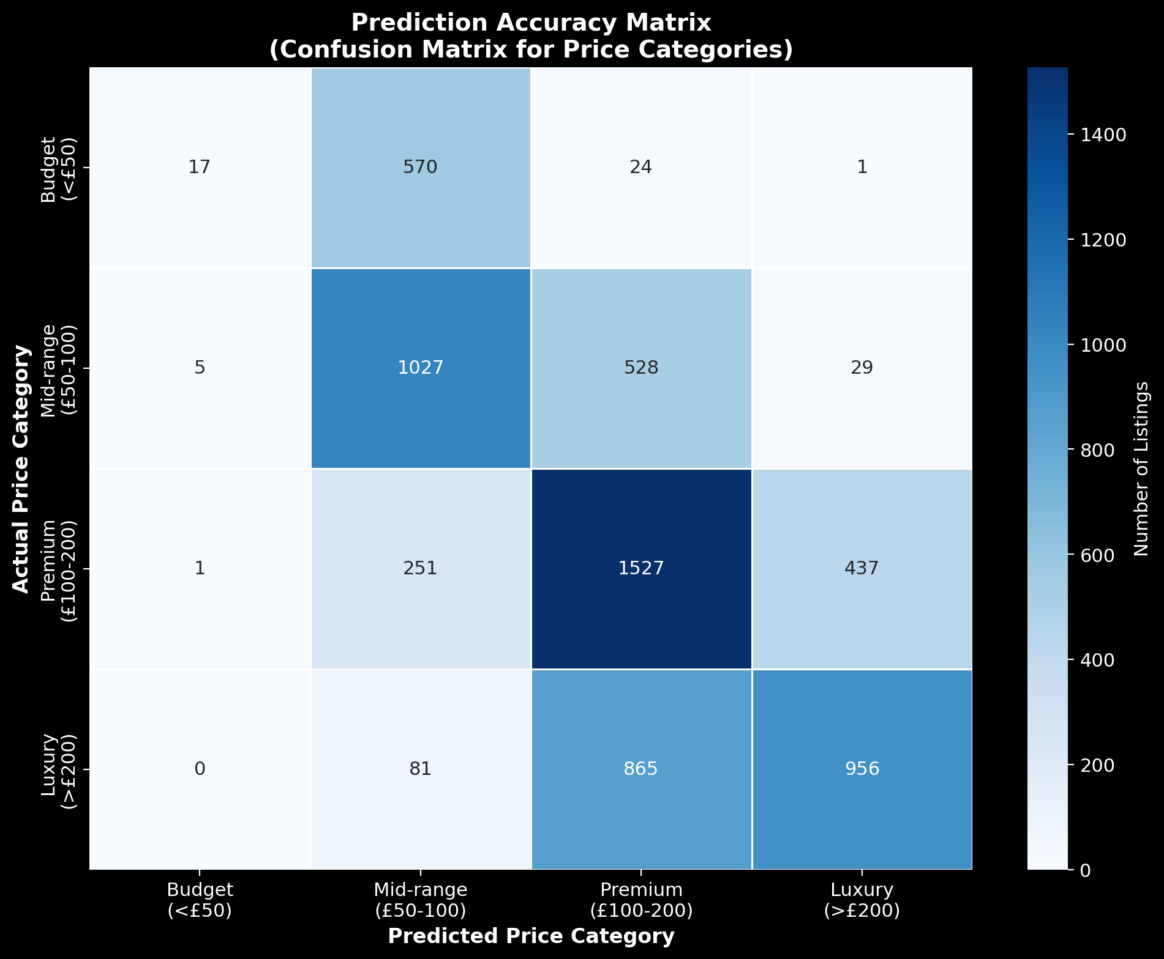
Residual Diagnostics
Checklist: - ✓ Mean residual ≈ 0 (unbiased) - ✓ Random scatter (no patterns) - ✓ Constant variance (homoscedasticity) - ✓ Log-transform worked
Conclusion: OLS assumptions satisfied. Model is valid for inference.
Residuals vs Fitted

Slide 33
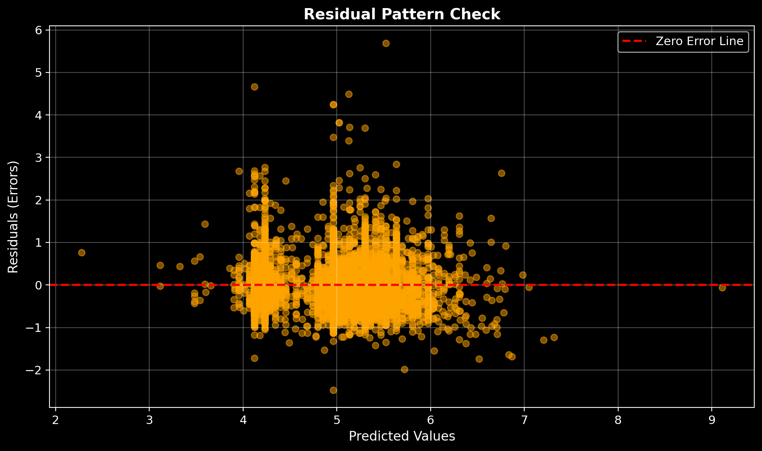
Residual Distribution
Normality check: - Approximately bell-shaped distribution - Centered at zero (unbiased predictions) - Slight right tail (luxury listings underpredicted)
Implication: OLS standard errors are valid; t-tests reliable.
Residual Histogram

Slide 34
The Honest Limitations
What’s Missing | Why It Matters
Amenities | WiFi, parking, pool can add 10-30%
Reviews | Superhost status = trust premium
Photos | Professional shots increase bookings
Exact location | Street-level matters more than borough
Seasonality | Summer vs. winter pricing differs 20%+

Slide 35
This model explains 50%. The other 50% needs richer data.

Slide 36
The Multicollinearity Trade-off
Concept | Business Meaning
Accommodates | Legal capacity (fire code, insurance)
Bedrooms | Privacy units (couples, families)
Beds | Sleeping surface configuration
The statistical concern: - accommodates VIF = 11.6 (above 10 threshold) - bedrooms VIF = 9.0 - beds VIF = 8.7
Why we kept all three:

Slide 37
A 4-person property with 2 bedrooms and 2 king beds ≠ 4-person property with 1 bedroom and 4 bunk beds.
The first is a couples retreat (premium). The second is a hostel (budget).
We chose domain validity over statistical purity.

Slide 38
So What? For Hosts
Pricing levers you control:
Maximize capacity (+12% per guest)
  Add sofa beds, loft spaces
  But don’t overcrowd—reviews suffer
Emphasize privacy (+52% for entire home vs private room)
  If offering private room, highlight exclusive bathroom/entrance
  Consider lockboxes for true separation
Benchmark aggressively
  Use this model to check: am I leaving money on table?
  Central London? You can charge 30% more than you think.

Slide 39
So What? For Airbnb
Platform opportunities:
Smart Pricing 2.0
  Integrate regression model into algorithm
  Show hosts: “Your price is in the 35th percentile for your area”
Onboarding nudges
  New hosts misprice by 25% on average
  First-listing guidance: “Similar properties charge £95”
Segment-specific dashboards
  Budget hosts need occupancy tips
  Luxury hosts need photography guidance

Slide 40
So What? For Investors
Attribute | Optimal
Bedrooms | 2-3
Zone | 2 (Hackney, Camden, Southwark)
Config | 4-6 guests
Type | Entire home
Transport | <5 min walk to Tube
Target acquisition profile:

Slide 41
Arbitrage opportunity: Scan for listings priced 15%+ below model prediction. Host likely doesn’t understand market.

Slide 42
The Ethical Footnote
Concern | Our Response
Data privacy | Only public listing data; no guest PII
Algorithmic fairness | No host demographics in model
Geographic proxies | Lat/long may encode socioeconomic signals
Housing impact | Pricing tools affect local rental markets

Slide 43
This model is for education. Production use requires fairness audits.

Slide 44
What We’d Do Next
Phase | Action | Expected R²
Phase 2 | Add amenities, reviews, host traits | 0.65-0.70
Phase 3 | Incorporate seasonality, events | 0.75
Phase 4 | Tree-based models (XGBoost) | 0.80+

Slide 45
But for an intro course with 6 predictors? R² = 0.50 is solid.

Slide 46
The Bottom Line
Room type drives price more than any other factor.
Entire homes earn 52-75% more than private/shared spaces.
Each guest capacity adds ~12%, each bedroom +18% to nightly rate.
Model explains half the variance—enough for benchmarking, not precision.

Slide 47
Questions?
Thank you.

Slide 48
Appendix: Technical Summary
Item | Detail
Sample | 6,319 listings (stratified from ~10k raw)
Target | ln(price)
Predictors | accommodates, bedrooms, beds, room_Hotel, room_Private, room_Shared
Method | OLS regression (statsmodels)
Diagnostics | VIF, residual plots, confusion matrix
Limitations | Cross-sectional, missing amenities/reviews

Slide 49
GitHub: Kartavya_Business_Analytics2025

Slide 50
Appendix: Coefficient Table (Full)
coef std err t P>|t|
--------------------------------------------------------------------
const 4.6250 0.018 252.981 0.000
accommodates 0.1122 0.007 16.752 0.000
bedrooms 0.1644 0.012 13.828 0.000
beds -0.0523 0.009 -5.857 0.000
room_Hotel room 0.8721 0.190 4.595 0.000
room_Private room -0.7310 0.018 -40.994 0.000
room_Shared room -1.3692 0.134 -10.244 0.000
All p-values < 0.05. Model is statistically significant.

Slide 51
Appendix: References
Wang, D. & Nicolau, J.L. (2017). Price determinants of sharing economy based accommodation. International Journal of Hospitality Management, 62, 120-131.
Gibbs, C., Guttentag, D., Gretzel, U., Yao, L., & Morton, J. (2018). Use of dynamic pricing strategies by Airbnb hosts. International Journal of Contemporary Hospitality Management, 30(1), 2-20.
Teubner, T., Hawlitschek, F., & Dann, D. (2017). Price determinants on Airbnb: How reputation pays off in the sharing economy. Journal of Self-Governance and Management Economics, 5(4), 53-80.

Slide 52
“Numbers whisper patterns, but only those who listen with discipline, skepticism, and imagination can turn them into wisdom.”
— The Business Analytics Guru

