Slide 1
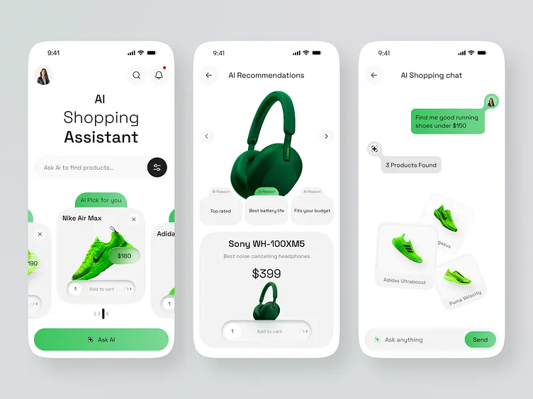
From SEO to AEO / GEO
Answer Engines & Generative Engines
When the shopper stops scrolling and starts asking
how brands get found, compared, and chosen by AI agents.
VISIBILITY
CONSIDERATION
LOYALTY-AS-API
MEASUREMENT
Extends Thread 04 of the Week 3 deck · September 2026 · All statistics flagged with evidence grades

Slide 2
01 · THE TRIGGER
The click is dying: search became an answer
Discovery is migrating from result lists to synthesized answers most journeys now end inside the chat.
37%
13.8%
54%
40.7%
of product-discovery queries now start in AI interfaces (ChatGPT, Perplexity…)
Vendor-tracked, 2026 — directional
overall AI citation rate across 15,730 live buyer-question checks
Boring Marketing audit engine, Sep 2026
of audited brands were INVISIBLE on all four major AI platforms
Same source the new ‘page 2’
of voice answers are pulled from featured snippets
From your Week 3 deck · voice = AEO-native
THE ZERO-CLICK ECONOMY
Traditional SEO: query → 10 blue links → click → your site → conversion.
Answer engines: prompt → synthesized recommendation → often NO visit at all.
Future of Commerce · BBA — Deep Dive: The Shift from SEO to AEO/GEO
2

Slide 3
02 · THE MECHANISM
From ranking pages to synthesizing consensus
Google ranked documents. Answer engines build agreement across independent sources before they dare to recommend.
SEO THE INDEX MODEL
AEO / GEO THE CONSENSUS MODEL
1 · CRAWL Bots fetch pages; keywords & backlinks signal relevance
1 · PROMPT Conversational, multi-constraint, ~29 words (voice)
2 · RANK One winner per position · Page 1 or nothing
2 · RETRIEVE RAG pulls live sources feeds, reviews, Reddit, editorial
3 · CLICK User leaves the SERP · you own the visit
3 · CONSENSUS Agreement across INDEPENDENT sources builds confidence
4 · CONVERT Funnels, landing pages, CRO
4 · SYNTHESIZE One answer names 3–5 brands · cite or disappear
Unit of competition: the POSITION
Unit of competition: the MENTION
Future of Commerce · BBA — Deep Dive: The Shift from SEO to AEO/GEO
3

Slide 4
03 · DEFINITIONS
SEO vs AEO vs GEO
Microsoft (Jan 2026): “SEO drove clicks. AEO drives clarity with enriched real-time data. GEO establishes credibility through an authoritative voice.”
SEO · Search Engine Optimisation
AEO · Answer Engine Optimisation
GEO · Generative Engine Optimisation
Be found in ranked lists
Be the cited answer
Shape what models believe
• Keyword research & density
• Backlinks & domain authority
• Meta tags · CTR optimisation
• Unit: the click
• Structured data (schema.org, JSON-LD)
• Product feeds & APIs pushed to engines
• Direct, extractable, dated answers
• Unit: the citation
• Third-party consensus & reviews
• Brand mentions across trusted sources
• Narrative & authority signals
• Unit: the recommendation
Same product, three eras: SEO: “Waterproof rain jacket” → AEO: “Lightweight, packable waterproof jacket with stuff pocket, ventilated seams, reflective piping” → GEO: “Best-rated waterproof jacket by Outdoor magazine, 4.8★, 180-day returns, 3-year warranty.”
Future of Commerce · BBA — Deep Dive: The Shift from SEO to AEO/GEO
4

Slide 5
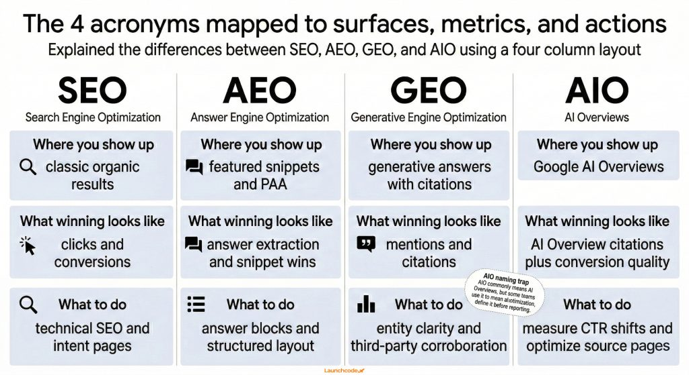

Slide 6
04 · THE EVIDENCE
What answer engines actually cite
15,730 live buyer-question checks across ChatGPT, Perplexity, Claude & Gemini (Boring Marketing, Sep 2026).
BRAND CITATION RATE BY PLATFORM
WHERE CITATIONS COME FROM
Perplexity
17.7%
Brand's own site (when machine-readable)
51.7%
Guides & blog posts
14.3%
Gemini
17.3%
Listicles & roundups
12.4%
ChatGPT
12.3%
Community & social
8.0%
Claude
7.6%
Video
6.0%
Same brands, same questions four different answers. Optimising for one engine leaves the other three dark.
Reddit appears in answers for 56% of brands more than Forbes & Wikipedia combined. YouTube: 51%.
Future of Commerce · BBA — Deep Dive: The Shift from SEO to AEO/GEO
5

Slide 7
05 · THE GATE
Machine-readability is the new gatekeeper
2,225 crawled pages: AI cites what it can extract, date and attribute.
36%
77%
21%
3.6×
of pages were thin or non-extractable invisible by default
Boring Marketing crawl, 2026
carried no visible date engines distrust undated claims
Same crawl
showed author signals attribution builds cite-confidence
Same crawl
more customer reviews on recommended vs non-recommended products in ChatGPT's carousel
WitsCode 2026 — vendor playbook
THE AEO TECH-CHECK
Autonomous Filtering: AI assistants like Amazon Alexa for Shopping and research tools curate shortlists of 3 to 5 options based on logic, price, and specs, entirely bypassing traditional top-of-funnel brand awareness
Generative Engine Optimization (GEO) replaces traditional SEO by rewarding clarity, structured data, and citability over keyword volume and backlinks
Elimination of Vague Content: AI models ignore lifestyle videos, hero images, and hidden text, extracting meaning strictly from clean, parsable data and physical text.
Future of Commerce · BBA — Deep Dive: The Shift from SEO to AEO/GEO
6

Slide 8
06 · THE PLAYBOOK
The AEO/GEO stack
What actually moves the citation needle, ordered by effort vs impact.
L4 · NARRATIVE
GEO
Earned mentions in trusted publications & communities; consistent positioning everywhere the model looks
Slow · compounding
L3 · CONSENSUS
GEO
Reviews on G2/Capterra/Trustpilot, Reddit threads, YouTube — independent validation at scale
Medium · high trust
L2 · STRUCTURE
AEO
Schema.org JSON-LD, product feeds (ChatGPT Merchant Program, Google Shopping), llms.txt
Fast · table stakes
L1 · TRUTH
AEO
Real-time price & stock APIs, canonical data, dated content the RAG pipeline can fetch
Fast · foundational
Future of Commerce · BBA — Deep Dive: The Shift from SEO to AEO/GEO
7

Slide 9
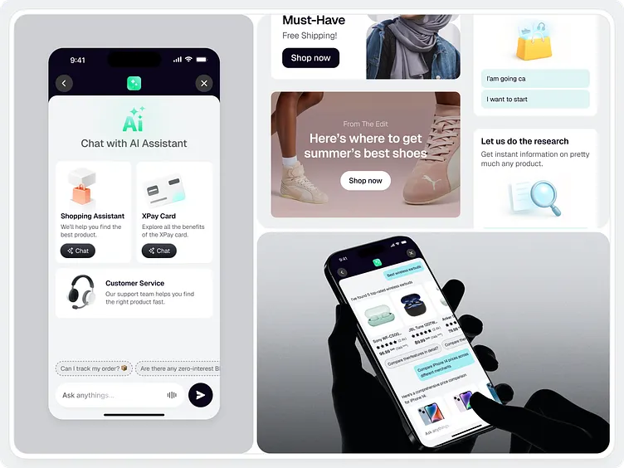
07 · IN PRACTICE
One running shoe, three eras of discovery
How the same product gets found from keywords to conversations to machine consensus.
2015 · SEO
Maya googles “best running shoes flat feet”. Ten blue links; Nike and Brooks fight for position 1. Winner takes the click.
2024 · AEO
She asks Perplexity “best cushioned shoes for flat feet under £130, in stock near me?” the engine synthesises; brands with structured feeds & reviews get cited.
2026 · GEO
The agent interface is the new shelf edge (Dribbble UI concept)
Her agent compares five options, weighs her 400km history, checks Reddit consensus and surfaces the brand the internet collectively vouches for.
Future of Commerce · BBA — Deep Dive: The Shift from SEO to AEO/GEO
8

Slide 10
08 · STRATEGY RESET
The consideration-set paradox: AI EXPANDS choice
OLD WORLD — FUNNEL NARROWS
AGENTIC WORLD SET EXPANDS
20 results seen
Maya: “find me shoes like these, vegan, under £120, 4★+”
Brand A — cited (structured feed)
5 clicked
Brand B — cited (Reddit consensus)
Brand C — cited (editorial roundup)
2 compared
Brand D — NEW entrant, poached in
Brand E — NEW entrant, niche
1 bought
Your brand — invisible: no schema, no reviews
SEO goal: survive the narrowing → win position 1.
Agents industrialise curation is the agent the shopper's filter or the store's recommender?
Future of Commerce · BBA — Deep Dive: The Shift from SEO to AEO/GEO
9

Slide 11
09 · THE CONFLICT
Who pays the agent?
TODAY EARNED
TOMORROW BOUGHT?
• ChatGPT recommendations are organic & unsponsored “ranked purely on relevance” (OpenAI, 2026)
• “Sponsored visibility inside agent answers” = the new retail-media inventory
• ChatGPT Merchant Program: submit product feeds directly — a free direct channel (chatgpt.com/merchants)
• Google already monetises AI Overviews adjacency; agents will not stay ad-free
• Perplexity cites independent pages 3× more than brand PDPs — earned media is the moat
• If the agent is paid by the store, is it the shopper's filter or the store's recommender? BOTH depending on who pays
• Visibility = structured data × reviews × third-party consensus
• Discipline: disclose sponsorship or burn the trust that GEO is built on
Future of Commerce · BBA — Deep Dive: The Shift from SEO to AEO/GEO
10
Notes:
Class debate: should paid agent recommendations be labelled — and who enforces it?

Slide 12
10 · RETENTION
Loyalty-as-API: invisible benefits don't exist
1 · TRIGGER
2 · INITIAL SET
3 · EVALUATION
4 · PURCHASE
5 · POST-PURCHASE
Agent detects depletion, calendar, context machine-readable replenishment logic
Preference model + structured merchant data not ad recall
Parallel catalog scan; AEO/GEO is the battleground
Protocol checkout + human approval gate (UCP/ACP)
Tracking & returns speed = re-selection signal
37%
$177
MCP / UCP
KPI shift
of LOYAL customers would let an agent switch brands poachable at ~zero switching cost
Week 3 deck · Forrester 2026
average no-approval ceiling consumers set per purchase
expose points, tiers & member prices as agent-queryable tools loyalty must be COMPUTED by the shopper's agent
Visa & Mastercard building agentic loyalty rails — disintermediation risk (dunnhumby, Jan 2026)
loyalty KPIs move from card-scans to agent recommendation rate · member retention · share of agent-mind
Week 3 deck, Thread 04
Future of Commerce · BBA — Deep Dive: The Shift from SEO to AEO/GEO
11

Slide 13

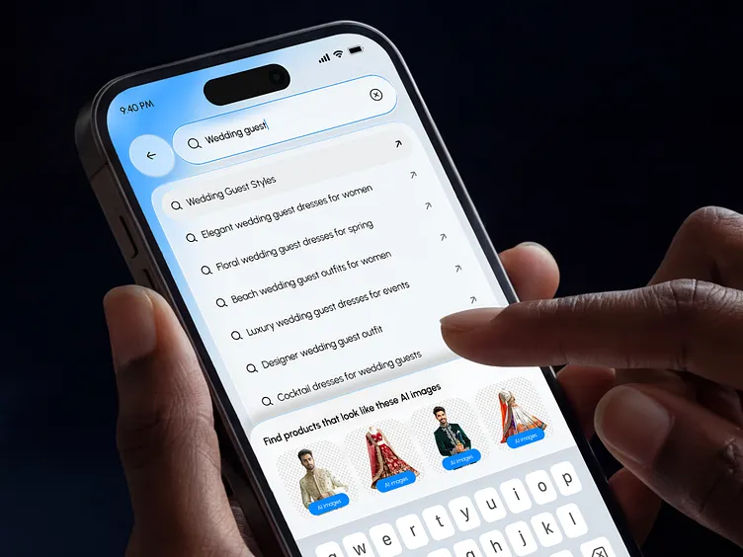
11 · THE SENSES
Voice, camera, location: three AEO front doors
Each sense collapses a different micro-moment and each demands a different optimisation play
VOICE the replenishment sense
Owns I-want-to-do + reorder. 72% of voice shoppers re-buy the same brand; queries average ~29 words vs 4 typed.
Play: conversational content, FAQ schema, featured snippets (40× more likely to be voice answers), Alexa Skills.
CAMERA the discovery sense
VLMs encode style as embeddings: “coastal grandmother” retrieves with zero keyword match. ~20B Google Lens searches/month.
Play: image assets as structured data, semantic alt text (~3× AI visibility), AI-readable brand guidelines (only ~15% of brands have them).
LOCATION the proximity sense
82% of “near me” queries carry intent modifiers; 28% of local voice searches convert same-day.
Play: intent maps over pin accuracy; opt-in is hard architecture (GDPR/CCPA/DPDP), not soft preference.
Future of Commerce · BBA — Deep Dive: The Shift from SEO to AEO/GEO
12

Slide 14
12 · MEASUREMENT
The dashboard dies, the answer-book is born
Attribution ≠ causation (Week 2, p38). AI influence often leaves no referral click measure the answer, not the visit.
Agent recommendation rate
Share of agent-mind
Answer accuracy
% of category prompts where you're cited in the top-5 answer
your mentions ÷ all brand mentions across ChatGPT · Perplexity · Gemini · Claude
% of AI answers about your brand with correct price, stock & claims
AI-assisted conversion
Citation drift
Zero-regret rate
brand-search lift & cohort conversion in high-visibility markets
40–60% of cited domains change monthly — trends need 3+ months of baseline
delegated purchases with no return, complaint or revocation (from the Week 3 activity)
Honesty rule: GA4 can't see most of this. Segment chat.openai.com referrals, survey “how did you first hear about us?”, and treat every AEO dashboard number as directional — vendor-graded, not peer-reviewed.
Future of Commerce · BBA — Deep Dive: The Shift from SEO to AEO/GEO
13

Slide 15
13 · CASE EVIDENCE
What the numbers say
In keeping with the deck's rule: estimates ≠ facts. Vendor-reported lifts are illustrative, not causal proof.
ChatGPT Shopping Research
ChatGPT Merchant Program
Perplexity consensus effect
52% vs 37%
Free feed
3×
product-accuracy on complex multi-constraint queries vs standard ChatGPT Search (OpenAI benchmark)
direct product-feed channel to 900M weekly users today's closest thing to a ‘submit to answer engines’ button
independent third-party pages cited 3× more often than brand-owned product pages
FLAG: first-party benchmark, unaudited
FLAG: platform still makes pricing errors; OpenAI tells users to verify on merchant sites
FLAG: single vendor analysis (True Margin 2026)
AI-referred traffic
Albertsons voice replenishment
~4,700%
46 → 4 min
growth in US retail traffic referred by AI (Adobe, May 2026); Shopify: 8× AI traffic, 13× AI-search orders YoY
per shop with AI assistant the replenishment-sense case from Week 3
FLAG: platform first-party data — directional, not peer-reviewed
FLAG: vendor-reported case study
Future of Commerce · BBA — Deep Dive: The Shift from SEO to AEO/GEO
14

Slide 16
14 · THE PLAYBOOK
A 90-day AEO/GEO sprint for a mid-size brand
Sequenced for effort vs impact: fix the truth, structure it, earn the consensus, then measure the answer.
DAYS 1–30 · TRUTH & STRUCTURE
DAYS 31–60 · CONSENSUS
DAYS 61–90 · MEASURE & DEFEND
▸ Unblock AI crawlers in robots.txt (GPTBot, OAI-SearchBot, PerplexityBot)
▸ Seed reviews: G2/Trustpilot/Amazon target the 3.6× review delta
▸ Stand up prompt-level tracking: % recommended, share of agent-mind
▸ Ship Product + Offer + AggregateRating + FAQPage JSON-LD
▸ Refresh editorial roundups & comparison pages with dated, structured data
▸ Segment AI referrals in GA4; add ‘heard about you via AI’ to checkout survey
▸ Submit feeds: Merchant Program + Google Shopping; GTIN everywhere
▸ Answer 10 real Reddit/forum threads weekly — where your buyers ask
▸ Draft agent-readiness of loyalty: points/tiers as queryable API
▸ Baseline: run 50 category prompts across 4 engines, log who gets cited
▸ Publish llms.txt + canonical pricing pages to kill hallucinations
▸ Stress-test the creepiness line (Week 2, p34) before scaling personalisation
Future of Commerce · BBA — Deep Dive: The Shift from SEO to AEO/GEO
15

Slide 17
15 · DISCUSSION ACTIVITY
Win the answer: the Maya prompt audit
Teams of 3 · 25 minutes · extends the Week 3 ‘Design the approval gate’ activity.
THE BRIEF
Maya asks ChatGPT: “I'm training for a half-marathon, flat feet, budget £130 — which running shoes should I buy, and where's cheapest near Shoreditch?”
Your team represents ONE brand. Run the audit, then redesign your presence to win the citation.
1 · RUN THE PROMPT
2 · DIAGNOSE THE GAP
3 · REWRITE ONE ASSET
4 · PITCH THE ANSWER
Actually prompt 2 AI engines with Maya's question. Who gets cited? Who is invisible? Screenshot the answers.
For one invisible brand: which stack layer failed — Truth, Structure, or Consensus? Point to the evidence.
Pick their PDP or a roundup page and rewrite it to AEO/GEO standard: schema, consensus, dated, extractable.
90 seconds: why your redesign would now win the citation — and which metric proves it in 90 days.
Completion criteria: prompt screenshots · one gap diagnosis · one rewritten asset · one proof metric · 90-second pitch.
Future of Commerce · BBA — Deep Dive: The Shift from SEO to AEO/GEO
16

Slide 18
16 · SUMMARY
Five takeaways for the answer-engine era
And the bridge back to Thread 04: visibility is no longer bought in auctions — it's earned in consensus.
1 · Clicks were the unit; mentions are
37% of discovery starts in AI interfaces. If the answer doesn't cite you, you were never considered.
2 · Consensus beats optimisation
51.7% of citations go to machine-readable brand sites; independent validation multiplies trust. GEO is earned media at machine speed.
3 · The set expands, the funnel dies
Agents industrialise curation — new entrants get poached in, loyal brands get switched out (37%). Post-purchase excellence now trains the machine gatekeeper.
4 · Loyalty must be an API
Benefits the agent can't query don't exist. Expose points, tiers and member prices — before Visa & Mastercard's rails disintermediate you.
5 · Measure the answer, not the visit
% recommended · share of agent-mind · answer accuracy · zero-regret rate. Attribution ≠ causation — flag every number with its evidence grade.
Future of Commerce · BBA — Deep Dive: The Shift from SEO to AEO/GEO
17

