Slide 1
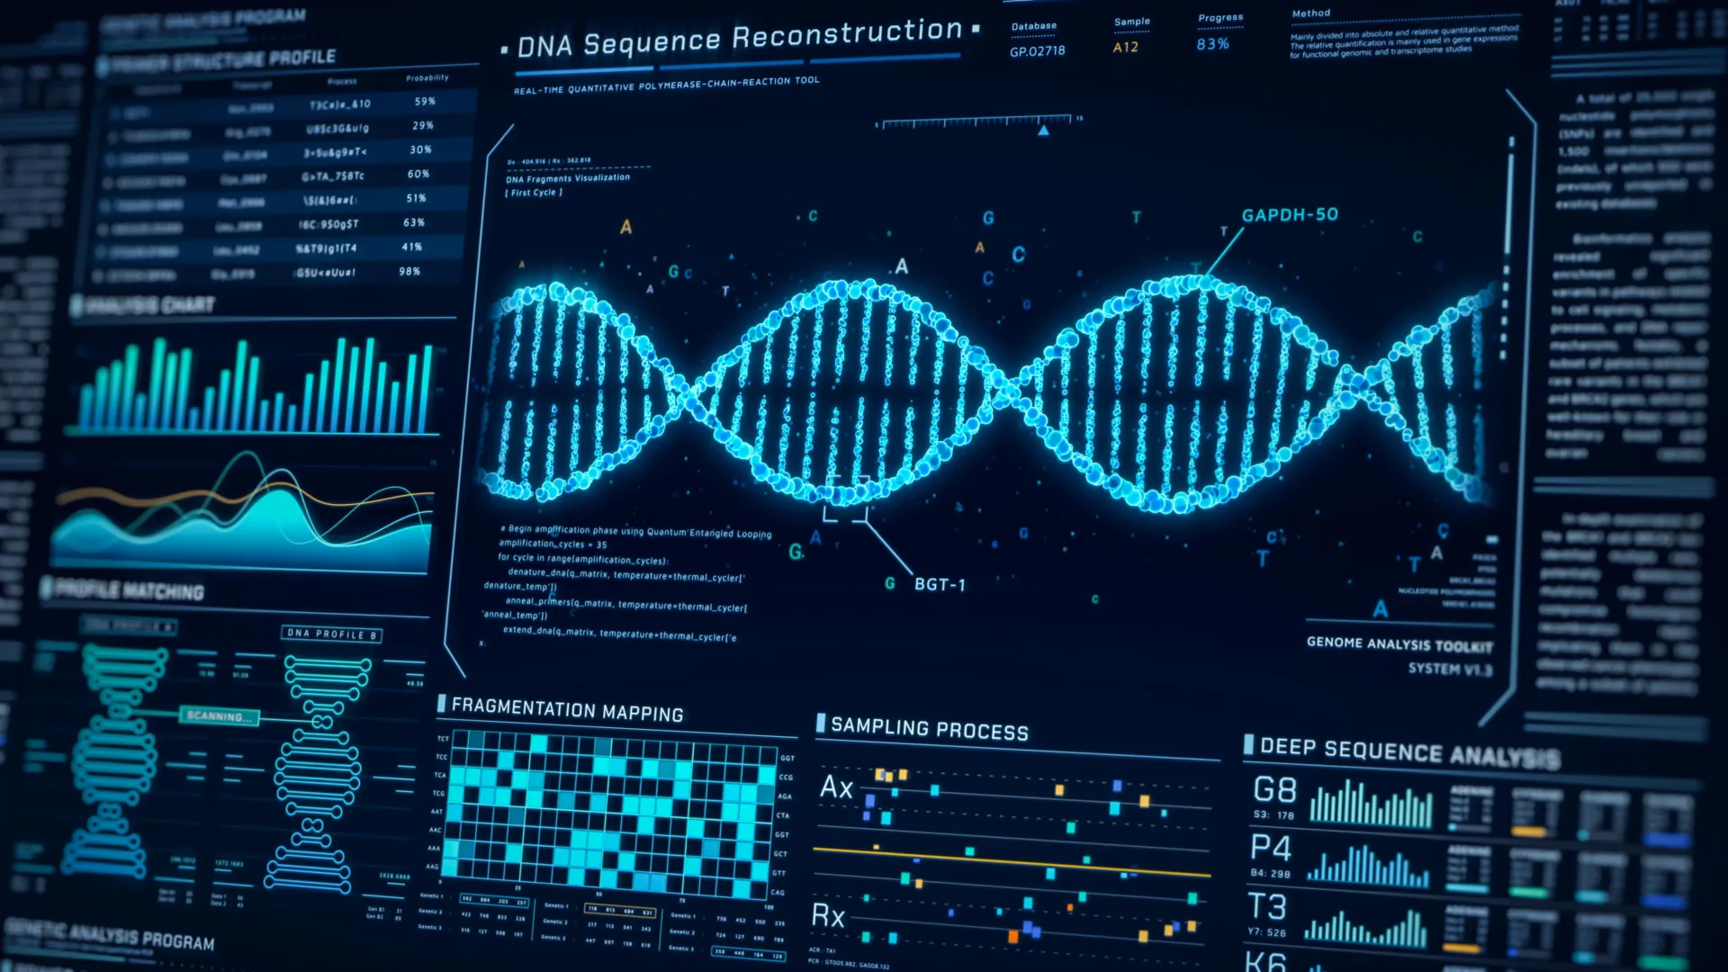
AI-Driven DNA Sequence Classification
Comparative Analysis on Encoded vs Raw DNA Sequences
Group 5
Swayam Shah
Krupalkumar Patel
Kartavya Mandora
Date: 04/03/2026
https://www.shutterstock.com/search/genetic-future?image_type=illustration
AI687_SPRING2026

Slide 2
OUTLINES
Introduction
Application
Literature Review
Literature Review result
Methodology
Dataset
Understanding the Functions
Obtained Results
Conclusion & Future work
Teamwork Distribution
Timeline
References

Slide 3
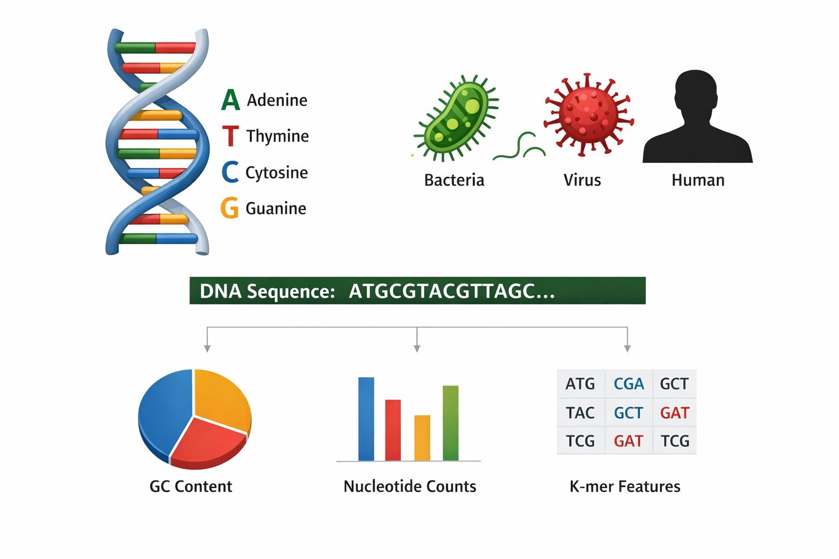
INTRODUCTION
DNA sequences consist of nucleotides: A, T, C, G Task: Splice Junction Classification Classes: • EI (Exon–Intron) • IE (Intron–Exon) • N (Non-splice) Challenge: • Complex biological patterns • Large-scale genomic data
https://www.shutterstock.com/search/genetic-future?image_type=illustration

Slide 4
INTRODUCTION
Problem Statement
The Challenge:
❌ Massive growth of genomic data
❌ Manual DNA analysis is slow & inefficient
❌ Traditional ML depends on handcrafted features
❌ Difficulty capturing complex sequence patterns
❌ Learning directly from raw DNA sequences (unstructured data)
Solution:
Proposed Model: CNN - BiLSTM
CNN:
Extracts local nucleotide motifs
BiLSTM:
Captures long-range dependencies
Key Advantage:
Works on both encoded and raw DNA data

Slide 5
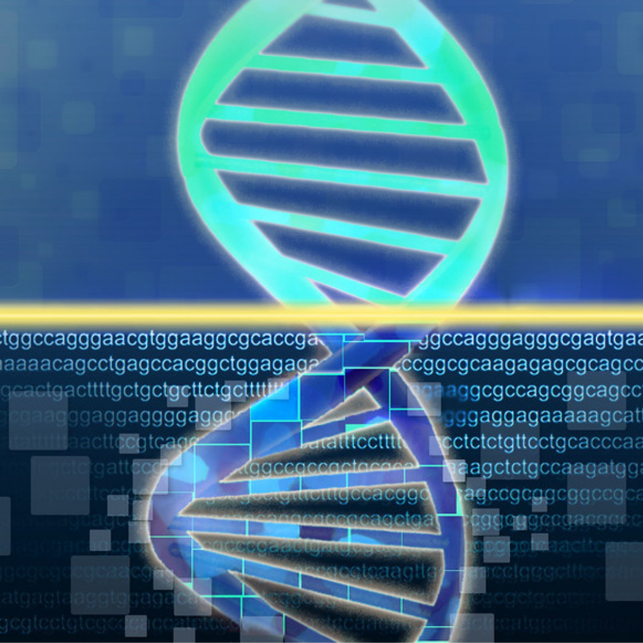
APPLICATION
Splice Site Detection (EI / IE classification)
Gene Structure Analysis
Genomic Data Processing
Disease Prediction (mutation detection)
Biomedical Research Support
Large-scale Genomic Analysis
https://www.shutterstock.com/search/genetic-future?image_type=illustration

Slide 6
LITERATURE REVIEW
Research paper 1
Paper: Wavelet Neural Networks(WNN) for DNA Sequence Classification (2016)
a Core Idea:
Uses Wavelet Neural Network (WNN) for DNA classification
Combines Genetic Algorithm (GA) + Least Trimmed Square (LTS) for optimization
Method: • DNA → Binary encoding → Power spectrum transformation • Wavelet-based feature extraction + K-means clustering Key Contribution: • Improves classification accuracy using signal-processing techniques Limitation: • Relies on handcrafted feature transformation • Cannot capture deep sequential dependencies in DNA

Slide 7
LITERATURE REVIEW
Research paper 2
Paper: SpliceRover - Interpretable Convolutional Neural Networks for Improved Splice Site Prediction (2018)
Core Idea: • Uses Convolutional Neural Networks (CNN) for splice site prediction • Learns features directly from raw DNA sequences Method: • One-hot encoding of DNA sequences • Multi-layer CNN + max pooling + softmax classifier Key Contribution: • Outperforms traditional ML models (~80% improvement) • Provides interpretability using DeepLIFT visualization
Limitation: • Focuses only on local sequence patterns (CNN) • Does not capture long-range dependencies
https://commons.wikimedia.org/wiki/File:DNA_animation.gif

Slide 8
LITERATURE REVIEW
Research paper 3
Paper: A Deep Learning Approach to DNA Sequence Classification (2016)
Core Idea: • Uses CNN with spectral (k-mer) representation of DNA • Converts sequences into fixed-length feature vectors Method: • k-mer based representation (4^k features) • CNN (LeNet-5 based) for classification Key Contribution: • Deep learning outperforms SVM, RF, and Naive Bayes • Works well for short DNA fragments Limitation: • Ignores positional information (bag-of-words approach) • Limited sequence dependency modeling

Slide 9
LITERATURE REVIEW RESULTS
Aspect | Splice Rover (2018) | WNN-GA (2016) | K-mer representation (2016)
Task | Splice site prediction | DNA sequence classification (includes splice dataset) | DNA sequence classification (16S genes)
Model Used | Convolutional Neural Network (CNN) | Wavelet Neural Network + Genetic Algorithm | Convolutional Neural Network (LeNet-5 based)
Input Representation | One-hot encoded DNA sequences | Binary encoding + Fourier Transform + Power Spectrum | k-mer spectral representation
Reported Performance | Around 78-81% reduction in false discovery rate vs SVM | 94% testing accuracy (splice dataset) | 95-99% accuracy (full-length sequences)
Key Contribution | High-accuracy CNN with biological interpretability | Hybrid optimization improves classification robustness | Demonstrates CNN superiority over classical ML models
Research Gap
Traditional methods → depend on feature engineering
CNN-only models capture only local patterns
k-mer methods → ignore sequence order
Limited evaluation on raw DNA data
No hybrid CNN + sequence modeling
Our contribution: Introduce a hybrid deep learning model that combines CNN and BiLSTM for both encoded and raw DNA sequences.

Slide 10
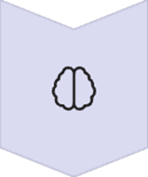


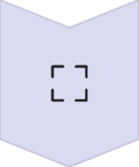
ALGORITHM/APPROACH/METHODOLOGY
DATA COLLECTION
• Collect labeled DNA sequences and raw sequence of dataset
• Use benchmark dataset (e.g., Kaggle)
DATA PREPARATION
• Encode sequences (One-Hot / Numerical) • Pad sequences to equal length
• Train / Validation split
MODEL DESIGN
• CNN → Feature Extraction • BiLSTM → Sequence Dependencies
• Hybrid Architecture. • Applied on : Encoded and Raw DNA Sequences Dataset
MODEL TRAINING
• Train on labeled data • Loss: Cross-Entropy • Hyperparameter tuning.
MODEL EVALUATION
• Validate on test set • Metrics: Accuracy, F1-Score • Error analysis.

Slide 11
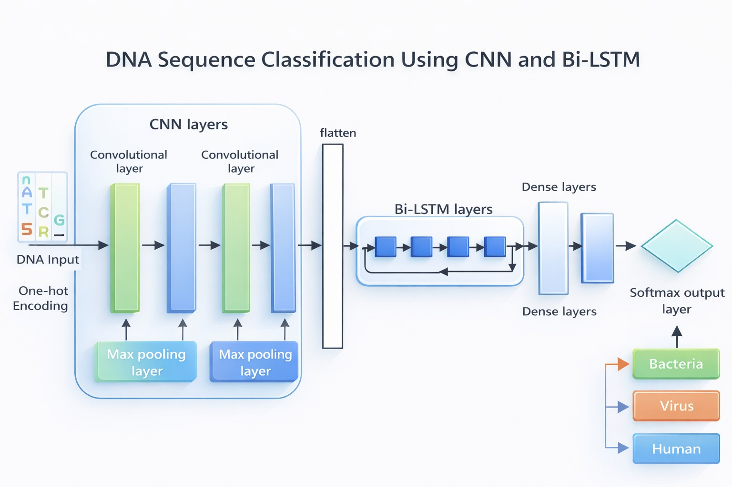
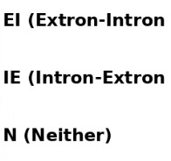
MODEL ARCHITECTURE

Slide 12
DATASET
Feature | Old Dataset | New Dataset
Samples | 3,190 | 45,619
Format | Encoded (180 features) | Raw DNA sequence
Input Shape | (60, 3) | (400, 4)
Preprocessing | Minimal | One-hot encoding
Complexity | Low | High
Realism | Moderate | High
Label | Old Dataset | New Dataset
0 | N (Neither / Non-splice) | EI (Exon-Intron)
1 | EI (Exon-Intron) | IE (Intron-Exon)
2 | IE (Intron-Exon) | N (Non-splice)
Note: Raw dataset is more complex but more realistic

Slide 13
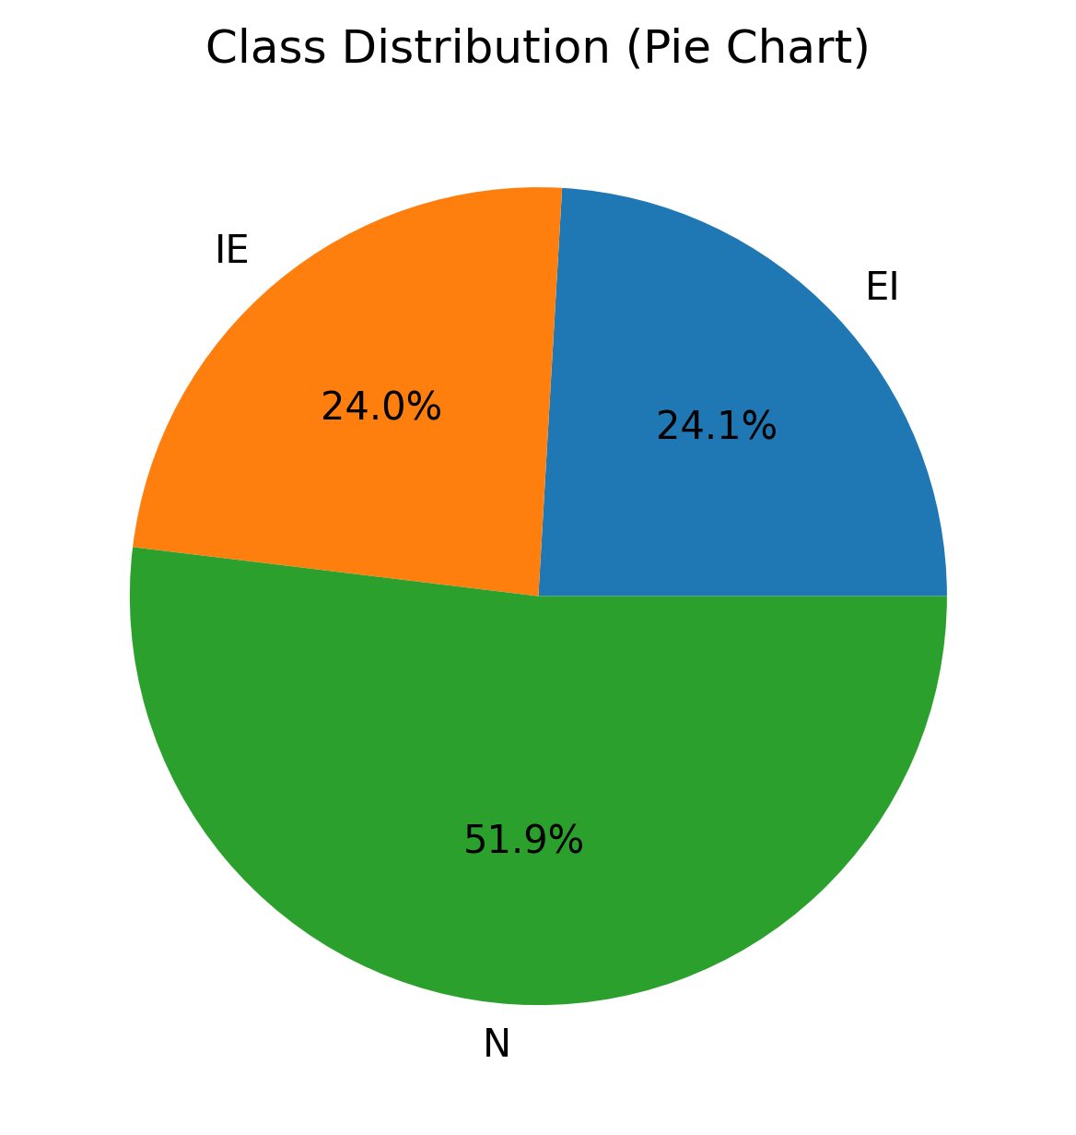
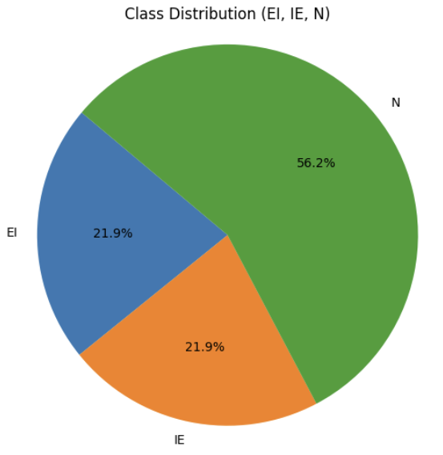
DATA EXPLORATION
Dataset Class Distribution (Old vs New)

Slide 14
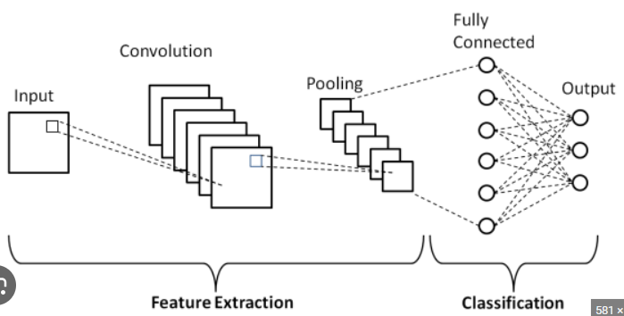
UNDERSTANDING THE FUNCTIONS
CNN Network
https://i.sstatic.net/pQHBE.png
Detects local nucleotide motifs
Learns spatial patterns
Reduces dimensionality using pooling
Learns hierarchical feature representations automatically
Automatically extracts features

Slide 15
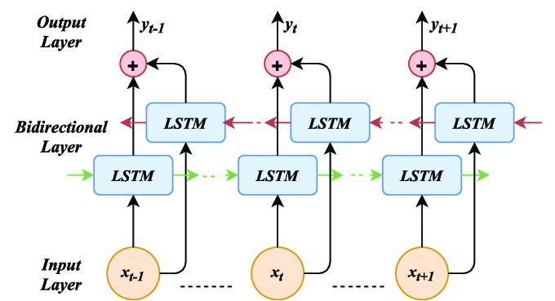
UNDERSTANDING THE FUNCTIONS
BiLSTM Model
https://medium.com/@anishnama20/understanding-bidirectional-lstm-for-sequential-data-processing-b83d6283befc
Captures long-range dependencies
Processes sequences bidirectionally
Learns contextual relationships
Improves classification accuracy
Enhances prediction accuracy when combined with CNN

Slide 16
TRAINING STRATEGY
Parameters Used:
Learning Rate: 0.001
Batch Size: 32
Epochs: 50
CNN Filters: 64, 128
BiLSTM Units: 64
Dropout: 0.3

Slide 17
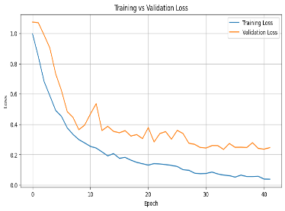
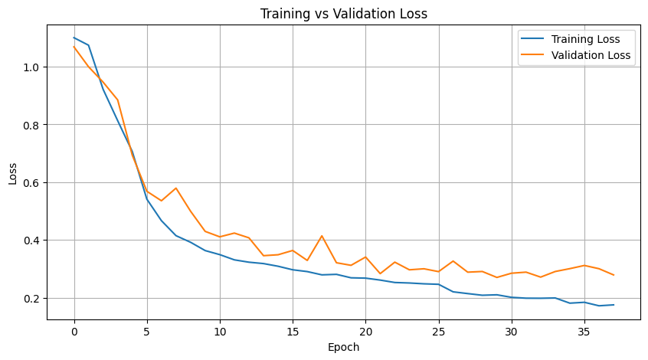
OBTAINED RESULTS
Training vs Validation Loss (Old & New)
Note: All the figures in comparison part → Left: Old dataset | Right: New dataset

Slide 18
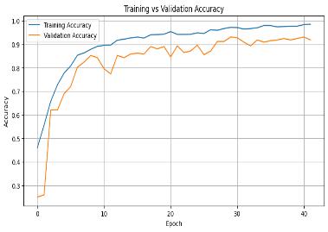
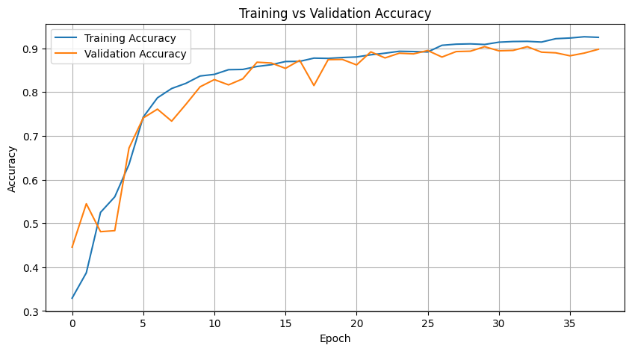
OBTAINED RESULTS
Training vs Validation Accuracy (Old vs New)
Old Dataset: Accuracy: 94.04% New Dataset: Accuracy: 90.50% Observation: • Slight drop due to raw sequence complexity

Slide 19
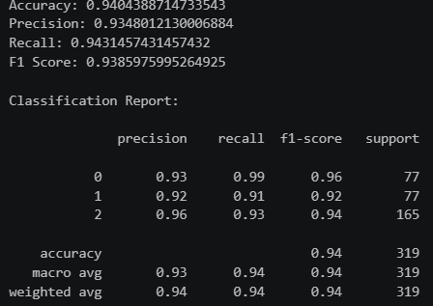
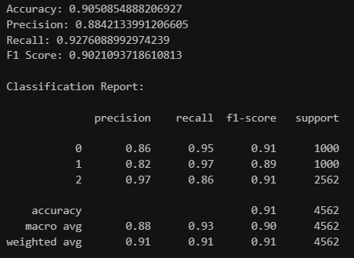
OBTAINED RESULTS
Classification Report Of Old vs New Dataset
Key Insight: Model performs better on structured data but generalizes well to raw sequences

Slide 20
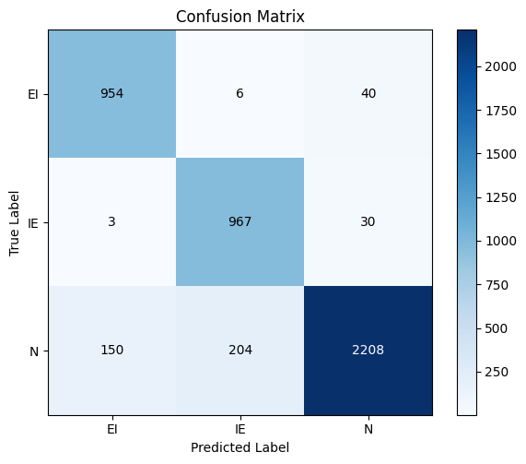
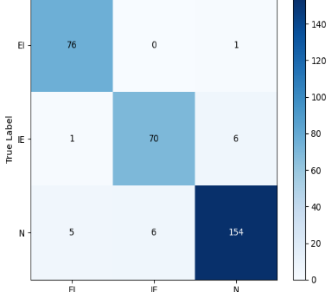
OBTAINED RESULTS
Confusion Matrix of CNN-BiLSTM Model (Old Vs New)

Slide 21
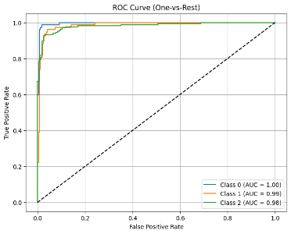
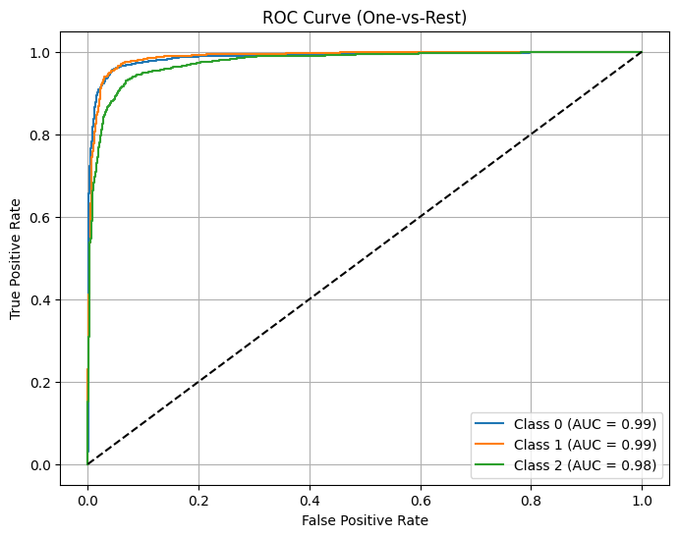
OBTAINED RESULTS
ROC curve showing model discrimination performance (Old vs New)

Slide 22
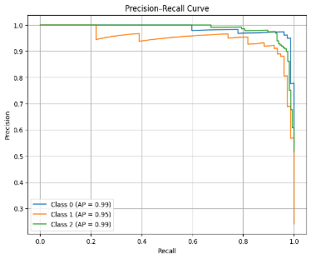
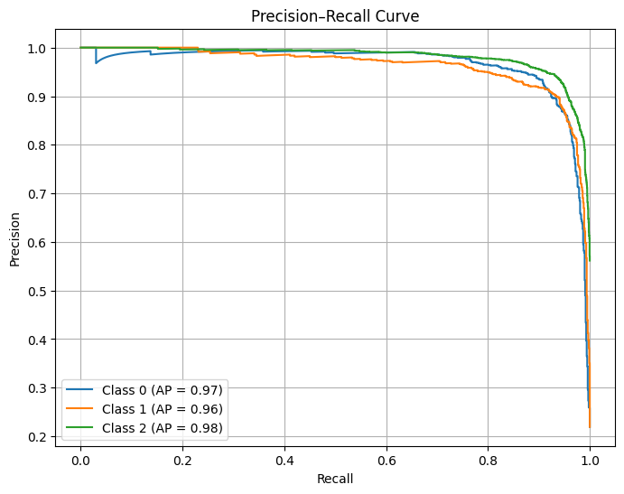
OBTAINED RESULTS
Precision-Recall curve (Old vs New)

Slide 23
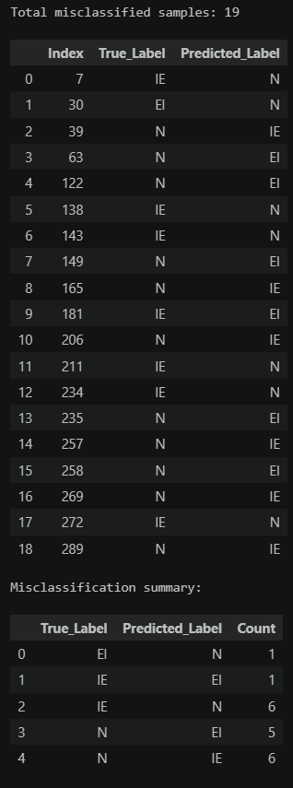
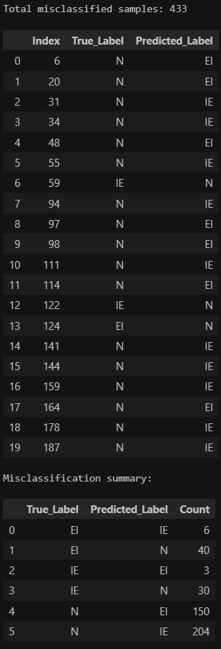
OBTAINED RESULTS
Misclassified Samples (Old Vs New)
Key Insight: Most errors occur in Non-splice (N) class

Slide 24
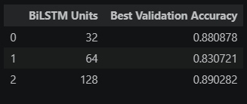
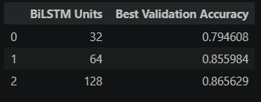
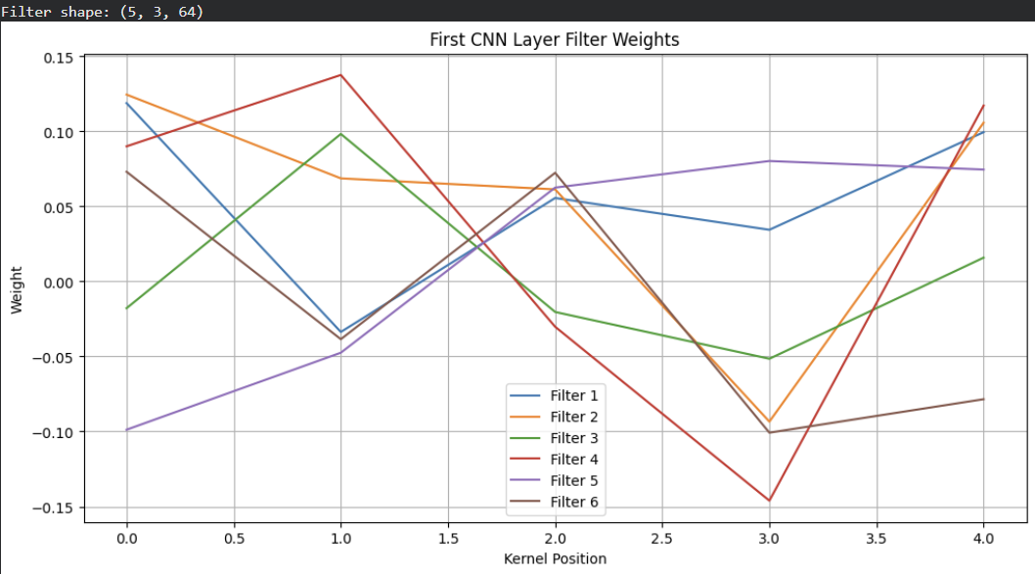
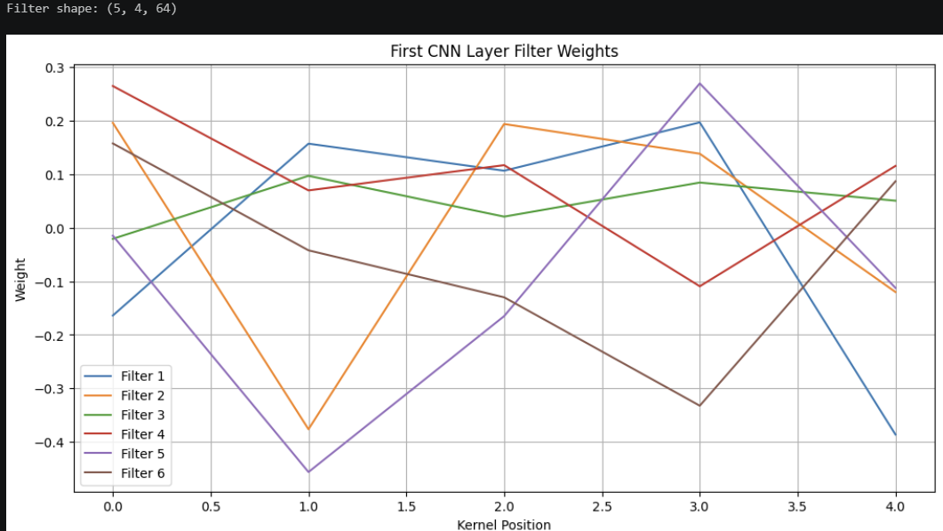
OBTAINED RESULTS
Hyperparameters Tuning Results (Old vs New)
CNN Filter Interpretation (Old vs New)
Key Insight: CNN filters learn biologically meaningful motifs

Slide 25
OBTAINED RESULTS
Metric | Old Dataset | New Dataset
Accuracy | 94.04% | 90.50%
Precision (Macro) | 93.48% | 88.40%
Recall (Macro) | 94.32% | 92.70%
F1 Score (Macro) | 93.86% | 90.20%
Model | Accuracy (Old) | Accuracy (New)
SVM | 95.92% | 79.15%
Random Forest | 96.24% | 73.69%
CNN - BiLSTM | 94.04% | 90.50%
OBSERVATIONS:
High accuracy (94.04% FOR Old and 90.50% for New)
Strong generalization
N class highest precision
EI / IE slight confusion
Robust across datasets

Slide 26
CONCLUSION & FUTURE WORK
Conclusion
CNN - BiLSTM model is effective
Outperforms traditional models
Captures local + sequential features
Works on both encoded and raw data
Future Work
Integration of attention mechanisms
Explore Transformer-based models
Apply Explainable AI techniques
Use larger genomic datasets

Slide 27
Team-Work Distribution
Team Member | Primary Contributions | Responsibilities
SWAYAM | • Project Coordination & Model Design • CNN - BiLSTM Architecture Planning • Literature Review Analysis • Final Report Structuring | • Design hybrid CNN - BiLSTM model architecture • Lead weekly discussions and milestone tracking • Review and integrate research findings • Compile and finalize proposal/report
KRUPAL | • Data Acquisition & Preprocessing • Dataset Encoding & Feature Engineering • Baseline Model Implementation • Results Visualization | • Download and clean splice junction dataset • Implement one-hot encoding and data splitting • Train SVM (Support Vector Machines), and Random Forest • Generate accuracy, F1-score, and confusion matrix plots
KARTAVYA | • Hybrid Model Implementation • CNN - BiLSTM Training & Optimization • Hyperparameter Tuning • Evaluation & Analysis | • Implement CNN - BiLSTM architecture in TensorFlow/PyTorch • Train model and monitor validation performance • Perform hyperparameter tuning • Conduct comparative analysis and error evaluation

Slide 28
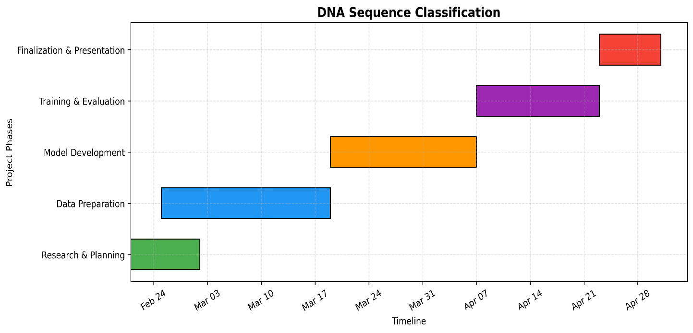
TIMELINE

Slide 29
REFERENCES
[1] Zuallaert, J., Godin, F., Kim, M., Soete, A., Saeys, Y., & De Neve, W. (2018). SpliceRover: interpretable convolutional neural networks for improved splice site prediction. Bioinformatics, 34(24), 4180-4188.
[2] Dakhli, A., & Bellil, W. (2016). Wavelet neural networks for DNA sequence classification using the genetic algorithms and the least trimmed square. Procedia Computer Science, 96, 418-427.
[3] Rizzo, R., Fiannaca, A., La Rosa, M., & Urso, A. (2015, September). A deep learning approach to DNA sequence classification. In International meeting on computational intelligence methods for bioinformatics and biostatistics (pp. 129-140). Cham: Springer International Publishing.
[4] Jaganathan, K., Panagiotopoulou, S. K., McRae, J. F., Darbandi, S. F., Knowles, D., Li, Y. I., ... & Farh, K. K. H. (2019). Predicting splicing from primary sequence with deep learning. Cell, 176(3), 535-548.

Slide 30
THANK YOU!!
Questions

