Slide 1

Inheritance

Slide 2
Today’s Agenda
Today we are going to cover -
Inheritance basics – base class , dervied class
Type of inheritance- simple, multi-level, multiple and hierarchical
Access specifier or mode (private, protected, public inheritance)
Access specifier (private, protected, public) , Protected members
Modes (private, protected, public inheritance)
Overriding member functions,
Order of execution of constructors and destructors,
Resolving ambiguities in inheritance,
Virtual base class.

Slide 3
C++
Let’s Get Started-

Slide 4
Inheritance basics
Inheritance is one of the object oriented programming paradigm as mentioned initially
Inheritance is the process of using properties of one class into the another class
This is achieved by deriving sub-class from the base class.
A class that is inherited is called a super class,base class or parent class and the derived class is called a sub-class, derived class or child class.
A sub-class is a specialized version of a super class.
Eg. we can categories the ‘animal’ into two categories: ‘wild animal’ and ‘pet animal’. Also we can categories ‘wild animal’ into ‘tiger’, ‘lion’, ‘leopard’ and ‘pet animal’ into ‘cat’, ‘dog’, ‘bull’.

Slide 5
Inheritance basics
It inherits all of the instance variables and methods defined by the super class and add its own, unique elements.
Inheritance provides the facility of re-usability.
We can add new features (new data and function) into existing class without modifying it.
This is done by deriving new class (subclass or child class) from existing class (super class or parent class).
The sub class contains the facility of super class as well as its own features..

Slide 6
Advantages of inheritance
Application development time is less.
Application take less memory.
Application execution time is less.
Redundancy (repetition) of the code is reduced or minimized so that we get consistence results and less storage cost.
Explaination:
Inheritance provides the facility of re-usability. Means Instead of writing the same code, again and again, we can simply inherit the properties of one class into the other. This makes it easier to create and maintain an application. OOP is all about real-world objects and inheritance is a way of representing real-world relationships.

Slide 7
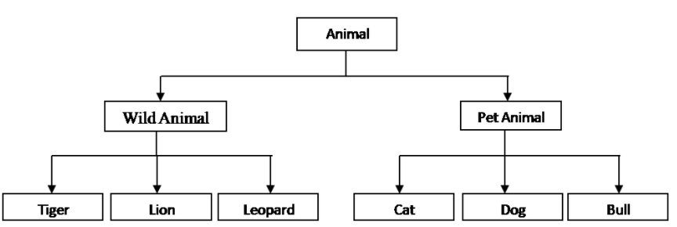
Knowledge check- question
Identify the base class and derived classes in the above figure.
What is ‘Animal’ class called here? What about rest all classes
Type the answers in the chat box.

Slide 8
Knowledge check - Answer
Base class : Animal and derived classes :Wild animal and Pet animal;
Base class : Wild animal , child classes : Tiger, Lion, Leopard;
Base class : Pet Animal , child classes: Cat, Dog, Bull
2. ‘Animal’ class : Base class /super class / Parent class
Wild Animal, Pet Animal: Derived class/ Sub class/ Child class.

Slide 9
Types of inheritance
Single inheritance : This is a form of inheritance in which a class inherits only one parent class.
Multi-level inheritance : In this form of inheritance , a base class is inherited by a derived class, which further becomes base class and inherited by next level derived class and so on
Multiple inheritance : Here a class inherits more than one parent class.
Hierarchical inheritance: In this, various child classes inherit a single Parent class.
Hybrid inheritance: It is the combination of multi-level, multiple and hierarchical inheritance.

Slide 10
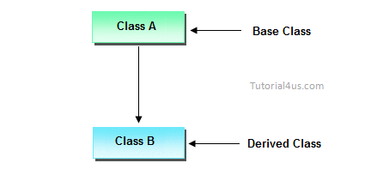
Single Inheritance
Eg. Parent-child, Animal- Dog, Fruit - Apple , doctor- pediatrician

Slide 11
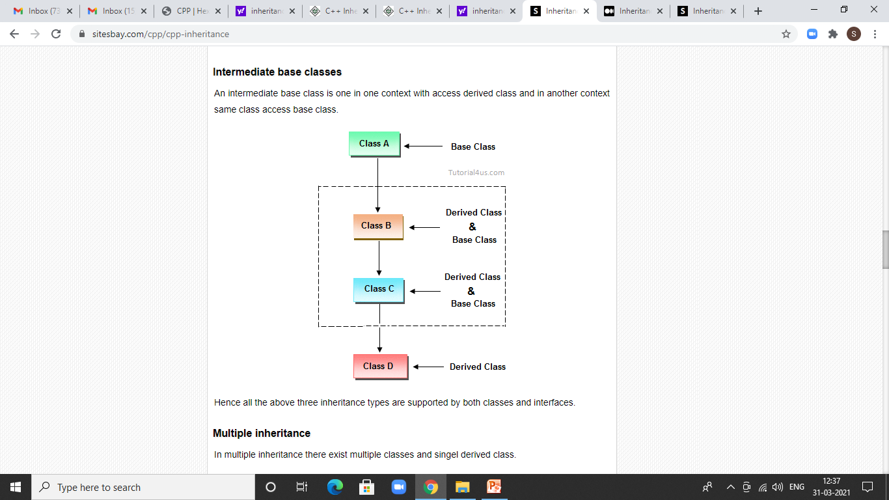
Multi-level Inheritance
Eg. Grandfather- Father- Child, Vehicle-Car- Audi, Doctor- Orthopedic- KneeSurgeon

Slide 12
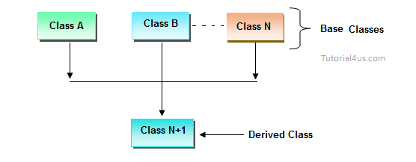
Multiple Inheritance
Eg. Mother, Father- Child , student , Teacher- Teaching Assistant

Slide 13
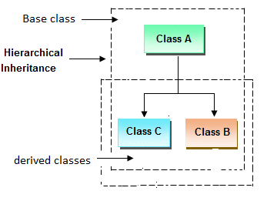
Hierarchical Inheritance
Eg. Animal- Dog, lion, cat etc,
Fruit- Apple, Mango etc,
Person- student ,Teacher, scientist, Engineer etc

Slide 14
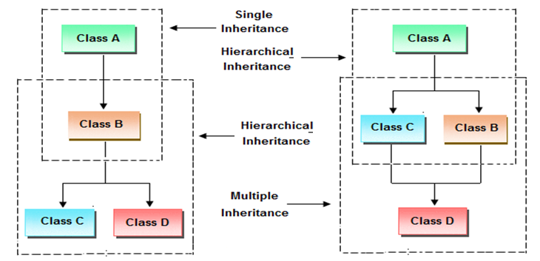
Hybrid Inheritance
Eg:Person- student ,Teacher – Teaching Assistant

Slide 15
Syntax of class derivation
class BaseClass{
// members....
// member function
}
class DerivedClass : public BaseClass{
// members....
// member function
}

Slide 16
Syntax of class derivation
A class can be derived from more than one classes, which means it can inherit data and functions from multiple base classes.
To define a derived class, we use a class derivation list to specify the base class(es).
A class derivation list names one or more base classes and has the form −
class derived-class: access-specifier base-class
Where access-specifier is one of public, protected, or private, and base-class is the name of a previously defined class.
If the access-specifier is not used, then it is private by default.

Slide 17
Assignment
Create a class Employee which stores and displays attributes of an employee like empname, empno, department, salary. Create a derived class called Project which allows to store project name. Write a C++ program to create object of project class.

Slide 18
Implementing inheritance
For creating a sub-class which is inherited from the base class we have to follow the below syntax.
Syntax:
class subclass_name : access_mode base_class_name
{
//body of subclass
};
Here, subclass_name is the name of the sub class.
access_mode is the mode in which you want to inherit this sub class for example: public, private etc.
base_class_name is the name of the base class from which you want to inherit the sub class.

Slide 19
Modes of inheritance
Public mode: If we derive a sub class from a public base class. Then the public member of the base class will become public in the derived class and protected members of the base class will become protected in derived class.
Protected mode: If we derive a sub class from a Protected base class. Then both public member and protected members of the base class will become protected in derived class.
Private mode: If we derive a sub class from a Private base class. Then both public member and protected members of the base class will become Private in derived class.
Let us understand it with example: First understand how private and public members of base class are affected by modes of inheritance

Slide 20
Practice Question - revisited
class student
{
int rollno;
public:
student() {rollno=1;}
};
class test: public student //here public is mode of inheritance
{
float marks;
public:
test() { marks=40;}
void display(void);
};

Slide 21
Practice Question
void test::display()
{
//cout<<"Rollno ="<<rollno<<endl; //not accessible here as private in base
cout<<"Marks ="<<marks<<endl;
}
int main()
{
test t1;
t1.display();
return 0;
}
Output:
Marks =40
Note that we always create objects of derived class and access all the members of base class and derived class using object of derived class.

Slide 22
Making private members public
class student
{
public:
int rollno;
public:
student() {rollno=1;}
};
class test: public student
{
public:
float marks;
public:
test() { marks=40;}
void display(void);
};

Slide 23
Making private members public
void test::display()
{
cout<<"Rollno ="<<rollno<<endl; //accessible here as public in base
cout<<"Marks ="<<marks<<endl;
}
int main()
{
test t1;
cout<<"rollno= "<<t1.rollno<<" Marks = "<<t1.marks<<endl;
t1.display(); //not required now
return 0;
}
Output:
Marks =40

Slide 24
Making private members accessible in derived class
Solution of making private members public works, but it is against the principle of OOP – Data hiding or encapsulation. Hence you should not make data members of a class public.
Then what is the solution: how to make base class members accessible in derived class?
Answer is using by making them protected.
Protected members: The protected members are the members in the base class which can be accessed directly in the derived class. The private members in the base class cannot be directly accessed in the derived class, while protected members can be directly accessed.

Slide 25
Practice Question – protected members
class student
{
protected:
int rollno;
public:
student() {rollno=1;}
};
class test: public student
{
float marks;
public:
test() { marks=40;}
void display(void);
};

Slide 26
Practice Question
void test::display()
{
cout<<"Rollno ="<<rollno<<endl; // accessible here as protected in base
cout<<"Marks ="<<marks<<endl;
}
int main()
{
test t1;
t1.display();
return 0;
}
Output:
Rollno=1
Marks =40

Slide 27
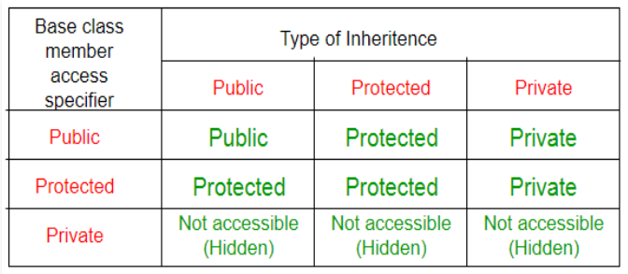
How Modes of inheritance impact the members

Slide 28
Impact on members of modes of inheritance
Private members : Irrespective of mode (type) of inheritance, the private members are not accessible outside the class (not even in main, or further derived classes)
Protected members: If mode of inheritance is public or protected, protected members of base class remain protected in derived class, if mode is private, protected members become private
public members: : If mode of inheritance is public , public members will remain public in derived class . In case of protected mode of inheritance, public members become protected in derived class, if mode is private, public members become private in derived class which cannot be inherited further
Let us understand it with example

Slide 29
Practice Question- observe the inheritance
class A
{
public:
int x;
protected:
int y;
private:
int z;
};
class B : public A
{
// x is public
// y is protected
// z is not accessible from B
};

Slide 30
Practice Question- observe the inheritance
class C : protected A
{
// x is protected
// y is protected
// z is not accessible from C
};
class D : private A // private' is default for classes
{
// x is private
// y is private
// z is not accessible from D
};

Slide 31
MCQ
When the inheritance is private, the private members of the base class are ______ in the derived class
Inaccessible
Accessible
Protected
Private

Slide 32
MCQ
When the inheritance is private, the private members of the base class are ______ in the derived class
Inaccessible
Accessible
Protected
Private
Answer: option A

Slide 33
Assignment
Create two classes Cuboid and CubiodVol. Cuboid with three data fields- length, width and height of int types. The class should have display() method, to print the length, width and height of the cuboid separated by space. TheCuboidVol class is derived from Cuboid class. The class should have read_input() method, to read the values of length, width and height of the Cuboid. The CuboidVol class should also the displayVol() method to print the volume of the Cuboid ( length * width * height ).
Output expected:
If length = 12, width = 10 and height = 2
Volume of the cuboid is = ( length * width * height )
= 12 * 10 * 2
= 240
Note: Assume necessary data wherever required

Slide 34
Assignment
Use the concept of multi-level inheritance. Create a class student with roll number as a member. Create 2 classes:
Test: containing the marks of a student in 5 subjects inheriting class student ( having roll number of the student).
Result: containing the function Display() to compute the total and average and then displaying the output as Roll number, total and average which are space separated.
Note: Assume necessary data wherever required

Slide 35
Assignment
Create a class shape with attributes as length and breath of float type. Create derived classes rectangle , circle to calculate area of them. Have display methods in both of these derived classes to display the areas calculated .
Note: Assume necessary data wherever required

Slide 36
Overriding member functions
Earlier we have discussed function overloading where same function takes various forms.
The function name is same , but the parameter list changes
Now let is see the concept of function overriding
If the member function in defined in both the derived class and the based class with the same name and same number/type of parameters, then the concept is called as function overriding
The function in derived class overrides the function in base class.
Access Overriding member functions using :: -another way
It is the redefinition of base class function in its derived class with same signature i.e return type and parameters.

Slide 37
Overriding member functions
#include <iostream>
using namespace std;
class Base {
public:
void print() {
cout << "Base Function" << endl;
}
};
class Derived : public Base {
public:
void print() {
cout << "Derived Function" << endl;
}
};

Slide 38
Overriding member functions
int main() {
Base base1;
base1.print();
return 0;
}
Output: Base Function
Had we called the print() function from an object of the Base class, the function would not have been overridden.

Slide 39
Overriding member functions
int main() {
Derived derived1;
derived1.print();
return 0;
}
Output: Derived Function
Here, the same function print() is defined in both Base and Derived classes. So, when we call print() from the Derived object derived1, the print() from Derived is executed by overriding the function in Base. The function was overridden because we called the function from an object of the Derived class.

Slide 40
Access Overriding member functions using ::
Consider above Base and Derived class
int main() {
Derived derived1, derived2;
derived1.print();
// access print() function of the Base class
derived2.Base::print();
return 0;
}
Output:
Derived Function
Base Function
The base class function can be accessed using scope resolution operator.

Slide 41
Order of execution in constructors and destructors
Whenever we create an object of a class, the default constructor of that class is invoked automatically to initialize the members of the class.
If we inherit a class from another class and create an object of the derived class, it is clear that the default constructor of the derived class will be invoked but before that the default constructor of all of the base classes will be invoked, i.e the order of invokation is that the base class’s default constructor will be invoked first and then the derived class’s default constructor will be invoked.

Slide 42
Why the base class’s constructor is called first?
Why the base class’s constructor is called on creating an object of derived class?
To understand this you will have to recall your knowledge on inheritance.
What happens when a class is inherited from other?
The data members and member functions of base class comes automatically in derived class based on the access specifier but the definition of these members exists in base class only.
So when we create an object of derived class, all of the members of derived class must be initialized but the inherited members in derived class can only be initialized by the base class’s constructor as the definition of these members exists in base class only.
This is why the constructor of base class is called first to initialize all the inherited members.

Slide 43
Order of constructor call for Multiple Inheritance
For multiple inheritance order of constructor call is, the base class’s constructors are called in the order of inheritance and then the derived class’s constructor.
class student
{
public:
student()
{
cout << "Inside first base class" << endl;
}
};
class teacher
{
public:
teacher()
{
cout << "Inside second base class" << endl;
}
};

Slide 44
Order of constructor call for Multiple Inheritance
class TeachingAssistant: public student, public teacher
{
public:
// child class's Constructor
TeachingAssistant()
{
cout << "Inside child class" << endl;
}
};
// main function
int main() {
// creating object of class Child
TeachingAssistant TA1;
return 0;
}
Output:
Inside first base class
Inside second base class
Inside child class

Slide 45
Parameterized Constructors in Derived Classes
To call the parameterized constructor of base class when derived class’s parameterized constructor is called, you have to explicitly specify the base class’s parameterized constructor in derived class
The general form of defining a derived class constructor is:
Derived-constructor (arglist1, arglist2,…….arglistN):
base1(arglist1),
base2(arglist2),
………
………
baseN(arglist N)
{
Body of derived constructor
}

Slide 46
Parameterized Constructors in Derived Classes
#include<iostream>
using namespace std;
class alpha
{
int x;
public:
alpha(int i)
{
x=i;
cout<<"\nalpha initialized\n";
}
void show_x(void)
{
cout<<"x="<<x<<endl;
}
};

Slide 47
Parameterized Constructors in Derived Classes
class beta
{
float y;
public:
beta(float j)
{
y=j;
cout<<"beta initialized\n";
}
void show_y(void)
{
cout<<"y="<<y<<"\n";
}
};

Slide 48
Parameterized Constructors in Derived Classes
class gamma:public beta, public alpha
{
int m, n;
public:
gamma(int a, float b, int c, int d): alpha(a), beta(b)
{
m=c;
n=d;
cout<<"gamma initialized\n";
}
void show_mn(void)
{
cout<<"m="<<m<<"\n"<<"n="<<n<<"\n";
}
};

Slide 49
Parameterized Constructor in Derived Class
int main()
{
gamma g(5, 10.75,20,30);
g.show_x();
g.show_y();
g.show_mn();
return 0;
}
Here the constructor is called in the order of inheritance and not in the order of constructor call.
To prove the above point , change the line as follows and observe the output
class gamma:public beta, public alpha
to
class gamma:public alpha, public beta
Output: beta initialized alpha initialized gamma initialized x=5 y=10.75 m=20 n=30

Slide 50
Points to remember
Whenever the derived class’s default constructor is called, the base class’s default constructor is called automatically.
The parameterised constructor of base class cannot be called in default constructor of sub class, it should be called in the parameterised constructor of sub class.
To call the parameterised constructor of base class inside the parameterised consructor of sub class, we have to mention it explicitly.
The constructor is called in the order of inheritance and not in the order of constructor call

Slide 51
Initialization list in constructors
class alpha
{
int x;
public:
alpha(int i)
{
x=i;
cout<<"\nalpha constructed\n";
}
void show_alpha(void)
{
cout<<"x="<<x<<endl;
}
};

Slide 52
Initialization list in constructors
class beta
{
float p,q;
public:
beta(float a, float b):p(a), q(b+p)
{
cout<<"beta constructed\n";
}
void show_beta(void)
{
cout<<"p="<<p<<"\n";
cout<<"q="<<q<<"\n";
}
};

Slide 53
Initialization list in constructors
class gamma:public alpha, public beta
{
int u, v;
public:
gamma(int a, float b, int c): alpha(a*2), beta(c,c), u(a)
{
v=b;
cout<<"gamma constructed\n";
}
void show_gamma(void)
{
cout<<"u="<<u<<"\n"<<"v="<<v<<"\n";
}
};

Slide 54
Initialization list in constructors
int main()
{
gamma g(2,2.5, 4);
cout<<"Display member values\n";
g.show_alpha();
g.show_beta();
g.show_gamma();
return 0;
}
Observe how the initializer list works in case of parameterized constructor call in inheritance.
Output:
alpha constructed beta constructed gamma constructed Display member values x=4 p=4 q=8 u=2 v=2

Slide 55
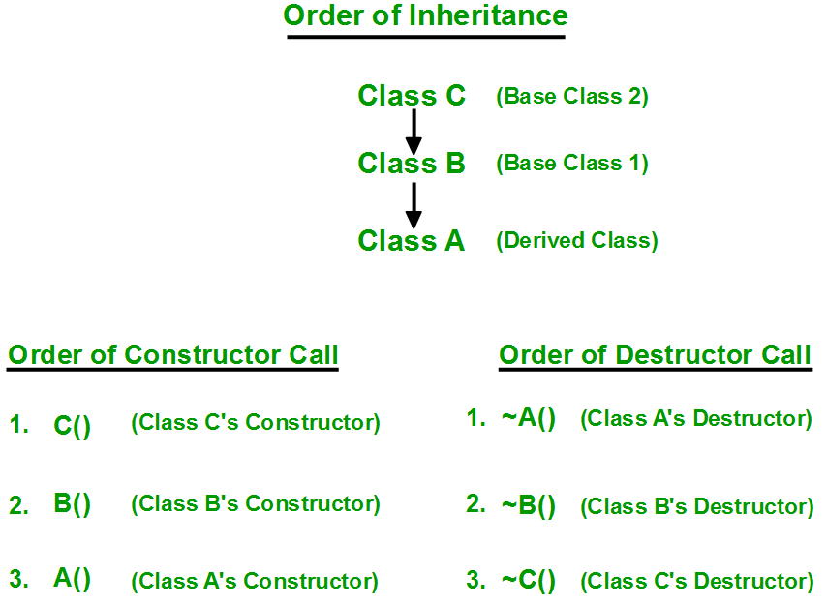
Destructor calls in inheritance
Destructors in C++ are called in the opposite order of that of Constructors.

Slide 56
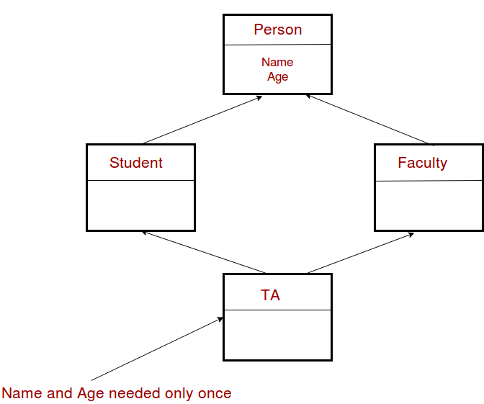
Multipath inheritance/diamond problem
The diamond problem occurs when two superclasses of a class have a common base class. For example, in the following diagram, the TA class gets two copies of all attributes of Person class, this causes ambiguities. This is a special case of hybrid inheritance

Slide 57
Special case of hybrid inheritance : Multipath inheritance
A derived class with two base classes and these two base classes have one common child class is called multipath inheritance. An ambiguity can arise in this type of inheritance.
class ClassA {
public:
int a;
};
class ClassB : public ClassA {
public:
int b;
};
class ClassC : public ClassA {
public:
int c;
};

Slide 58
Special case of hybrid inheritance : Multipath inheritance
class ClassD : public ClassB, public ClassC {
public:
int d;
};
void main()
{
ClassD obj;
// obj.a = 10; //Statement 1, Error
obj.ClassB::a = 10; // Statement 2
obj.ClassC::a = 100; // Statement 3
obj.b = 20;
obj.c = 30;
obj.d = 40;
cout << "\n A from ClassB : " << obj.ClassB::a;
cout << "\n A from ClassC : " << obj.ClassC::a;
cout << "\n B : " << obj.b;
cout << "\n C : " << obj.c;
cout << "\n D : " << obj.d;
}
Ouput:
A from ClassB : 10
A from ClassC : 100
B : 20
C : 30
D : 40

Slide 59
Special case of hybrid inheritance : Multipath inheritance
In the above example, both ClassB & ClassC inherit ClassA, they both have single copy of ClassA.
However ClassD inherit both ClassB & ClassC, therefore ClassD have two copies of ClassA, one from ClassB and another from ClassC.
If we need to access the data member a of ClassA through the object of ClassD, we must specify the path from which a will be accessed, whether it is from ClassB or ClassC, because compiler can’t differentiate between two copies of ClassA in ClassD.
There are 2 ways to avoid this ambiguity:
Avoiding ambiguity using scope resolution operator:
Using scope resolution operator we can manually specify the path from which data member a will be accessed, as shown in statement 3 and 4, in the above example. But Still, there are two copies of ClassA in ClassD.
2. Using virtual base class

Slide 60
Virtual Base class
class ClassA
{
public:
int a;
};
class ClassB : virtual public ClassA
{
public:
int b;
};
class ClassC : public virtual ClassA //order of public and virtual does not matter
{
public:
int c;
};

Slide 61
Virtual Base Class
class ClassD : public ClassB, public ClassC
{
public:
int d;
};
void main()
{
ClassD obj;
obj.a = 10; //Statement 3
obj.a = 100; //Statement 4
obj.b = 20;
obj.c = 30;
obj.d = 40;
cout<< "\n A : "<< obj.a<<"\n B : "<< obj.b;
cout<< "\n C : "<< obj.c<< "\n D : "<< obj.d;
}
Output:
A : 100
B : 20
C : 30
D : 40
Note: According to the above example, ClassD has only one copy of ClassA, therefore, statement 4 will overwrite the value of a, given at statement 3.

Slide 62
Assignment
Write a c++ program to implement following inheritance
without using virtual base class.
Define only constructors at each level of the
Inheritance. (need not have any other methods)
Observe the order of execution.
2. Using virtual base class.

Slide 63
MCQ
#include<iostream>
using namespace std;
class Base {
public:
int fun() { cout << "Base::fun() called"; }
int fun(int i) { cout << "Base::fun(int i) called"; }
};
class Derived: public Base {
public:
int fun() { cout << "Derived::fun() called"; }
};
int main() {
Derived d;
d.Base::fun(5);
return 0;
}
What is the output:
A. Compiler Error
B. Base::fun(int i) called

Slide 64
MCQ
#include<iostream>
using namespace std;
class Base {
public:
int fun() { cout << "Base::fun() called"; }
int fun(int i) { cout << "Base::fun(int i) called"; }
};
class Derived: public Base {
public:
int fun() { cout << "Derived::fun() called"; }
};
int main() {
Derived d;
d.Base::fun(5);
return 0;
}
What is the output:
A. Compiler Error
B. Base::fun(int i) called
Output: Option B.
We can access base class functions using scope resolution operator.

Slide 65
MCQ
Which one is false?
Whenever the derived class’s default constructor is called, the base class’s default constructor is called automatically.
The parameterised constructor of base class can be called in default constructor of sub class
To call the parameterised constructor of base class, the parameterised consructor of sub class must mention it explicitly.
The constructor is called in the order of inheritance and not in the order of constructor call

Slide 66
MCQ
Which one is false?
Whenever the derived class’s default constructor is called, the base class’s default constructor is called automatically.
The parameterised constructor of base class can be called in default constructor of sub class
To call the parameterised constructor of base class, the parameterised consructor of sub class must mention it explicitly.
The constructor is called in the order of inheritance and not in the order of constructor call
Answer: Option B

Slide 67
QNA Time
Any Questions??

Slide 68
Thank You!
See you guys in next class.

