Slide 1

Templates and STL

Slide 2
Today’s Agenda
Introduction to templates
Function template
class template
Inheritance in template class(single level)
Introduction to STL
Containers
Algorithms and iterators
Container - Vector and List.

Slide 3
C++
Let’s Get Started-

Slide 4
Introdution
Note: Encourage students to answers the following questions.
What are templates?
Ans: In general these are standard forms .
Have you all used a templates in your life?
Ans: Yes. We all have used templates somewhere in our life
Give example.
Ans: Suppose you go to bank to deposit or withdraw money. In earlier times, we had to fill the withdrawal or deposit form where we put necessary information like name, account number, amount, etc. Imagine what will happen if the form is not available? Everyone will try to provide the information in his / her own format. This form is called template.
Other examples of templates could be exam form, admission form, etc.

Slide 5
Why templates
Let us understand this with the help of example.
#include<iostream>
using namespace std;
int Max( int a, int b){
return a>b ? a :b;
}
int main(){
cout<< "Max of two numbers : " <<Max(4,5);
return 0;
}
The above program gives max to two integers. What if we want to use it for doubles?

Slide 6
Why templates
For doubles, we have to overload the function.
#include<iostream>
using namespace std;
int Max( int a, int b){
return a>b ? a :b;
}
double Max( double a, double b){
return a>b ? a :b;
}
int main(){
cout<<Max(4,5)<<endl;
cout<<Max(4.5, 3.2)<<endl;
return 0;
}

Slide 7
Why Templates
Similarly if we want to find out max of two strings , we have to modify the function to handle strings.
So for any new data type we want to use the same function, we have to overload the function with this new data type.
Instead we can make life simple by writing code in a way that is independent of any particular type.
This concept is called as template. A template is a simple and yet very powerful tool in C++.
The simple idea is to pass data type as a parameter so that we don’t need to write the same code for different data types.

Slide 8
Templates
A template is a blueprint or formula for creating a generic class or a function
C++ supports two types of templates: 1. Function 2. Class
Template is essential feature added recently to C++.
This new concept allows programmers to define generic classes and functions and thus provide support for generic programming.
Generic programming is an approach of C++ programming where generic types are used as parameters so that they can work for various cases of suitable data type and data structure.
The template is the basis for establishing the concept of generic programming, which entails writing code in a way that is independent of a particular type.

Slide 9
C++
Function template

Slide 10
Practice question
#include <iostream>
using namespace std;
template <class X> //additional line for template syntax
X Max (X a, X b) { //X is any data type
//The above two lines could be written on same or different lines as shown below
//template <class X> X Max (X a, X b){
return a >b ? a:b;
}
int main(){
cout<<Max(4,5)<<endl;
cout<<Max(4.5, 3.2)<<endl;
return 0;
}
Output:
5
4.5

Slide 11
Practice question
Explanation:
In addition to normal program, we have preceded the function definition with template <class T> which we always do.
X Max (X a, X b): is a function prototype where X could be any name you like. X works as placeholder written in <>. If you pass int as data type, X will be int. If you pass double as data type, X will be double.

Slide 12
syntax
A function template is also known as generic function.
Syntax:
template <class type> ret-type function_name(parameter list)
{
// body of function
}
template: is a keyword and is to be written in small case
class is a keyword which is madatory
Type is a placeholder which will be replaced with data type you pass from calling function.
Ret-type function_name (parameter list) : is a normal function prototype.

Slide 13
Practice question
What if I have different types of arguments in function call?
The above program can be modified with reference to the following syntax:
template <class type1, class type2> type1 or type2 function_name (type1 arg1, type2 arg2, ....)
Let us understand it better with the help of example.
Hint: Initially, Always write the program in usual way and then modify it to make it generic.

Slide 14
Practice question
#include <iostream>
using namespace std;
template <class T, class M> M Max(T a, M b)
{
return a>b ? a :b;
}
int main()
{
cout<<(3,4.6)<<endl;
cout<<(4.5, 4)<<endl;
return 0;
}
Output:
4.6
4
//second output is 4 as first argument is truncated from double to int as 4 .

Slide 15
Practice question
Write a function template to accept an array and its size and return sum of elements of an array.
Let us first write the simple program using function. Then convert to generic program.
#include <iostream>
using namespace std;
int Sum (int a[], int size)
{
int s=0;
for (int i=0; i<size;i++)
{
s=s+a[i];
}
return s;
}

Slide 16
Practice question
int main()
{
int x[]={10,20,30,40,50};
//double y[]={ 1.1,2.2,3.3};
cout<<"Sum of int array="<<Sum(x ,5);
}
Output:
Sum of int array=150

Slide 17
Practice question
Let us now modify the above program using template
template <class T>T Sum (T a[], int size)
{
T s=0;
for (int i=0; i<size;i++)
{
s=s+a[i];
}
return s;
}
int main() {
int x[]={10,20,30,40,50};
double y[]={ 1.1,2.2,3.3};
cout<<"Sum of int array="<<Sum(x ,5)<<endl;
cout<<"Sum of double array= "<<Sum(y,3)<<endl;
}
Output:
Sum of int array=150 Sum of double array=6.6

Slide 18
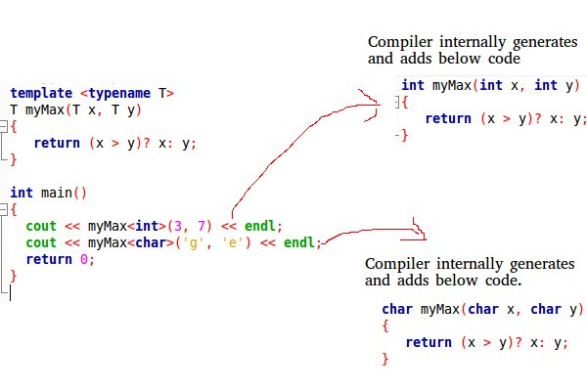
How templates work
Templates are expanded at compiler time. This is like macros.
The difference is, the compiler does type checking before template expansion. The idea is simple, source code contains only function/class, but compiled code may contain multiple copies of same function/class.

Slide 19
Assignment
Create a template function for addition of two numbers. This function returns the sum of the numbers to calling function. Pass different types of data to it :
(int, int)
(double, double)
(int , double)
(double, int)
Observe the advantages of template with respect to function overloading.

Slide 20
C++
Class template

Slide 21
Class template
Class Templates: Like function templates, class templates are useful when a class defines something that is independent of the data type.
Syntax:
template <class type>
class class-name
{
…
…
…
}
Here, type is the placeholder type name, which will be specified when a class is instantiated.

Slide 22
Practice question
Let is create a class with 2 data members and a constructor
class A {
int x;
int y;
public:
A() { cout<<"Constructor Called"<<endl; }
};
int main() {
A a;
return 0;
}
Output: Constructor Called

Slide 23
Practice question
Let us modify it to display the sum.
class A
{
int x;
int y;
public: A()
{
x=10; y=2;
cout<<"Constructor Called"<<endl;
}
int display()
{
return x+y;
}
};
int main()
{
A a;
cout<<a.display();
return 0;
}
Output:
Constructor Called
12

Slide 24
Practice question
Let us modify to make it generic class
Template <class T>
class A
{
T x;
T y;
public: A()
{
x=10; y=2;
cout<<"Constructor Called"<<endl;
}
T display()
{
return x+y;
}
};
int main()
{
A <int> a;
cout<<a.display();
return 0;
}
Output:
Constructor Called
12

Slide 25
Practice question
Explanation:
To make generic class, we precede class definition with Template <class T> .
In class definition, whichever data type we want to make generic , we will replace it with T. Here int is replaced with T.
T x; T y; // replaced int x;int y;
Also int display() replaced with T display() as we want the function to return the int value of sum of the variables.
In main(), usually we create objects using A a; ( i.e. classname objectname). In this case, memory is allocated to objects depending on types of data members.
But since we declared variables of type T, compiler does not know how much memory to allocate for object ‘a’ as T is unknown. Hence to give hint to compiler, we must create objects using following syntax:
A <int> a; //will create objects and allocate memory for integers
A <double > b; //will create objects and allocate memory for doubles.

Slide 26
Practice question
Let us modify it to have parameterized constructor
Template <class T>
class A
{
T x;
T y;
public: A(T m, T n)
{
x=m; y=n;
cout<<"Constructor Called"<<endl;
}
T display()
{
return x+y;
}
};
int main()
{
A <int> a(2,3);
cout<<a.display()<<endl;
A <double> a(3.4, 5.7);
cout<<a.display()<<endl;
return 0;
}
Output:
Constructor Called
5
Constructor Called
9.1

Slide 27
Practice question
Let us modify it to handle two different data types
Template <class T, class W>
class A
{
T x;
W y;
public: A(T m, W n) {
x=m; y=n;
cout<<"Constructor Called"<<endl;
}
double display() //always want double irrespective of input
{
return x+y;
}
};
int main()
{
A <int, double> a(2,3.4);
cout<<a.display()<<endl;
A <double,int> a(3.4, 5);
cout<<a.display()<<endl;
return 0;
}
Output:
Constructor Called
5.4
Constructor Called
8.4

Slide 28
Practice question
The only member function in the previous class template has been defined inline within the class declaration itself.
In case that we define a function member outside the declaration of the class template, we must always precede that definition with the template <...> prefix:
Let us see how the member function definition will be modified.

Slide 29
Practice question
Let us modify it to have the member function definition outside the class
Template <class T>
class Myclass
{
T x;
T y;
public: Myclass(T m, T n)
{
x=m; y=n;
cout<<"Constructor Called"<<endl;
}
T display() ;
};
template <class T>
T Myclass <T> :: display()
{
return x+y;
}
int main()
{
Myclass <int> a(2,3);
cout<<a.display()<<endl;
return 0;
}
Output:
Constructor Called
5

Slide 30
Practice question
Explanation:
T Myclass :: display() //ideally this would have been the definition for generic member .
{
return x+y;
}
template <class T> //but highlighted below are the additional changes
T Myclass <T> :: display()
{
return x+y;
}
Confused by so many T's? There are three T's in this declaration: The first one is the template parameter. The second T refers to the type returned by the function. And the third T (the one between angle brackets) is also a requirement: It specifies that this function's template parameter is also the class template parameter.

Slide 31
Assignment
Provide the definition for the function display() out the class.
Template <class T, class W>
class A
{
T x;
W y;
public: A(T m, W n) {
x=m; y=n;
cout<<"Constructor Called"<<endl;
}
double display() ;
};
// display()???
int main()
{
A <int, double> a(2,3.4);
cout<<a.display()<<endl;
A <double,int> a(3.4, 5);
cout<<a.display()<<endl;
return 0;
}
Output:
Constructor Called
5.4
Constructor Called
8.4

Slide 32
Practice question
Which of the following is true about templates. 1) Template is a feature of C++ that allows us to write one code for different data types. 2) We can write one function that can be used for all data types including user defined types. 3) We can write one class or struct that can be used for all data types including user defined types. 4) Template is an example of compile time polymorphism.
Options:
1,2
1,2,3
1,2,4
1,2,3,4

Slide 33
Practice question
Which of the following is true about templates. 1) Template is a feature of C++ that allows us to write one code for different data types. 2) We can write one function that can be used for all data types including user defined types. 3) We can write one class or struct that can be used for all data types including user defined types. 4) Template is an example of compile time polymorphism.
Options:
1,2
1,2,3
1,2,4
1,2,3,4

Slide 34
Practice question
What will be the output of the following program?
int main()
{
fun<int> (1);
cout << endl;
fun<int>(1);
cout << endl;
fun<double>(1.1);
cout << endl;
return 0;
}
template <typename T> void fun(const T&x) { static int count = 0; cout << "x = " << x << " count = " << count << endl; ++count; return; }

Slide 35
Practice question
x = 1 count = 0 x = 1 count = 1 x = 1.1 count = 0 Compiler creates a new instance of a template function for every data type. So compiler creates two functions in the above example, one for int and other for double. Every instance has its own copy of static variable. The int instance of function is called twice, so count is incremented for the second call.

Slide 36
Practice question
Which of the following is correct about templates in C++? (1)When we write overloaded function we must code the function for each usage. (2)When we write function template we code the function only once. 1 only 2 only Both are true Both are false

Slide 37
Practice question
Which of the following is correct about templates in C++? (1)When we write overloaded function we must code the function for each usage. (2)When we write function template we code the function only once. 1 only 2 only Both are true Both are false

Slide 38
Practice question
What will be the output of the following ? #include <iostream> using namespace std; template <typename T> T max(T x, T y) { return (x > y)? x : y; } int main() { cout << max(3, 7) << std::endl; cout << max(3.0, 7.0) << std::endl; cout << max(3, 7.0) << std::endl; return 0; }
Output:
Compiler error in all cout statements
Compiler error in last cout statements
7
7.0
7.0
4. Runtime error

Slide 39
Practice question
What will be the output of the following ? #include <iostream> using namespace std; template <typename T> T max(T x, T y) { return (x > y)? x : y; } int main() { cout << max(3, 7) << std::endl; cout << max(3.0, 7.0) << std::endl; cout << max(3, 7.0) << std::endl; return 0; }
Output:
Compiler error in all cout statements
Compiler error in last cout statements
7
7.0
7.0
4. Runtime error

Slide 40
C++
STL

Slide 41
Introduction
We have already understood the concept of C++ Template
The C++ STL (Standard Template Library) is a powerful set of C++ template classes to provide general-purpose classes and functions with templates that implement many popular and commonly used algorithms and data structures like vectors, lists, queues, and stacks.
It is a generalized library and so, its components are parameterized.
At the core of the C++ Standard Template Library are following three well-structured components −
Containers
Algorithms
Iterators
Learning STL is important for every C++ programmer as it saves a lot of time while writing code.

Slide 42
Components
All the three components have a rich set of pre-defined functions which help us in doing complicated tasks in very easy fashion.
Containers
Containers are used to manage collections of objects of a certain kind. There are several different types of containers like deque, list, vector, map etc.
Algorithms
Algorithms act on containers. They provide the means by which you will perform initialization, sorting, searching, and transforming of the contents of containers.
Iterators
Iterators are used to step through the elements of collections of objects. These collections may be containers or subsets of containers.
Will discuss about each component in detail soon

Slide 43
C++
Containers

Slide 44
Containers
Containers are library used to manage collections of classes and objects of a certain kind.
The containers are implemented as generic class templates.
Containers help us to implement and replicate simple and complex data structures very easily like arrays, lists, trees , stack, queues, etc.
For example you can very easily define a linked list in a single statement by using list container of container library in STL , saving your time and effort. It means a linked list template is already defined. You have to simply use it by creating objects from it and calling methods of it.
Containers can be used to hold different kind of objects. It means same container can be operated on any data types , you don’t have to define the same container for different type of elements.

Slide 45
Data structures
Array: is a linear collection of elements of similar data types. Operations possible on array : addition of elements. Addition can be done randomly.
Stack: collection of items arranged on top of each other in the form of pile where elements are inserted and extracted only from one end of the pile.. Stack is a linear data structure which follows a particular order in which the operations are performed. The order may be LIFO (Last In First Out) or FILO (First In Last Out)
Queue: A Queue is a linear structure which follows a particular order in which the operations are performed. specifically designed to operate in a FIFO context (first-in first-out), where elements are inserted into one end of the container and extracted from the other

Slide 46
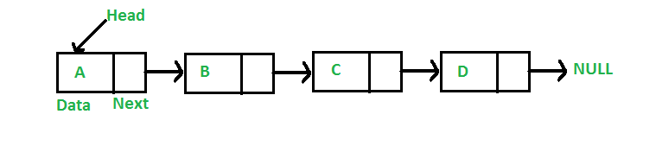
Data structures
Linked list: A linked list is a linear data structure, in which the elements are not stored at contiguous memory locations.
To create a linked list, following structure need to be created. Program will work around this structure.
// A linked list node struct Node { int data; struct Node* next; };

Slide 47
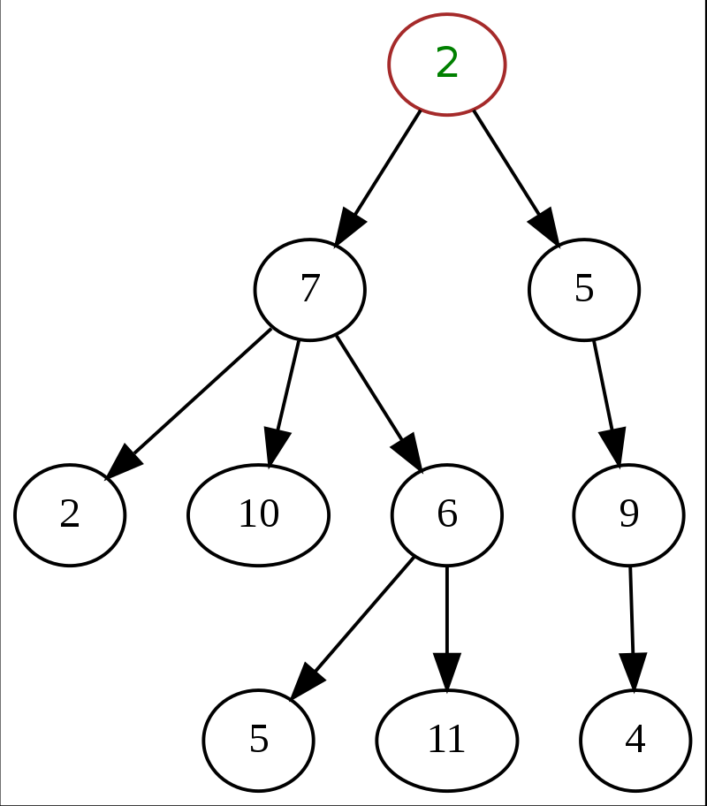
Data structures
Tree: A tree is a nonlinear data structure, compared to arrays, linked lists, stacks and queues which are linear data structures. It is a collection of nodes connected by directed (or undirected) edges.

Slide 48
Common containers
vector: replicates arrays
queue: replicates queue
stack: replicates stack
list: replicates linked list
set: replicates trees
maps: associative arrays
And many more…

Slide 49
How to use container library
When we use container library, then we have to include that header file first and use the constructor to initialize the object.
Eg. While using list container, include container list and create object as follows:
#include <iostream>
#include <list>
int main()
{
list <int> mylist;
list <double> mylist1;
…..
…..
}

Slide 50
How to use container library
In the above example shown, we don’t have to create list class. It already exists.
There are pre-defined containers in c++, which are list, vector, queues , stacks , etc.

Slide 51
Vector container in STL
Earlier we have learnt array container in STL (or in general) using
Array<int, 5> A;
This array can contain 5 elements in an array named A. It is fixed size array.
Drawbacks of array:
-The size of an array is fixed.
-User must know number of elements to be stored beforehand declaring an array.
- Defining oversized array is a wastage of memory ( to store 10 elements, we are declaring array of size)
So we need solution which will allow us flexibility to add elements into an array as and when required at runtime
Solution to this is Vector container in STL

Slide 52
Vector container in STL
As we have identifie solution of the fixed size or static size arrays problem is dynamic arrays!
They have dynamic size, i.e. their size can change during runtime.
Container library provides vectors to replicate dynamic arrays.
SYNTAX for creating a vector is:
vector< object_type > vector_name;

Slide 53
Vector Container
#include <iostream>
#include <vector>
using namespace std;
int main() {
vector <int> v;
}
Vector being a dynamic array, doesn't needs size during declaration, hence the above code will create a blank vector. Initially the vector is blank, as it has no data. but as you add data, it grows.
Vector <char> V1(5);
//it will create a vector V1 of size 5 initially which can grow dynamically

Slide 54
Vector Container
1. There are many ways to initialize a vector
#include <iostream>
#include <vector>
using namespace std;
int main() {
vector<string> v {“c++" ,“STL" ,“looks" ,“great"};}
}
2. You can also initialize a vector with one element a certain number of times
vector<string> v(4 , “Test");
However this is not the end of the vector, still more elements can always be added at the end.
C++ | STL | looks | great
Test | Test | Test | Test

Slide 55
Member functions of vector
push_back function:
push_back() is used for inserting an element at the end of the vector. If the type of object passed as parameter in the push_back() is not same as that of the vector or is not interconvertible an exception is thrown.
#include <iostream>
#include <vector>
using namespace std;
int main()
{
vector<int> v; //will create a blank vector
v.push_back(1); //insert 1 at the back of v
v.push_back(2); //insert 2 at the back of v
v.push_back(3); //insert 3 at the back of v
}

Slide 56
Member functions of vector
Subscript Operator []
#include <iostream>
#include <vector>
using namespace std;
int main()
{
vector<int> v; //will create a blank vector
v.push_back(1); //insert 1 at the back of v
v.push_back(2); //insert 2 at the back of v
v.push_back(3); //insert 3 at the back of v
cout<<v[0]; //prints 1
cout<<v[1]; //prints 2
cout<<v[2]; ///prints 3
}

Slide 57
Member functions of vector
Subscript Operator []
#include <iostream>
#include <vector>
using namespace std;
int main()
{
vector<int> v; //will create a blank vector
v.push_back(1); //insert 1 at the back of v
v.push_back(2); //insert 2 at the back of v
v.push_back(3); //insert 3 at the back of v
for (int i=0;i<3;i++)
{
cout<<v[i];
}
}

Slide 58
Member functions of vector
size function : This method returns the size of the vector.
empty function :This method returns true if the vector is empty else returns false.
at function : This method works same in case of vector as it works for array. vector_name.at(i) returns the element at ith index in the vector vector_name.
front and back functions :vector_name.front() retuns the element at the front of the vector (i.e. leftmost element). While vector_name.back() returns the element at the back of the vector (i.e. rightmost element).
clear function:This method clears the whole vector, removes all the elements from the vector but do not delete the vector. SYNTAX: clear() . For a vector v, v.clear() will clear it, but not delete it.
capacity() function: This method returns the number of elements that can be inserted in the vector based on the memory allocated to the vector.

Slide 59
Member functions of vector
int main()
{
vector<int> v; //will create a blank vector
cout<<"current capacity =" <<v.capacity()<<endl;
for(int i=0;i<=9;i++)
{
v.push_back(10*(i+1)); //insert 10,20,30, upto 100 etc at the back of v
cout<<"current capacity =" <<v.capacity()<<endl;
}
cout<<" Front element in vector " <<v.front()<<endl;
cout<<" Back element in vector " <<v.back()<<endl;

Slide 60
Member functions of vector
for (int i=0;i<v.size();i++)
{
cout<<v.at(i) <<" ";
}
v.clear();
cout<<" \n size of vector"<<v.size()<<endl;
if(v.empty())
cout<<" Vector is empty " <<endl;
cout<< " capacity of vector"<<v.capacity();
}

Slide 61
Member functions of vector
Output:
current capacity =0
current capacity =1
current capacity =2
current capacity =4 current capacity =4
current capacity =8
current capacity =8
current capacity =8
current capacity =8
current capacity =16
current capacity =16
Front element in vector 10 Back element in vector 100 10 20 30 40 50 60 70 80 90 100 size of vector 0 Vector is empty capacity of vector 16

Slide 62
Size and capacity difference
Capacity and size are different functions. Size returns current number of elements where capacity function returns the size of the storage space currently allocated for the vector, expressed in terms of elements.
The vector::capacity() function is a built-in function which returns the size of the storage space currently allocated for the vector, expressed in terms of elements.
This capacity is not necessarily equal to the vector size.
It can be equal to or greater, with the extra space allowing to accommodate for growth without the need to reallocate on each insertion.
The capacity does not suppose a limit on the size of the vector.

Slide 63
Size and capacity difference
using namespace std;
int main()
{
vector<int> v;
// inserts elements
for (int i = 0; i < 10; i++) {
v.push_back(i * 10);
}
cout << "The size of vector is " << v.size();
cout << "\nThe maximum capacity is " << v.capacity();
return 0;
}

Slide 64
Size and capacity difference
Current size = 1 Current capacity allocated = 1 Current size = 2 Current capacity allocated = 2 Current size = 3 Current capacity allocated = 4
Current size = 4 Current capacity allocated = 4 Current size = 5 Current capacity allocated = 8 Current size = 6 Current capacity allocated = 8 Current size = 7 Current capacity allocated = 8 Current size = 8 Current capacity allocated = 8 Current size = 9 Current capacity allocated = 16 Current size = 10 Current capacity allocated = 16 The size of vector is 10 The maximum capacity is 16

Slide 65
MCQ
What will the following line do?
vector <int> v3(5,10);
Create an integer vector v3 with 2 elements as 5,10.
Create an integer vector v3 of size 5 with every element value as 10
Compiler Reports an error as two values specified in vector size .
Compiler Reports an error as vector does not take size initially.

Slide 66
MCQ
What will the following line do?
vector <int> v3(5,10);
Create an integer vector v3 with 2 elements as 5,10.
Create an integer vector v3 of size 5 with every element value as 10
Compiler Reports an error as two values specified in vector size .
Compiler Reports an error as vector does not take size initially.

Slide 67
MCQ
Which of the following is not a function of Vector container in STL
at
empty
throw
size

Slide 68
MCQ
Which of the following is not a function of Vector container in STL
at
empty
throw
size
// arr[i] == arr.at(i)

Slide 69
Assignment
Create a vector of 5 strings and perform following functions and observe the output
Pop_back()
Pop_front()
Front()
Back()
Size()
Capacity()
Push_front()
Push_back()
At
empty

Slide 70
QNA Time
Any Questions??

Slide 71
Thank You!
See you guys in next class.

