Slide 1

EditEdit MasterMaster texttext stylesstyles
Practical Lecture : inheritance 3

Slide 2

Quick Recap
Let’s take a quick recap of previous lecture –
Access specifier (private, protected, public) , Protected members
Modes (private, protected, public inheritance)
Overriding member functions,

Slide 3
Today’s Agenda
Today we are going to cover -
Order of execution of constructors and destructors
Resolving ambiguities in inheritance
Virtual base class.

Slide 4
C++
Let’s Get Started-

Slide 5
Order of execution in constructors and destructors
Whenever we create an object of a class, the default constructor of that class is invoked automatically to initialize the members of the class.
If we inherit a class from another class and create an object of the derived class, it is clear that the default constructor of the derived class will be invoked but before that the default constructor of all of the base classes will be invoked, i.e the order of invokation is that the base class’s default constructor will be invoked first and then the derived class’s default constructor will be invoked.

Slide 6
Order of execution in constructors and destructors
#include <iostream>
using namespace std;
// base class
class person
{
public:
// base class constructor
person()
{
cout << "Inside base class" << endl;
}
};
// sub class

Slide 7
Order of execution in constructors and destructors
class student : public person
{
public:
//sub class constructor
student()
{
cout << "Inside sub class" << endl;
}
};
// main function
int main() {
// creating object of sub class
student s1;
return 0;
}

Slide 8
Order of execution in constructors and destructors
Ouput:
Inside base class
Inside sub class

Slide 9
Why the base class’s constructor is called first?
Why the base class’s constructor is called on creating an object of derived class?
To understand this you will have to recall your knowledge on inheritance.
What happens when a class is inherited from other?
The data members and member functions of base class comes automatically in derived class based on the access specifier but the definition of these members exists in base class only.
So when we create an object of derived class, all of the members of derived class must be initialized but the inherited members in derived class can only be initialized by the base class’s constructor as the definition of these members exists in base class only.
This is why the constructor of base class is called first to initialize all the inherited members.

Slide 10
Order of constructor call for Multiple Inheritance
For multiple inheritance order of constructor call is, the base class’s constructors are called in the order of inheritance and then the derived class’s constructor.
class student
{
public:
student()
{
cout << "Inside first base class" << endl;
}
};
class teacher
{
public:
teacher()
{
cout << "Inside second base class" << endl;
}
};

Slide 11
Order of constructor call for Multiple Inheritance
class TeachingAssistant: public student, public teacher
{
public:
// child class's Constructor
TeachingAssistant()
{
cout << "Inside child class" << endl;
}
};
// main function
int main() {
// creating object of class Child
TeachingAssistant TA1;
return 0;
}
Output:
Inside first base class
Inside second base class
Inside child class

Slide 12
Parameterized Constructors in Derived Classes
To call the parameterized constructor of base class when derived class’s parameterized constructor is called, you have to explicitly specify the base class’s parameterized constructor in derived class
The general form of defining a derived class constructor is:
Derived-constructor (arglist1, arglist2,…….arglistN):
base1(arglist1),
base2(arglist2),
………
………
baseN(arglist N)
{
Body of derived constructor
}

Slide 13
Parameterized Constructors in Derived Classes
#include<iostream>
using namespace std;
class alpha
{
int x;
public:
alpha(int i)
{
x=i;
cout<<"\nalpha initialized\n";
}
void show_x(void)
{
cout<<"x="<<x<<endl;
}
};

Slide 14
Parameterized Constructors in Derived Classes
class beta
{
float y;
public:
beta(float j)
{
y=j;
cout<<"beta initialized\n";
}
void show_y(void)
{
cout<<"y="<<y<<"\n";
}
};

Slide 15
Parameterized Constructors in Derived Classes
class gamma:public beta, public alpha
{
int m, n;
public:
gamma(int a, float b, int c, int d): alpha(a), beta(b)
{
m=c;
n=d;
cout<<"gamma initialized\n";
}
void show_mn(void)
{
cout<<"m="<<m<<"\n"<<"n="<<n<<"\n";
}
};

Slide 16
Parameterized Constructor in Derived Class
int main()
{
gamma g(5, 10.75,20,30);
g.show_x();
g.show_y();
g.show_mn();
return 0;
}
Here the constructor is called in the order of inheritance and not in the order of constructor call.
To prove the above point , change the line as follows and observe the output
class gamma:public beta, public alpha
to
class gamma:public alpha, public beta
Output: beta initialized alpha initialized gamma initialized x=5 y=10.75 m=20 n=30

Slide 17
Points to remember
Whenever the derived class’s default constructor is called, the base class’s default constructor is called automatically.
The parameterised constructor of base class cannot be called in default constructor of sub class, it should be called in the parameterised constructor of sub class.
To call the parameterised constructor of base class inside the parameterised consructor of sub class, we have to mention it explicitly.
The constructor is called in the order of inheritance and not in the order of constructor call

Slide 18
Initialization list in constructors
class alpha
{
int x;
public:
alpha(int i)
{
x=i;
cout<<"\nalpha constructed\n";
}
void show_alpha(void)
{
cout<<"x="<<x<<endl;
}
};

Slide 19
Initialization list in constructors
class beta
{
float p,q;
public:
beta(float a, float b):p(a), q(b+p)
{
cout<<"beta constructed\n";
}
void show_beta(void)
{
cout<<"p="<<p<<"\n";
cout<<"q="<<q<<"\n";
}
};

Slide 20
Initialization list in constructors
class gamma:public alpha, public beta
{
int u, v;
public:
gamma(int a, float b, int c): alpha(a*2), beta(c,c), u(a)
{
v=b;
cout<<"gamma constructed\n";
}
void show_gamma(void)
{
cout<<"u="<<u<<"\n"<<"v="<<v<<"\n";
}
};

Slide 21
Initialization list in constructors
int main()
{
gamma g(2,2.5, 4);
cout<<"Display member values\n";
g.show_alpha();
g.show_beta();
g.show_gamma();
return 0;
}
Observe how the initializer list works in case of parameterized constructor call in inheritance.
Output:
alpha constructed beta constructed gamma constructed Display member values x=4 p=4 q=8 u=2 v=2

Slide 22
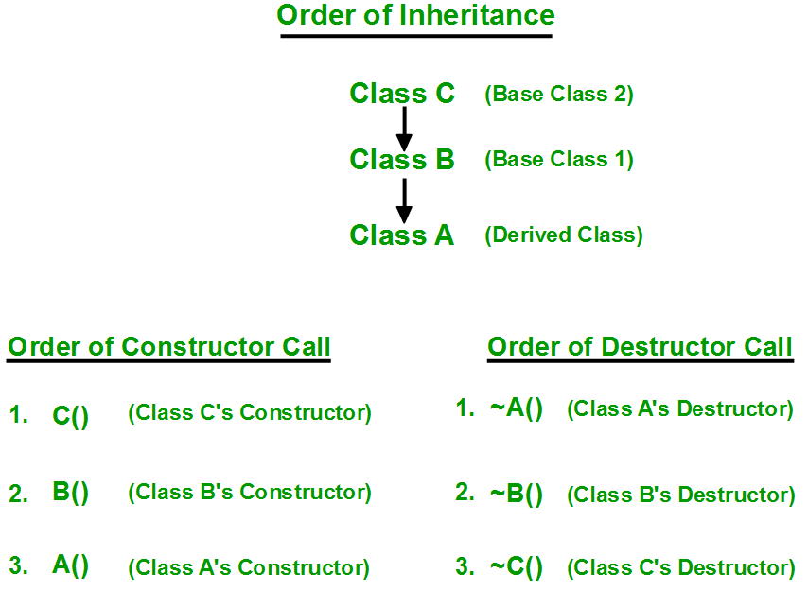
Destructor calls in inheritance
Destructors in C++ are called in the opposite order of that of Constructors.

Slide 23
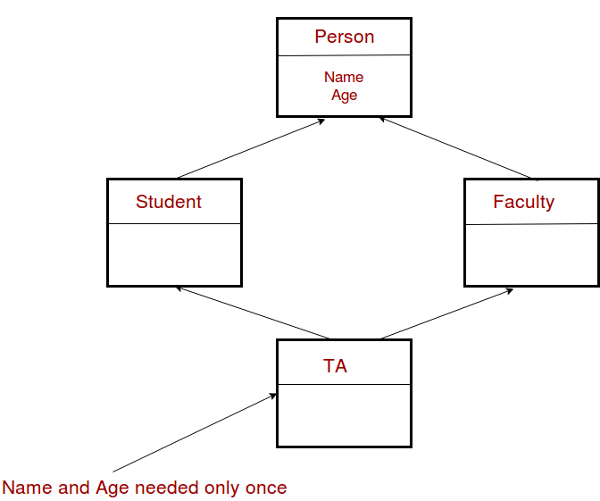
Multipath inheritance/diamond problem
The diamond problem occurs when two superclasses of a class have a common base class. For example, in the following diagram, the TA class gets two copies of all attributes of Person class, this causes ambiguities. This is a special case of hybrid inheritance

Slide 24
Special case of hybrid inheritance : Multipath inheritance
A derived class with two base classes and these two base classes have one common child class is called multipath inheritance. An ambiguity can arise in this type of inheritance.
class ClassA {
public:
int a;
};
class ClassB : public ClassA {
public:
int b;
};
class ClassC : public ClassA {
public:
int c;
};

Slide 25
Special case of hybrid inheritance : Multipath inheritance
class ClassD : public ClassB, public ClassC {
public:
int d;
};
void main()
{
ClassD obj;
// obj.a = 10; //Statement 1, Error
obj.ClassB::a = 10; // Statement 2
obj.ClassC::a = 100; // Statement 3
obj.b = 20;
obj.c = 30;
obj.d = 40;
cout << "\n A from ClassB : " << obj.ClassB::a;
cout << "\n A from ClassC : " << obj.ClassC::a;
cout << "\n B : " << obj.b;
cout << "\n C : " << obj.c;
cout << "\n D : " << obj.d;
}
Ouput:
A from ClassB : 10
A from ClassC : 100
B : 20
C : 30
D : 40

Slide 26
Special case of hybrid inheritance : Multipath inheritance
In the above example, both ClassB & ClassC inherit ClassA, they both have single copy of ClassA.
However ClassD inherit both ClassB & ClassC, therefore ClassD have two copies of ClassA, one from ClassB and another from ClassC.
If we need to access the data member a of ClassA through the object of ClassD, we must specify the path from which a will be accessed, whether it is from ClassB or ClassC, because compiler can’t differentiate between two copies of ClassA in ClassD.
There are 2 ways to avoid this ambiguity:
Avoiding ambiguity using scope resolution operator:
Using scope resolution operator we can manually specify the path from which data member a will be accessed, as shown in statement 3 and 4, in the above example. But Still, there are two copies of ClassA in ClassD.
2. Using virtual base class

Slide 27
Virtual Base class
class ClassA
{
public:
int a;
};
class ClassB : virtual public ClassA
{
public:
int b;
};
class ClassC : public virtual ClassA //order of public and virtual does not matter
{
public:
int c;
};

Slide 28
Virtual Base Class
class ClassD : public ClassB, public ClassC
{
public:
int d;
};
void main()
{
ClassD obj;
obj.a = 10; //Statement 3
obj.a = 100; //Statement 4
obj.b = 20;
obj.c = 30;
obj.d = 40;
cout<< "\n A : "<< obj.a<<"\n B : "<< obj.b;
cout<< "\n C : "<< obj.c<< "\n D : "<< obj.d;
}
Output:
A : 100
B : 20
C : 30
D : 40
Note: According to the above example, ClassD has only one copy of ClassA, therefore, statement 4 will overwrite the value of a, given at statement 3.

Slide 29
Assignment
Write a c++ program to implement following inheritance
without using virtual base class.
Define only constructors at each level of the
Inheritance. (need not have any other methods)
Observe the order of execution.
2. Using virtual base class.

Slide 30
MCQ
#include<iostream>
using namespace std;
class Base {
public:
int fun() { cout << "Base::fun() called"; }
int fun(int i) { cout << "Base::fun(int i) called"; }
};
class Derived: public Base {
public:
int fun() { cout << "Derived::fun() called"; }
};
int main() {
Derived d;
d.Base::fun(5);
return 0;
}
What is the output:
A. Compiler Error
B. Base::fun(int i) called

Slide 31
MCQ
#include<iostream>
using namespace std;
class Base {
public:
int fun() { cout << "Base::fun() called"; }
int fun(int i) { cout << "Base::fun(int i) called"; }
};
class Derived: public Base {
public:
int fun() { cout << "Derived::fun() called"; }
};
int main() {
Derived d;
d.Base::fun(5);
return 0;
}
What is the output:
A. Compiler Error
B. Base::fun(int i) called
Output: Option B.
We can access base class functions using scope resolution operator.

Slide 32
MCQ
Which one is false?
Whenever the derived class’s default constructor is called, the base class’s default constructor is called automatically.
The parameterised constructor of base class can be called in default constructor of sub class
To call the parameterised constructor of base class, the parameterised consructor of sub class must mention it explicitly.
The constructor is called in the order of inheritance and not in the order of constructor call

Slide 33
MCQ
Which one is false?
Whenever the derived class’s default constructor is called, the base class’s default constructor is called automatically.
The parameterised constructor of base class can be called in default constructor of sub class
To call the parameterised constructor of base class, the parameterised consructor of sub class must mention it explicitly.
The constructor is called in the order of inheritance and not in the order of constructor call
Answer: Option B

Slide 34

QNA Time
Any Questions??
Any Questions ??

Slide 35
Thank You!
See you guys in next class.

