Slide 1

EditEdit MasterMaster texttext stylesstyles
Practical Lecture 1: Concepts & Basics of C++ Programming
Lecture by Kartavya Kothari

Slide 2

Quick Recap
Let’s take a quick recap of previous lecture –
A) Features of IO stream
B) Reading writing data using cin cout
C) Creating classes
D) Class objects and member funtions
E) Difference between structures and union

Slide 3
Today’s Agenda
Today we are going to cover -
MCQ Practice Questions
Theory Practice Question
Coding Practice Question
Q&A Time

Slide 4
MCQ Questions
Let’s Get Started-

Slide 5
Problem - 1
Ques 1. Which of the following statement is incorrect about “cin”?
A. “cin” statement is the instance of the class istream
B. It is used to display output on the screen.
C. The extraction operator << is used along with the object cin for reading inputs.
D. Option B and C is correct.

Slide 6
Solution
Ques 1. Which of the following statement is incorrect about “cin”?
A. “cin” statement is the instance of the class istream
B. It is used to display output on the screen.
C. The extraction operator << is used along with the object cin for reading inputs.
D. Option B and C is correct.

Slide 7
Problem - 2
2. Which of the following is a valid class declaration?
A. Class A { int x; };
B. Class B { }
C. Public class A { }
D. Object A { int x; };

Slide 8
Solution
2. Which of the following is a valid class declaration?
A. Class A { int x; };
B. Class B { }
C. Public class A { }
D. Object A { int x; };
Explanation: Class A { int x; }; is a valid class declaration.

Slide 9
Problem - 3
3. Which of the following keywords is used to control access to a class member?
A. Default
B. Break
C. Protected
D. Asm

Slide 10
Solution
3. Which of the following keywords is used to control access to a class member?
A. Default
B. Break
C. Protected
D. Asm
Ans : C
Explanation: Protected keywords is used to control access to a class member

Slide 11
Problem - 4
4.What is the size of empty class?
A. 0
B. 2
C. 4
D. 1

Slide 12
Solution
4.What is the size of empty class?
A. 0
B. 2
C. 4
D. 1
Explanation: When we create object of empty class at that time State of that object is nothing. Behaviour of that object is also nothing, but compiler assigns a unique address to that object. Memory in Computer is always organized in the form of bytes and minimum memory available at object address location is 1 byte. That's why size of object of empty class is 1 byte

Slide 13
Problem - 5
5. The data elements in the structure are also known as what?
A.) objects
B.) members
C.) data
D.) objects & data

Slide 14
Solution
5. The data elements in the structure are also known as what?
A.) objects
B.) members
C.) data
D) objects & data
Explanation: Variables declared inside a class are called as data elements or data members.

Slide 15
Problem - 6
6. What will happen when the structure is declared?
A.) it will not allocate any memory
B.) it will allocate the memory
C.) it will be declared and initialized
D) it will be declared

Slide 16
Solution
6. What will happen when the structure is declared?
A.) it will not allocate any memory
B.) it will allocate the memory
C.) it will be declared and initialized
D.) it will be declared
Explanation: While the structure is declared, it will not be initialized, So it will not allocate any memory

Slide 17
Problem-7
7. Which of the following is a properly defined structure?
A.) struct {int a;}
B.) struct a_struct {int a;}
C.) struct a_struct int a;
D.) struct a_struct {int a;};

Slide 18
Solution
7. Which of the following is a properly defined structure?
A.) struct {int a;}
B.) struct a_struct {int a;}
C.) struct a_struct int a;
D.) struct a_struct {int a;};
Explanation: option struct {int a;} is not correct because name of structure and ;(after declaration) are missing. In option struct a_struct {int a;} ; is missing. In option struct a_struct int a; {} are missing.

Slide 19
Problem-8
8. Which keyword should be used to declare static variables?
A.) static
B.) stat
C.) common
D.) const

Slide 20
Solution
8. Which keyword should be used to declare static variables?
A.) static
B.) stat
C.) common
D.) const
Answer: a
Explanation: The keyword used to declare static variables is static. This is must be used while declaring the static variables. The compiler can make variables static if and only if they are mentioned with static keyword.

Slide 21
Problem-9
9.The static data member ______________________
A.) Must be defined inside the class.
B.) Must be defined outside the class.
C.) Must be defined in main function.
D.) Must be defined using constructor.

Slide 22
Solution
9.The static data member ______________________
A.) Must be defined inside the class.
B.) Must be defined outside the class.
C.) Must be defined in main function.
D.) Must be defined using constructor.
Answer: b
Explanation: The static data members must be defined outside the class. Since these are common to all the objects and should be created only once, they must not be defined in the constructor

Slide 23
Problem-10
10.If object of class are created, then the static data members can be accessed ____________
A.) Using dot operator
B.) Using arrow operator
C.) Using colon
D.) Using dot or arrow operator

Slide 24
Soultion
10.If object of class are created, then the static data members can be accessed ____________
A.) Using dot operator
B.) Using arrow operator
C.) Using colon
D.) Using dot or arrow operator
Explanation: The static data members can be accessed in usual way as other members are accessed using the objects. The dot operator is used generally. Arrow can be used with the pointers.

Slide 25
Problem - 1
1.Which of the following statement is correct about cout?
A.It is an instance of the iostream class.
B.It is used to display output on the screen.
C.The data displayed should be displayed in >>.
D. Option 1 and 2 in correct.

Slide 26
Solution
1.Which of the following statement is correct about cout?
A.It is an instance of the ostream class.
B.It is used to display output on the screen.
C.The data displayed should be displayed in >>.
D. Option 1 and 2 in correct.

Slide 27
Problem - 2
2.How does the object is created?
A. Class
B. Constructor
C. Destructors
D. Attributes

Slide 28
Solution
2.How does the object is created?
A. Class
B. Constructor
C. Destructors
D. Attributes
Explanation: In class, only all the listed items except class will be declared.

Slide 29
Problem - 3
3. Which of the following is not correct (in C++) ?
A.) Class templates and function templates are instantiated in the same way .
B.) Class templates differ from function templates in the way they are initiated.
C.) Class template is initiated by defining an object using the template argument.
D.) Class templates are generally used for storage classes.
A. i
B. i & ii
C. ii ,iii, iv
D. iv

Slide 30
Solution
3. Which of the following is not correct (in C++) ?
A.) Class templates and function templates are instantiated in the same way .
B.) Class templates differ from function templates in the way they are initiated.
C.) Class template is initiated by defining an object using the template argument.
D.) Class templates are generally used for storage classes.
A. i
B. i & ii
C. ii ,iii, iv
D. Iv
https://www.geeksforgeeks.org/templates-cpp/

Slide 31
Problem - 4
4. Which operator can not be overloaded?
A.)+
B.)::
C.) -
D.) *

Slide 32
Solution
4. Which operator can not be overloaded?
A.)+
B.)::
C.) -
D.) *
Explanation: :: operator can not be overloaded.

Slide 33
Problem - 5
5. When struct is used instead of the keyword class means, what will happen in the program?
A.) Access is public by default.
B.) Access is private by default.
C.) Access is protected by default.
D.) None of the mentioned.

Slide 34
Solution
5. When struct is used instead of the keyword class means, what will happen in the program?
A.) Access is public by default.
B.) Access is private by default.
C.) Access is protected by default.
D.) None of the mentioned.
Explanation: Access is public by default will happen When struct is used instead of the keyword class.

Slide 35
Problem - 6
6.What will be used when terminating a structure?
a) :
b) }
c) ;
d) ;;

Slide 36
Solution
6.What will be used when terminating a structure?
A) :
B) }
C) ;
D) ;;
Explanation: While terminating a structure, a semicolon is used to end this up.

Slide 37
Problem-7
7.What is the similarity between a structure, union and enumeration?
A.)All of them let you define new values.
B.)All of them let you define new data types.
C.)All of them let you define new pointers.
D.)All of them let you define new structures.

Slide 38
Solution
7.What is the similarity between a structure, union and enumeration?
A.)All of them let you define new values.
B.)All of them let you define new data types.
C.)All of them let you define new pointers.
D.)All of them let you define new structures.

Slide 39
Problem-8
8.A union cannot be nested in a structure
A.True
B.False

Slide 40
Solution
8.A union cannot be nested in a structure
A.True
B.False
Answer: Option B

Slide 41
Problem-9
9.Any changes made to static data member from one member function _____________
A.) Is reflected to only the corresponding object.
B.) Is reflected to all the variables in a program.
C.) Is reflected to all the objects of that class.
D.) Is constant to that function only.

Slide 42
Solution
9.Any changes made to static data member from one member function _____________
A.) Is reflected to only the corresponding object.
B.) Is reflected to all the variables in a program.
C.) Is reflected to all the objects of that class.
D.) Is constant to that function only.
Explanation: The changes made from any function to static data member will be a common change for all the other objects also.
If the change is made with respect to one object and change is printed from another object, the result will be same.

Slide 43
Problem-10
10. Which data members among the following are static by default?
A.) extern
B.) integer
C.) const
D.) void

Slide 44
Soultion
10. Which data members among the following are static by default?
A.) extern
B.) integer
C.) const
D.) void
Explanation: The const data members of any class are made static by default. This is an implicit meaning given by the compiler to the member. Since const values won’t change from object to object,hence are made static instead.

Slide 45
Let’s have a quick hands-on some practice Questions
1.Explain Procedural paradigms with example.
2.What do you understand by input and output stream.
3.What do you understand by class explain with example.
4.What is difference b/w class and object?
5.How can we access private data members?
6.How can we access protected data members?
7.What is structure explain with example.
8.What Union are important explain with example.
9.Explain Enumeration with example.
10.What is static members and static members functions.

Slide 46
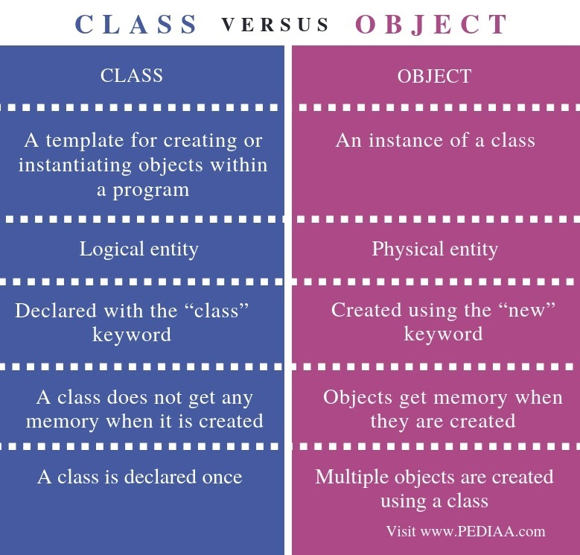

Slide 47
Coding Questions Time
1. Write a program in C++ to convert temperature in Celsius to Fahrenheit.
Sample Output:
Convert temperature in Celsius to Fahrenheit :
Input the temperature in Celsius : 35
The temperature in Celsius : 35
The temperature in Fahrenheit : 95

Slide 48
Coding Questions Time
2.Write a program to print all the prime number from 1-100.
3.Write a program to print the factorial of a number.
Input:-5
Output:-120
4.Write a C++ program to find LCM of two numbers using functions.

Slide 49
Coding Questions Time
5. Define a class TEST in C++ with following description:
Private Members
TestCode of type integer
Description of type string
NoCandidate of type integer
CenterReqd (number of centers required) of type integer
A member function CALCNTR() to calculate and return the number of centers as
(NoCandidates/100+1)
Public Members
- A function SCHEDULE() to allow user to enter values for TestCode, Description, NoCandidate & call function CALCNTR() to calculate the number of Centres
A function DISPTEST() to allow user to view the content of all the data members

Slide 50
Coding Questions Time
6. An array stores details of 25 students (roll no, name, marks in three subject).
Write a program to create such an array and print out a list of students who have failed in more than one subject.

Slide 51
Coding Questions Time
1.Write a program in C++ to swap two numbers without taking third variable.
Sample Output:
Swap two numbers :
Int a, b, temp;
Temp = b;
B = a;
A = temp;
Input 1st number : 25
Input 2nd number : 39
After swapping the 1st number is : 39
After swapping the 2nd number is : 25

Slide 52
Coding Questions Time
2.Write a program to print the sum and product of all number in a given array.
a=[2,3,4,1,10,8]
sum=28
product=1920

Slide 53
Coding Questions Time
3.Write a program to print the sum of all numbers in a digit.
Input:-2981
Output:-20
4.Write a program to check whether a number is palindrome or not.
Input:13231

Slide 54
Coding Questions Time
5.Write a program to print the area and perimeter of a triangle having sides of 3, 4 and 5 units by creating a class named 'Triangle' with a function to print the area and perimeter.
6.Declare a structure to represent a complex number (a number having a real part and imaginary part). Write C++ functions to add, subtract, multiply and divide two complex numbers

Slide 55

QNA Time
Any Questions??
Any Questions ??

Slide 56
Thank You!
See you guys in next class.

