Slide 1

EditEdit MasterMaster texttext stylesstyles
Practical Lecture : Pointers

Slide 2

Quick Recap
Let’s take a quick recap of previous lecture –
A) Friend Function
B) Friend Class
C) Call by value
D) Call by reference
E) Call by Address
F)Recurssion

Slide 3
Today’s Agenda
Today we are going to cover -
Pointers
Difference b/w pointers and reference variables
Void pointer
Pointer to Pointer

Slide 4
C++
Let’s Get Started-

Slide 5
Pointers
Pointer is a variable in C++ that holds the address of another variable. They have data type just like variables, for example an integer type pointer can hold the address of an integer variable and an character type pointer can hold the address of char variable.
Syntax:-
data_type *pointer_name;
int *p, var
As I mentioned above, an integer type pointer can hold the address of another int variable. Here we have an integer variable var and pointer p holds the address of var. To assign the address of variable to pointer we use ampersand symbol (&).
p = &var;

Slide 6
Pointers
#include <iostream>
using namespace std;
int main(){
//Pointer declaration
int *p, var=101;
//Assignment
p = &var;
cout<<"Address of var: "<<&var<<endl;
cout<<"Address of var: "<<p<<endl;
cout<<"Address of p: "<<&p<<endl;
cout<<"Value of var: "<<*p;
return 0;
}

Slide 7
Output
Address of var: 0x7fff5dfffc0c Address of var: 0x7fff5dfffc0c Address of p: 0x7fff5dfffc10 Value of var: 101

Slide 8
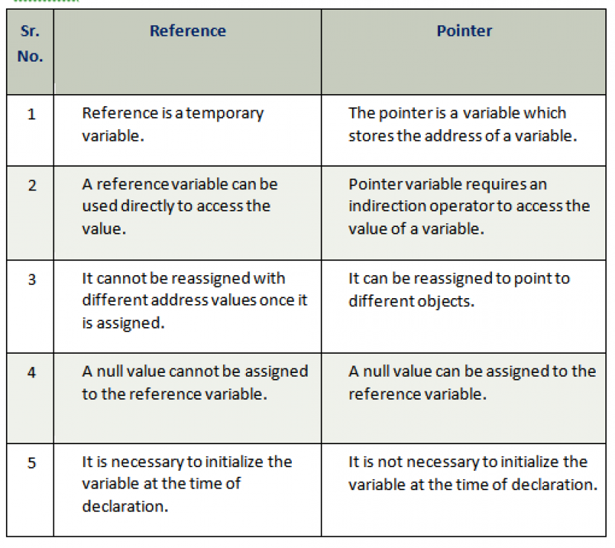
Difference b/w pointers and reference variable

Slide 9
Void Pointers
A void pointer is a general-purpose pointer that can hold the address of any data type, but it is not associated with any data type.
void *ptr;

Slide 10
Void Pointers
#include <iostream>
using namespace std;
int main()
{
void *ptr; // void pointer declaration
int a=9; // integer variable initialization
ptr=&a; // storing the address of 'a' variable in a void pointer variable.
std::cout << &a << std::endl;
std::cout << ptr << std::endl;
return 0;
}

Slide 11
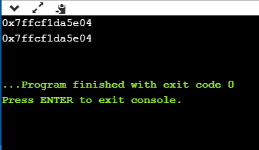
Output

Slide 12
Arithmetic Pointer
A pointer is an address which is a numeric value; therefore, you can perform arithmetic operations on a pointer just as you can a numeric value.

Slide 13
Incrementing a Pointer
#include <iostream>
using namespace std;
const int MAX = 3;
int main () {
int var[MAX] = {10, 100, 200};
int *ptr;
ptr = var;
for (int i = 0; i < MAX; i++) {
cout << "Address of var[" << i << "] = ";
cout << ptr << endl;
cout << "Value of var[" << i << "] = ";
cout << *ptr << endl;
ptr+; }
}

Slide 14
Output
Address of var[0] = 0xbfa088b0 Value of var[0] = 10 Address of var[1] = 0xbfa088b4 Value of var[1] = 100 Address of var[2] = 0xbfa088b8 Value of var[2] = 200

Slide 15
Decrementing a Pointer
#include <iostream>​
​using namespace std;​
const int MAX = 3;​
​
int main () {​
int var[MAX] = {10, 100, 200};​
int *ptr;​
ptr = &var[MAX-1];​
​for (int i = MAX; i > 0; i--) {​
cout << "Address of var[" << i << "] = ";​
cout << ptr << endl;​
​ cout << "Value of var[" << i << "] = ";​
cout << *ptr << endl;​
ptr--;​
}​}
​

Slide 16
Decrementing a Pointer
Address of var[3] = 0xbfdb70f8 Value of var[3] = 200 Address of var[2] = 0xbfdb70f4 Value of var[2] = 100 Address of var[1] = 0xbfdb70f0 Value of var[1] = 10
​

Slide 17
Pointer Comparisons
Pointers may be compared by using relational operators, such as ==, <, and >. If p1 and p2 point to variables that are related to each other, such as elements of the same array, then p1 and p2 can be meaningfully compared.
#include <iostream> using namespace std; const int MAX = 3;

Slide 18
Pointer Comparisons
int main () { int var[MAX] = {10, 100, 200}; int *ptr; ptr = var; int i = 0; while ( ptr <= &var[MAX - 1] ) { cout << "Address of var[" << i << "] = "; cout << ptr << endl; cout << "Value of var[" << i << "] = "; cout << *ptr << endl; ptr++; i++; } }

Slide 19
Output
Address of var[0] = 0xbfce42d0 Value of var[0] = 10 Address of var[1] = 0xbfce42d4 Value of var[1] = 100 Address of var[2] = 0xbfce42d8 Value of var[2] = 200

Slide 20
Pointer to Pointer
We already know that a pointer points to a location in memory and thus used to store the address of variables. So, when we define a pointer to pointer. The first pointer is used to store the address of the variable. And the second pointer is used to store the address of the first pointer. That is why they are also known as double pointers.
Declaration:-
int **ptr;

Slide 21
Pointer to Pointer
#include<iostream>
using namespace std;
int main()
{
int var = 789;
int *ptr2;
int **ptr1;
ptr2 = &var;
ptr1 = &ptr2;
cout<< var<<endl;
cout<<*ptr2<<endl ;
cout<<**ptr1;
}

Slide 22
Output
789 789 789

Slide 23
MCQ 1
1. What does the following statement mean?
int (*fp)(char*)
a) pointer to a pointer
b) pointer to an array of chars
c) pointer to function taking a char* argument and returns an int
d) function taking a char* argument and returning a pointer to int

Slide 24
MCQ 1
1. What does the following statement mean?
int (*fp)(char*)
a) pointer to a pointer
b) pointer to an array of chars
c) pointer to function taking a char* argument and returns an int
d) function taking a char* argument and returning a pointer to int
Explanation: The (*fn) represents a pointer to a function and char* as arguments and returning int from the function. So according to that, the above syntax represents a pointer to a function taking a char* as an argument and returning int.

Slide 25
MCQ 2
2. The operator used for dereferencing or indirection is ____
a) *
b) &
c) ->
d) –>>

Slide 26
MCQ 2
2. The operator used for dereferencing or indirection is ____
a) *
b) &
c) ->
d) –>>
Explanation: * is used as dereferencing operator, used to read value stored at the pointed address

Slide 27
MCQ 3
3.What will happen in the following C++ code snippet?
int a = 100, b = 200;
int *p = &a, *q = &b;
p = q;
a) b is assigned to a
b) p now points to b
c) a is assigned to b
d) q now points to a

Slide 28
MCQ 3
3.What will happen in the following C++ code snippet?
int a = 100, b = 200;
int *p = &a, *q = &b;
p = q;
a) b is assigned to a
b) p now points to b
c) a is assigned to b
d) q now points to a
Assigning to reference changes the object to which the reference is bound.

Slide 29
MCQ 4
4.Void pointer can point to which type of objects?
A)int
B) float
C) double
D) all of the mentioned

Slide 30
MCQ 4
Void pointer can point to which type of objects?
A)int
B) float
C) double
D) all of the mentioned

Slide 31
MCQ 5
The correct statement for a function that takes pointer to a float, a pointer to a pointer to a char and returns a pointer to a pointer to a integer is ____________
a) int **fun(float**, char**)
b) int *fun(float*, char*)
c) int **fun(float*, char**)
d) int ***fun(*float, **char)

Slide 32
MCQ 5
The correct statement for a function that takes pointer to a float, a pointer to a pointer to a char and returns a pointer to a pointer to a integer is ____________
a) int **fun(float**, char**)
b) int *fun(float*, char*)
c) int **fun(float*, char**)
d) int ***fun(*float, **char)
Function that takes pointer to a float, a pointer to a pointer to a char and returns a pointer to a pointer to a integer is int **fun(float*, char**).

Slide 33
Predict the ouput 1
#include <iostream>
using namespace std;
int main()
{
char arr[20];
int i;
for(i = 0; i < 10; i++)
*(arr + i) = 65 + i;
*(arr + i) = '\0';
cout << arr;
return(0);
}

Slide 34
Ouput
ABCDEFGHIJ
Each time we are assigning 65 + i. In first iteration i = 0 and 65 is assigned. So it will print from A to J.

Slide 35
Predict the ouput 2
#include <iostream>
using namespace std;
int main()
{
int a = 5, b = 10, c = 15;
int *arr[ ] = {&a, &b, &c};
cout << arr[1];
return 0;
}

Slide 36
Ouput
it will return some random number
Array element cannot be address of auto variable. It can be address of static or extern variables.

Slide 37
Predict the ouput 3
#include <iostream>
using namespace std;
int main()
{
int a = 32, *ptr = &a;
char ch = 'A', &cho = ch;
cho += a;
*ptr += ch;
cout << a << ", " << ch << endl;
return 0;
}

Slide 38
Ouput
129, a

Slide 39
Predict the ouput 4
#include <iostream>
using namespace std;
int main()
{
int arr[] = { 4, 5, 6, 7 };
int* p = (arr + 1);
cout << *arr + 10;
return 0;
}

Slide 40
Ouput
14

Slide 41
Coding Question
Write a program to print all the alphabets using a pointer.
Write a program to print the elements of an array in reverse order using pointer.
Write a program to count the number of vowels and consonants in a string using a pointer.
Write a program to find the maximum number between three numbers using a pointer.

Slide 42

QNA Time
Any Questions??
Any Questions ??

Slide 43
Thank You!
See you guys in next class.

