Slide 1
Rendering Photorealistic Mountain Terrain
Karteek Mekala Graduate Student Department of Computer Science Rochester Institute of Technology
November 2014

Slide 2
Agenda
Overview
Background & Motivation
Height-map Generation
Rendering Techniques
Technology
Challenges
Conclusion
Future Work
Demo
Questions

Slide 3
Overview
Height map generation
Tessellation
Calculating Normals
Lighting
Texturing
Skybox
Camera Controls
Performance Statistics

Slide 4
Background
Diamond Square Recursive Subdivision
Applications

Slide 5
Height-map Generation
Perlin Noise

Slide 6
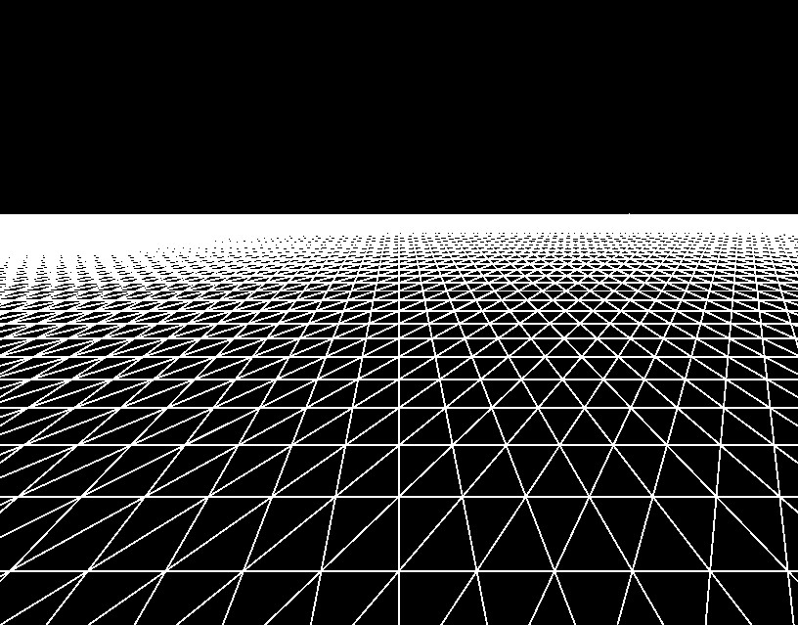
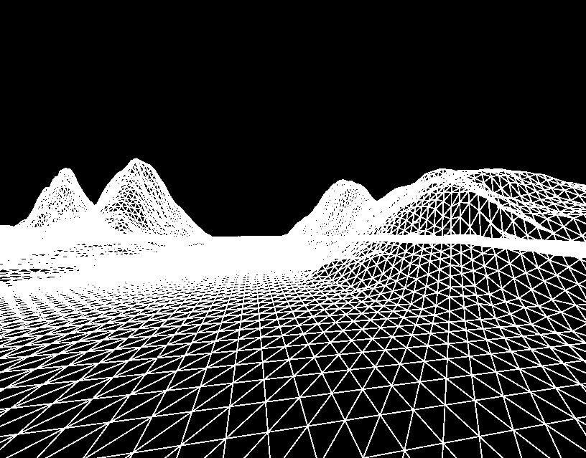
Tessellation

Slide 7
Calculating Normals

Slide 8
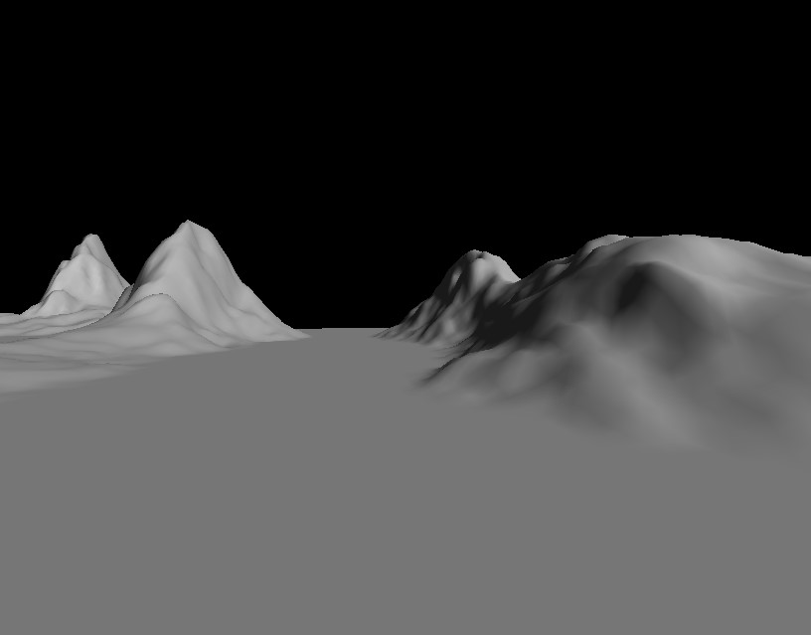
Lighting

Slide 9
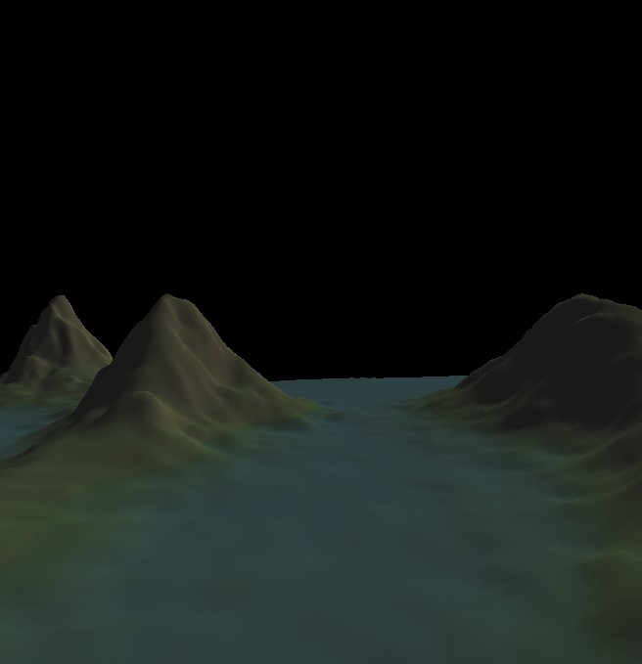
Texturing

Slide 10
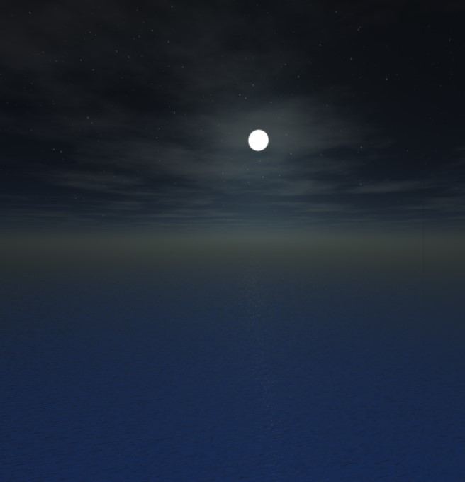
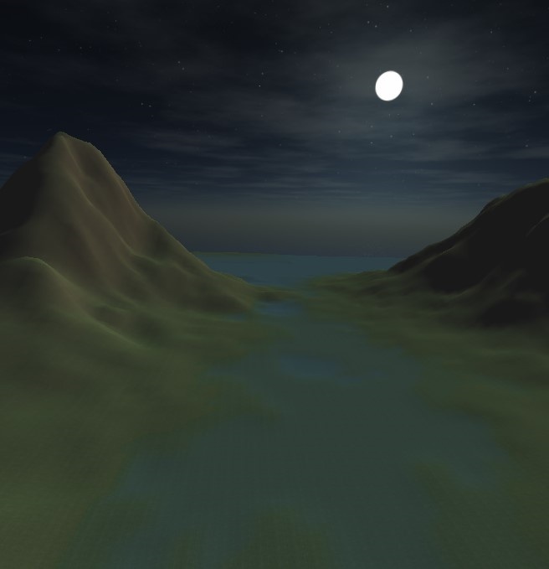
Skybox

Slide 11
Camera Controls

Slide 12
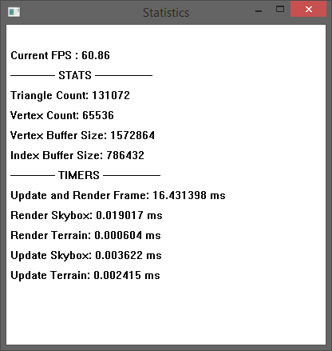
Performance Statistics
FPS

Slide 13
Technology
C++
Windows 8.1 SDK
DirectX 11 SDK
DirecXTK
Visual Studio 2013
Github / GitExtentions

Slide 14
Challenges
Sharp Transitions
Texture Stretching
Sea Level Transisiton
Clipping
Skybox Edges

Slide 15
Conclusion

Slide 16
Future Enhancements
Shadow Mapping
Tessellation Shader
Terrain Editor
Ocean Shader
User Interface
Segway to Game Engine

Slide 17
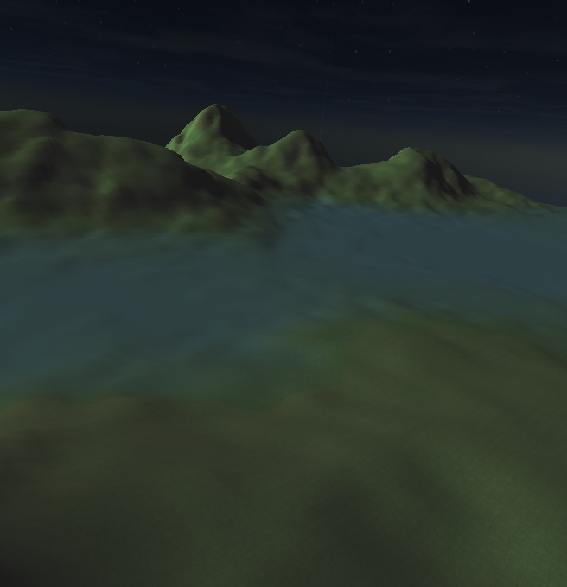
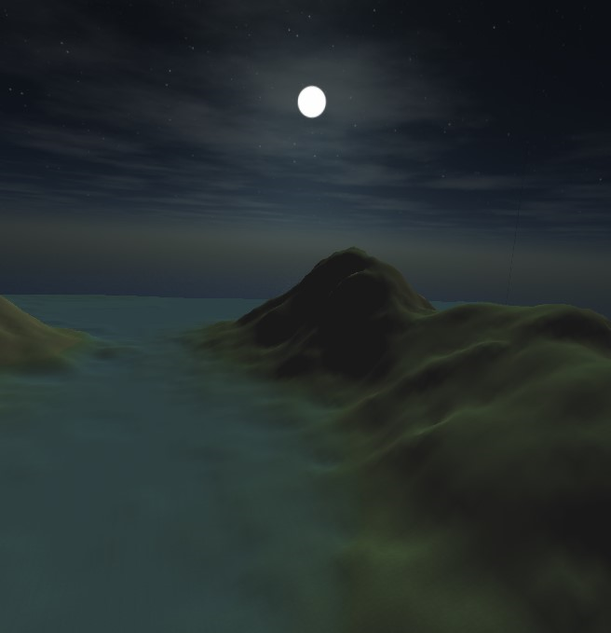
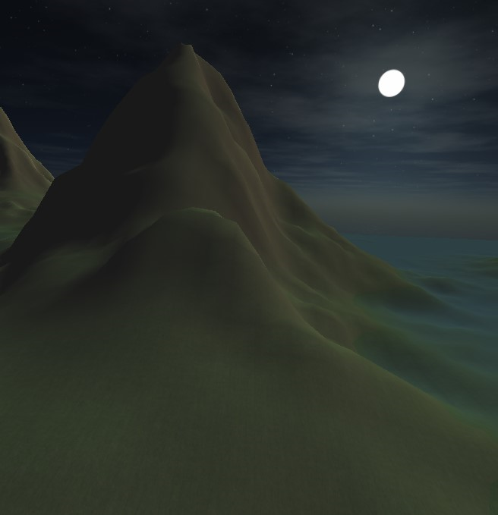
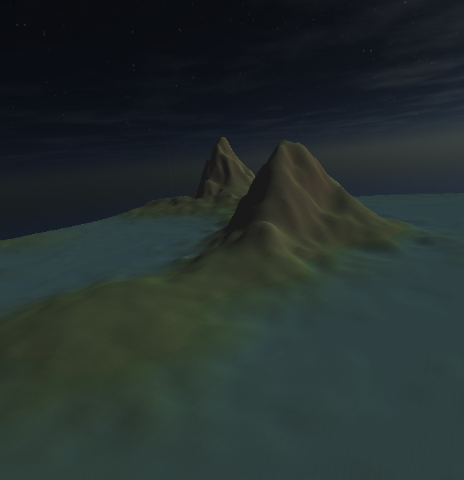
Demo
THANK YOU !
‘w’ – Move camera forward
‘s’ – Move camera back
‘a’ – Yaw camera left
‘d’ – Yaw camera right
‘e’ – Pitch camera up
‘c’ – Pitch camera down
‘k’ –Screen shot
‘l’ – Toggle Lighting
‘m’ – Toggle wire-mesh
‘t’ – Toggle texturing
‘1’ – Toggle terrain
‘2’ – Toggle skybox

