Slide 1
Rendering Photorealistic Mountain Terrain
Karteek Mekala Graduate Student Department of Computer Science Rochester Institute of Technology
November 2014

Slide 2
Agenda
Overview
Background & Motivation
Height-map Generation
Rendering Techniques
Technology
Challenges
Conclusion
Future Work
Demo
Questions

Slide 3
Overview
Height map generation
Tessellation
Lighting
Texturing
Skybox
Camera Controls
Performance Statistics

Slide 4




Height map generation
John Carpenter – “Computer Rendering of Fractal Curves and Surfaces” 1979-80
Diamond Square Recursive Subdivision

Slide 5
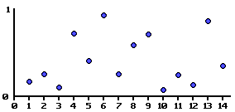
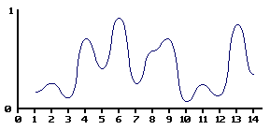
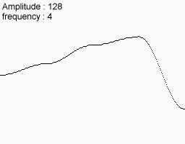
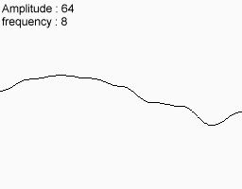
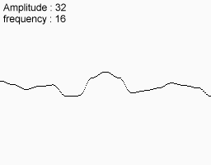
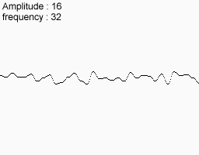
Height-map Generation
Perlin Noise Generation

Slide 6
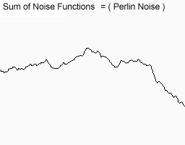
Height map generation
Perlin Noise Generation

Slide 7
Learning here
Perlin Noise generation – Good for parallel programming
Save the generated height map
Avoid run time calculation
Can use bitmap compression techniques if needed
Control of the roughness/smoothness of the height-map is desired

Slide 8
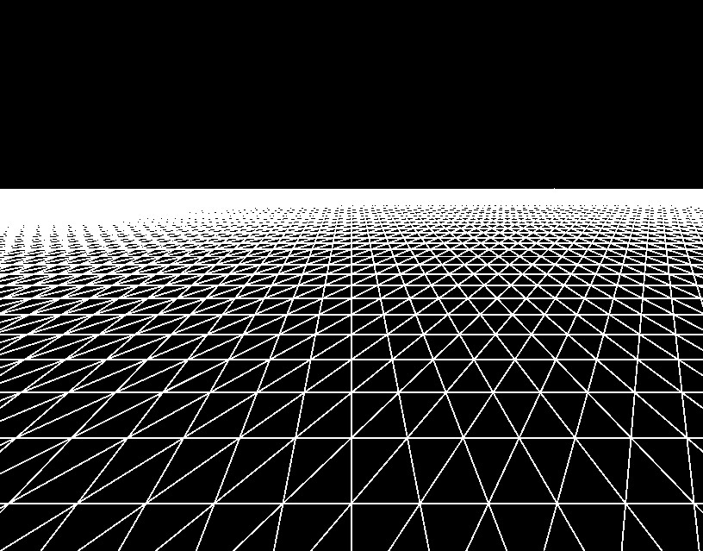
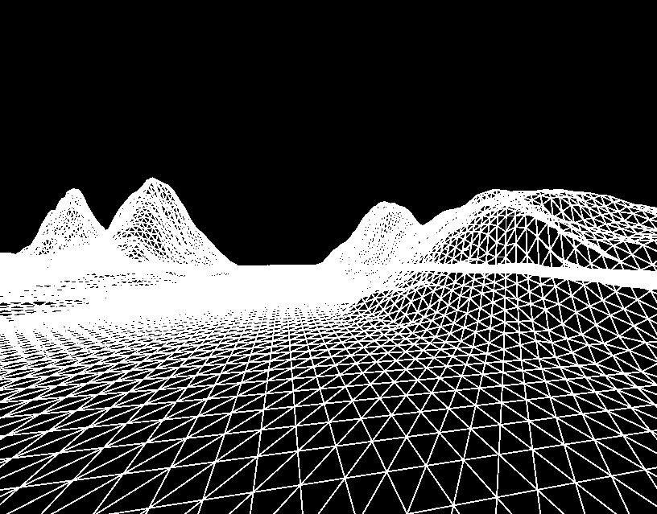
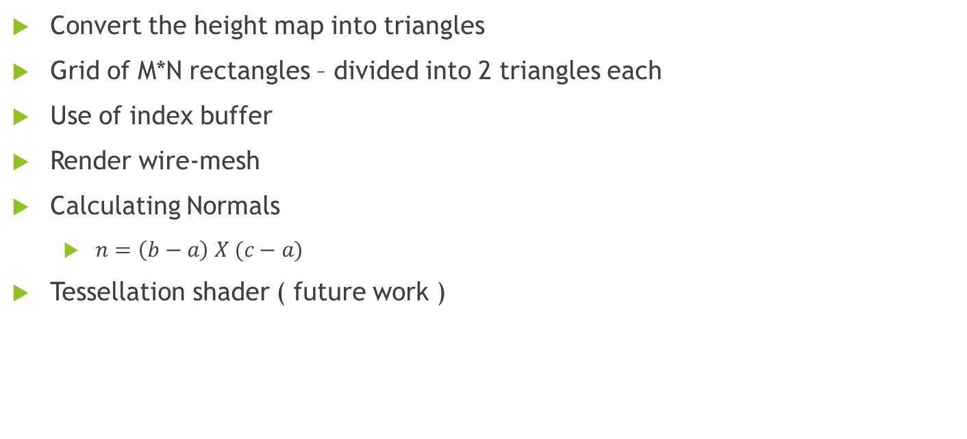
Tessellation
Convert the height map into triangles
Grid of M*N rectangles – divided into 2 triangles each
Use of index buffer
Render wire-mesh
Calculating Normals
$n=\left(b−a\right) X (c−a)$
Tessellation shader ( future work )

Slide 9
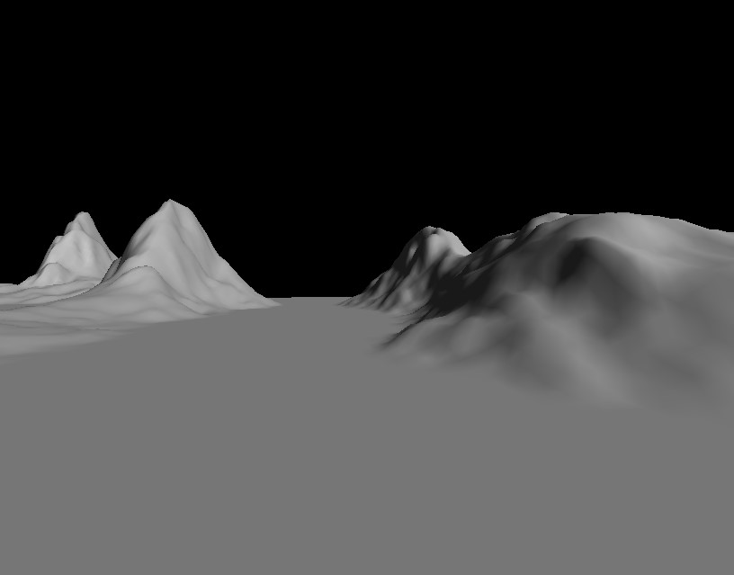
Lighting
Fixed shader pipelines vs programmable shader pipeline
Ambient Light
Diffuse Light
Single source – directional light
Calculated at the pixel shader

Slide 10
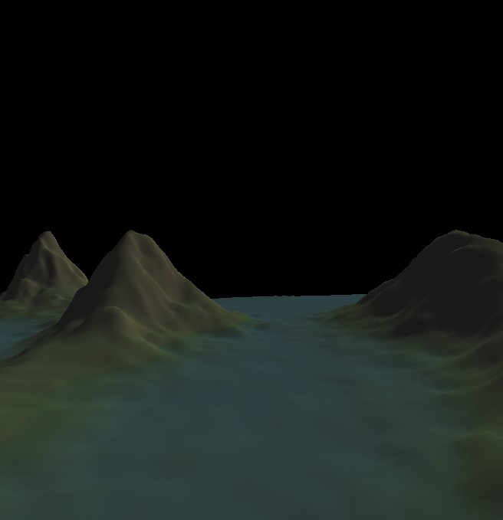
Texturing
Slope factor
S = Up . N where, S - is the slope factor being calculated Up - is the Up vector (0,1,0) N – is the normal calculated for the vertex
S is used to calculate percentage combination grass and rock texture
Sea level
Transition from water to rock

Slide 11
Gains in this technique
Uses the Normal and the up-vector
Normal vector is needed for lighting calculation
Up-vector is required for camera movement
No additional resources such as UV maps are required
Simple and intuitive
Can easily be implemented at the pixel shader

Slide 12
Tri-planar mapping
Image stretching
Cannot calculate texture mapping in 2 dimensions
Must take into account height
3 phases
XZ mapping
XY mapping
YZ mapping
Slope determines the contribution of each phase (already calculated)

Slide 13
Gains in this technique
Need to sample thrice – but is still fast
Textures are already loaded into memory
No additional resources/complex computations required
Slope factor has already been calculated
Works well even with extremely steep and extremely flat surfaces
Simple and intuitive
Easily implemented in the pixel shader

Slide 14
Camera Controls
Eye position (e) – position of the camera
Look-at position (p) – the position in the 3d world that the camera is focused at
Up vector (u) – the vector that is up relative to the view direction
View direction (v) = (p-e)
Right vector (r) = u X v

Slide 15
Camera controls
Move forward/back
Move eye position and the look-at position along the view direction
Maintain distance between eye and look-at
Yaw
Rotate look-at position around the axis defined by up-vector and the eye position
Maintain distance between eye and look-at
Pitch
Rotate the look-at position around the axis defined by right-vector and the eye position
Maintain distance between eye and look-at

Slide 16
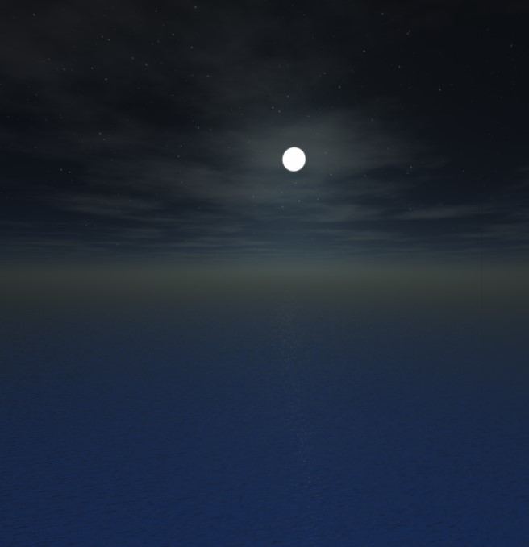
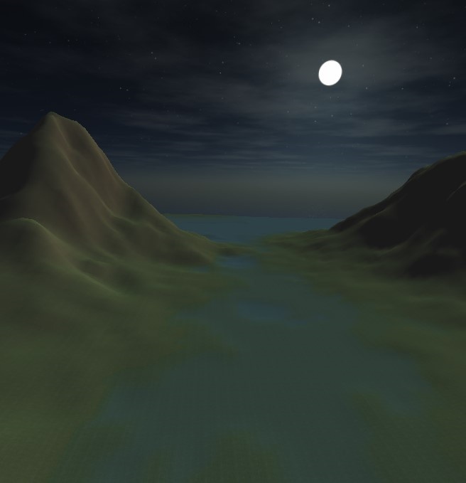
Skybox
Cube centered at the camera position
Perception of infinite distance
Must be closer than the far plane
Try to line up direction of light with placement of sun/moon
Use a separate sprite for sun/moon (future work)

Slide 17
Feature Toggling
Importance learnt from previous project
Valuable while developing features in isolation and combination
Extremely valuable while debugging
Great to explain the techniques to a graphics enthusiast

Slide 18
Feature Toggling

Slide 19
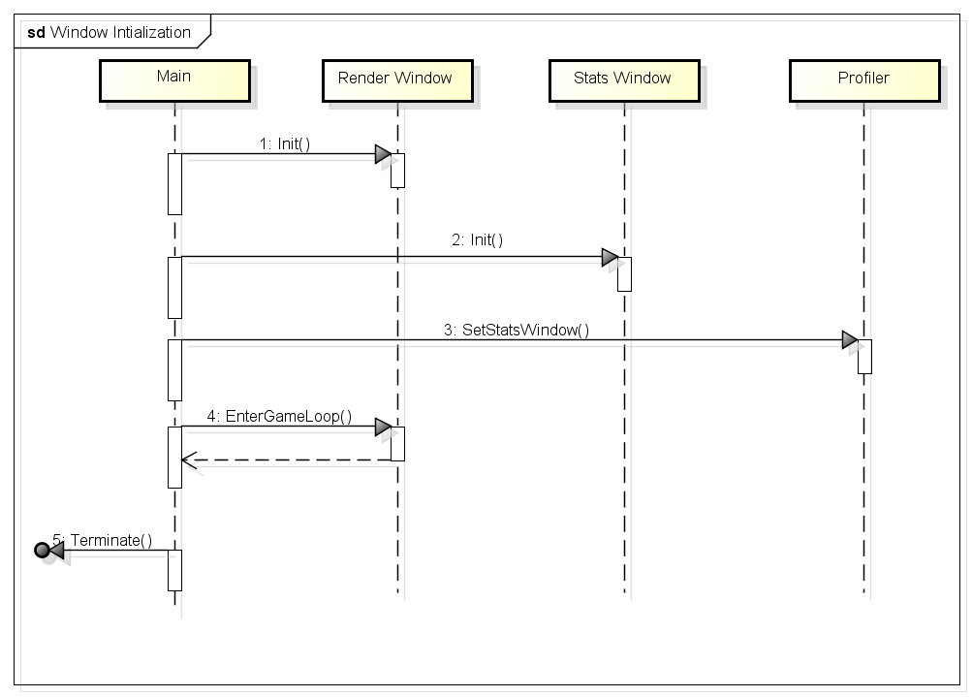
Implementation
Window Initialization

Slide 20
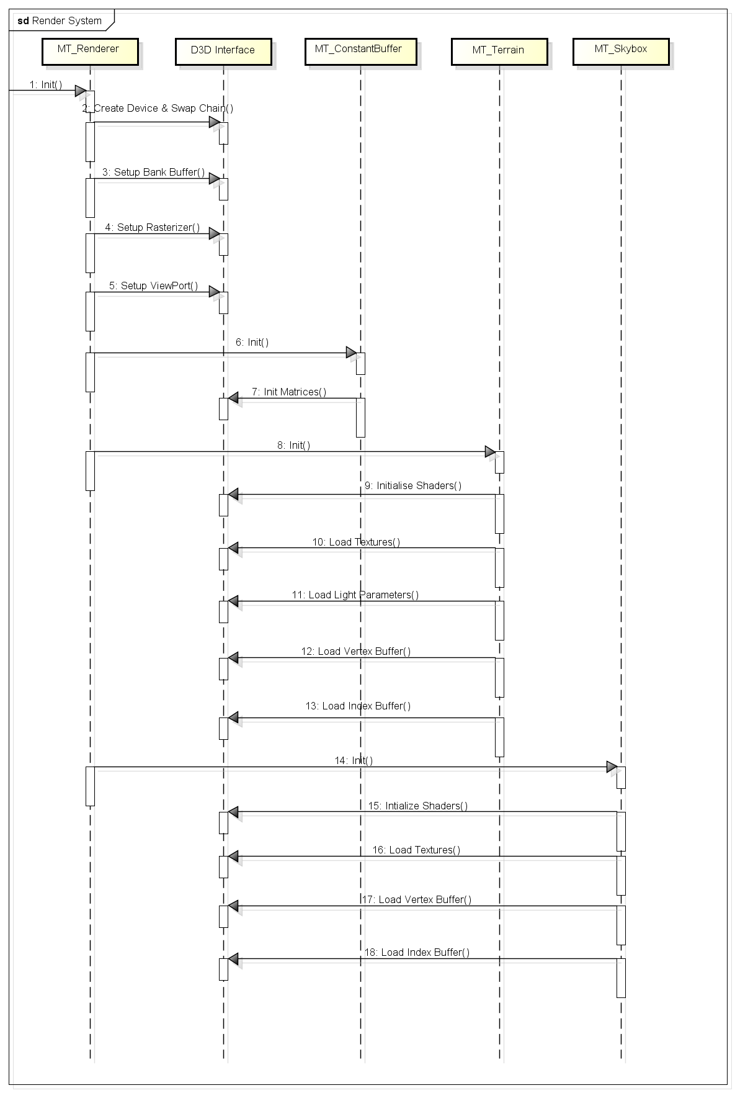
Implementation
DirectX interface setup
Create device and swap chain
Setup Back buffer
Setup Rasterizer
Setup Viewport
Preparing for the render loop
Initialize Shaders
Load Textures
Initialize Lighting parameters
Load Vertex buffer
Load Index buffer

Slide 21
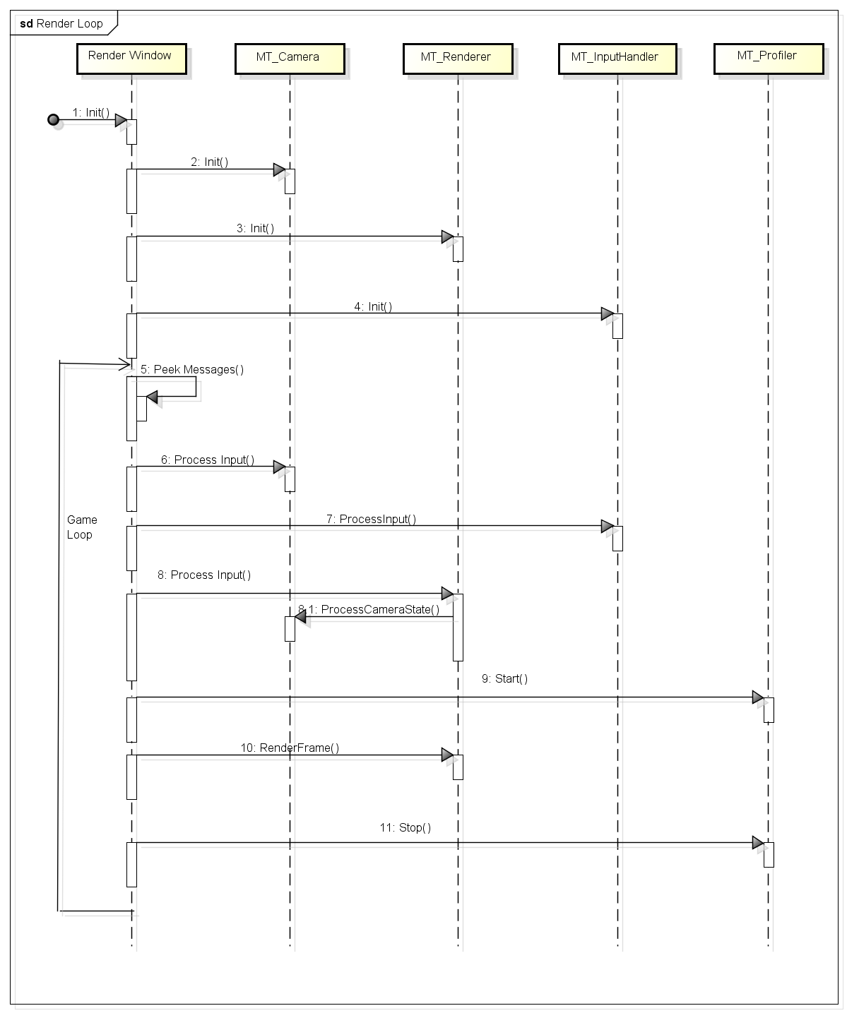
Implementation
Render Loop
Message queue
Input Processing
Render frame
Profiling

Slide 22
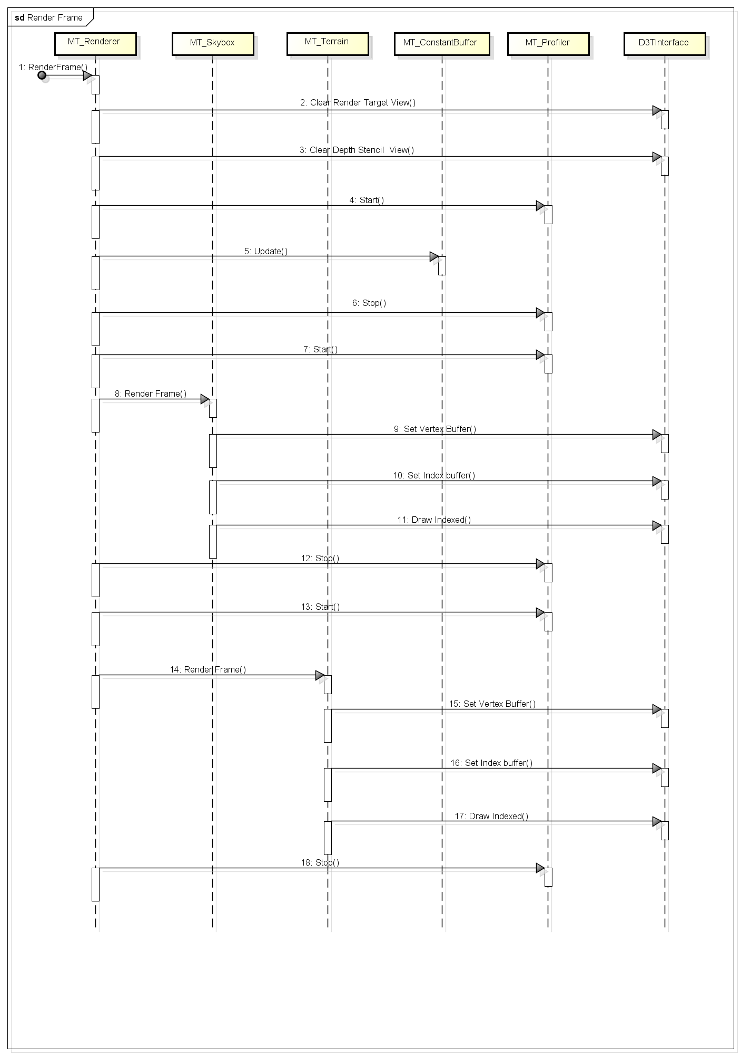
Implementation
Render Frame
Update scene
Clear Render Target
Set active shaders
Set active vertex buffer
Set active index buffer
Draw calls
Profiling

Slide 23
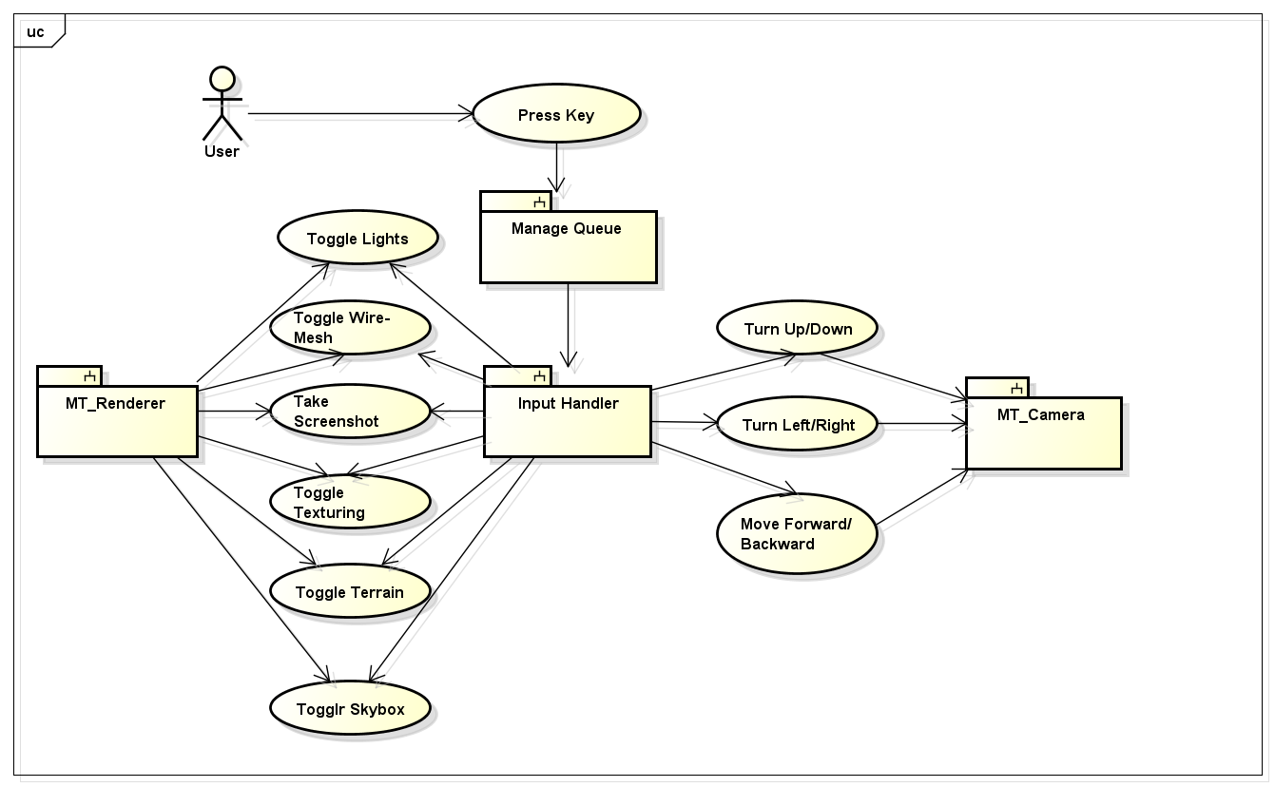
Implementation
User Interaction

Slide 24
Technology
C++
Windows 8.1 SDK
DirectX 11 SDK
DirectXTK
Visual Studio 2013
Github / GitExtentions

Slide 25
Gains from using modern Graphics API
Fixed shader pipeline vs DirectX 11 shader pipeline
Vertex buffers and Index Buffers
CPU vs GPU computation power
Performance Gains
Unable to achieve 60fps in original implementation
Enough spare time to incorporate into much larger projects with this implementation
No more keeping track of current “state” and matrix operations
Development Tools
Visual Studio Editor and Debugger
Visual Studio Graphics Debugger

Slide 26
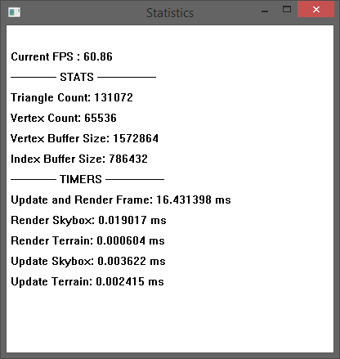
Performance Statistics
With sync enabled

Slide 27
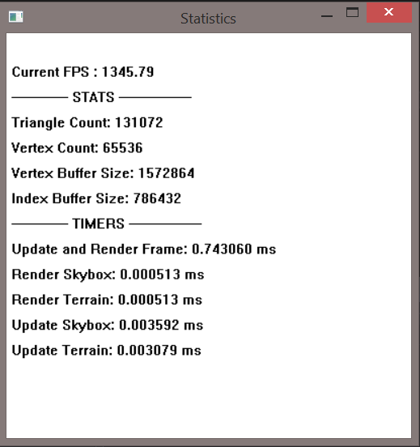
Performance Statistics
With sync disabled

Slide 28
Performance Statistics
Observations
Small frame time
Update + Render of Skybox and terrain together takes < 0.008ms
Majority of the frame time can be utilized to implement complex and/or interactive scenes
Small memory footprint
Buffers together are in the range < 2MB
No additional resources used for texturing

Slide 29
Challenges
Sharp Transitions
Had to play with height generation parameters and smoothing
Texture Stretching
Tri-planar texture mapping
Sea Level Transition
Interpolating texture mapping between water and land
Clipping
Skybox vs Far-plane
Collision detection ( future work )
Skybox Edges
Matching choice of skybox and water texture
Bounds to the scene

Slide 30
Conclusion
Simple and intuitive techniques that can be examined in isolation
Recap of texturing techniques gains
Advantages of height map generation
Gains observed in performance statistics
Frame time
Buffer sizes
Candidate for integration into larger projects
Importance of feature toggling
Understanding contribution of each stage
Benefits of DirectX 11
Great for explaining techniques to a graphics enthusiast

Slide 31
Future Enhancements
Shadow Mapping
Tessellation Shader
Terrain Editor
Ocean Shader
User Interface
Collision detection
Segue to Game Engine

Slide 32
Demo
‘w’ – Move camera forward
‘s’ – Move camera back
‘a’ – Yaw camera left
‘d’ – Yaw camera right
‘e’ – Pitch camera up
‘c’ – Pitch camera down
‘k’ –Screen shot
‘l’ – Toggle Lighting
‘m’ – Toggle wire-mesh
‘t’ – Toggle texturing
‘1’ – Toggle terrain
‘2’ – Toggle skybox

Slide 33
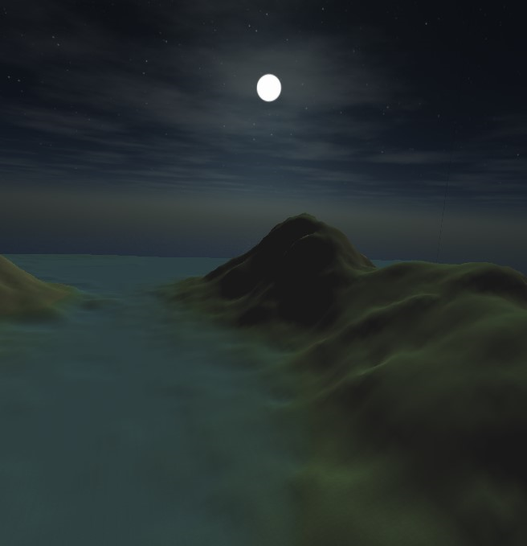
Questions ?
THANK YOU !
Karteek Mekala

