Slide 1
Crop Plantation Prediction using Analysis of Weather Data
Team Members
Aakash.R(1031340010)
Karteek Rakshit(1031340024)
Ganapathy.K(1031340064)
Guided By,
Mr.N.Muthurasu , B.E. , M.E.
Assistant Professor
Computer Science and Engineering
SRM University, Chennai.

Slide 2
Objectives
Analyze the weather data using Map-Reduce Algorithm .
Using the result , one must be able to predict what kind of crops can be planted and must help in yielding the maximum profit .

Slide 3
Existing System
Using K-means Clustering
Existing System uses K-Means Clustering to analyze and predict .
Limitations
Takes more time to execute
Only based on weather data and cannot be applied for soil based identification
Had Data Limitation
Maintenance cost was high

Slide 4
Proposed System
Map Reduce Algorithm analyses the weather data and fuzzy reasoning is used for Crop Plantation Prediction .
Varying from crops that need more water and the ones that need least amount of water can be classified for each district with utmost accuracy .

Slide 5



Architecture
Weather
Data
Hadoop
[HDFS]
Sqoop
Import
Map
Reduce
Fuzzy
Reasoning
Crop
Prediction

Slide 6
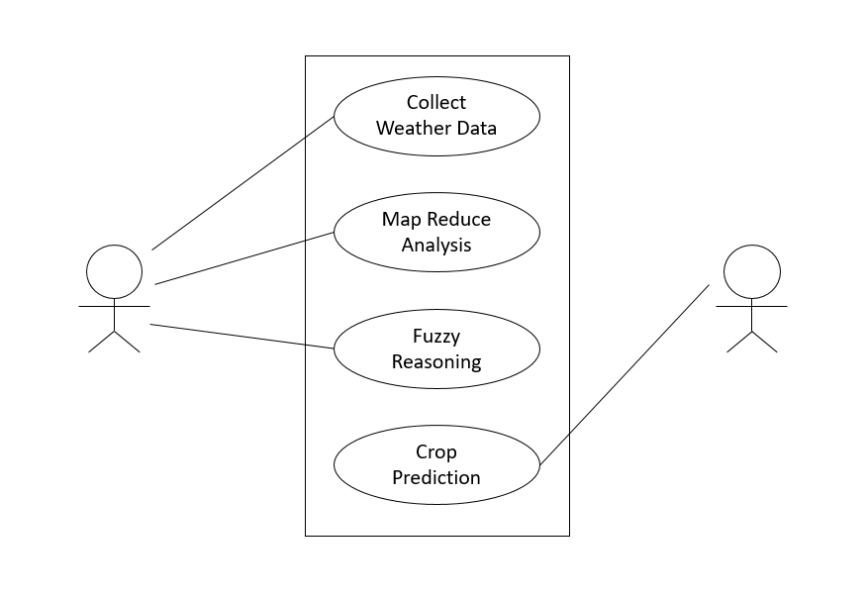
Use Case Diagram
Developer
User

Slide 7
Data Flow Diagram
Weather Data
HDFS
Map Reduce
Crop Prediction
Choice of District and Month
Fuzzy Reasoning

Slide 8
Modules
Data Preprocessing and Migration using Sqoop Module
Data Analytic Module with Map Reduce
Crop Prediction Module

Slide 9
Data Preprocessing and Migration using Sqoop Module
The dataset is first moved into MySQL database and from there it is moved into HDFS where further operations takes place.
MySQL Database
Sqoop Import
Hadoop
[HDFS]
Weather Details

Slide 10
Data Analytic Module with Map-Reduce
Map-Reduce is a processing technique and a program model for distributed computing based on java. The Map-Reduce algorithm contains two important tasks, namely Map and Reduce.
In this module we analyze data set using MAP and REDUCE. Map Reduce processes is run by a Java Program.

Slide 11
Crop Plantation Prediction Module
After the analysis of Weather Data , the result can be used to predict the crop plantation pattern .
Classification would be either heavy rain or low rain , depending on this what kind of crop to be planted can be predicted easily with utmost accuracy and helps in yielding maximum profit.

Slide 12
Hardware Requirements
Processor : Any Intel or AMD x86-64 processor
Disk Space : Minimum 30 – 40 GB
Ram : 4GB
Graphics : Hardware accelerated graphics card supporting OpenGL 3.3 with 1GB GPU memory is recommended.

Slide 13
Software Requirements
MySql – for Front End
Hadoop – for Back End
OS – Preferably Linux or Windows
IDE – Eclipse or any other similar IDE

Slide 14
IEEE Base Papers
The Analysis of Large-Scale Climate Data: Jordan Case Study - Priyanka Dhaka , Rahul Johari
in year:2016, Pages: 288-294
Agricultural Decision Support Framework for Visualization and Prediction of Western Australian Crop Production
Leisa J. Armstrong , Sreedhar A. Nallan
in year:2016 , Pages: 1907-1912

Slide 15
Reference Papers
A Study & Survey on Rainfall Prediction And Production of Crops Using Data Mining Techniques
N. Sundaravalli , Dr.A.Geetha
in year : 2016
A Survey on Crop Yield Prediction based on Agricultural Data
Dhivya B H, Manjula R, Siva Bharathi S , Madhumathi R
in year : 2017

Slide 16
Thank You

