Slide 1



WIFI controlled car using NODEMCU
Presented By,
KARTEESWAR K P 20ECR071
GRYTHIC M 20ECL216
KARTHIK RAJA 20ECL220
GOKUL D 20ECL213
GOKULANAND 20ECL215
Supervised By,
G THIRUNAVUKKARASU

Slide 2
PROBLEM STATEMENT
In this Pandamic suituations (COVID 19) ,we were faced huge loss.
Covid affected person ,must maintain distance from another persons .
To avoid spreading diseases.
Example : they have to maintain atleast 6 to 7 meters
so , To recover this ,we are going avoid interacting with humans, instant of we are using machines ,which is not an new things it is related to using mobile phones …..

Slide 3
Problem Category : Hardware… Domain :Ex: mainly hospital … etc End User :Ex: companies…etc Any Collaboration (Optional) : while Pandamic periods we can use any where , not only at specfic areas

Slide 4
OBJECTIVE
KEC-IT
It mainly reduces the interaction between humans. So they easily phurches, what they want ,like medicine ,food products Ect…
Avoid human error.
Simple in construction.
majorly it is useful aged persons , because risk percentage is comparitvely very less , also an fear less inter action.. Ect.

Slide 5
DESCRIPTION:
With increasing urban population and rapid expansion of cities, there is a nees for better communication and inter connectivity among these vehicles due to mobility.
Consumers nowadays progressively utilizing online services for more than shopping. So, continuously growing online platform. We have improved to next level which means the food and medicinal products by using with help of machines.

Slide 6
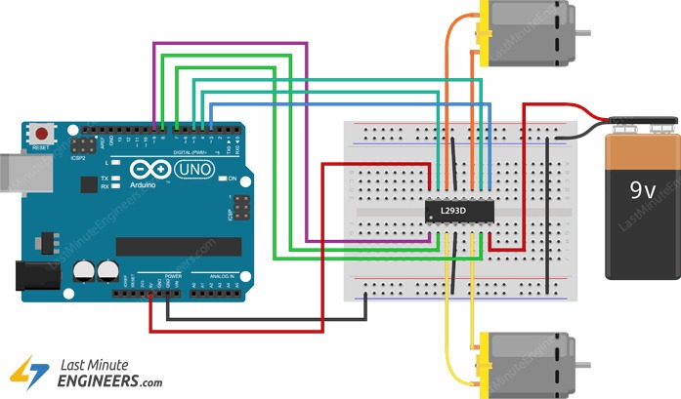
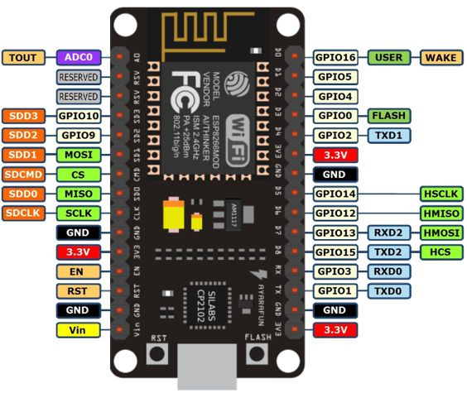
Photos
PHOTO

Slide 7
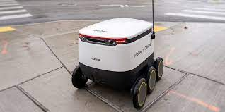
Video
Video link:
https://youtu.be/Jc-o6XFlv_E

Slide 8
Thank you

