Slide 1


Swami Keshvanand Institute of Technology, Management & Gramothan, Jaipur
(An Autonomous Institute Affiliated to Rajasthan Technical University, Kota)
Industrial Training
Presentation
TOPIC:
AI Job Market Intelligence Platform
Submitted To:
Name:- Mr. Shivank Lavania
Assistant Professor
Submitted By:
Name:-Kartev Vashisth
Roll No.:- 23ESKC049

Slide 2
Index
Company Introduction
Certificate
Technology Used
Goal of Training
Project Overview
Working Project
Future Scope
Q&A
SKIT, JAIPUR www.skit.ac.in

Slide 3

Company Introduction
Coplur Technologies Pvt. Ltd. (in association with SKIT , Jaipur) is a Jaipur-based B2B EdTech and HRTech company that focuses on improving student employability through AI-powered assessments and industry-oriented training.
The company bridges the gap between academia and industry by providing:
AI-based Work Readiness Assessments
Skill Development & Technical Training
Internship and Placement Support
Corporate Hiring Solutions
Career Readiness Analytics
Its mission is to create job-ready professionals by equipping students with practical skills aligned with industry requirements.
SKIT, JAIPUR www.skit.ac.in

Slide 4
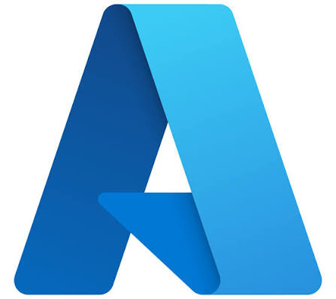



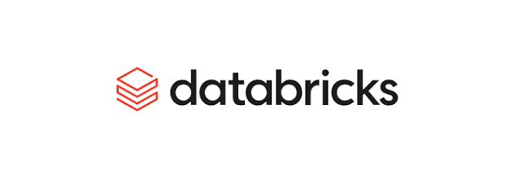





Technology Stack Used
SKIT, JAIPUR www.skit.ac.in

Slide 5
Goal Of Training
Gain practical knowledge of Data Engineering concepts and industry workflows.
Build a strong foundation in Python, SQL, NumPy, and Pandas for data processing.
Learn Git and version control for collaborative software development.
Understand Apache Spark and PySpark for large-scale data processing.
Explore Docker, Apache Kafka, and Apache Airflow for modern data pipeline development.
Work with Azure Data Lake Storage (ADLS), Azure Data Factory (ADF), and Azure Databricks for cloud-based ETL pipelines.
Learn Delta Lake for reliable and efficient data storage and management.
Design and implement an end-to-end Data Engineering pipeline using Azure services.
Apply the acquired skills by developing a Telecom Customer Churn Data Engineering Project.
SKIT, JAIPUR www.skit.ac.in

Slide 6
AI Job Market Intelligence Platform
Project Overview
Project: AI Job Market Intelligence Platform
Built an end-to-end data engineering pipeline using Microsoft Azure to process approximately 500,000 job records.
Implemented Bronze–Silver–Gold architecture using Azure Databricks, PySpark, and Delta Lake.
Automated data ingestion using Azure Data Factory and Storage Event Triggers.
Loaded analytical data into Azure SQL Database using Spark JDBC.
Created interactive Power BI dashboards to analyze job trends, skills, salaries, and technology demand.
SKIT, JAIPUR www.skit.ac.in

Slide 7
AI Job Market Intelligence Platform
Problem Statement:
Finding useful information from large amounts of job market data is not easy. It takes time to identify which skills are in demand, which companies are hiring, and what salaries are being offered. Manually managing and analyzing this data can also lead to errors and outdated information. This project aims to automate the process of collecting, processing, and analyzing job data using Azure and presenting the results through Power BI dashboards.
SKIT, JAIPUR www.skit.ac.in

Slide 8
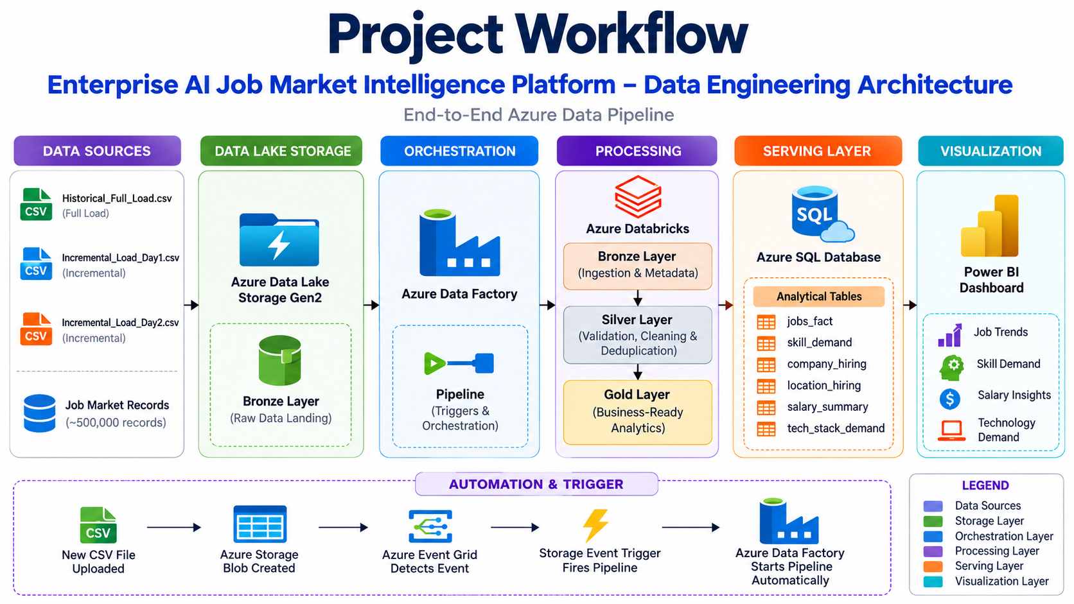
Project Workflow

Slide 9
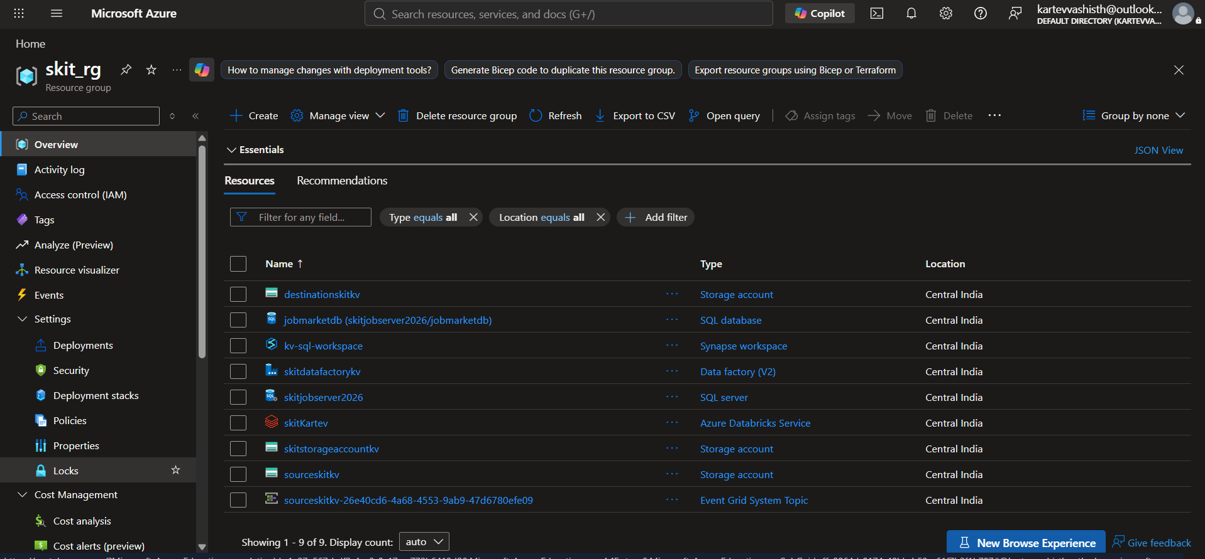
Resource Group

Slide 10
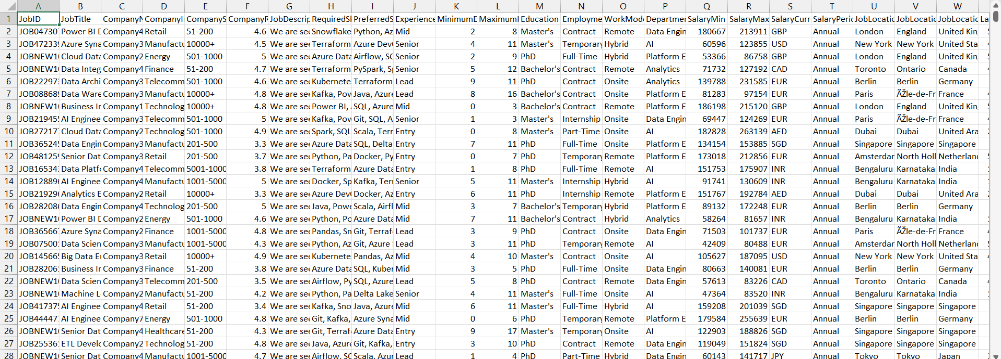
Data

Slide 11
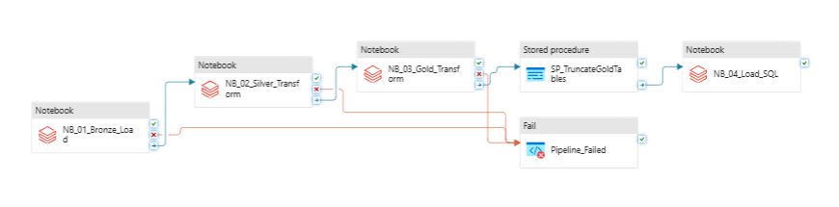
ETL Pipeline Flow

Slide 12
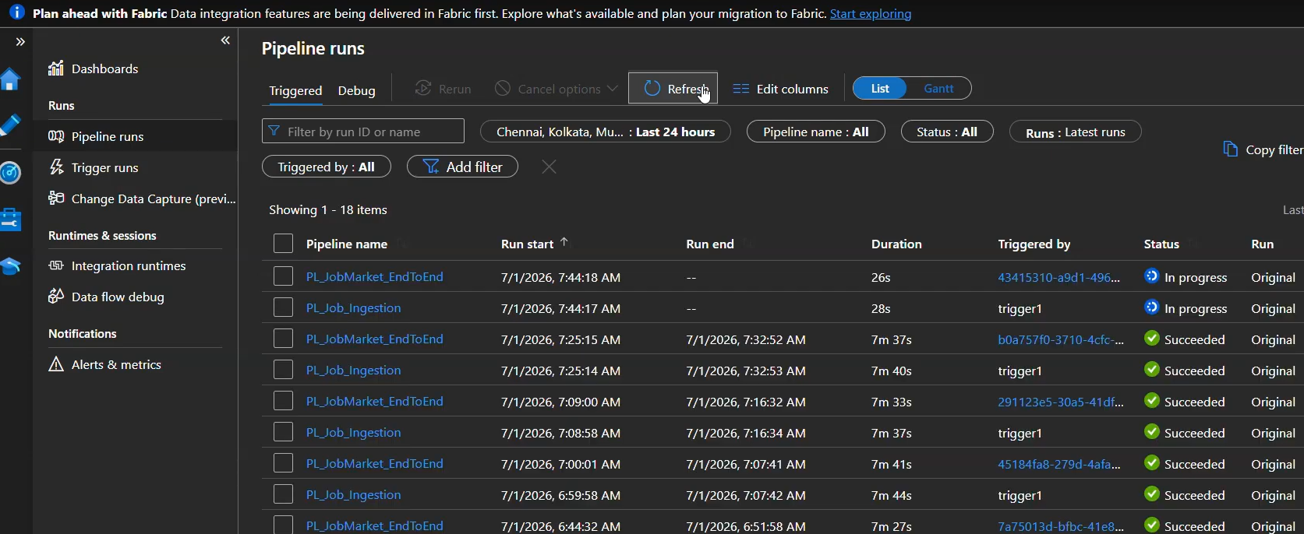
Automated Trigger for new data

Slide 13
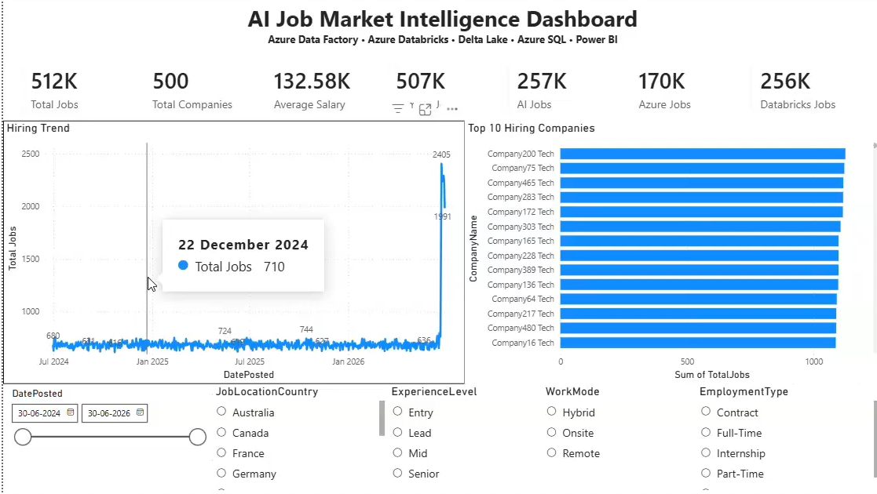
PowerBI generated Dashboard

Slide 14
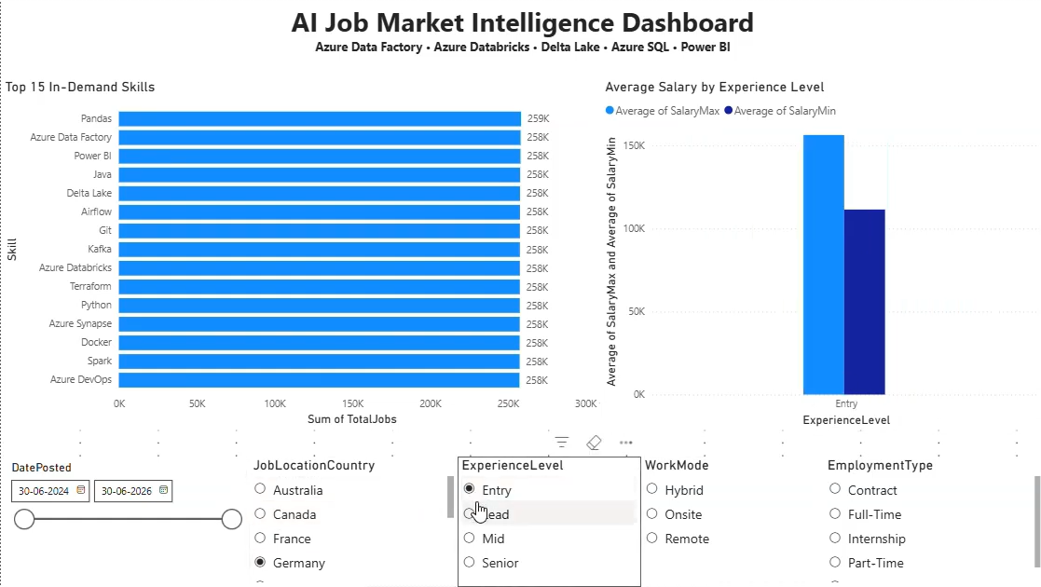
PowerBI generated Dashboard

Slide 15
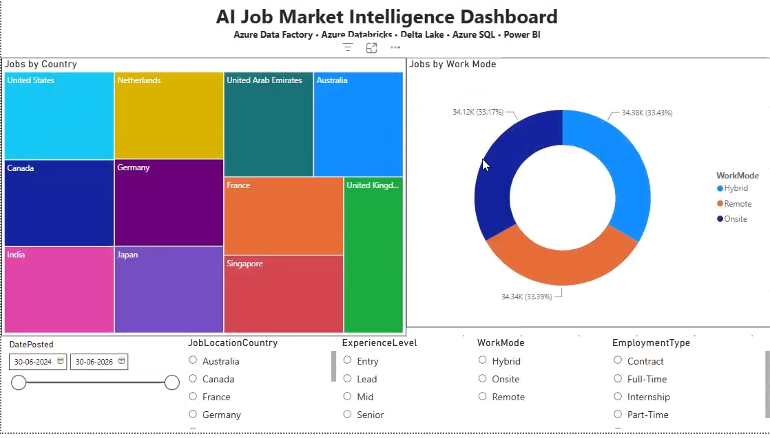
PowerBI generated Dashboard

Slide 16
Future Scope
Integrate real-time job market data from APIs.
Implement advanced AI/ML models for job demand and salary prediction.
Optimize pipeline performance for larger datasets.
Enhance data quality monitoring and error handling
Automate Power BI dashboard refresh and reporting
Deploy the platform with scalable, secure cloud infrastructure
SKIT, JAIPUR www.skit.ac.in

Slide 17
Q & A
SKIT, JAIPUR www.skit.ac.in

Slide 18
Thank You
SKIT, JAIPUR www.skit.ac.in

