Slide 1

2D Topology optimisation code for unstructured meshes in Blender (BlenderTopOpt) and its applications
A presentation by:
Karthikeyan

Slide 2
Project Description
BlenderTopOpt, an open-source 2D topology optimisation solver using unstructured triangular meshes was coded in Python using Blender API for user input and Numpy and Matplotlib for solution and output.
Found a need for a topopt solver for unstructured meshes and the freedom to model any structure quickly unlike topopt 88 which is very restrictive.
Allows users to model any 2d surface in Blender using its powerful modelling and 2D meshing capabilities.
The goal is to use BlenderTopOpt for optimizing a spanner and other common scenarios like bridges and validate it with established software
Uses 2D CST elements for finite element analysis.

Slide 3
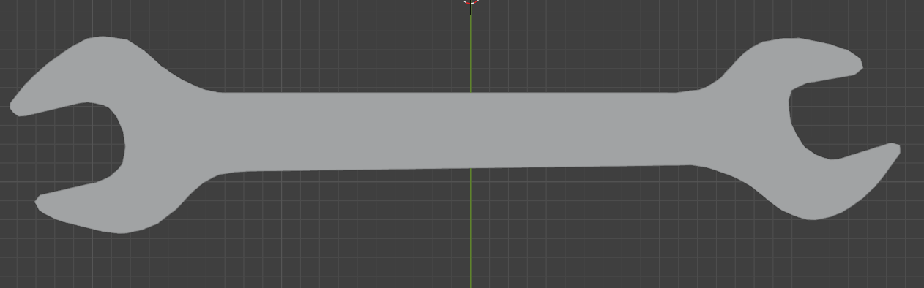
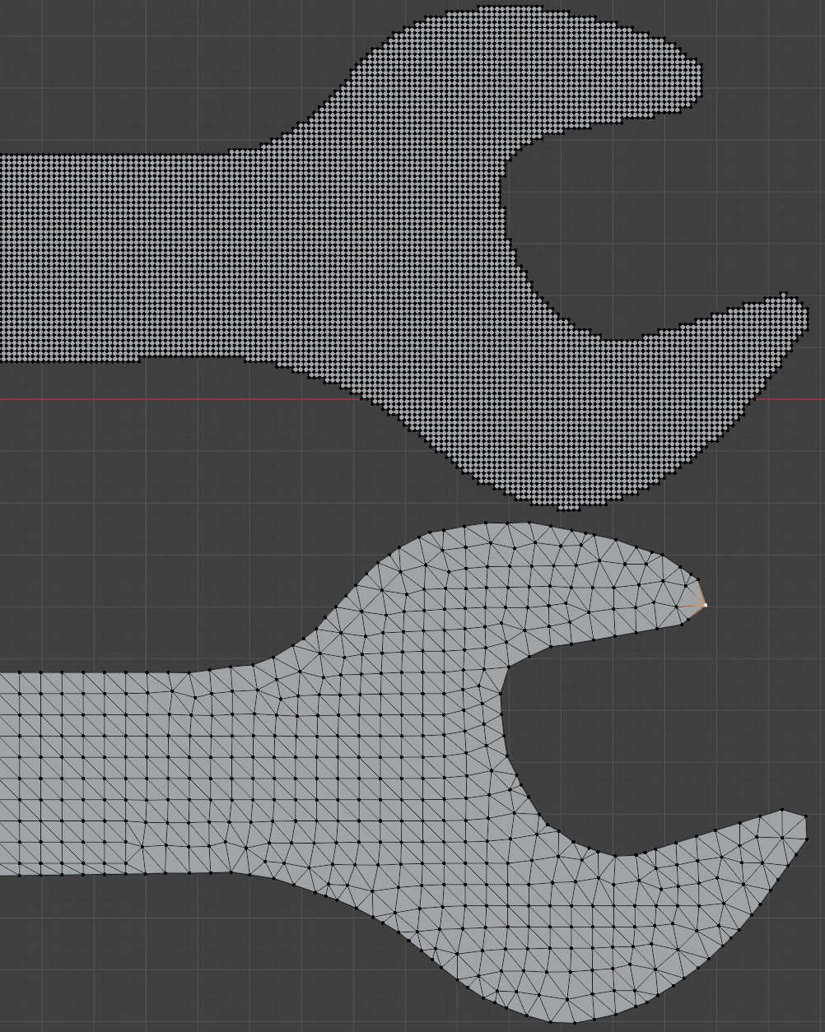
What is Blender and why unstructured meshes?
Blender is an amazing open-source tool to model surfaces in 2D and 3D.
The user is free to model whatever 2d mesh they want to.
Structured meshes don’t follow the contours of the model. Need high degree of refinement to be accurate for model.
Unstructured meshes accurately follow the contour of the model.
Structured mesh with 76168 elements
Unstructured mesh with 2658 elements

Slide 4
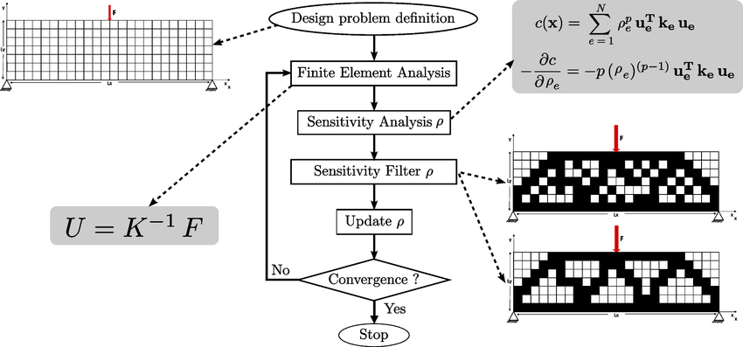
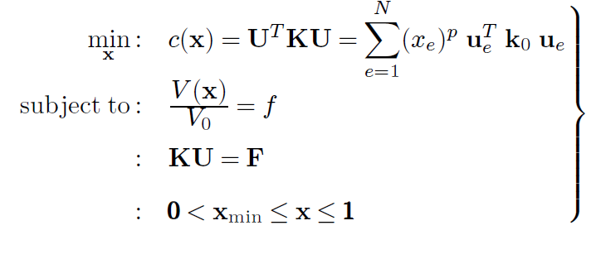
Methodology

Slide 5
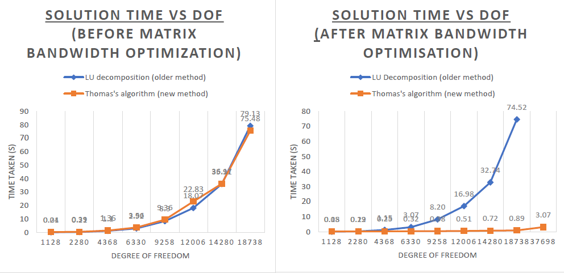
Finite element analysis

Slide 6
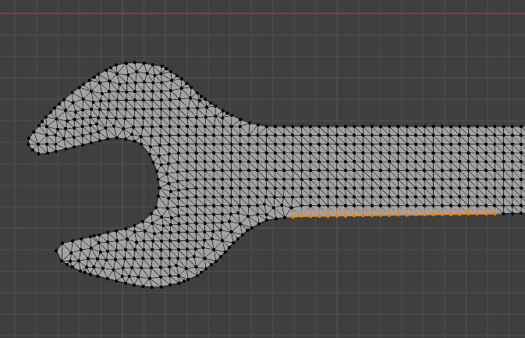
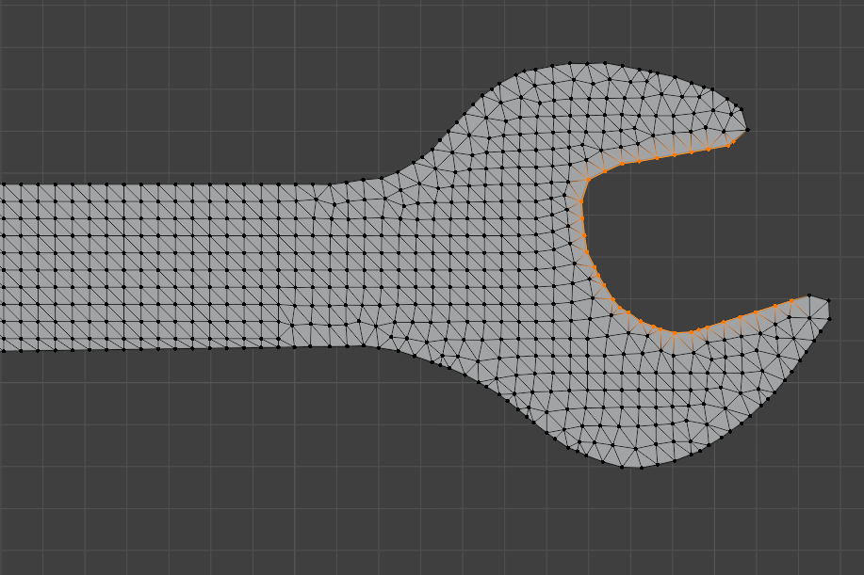
Finite element analysis
2D CST unstructured meshes
Load applied on orange edges
Fixed boundary conditions
applied on orange edges

Slide 7
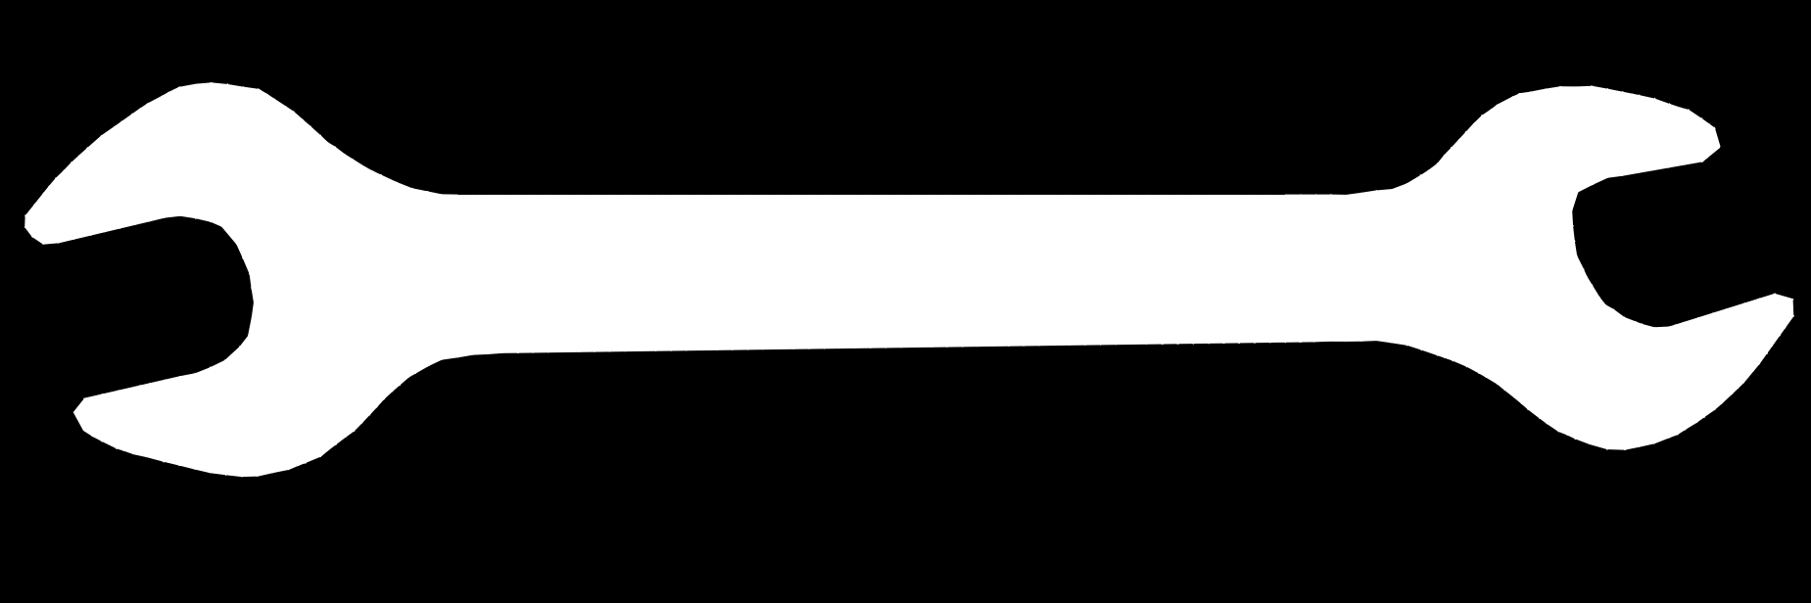
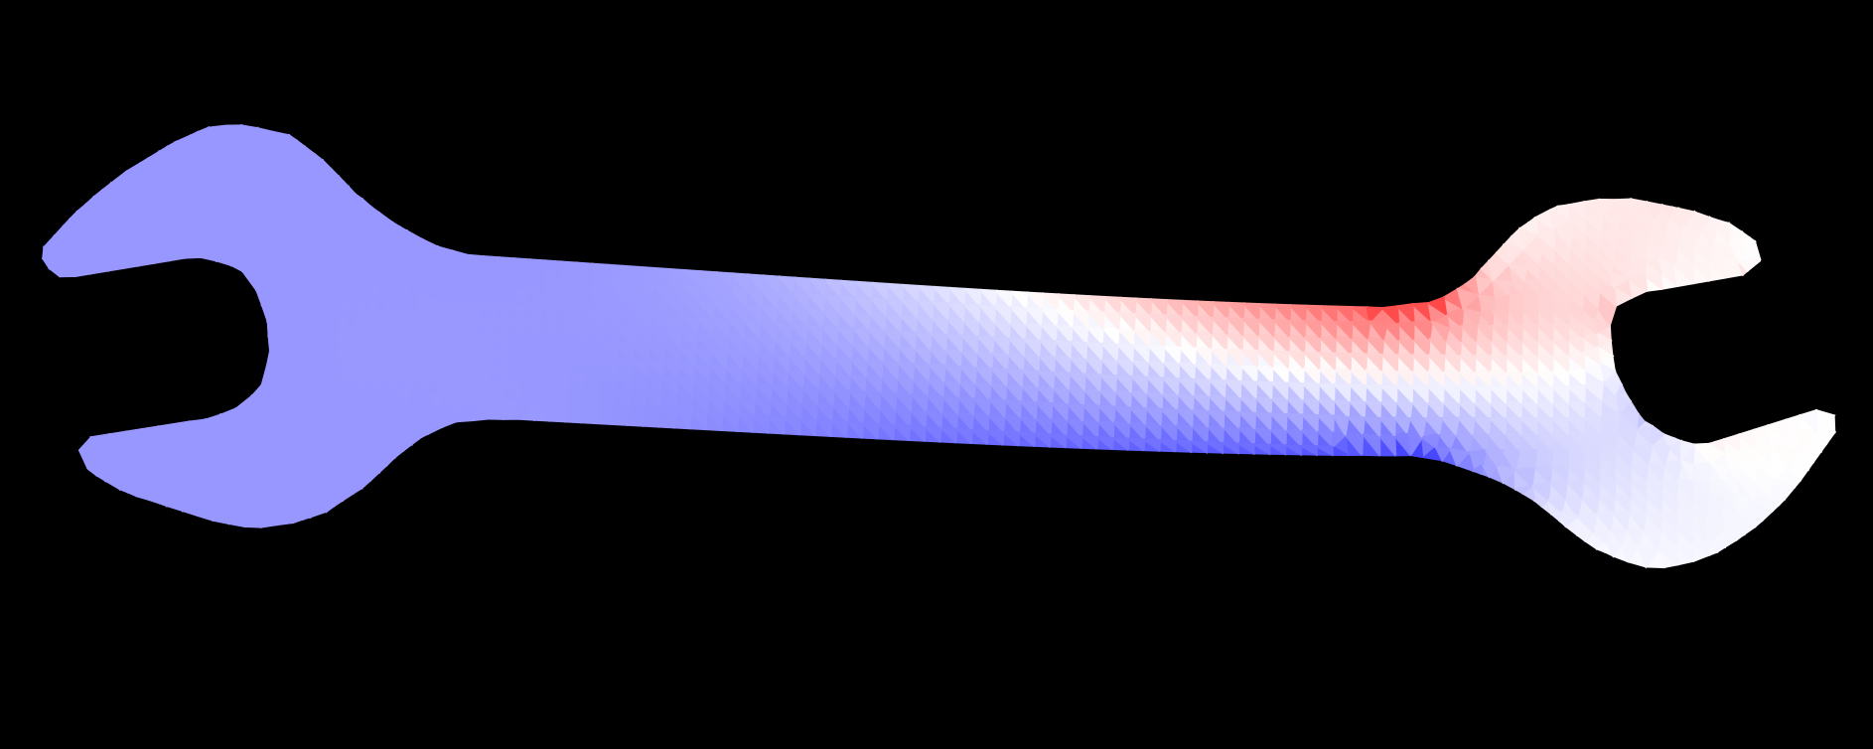
Undeformed mesh
Deformed mesh

Slide 8
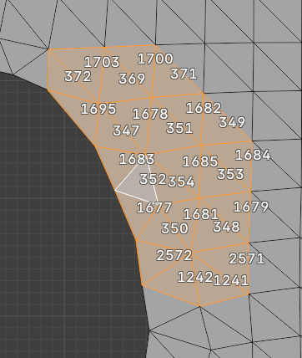
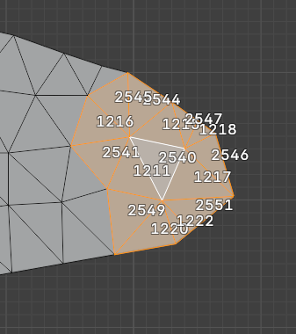
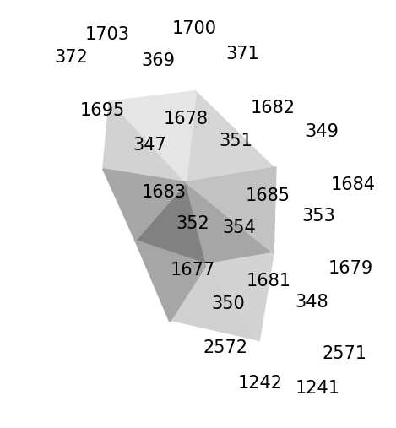
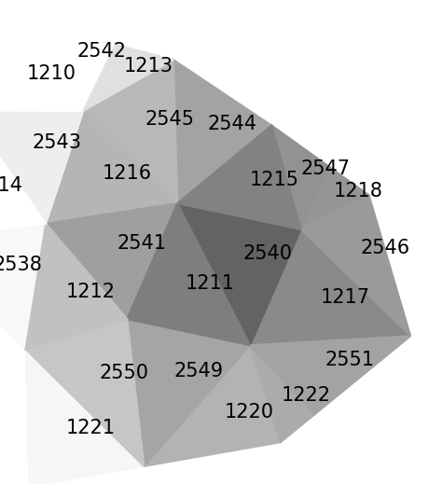
Sensitivity filtering
Involves finding out the neighbouring triangles and the distance from them.
Unstructured meshes are difficult in dealing with sensitivities since they don’t have a orderly element numbering to be exploited for filtering the neighbouring elements based on distance.
A custom recursive algorithm was developed using mesh tools from Blender to define the “levels ” of filtering.
It calculates the adjacent elements recursively based on the element connectivity

Slide 9
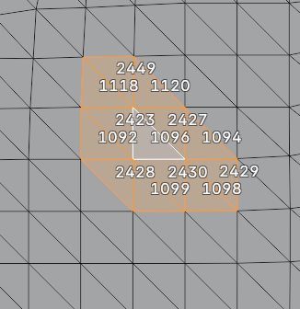
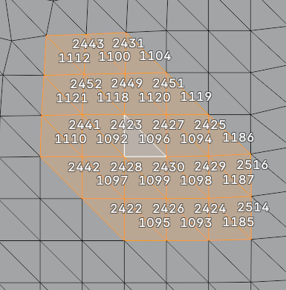
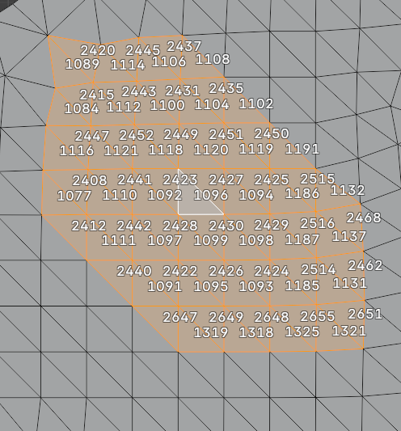
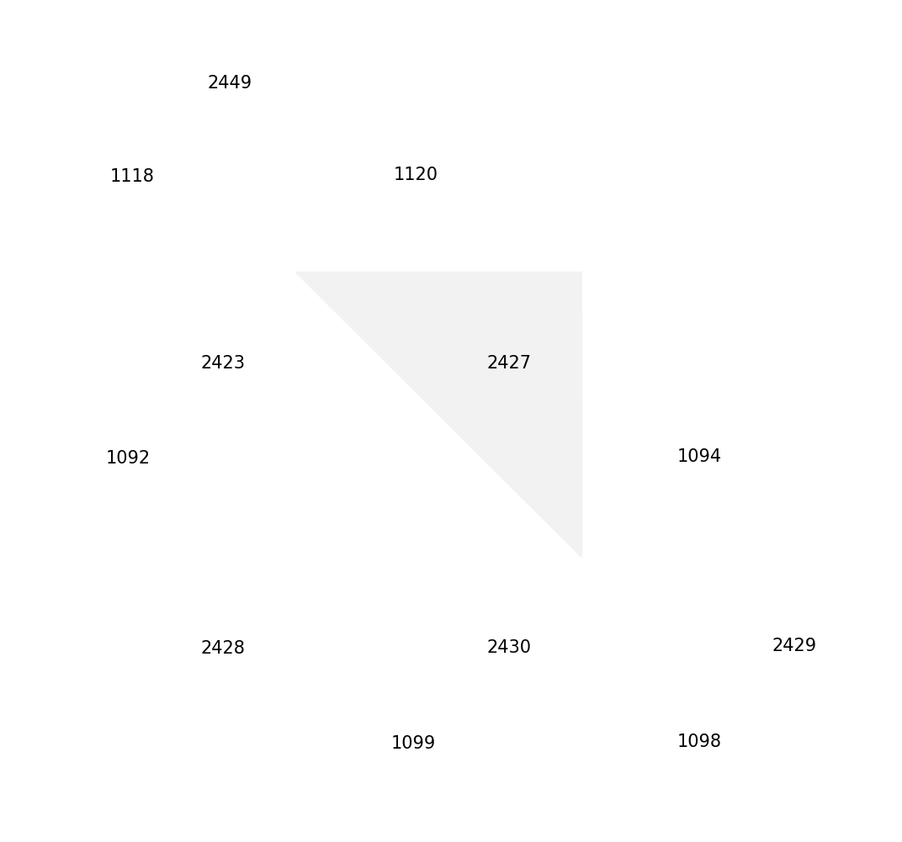
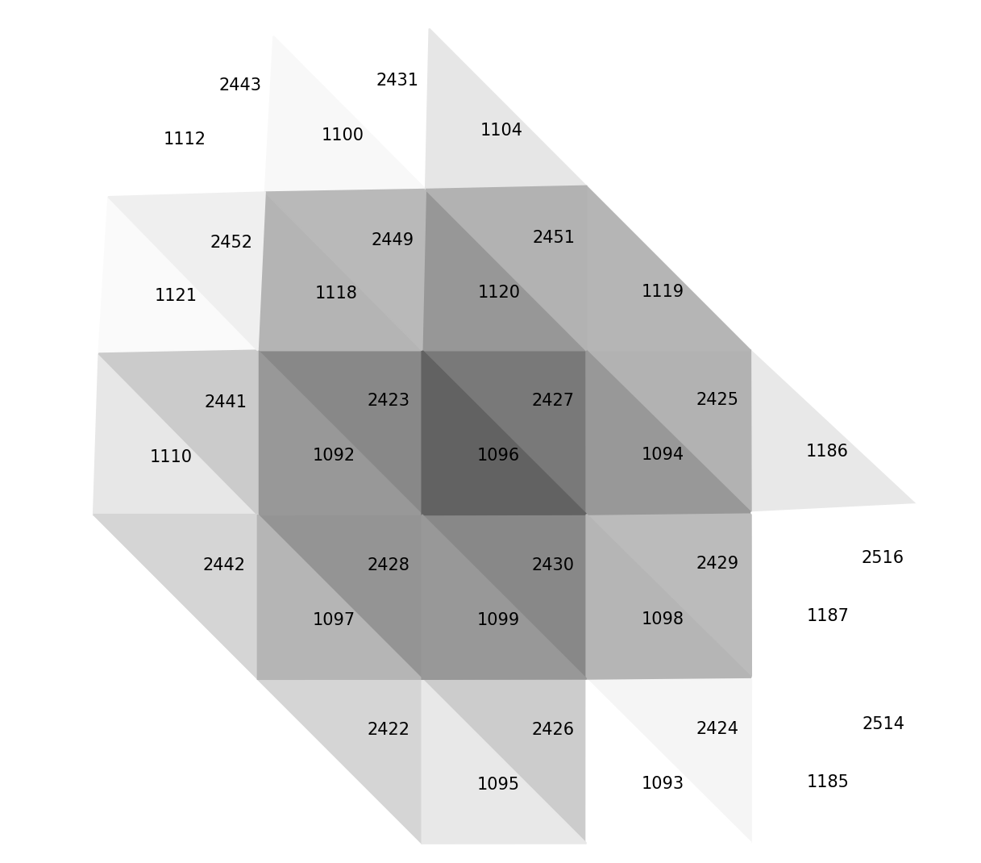
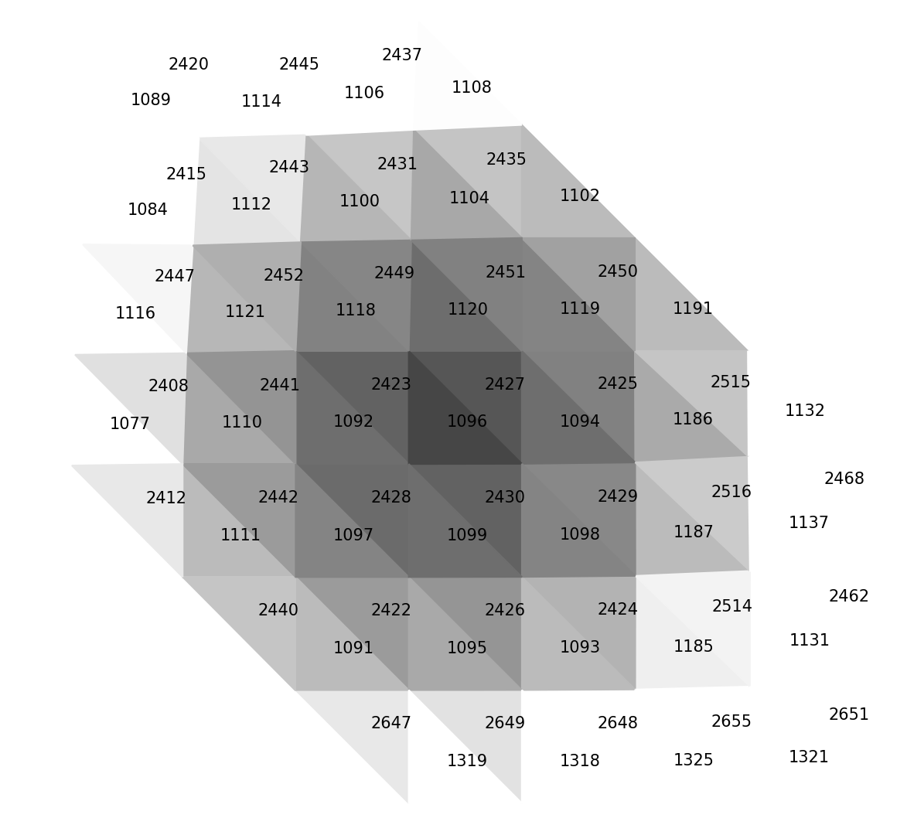
Level 1 filtering,
Filtering radius 1
Level 2 filtering,
Filtering radius 2
Level 3 filtering,
Filltering radius 3

Slide 10
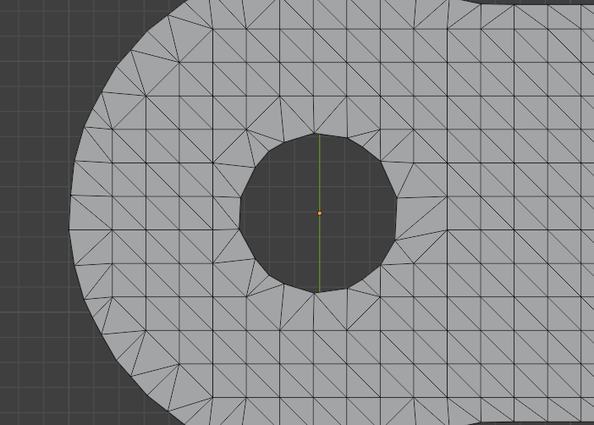
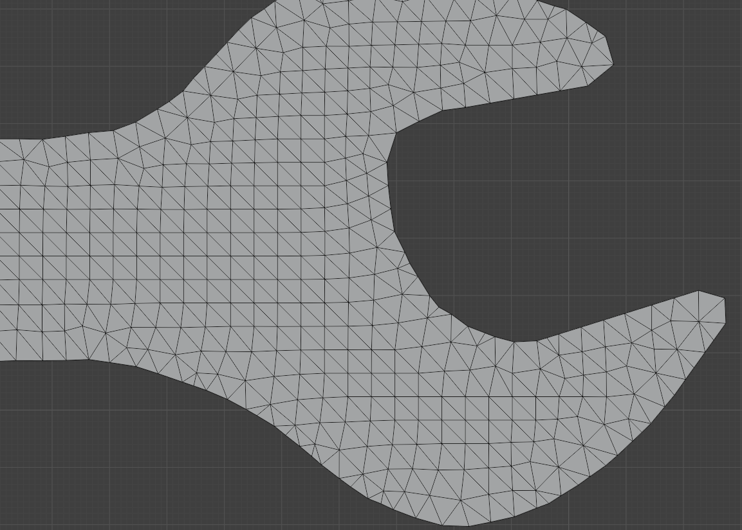
Further improvement
The mesh has a lot of structured right isosceles elements which are identical in shape and size.
This property can be exploited to copy the stiffness matrices instead of creating one every time.

Slide 11
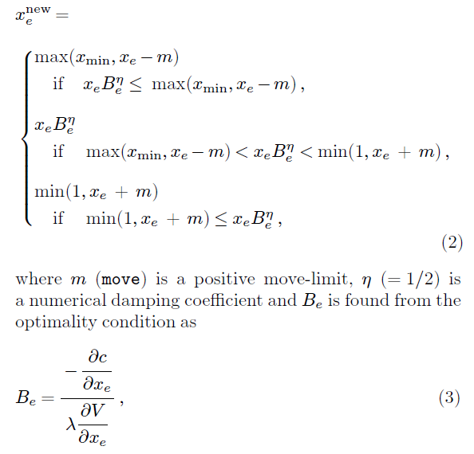
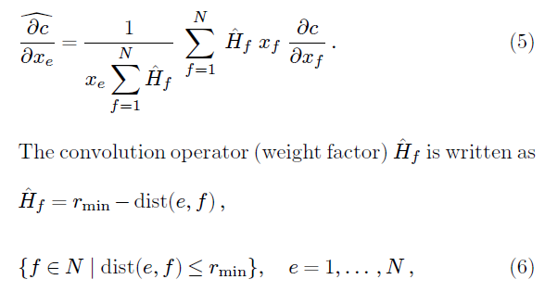
Solution scheme
The model is solved by heuristic updating scheme for the design variables by Bendsoe. (Refer to topopt 99). This is to satisfy the volume fraction constraint.
This scheme is used to satisfy the volume constraint

Slide 12
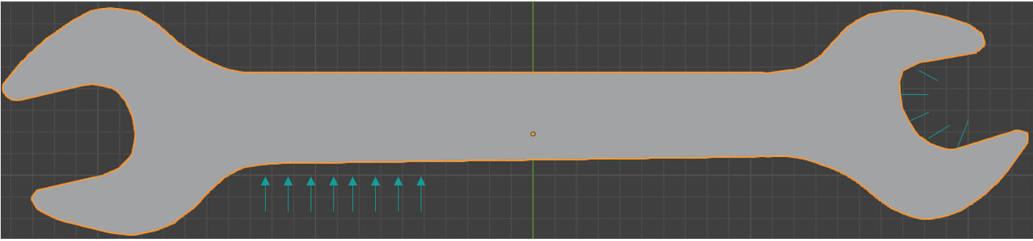
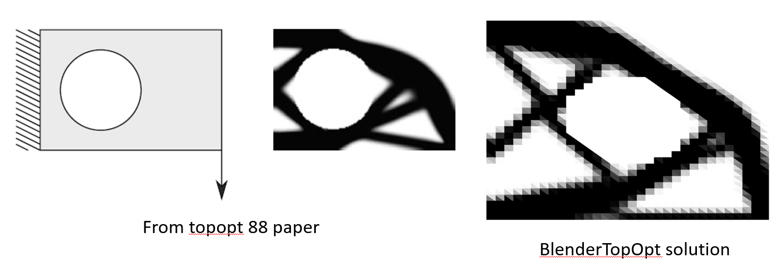
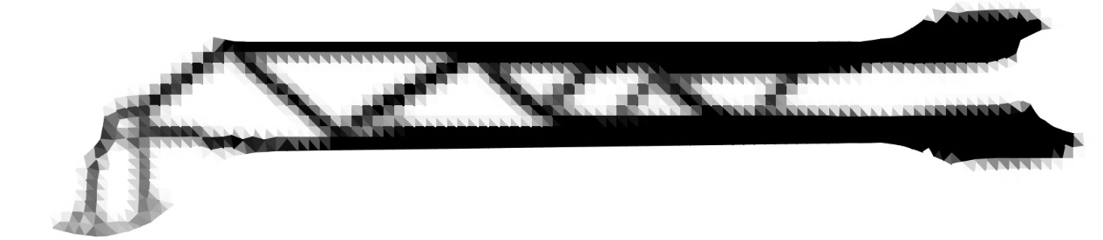
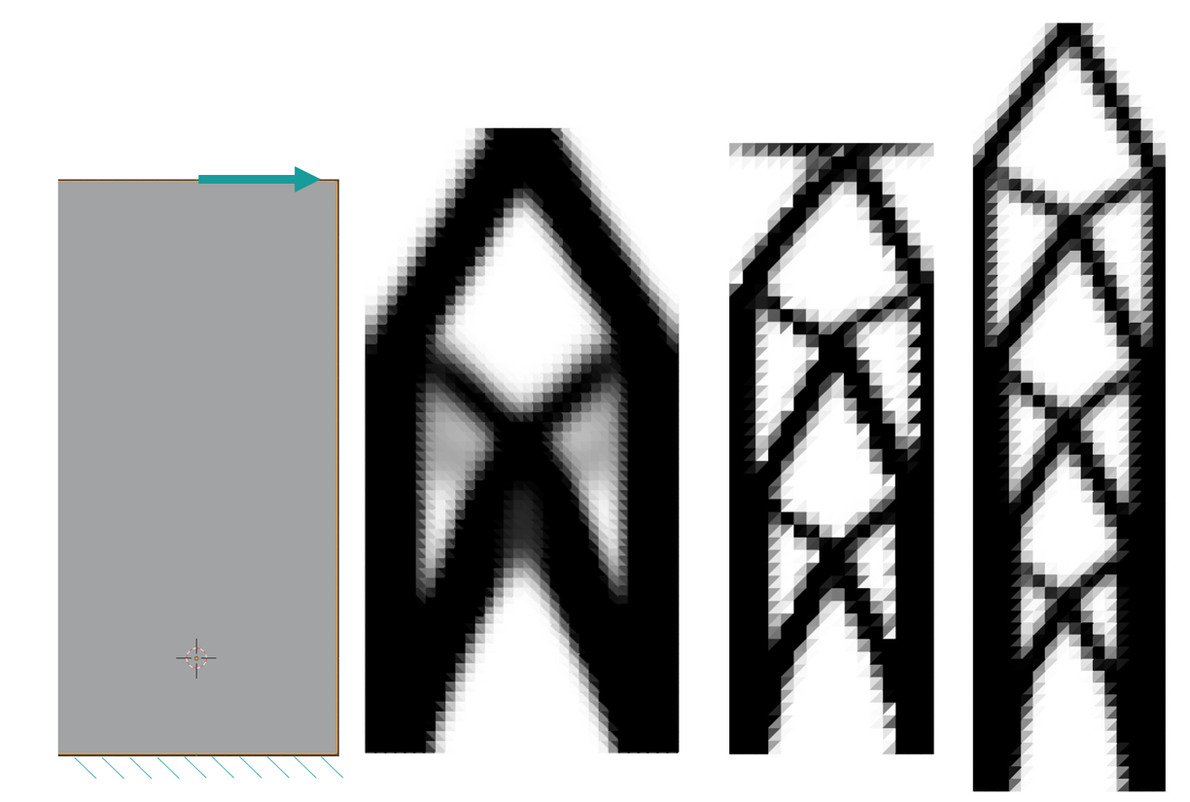
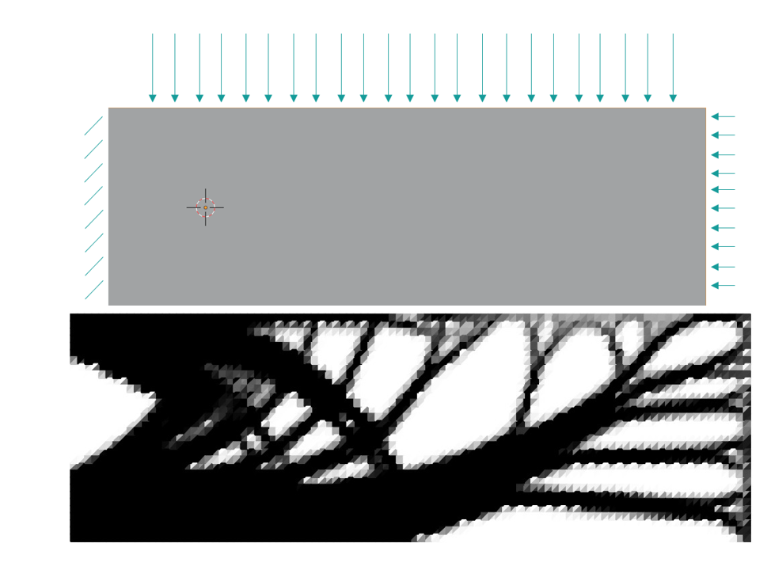
Implementation and results

Slide 13
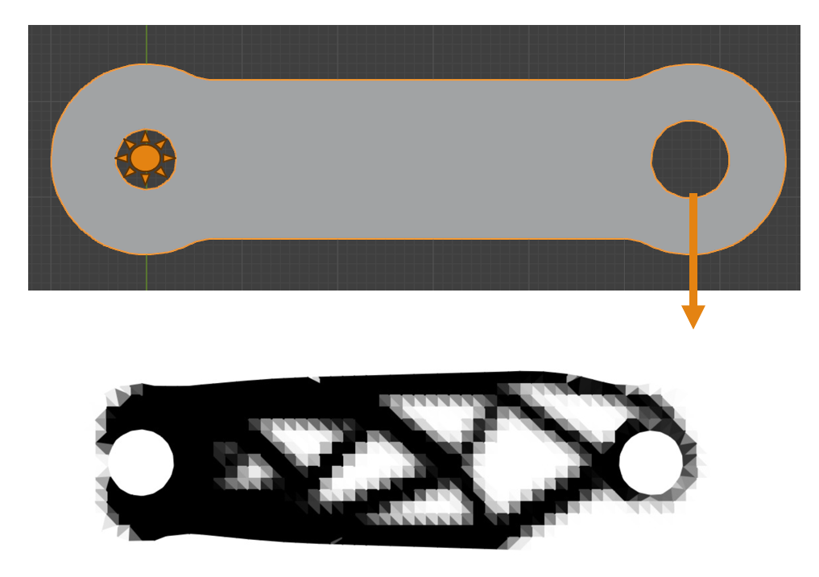
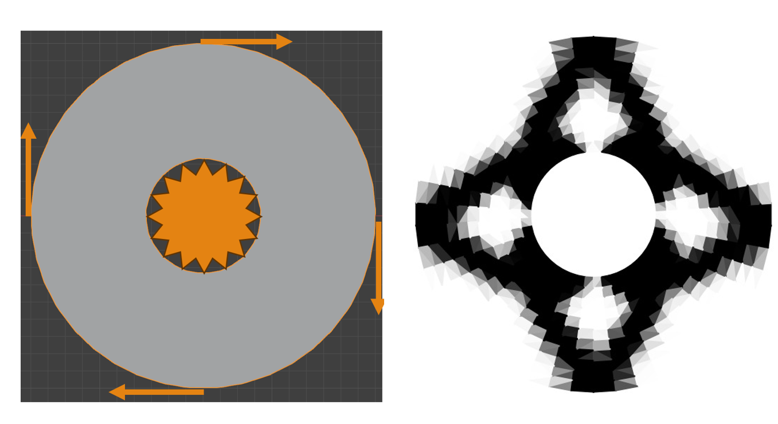
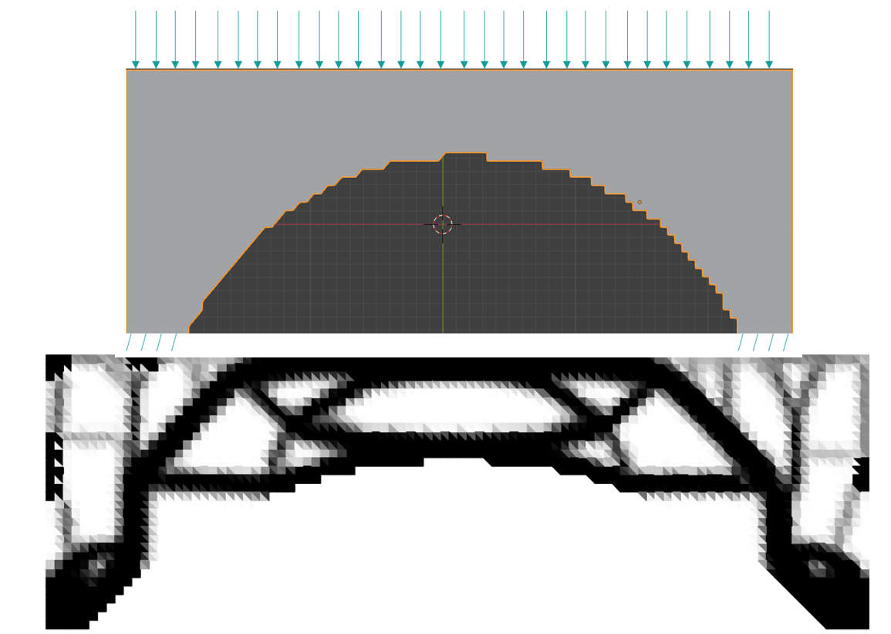
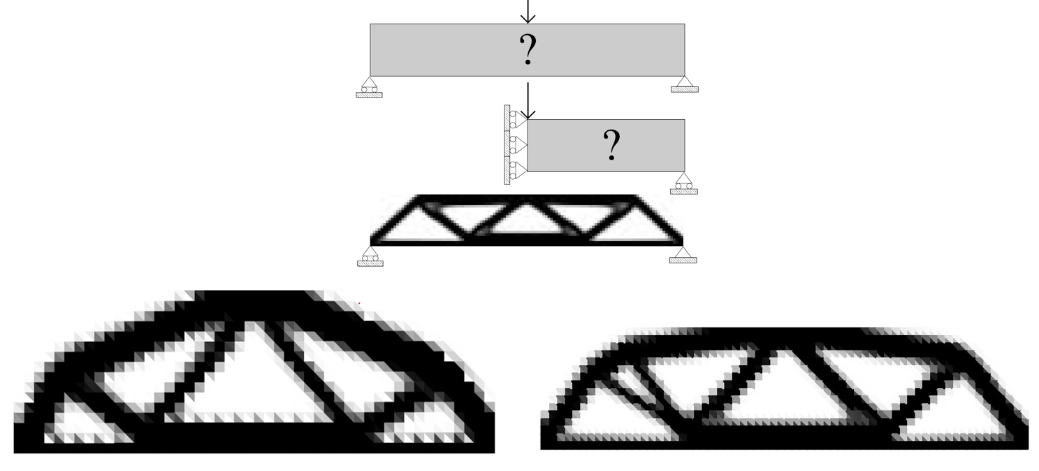

Slide 14
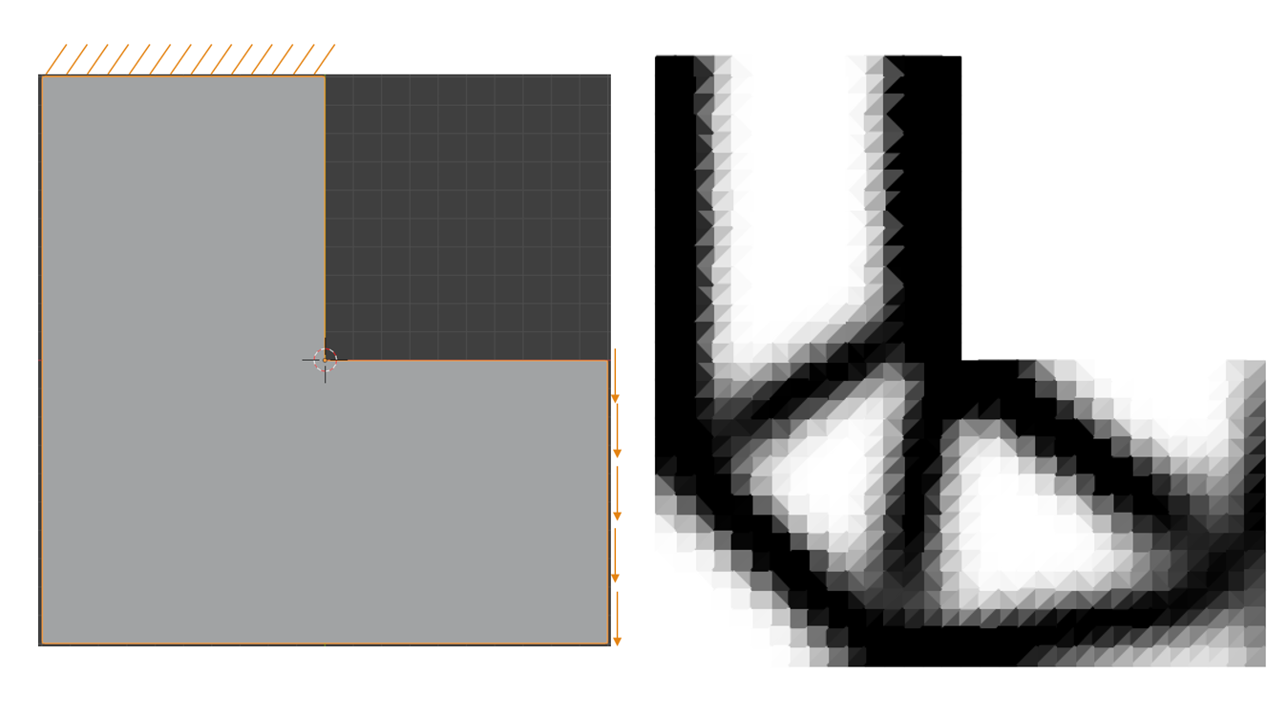
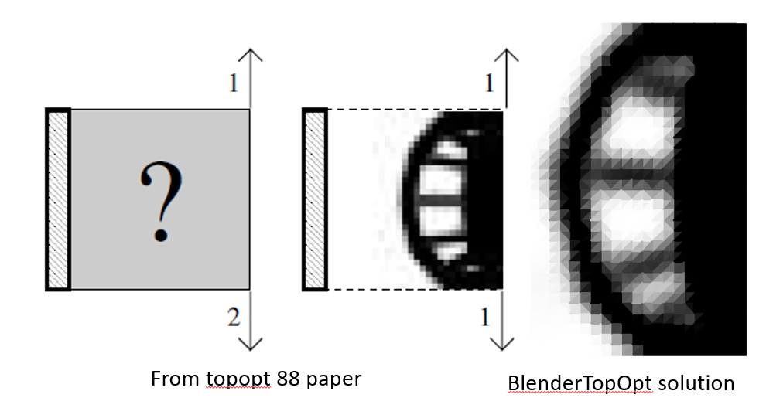
THANK YOU!

Slide 15
A
D
G
B
E
H
C
F
I

Slide 16
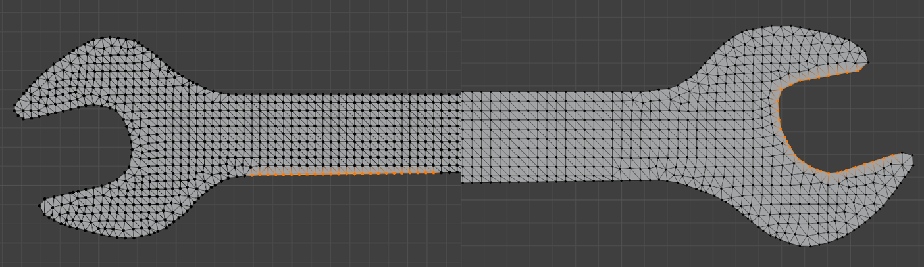
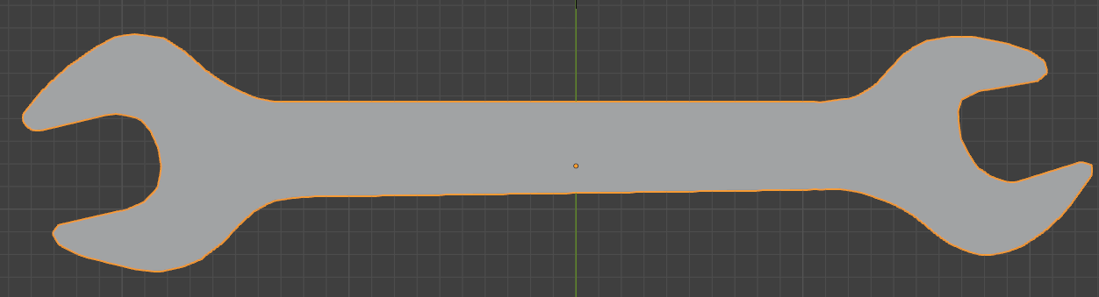
A
B

Slide 17
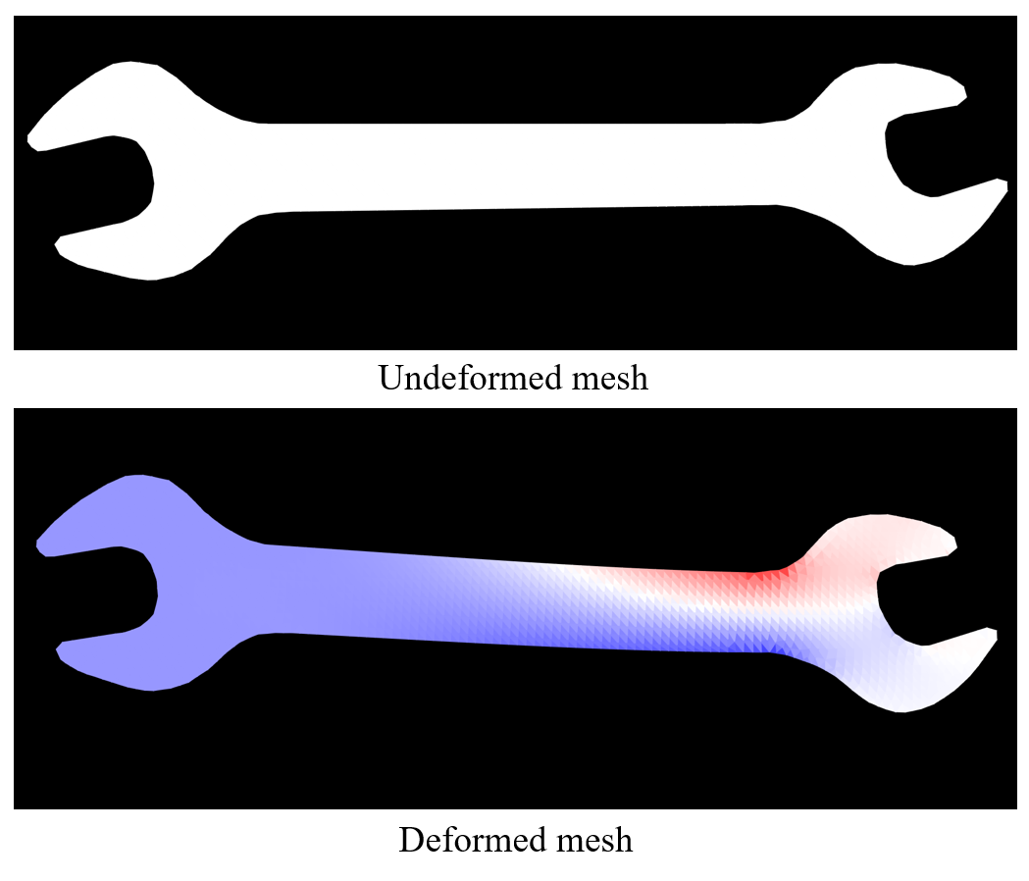
A1
B
A2

Slide 18
