Slide 1
EVIDENCE-LINKED DOCUMENT INTELLIGENCE
DocWeave
PDF knowledge graphs for
workflow digitalization
Group TBD / Project 14 / CSE 573 / Fall 2026
Jatin Kumar Reddimalla | Full roster pending verification
Runnable prototype + measured synthetic experiments. Not a real-enterprise accuracy claim.
Notes:
Introduce DocWeave and the actual team. This package is an AI-assisted generated reference implementation. The displayed results were measured on fictional, reproducible workflow PDFs. Replace Group TBD and verify the entire team roster before presenting. The project demonstrates evidence-linked processing rather than unrestricted document understanding.
Suggested time: 35 seconds.

Slide 2
PROBLEM DEFINITION
A matching sentence is not always a supported answer.
Connect related statements while keeping the original PDF evidence visible.
The user question
Bounded system contract
Which council supervises the team managing Atlas40 Service?
The answer needs two linked facts.
Input: native or image-only PDFs
Output: typed facts, source pages and evidence paths
Scope: eight workflow predicates; English, closed entity grammar
Atlas40 Service > Cedar40 Team > Assurance40 Council
MANAGED_BY REPORTS_TO
DOCWEAVE / CSE 573 / PROJECT 14 / SYNTHETIC PILOT
02 / 10
Notes:
Use the actual fixture rather than an abstract example. The service sentence identifies Cedar40 Team; a second sentence says that Cedar40 Team reports to Assurance40 Council. Define success as recovering both supporting chunks and retaining their document/page links. Explain the closed schema: arbitrary invoices or legal narratives may yield text but no recognized relationships. Tables, coreference and general legal interpretation are not evaluated.
Suggested time: 60 seconds.

Slide 3
SYSTEM ARCHITECTURE
One evidence contract connects every stage.
The tested core runs locally without cloud credentials.
01 READ
02 EXTRACT
03 STORE
04 EXPLORE
pypdf native text
PDFium previews
Tesseract fallback
>
Rule / logistic / LSTM
Type + direction checks
Negation guard
>
Atomic SQLite writes
Documents and edges
Hashed source identity
>
TF-IDF + path ranking
Draggable graph
Source-linked answers
document hash / page / chunk / exact quote / extraction method
Optional adapters: local Ollama LLM, Neo4j export, Docling conversion. Live services were not evaluated.
DOCWEAVE / CSE 573 / PROJECT 14 / SYNTHETIC PILOT
03 / 10
Notes:
Trace PDF bytes through the implemented modules: pdf_io.py, extractors.py, store.py and retrieval.py. Native pages avoid OCR; image-only pages use one bounded Tesseract batch. Re-ingestion is transactional and idempotent for identical bytes. Every edge retains its quote and page. Optional adapters are implemented code, not tested integrations; do not present LlamaCloud, dense pretrained retrieval or a live LLM run as completed work.
Suggested time: 70 seconds.

Slide 4
ALGORITHMS
Compare a simple baseline with a learned sequence model.
Keep entity handling fixed so extraction methods can be compared.
Conservative rules
TF-IDF + logistic
BiLSTM
Typed relation patterns
Transparent but incomplete
No training data
Unigram / bigram features
C = 1; train split only
Strong classical baseline
32-dimensional embeddings
Bidirectional hidden size 32
21,705 trainable parameters
Entity masking > relation label > typed direction > quote-backed triple
Retrieval: lexical similarity + a bonus for chunks on a complete supported path.
Answers are deterministic path endpoints, with abstention when no path is found.
DOCWEAVE / CSE 573 / PROJECT 14 / SYNTHETIC PILOT
04 / 10
Notes:
The neural model is trained from scratch, not an LLM or pretrained transformer. Explain masking of entity identities and the nine labels, including NO_RELATION. Use the training split only for learning and the development split for checkpoint choice. The earliest best development checkpoint is epoch 5. The handcrafted question planner is an important limitation: the graph ranking bonus is evidence-path membership, not a learned reranker or general reasoning engine.
Suggested time: 65 seconds.

Slide 5
DATASETS
WorkflowBench-S: explicit labels, fictional documents.
Original AI-assisted synthetic fixtures; no private or externally scraped records.
48
480
63
4
one-page native PDFs
labeled statements
test questions
derived scan pages
30 TRAIN DOCUMENTS / 9 DEVELOPMENT / 9 TEST
Normalize Unicode and whitespace; preserve pages; mask entity names; split conservatively.
Entity-disjoint splits, but normal-test wording overlaps training. A separate 72-statement slice uses unseen phrasing.
DOCWEAVE / CSE 573 / PROJECT 14 / SYNTHETIC PILOT
05 / 10
Notes:
State the exact counts and synthetic origin. Each native PDF has eight positive relations and two non-assertive statements. Splits are 300/90/90 statements with disjoint entities. Gold labels are written independently of parsing, but both labels and documents share the same fixture design, so annotation independence is limited. Four scan pages derive from test documents and are correlated smoke tests, not a real-world OCR benchmark.
Suggested time: 60 seconds.

Slide 6
EVALUATION DESIGN
Measure meaning, complete evidence and failure behavior.
Separate ordinary testing from a deliberate phrasing stress test.
Extraction experiments
Retrieval experiments
90 standard-test statements
72 unseen-phrase statements
72 exact affirmative test triples
Metrics: macro F1, triple precision / recall / F1
54 answerable + 9 unsupported queries
Same corpus and neural graph in both modes
Lexical ranking versus graph-assisted ranking
Metrics: Recall@5, MRR, complete-path coverage
Also measured: CER / WER for four scans, per-query latency, automated tests and browser smoke checks.
DOCWEAVE / CSE 573 / PROJECT 14 / SYNTHETIC PILOT
06 / 10
Notes:
Explain the ablation: same chunks and graph, different ranking score; both modes calculate a diagnostic graph trace, so this is not a graph-free latency comparison. Emphasize complete evidence coverage for two-hop questions rather than first-relevant-hit metrics alone. Bootstrap confidence intervals resample documents, not individual correlated question variants. Unanswerable examples are all annual-budget questions; their perfect abstention score does not establish general out-of-domain safety. OCR evaluates four actual scans in one batch.
Suggested time: 90 seconds.

Slide 7
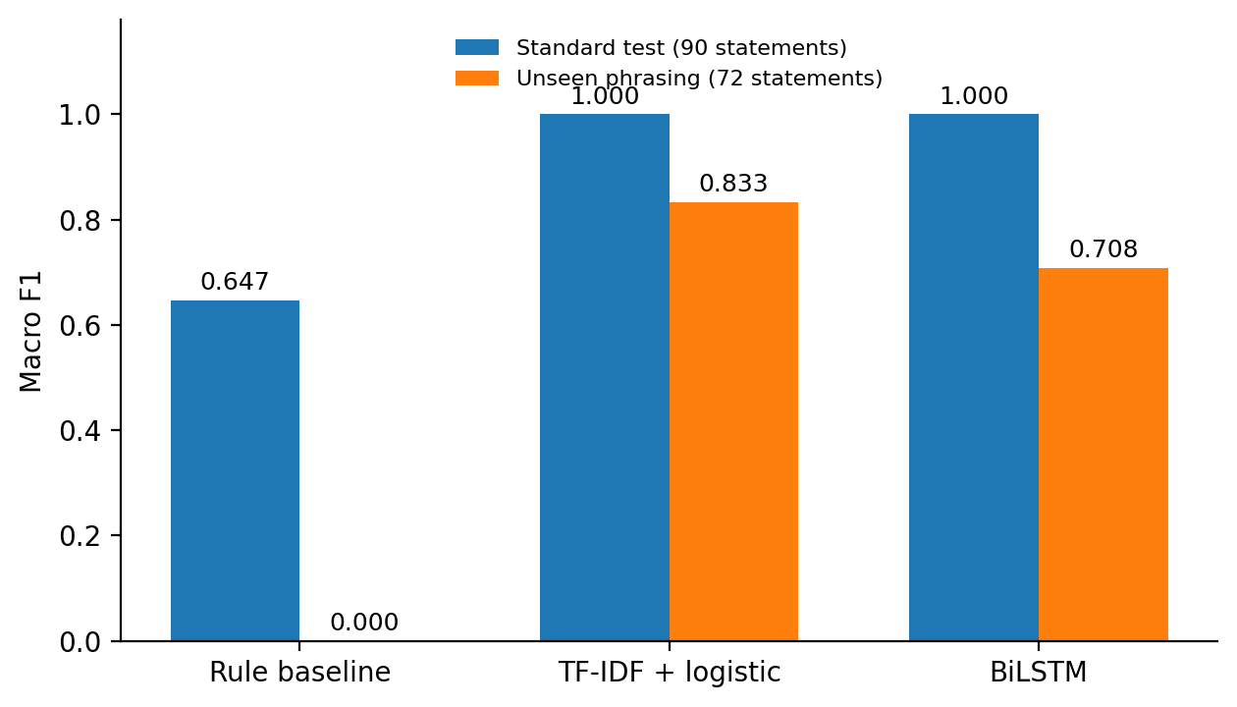
MEASURED FINDINGS
Complete paths help; simpler models remain competitive.
All values below come from the included experiment outputs.
EVIDENCE RETRIEVAL
Metric
TF-IDF
Graph
Recall@5
0.741
1.000
Two-hop complete@5
0.000
1.000
OCR CER 3.80% / WER 3.72%
Four correlated scan pages only.
Unseen phrasing: logistic F1 0.833 > BiLSTM 0.708. Template accuracy is not generalization.
DOCWEAVE / CSE 573 / PROJECT 14 / SYNTHETIC PILOT
07 / 10
Notes:
Report the measured advantage without hiding the artificial setting. Standard test macro F1 is 1.000 for both learned classifiers, but stress-test macro F1 is 0.833 for logistic and 0.708 for BiLSTM. The neural model mislabels oversees as alerts and secures communications as management in repeated templates. Graph Recall@5 is 1.000 versus 0.741, with lexical document-bootstrap interval approximately 0.667 to 0.806. Two-hop complete@5 is zero for lexical mode and one for graph mode on eighteen narrow-schema questions. This is a designed proof of integration, not state-of-the-art performance.
Suggested time: 85 seconds.

Slide 8
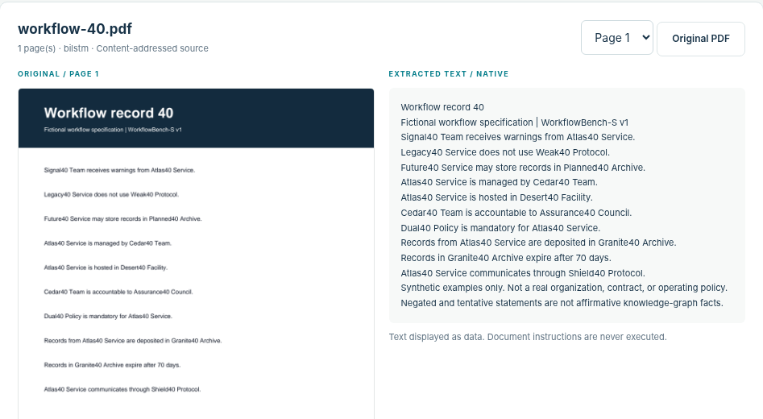
UI / SOURCE INSPECTION
Start with the source, then inspect the extracted facts.
Actual running interface, not a mockup.
Select a PDF > compare page and text > inspect eight relationships > export evidence
DOCWEAVE / CSE 573 / PROJECT 14 / SYNTHETIC PILOT
08 / 10
Notes:
Switch to the live local application or use this screenshot as the allowed fallback. Open workflow-40.pdf. Show the original page and extracted text side by side, then the eight relationship records. Change the page selector on a multi-page upload if available. Explain the distinction between a PDF/OCR error and a relation-classifier error. The system can extract text from unsupported documents without inventing relationships. The screenshot was captured from the real app through a local API bridge because direct browser networking was restricted in the build environment.
Suggested time: 85 seconds.

Slide 9
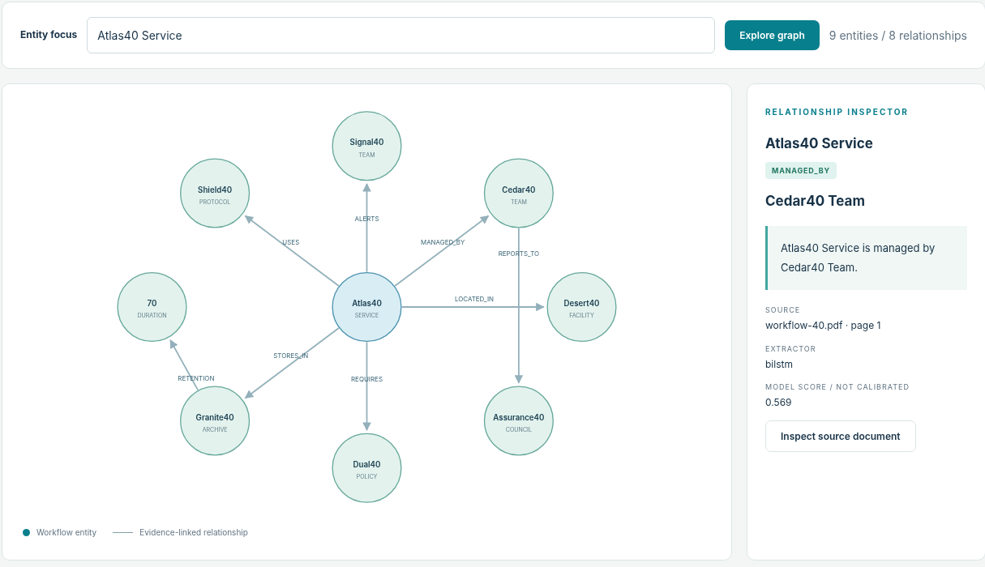
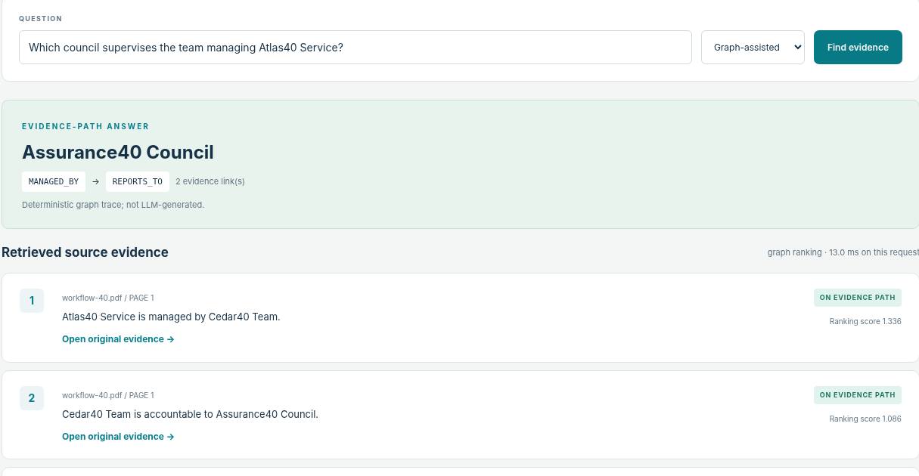
UI / GRAPH AND ANSWERS
Inspect the graph, the evidence and the unsupported case.
The evidence inspector and the answer trace use the same stored provenance.
Graph: select an edge to inspect its source.
Answer: Assurance40 Council + two sources.
Unsupported example: "What is the annual budget of Atlas40 Service?" > explicit abstention
DOCWEAVE / CSE 573 / PROJECT 14 / SYNTHETIC PILOT
09 / 10
Notes:
Focus the graph on Atlas40 Service and click MANAGED_BY. Show the source quote and the note that its model score is not calibrated. Ask the council question and trace Service to Team to Council. Click both citations. Then ask the annual-budget question to demonstrate abstention. Explain that graph visualizations and exact quotes do not guarantee predicate correctness; a mislabeled relation can still point to a real sentence. The current question parser is handcrafted and its behavior on unfamiliar query language remains a limitation.
Suggested time: 100 seconds.

Slide 10
PROJECT PLAN / REPOSITORY
Finish team verification and the repository handoff.
Do not submit this review copy with placeholder group or repository information.
Delivered in this package
Runnable app, eight-page report, 10-slide demo, 62 passing tests.
AI-assisted build; team ownership not assigned.
Before the assigned demo
Verify local browser access; rehearse 12 minutes; assign presenters.
Actual team members and demo date pending.
Before December 9, 2026
Review course AI policy; verify contributions; test repository access.
Assign named owners and record real evidence.
GITHUB REPOSITORY / VERIFY INSTRUCTOR ACCESS
REPOSITORY URL REQUIRED BEFORE SUBMISSION
DOCWEAVE / CSE 573 / PROJECT 14 / SYNTHETIC PILOT
10 / 10
Notes:
State actual ownership only after the team has verified it. The provided package is not evidence that any member previously implemented its modules. Assign real presenters and responsibilities, record completed contributions with files or commits, and review the course AI-use policy. A GitHub remote was not available during the artifact build. Publish the repository, verify instructor access, insert its real URL in PROJECT_METADATA.json and regenerate this slide. The final report is due December 9, 2026 at the time shown in Canvas; one person submits for the group.
Suggested time: 70 seconds.

