Slide 1
Implementing Multiclass SVM
Team No : 44
Team Name : Random_team_1
Project ID : 26
Project Title : Implement MULTICLASS SVM WITH DIFFERENT KERNELS
Team Members :
1.2018801010 - Karnati Venkata Kartheek
2.2018900061 - Shashikant Ghangare

Slide 2
FORMULATION OF MULTICLASS SVM
Binary SVM Formulation
min L = ½ w’w + C ∑_{i}^{n} ξ_{i}
such that y_{i}f(x_{i}) ≥ 1 - ξ_{i}, for all i(1 to n)
ξ_{i} ≥ 0

Slide 3
FORMULATION OF MULTICLASS SVM
MultiClassSVM formulation
min L = ½ ∑_{t} w_{t}’w_{t} + C ∑_{i} ∑_{m(≠}y_{i)} ξ_{i}^{m}
such that for ever point i(1 to n),
W_{yi}’ x_{i} - W_{m}’ x_{i} ≥ 1 - ξ_{i}^{m}, for m_{(≠}y_{i)} = 1,2 ..k

Slide 4
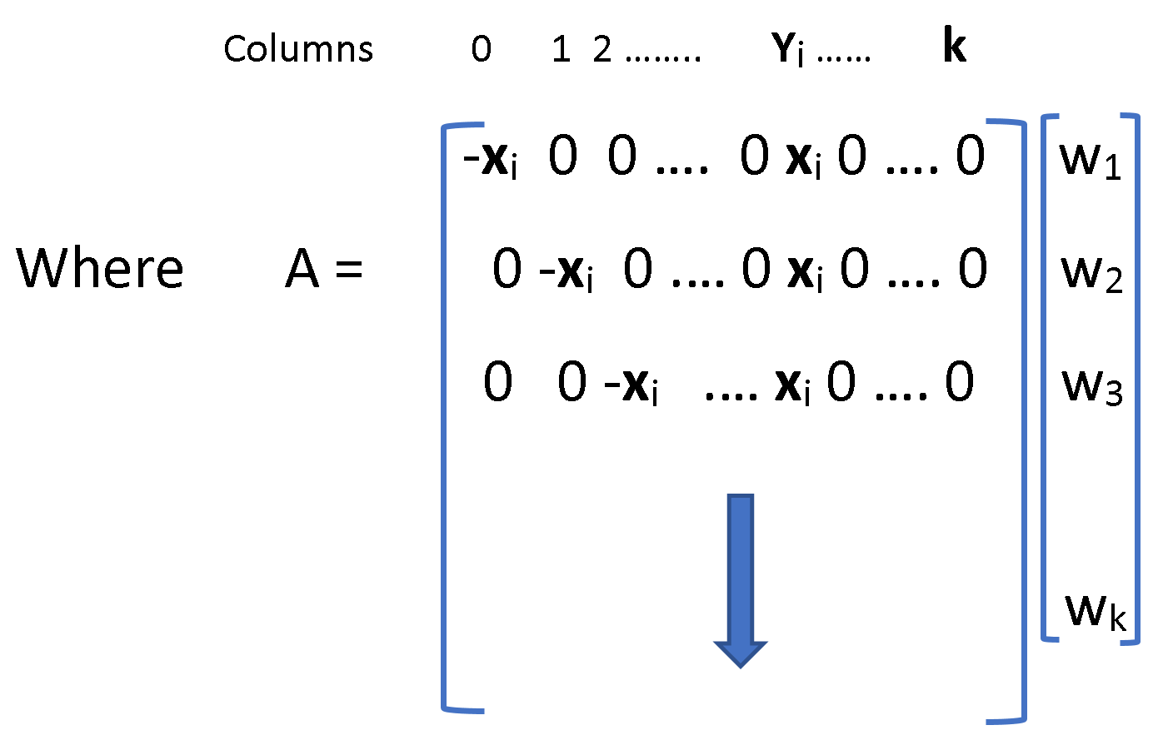
W =[ w₁ w₂ w_{3 ……} w_{k}]
L = ½ W’W + C 1’ ξ
The constraints W_{yi}’ x_{i} - W_{m}’ x_{i} ≥ 1 - ξ_{i}^{m}, for m_{(≠}y_{i)} = 1,2 ..k are converted into the form
A*W ≥ 1- ξ
Dimensions of A = [n(k-1),k(d+1)]

Slide 5
We can form the Legrangian
L = ½ W’W + C 1’ ξ - α’ (A*W-(1- ξ)) – β‘ ξ
L = ½ W’W + C 1’ ξ - α’ (A*W) + α’1- α’ξ – β‘ ξ
Differentiating w.r.to W = 0
½ 2W’ = α’A
W = A’ α ------ 1
Differentiating w.r.to ξ = 0
C *1’ - α’ – β’ = 0
C *1’ = α’ + β’ ------ 2
i.e 0 ≤ α’≤ C
Substituting 1 , 2 back into legrangian, we get
L = ½ W’W + C 1’ ξ - α’ (A*W) + α’1- α’ξ – β‘ ξ
L = ½ α’ A’ A α + (α’ + β’) ξ - α’ A A’ α + α’1- α’ξ – β‘ ξ
Maximize L = α’1- ½ α’ A’ A α
Or
Minimize L = ½ α’ A’ A α – 1’α
Such that 0 ≤ α’≤ C or α’≤ C and -α’≤ 0

Slide 6
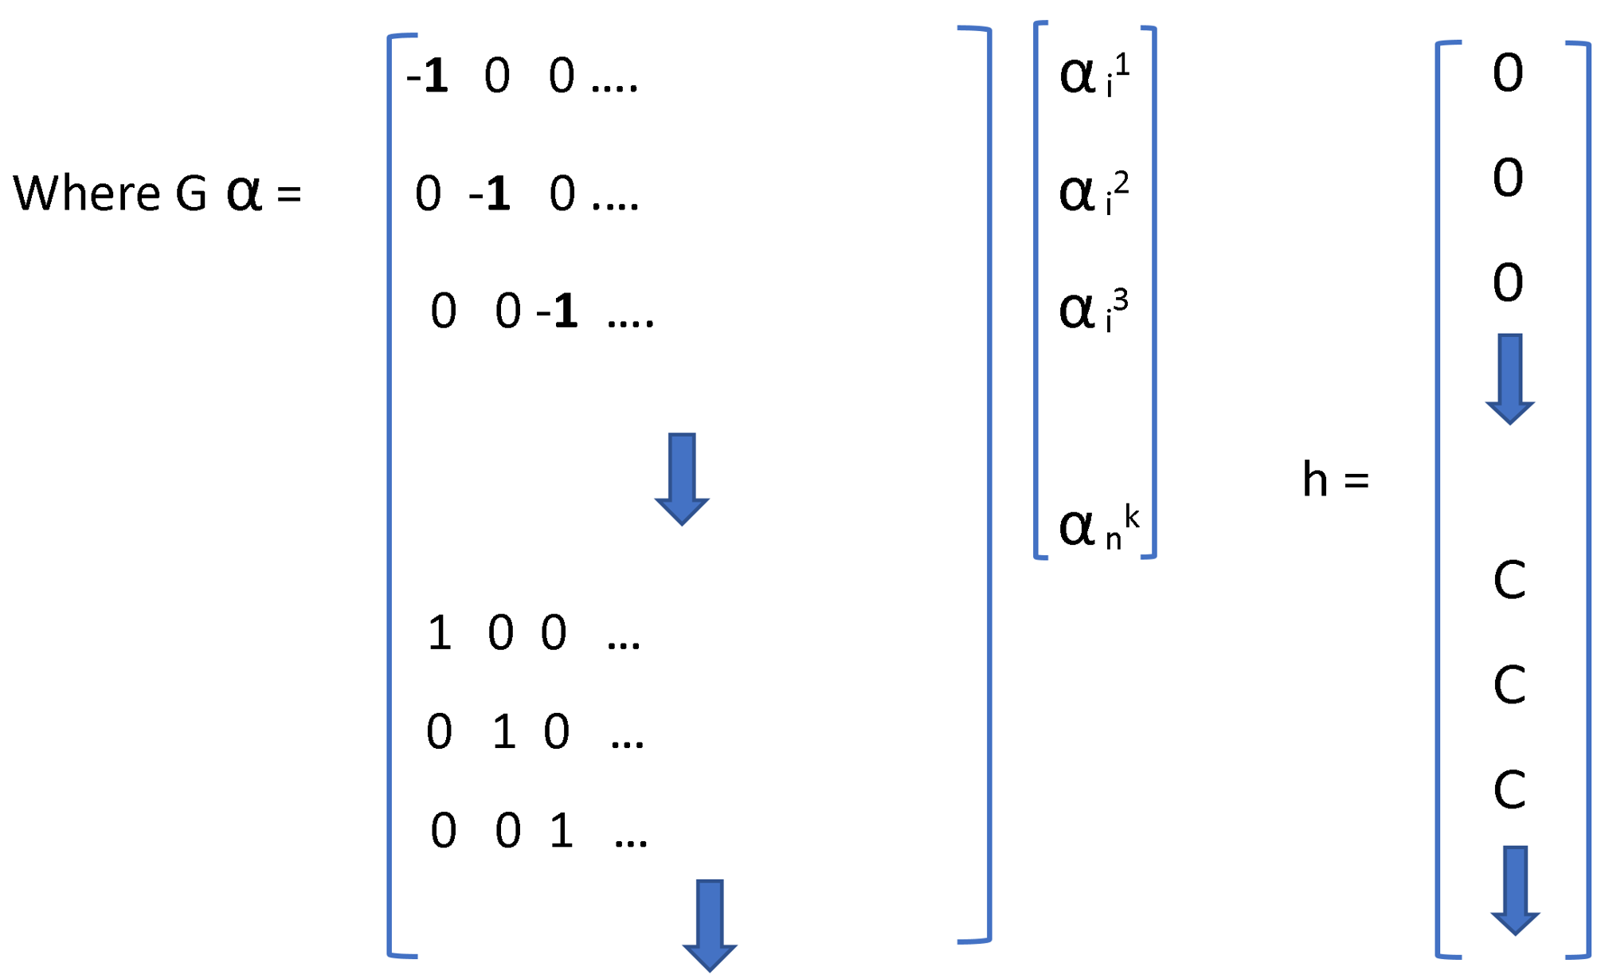
Optimization format accepted by CVXOPT is
Minimize ½ α’P α + q’ α
Subject to G α ≤ h
So in order to solve using CVXOPT
Here P = A’ A q = [-1 -1 -1 ….]

Slide 7
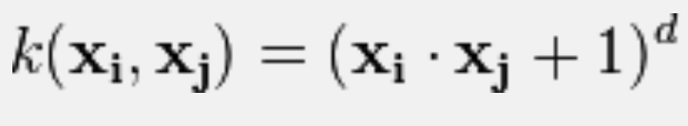
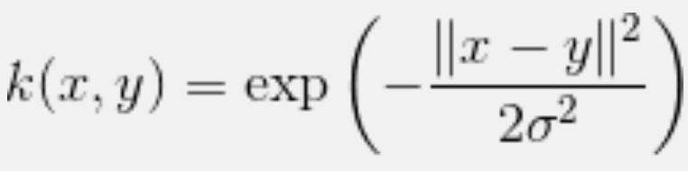
For the linear kernel just the product A’ A is enough but for the polynomial kernel and rbf kernel every dot product x_{i}’x_{j} involved in A’A calculation is replaced respectively by

Slide 8
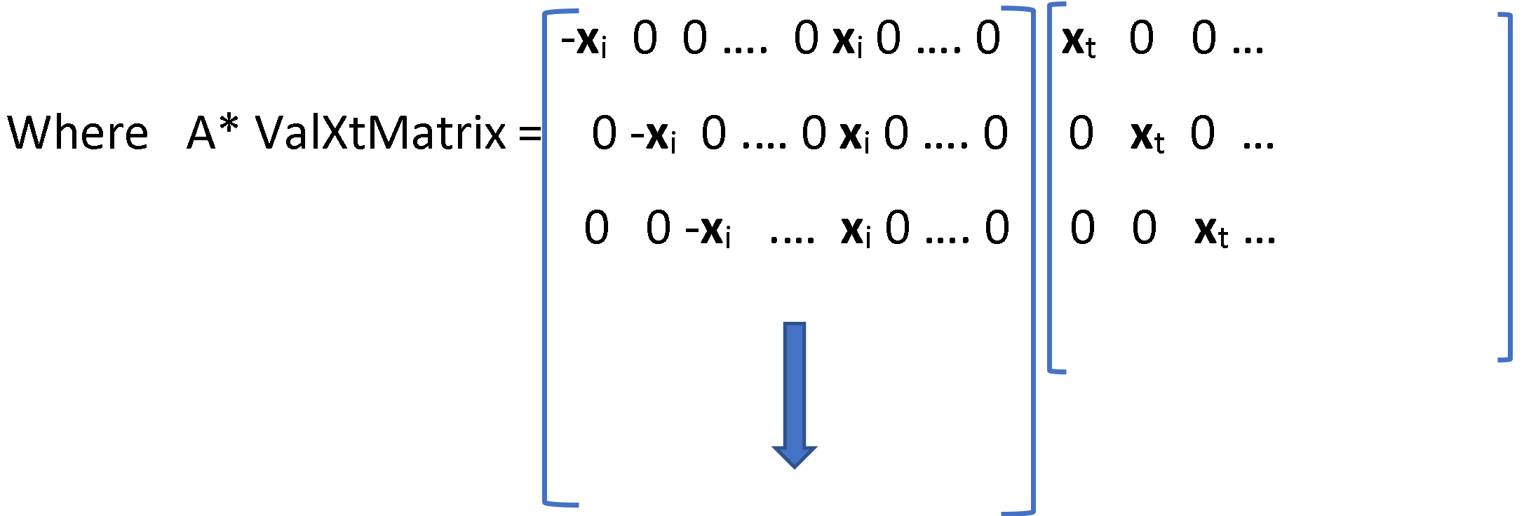
To predict the label for point x_{t} we calculate
argmax ([W₁’ x_{t} , W₂’ x_{t} , …….., W_{k}’ x_{t}])
[W₁’ x_{t}, W₂’ x_{t} , …….., W_{k}’ x_{t}] = W’*ValXtMatrix
= α’A*ValXtMatrix
= α’kernel(A*ValXtMatrix)

Slide 9
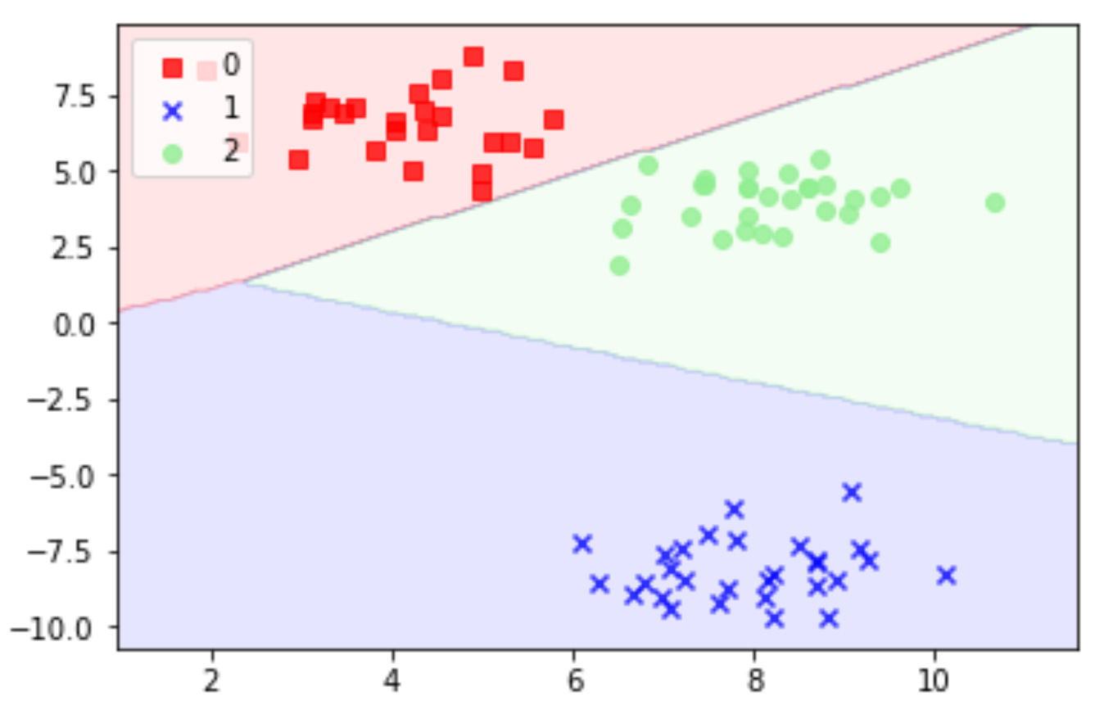
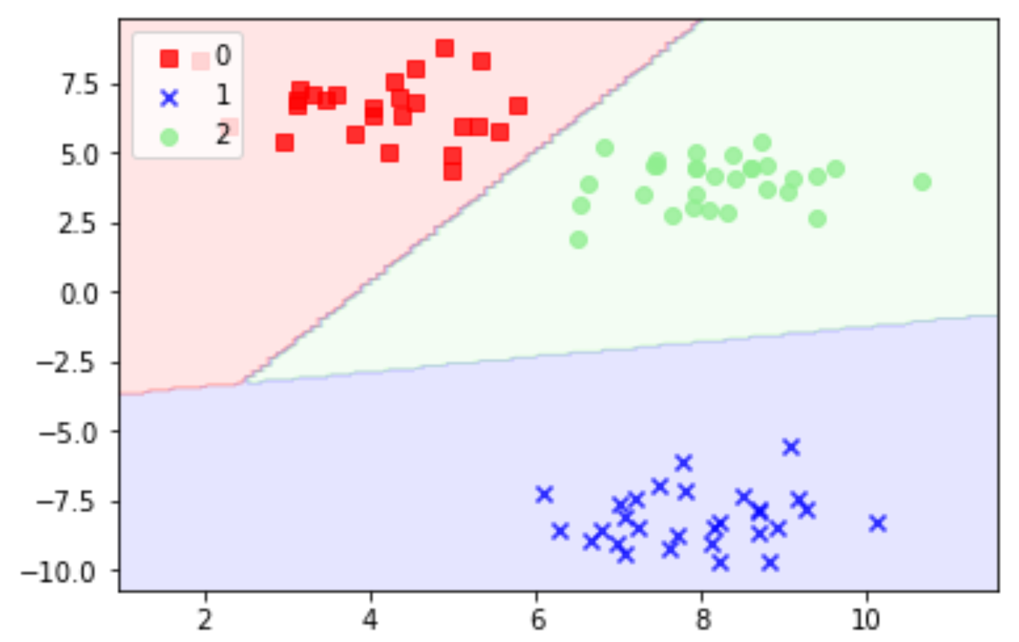
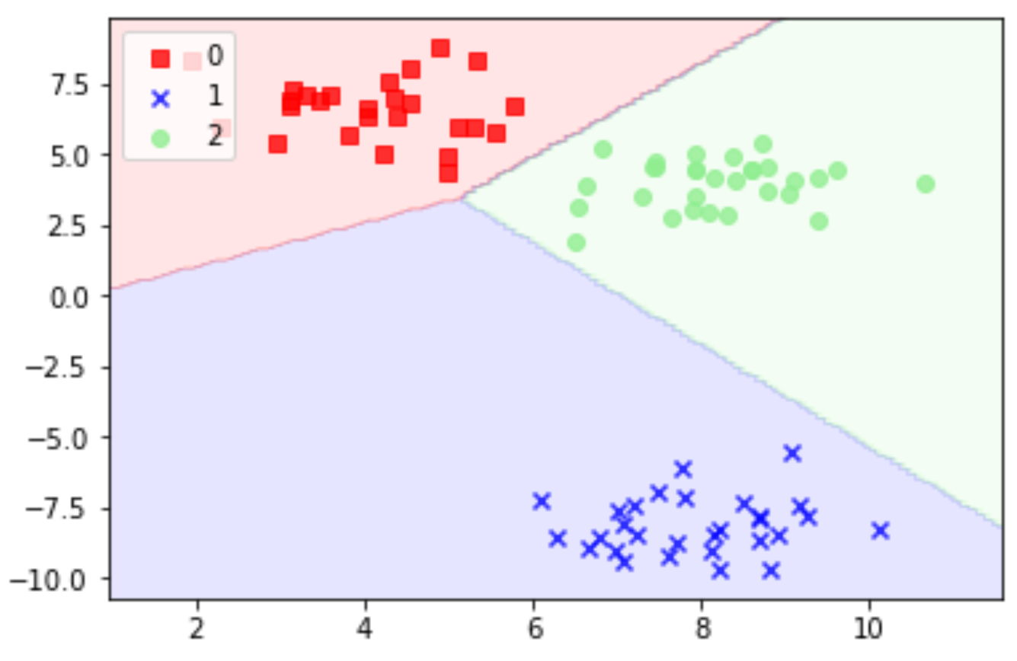
SMC vs OVO vs OVR Comparison
Top Left SMCSVM
Top Right OVO
Bottom Right OVR
make blobs(n_features=2, centers=3)
kernel = 'linear' C = 100000

Slide 10
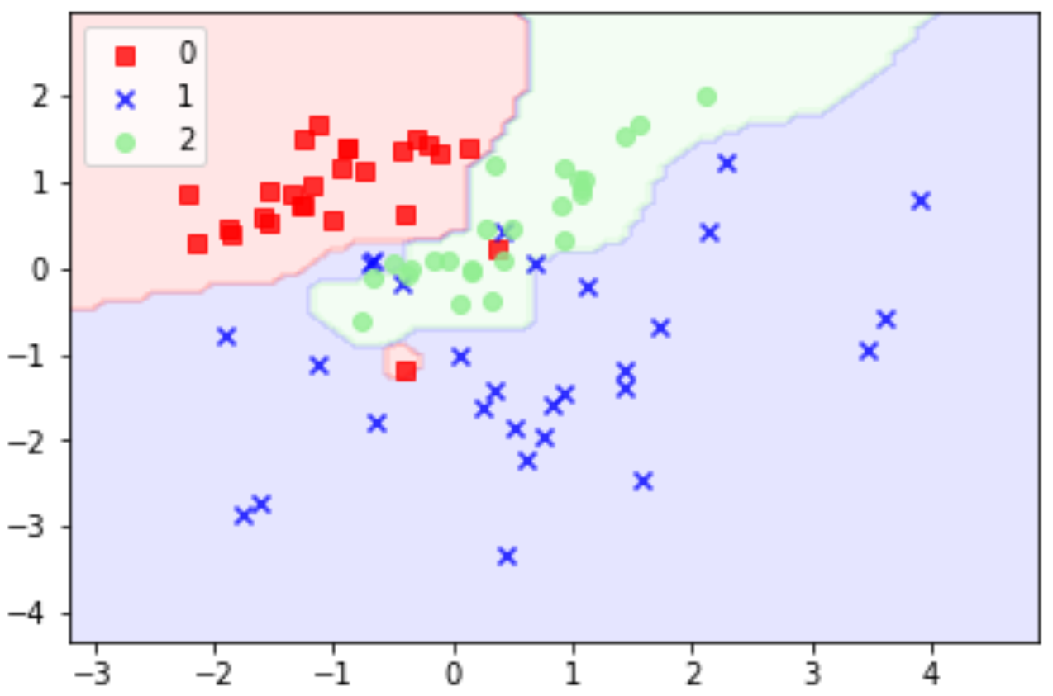
Visualization on some datasets, different kernels
n_features=2 ,
n_clusters_per_class=1
n_classes=3
(overfitted)
kernel = 'rbf'
degree = 4
sigma = 0.4
C = 100

Slide 11
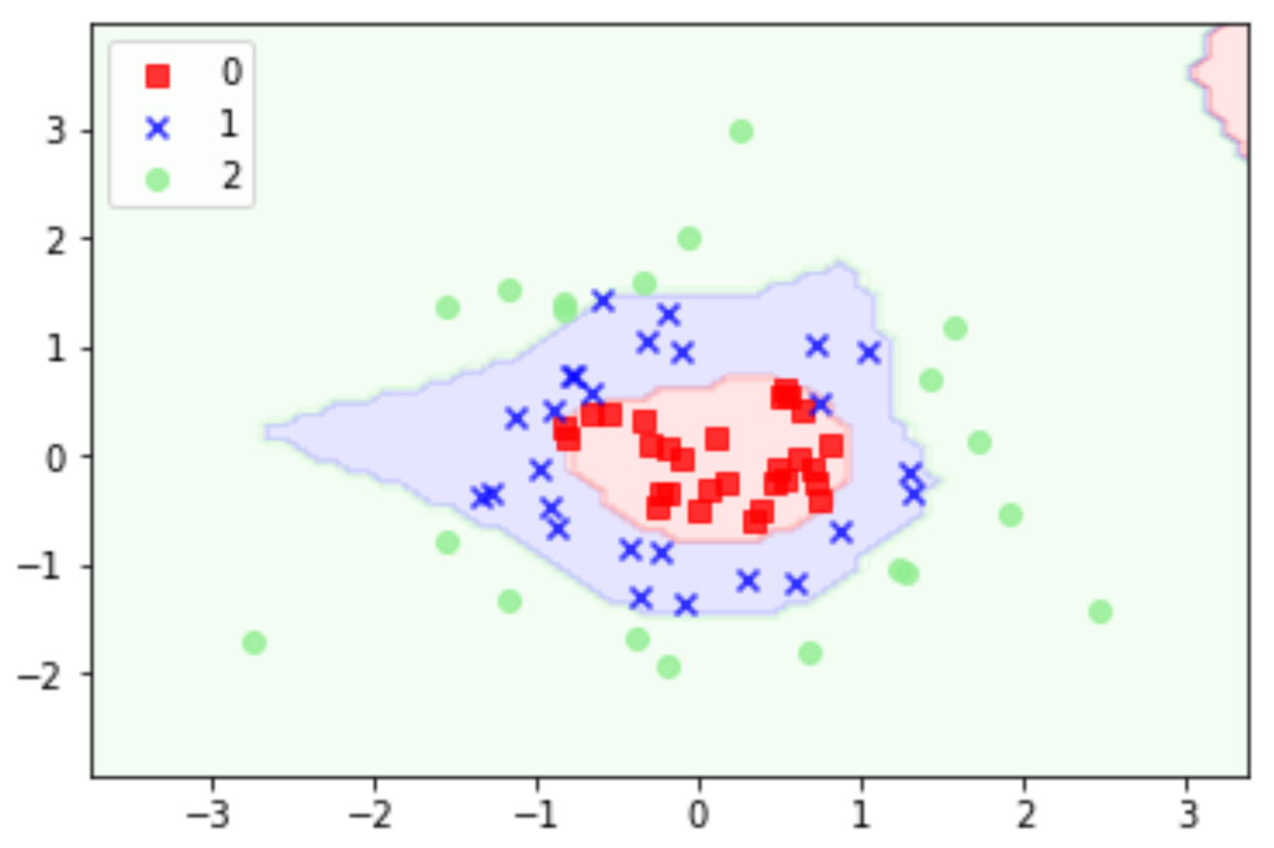
Visualization on some datasets, different kernels
gaussian_quantiles
(n_features=2, n_classes=3)
(overfitted)
kernel = 'rbf' degree = 4 sigma = 0.4
C = 100

Slide 12
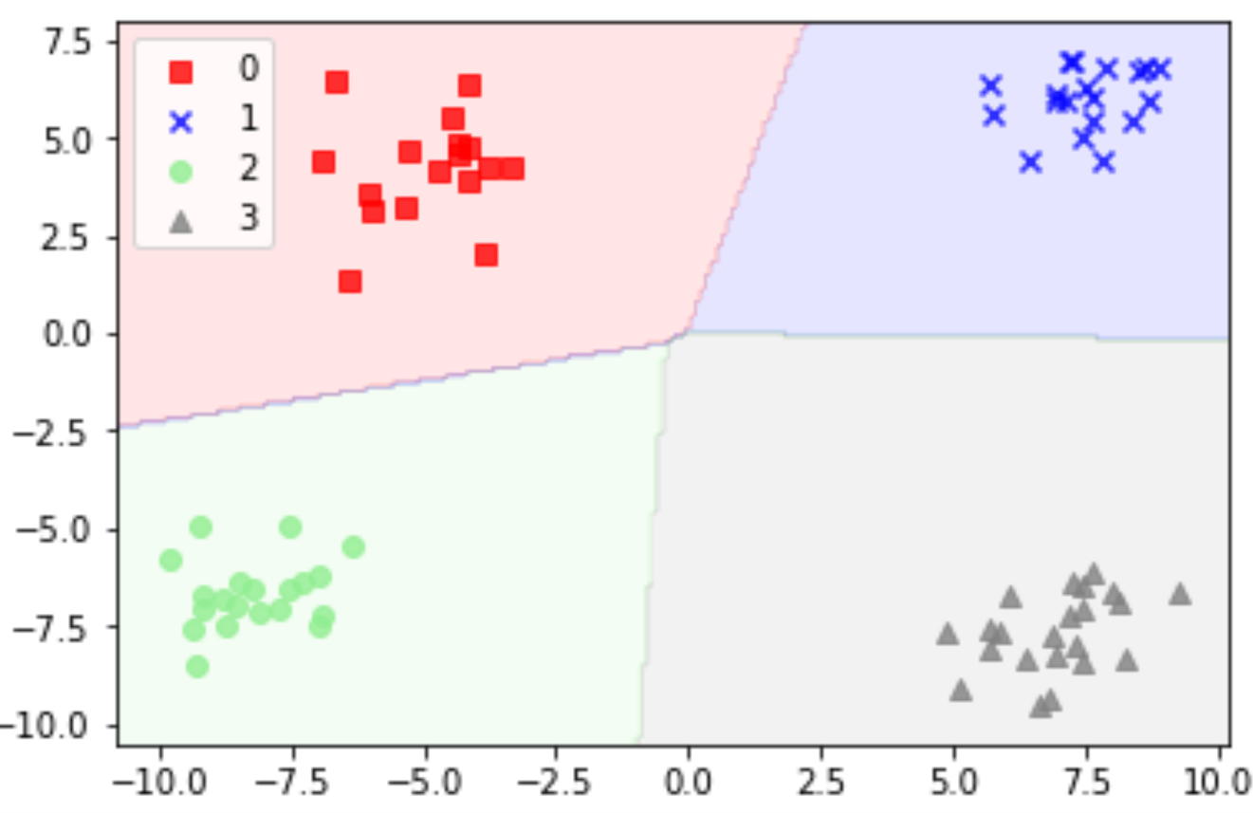
Visualization on some datasets, different kernels
make_blobs(n_features=2, centers=4)
kernel = 'linear' C = 10000

Slide 13
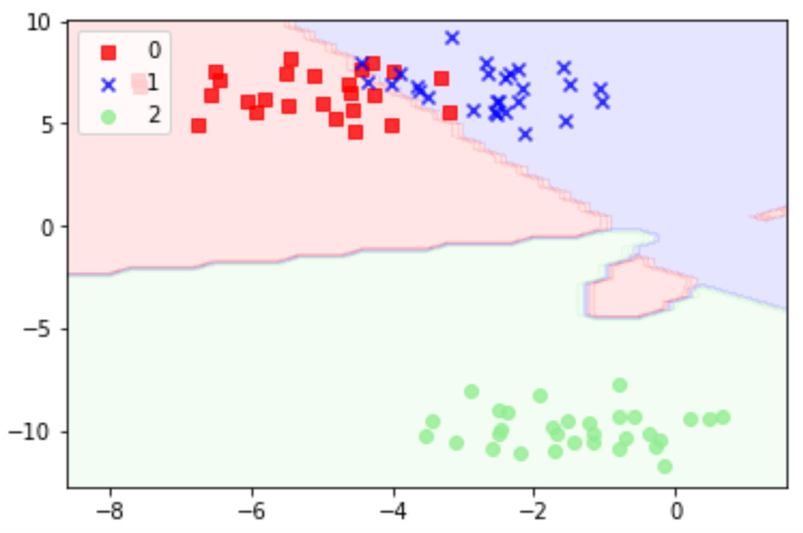
Visualization on some datasets, different kernels
make_blobs(n_features=2, centers=3)
kernel = ‘polynomial‘ degree =3 C = 100

Slide 14
Cross Validated Error rates comparison on different datasets and Avg Time
Dataset = IRIS
Method - SMCSVM
c=1,10,50 kernel='rbf' sigma='0.7' degree=1
mean_error= 0.0608
Avg Time Taken = 6.32 secs
Method – LinearSVC(OVR)
C=1,10 kernel='linear'
mean_error = 0.0605
Avg Time Taken = 0.006 secs
method – SVC(OVO)
C=50 kernel = 'rbf', 'linear', poly sigma = 0.2,0.7,1.2 degree = 2,3,4
mean_error = 0.1078
Avg Time Taken = 1.9 secs

Slide 15
Dataset = Wine
Method – SMCSVM
c=1 kernel='linear' mean_error= 0.208 Avg Time Taken = 0.65 secs
Note: Using a higher sigma value above 10 increases accuracy of RBF kernel
Method – LinearSVC(OVR)
C=1,10,50 kernel='poly', 'linear' degree = 2,3,4
mean_error = 0.2254
Avg Time Taken = 0.38 secs
method - SVC(OVO)
C=10 kernel = 'rbf' sigma= 0.2 mean_error = 0.1682 Avg Time Taken = 3 secs

Slide 16
Space requirements
OVO(one vs one) kC2 binary classifiers
OVR(one vs rest) k binary classifiers in OVR case
dim(A) = [n(k-1),k(d+1)]
dim(A’A) = [n(k-1), n(k-1)]
A’A has to be supplied to the classifier and with increase in k and n the space requirements will increase in multiclass classifier

Slide 17
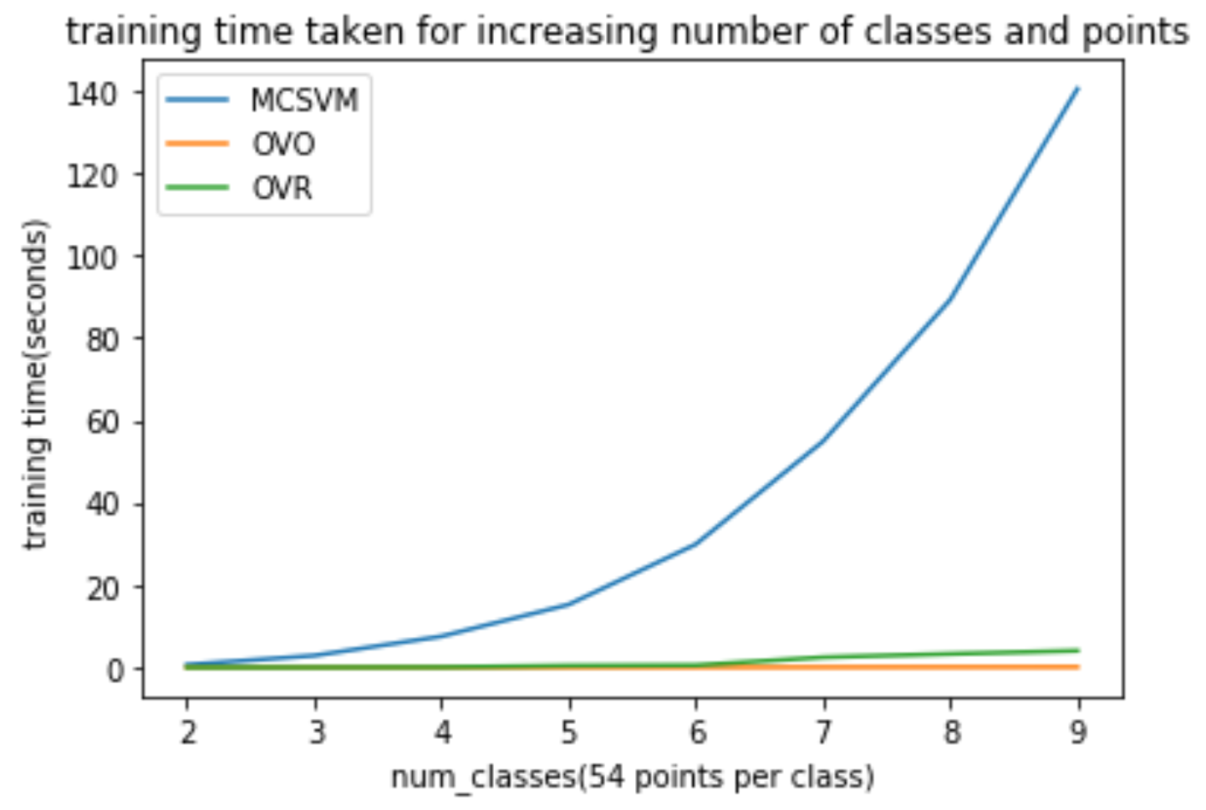
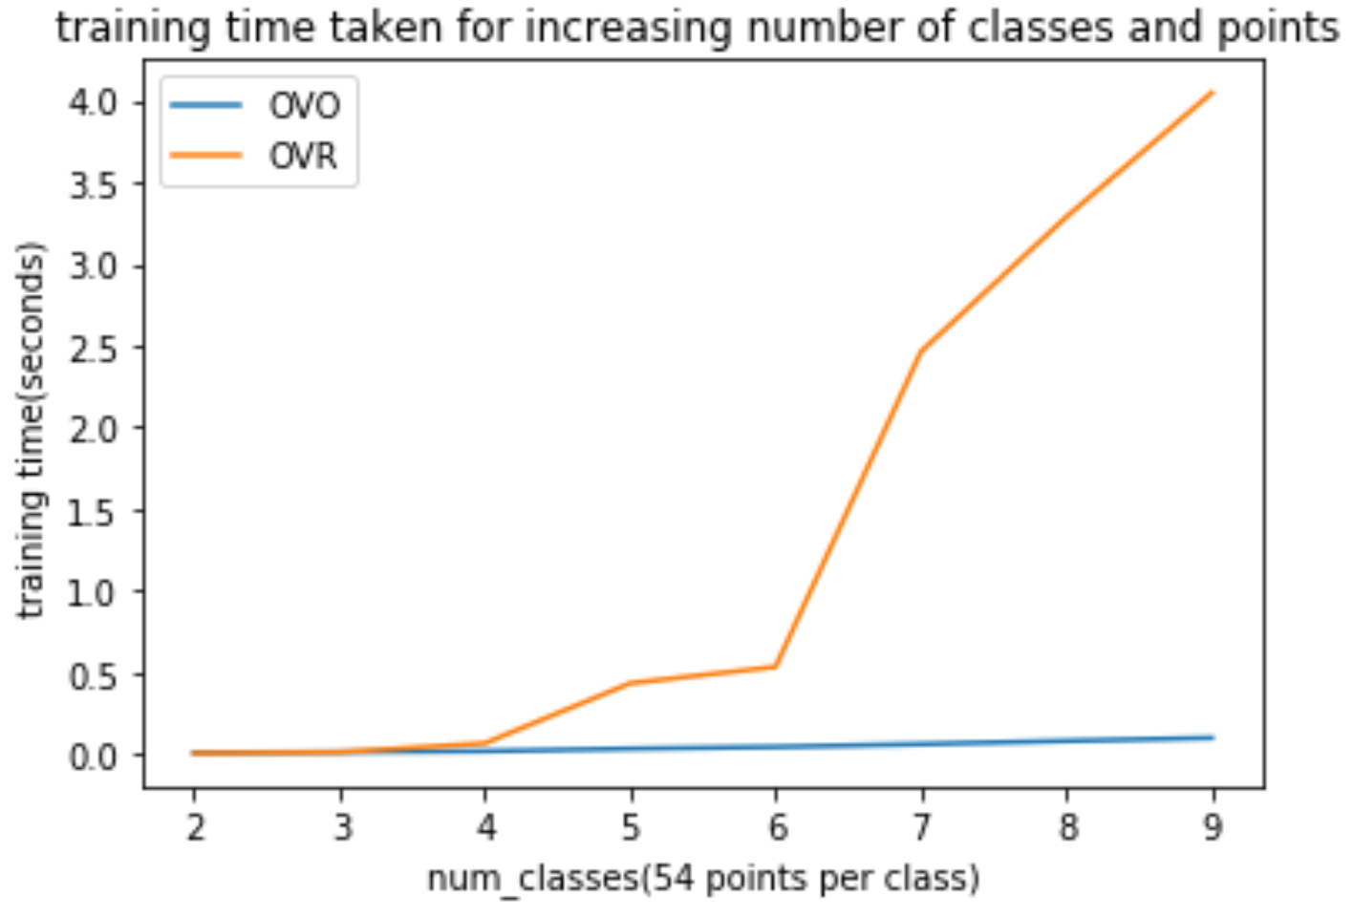
Comparison while increasing number of points and number of classes

Slide 18
THANK YOU

Slide 19


Slide 20


