Slide 1
SALES DASHBOARD ANALYSIS
KARTHIKEYAN G
Data Analyst Internship Task 3
Tool: Tableau

Slide 2
Project Overview
Objective: Analyse sales performance and customer trends.
Dataset: Sales Financial Dataset
Tool Used: Tableau

Slide 3
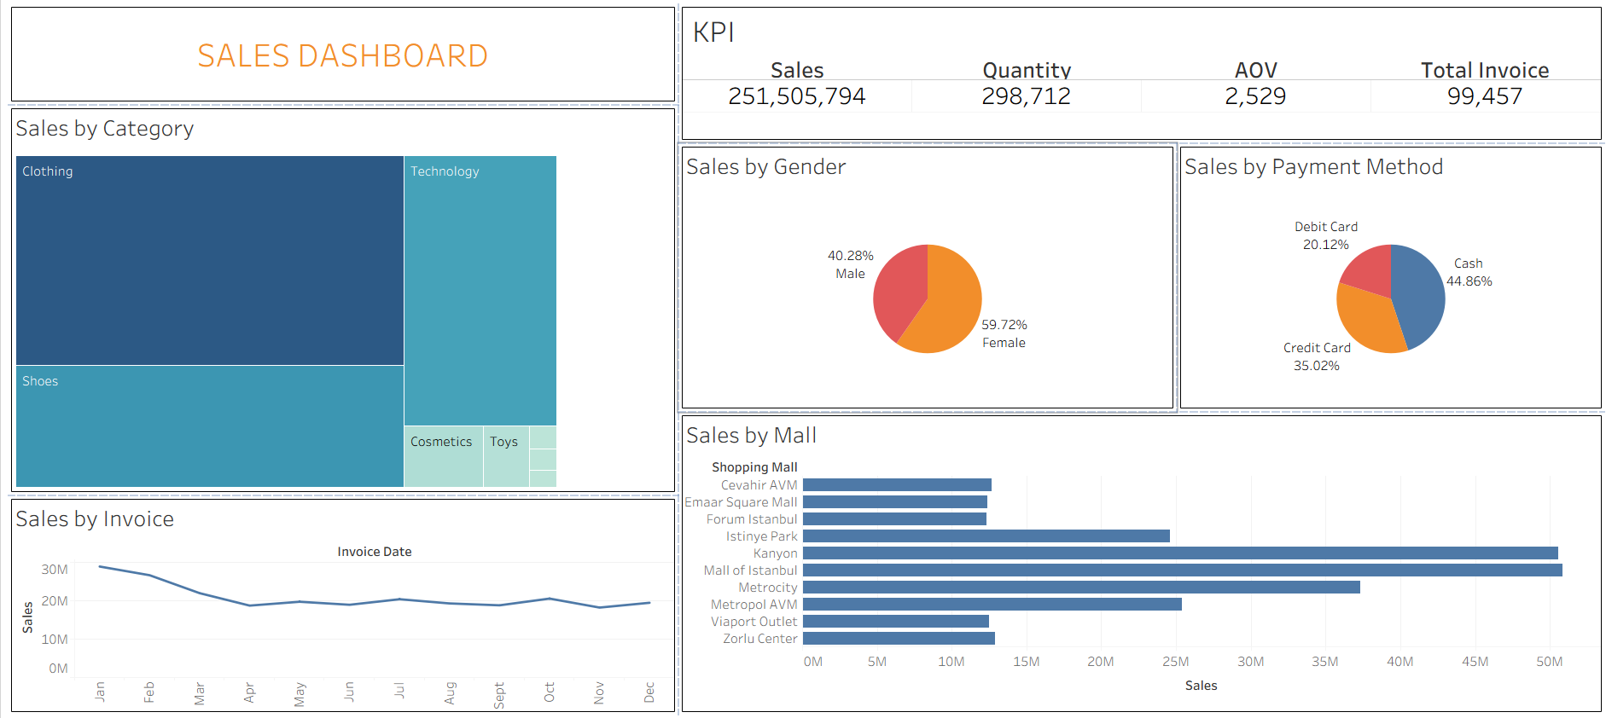

Slide 4
KPI
Total Sales: 251.5M
Quantity: 298K
AOV: 2529
Total Invoices: 99K

Slide 5
Observations
Clothing category has the highest sales.
Female customers contribute more sales.
Cash is the most preferred payment method.
Mall of Istanbul records the highest sales

