Slide 1
CHAT CONSOLE APPLICATION
BY
KARTHI S – 18ISR019
SANKARANANTH S – 18ISR042

Slide 2
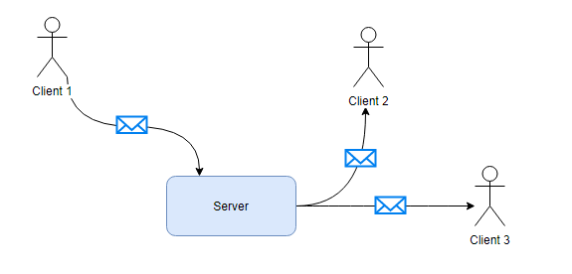
What is a Chat Console?
Chat console application is used to communicate with the clients by the help of Chat server.
The server and clients can run on different computers in the same network, e.g. Local Area Network (LAN).

Slide 3
Overview:
Multiple clients can connect to a server and they can chat to each other. Everyone can see other users’ messages like in the chat room.
The server sends a list of currently online users to the new user.
The application consists of two parts:
Server
Client
Each part can run independently on separate computers.

Slide 4
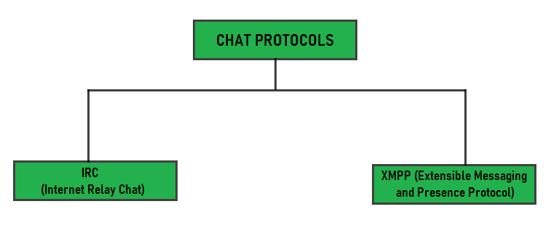
Chat Conferencing Protocols:
Chat conferencing refers to chatting in the internet.
Chatting is the one of the most effective means of communication.
Online chats on the Internet include texting, sharing videos, sharing images, etc. It is generally is textual communication between two or many peoples.
The chatting protocols IRC and XMPP.

Slide 5
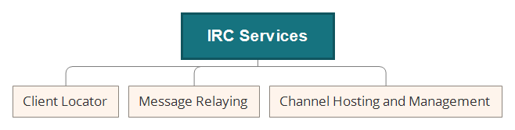
Internet Relay Chat (IRC) :
Introduced in 1988.
Text-based conferencing protocol.
Used for group chatting on Channels also known as chat rooms.
C2 server or Command and Control server are the IRC servers that contain channels.
TCP Sockets are used for connecting.
IRC Operators (IRCops) are used to manage servers.

Slide 6
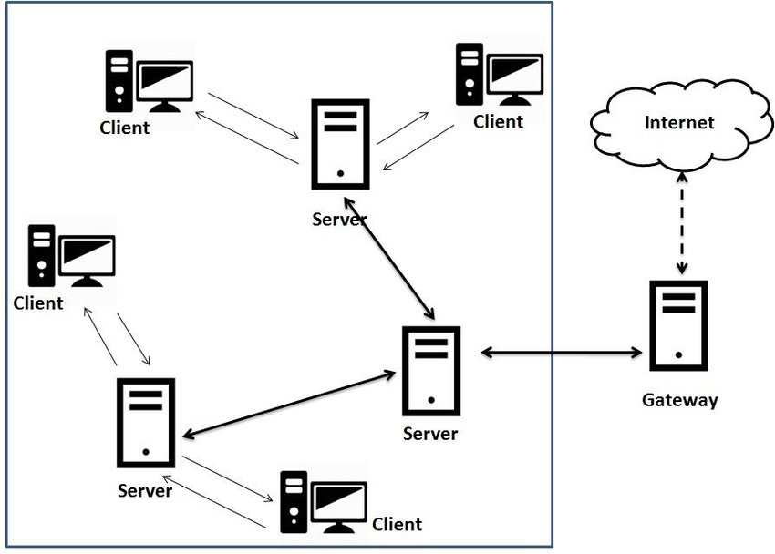
Extensible Messaging and Presence Protocol (XMPP) :
Developed by Jabber open-source community.
Real time messaging system.
TCP/IP, HTTP, or WebSocket are used for connecting.
Some applications can be Gtalk and Whatsapp.
Features such as publish/subscribe, authentication and its security uses to implement IoT.

Slide 7
Chat Server Program :
It consists of two classes.
ChatServer
UserThread
The ChatServer class starts the server, listening on a specific port.
When a new client gets connected, an instance of UserThread is created to serve that client.
Chat Server
ChatServer
UserThread

Slide 8
Chat Server Program (Contn.) :
The ChatServer class has two Set collections to keep track the names and threads of the connected clients.
Set is used because it doesn’t allow duplication and the order of elements does not matter.
The two Set collections are:
private Set<String> userNames = new HashSet<>();
private Set<UserThread> userThreads = new HashSet<>();
An important method in the ChatServer class is broadcast() which deliver a message from one client to all others clients.

Slide 9
Chat Server Program (Contn.) :
void broadcast(String message, UserThread excludeUser)
{
for (UserThread aUser : userThreads)
{
if (aUser != excludeUser)
{
aUser.sendMessage(message);
}
}
}
The UserThread class is responsible for reading messages sent from the client and broadcasting messages to all other clients.
Finally it notifies other users about the disconnection of this user and closes the connection.

Slide 10
Chat Client Program:
The client is implemented by three classes:
ChatClient,
ReadThread
WriteThread
The ChatClient starts the client program, connects to a server specified by hostname/IP address and port number.
Once the connection is made, it creates and starts two threads ReadThread and WriteThread.
Chat Client
ChatClient
ReadThread
WriteThread

Slide 11
Chat Client Program (Contn.):
The ReadThread is responsible for reading input from the server and printing it to the console repeatedly, until the client disconnects.
The WriteThread is responsible for reading input from the user and sending it to the server, continuously until the user types ‘bye’ to end the chat.
Reasons for running these two threads simultaneously is that the reading operation always blocks the current thread.
That means if the current thread is waiting for the user’s input, it can’t read input from the server.
Therefore, two separate threads are used to make the client responsive, it can display messages from other users while reading message from the current user.

Slide 12
How to Run the Chat Server?
Specify the port number when running the server program from the command line.
java ChatServer 8080
This starts the server listening on the port number 8080, and you see the following output in the server once it started,
Chat Server is listening on port 8080
The server is waiting for new clients forever, so press Ctrl + C to terminate it.

Slide 13
How to Run a Chat Client?
Specify the server’s hostname/IP address and port number in the command line.
java ChatClient localhost 8080
This tells the client to connect to the server at localhost on port 8080.
Message in the server’s console:
New user connected
Message in the client’s console:
Connected to chat server
No other users connected

Slide 14
How to Run a Chat Client? (Contn.)
The server tells the client how many users are connected, but there’s no user at this time. Then the program asks for the username.
Enter your name:_
Enter a username, say Karthi , and then you can start chatting…
Enter your name: Karthi
[Karthi]:_
Let’s start the second client with the username as Sankar. At this time, you see the server tells that there’s one online user is Karthi:
Connected users: [Karthi]

Slide 15
How to Run a Chat Client? (Contn.)
The user Karthi is notified about new user Sankar:
New user connected: Sankar
Now, both users are talking in a chat room.
Now, Karthi wants to quit so he types ‘bye’- the client program terminates,
Message in the server’s console:
The user Karthi quitted.
Sankar also gets a message from the server:
Karthi has quitted.

Slide 16
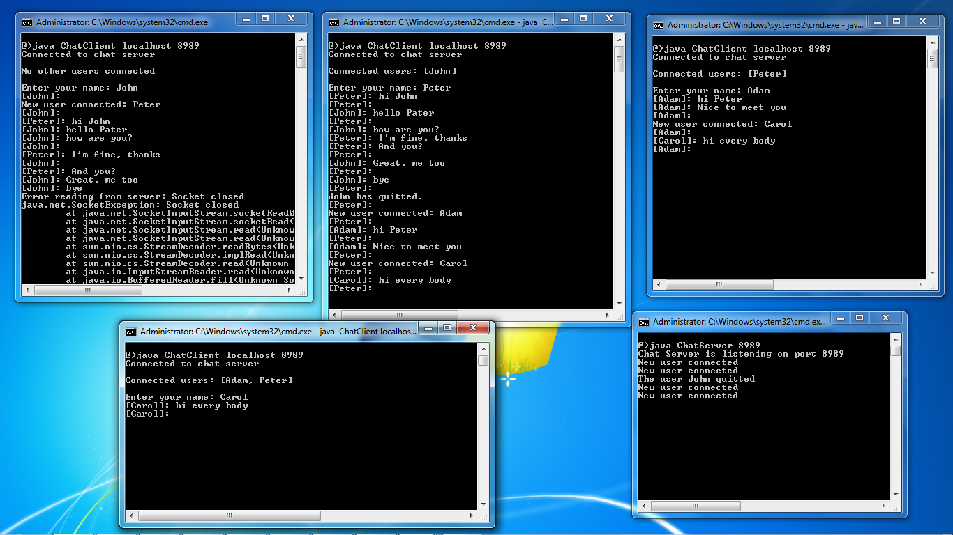
Output of the Program:

Slide 17
Applications:
Applications like Whatsapp, email, Facebook, hike, etc. provide best features and effective ways for textual conversation.
Services like the Web, electronic mail, and newsgroups uses these protocols for the textual cummunication.
And also several services available on the Internet allow people to interact in real time on the Internet, ranging from "chat rooms“.
In those chat rooms, where people can send text messages to teleconferencing programs with video, audio, and whiteboard facilities.

Slide 18
References:
https://www.codeproject.com/Articles/14032/Chat-Client-Server
https://www.geeksforgeeks.org/chat-conferencing-protocols/
https://www.geeksforgeeks.org/internet-relay-chat-irc/
https://xmpp.org/about/technology-overview.html

Slide 19


Slide 20
PRESENTATION INFO:
COURSE CODE : 18ISE01
COURSE NAME: NETWORK PROTOCOLS
DEPARTMENT: COMPUTER TECHNOLOGY – PG
BRANCH: M.Sc SOFTWARE SYSTEMS
YEAR: III SEMESTER: V DATE: 12-11-2020
PROJECT TITLE: CHAT CONSOLE APPLICATION
TEAM MEMBERS:
KARTHI S – 18ISR019
SANKARANANTH S – 18ISR042

