Slide 1
VELLORE INSTITUTE OF TECHNOLOGY (VIT), CHENNAI • SCHOOL OF COMPUTER SCIENCE AND ENGINEERING (SCOPE)
VITCC ENTERPRISE LIBRARY MANAGEMENT SYSTEM
Dual-Paradigm Relational (Oracle 21c) and Graph (Neo4j AuraDB) Database Application Project
Course Project Assessment (DA-3) covering Schema Normalization, PL/SQL Automation, Graph Traversal & Role-Based Access Control
COURSE & FACULTY DETAILS
Course Code: BACSE202
Course Name: Database Systems
Class Slot: F1+TF1
Faculty Guide: Dr. R. Priyadarshini
Department: Department of Computer Science & Engineering
Institution: VIT Chennai Campus
SUBMITTED BY (PROJECT TEAM)
KARTHIK VALLIAPPAN C (25BAI1051)
System Architecture, Neo4j Graph Model & Web Controllers
NITHIN RANGASWAMY (25BAI1210)
Relational Schema, Oracle DDL/DML, Constraints & Auditing
NATRAJ (25BAI1079)
PL/SQL Programming, Stored Procedures, Functions & Triggers

Slide 2
SECTION 1: PROJECT INTRODUCTION & DESIGN
02 / 22
Presentation Roadmap & Topics Covered
SECTION 1
Introduction & Architecture
SECTION 2
Database Design & Schema
SECTION 3
SQL & Database Programming
SECTION 4
Implementation & Results
• Problem Statement & Objectives
• Proposed Dual-Database Solution
• 4-Tier Architecture & Tech Stack
• Core Modules & Data Interaction
• Entity-Relationship (ER) Diagram
• Relational Mapping & Normalization (BCNF)
• Table DDL & Integrity Constraints
• Sample Records & Referential Integrity
• Feature-to-Query Mapping
• DDL, DML & Role-Based DCL Security
• Analytical Subqueries & Complex Joins
• PL/SQL Triggers, Cursors & Procedures
• Application Workflow & Code Structure
• Working Application Screenshots (8 views)
• Role-Based Access Control & Innovations
• Build Steps, GitHub Repository & Conclusion

Slide 3
SECTION 1: PROJECT INTRODUCTION & DESIGN
03 / 22
Problem Statement, Objectives & Solution Scope
PROBLEM STATEMENT
• Traditional relational library management systems struggle with recursive multi-table joins when discovering multi-degree book connections.
• Students lack structured academic reading roadmaps showing prerequisite foundational books before advanced texts.
• Manual circulation desk verification often fails to enforce patron loan limits (3 books) and calculate overdue penalties reliably.
• Borrowing histories are exposed across patrons without proper role-based privacy masking.
PROPOSED SOLUTION & SCOPE
• Phased Database Migration: Phase 1 utilized Oracle 21c for strict relational modeling, while Phase 2 (DA-3) completely migrated the backend to Neo4j AuraDB to unlock advanced graph traversals and recommendations.
• Role-Based Access Control (RBAC): Provides four distinct experiences for Admin, Librarian, Staff (Faculty), and Students.
• Automated Circulation Rules: Real-time 3-book borrowing quota enforcement and daily Rs. 10/day overdue fine calculation.
• Interactive Graph Capabilities: Real-time knowledge graph visualizer, shortest-path degrees of separation, and DAG prerequisite learning tracks.
TECHNOLOGY STACK SUMMARY
Web Framework
Python 3.12, Flask 3.1, Flask-Session, Flask-WTF CSRF
Relational Engine
Oracle Database 21c (Tables, Constraints, PL/SQL)
Graph Engine
Neo4j AuraDB v5+ (Cypher, Graph Traversal Algorithms)
Frontend UI
HTML5, Vanilla CSS, Plus Jakarta Sans, JetBrains Mono
Graph Canvas
Vis.js Network v9.1.2 (Interactive Physics Rendering)
Verification
7 End-to-End Automated Verification Suites (100% Pass)

Slide 4
SECTION 1: PROJECT INTRODUCTION & DESIGN
04 / 22
Overall System Architecture & Multi-Tier Data Interaction
Tier 1: Client & Presentation Layer
Web Browser UI & Interactive Graph Canvas
• Responsive Web Portal implemented in HTML5 and clean Vanilla CSS (Modern Slate Theme).
• Vis.js physics-driven canvas rendering interactive knowledge graphs and prerequisite roadmaps.
• Role-specific UI views tailored for Admin, Librarian, Faculty/Staff, and Students.
Tier 2: Application Controller & Security Layer
Flask WSGI Middleware & RBAC Controllers
• Central request router managing authentication, catalog browsing, loan processing, and graph APIs.
• Flask-WTF CSRF token validation on all mutable operations (loan issue, returns, password updates).
• 10-minute idle session timeout with automatic server-side cleanup and institutional email checks.
Tier 3: Data Access & Business Logic Layer
Parameterized Database Drivers & Controllers
• Neo4j Bolt Protocol (neo4j+s://) executing optimized Cypher shortestPath() and prerequisite queries.
• Dynamic patron privacy masking to anonymize fellow student loan requests on shared canvases.
Tier 4: Enterprise Storage Tier
Phase 1 (Legacy Oracle) & Phase 2 (Live Neo4j Graph)
• Oracle 21c Database: 10 normalized tables in BCNF, foreign key cascades, triggers, and views.
• Neo4j AuraDB: 9 node entity types, 7 relationship edges, and 12 schema uniqueness constraints.
• Automated quota enforcement, copy status synchronization, and audit logging.

Slide 5
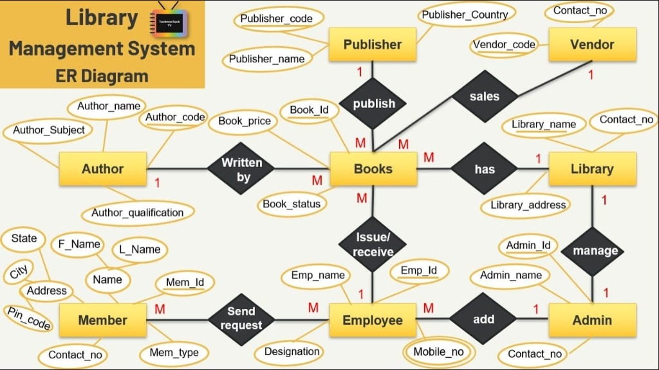
SECTION 2: DATABASE DESIGN & IMPLEMENTATION
05 / 22
Conceptual Data Model — Entity-Relationship (ER) Diagram
ENTITY & CARDINALITY MAPPING
1:N Publisher to Books
Each publisher publishes multiple titles; every book is linked to a single registered publisher.
M:N Books to Authors
A book may have co-authors, and authors write multiple books. Mapped into the BOOK_AUTHORS relationship table.
1:N Book to Copies
Separates abstract bibliographic titles from physical inventory tracking copies (status: Available, Borrowed, Reserved).
1:N User to Loans
Patrons record historical loans over time, strictly capped at 3 active concurrent borrowed books.
1:1 Loan to Fines
Overdue book returns automatically generate a financial disciplinary record (Rs. 10 per overdue day).
Relational Normalization
Conceptual Member, Employee, and Admin roles are unified into the USERS entity with Role-Based Access Control.
Figure: Conceptual Entity-Relationship (ER) Diagram of the Library Management System

Slide 6
SECTION 2: DATABASE DESIGN & IMPLEMENTATION
06 / 22
Relational Schema & Functional Dependency Normalization (BCNF)
RELATIONAL SCHEMA SPECIFICATIONS
CATEGORIES (category_id [PK], category_name, description)
PUBLISHERS (publisher_id [PK], name, address, phone, email)
AUTHORS (author_id [PK], first_name, last_name, bio)
BOOKS (book_id [PK], title, isbn, publication_year, category_id [FK], publisher_id [FK])
BOOK_AUTHORS (book_id [PK, FK], author_id [PK, FK])
BOOK_COPIES (copy_id [PK], book_id [FK], status, acquisition_date)
USERS (user_id [PK], username, password_hash, email, role, account_status)
LOANS (loan_id [PK], copy_id [FK], user_id [FK], issue_date, due_date, return_date, issued_by [FK])
LOAN_REQUESTS (request_id [PK], user_id [FK], book_id [FK], request_date, status, copy_id [FK])
FINES (fine_id [PK], loan_id [FK], fine_amount, payment_status, payment_date, collected_by [FK])
NORMALIZATION DECOMPOSITION
1NF (First Normal Form)
All table attributes contain atomic values. Repeated author and copy collections are separated into distinct tables.
2NF (Second Normal Form)
Eliminated all partial key dependencies. In BOOK_AUTHORS, the composite key {book_id, author_id} determines full relationship status.
3NF (Third Normal Form)
Eliminated all transitive functional dependencies (e.g., category_name is determined exclusively by category_id, not transitively by book_id).
BCNF (Boyce-Codd Normal Form)
Every determinant is a candidate key. Protects against update, insertion, and deletion anomalies across the loan lifecycle.

Slide 7
SECTION 2: DATABASE DESIGN & IMPLEMENTATION
07 / 22
Table Creation & Comprehensive Integrity Constraints (DDL)
-- Table Creation with Integrity Constraints (Oracle SQL)
CREATE TABLE USERS (
user_id NUMBER GENERATED BY DEFAULT AS IDENTITY PRIMARY KEY,
username VARCHAR2(50) NOT NULL UNIQUE,
email VARCHAR2(100) NOT NULL UNIQUE,
password_hash VARCHAR2(255) NOT NULL,
role VARCHAR2(20) DEFAULT 'Student' NOT NULL,
account_status VARCHAR2(20) DEFAULT 'Active' NOT NULL,
CONSTRAINT chk_user_role CHECK (role IN ('Admin', 'Librarian', 'Staff', 'Student')),
CONSTRAINT chk_user_status CHECK (account_status IN ('Active', 'Suspended'))
);
CREATE TABLE BOOK_COPIES (
copy_id NUMBER PRIMARY KEY,
book_id NUMBER NOT NULL REFERENCES BOOKS(book_id) ON DELETE CASCADE,
status VARCHAR2(20) DEFAULT 'Available' NOT NULL,
CONSTRAINT chk_copy_status CHECK (status IN ('Available', 'Borrowed', 'Reserved', 'Maintenance'))
);
CREATE TABLE LOANS (
loan_id NUMBER PRIMARY KEY,
copy_id NUMBER NOT NULL REFERENCES BOOK_COPIES(copy_id),
user_id NUMBER NOT NULL REFERENCES USERS(user_id) ON DELETE CASCADE,
issue_date DATE DEFAULT SYSDATE NOT NULL,
due_date DATE NOT NULL,
return_date DATE,
CONSTRAINT chk_loan_dates CHECK (due_date >= issue_date)
);
INTEGRITY CONSTRAINTS IMPLEMENTED
PRIMARY KEY Constraints
Enforces entity integrity (user_id, book_id, loan_id). Prohibits duplicate or NULL primary records.
FOREIGN KEY & CASCADES
Maintains referential integrity. Removing a book cascades to dependent copies (ON DELETE CASCADE), preventing dangling references.
CHECK Constraints
chk_user_role restricts accounts to authorized roles; chk_copy_status ensures valid inventory states; chk_loan_dates guarantees due_date >= issue_date.
UNIQUE Constraints
Prevents duplicate ISBN registrations, identical usernames, and duplicate institutional email addresses.
NOT NULL & DEFAULT
Mandates critical metadata (password_hash, email) while initializing default statuses ('Available', 'Active', 'Unpaid').

Slide 8
SECTION 2: DATABASE DESIGN & IMPLEMENTATION
08 / 22
Sample Data Records & Referential Integrity Verification
SAMPLE ENTITY RECORDS POPULATED IN DATABASE
Table | Identifier (PK) | Attribute 1 | Attribute 2 | Status / Role | Foreign Key Ref
USERS | user_id = 1 | admin | admin@vit.edu | Role: Admin | Account: Active
BOOKS | book_id = 2 | Clean Code: Agile Craft | ISBN: 978-0132350884 | Pub Year: 2008 | Category: CS (ID: 1)
LOANS | loan_id = 14 | copy_id = 2 | user_id = 6 (student) | Issue: 2026-03-01 | Due: 2026-03-15 (Overdue)
REFERENTIAL INTEGRITY ENFORCEMENT
• Foreign Key Cascading: Deleting a category safely cascades to dependent book records or blocks deletion if active loans exist.
• Copy Status Synchronization: Physical copies transition automatically to 'Borrowed' upon loan issue and 'Available' upon check-in.
• Borrower Anonymization on Account Deletion: Historical loans retain record integrity (borrower_id = 0) to maintain statistical ledgers.
CONSTRAINT REJECTION TESTING (ERROR-PROOFING)
• Duplicate ISBN Rejection: ORA-00001 unique constraint violation raised when attempting to re-register an existing ISBN.
• Borrowing Quota Rejection: PL/SQL trigger and Flask controllers immediately reject a 4th concurrent loan request.
• Disciplinary Fine Locking: Loan issuance is blocked when outstanding disciplinary fines exist on a patron's record.

Slide 9
SECTION 3: SQL QUERIES & DATABASE PROGRAMMING
09 / 22
SQL Queries Mapped to Application Features
Catalog & Category Search (/catalog, /category/<id>)
SELECT b.book_id, b.title, b.isbn, b.publication_year, c.category_name,
COUNT(cp.copy_id) AS total_copies,
SUM(CASE WHEN cp.status = 'Available' THEN 1 ELSE 0 END) AS available_copies
FROM BOOKS b
JOIN CATEGORIES c ON b.category_id = c.category_id
LEFT JOIN BOOK_COPIES cp ON b.book_id = cp.book_id
WHERE LOWER(b.title) LIKE :query OR REPLACE(b.isbn, '-', '') LIKE :isbn_query
GROUP BY b.book_id, b.title, b.isbn, b.publication_year, c.category_name;
Operational Purpose: Enables fast searching across titles, authors, and hyphenated/unhyphenated ISBNs with real-time copy availability counts.
Issue Loan Transaction (/issue_loan)
-- Atomic Loan Creation and Copy Status Lock
INSERT INTO LOANS (loan_id, copy_id, user_id, issue_date, due_date, issued_by)
VALUES (seq_loan_id.NEXTVAL, :copy_id, :user_id, SYSDATE, SYSDATE + 14, :admin_id);
UPDATE BOOK_COPIES
SET status = 'Borrowed'
WHERE copy_id = :copy_id;
Operational Purpose: Guarantees that a physical copy cannot be concurrently double-issued to another patron at the circulation desk.

Slide 10
SECTION 3: SQL QUERIES & DATABASE PROGRAMMING
10 / 22
DDL, DML, and Role-Based DCL Security Commands
DDL (DATA DEFINITION)
DML (DATA MANIPULATION)
DCL (DATA CONTROL)
CREATE TABLE / INDEX
CREATE TABLE LOAN_REQUESTS (
request_id NUMBER PRIMARY KEY,
user_id NUMBER REFERENCES USERS,
book_id NUMBER REFERENCES BOOKS,
status VARCHAR2(20) DEFAULT 'Pending'
);
ALTER TABLE CONSTRAINT
ALTER TABLE FINES ADD CONSTRAINT chk_fine_amt
CHECK (fine_amount >= 0);
CREATE UNIQUE INDEX
CREATE UNIQUE INDEX idx_isbn ON BOOKS(isbn);
INSERT DATA
INSERT INTO BOOK_COPIES (copy_id, book_id, status)
VALUES (seq_copy.NEXTVAL, 2, 'Available');
UPDATE TRANSACTION
UPDATE FINES SET payment_status = 'Paid',
payment_date = SYSDATE WHERE fine_id = :fid;
DELETE CONDITIONAL
DELETE FROM LOAN_REQUESTS
WHERE status = 'Rejected' AND request_date < SYSDATE-30;
ROLE PROVISIONING
CREATE ROLE LIBRARIAN_ROLE;
CREATE ROLE STUDENT_ROLE;
GRANT PRIVILEGES
GRANT SELECT, INSERT, UPDATE ON LOANS
TO LIBRARIAN_ROLE;
GRANT SELECT ON BOOKS TO STUDENT_ROLE;
REVOKE RESTRICTIONS
REVOKE DELETE ON BOOKS FROM STUDENT_ROLE;
REVOKE UPDATE ON USERS FROM LIBRARIAN_ROLE;

Slide 11
SECTION 3: SQL QUERIES & DATABASE PROGRAMMING
11 / 22
Single-Row, Multiple-Row & Correlated Subqueries
1. Single-Row Subquery (Scalar Comparison)
SELECT b.book_id, b.title, b.publication_year
FROM BOOKS b
WHERE b.publication_year > (
SELECT AVG(publication_year)
FROM BOOKS
WHERE category_id = b.category_id
);
Operational Analytics: Identifies books published more recently than the average publication vintage of their respective subject category.
2. Multiple-Row Subquery with IN Operator
SELECT u.user_id, u.username, u.email
FROM USERS u
WHERE u.user_id IN (
SELECT DISTINCT l.user_id
FROM LOANS l
JOIN FINES f ON l.loan_id = f.loan_id
WHERE f.payment_status = 'Unpaid'
);
Operational Analytics: Flags all patrons with outstanding overdue financial penalties to restrict borrowing permissions at checkout.
3. Correlated Subquery with EXISTS Operator
SELECT b.book_id, b.title
FROM BOOKS b
WHERE EXISTS (
SELECT 1
FROM BOOK_COPIES cp
JOIN LOANS l ON cp.copy_id = l.copy_id
WHERE cp.book_id = b.book_id
GROUP BY cp.copy_id
HAVING COUNT(l.loan_id) >= 3
);
Operational Analytics: Discovers 'High Circulation Velocity' titles where copies have been actively checked out 3 or more times.

Slide 12
SECTION 3: SQL QUERIES & DATABASE PROGRAMMING
12 / 22
SQL Functions — Aggregate, String, Date & Analytical Math
AGGREGATE FUNCTIONS & GROUP BY
COUNT(*), COUNT(DISTINCT l.user_id)
Measures total circulation transactions and distinct active patron engagement across semesters.
SUM(f.fine_amount)
Computes cumulative institutional penalty revenue and outstanding unpaid receivables.
AVG(MONTHS_BETWEEN(SYSDATE, b.acquisition_date))
Computes the mean retention age of catalog acquisitions for inventory deprecation.
MIN(due_date), MAX(due_date)
Identifies the earliest pending return and latest active return deadlines across campus.
GROUP BY ... HAVING COUNT(*) > 5
Filters prolific authors and high-density categories exceeding borrowing thresholds.
SCALAR, STRING & DATE FUNCTIONS
TO_CHAR(issue_date, 'YYYY-MM-DD HH24:MI')
Standardizes temporal audit timestamps across disparate client locales.
TRUNC(SYSDATE) - TRUNC(due_date)
Evaluates precise elapsed calendar days for overdue fine calculations.
UPPER(u.username), LOWER(u.email)
Normalizes patron authentication credentials to ensure case-insensitive identity matching.
REPLACE(b.isbn, '-', '')
Strips punctuation from ISBN strings for seamless barcode and query pattern matching.
NVL(return_date, 'Active Loan')
Handles NULL return dates gracefully in patron financial ledgers and dashboard reports.

Slide 13
SECTION 3: SQL QUERIES & DATABASE PROGRAMMING
13 / 22
Multi-Table Relational Joins & Abstract Database Views
MULTI-TABLE RELATIONAL JOINS (INNER & LEFT OUTER)
-- 5-Table Master Circulation Ledger Join
SELECT l.loan_id, u.username, u.role, b.title, c.category_name, cp.copy_id, l.issue_date, l.due_date, l.return_date
FROM LOANS l
INNER JOIN USERS u ON l.user_id = u.user_id
INNER JOIN BOOK_COPIES cp ON l.copy_id = cp.copy_id
INNER JOIN BOOKS b ON cp.book_id = b.book_id
INNER JOIN CATEGORIES c ON b.category_id = c.category_id
LEFT OUTER JOIN FINES f ON l.loan_id = f.loan_id;
DATABASE VIEWS FOR APPLICATION REPORTING & SECURITY MASKING
-- Abstract View: Masks sensitive password hashes and pre-aggregates patron financial exposure
CREATE OR REPLACE VIEW VIEW_PATRON_FINANCIAL_SUMMARY AS
SELECT u.user_id, u.username, u.email, u.role, u.account_status,
COUNT(DISTINCT l.loan_id) AS total_borrowings,
NVL(SUM(CASE WHEN f.payment_status = 'Unpaid' THEN f.fine_amount ELSE 0 END), 0) AS total_unpaid_fines
FROM USERS u
LEFT JOIN LOANS l ON u.user_id = l.user_id
LEFT JOIN FINES f ON l.loan_id = f.loan_id
GROUP BY u.user_id, u.username, u.email, u.role, u.account_status;

Slide 14
SECTION 3: SQL QUERIES & DATABASE PROGRAMMING
14 / 22
Database Triggers, Explicit Cursors & Automated Auditing
PL/SQL TRIGGER: QUOTA ENFORCEMENT
CREATE OR REPLACE TRIGGER trg_check_borrow_quota
BEFORE INSERT ON LOANS
FOR EACH ROW
DECLARE
v_active_loans NUMBER;
BEGIN
-- Count currently active unreturned books
SELECT COUNT(*)
INTO v_active_loans
FROM LOANS
WHERE user_id = :NEW.user_id
AND return_date IS NULL;
IF v_active_loans >= 3 THEN
RAISE_APPLICATION_ERROR(-20001,
'Policy Violation: Patron has reached max 3-book quota.');
END IF;
END;
EXPLICIT CURSOR: OVERDUE FINE BATCH
DECLARE
CURSOR c_overdue IS
SELECT loan_id, due_date, TRUNC(SYSDATE) - TRUNC(due_date) AS days_late
FROM LOANS
WHERE return_date IS NULL
AND due_date < SYSDATE;
r_ov c_overdue%ROWTYPE;
BEGIN
OPEN c_overdue;
LOOP
FETCH c_overdue INTO r_ov;
EXIT WHEN c_overdue%NOTFOUND;
-- Auto-calculate Rs. 10/day fine
UPDATE FINES
SET fine_amount = r_ov.days_late * 10.0
WHERE loan_id = r_ov.loan_id
AND payment_status = 'Unpaid';
END LOOP;
CLOSE c_overdue;
COMMIT;
END;

Slide 15
SECTION 3: SQL QUERIES & DATABASE PROGRAMMING
15 / 22
Stored Procedures, Functions & Robust Exception Handling
ENTERPRISE PL/SQL STORED PROCEDURE WITH PARAMETERS & TRANSACTION CONTROL
CREATE OR REPLACE PROCEDURE sp_issue_book_loan (
p_user_id IN NUMBER,
p_copy_id IN NUMBER,
p_admin_id IN NUMBER,
p_loan_id OUT NUMBER,
p_status OUT VARCHAR2
) AS
v_copy_status VARCHAR2(20);
v_unpaid_fines NUMBER;
ex_copy_busy EXCEPTION;
ex_unpaid_fines EXCEPTION;
BEGIN
-- Step 1: Verify physical inventory availability
SELECT status INTO v_copy_status FROM BOOK_COPIES WHERE copy_id = p_copy_id FOR UPDATE;
IF v_copy_status != 'Available' THEN RAISE ex_copy_busy; END IF;
-- Step 2: Verify zero outstanding financial penalties
SELECT NVL(SUM(fine_amount), 0) INTO v_unpaid_fines
FROM FINES f JOIN LOANS l ON f.loan_id = l.loan_id
WHERE l.user_id = p_user_id AND f.payment_status = 'Unpaid';
IF v_unpaid_fines > 0 THEN RAISE ex_unpaid_fines; END IF;
-- Step 3: Insert loan and flip copy status atomically
INSERT INTO LOANS (copy_id, user_id, issue_date, due_date, issued_by)
VALUES (p_copy_id, p_user_id, SYSDATE, SYSDATE + 14, p_admin_id)
RETURNING loan_id INTO p_loan_id;
UPDATE BOOK_COPIES SET status = 'Borrowed' WHERE copy_id = p_copy_id;
COMMIT;
p_status := 'SUCCESS';
EXCEPTION
WHEN ex_copy_busy THEN
ROLLBACK;
p_status := 'ERROR: Physical book copy is currently reserved or checked out.';
WHEN ex_unpaid_fines THEN
ROLLBACK;
p_status := 'ERROR: Patron has outstanding unpaid disciplinary fines.';
WHEN OTHERS THEN
ROLLBACK;
p_status := 'ERROR: ' || SQLERRM;
END sp_issue_book_loan;

Slide 16
SECTION 4: APPLICATION IMPLEMENTATION & DEMONSTRATION
16 / 22
Application Workflow & Modular Code Architecture
PROJECT DIRECTORY TREE
DBS DA/
├── app.py # Core Flask app (24 routes, RBAC, Cypher/SQL)
├── seed_all_data.py # Neo4j schema constraints & sample data seed
├── requirements.txt # Python dependencies (Flask, Neo4j, WTForms)
├── .env.example # Database connection template
├── .gitignore # Clean Git exclusions
├── README.md # Comprehensive architecture documentation
├── templates/ # 24 Jinja2 HTML5 Professional Views
│ ├── base.html # Sidebar, topbar, navigation & CSRF token
│ ├── dashboard.html # Role-based dashboard (Admin/Staff/Student)
│ ├── catalog.html # Category directory with copy aggregations
│ ├── issue_loan.html # Physical loan creation desk
│ ├── graph_visualizer # Interactive Vis.js live knowledge graph
│ ├── book_bridge.html # Shortest path traversal explorer
│ └── learning_paths # Acyclic prerequisite roadmaps
└── scratch/ # Verification suites (phase1..phase6, test runners)
HTTP REQUEST EXECUTION LIFECYCLE
Step 1: Inbound HTTP Request
Client browser triggers route (e.g. POST /issue_loan) with form payload and CSRF token.
Step 2: Security & Session Middleware
Verifies active session in filesystem, validates 10-minute idle activity timestamp, and decrypts CSRF token.
Step 3: Role-Based Authorization
@role_required(['Admin', 'Librarian']) decorator checks user role; redirects unauthorized roles to 403 Access Denied.
Step 4: Query Execution & Business Logic
Cypher query or PL/SQL procedure invoked via database driver session with parameterized injection protection.
Step 5: Dynamic View Rendering
Jinja2 compiles response template with DateWrapper objects and privacy-masked attributes.
Step 6: Client DOM Update
Rendered HTML/CSS returned with clean professional visuals and interactive Vis.js graph physics.

Slide 17
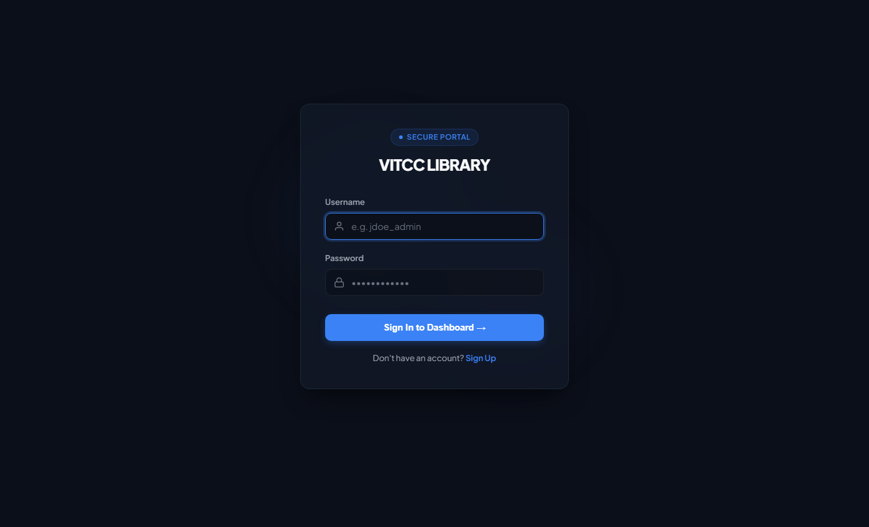
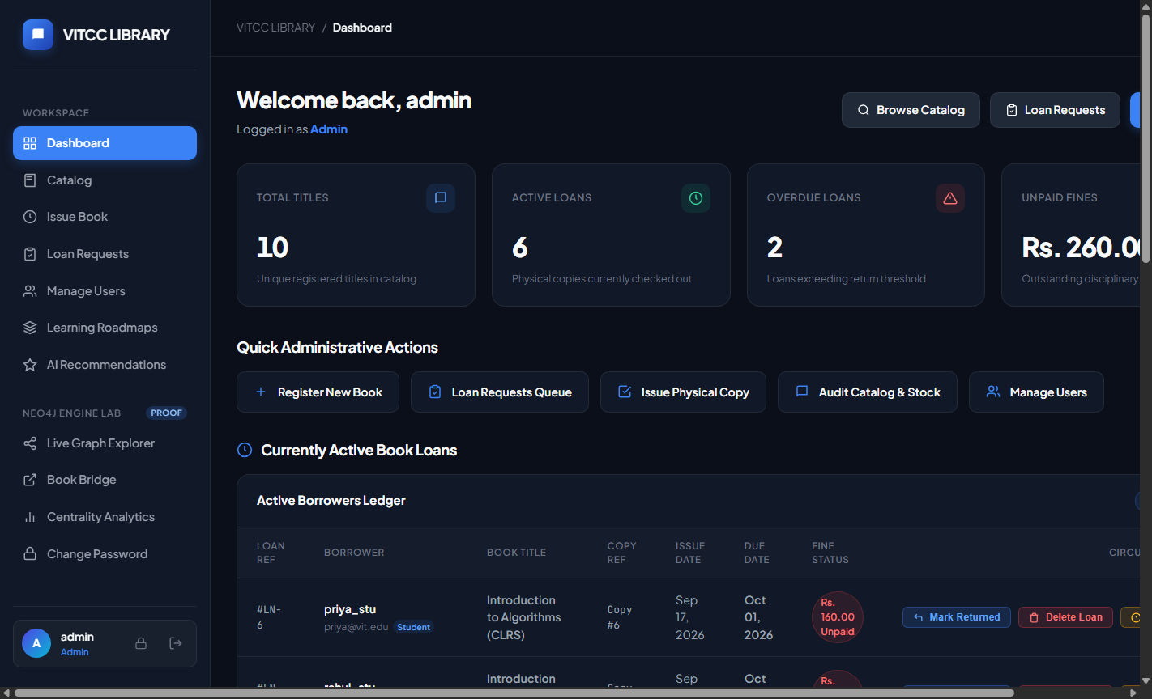
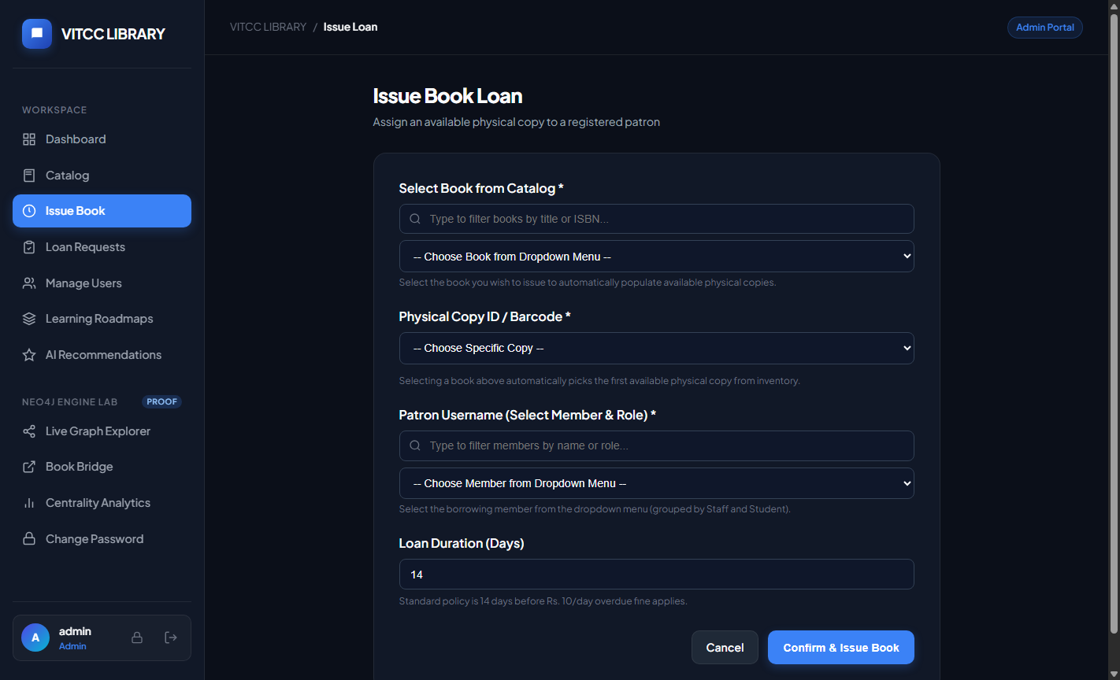
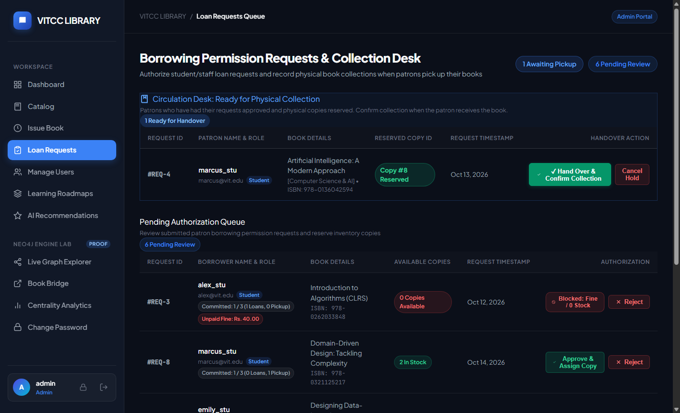
SECTION 4: APPLICATION IMPLEMENTATION & DEMONSTRATION
17 / 22
Working Application Screenshots — Circulation & Administration
1. Secure Multi-Role Login Portal
2. Admin Dashboard & Active Circulation Ledgers
3. Physical Book Loan Issuance Desk
4. Digital Loan Requests & Copy Reservation Desk

Slide 18
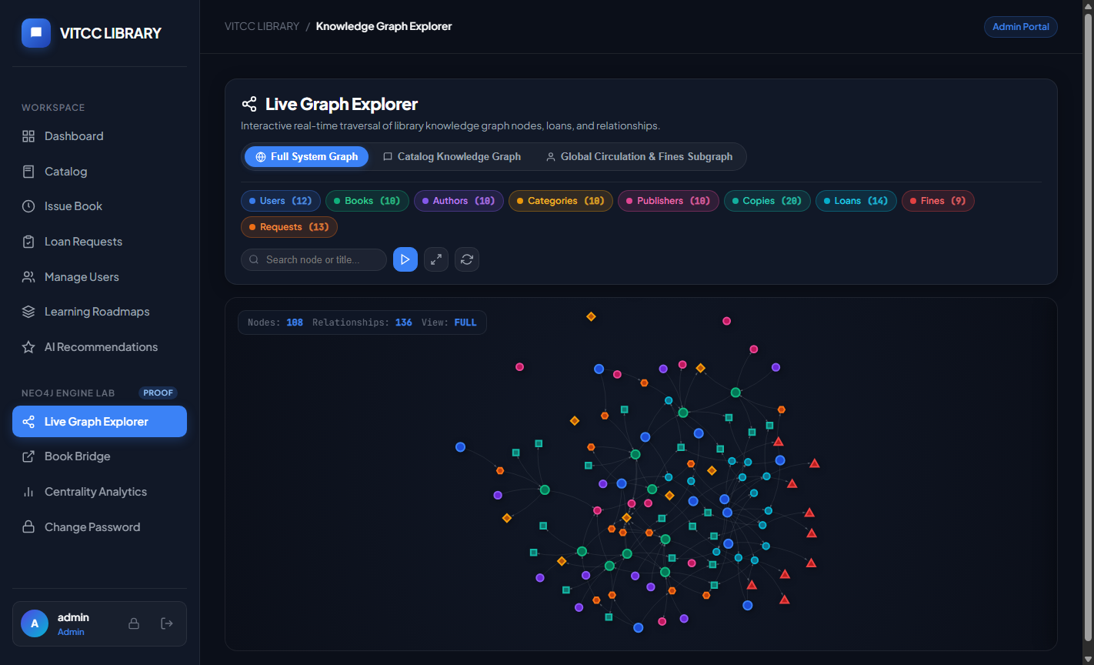
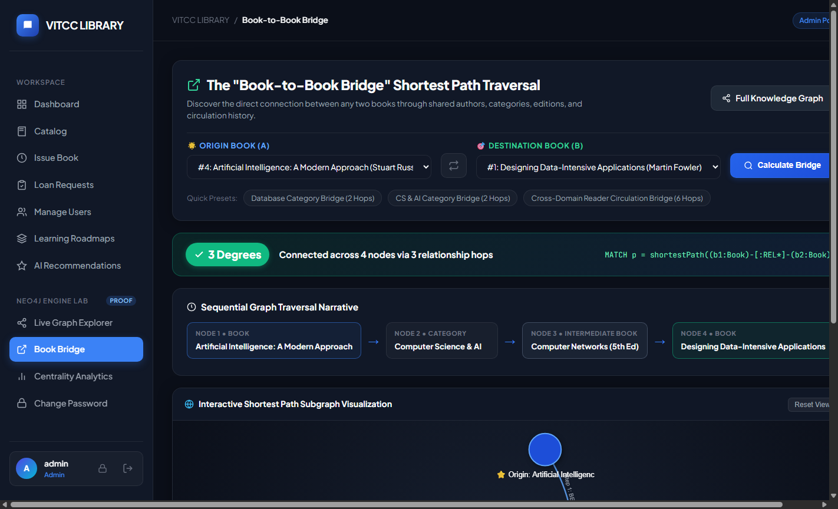
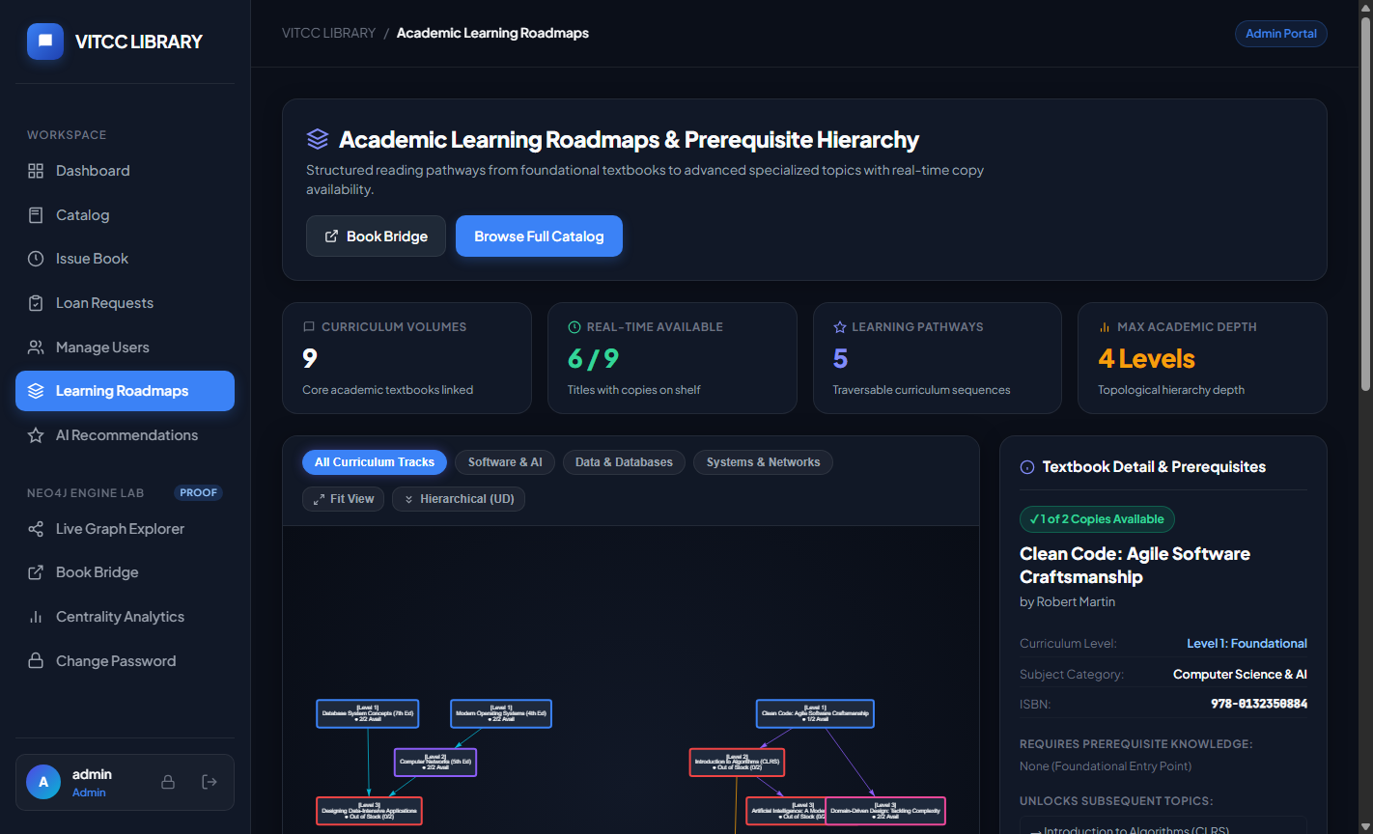
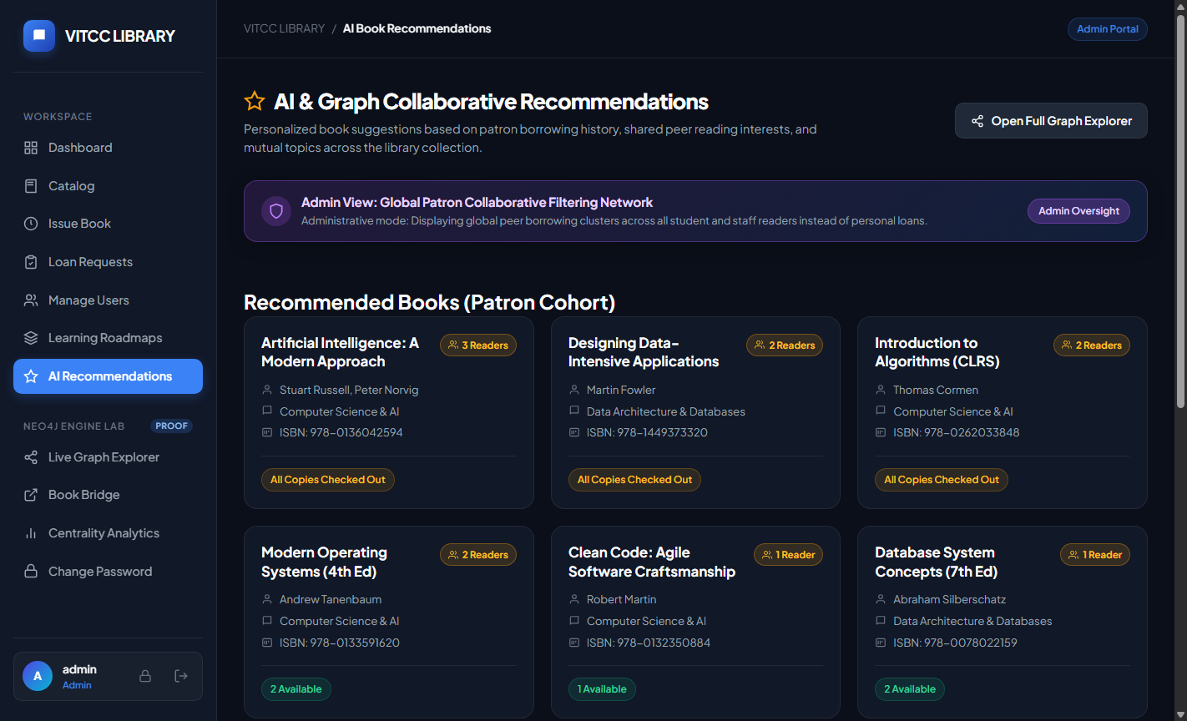
SECTION 4: APPLICATION IMPLEMENTATION & DEMONSTRATION
18 / 22
Working Application Screenshots — Graph & AI Innovations
1. Live Knowledge Graph Explorer (/graph_visualizer)
2. Book Bridge Shortest Path Traversal (/book_bridge)
3. Academic Learning Roadmaps DAG (/learning_paths)
4. AI Collaborative Filtering Recommendations

Slide 19
SECTION 4: APPLICATION IMPLEMENTATION & DEMONSTRATION
19 / 22
Role-Based Access Control & Advanced Graph Innovations
ROLE-BASED ACCESS CONTROL (RBAC) MATRIX
ADMINISTRATOR
Full authority: User provisioning, role assignment, account suspension, password reset, book catalog registration and book deletion. Complete audit visibility.
LIBRARIAN
Circulation desk manager: Book loan creation, digital request approvals, copy reservations, check-in returns, and fine settlement. Cannot manage user accounts.
STAFF (FACULTY)
Academic borrower: Search catalog, borrow up to 3 books, view academic prerequisite roadmaps, explore author degree centrality, and review fine ledgers.
STUDENT (PATRON)
Academic patron: Search catalog, submit loan requests, view personalized AI recommendations, track prerequisite roadmaps, and monitor individual fines.
CUSTOM ARCHITECTURAL INNOVATIONS
1. Book-to-Book Bridge (Degrees of Separation)
Uses Cypher shortestPath() algorithm to uncover multi-hop links between disparate titles via prerequisites, co-authors, and categories.
2. Academic Learning Roadmaps (Directed Acyclic Graphs)
Hierarchical Vis.js network visualizer mapping foundational courses to advanced texts across CS, AI, and Distributed Systems.
3. Privacy-Preserving Patron Masking
When Students or Staff browse the Live Knowledge Graph, other patrons' identities and borrow requests are anonymized in real time.
4. Author Degree Centrality & Borrowing Density
Computes influential scholars by loan volume and category closeness centrality to inform faculty acquisition budgets.

Slide 20
SECTION 4: APPLICATION IMPLEMENTATION & DEMONSTRATION
20 / 22
Build, Setup & Execution Instructions
STEP 1: CLONE REPOSITORY & CREATE VIRTUAL ENVIRONMENT
git clone https://github.com/Karthi16-png/LIBRARAY-MANAGEMENT-SYSTEM.git
cd "DBS DA"
python -m venv .venv
.venv\Scripts\activate (Windows) OR source .venv/bin/activate (macOS/Linux)
STEP 2: INSTALL DEPENDENCIES & CONFIGURE ENVIRONMENT
pip install -r requirements.txt
Configure Neo4j AuraDB credentials in .env or environment variables:
NEO4J_URI=neo4j+s://<instance>.databases.neo4j.io
NEO4J_USERNAME=neo4j | NEO4J_PASSWORD=<password>
STEP 3: SEED GRAPH DATABASE (INITIAL SETUP)
python seed_all_data.py
-> Establishes 12 schema uniqueness constraints
-> Seeds 11 users across all 4 roles, 10 categories, 15+ books, copies, and prerequisite edges
STEP 4: LAUNCH PORTAL & RUN TEST SUITES
python app.py
-> Access interactive portal at http://127.0.0.1:5000/
Execute complete 7-phase automated verification runner:
python scratch/run_all_phases.py (100% Passing)

Slide 21
SECTION 4: APPLICATION IMPLEMENTATION & DEMONSTRATION
21 / 22
GitHub Repository & Project Key Learning Outcomes
OPEN-SOURCE GITHUB REPOSITORY
Repository URL:
https://github.com/Karthi16-png/LIBRARAY-MANAGEMENT-SYSTEM
Production Codebase
Contains app.py (4,230 lines), seed scripts, 24 template views, and full verification test suites.
Branching & Hygiene
Clean Git commit history on branch main with .gitignore preventing credential exposure and cache staging.
Documentation & Dossier
Includes detailed README.md setup instructions and the 211-page master forensic audit report PDF.
PROJECT OUTCOMES & FUTURE ROADMAP
Database Migration Mastery
Gained deep architectural expertise by successfully migrating a transactional relational schema (Oracle 21c) into a modern, highly-connected graph store (Neo4j AuraDB).
PL/SQL & Constraint Automation
Successfully replaced error-prone application validation with autonomous database triggers, procedures, and check constraints.
Enterprise RBAC Implementation
Engineered strict multi-role permission separation with patron privacy masking and audit trail logging.
Future Roadmap 1: RFID Hardware Integration
Deploy physical RFID return drop-boxes for automated instantaneous check-in without librarian intervention.
Future Roadmap 2: SMS & Webhook Alerts
Automated email and WhatsApp notifications for books nearing return deadlines to minimize disciplinary fines.

Slide 22
THANK YOU!
Questions & Faculty Evaluation Discussion
VITCC Enterprise Library Management System
Dual Relational & Graph Database Implementation
Course: BACSE202 — Database Systems | Slot: F1+TF1
Faculty Guide: Dr. R. Priyadarshini
Team Members: KARTHIK VALLIAPPAN C (25BAI1051) | NITHIN RANGASWAMY (25BAI1210) | NATRAJ (25BAI1079)
School of Computer Science & Engineering (SCOPE), VIT Chennai

