Slide 1
Fandango movie rating discrepancy analysis
CAPSTONE PROJECT
Presented By:
1. S.Karthikeyan-8144-Sudharsan Engineering College - EEE

Slide 2
OUTLINE
Problem Statement
Proposed System/Solution
System Development Approach
Algorithm & Deployment
Result
Conclusion
Future Scope
References

Slide 3
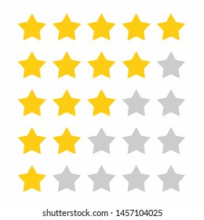
Problem Statement
Fandango is one of the most well-known movie ticketing platforms in the world. Fandango has been the target of criticism for its questionable movie rating system.
The accuracy of movie ratings is essential for consumers to make informed choices. There are many factors that can affect the accuracy of a rating system, such as bias, mistakes, or manipulation.
These factors can have a negative impact on consumer confidence and the credibility of the industry.

Slide 4
Proposed Solution
We propose a systematic approach to analyze Fandango rating data and identify discrepancies.
Our solution aims to provide insights into the accuracy and consistency of movie ratings on the platform.
By implementing robust analysis techniques, we seek to enhance transparency and trustworthiness in movie ratings.

Slide 5
System Approach
Building the proposed solution would involve a combination of data procrssing, feature engineering ,and machine learning,
Here are the key system and library requirements
System requirements
1.Hardware
A computer with sufficient processing power preferably with mulpile cores or a GPU for faster traning of machine learning models .
2. Software
An operating system compatible with the required machine learning libraries.
Eg- windows Linux
Library Requirements:
1.Data Processing and Analysis
-Pandas: For data manipulation and analysis
-Numpy: For numerical operation on data
2.Data visualization
-Mathplotlib and seaborn: For creating visualizations to understand data patterns
-Plotly or Bokeh : Interactive visualization libraries for more comple visualizations

Slide 6
Algorithm & Deployment
We employ statistical methods such as hypothesis testing and anomaly detection to identify rating anomalies.
Deployment Strategy: The analysis program can be deployed as a standalone Python application or integrated into a web service for broader accessibility.
Scalability: The program is designed to handle large datasets efficiently, ensuring scalability as Fandango rating data grows over time.
plt.figure(figsize=(10,5),dpi=200)
sns.histplot(data=all_sites,x='Rotten_Diff',kde=True,bins=20)
plt.title("RT Critics Score minus RT User Score")

Slide 7
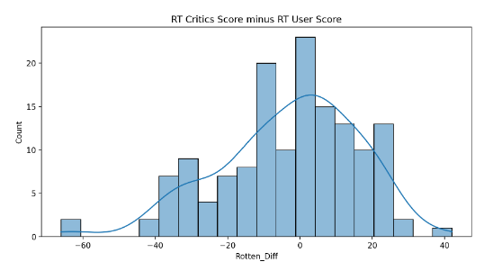
Result
Analysis Results: Our analysis reveals notable discrepancies in Fandango movie ratings, highlighting instances of inflated or biased ratings.
Visualizations: Graphical representations of rating distributions and anomalies provide clear insights into the findings.
Insights: Key findings shed light on the underlying factors contributing to rating inconsistencies and their implications for consumers and the movie industry.

Slide 8
Conclusion
In conclusion, our analysis underscores the importance of addressing rating discrepancies on Fandango.
Impact: Addressing these discrepancies can enhance consumer trust, promote fair competition among movies, and uphold industry standards.
Future Directions: Further research and collaboration are needed to refine our analysis techniques and promote transparency in movie rating systems.

Slide 9
Future scope
Enhancements: Future enhancements may include incorporating user reviews, sentiment analysis, and real-time monitoring of rating changes.
Collaboration Opportunities: Collaboration with Fandango and other stakeholders can facilitate access to additional data and insights.
Research Areas: Opportunities for research include exploring the impact of rating discrepancies on consumer behavior and developing robust methodologies for rating analysis.

Slide 10
References
List of References: Citations for relevant literature, datasets, and tools used in the analysis.
Acknowledgments: Thank collaborators, advisors, and contributors to the project for their support and guidance.
https://www.kaggle.com/code/tarizatique/fandango-project

Slide 11
THANK YOU

