Slide 1
B KARTHI
B. TECH
AI & DS
211521243080
3/21/2024 Annual Review

Slide 2
TITLE
Fashion Design and Apparel Generation Using AI
3/21/2024 Annual Review

Slide 3


AGENDA
Introduction
Project Overview
Implementation Details
Additional Processes
Demonstration
Conclusion & Discussion
3/21/2024 Annual Review

Slide 4

PROBLEM STATEMENT
The fashion industry faces challenges in keeping pace with rapidly changing trends and consumer demand for personalized and unique apparel. Traditional design processes can be time-consuming and often lack the scalability and agility needed to address these dynamic market conditions.
3/21/2024 Annual Review

Slide 5

PROJECT OVERVIEW
This project aims to create a cutting-edge solution that utilizes Generative Adversarial Networks (GANs) and other deep learning techniques to automate the generation of fashion designs and apparel patterns. This AI tool will analyze current trends, historical data, and consumer preferences to produce innovative and personalized fashion designs.
3/21/2024 Annual Review

Slide 6

WHO ARE THE END USERS?
The primary users are fashion designers and brands looking to streamline their design process and explore new creative avenues. Additionally, online retail platforms and consumers seeking personalized fashion items will also benefit from this technology.
3/21/2024 Annual Review

Slide 7

YOUR SOLUTION AND ITS VALUE PROPOSITION
Implement a GAN-based model that learns from a vast dataset of fashion items to generate new designs. The system will allow users to input preferences or constraints (e.g., style, color, fabric) to guide the generation process towards desired outcomes. The model will also incorporate feedback loops for continuous improvement based on user interactions and market trends.
3/21/2024 Annual Review

Slide 8

THE WOW IN YOUR SOLUTION
The project's wow factor lies in its ability to democratize fashion design, making it possible for smaller brands and individual designers to compete with industry giants by reducing the time and cost associated with the design process. Furthermore, its capacity to generate personalized apparel designs in real-time based on user inputs and preferences sets a new standard for consumer-driven fashion.
3/21/2024 Annual Review

Slide 9
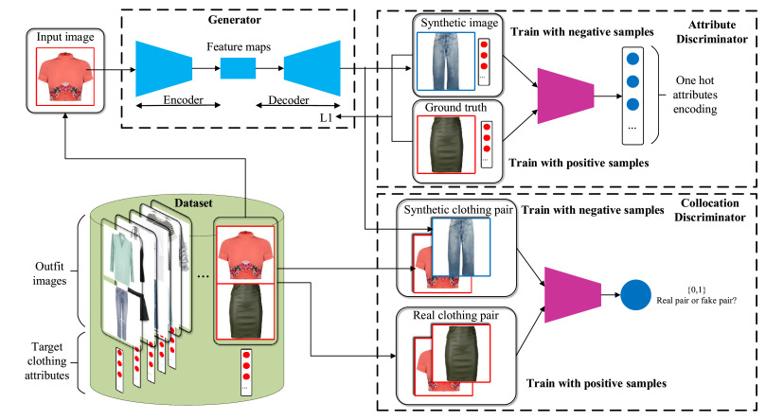
MODELLING
3/21/2024 Annual Review

Slide 10
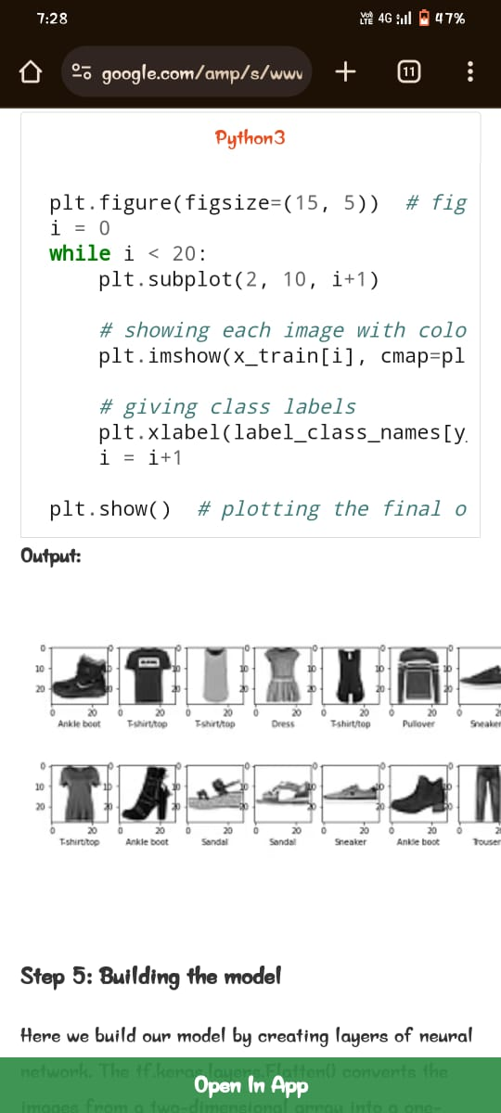
RESULTS
Demo Link
3/21/2024 Annual Review

