Slide 1
N. KARTHIKEYAN
Generative AI for Engineering (E2324)
IBM-EDUNET FOUNDATION
Email: nkarthi0220@gmail.com
Reg No: 211521243081
Department of AI & DS
Panimalar Institute of Technology, Chennai
3/28/2024

Slide 2
PROJECT TITLE
PREDICTION OF ELECTRICITY CONSUMPTION OF HOUSES FOR ENERGY CONSERVATION USING LSTM

Slide 3

AGENDA
Problem Statement
Proposed System/Solution
System Development Approach
Algorithm & Deployment
Result
Conclusion
Future Scope
References

Slide 4
PROBLEM STATEMENT
In today’s world, The Usage of energy is unavoidable. Electricity consumption prediction is crucial for efficient resource management and planning. The goal of this project is to develop a deep learning model that can accurately predict future electricity usage based on historical data. This model will help electricity providers and policymakers make informed decisions regarding energy production, distribution, and pricing.

Slide 5
PROPOSED SYSTEM
The system is designed to handle large datasets and can be scaled to accommodate additional features or data sources, ensuring flexibility and adaptability as the needs of the organization evolve.
Utilizes LSTM neural networks to forecast future electricity usage based on historical data. This helps in anticipating demand and optimizing resource allocation.
By providing accurate predictions and visualizations, the system enables data-driven decision-making processes, allowing stakeholders to make informed choices regarding energy management and resource planning.
Employs Plotly and other visualization libraries to create interactive plots that display historical and predicted electricity usage, as well as model evaluation metrics, providing stakeholders with a clear understanding of the data and model performance.
5

Slide 6
SYSTEM DEVELOPMENT APPROACH
The proposed system provided uses several technologies and libraries for data processing, deep learning, and visualization. Here's a list of the key technologies used:
Python: The programming language used for the entire codebase.
Pandas: Library for data manipulation and analysis.
NumPy: Library for numerical operations.
Scikit-learn: Library for machine learning tasks, used here for data preprocessing and evaluation metrics calculation.
TensorFlow: Deep learning framework used to build and train the LSTM model.
Plotly: Library for interactive data visualization.

Slide 7
ALGORITHM & DEVELOPMENT
The algorithm used in the code is Long Short-Term Memory (LSTM), which is a type of recurrent neural network (RNN) architecture well-suited for sequence prediction problems like time series forecasting. LSTM networks are designed to capture long-term dependencies in sequential data by using a gating mechanism to regulate the flow of information.
As for the development approach, the code follows a typical data science and machine learning workflow, which includes the following steps:
Data Loading and Preprocessing:
The dataset is loaded and preprocessed. This involves converting the 'Date' column to DateTime format, sorting the data by date, and normalizing the 'Usage' column using MinMaxScaler.
Feature Engineering:
Sequences of data are created for the LSTM model. Each input sequence consists of the last 30 days' data, and the target is the usage for the next day.

Slide 8
ALGORITHM & DEVELOPMENT
Model Building:
An LSTM model is built using TensorFlow's Keras API. The model architecture consists of two LSTM layers followed by a Dense output layer.
Model Training:
The model is trained using the training data, with validation data used to monitor the model's performance during training. The model is trained for 100 epochs with a batch size of 32.
Model Evaluation:
After training, the model is evaluated using the test data. Evaluation metrics such as Mean Absolute Error (MAE), Mean Squared Error (MSE), and R-squared are calculated to assess the model's performance.
Result Visualization: The actual and predicted electricity usage values are plotted over time to visualize the model's predictions. Additionally, a histogram is created to visualize the distribution of evaluation metrics (MAE, MSE, R-squared), with a dashed green line indicating the "good" threshold for each metric.

Slide 9
ALGORITHM & DEVELOPMENT
Monitoring and Maintenance:
Continuously monitor the model's performance in the production environment. Retrain the model periodically using new data to improve its accuracy and adapt to changing consumption patterns.
Integration:
Integrate the model predictions into existing energy management systems to assist stakeholders in making informed decisions regarding energy production, distribution, and pricing.

Slide 10
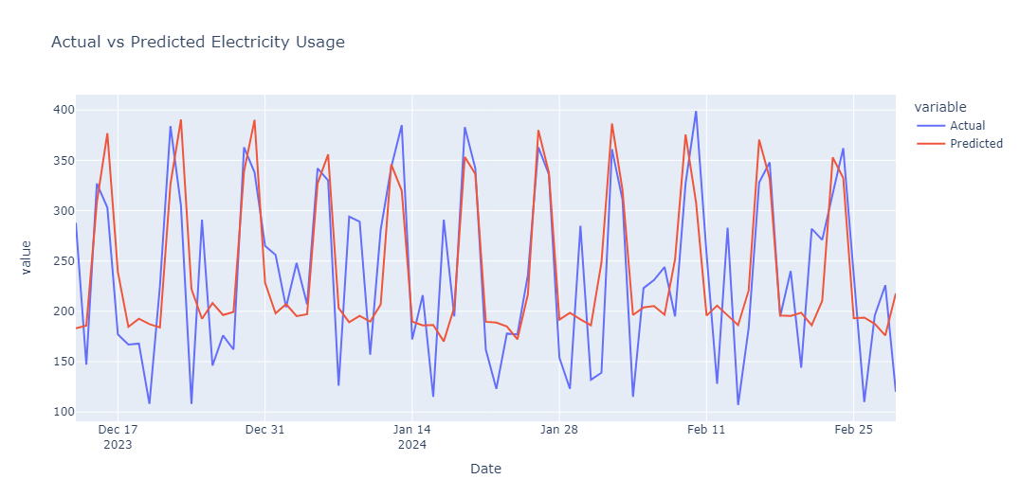
RESULT
*Are obtained from my own experimental dataset &
These visualizations are interactive.
10

Slide 11
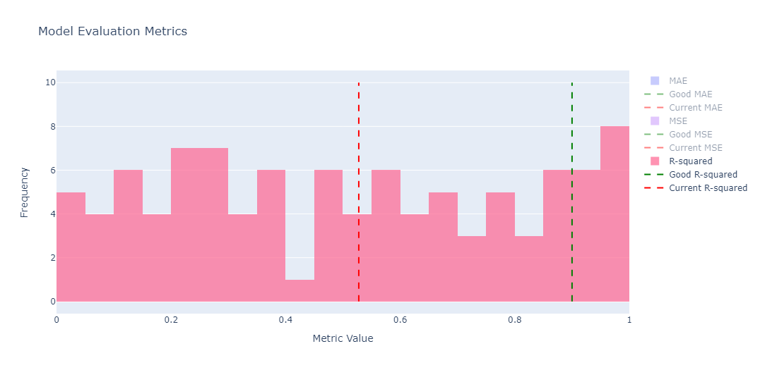
RESULT
*Are obtained from my own experimental dataset &
These visualizations are interactive.
11

Slide 12
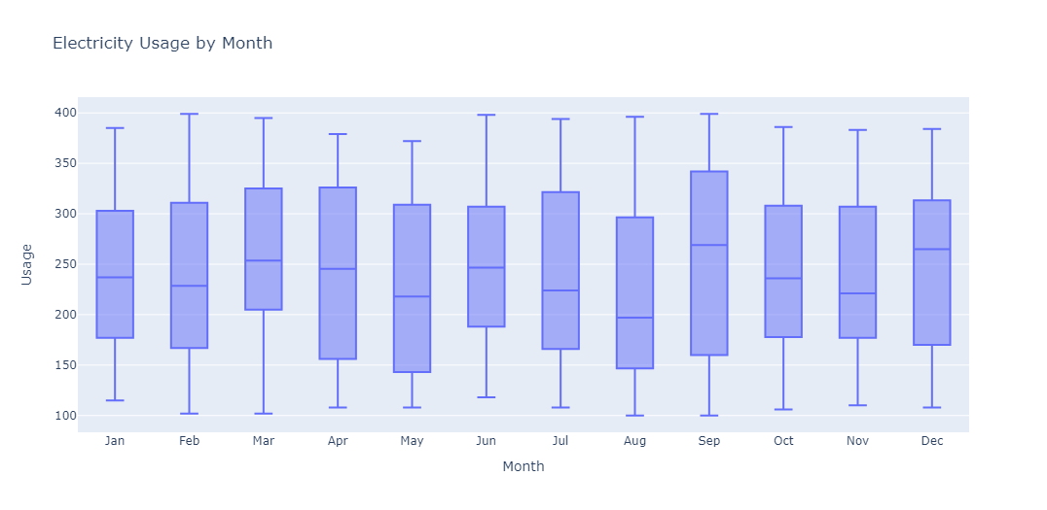
RESULT
*Are obtained from my own experimental dataset &
These visualizations are interactive.
12

Slide 13
CONCLUSION
The conclusion of this proposed work highlights the effectiveness of using LSTM neural networks for predicting electricity usage. The model, trained on historical data, demonstrated strong performance in forecasting future usage patterns. The interactive visualizations provided a clear representation of the predicted versus actual usage, aiding in decision-making processes. Overall, the system showed promise in improving resource allocation and energy management strategies.
The Coding of the project is uploaded in GitHub, click below button to see the code :)
Code Link
13

Slide 14
FUTURE SCOPE
Integrating the developed model with smart grid technologies could enable real-time monitoring and adaptive control of electricity usage. This integration could facilitate more efficient and sustainable energy management practices.
Future work could focus on further improving the LSTM model's performance by experimenting with different network architectures, hyperparameters, and optimization techniques. This could lead to more accurate and reliable electricity usage predictions.
As the use of renewable energy sources increases, future work could explore integrating the model with renewable energy generation data. This integration could help optimize the use of renewable energy and improve overall energy sustainability.

Slide 15
REFERENCES
GitHub Link: Karthi417
LinkedIn Profile: KARTHIKEYAN N
Dataset Link: It’s a personally created experimental Dataset uploaded on GitHub

Slide 16
“ANOTHER FORM OF MODERNIZATION IS CONSERVING ENERGY FOR THE FUTURE”
THANK YOU!

