Slide 1
Smart Transformer Health Monitoring
and Preventive Protection System Using Arduino UNO
Student Name : KARTHIKEYAN M
Register Number : 723723105010
Department : Electrical and Electronics Engineering
Institution : V.S.B College of Engineering Technical Campus
University : Anna University, Chennai
Academic Year : 2025 – 2026
1

Slide 2
Introduction
Transformers are key components in a power system
They operate continuously under electrical and thermal stress
Most low-cost protection systems react only after a fault occurs
This project monitors temperature and load together
Arduino UNO is used to calculate a transformer health score
Gives early warning before the transformer actually fails
2

Slide 3
Problem Statement
Conventional systems use a single fixed temperature threshold
Load condition is not considered along with temperature
No early warning is given before a critical failure
No health tracking or fault history is maintained
Need for a low-cost, predictive protection system
3

Slide 4
Objectives
Monitor transformer temperature using a DHT22 sensor
Monitor transformer load using a potentiometer
Calculate a combined health score for the transformer
Classify risk level as LOW, MEDIUM, HIGH or CRITICAL
Estimate failure probability and remaining life
Activate cooling and protection automatically when needed
4

Slide 5
Existing System
Thermal cut-off systems trip at one fixed temperature
Oil level and pressure-based protection used in large transformers
SCADA-based monitoring used in big substations
IoT hobby projects mostly use simple threshold logic
No predictive health analysis is available in most existing systems.
5

Slide 6
Proposed System
Combines temperature and load readings together
Calculates a single, combined health score
Classifies transformer risk into four levels
Predicts failure probability and remaining life
Automatically activates cooling and relay protection
Provides predictive monitoring and preventive protection.
6

Slide 7
Hardware Components
Arduino UNO — Main controller of the system
Servo Motor — Represents the cooling fan
DHT22 Sensor — Measures transformer temperature
Relay Module — Disconnects supply when critical
Potentiometer — Simulates transformer load
LED and Buzzer — Provide visual and sound alert
16×2 I2C LCD — Displays health and status data
7

Slide 8
Software Requirements
Arduino IDE — used to write and upload the program
Embedded C — programming language used
Wokwi Simulator — used to build and test the circuit
Libraries used: DHT, LiquidCrystal_I2C, Servo
8

Slide 9
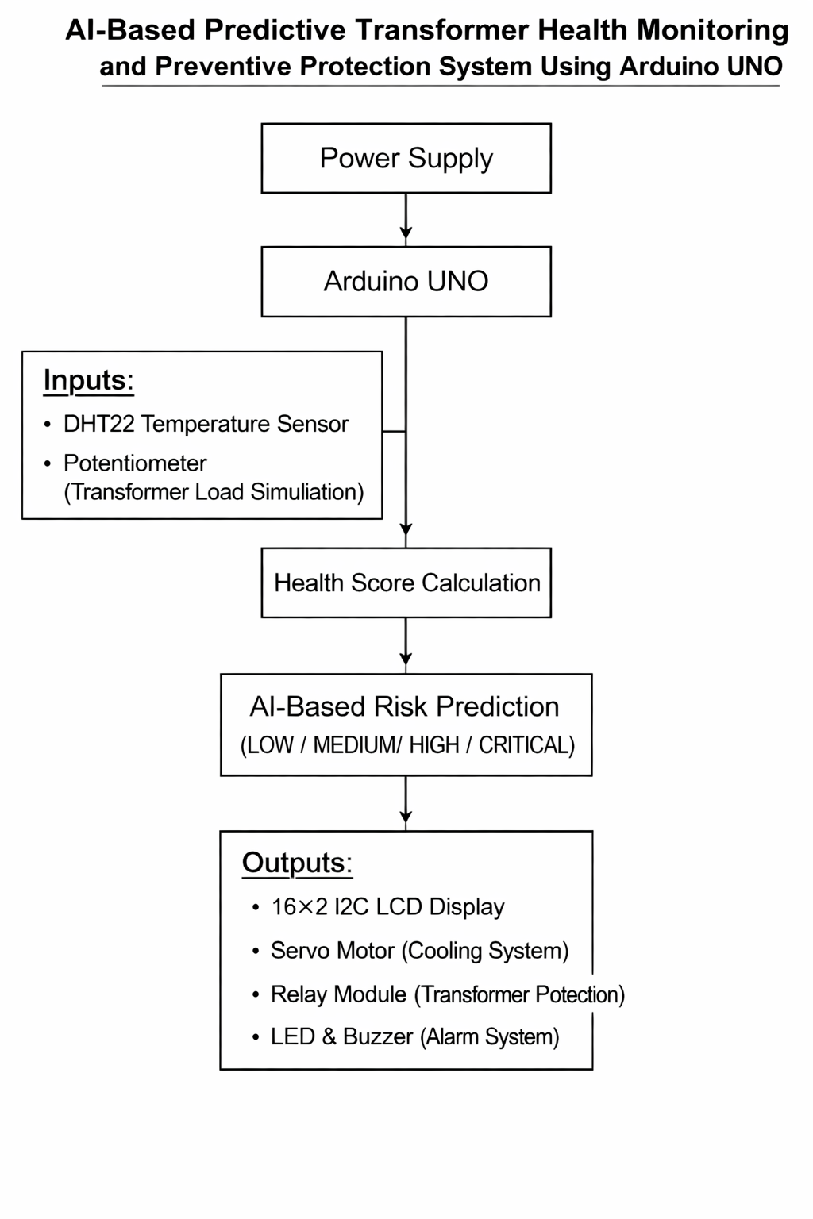
Block Diagram
Fig 4.1 : Block Diagram of the Proposed System
9

Slide 10
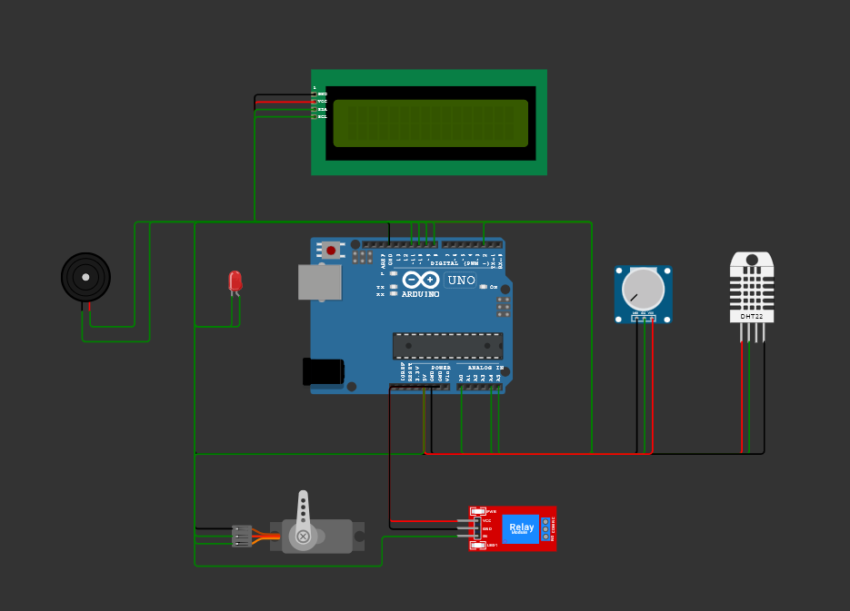
Circuit Diagram
Pin Configuration
Component | Pin
DHT22 Data | D2
Potentiometer | A0
LCD SDA / SCL | A4 / A5
Servo Signal | D10
Relay Control | D11
LED | D8
Buzzer | D9
Fig 5.1 : Circuit Diagram (redrawn from simulation circuit)
10

Slide 11
Working Principle
Sensors are read every one second by the Arduino
Health score is calculated from temperature and load
Risk level is classified based on the health score
Cooling fan (servo) is activated above 45°C
Relay disconnects supply when condition is CRITICAL
LCD dashboard refreshes every three seconds
11

Slide 12
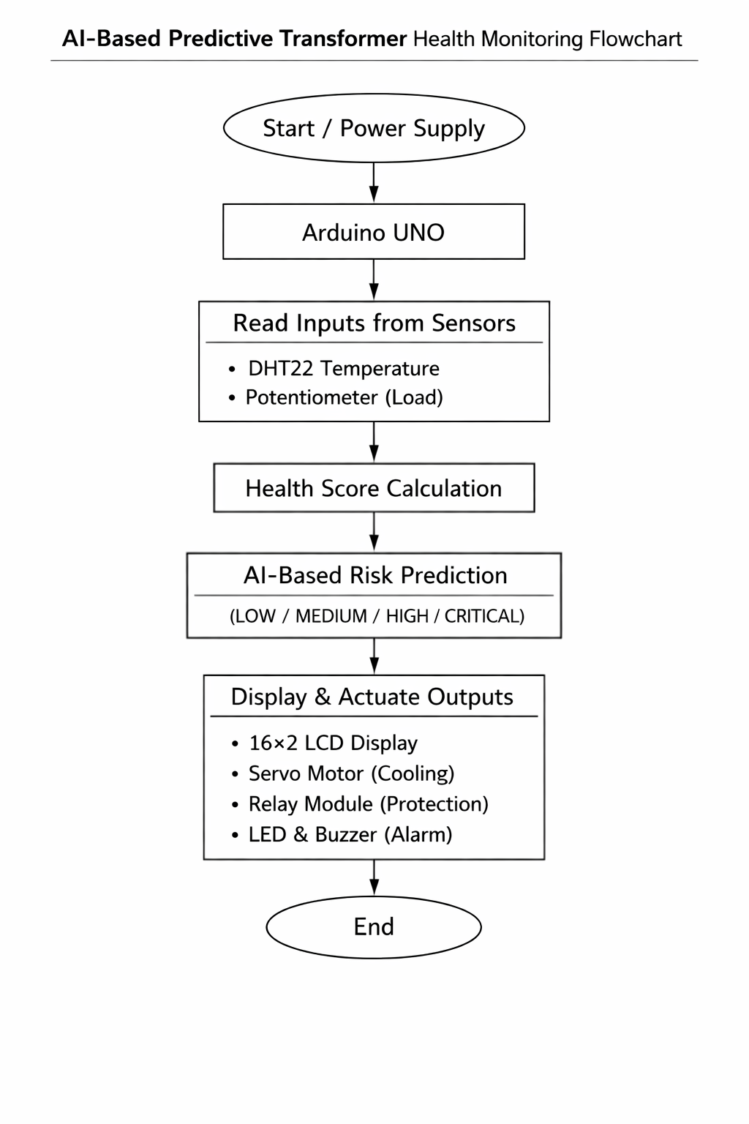
Flowchart
Fig 4.2 : Flowchart of System Operation
12

Slide 13
Health Score Calculation
Base health score starts at 100
Penalty applied when temperature is above 40°C
Penalty applied when load is above 75%
Health Score = 100 − Temperature Penalty − Load Penalty
Failure Probability = 100 − Health Score
Remaining Life = (Health Score ÷ 100) × 15 years
13

Slide 14
Risk Classification
Risk Level | Health Score Range
LOW | 80 and above
MEDIUM | 50 to 79
HIGH | 25 to 49
CRITICAL | Below 25
Higher risk level indicates greater chance of transformer failure.
14

Slide 15
Simulation Results
LCD Normal — Test Case 1
LCD Status
Health: 100%
Temp: 27.3 C
Risk: LOW
Load: 39.3%
LCD Prediction
LCD Critical — Test Case 4
Rem.Life: 15.0Yr
Health: 10%
Failure: 0%
Risk: CRITICAL
Tested under four conditions — cooling, relay and alert response verified.
15

Slide 16
Advantages
Combines temperature and load for better accuracy
Graded risk levels instead of a single alarm
Early warning through failure probability estimate
Automatic cooling and protective action
Low-cost and simple to build
Maintains a fault history for maintenance
16

Slide 17
Applications
Small and medium distribution substations
Industrial transformers
Educational laboratories
Rural and remote installations
17

Slide 18
Future Scope
Use an actual current sensor for real load measurement
Add ESP32 for IoT-based remote monitoring
Cloud-based data logging of health trends
Mobile application for real-time alerts
Machine learning based failure prediction
18

Slide 19
Conclusion
System was successfully designed and simulated
Health score based prediction was achieved
All four risk levels were tested successfully
Cooling and protection worked as expected
Provides a base for future development
Suitable for educational demonstrations and low-cost transformer monitoring applications.
19

Slide 20
Thank You
Presented by
Karthikeyan M
Register No: 723723105010
20

