Slide 1

EDUDROPOUT PREDICTOR
EARLY IDENTIFICATION OF STUDENTS AT RISK
SRM INSTITUTE OF SCIENCE AND TECHNOLOGY
AIML -A
S K KARTHIKESH
SEENU C

Slide 2
PROBLEM STATEMENT
Student dropout is a major issue in the education system, affecting both individual students and society as a whole. Many students leave school due to factors such as poor academic performance, lack of proper study habits, and high absenteeism. Traditional methods of identifying at-risk students are often ineffective and delayed, which makes it difficult to take timely action. Therefore, there is a need for a data-driven predictive system that can identify students at risk of dropping out at an early stage.

Slide 3
OBJECTIVE
The main objective of this project is to predict students who are at risk of dropping out using machine learning techniques. The project aims to analyze academic and behavioral factors such as study time, attendance, and performance. By building a predictive model, the system helps in early identification of at-risk students and enables timely intervention to improve student retention and academic outcomes.

Slide 4
DATASET
The dataset used in this project is the Student Performance Dataset obtained from Kaggle. It consists of approximately 649 student records with more than 30 features. The dataset includes academic data such as grades and study time, behavioral data such as absences, and socio-economic data such as family background. A new target variable called “dropout” is created based on the final grade (G3) to classify students as at risk or not at risk.

Slide 5
DATA PREPROCESSING
Data preprocessing is an essential step in preparing the dataset for machine learning. In this project, unnecessary columns such as G1 and G2 were removed to reduce redundancy. A new column called “dropout” was created to define the target variable. Categorical data was converted into numerical format using encoding techniques, and the dataset was cleaned and structured properly. These steps help improve the quality of data and enhance the performance of the model
Data preprocessing is an important step before applying machine learning
Removed unnecessary columns like G1 and G2 to avoid redundancy
Created a new column called “dropout” as the target variable
Converted categorical data (text values) into numerical format using encoding
Cleaned the dataset by organizing and structuring the data properly
These steps improve data quality and help the model perform better

Slide 6
VISUALIZATION
Various graphs were created to understand the relationship between different features and dropout risk. The dropout distribution graph shows that most students are not at risk, while a smaller portion falls into the at-risk category. The study time versus dropout graph indicates that students with lower study time are more likely to drop out. The absences graph shows that higher absenteeism increases dropout risk. The correlation heatmap helps in identifying relationships between different features in the dataset . There are four graphs for this project i.e Dropout Distribution , Study Time vs Dropout , Absences vs Dropout , Correlation Heatmap

Slide 7
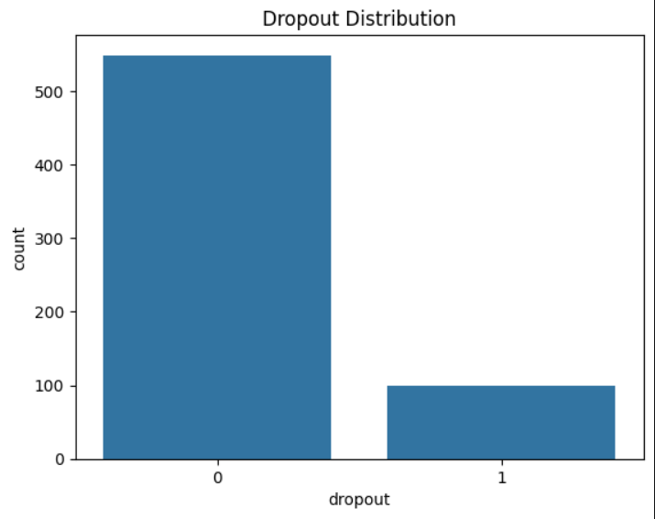
DROPOUT DISTRIBUTION
Shows the number of students in each category (At Risk vs Not At Risk)
Most students are not at risk of dropout
Only a small number of students fall into the at-risk category
Indicates that the dataset is slightly imbalanced

Slide 8
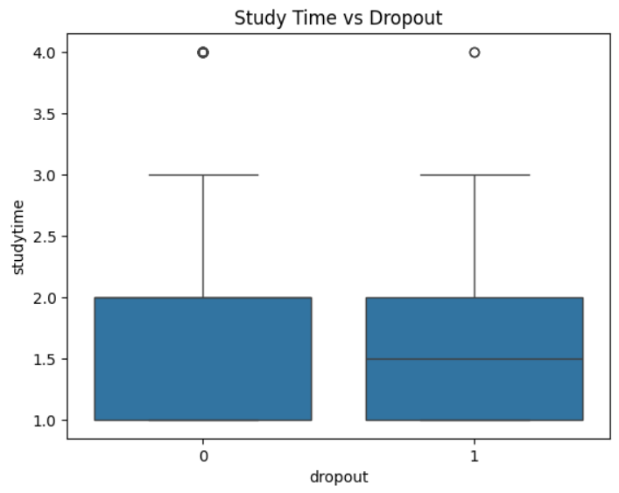
STUDY TIME VS DROPOUT
Shows relationship between study time and dropout risk
Students with lower study time are more likely to drop out
Students who study more are less likely to be at risk
Highlights the importance of consistent study habits

Slide 9
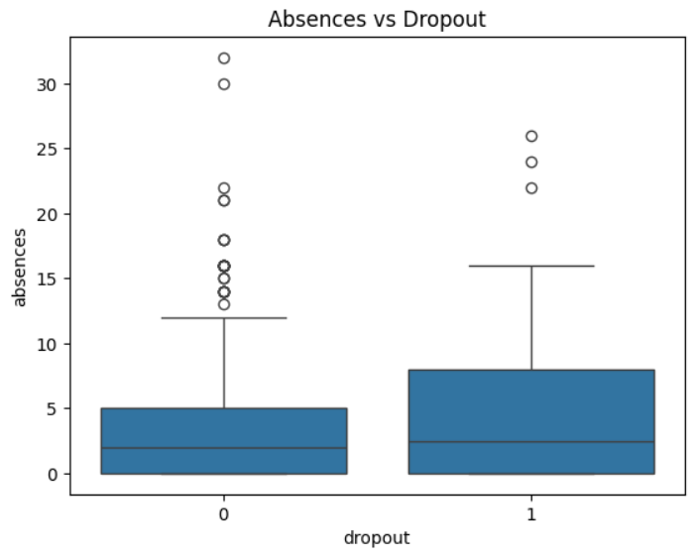
ABSENCES VS DROPOUT
Shows relationship between attendance and dropout risk
Students with higher absences are more likely to drop out
Frequent absence leads to poor academic performance
Emphasizes the importance of regular attendance

Slide 10
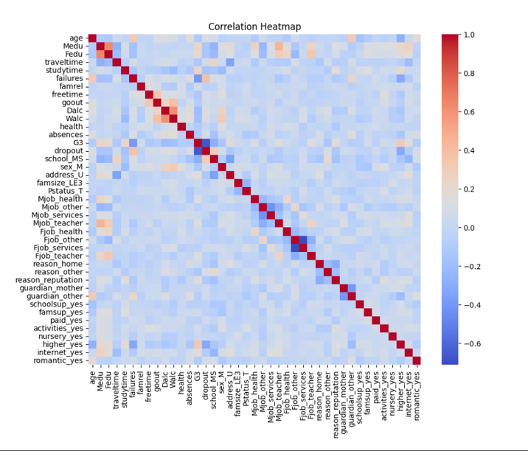
CORRELATION HEATMAP
Shows relationships between different features in the dataset
Helps identify which variables are strongly related
Academic features like grades show strong correlation
Useful for feature selection in model building

Slide 11
MODEL
In this project, Logistic Regression was used as the machine learning model to predict student dropout. It is a binary classification algorithm that is simple, efficient, and suitable for this type of problem. The dataset was divided into training and testing sets in an 80:20 ratio. The model learns patterns from the training data and predicts whether a student is at risk of dropping out based on input features.

Slide 12
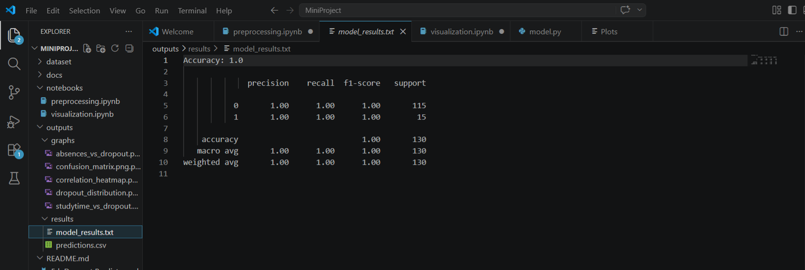
RESULT
The model achieved high accuracy in predicting student dropout risk. Performance metrics such as precision, recall, and F1-score indicate that the model performs well in classifying both at-risk and non-risk students. The confusion matrix further shows that most predictions are correct, with very few errors. This demonstrates that the model is effective in identifying students who may require early intervention

Slide 13
CONCLUSION
In conclusion, this project successfully demonstrates how machine learning can be used to predict student dropout risk. The analysis shows that study time and absences are key factors influencing student performance. The Logistic Regression model provides accurate predictions and can help educational institutions take proactive measures to support students. Overall, this project highlights the importance of data-driven decision-making in improving education outcomes.

