Slide 1

OPEN-EASE
Case Study by
Karthic – 2022118
Bharat – 2022122

Slide 2
Open-EASE
OpenEASE - a web-based knowledge service providing robot and human activity data.
contains semantically annotated data of manipulation actions,
  the environment the agent is acting in,
  the objects it manipulates,
  the task it performs, and
  the behavior it generates.
The episode representations can include images captured by the robot,
other sensor datastreams as well as full-body poses.
Based on the data and using the inference tools robots can answer queries regarding to
what they did, why, how, what happened, and what they saw.
openEASE can be used by humans using a browser-based query and visualization interface, but also remotely by robots via a WebSocket API.

Slide 3
Robotics Enabling Fully‐Integrated Logistics Lines for Supermarkets — REFILLS
While online grocery stores are expanding,
supermarkets continue to provide customers with the sensory experience of choosing goods while walking between display shelves.
Ref: http://www.refills-project.eu/

Slide 4
Dataset
The Kuka KMR-IIWA was used to create a semantic store map
of the retail lab at the University Bremen.
The robot is equipped with 2 cameras,
  one high resolution rgb and
  one rgbd camera
The episodes contain the poses of all 19 shelf frames.
For four of these shelves, the shelf monitoring was executed, where shelf layers, product labels, separators and number of products in facings were detected.
This experiment was repeated to create three episodes in total.
The software used is available on github:
https://github.com/refills-project

Slide 5
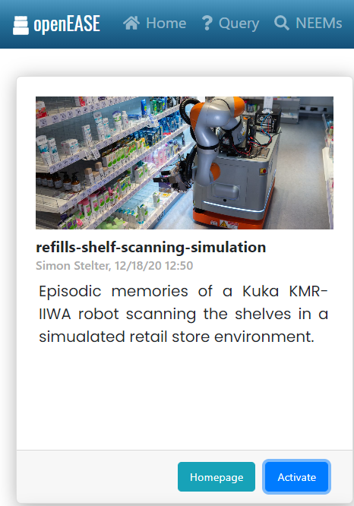
Explanation using Website
https://data.open-ease.org/QA

Slide 6
References:
Open-EASE : http://www.open-ease.org/
NEEM - Narrative-Enabled Episodic Memories http://data.open-ease.org/neems
https://github.com/KarthicAnnadurai/AI_CaseStudy
Simulation – Youtube Videos
  * [Autonomous and collaborative shelf-filling](https://youtu.be/a1i7BI1_9ak)
  * [Autonomous acquisition of semantic store maps](https://youtu.be/pIJGdvPnCmg)
  * [Fine manipulation for autonomous shelf replenishment](https://youtu.be/ad3i1R4m6R4)
  * [Autonomous shelf replenishment with mobile robot](https://youtu.be/UQHlDBVskAg)

Slide 7


