Slide 1

MYCIN – An Expert System
Case Study by
Karthic – 2022118
Bharat – 2022122

Slide 2
Expert System
Computer program designed to
solve complex problems
provide decision-making ability like a human expert
It performs this by extracting knowledge from its knowledge base
using the reasoning and inference rules according to the user queries.
One of the popular example of Expert System is Mycin.

Slide 3
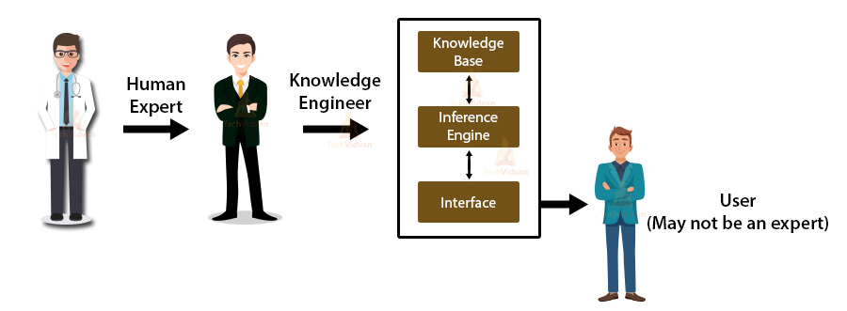
Components of Expert System
An expert system mainly consists of three components:
User Interface
Inference Engine
Knowledge Base
Ref:
https://techvidvan.com/tutorials/expert-systems-in-ai/

Slide 4
Components of Expert System
User Interface:
To help a non-expert user to communicate with the expert system to find a solution.
Inference Engine(Rules of Engine):
The brain of the expert system - the main processing unit of the system.
Applies inference rules to the knowledge base to derive a conclusion or deduce new information.
Helps in deriving an error-free solution of queries asked by the user.
Knowledge Base:
A type of storage that stores knowledge acquired from the different experts of the particular domain.
It is considered as big storage of knowledge.
The more the knowledge base, the more precise will be the Expert System.

Slide 5
What’s the Problem?
Diagnosing and treating patients with infectious blood diseases
Difficulties
  Time consuming
  Misuse and overuse of antibiotics
  Shortage of expertise
    System to help physicians

Slide 6
Why need an Expert System?
An expert was required to solve the problem.
Expert on the problem were scarce (or)
unavailable because of time constraints
Immediate expertise was needed
in a possibly life treating situation.
Time constraints required decisions to be made
with limited or inexact information.

Slide 7
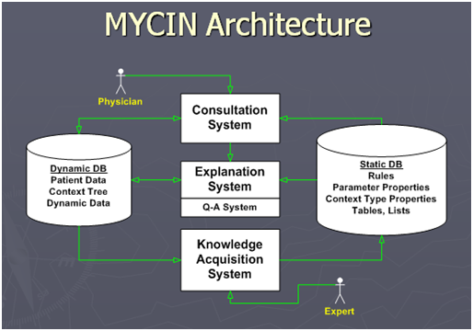
Ref: http://aimaterials.blogspot.com/p/mycin.html

Slide 8
Development of Expert System
Steps to build a MYCIN:
Firstly, ES should be fed with expert knowledge. In the case of MYCIN, human experts specialized in the medical field of bacterial infection, provide information about the causes, symptoms, and other knowledge in that domain.
The KB of the MYCIN is updated successfully. In order to test it, the doctor provides a new problem to it. The problem is to identify the presence of the bacteria by inputting the details of a patient, including the symptoms, current condition, and medical history.
The ES will need a questionnaire to be filled by the patient to know the general information about the patient, such as gender, age, etc.

Slide 9
Development of Expert System
Now the system has collected all the information, so it will find the solution for the problem by applying if-then rules using the inference engine and using the facts stored within the KB.
In the end, it will provide a response to the patient by using the user interface.

Slide 10
Advantages of Expert System
systems are highly reproducible.
can be used for risky places where the human presence is not safe.
Error possibilities are less if the KB contains correct knowledge.
The performance of these systems remains steady as it is not affected by
emotions, tension, or fatigue.
provides a very high speed response to a particular query.

Slide 11
Limitations of Expert System
The response of the expert system may get wrong,
if the knowledge base contains the wrong information.
Like a human being, it cannot produce a creative output for different scenarios.
Its maintenance and development costs are very high.
Knowledge acquisition for designing is much difficult.
For each domain, we require a specific ES, which is one of the big limitations.
It cannot learn from itself and hence requires manual updates.

Slide 12
MYCIN
An expert system for treating blood infections.
In 1972, work began on MYCIN at Stanford University in California.
MYCIN used about 500 to 600 production rules in its system.
MYCIN could also explain the reasoning that led to its diagnosis and recommendation.
It was written in LISP Programming language.
MYCIN is mainly a goal-directed system, using the backward chaining reasoning approach.

Slide 13
MYCIN Architecture
User Interface
Inference Engine
Knowledge Base
User
Human Expert
(Doctor)

Slide 14
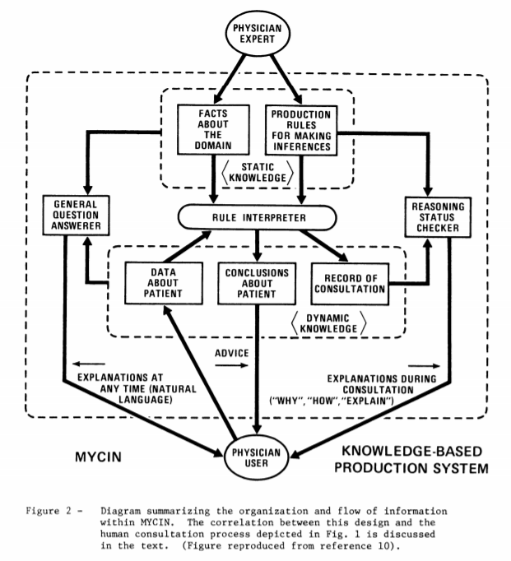

Ref:
Edward et al.
“Mycin: a knowledge-based computer program applied to infectious diseases”

Slide 15
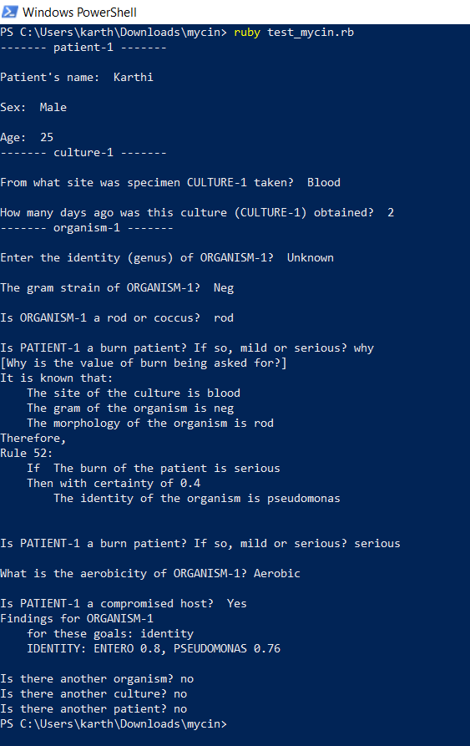

Slide 16
Knowledge Base of MYCIN
Knowledge Base consists of information in the form of facts.
Expert System uses these facts to make a decision.
The facts stored in the Knowledge base are collected from Domain Experts.
It consists of three components:
  Inferential Knowledge
  Static Knowledge
  Dynamic Knowledge

Slide 17
Inference Engine of MYCIN
Mycin uses Backward Chaining or a goal directed control strategy.
Goals + Rules = Facts
The Inference Engine acquires and manipulates the knowledge
from the Knowledge Base to arrive at a particular solution.

Slide 18
User Interface of MYCIN
Interaction between User and Expert System.
Uses Natural Language Processing.
Designed to adapt to user’s requirements.
Efficient use of inputs.
MYCIN uses Command Line Interface.

Slide 19
Practical Use
MYCIN was never actually used in practice.
Some observers raised ethical and legal issues related to the use of computers in medicine.
Research conducted at the Stanford Medical School found MYCIN received an acceptability rating of 65% on treatment plan from a panel of eight independent specialists.

Slide 20
Summary
Knowledge is Power
Easy modification of knowledge base
Separate knowledge from control
Inexact reasoning
Accommodate the user
Meta-rules
Report immediate important results
Only recommend the user!

Slide 21
Other Mycin’s
EMYCIN
  Empty MYCIN
  Large Amount of LISP Code
TMYCIN
  Tiny EMYCIN
  Only some features of EMYCIN
PUFF
  Based on EMYCIN
  Has knowledge of lung diseases
NEOMYCIN
  Base on MYCIN
  For teaching, in the laboratories

Slide 22
References:
Edward et al.
https://people.dbmi.columbia.edu/~ehs7001/Buchanan-Shortliffe-1984/MYCIN%20Book.htm
https://web.archive.org/web/20120110143239/http://lazax.com/software/Mycin/mycin.html
https://en.wikipedia.org/wiki/Mycin
https://github.com/KarthicAnnadurai/AI_Mycin_CaseStudy

Slide 23
