Slide 1
WARFARIN MODELING PROGRAM
Dose prediction, time-to-stability prediction, and continual model updates
This deck consolidates the full workflow: benchmarking dose prediction against the IWPC calculator, evaluating time-to-stability models, and testing repeated retraining on shifted incoming cohorts.
BEST DOSE MODEL
Our Model (Tuned LightGBM)
01
02
03
RMSE 11.90
Dosage Prediction
Time to Stability
Continual Updates
Stability RMSE 4.19d
Best model slightly outperforms the IWPC pharmacogenetic calculator on RMSE.
Current synthetic target remains nearly linear, so simple models hold up well.
Retraining on shifted batches recovers large amounts of lost accuracy.
Dose adaptation 18.0 -> 6.3
Combined summary for all three requested tasks
01

Slide 2
DOSE PREDICTION
Dose benchmarking against IWPC and baseline machine-learning models
rank | model | rmse | mae | r2 | within_20_pct
1 | Our Model (Tuned LightGBM) | 11.9034 | 8.7012 | 0.4209 | 41.9530
2 | IWPC Pharmacogenetic Calculator | 11.9198 | 8.6526 | 0.4193 | 41.6817
3 | Linear Regression | 11.9238 | 8.7364 | 0.4190 | 41.3201
4 | Neural Network | 12.0937 | 8.8810 | 0.4023 | 41.5009
5 | XGBoost | 12.2332 | 8.8270 | 0.3884 | 41.4105
6 | Random Forest | 13.0928 | 9.5326 | 0.2994 | 39.6022
7 | IWPC Clinical Formula | 13.8394 | 10.0696 | 0.2173 | 35.6239
TOP FINDING
Our Model (Tuned LightGBM)
RMSE 11.90, MAE 8.70, R² 0.421
IWPC PGx RMSE 11.92, MAE 8.65
TOP SHAP FEATURES
VKORC1 A/A
4.292
VKORC1 G/G
3.202
Weight kg
3.053
Age Decades
3.011
CYP2C9 *1/*1
1.855
Height cm
1.021
Dose prediction on the IWPC cohort
02

Slide 3
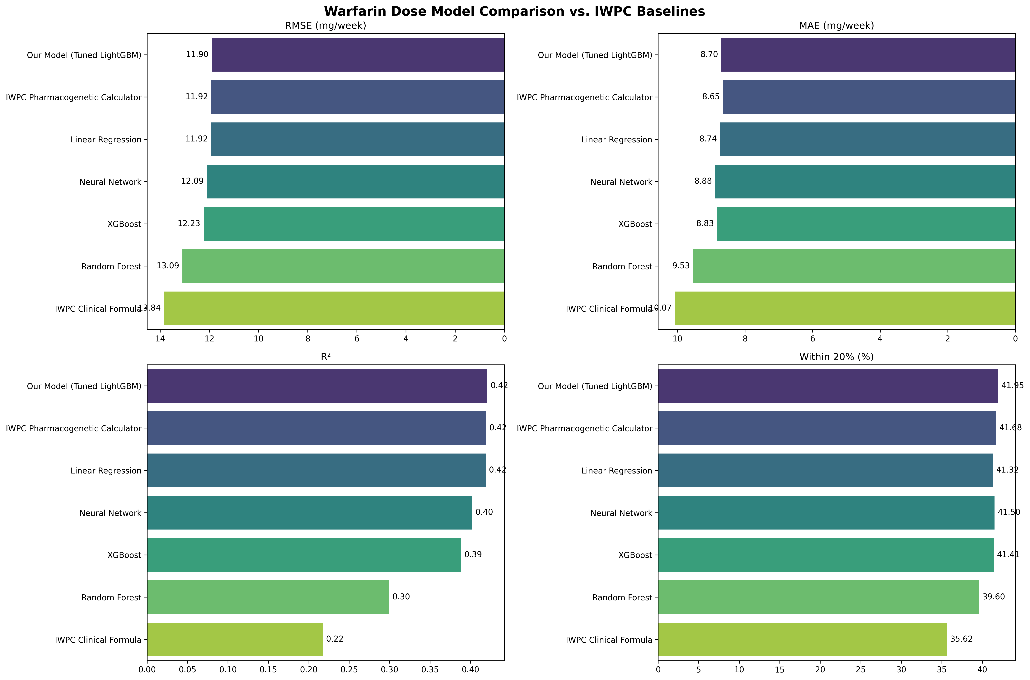
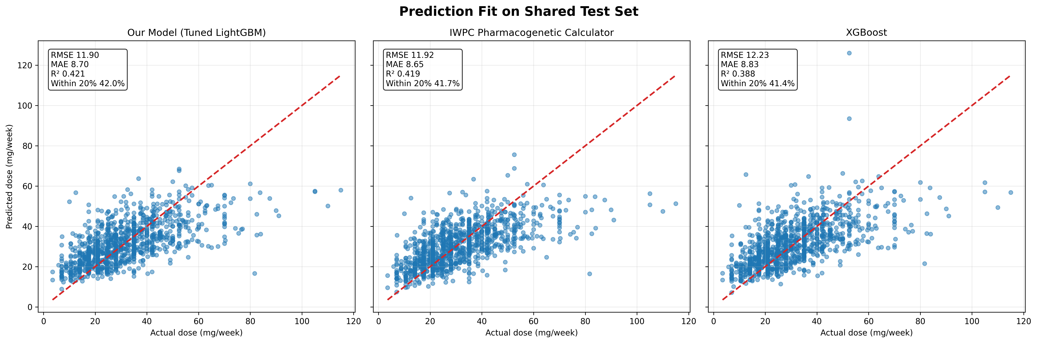
DOSE VISUALS
Leaderboard and fit diagnostics stay tightly clustered at the top
Dose comparison and patient-level fit
03

Slide 4
TIME TO STABILITY
The synthetic stability target is comparatively linear
rank | model | rmse | mae | r2 | within_7_days_pct
1 | Linear Regression | 4.1890 | 3.3222 | 0.1317 | 89.6000
2 | Neural Network | 4.1973 | 3.3245 | 0.1283 | 90.0000
3 | XGBoost | 4.2381 | 3.3537 | 0.1112 | 90.2000
4 | LightGBM | 4.2452 | 3.3213 | 0.1083 | 90.6000
5 | Random Forest | 4.2930 | 3.3777 | 0.0881 | 89.2000
BEST MODEL
Linear Regression
RMSE 4.19 days, MAE 3.32, within 7 days 89.6%
TOP SHAP FEATURES
CYP2C9 *1/*1
0.872
VKORC1 GG
0.544
Renal Function
0.373
Height
0.310
VKORC1 AA
0.271
VKORC1 GA
0.200
Time-to-stability comparison on the synthetic cohort
04

Slide 5
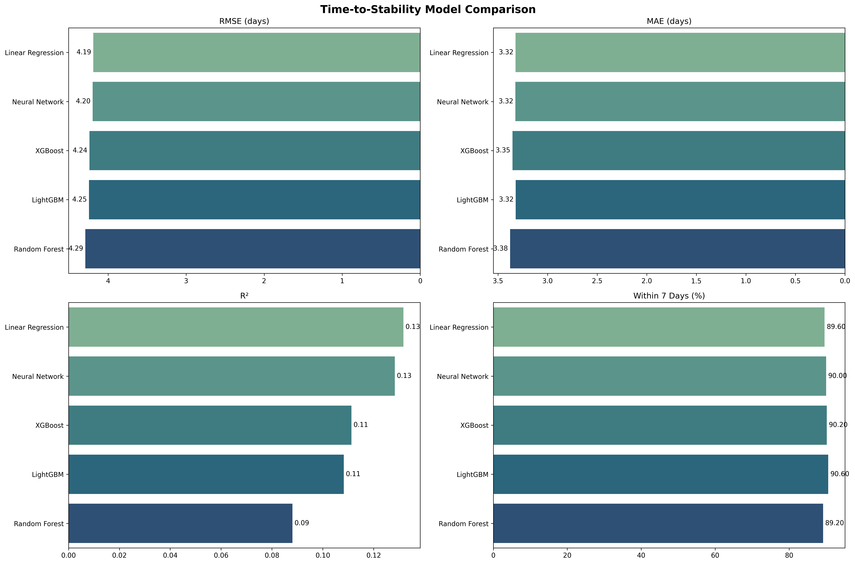
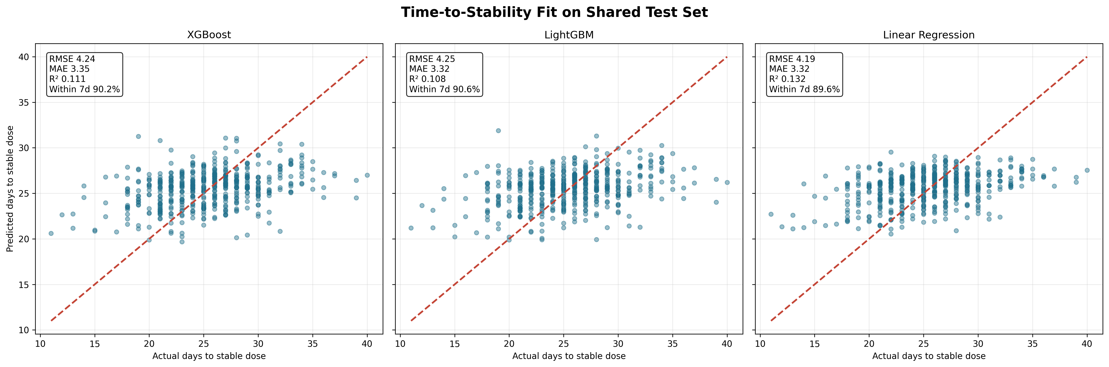
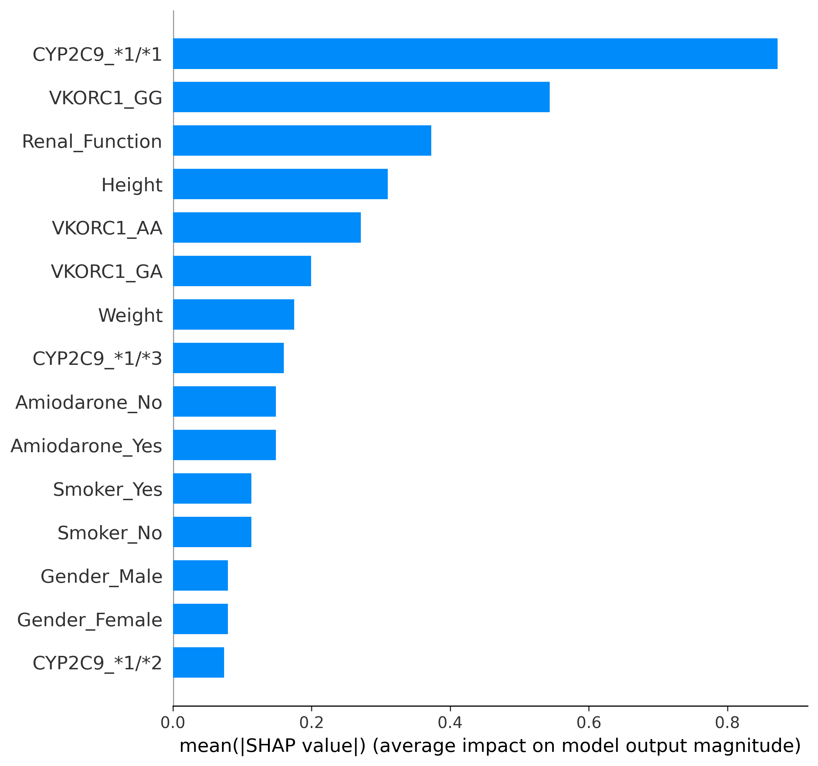
STABILITY VISUALS
Scatter fit and SHAP views support a simpler operational model
Stability leaderboard, fit, and explainability
05

Slide 6
CONTINUAL UPDATES
Sequential retraining on shifted incoming cohorts materially restores performance
round | train_size | dose_rmse | dose_within_20_pct | stability_rmse | stability_within_7_days_pct
Initial | 2500 | 17.9595 | 22.3333 | 11.4675 | 39.0000
Update 1 | 2800 | 7.8012 | 74.1667 | 6.2159 | 74.3333
Update 2 | 3100 | 6.8023 | 81.6667 | 6.1223 | 75.3333
Update 3 | 3400 | 6.2852 | 85.6667 | 6.0645 | 75.5000
DOSE ADAPTATION
RMSE 17.96 -> 6.29
Within 20% 22.3% -> 85.7%
STABILITY ADAPTATION
RMSE 11.47 -> 6.06
Within 7 days 39.0% -> 75.5%
Continual-update experiment on shifted incoming data
06

Slide 7
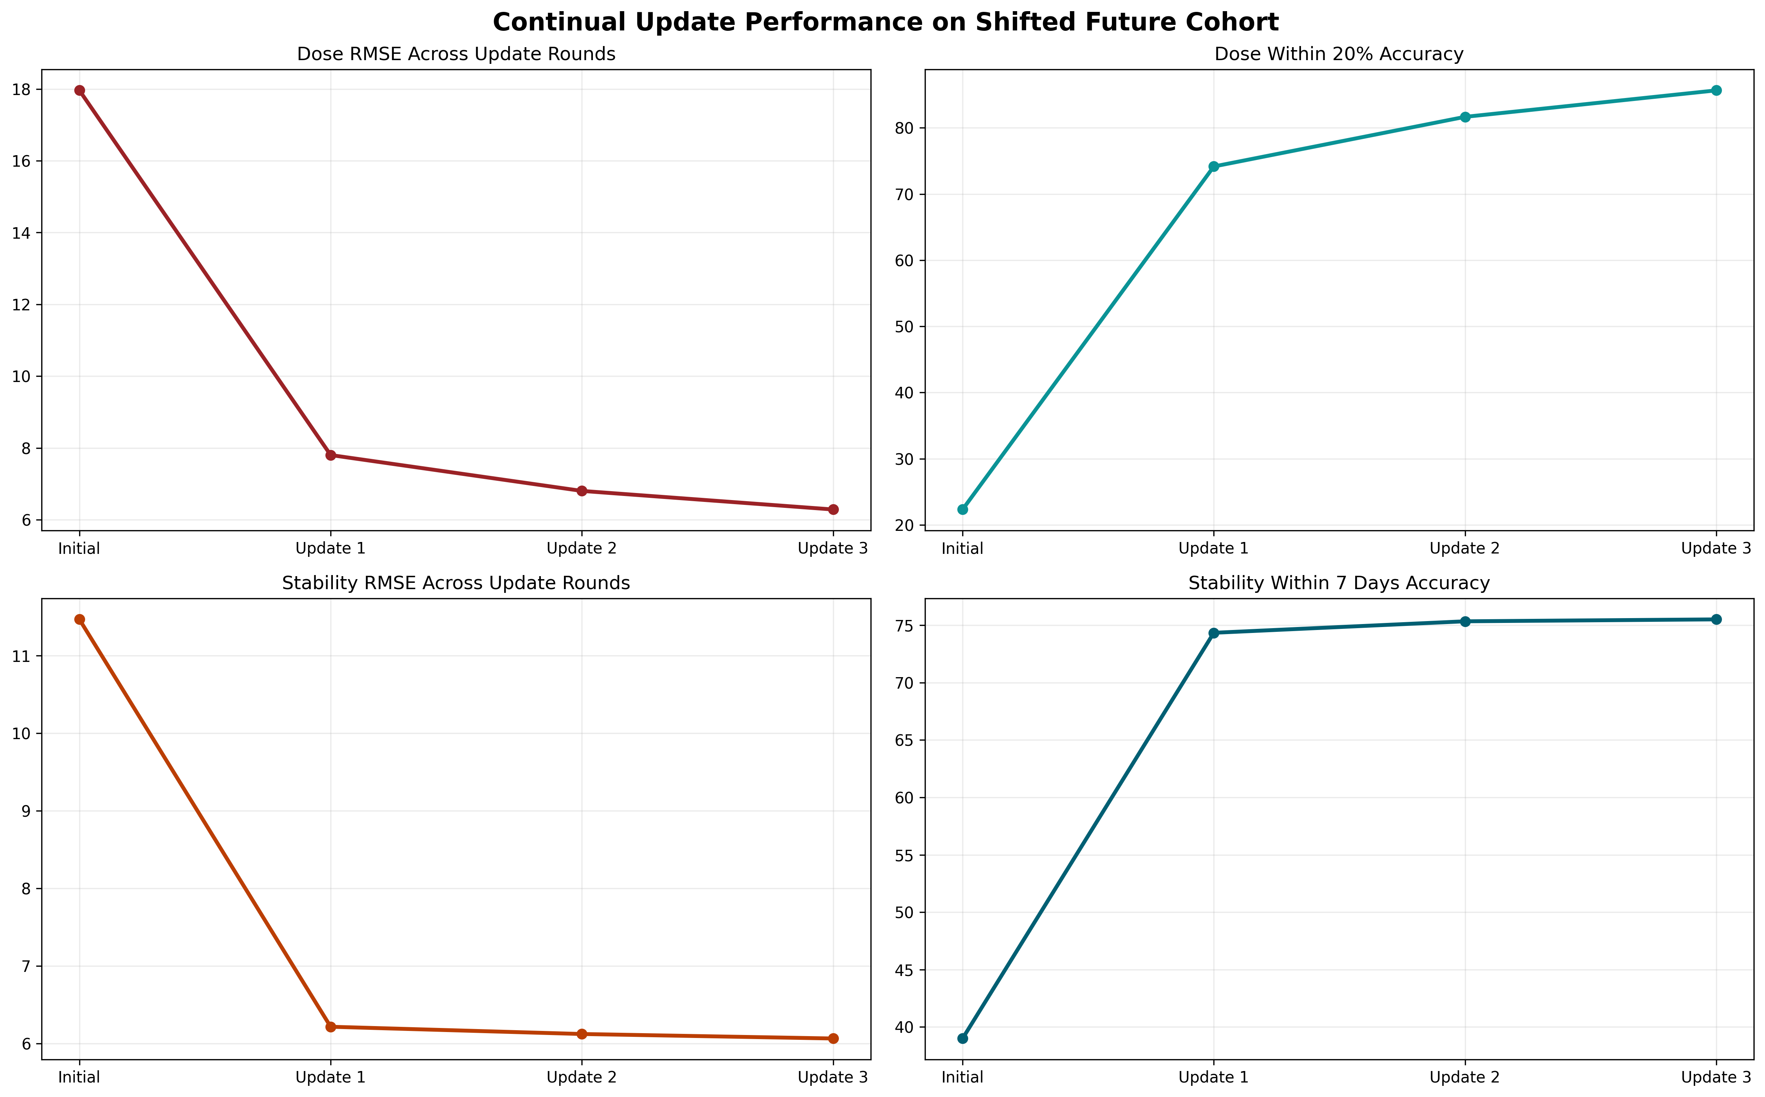
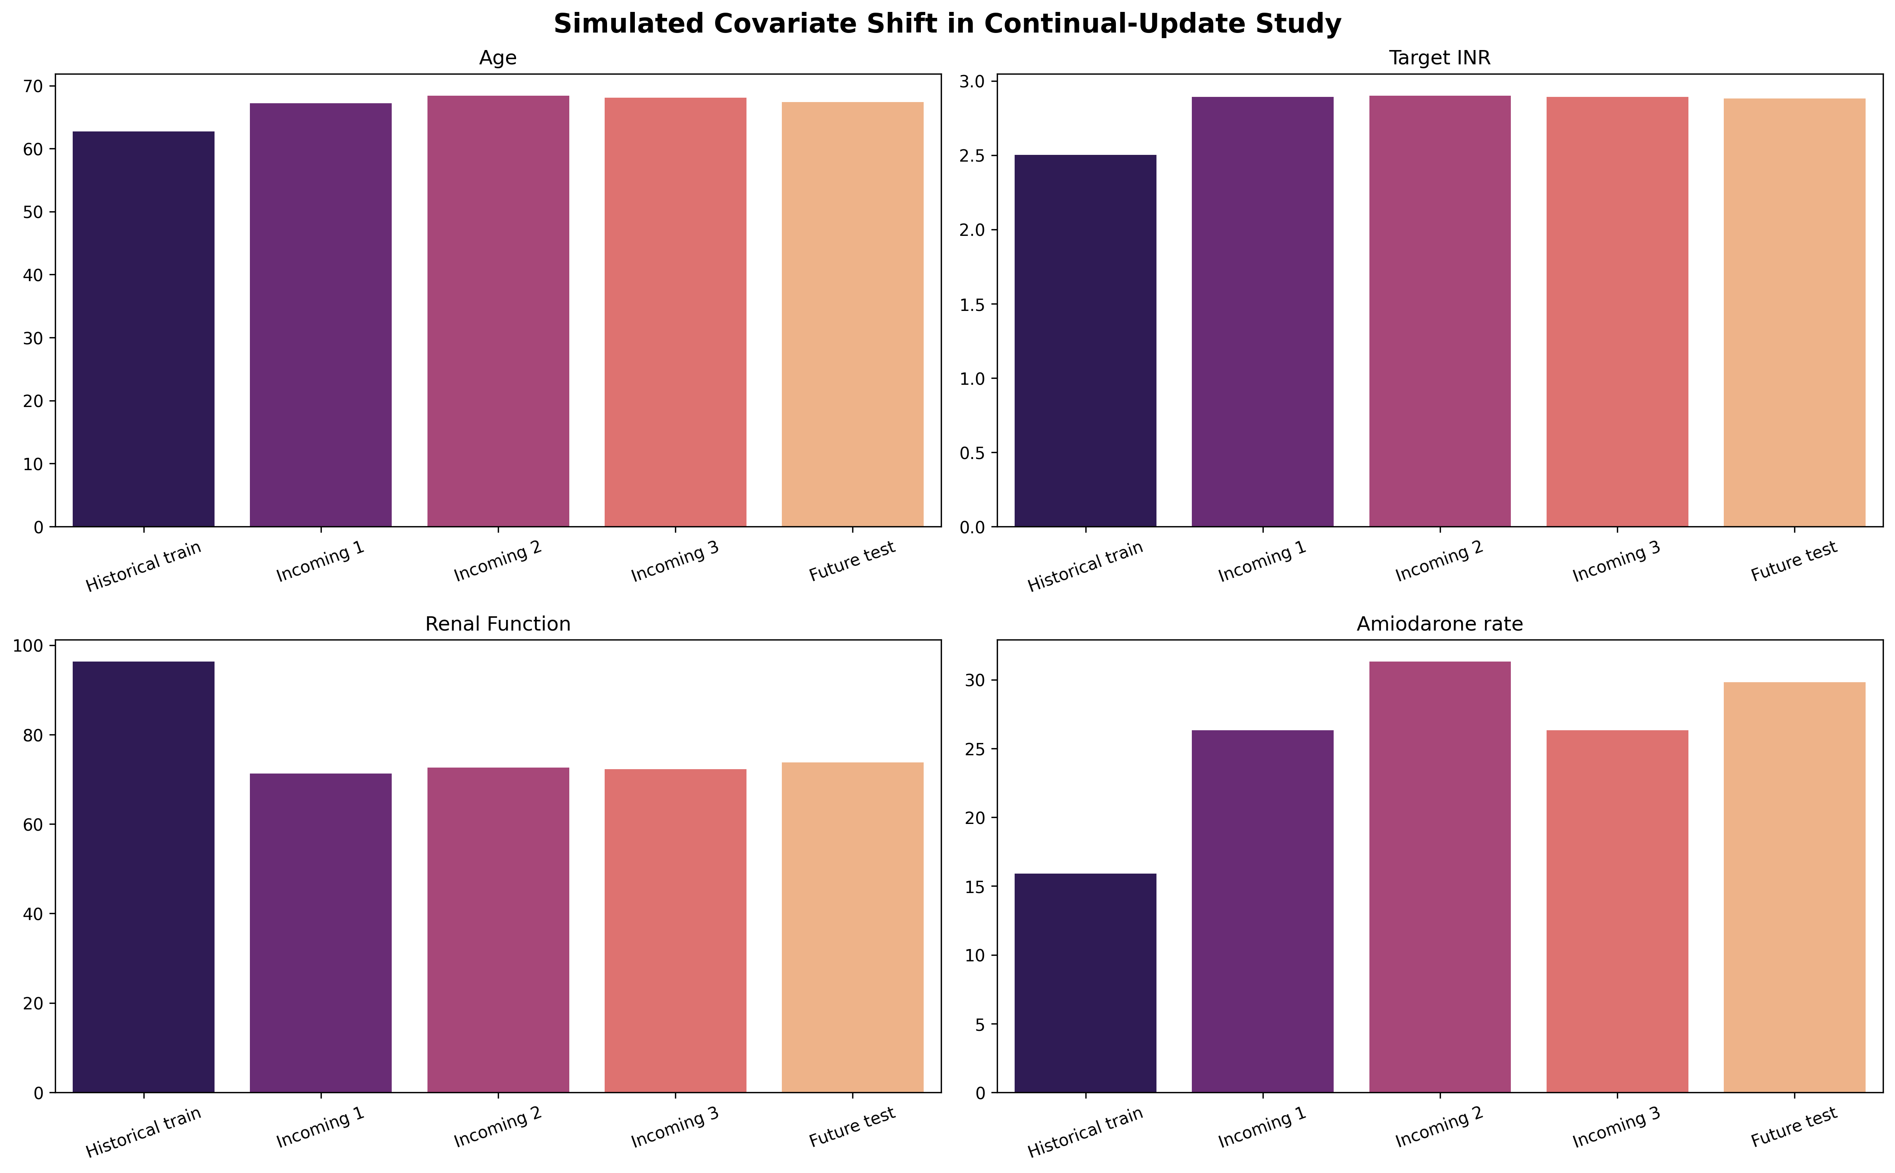
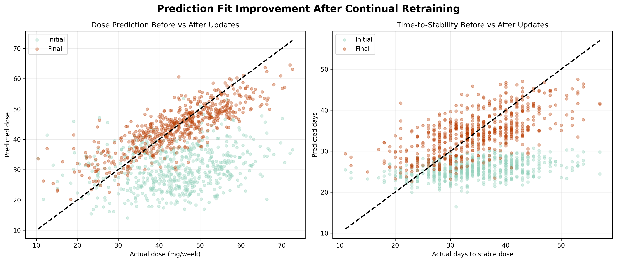
UPDATE VISUALS
The first update batch delivers the largest recovery, with smaller gains after that
Performance recovery, cohort shift, and pre/post fit
07

Slide 8
RECOMMENDATIONS
What to deploy, what to keep simple, and what to operationalize
Deploy for Dose
Keep Stability Simple
Operational Retraining
Use the tuned LightGBM dose model when the objective is best holdout accuracy against IWPC-style baselines.
Use the linear stability model unless a richer real-world target becomes available.
Schedule cumulative retraining when incoming cohorts diverge from the original patient mix.
MASTER REPORT
HTML DECK
PDF DECK
PPT DECK
docs/warfarin_full_program_report.md
docs/warfarin_program_slides.html
docs/warfarin_program_slides.pdf
docs/warfarin_program_slides.pptx
Final recommendations and artifact map
08

