Slide 1
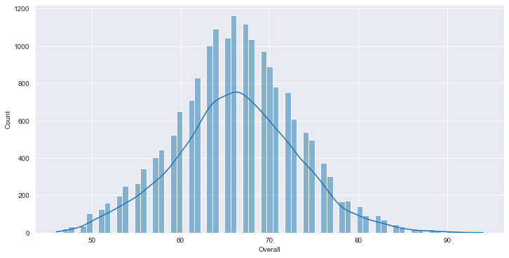
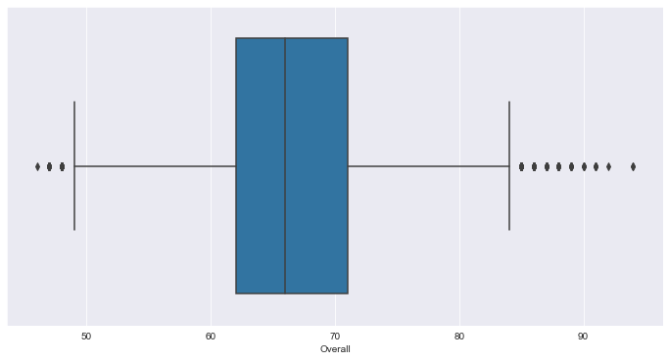
DISTRIBUTION OF “OVERALL” RATING FOR ALL PLAYERS
From the 2 plots, we can observe that there are very few players with Overall less than 50 or greater than 85, and only a handful with Overall more than 90.
The IQR for ‘Overall’ is around 65-75, hence the mid 50% lies in this range.

Slide 2
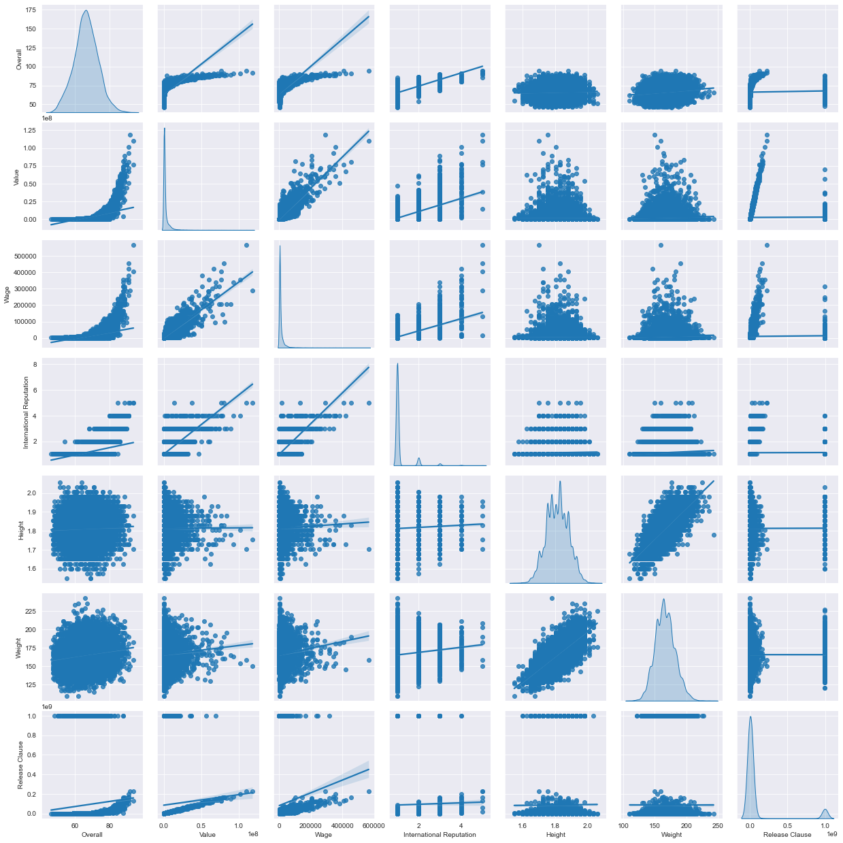
Dependency of Player Attributes :

Slide 3
The following inferences can be drawn by analysing the above pair-plots :
Attributes | Strong Dependency | Medium Dependency | No Correlation
Value | Overall | - | Height, Weight
Wage | Value | Overall, International Reputation | Height, Weight
International Reputation | Value | Overall | Height, Weight
Weight | Height | - | Others
Release Clause | Wage | Overall, Value, International Reputation | Height, Weight

Slide 4
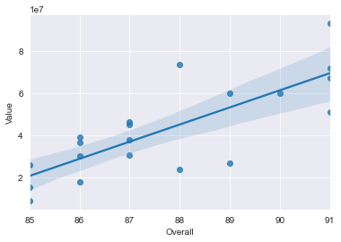
The Average Wage for top 20 players whose contract expires at 2020 is : €205440 euros.
The Average Age for top 20 players whose contract expires at 2020 is : 30.65 yrs.
The ‘Value’ of a Player has a strong positive correlation with his ‘Overall’ rating, with a correlation values of 0.78, the same is depicted in the below regression plot.

Slide 5
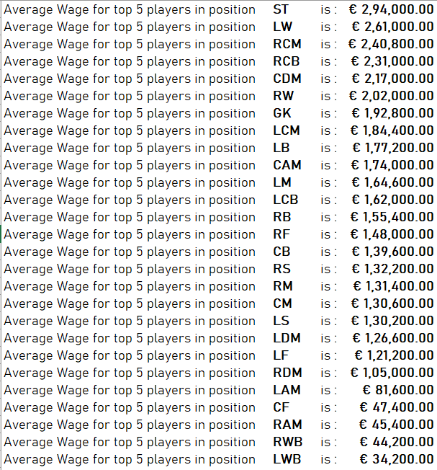
After grouping the players by their position, and analysing the top 5 players for each unique position we can infer:
There is no player who appears in the top 5 in more than one position. Top 5 players for each position are unique.
The average weekly wage for the top 5 players in each position is depicted in the displayed table.
We can infer that the strikers/forwards are paid the most and defenders and defensive midfields being the least paid.

