Slide 1
IBM Mobile Foundation on Bluemix Solution Architecture Pattern
Ajay Chebbi – Sr. Architect Mobile on Bluemix
Simon Wong – Technical Sales Leader

Slide 2
Please note
IBM’s statements regarding its plans, directions, and intent are subject to change or withdrawal without notice at IBM’s sole discretion.
Information regarding potential future products is intended to outline our general product direction and it should not be relied on in making a purchasing decision.
The information mentioned regarding potential future products is not a commitment, promise, or legal obligation to deliver any material, code or functionality. Information about potential future products may not be incorporated into any contract.
The development, release, and timing of any future features or functionality described for our products remains at our sole discretion.
Performance is based on measurements and projections using standard IBM benchmarks in a controlled environment. The actual throughput or performance that any user will experience will vary depending upon many factors, including considerations such as the amount of multiprogramming in the user’s job stream, the I/O configuration, the storage configuration, and the workload processed. Therefore, no assurance can be given that an individual user will achieve results similar to those stated here.

Slide 3
Mobile Foundation
(aka IBM MobileFirst platform Foundation)
Deployment patterns on Bluemix

Slide 4
Options for Mobile Foundation on Bluemix
BYOL Scripts | Mobile Foundation service
If you have On-prem license | If you want pay-go
Download from IBM Fix central | Bluemix catalog
Manually manage upgrades | On demand auto upgrades
Pay for Runtime and dashDB* | Pay for MF plan charges, runtime and dash DB**
*Because you already paid for the MF license
** dashDB not needed for “Developer” plan

Slide 5
What to use when
 | Dedicated/Local (Cloudant is added by default) | Public (Customer has paid for Cloudant) | Public
Lift and shift existing app | BYOL 7.1 + Cloudant | BYOL 7.1 + Cloudant | BYOL 7.1 + dashDB
Already has On prem license; new app | BYOL 7.1 + Cloudant | BYOL 7.1 + Cloudant | BYOL 7.1 + dashDB BYOL 8.0 + dashDB
New Bluemix implementation | BYOL 7.1 + Cloudant BYOL 8.0 + dashDB | BYOL 7.1 + Cloudant | MF Service + dashDB
 | MFP Server | Analytics server | Pay for
BYOL 7.1 | Container | Container | Runtime + DB
BYOL 8.0 | LBP | Container | Runtime + DB
MF Service | LBP | In Built | Runtime + DB + Plan
If Secure gateway is not an acceptable solution - Stay with Containers

Slide 6





Cloud Deployment pattern - I
Mobile Foundation
Bluemix

Slide 7






Cloud Deployment pattern - II
Bluemix
Mobile Foundation
Secure Gateway

Slide 8
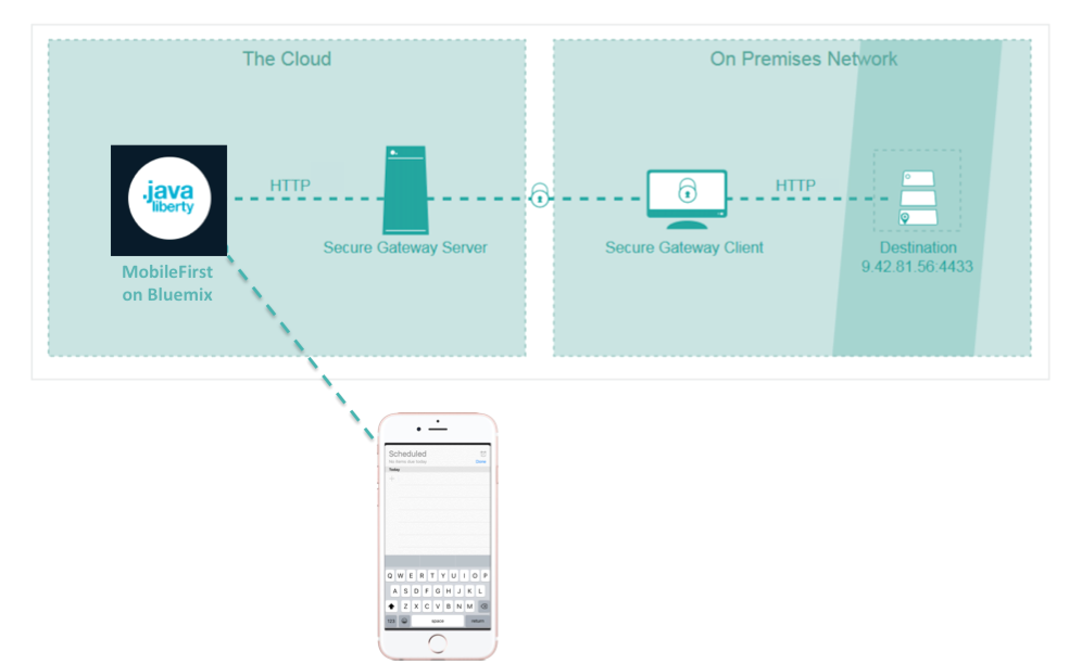
On prem connect: Secure gateway
Secure Gateway needs either Datapower or a gateway client running in the
customers On prem datacentre

Slide 9
On prem connect : VPN Service
VPNaaS can connect to any IPSec standard gateway
Available only with BYOL containers
Bluemix
VPN Service

Slide 10






Mobile Foundation Pricing calculation
Per GB-Hour
Mobile Foundation (Developer Pro and Professional per capacity)
Liberty for Java (for the Mobile Server)
Containers (for Analytics), optional
Per capacity
Storage for Analytics, optional
Secure gateway, optional
Per instance
DashDB
HTTP
HTTPS
myApp.mybluemix.net
…
Secure connection
On-premises
data center
Needs to be sized and priced

Slide 11
TPS drives production sizing
1 GB of Cloud Foundry Liberty for Java = 40 TPS (for a typical app – your mileage may vary)
Example: 2x2GB = 160 TPS
Tip: Use 2x2GB as a starting point – and then scale later
In average, Analytics requires x1.5 the size of the Mobile Server
Example: if the server is 2x2GB, Analytics requires 2x3GB
Production requires at least 2 nodes. More nodes → better availability
Note
TPS rate must be determined based on user interaction of the app
Concurrent users depend on multiple factors (session duration, frequency of transactions, etc.)

Slide 12
Lab instructions
Adapter compile and invoke

Slide 13
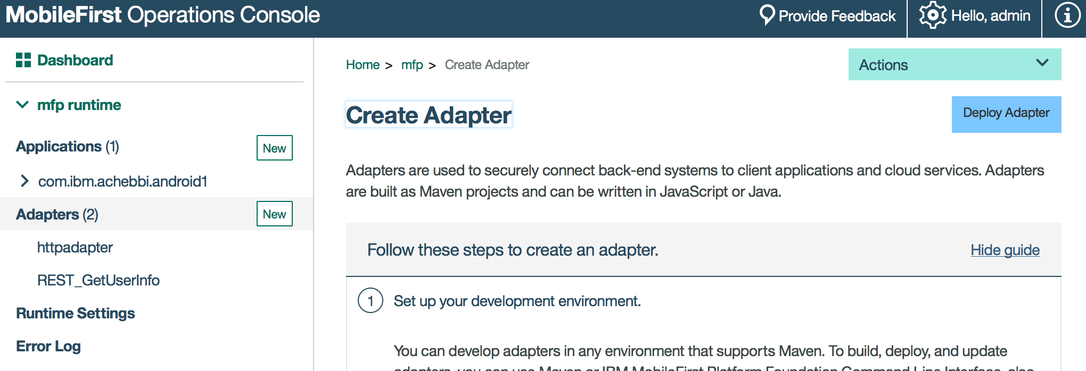
Steps
Create MF service on Bluemix
Build the adapter
>cd home/ibm/dev/workspaces/Interconnect/InterconnectAdapterServices/REST_GetUserInfo
>mvn install
This builds the adapter.In the target folder
Deploy

Slide 14
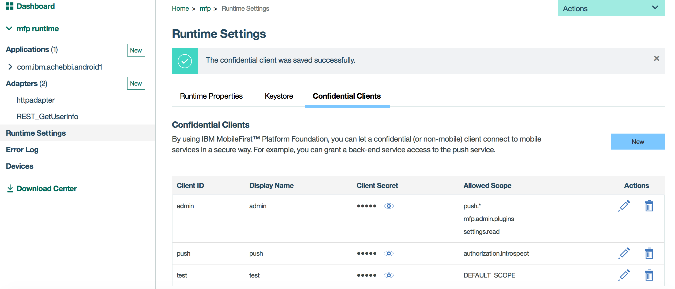
Steps
Normally you will use a challenge handler - but since we don’t have a app
Go to Console>Runtime Settings> Confidential clients
Create a client with DEFAULT_SCOPE

Slide 15
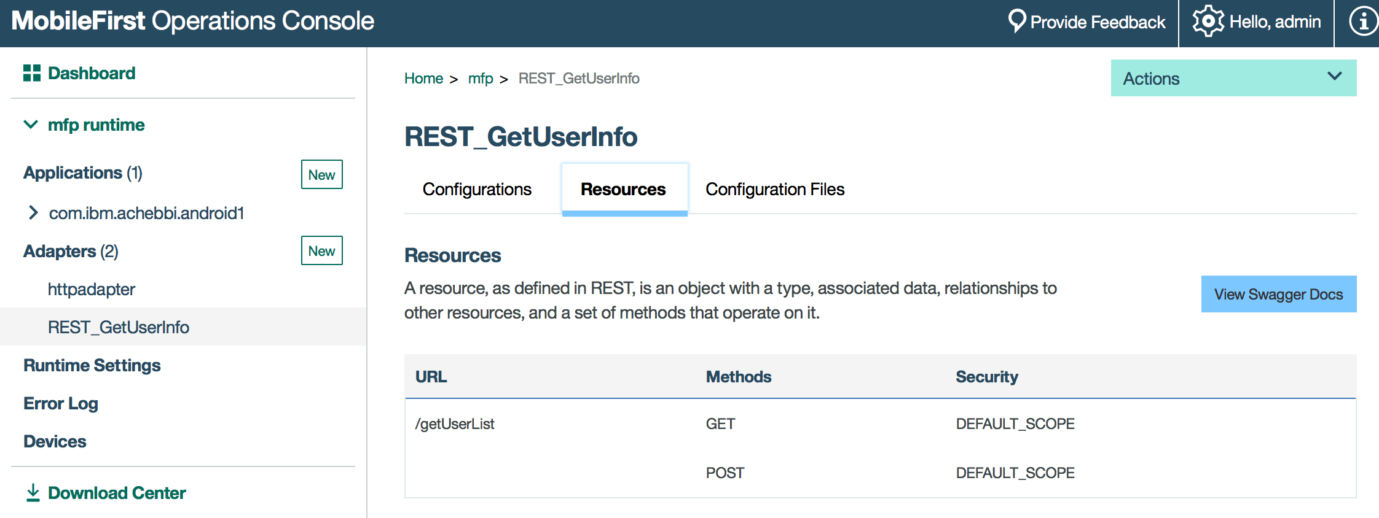
Steps
Call the adapter

Slide 16
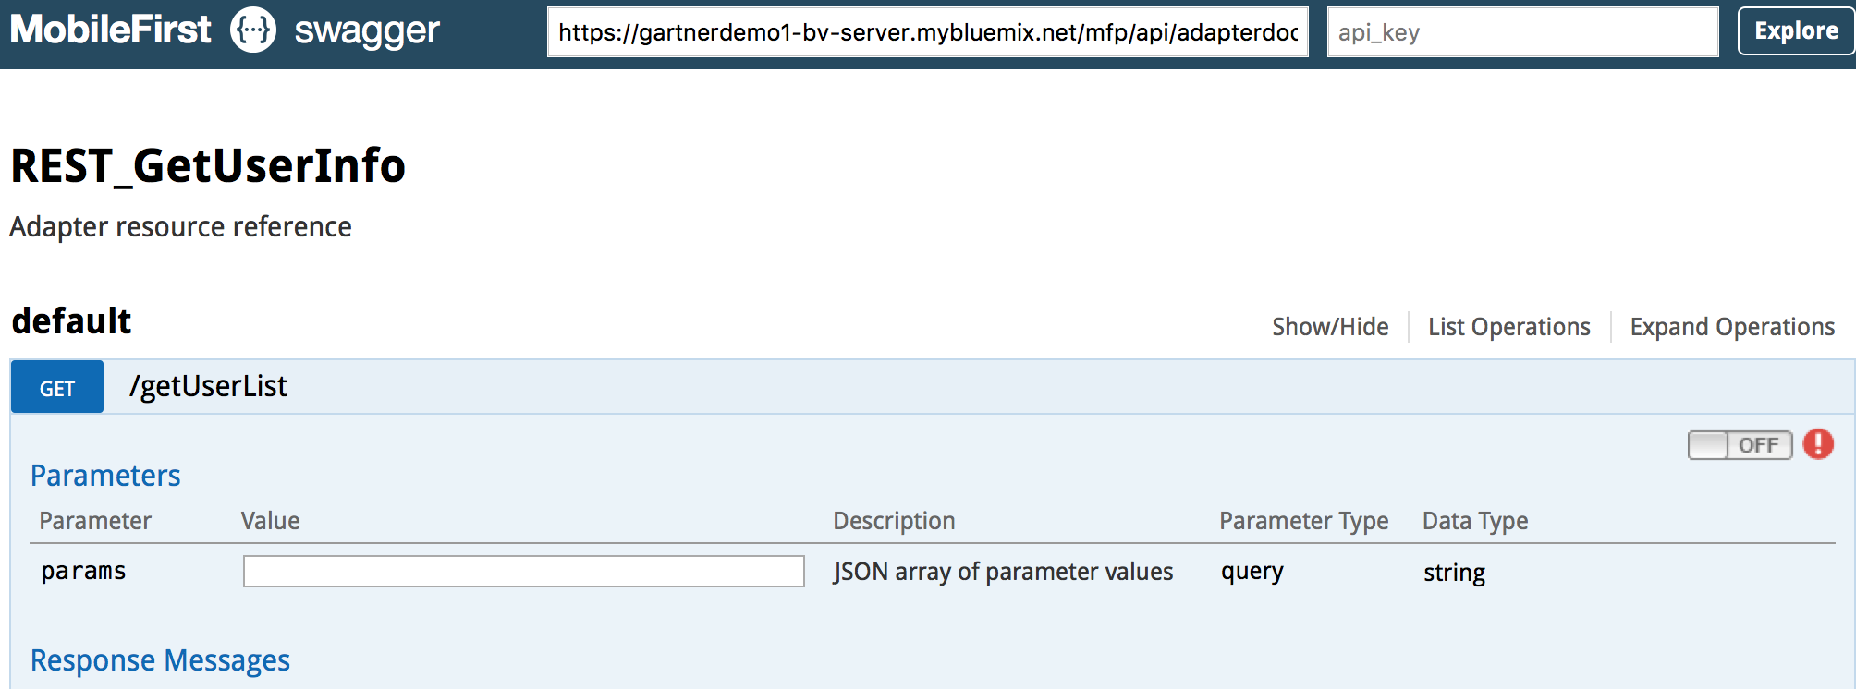
Steps
Authenticate using the confidential client

Slide 17
Notices and disclaimers
Copyright © 2017 by International Business Machines Corporation (IBM). No part of this document may be reproduced or transmitted in any form without written permission from IBM.
U.S. Government Users Restricted Rights — use, duplication or disclosure restricted by GSA ADP Schedule Contract with IBM.
Information in these presentations (including information relating to products that have not yet been announced by IBM) has been reviewed for accuracy as of the date of initial publication and could include unintentional technical or typographical errors. IBM shall have no responsibility to update this information. This document is distributed “as is” without any warranty, either express or implied. In no event shall IBM be liable for any damage arising from the use of this information, including but not limited to, loss of data, business interruption, loss of profit or loss of opportunity. IBM products and services are warranted according to the terms and conditions of the agreements under which they are provided.
IBM products are manufactured from new parts or new and used parts. In some cases, a product may not be new and may have been previously installed. Regardless, our warranty terms apply.”
Any statements regarding IBM's future direction, intent or product plans are subject to change or withdrawal without notice.
Performance data contained herein was generally obtained in a controlled, isolated environments. Customer examples are presented as illustrations of how those customers have used IBM products and the results they may have achieved. Actual performance, cost, savings or other results in other operating environments may vary.
References in this document to IBM products, programs, or services does not imply that IBM intends to make such products, programs or services available in all countries in which IBM operates or does business.
Workshops, sessions and associated materials may have been prepared by independent session speakers, and do not necessarily reflect the views of IBM. All materials and discussions are provided for informational purposes only, and are neither intended to, nor shall constitute legal or other guidance or advice to any individual participant or their specific situation.
It is the customer’s responsibility to insure its own compliance with legal requirements and to obtain advice of competent legal counsel as to the identification and interpretation of any relevant laws and regulatory requirements that may affect the customer’s business and any actions the customer may need to take to comply with such laws. IBM does not provide legal advice or represent or warrant that its services or products will ensure that the customer is in compliance with any law.

Slide 18
Notices and disclaimers continued
Information concerning non-IBM products was obtained from the suppliers of those products, their published announcements or other publicly available sources. IBM has not tested those products in connection with this publication and cannot confirm the accuracy of performance, compatibility or any other claims related to non-IBM products. Questions on the capabilities of non-IBM products should be addressed to the suppliers of those products. IBM does not warrant the quality of any third-party products, or the ability of any such third-party products to interoperate with IBM’s products. IBM expressly disclaims all warranties, expressed or implied, including but not limited to, the implied warranties of merchantability and fitness for a particular, purpose.
The provision of the information contained herein is not intended to, and does not, grant any right or license under any IBM patents, copyrights, trademarks or other intellectual property right.
IBM, the IBM logo, ibm.com, Aspera®, Bluemix, Blueworks Live, CICS, Clearcase, Cognos®, DOORS®, Emptoris®, Enterprise Document Management System™, FASP®, FileNet®, Global Business Services®, Global Technology Services®, IBM ExperienceOne™, IBM SmartCloud®, IBM Social Business®, Information on Demand, ILOG, Maximo®, MQIntegrator®, MQSeries®, Netcool®, OMEGAMON, OpenPower, PureAnalytics™, PureApplication®, pureCluster™, PureCoverage®, PureData®, PureExperience®, PureFlex®, pureQuery®, pureScale®, PureSystems®, QRadar®, Rational®, Rhapsody®, Smarter Commerce®, SoDA, SPSS, Sterling Commerce®, StoredIQ, Tealeaf®, Tivoli® Trusteer®, Unica®, urban{code}®, Watson, WebSphere®, Worklight®, X-Force® and System z® Z/OS, are trademarks of International Business Machines Corporation, registered in many jurisdictions worldwide. Other product and service names might be trademarks of IBM or other companies. A current list of IBM trademarks is available on the Web at "Copyright and trademark information" at: www.ibm.com/legal/copytrade.shtml.

