Slide 1
WEB TECHNOLOGY | INDIVIDUAL PROJECT
PIXEL FORGE STUDIO
A company website for a game studio, with visitor tracking and A/B testing
Karthick G | Roll No: 241001106

Slide 2
ABOUT THE PROJECT
Introduction
About
Pixel Forge Studio is a company profile website for a game studio that I made up. The site shows the studio, its games, team and jobs, and an admin panel is used to manage all of it.
Problem
Many company websites are just static pages. The owner cannot see how many people visit, which pages they open, or whether a change to a page helps.
What I built
The site records how visitors use it and runs an A/B test on a button, so the studio can see which version works better.

Slide 3
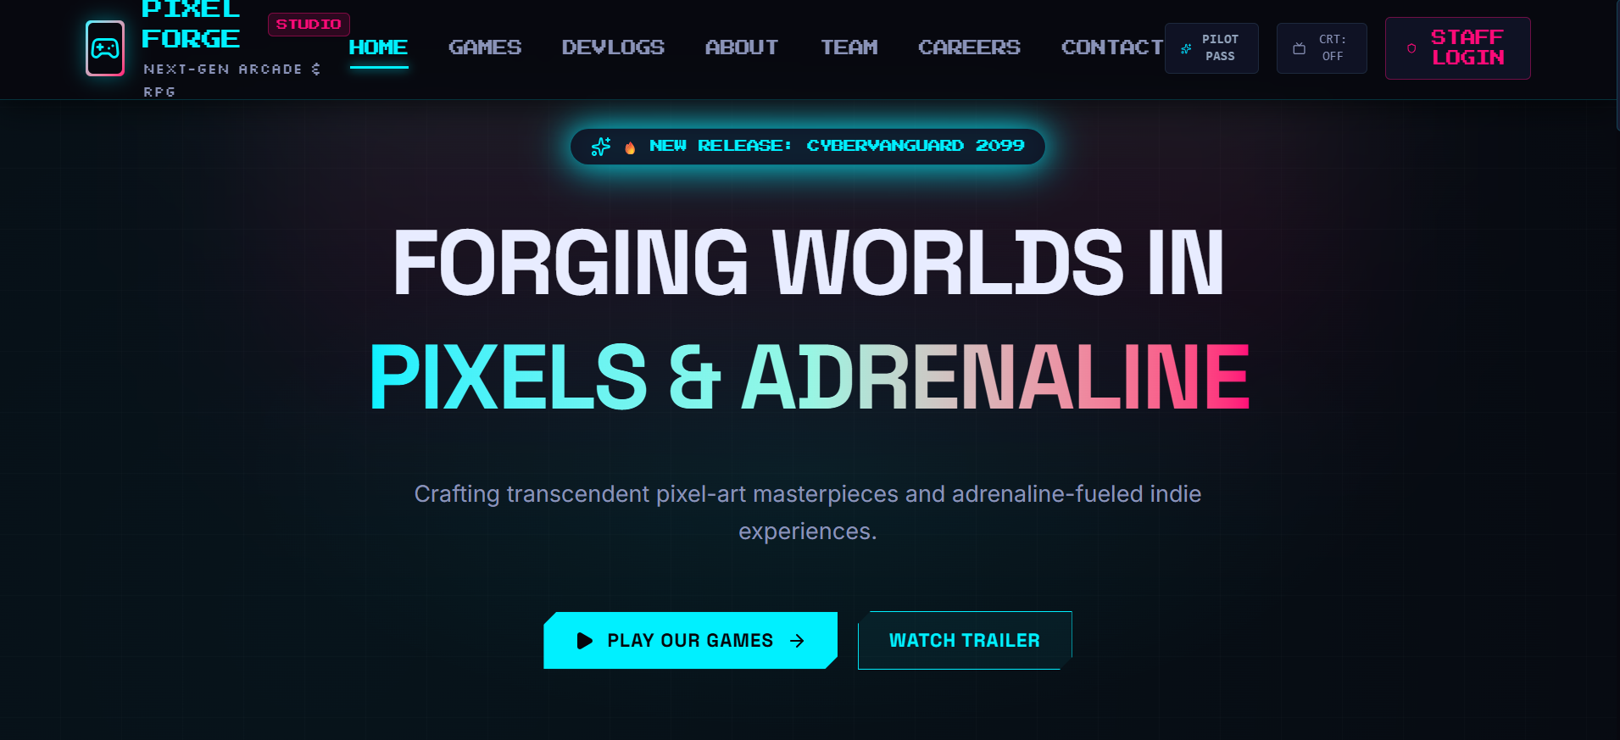
FRONT END AND WEB DESIGN
Public website
Home: banner, games and latest devlogs
Games: the studio's games with details
Devlogs: articles about development
About and Team: studio story and members
Careers: job openings and application form
Contact: form to message the studio
Dark theme with neon colours and pixel-style headings. The layout works on phone, tablet and desktop, and all content is loaded from the back end.

Slide 4
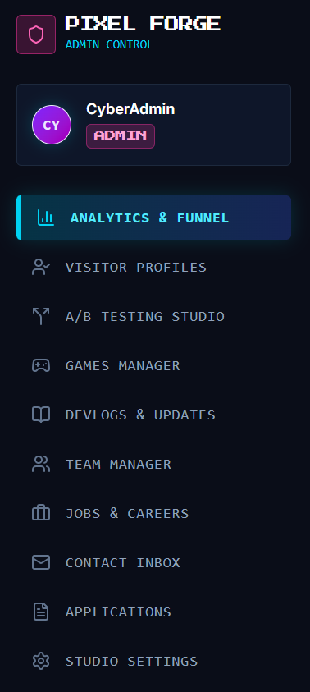
BACK END MANAGEMENT
Admin panel
Games Manager: add, edit and delete games
Devlogs and Updates: write and publish devlog articles
Team Manager: add members and their social links
Jobs and Careers: create openings for the Careers page
Contact Inbox and Applications: read messages and job applications
Studio Settings: change the studio name and contact details
Only staff can open the admin area. They have to log in first.

Slide 5
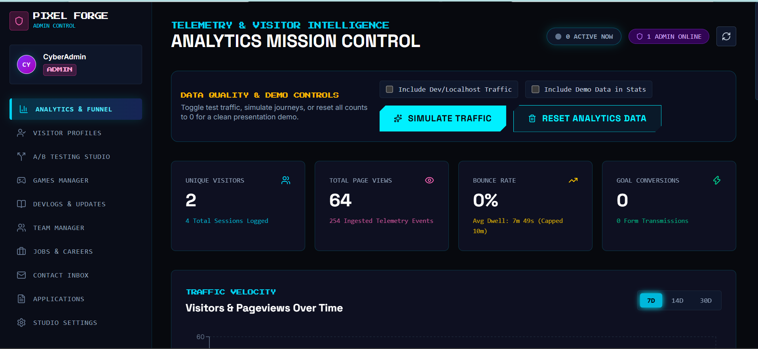
TRACKING BUILT INTO THE SITE
Visitor analytics
What is recorded
Page views and sessions
Unique and returning visitors
Time on page, device and browser
Where visitors came from
Goals, like sending the contact form
What the dashboard shows
Visitors active right now
Traffic for 7, 14 or 30 days
Most visited pages and bounce rate
A reset button for test data
The analytics dashboard in the admin area, with controls to include or reset test data.

Slide 6
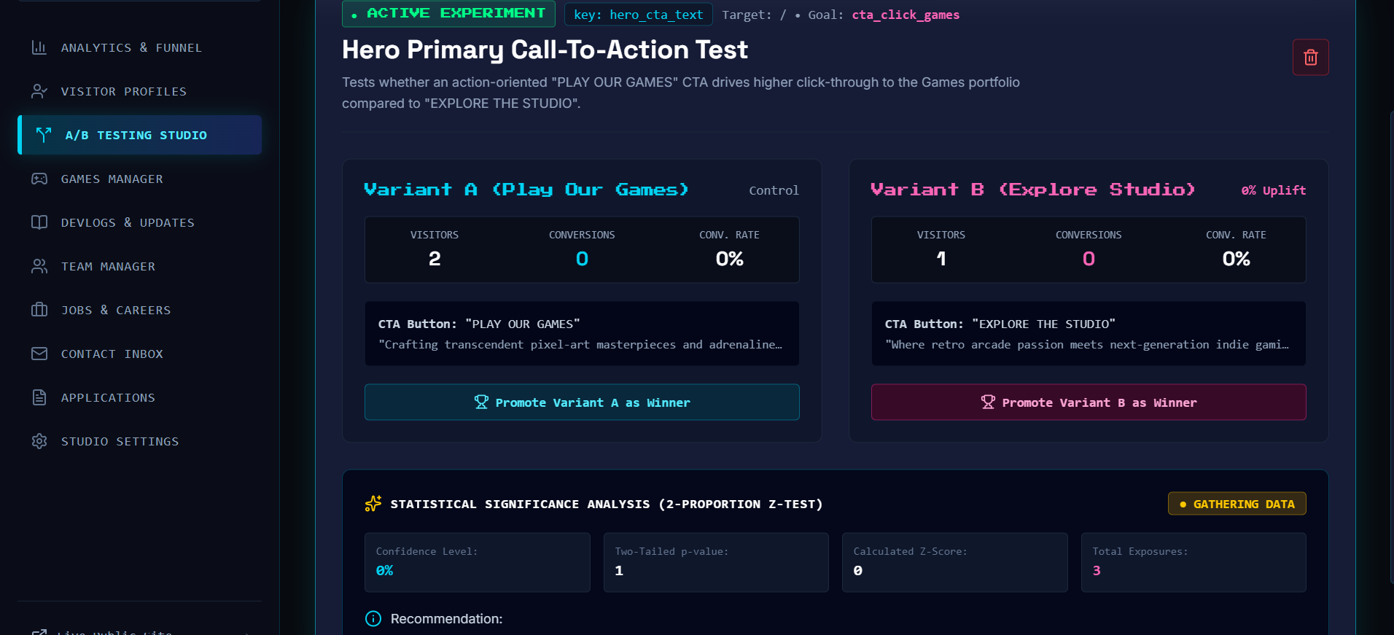
MAIN FEATURE
A/B testing
1. Create: the admin makes an experiment
2. Assign: each visitor gets version A or B and keeps it
3. Count: clicks on the goal are counted for each version
4. Compare: the results page shows which version did better
My test compares the button text "Play Our Games" (version A) with "Explore the Studio" (version B). The results page also runs a z-test to check if the difference is real.

Slide 7
REMEMBERING VISITORS
Visitor identity and Pilot Pass
Automatic recognition
Each browser gets a visitor ID saved in a cookie and local storage
A new session starts after a period of no activity
Returning visitors see a welcome-back message
A visitor always sees the same A/B version
Pilot Pass
A visitor can make an optional profile and get a recovery code
The code restores the profile on a new device
Limit: if browser data is cleared and there is no code, the visitor counts as new

Slide 8
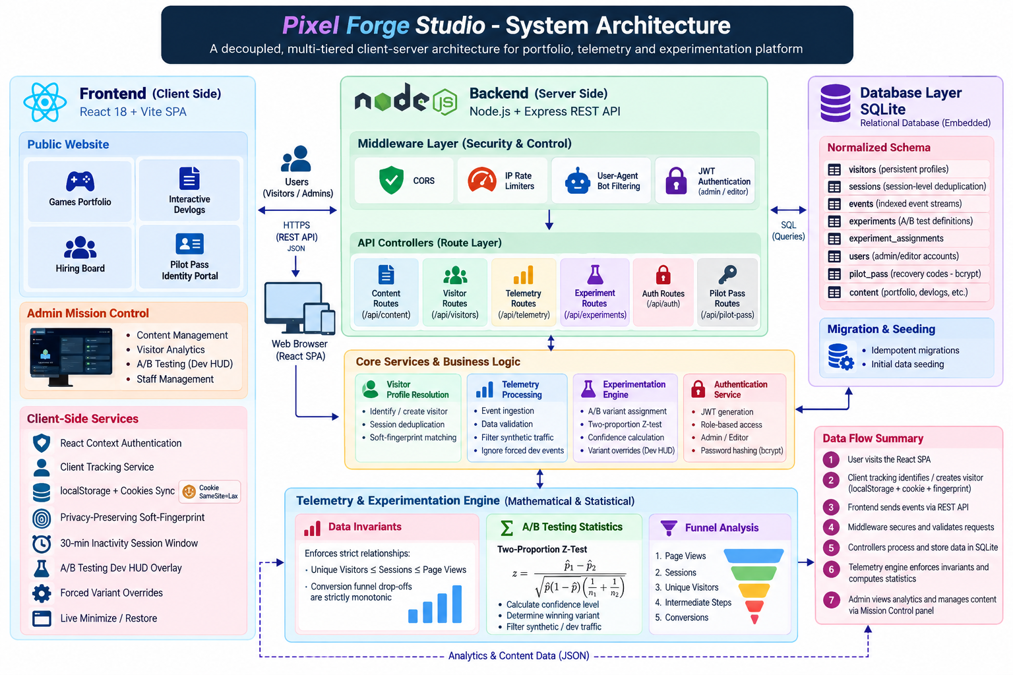
HOW THE PARTS CONNECT
Architecture
Frontend: the React website that visitors and admins use.
Backend: a Node and Express server. It checks every request and sends it to the right route.
Services: the logic for visitor recognition, tracking, the A/B test and login.
Database: SQLite stores the content, visitors, events and test data.
Flow: visit, tracking event, API, database, dashboard.

Slide 9
TECH STACK
Technologies used
Technology | Side | Used for
HTML | Front end | structure of every page
CSS | Front end | colours, layout and responsive design
JavaScript | Front end | page logic and the tracking code
React and Vite | Front end | builds pages from components; Vite runs and builds the app
React Router | Front end | moves between pages without reloading
Node.js | Back end | runs JavaScript on the server
Express | Back end | creates the REST API routes
SQLite | Back end | database that stores content, visitors and events
JWT and bcrypt | Back end | staff login tokens and password hashing
REST API | Both | how the front end talks to the server

Slide 10
WHAT I LEARNED
Challenges and solutions
Problem | How I fixed it
The dashboard showed fake numbers | It now shows only real tracked data, with empty states.
Visits were counted on every refresh | A visit is now one session, not one page load.
A page crashed when data was missing | Added checks so missing fields do not break the page.
A visitor was lost when browser data was cleared | Added a recovery code to restore the profile.

Slide 11
WRAP UP
Conclusion
This project covers web design, front end and back end in one website. The site manages its own content, records visitors and tests two versions of a page.

