Slide 1
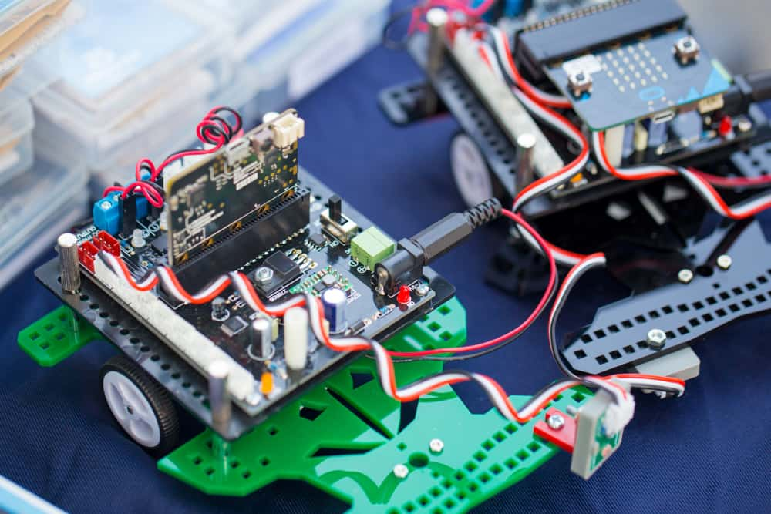
EMBEDDED SYSTEM

Slide 2
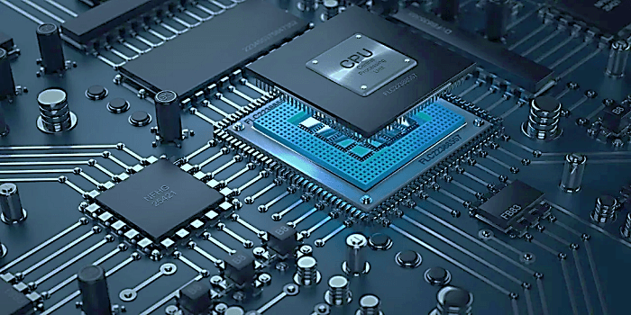

WHAT IS EMBEDDED SYSTEM
An embedded system is a combination of computer hardware and software designed for a specific function

Slide 3
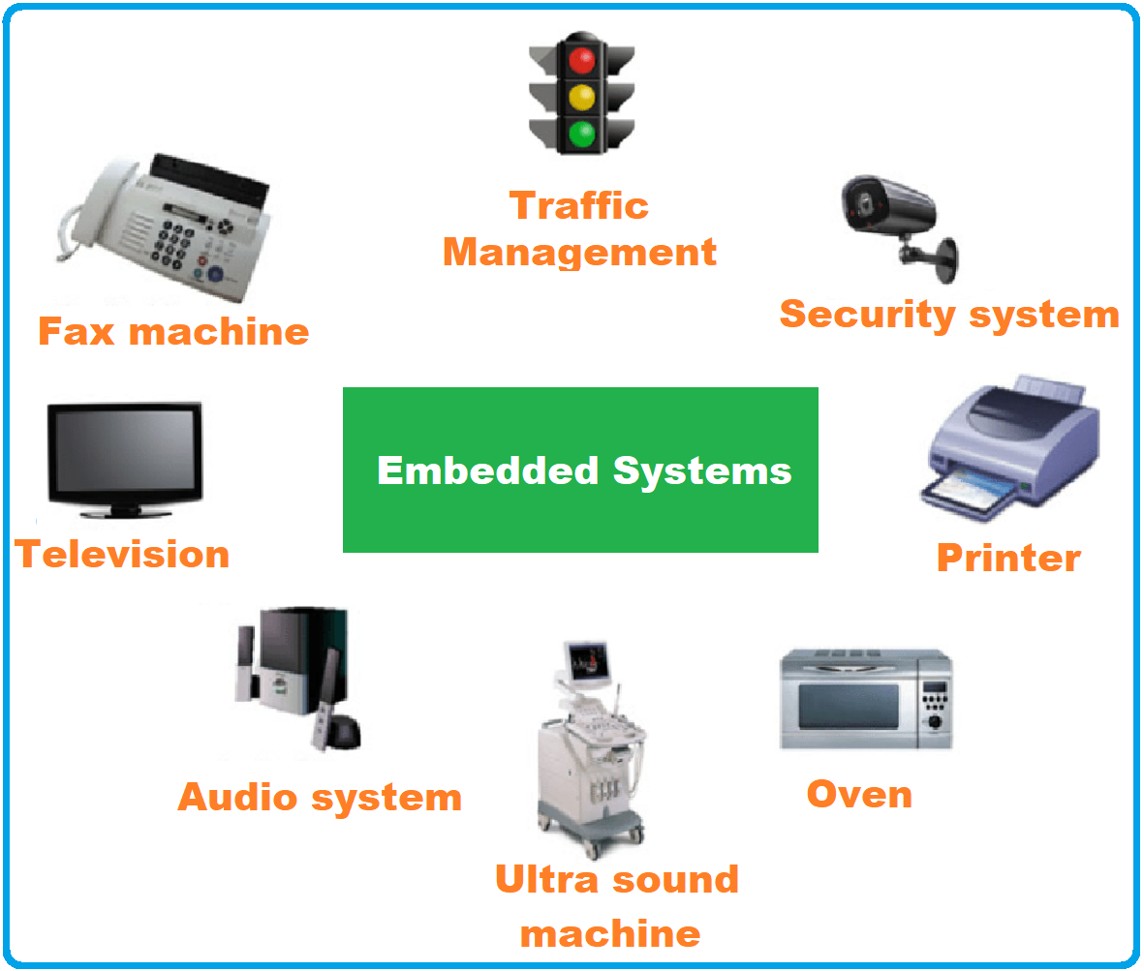

Slide 4
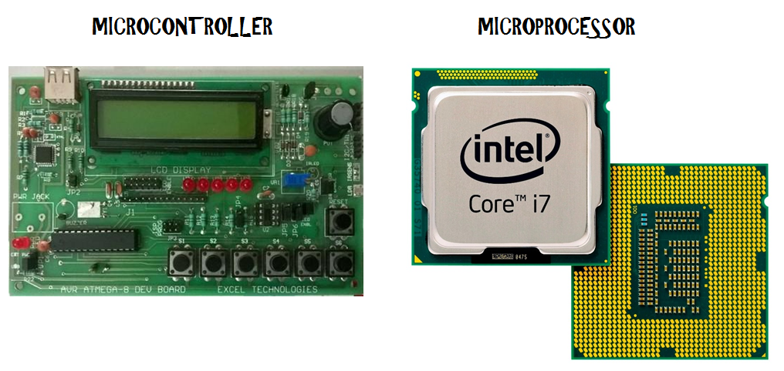
HARDWARE

Slide 5

SOFTWARE SKILLS

Slide 6



EMBEDDED SOFTWARE

Slide 7
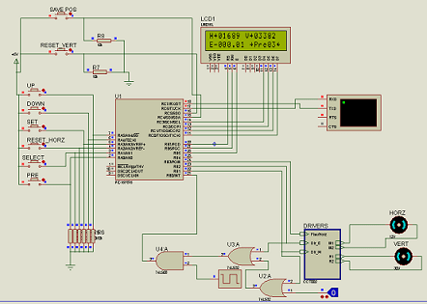
SLIMUATION SOFTWARE

Slide 8
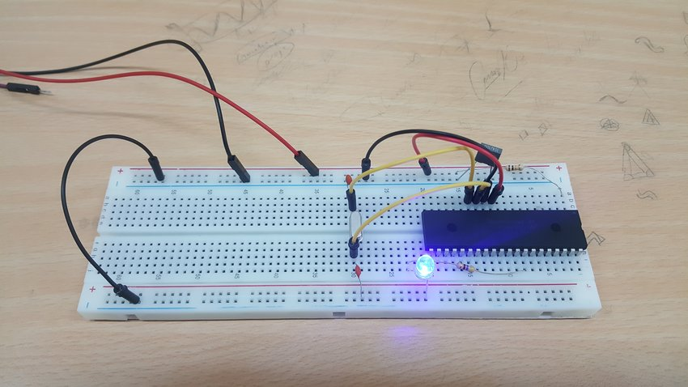
SIMPLE LED BLINKING CODING

Slide 9
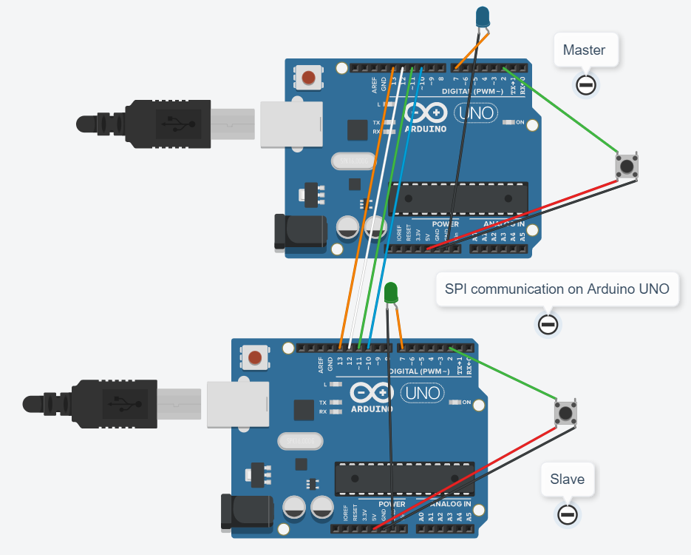
COMMUNICATION PROTOCOLS

Slide 10
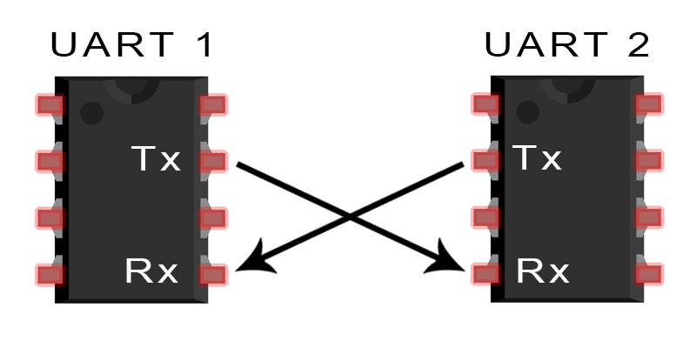
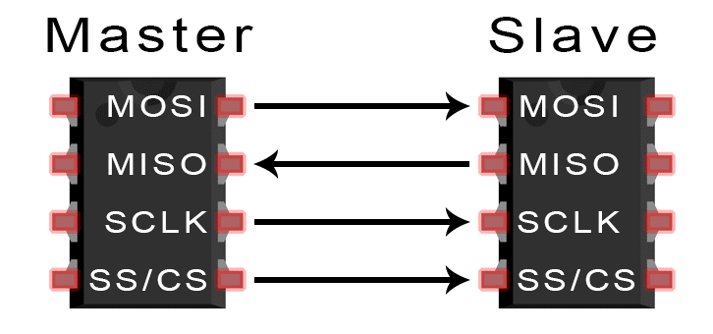
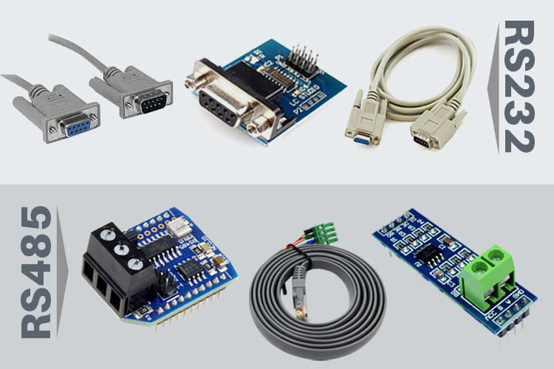
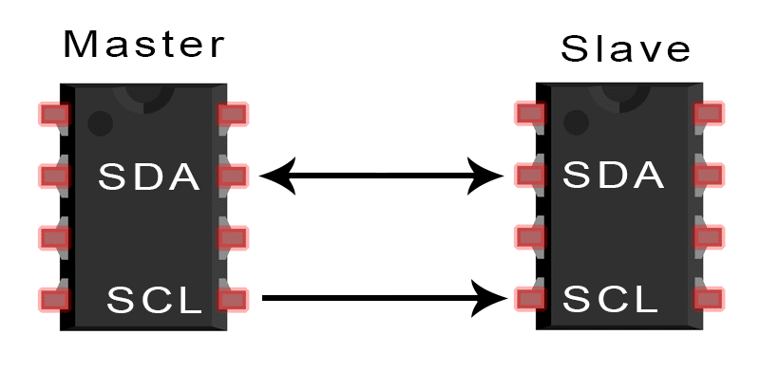
EXAMPLE OF COMMUNICATION PROTOCOLS
1.UART
2.RS 232
3.RS485
4.SPI
5.I2C
6.CAN

Slide 11

JOB OPPORTUNITIES
1.EMBEDDED SOFTWARE DEVELOPER
2.EMBEDDED SOFTWARE TESTING
3.EMBEDDED HARDWARE ENGINEER
4.R&D ENGINEER

Slide 12





EMBEDDED COMPANY

