Slide 1
Linux 3.x/4.x Device Driver Module Design and Implementation
Karthick Mahalingam Sachin Nagpal CSU, EastBay
November 30, 2016
INSTRUCTOR: Dr. Ching-Cheng Lee

Slide 2
What is a driver?
Device driver is a program that controls a particular type of device that is attached to your computer.
There are device drivers for printers, displays, CD-ROM readers, diskette drives, and so on.
Block drivers are designed to be integrated with the Linux buffer cache mechanism for efficient data access. Character drivers are pass-through drivers, accessing the hardware directly.
Examples:
Character Devices : audio or graphics cards, or input devices like keyboard and mouse.
Block Devices: storage devices, capable of buffering output and storing data for later retrieval.

Slide 3
Proc File System - /proc
Additional mechanism for the kernel and kernel modules to send information to processes - the /proc file system
A structure is provided with all the information needed for the
/proc file, including pointers to any handler functions.
Then, init module() registers the structure and it is similar to main function()
cleanup module() unregisters it.

Slide 4
File Operations
Allocation and freeing the device numbers
a) major number
b) minor number
int register_chrdev(major, name of device ,file pointer)
int unregister_chrdev(major , name of device)
file operations structure is defined in linux/fs.h

Slide 5

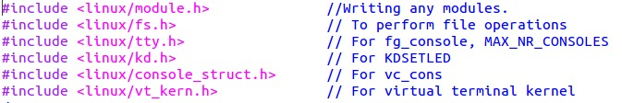
File Operations
file operations structure is defined in linux/fs.h

Slide 6
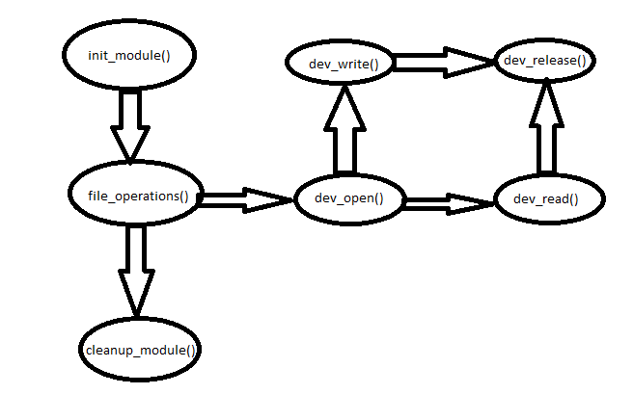
Program Flow:

Slide 7
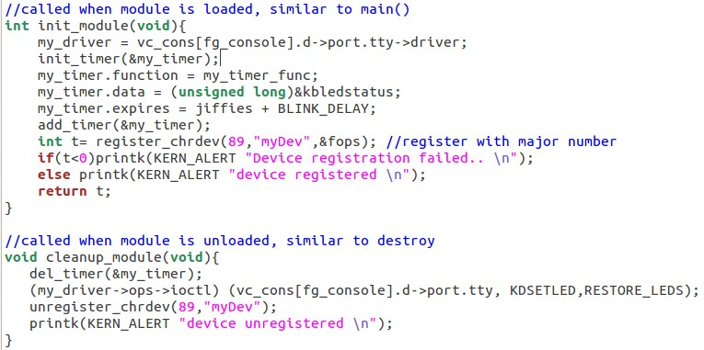
Program
module inialize and clean:

Slide 8
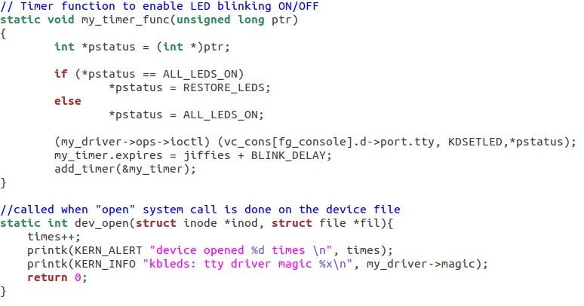
Timer and dev open() operations

Slide 9
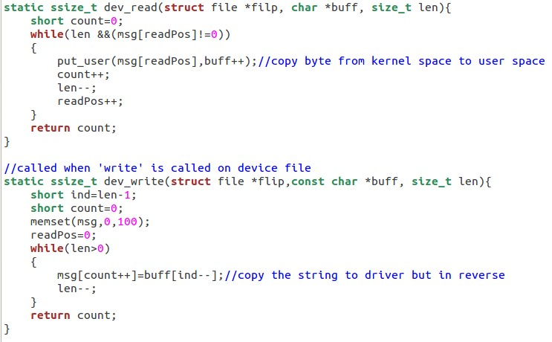
dev read() and write():

Slide 10
Challenges Faced and future development:
Linux kernel issue - Kernel codes are neither upward compatible nor downward compatible
Make the device block available to multiple resources and enable LED blink until an intended operation is completed

Slide 11
References
[1] http://kevinboone.net/linuxkernel file0.html
[2] http://www.makelinux.net/books/lkmpg/x1194
[3] https://www.apriorit.com/dev-blog/195-simple-driver-for-linux-os
[4] http://tldp.org/LDP/lkmpg/2.6/html/lkmpg.html#AEN569
[5] https://www.freebsd.org/doc/en/books/arch-handbook/driverbasics-char.html
[6] http://www.tldp.org/LDP/lkmpg/2.4/html/c577.htm

