Slide 1
NovaOps Technologies
Custom Domain Email Configuration
Cloudflare Email Routing + Gmail + SMTP2GO
Domain: novaopstechnologies.online
Receiving: Cloudflare → Gmail
Sending: Gmail → SMTP2GO → recipient
Custom addresses
info@ • support@ • admin@ • karthicksuresh@
Step-by-step guide with screenshots from the actual setup

Slide 2
How the setup works
2
One Gmail mailbox, multiple custom addresses, one SMTP2GO SMTP user
External sender
Cloudflare
Email Routing
Gmail
Mailbox
SMTP2GO
SMTP relay
Recipient
Incoming: custom address → Cloudflare → novaopstechnologies@gmail.com
Outgoing: Gmail → SMTP2GO → recipient. The selected custom address is shown in From.
NovaOps Technologies • Custom Domain Email Setup

Slide 3
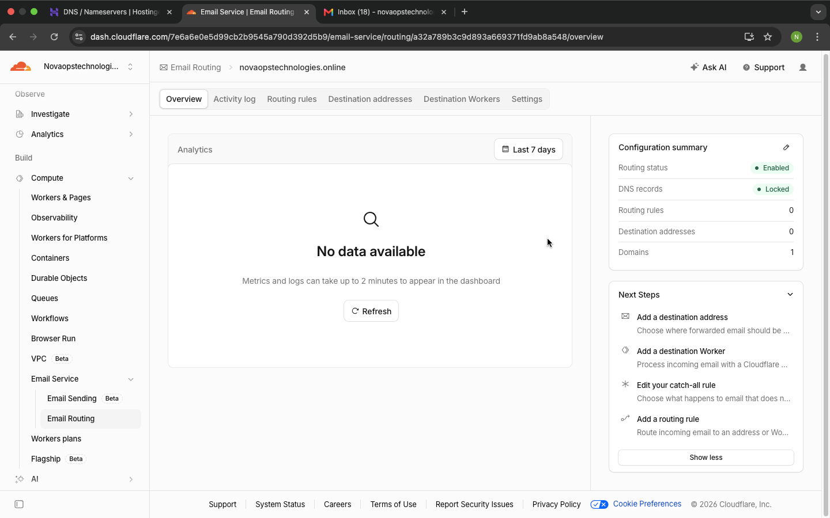
Step 1 — Connect the domain to Cloudflare
3
Success condition: the Cloudflare zone is Active
Add novaopstechnologies.online to Cloudflare.
Replace Hostinger nameservers with Cloudflare's assigned nameservers.
Keep website A/CNAME records unless you intentionally want to change the website.
Confirm Cloudflare shows the zone as Active.
Do not delete website DNS records just because Email Routing is enabled.
Cloudflare zone / Email Service screen
NovaOps Technologies • Custom Domain Email Setup

Slide 4
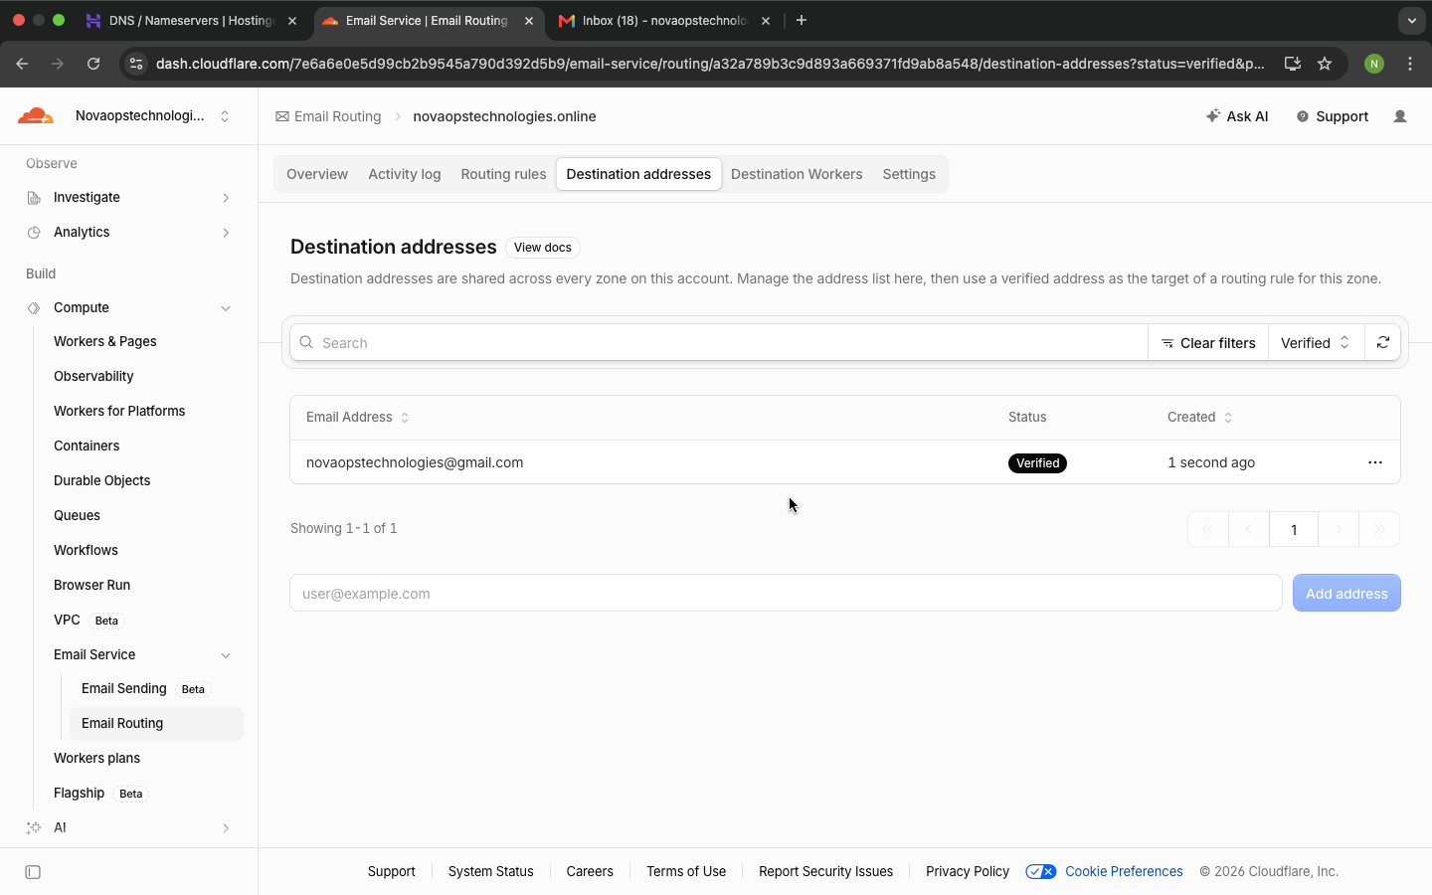
Step 2 — Add the Gmail destination
4
Cloudflare forwards incoming custom-domain mail to the verified Gmail mailbox
Go to Cloudflare → Email Routing → Destination addresses → Add address
Enter: novaopstechnologies@gmail.com
Destination address verified
NovaOps Technologies • Custom Domain Email Setup

Slide 5
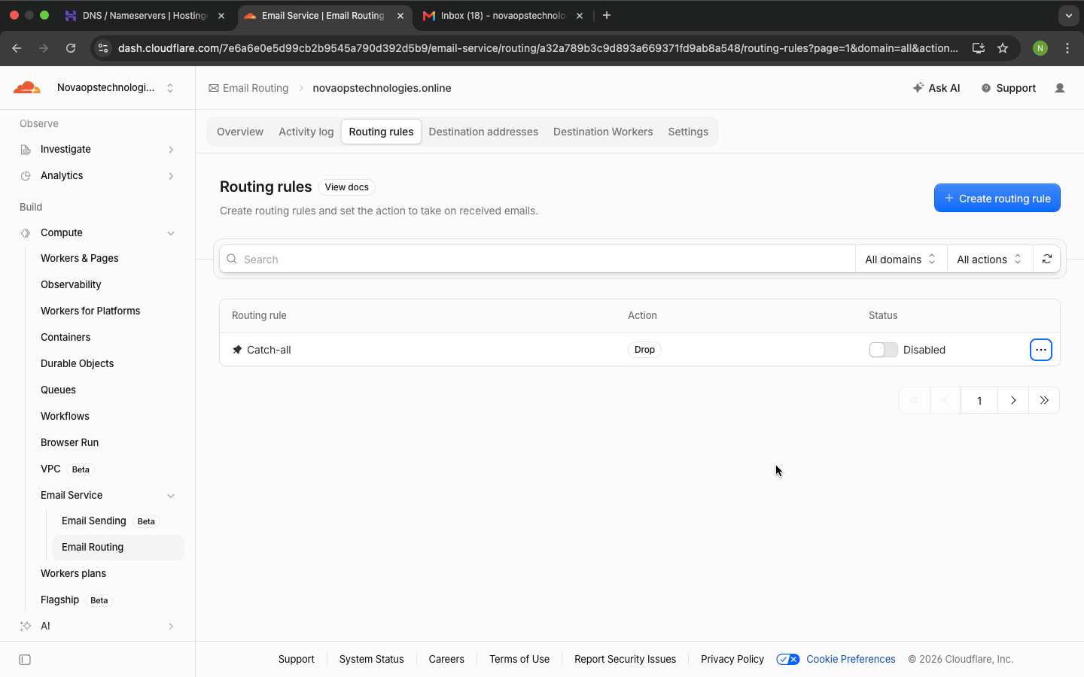
Step 3 — Create routing rules
5
Create one forwarding rule for each custom address
Cloudflare Routing Rules
info → Gmail | support → Gmail | admin → Gmail | karthicksuresh → Gmail
NovaOps Technologies • Custom Domain Email Setup

Slide 6
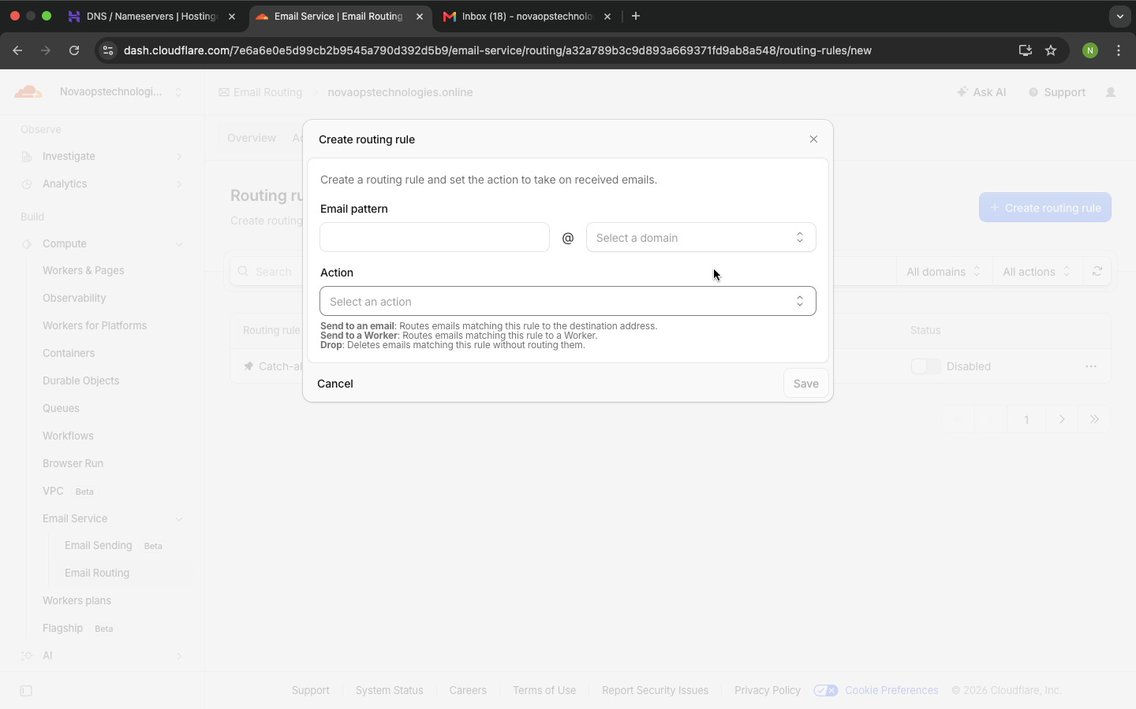
Routing rule form — example
6
Create info@novaopstechnologies.online → novaopstechnologies@gmail.com
Email pattern: info • Domain: novaopstechnologies.online • Action: Send to an email
Create routing rule
NovaOps Technologies • Custom Domain Email Setup

Slide 7
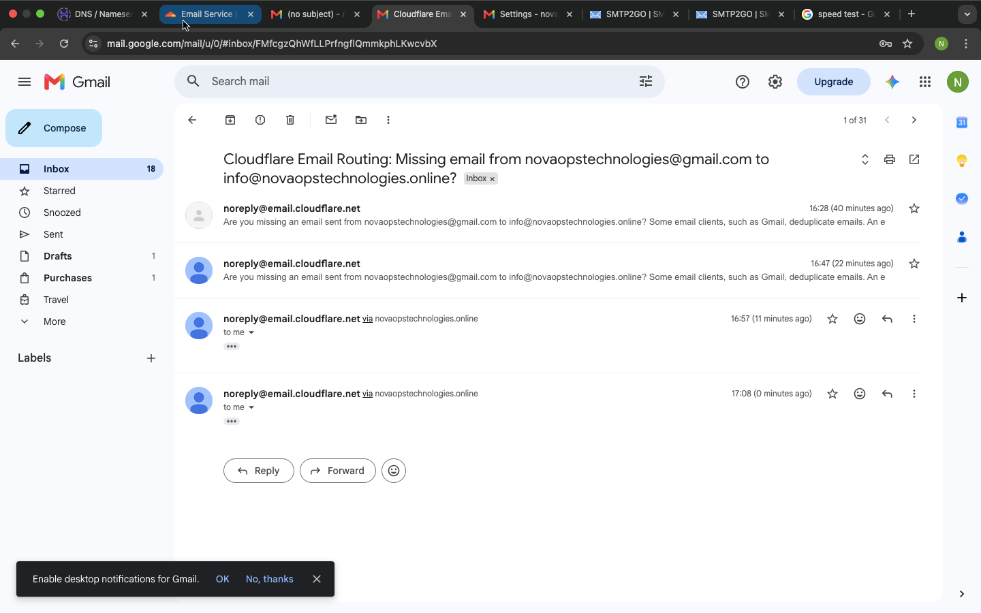
Step 4 — Test incoming mail
7
Use a different/external mailbox for the cleanest test
Send from a different email account to info@novaopstechnologies.online.
Confirm the message arrives in novaopstechnologies@gmail.com.
Later repeat for support, admin and karthicksuresh.
Avoid testing from the same Gmail account that is the Cloudflare destination. Gmail/Cloudflare can flag duplicate or loop-like routing.
Cloudflare routing-related test email
NovaOps Technologies • Custom Domain Email Setup

Slide 8
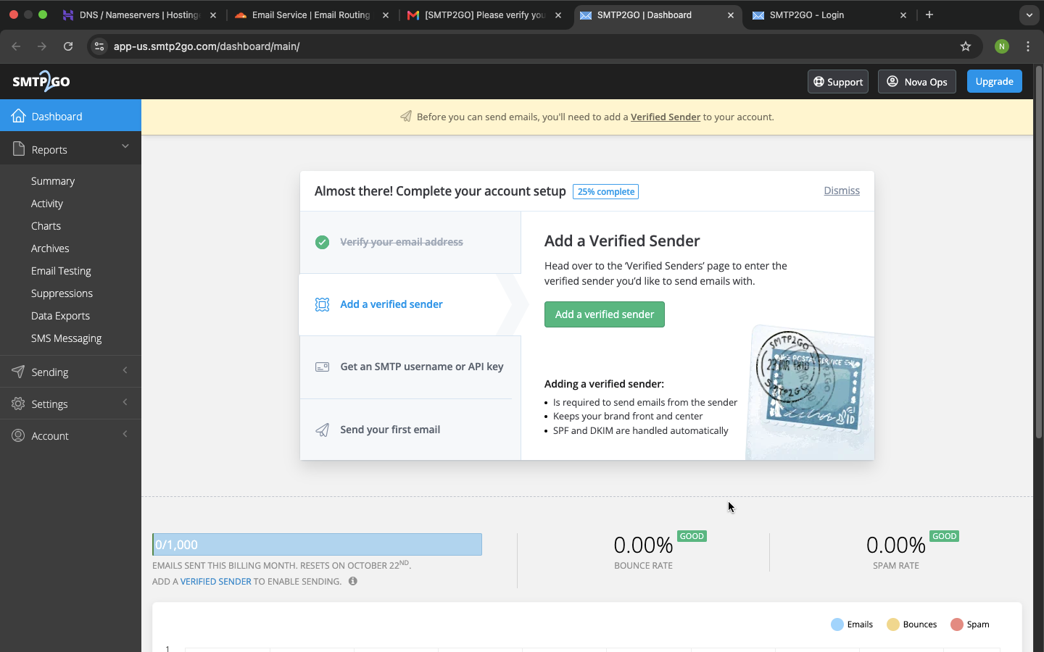
Step 5 — Set up SMTP2GO
8
SMTP2GO handles outgoing email; Cloudflare handles incoming routing
SMTP2GO account / Verified Sender setup
Verify the sending domain: novaopstechnologies.online. One SMTP2GO account is enough for all four custom addresses.
NovaOps Technologies • Custom Domain Email Setup

Slide 9
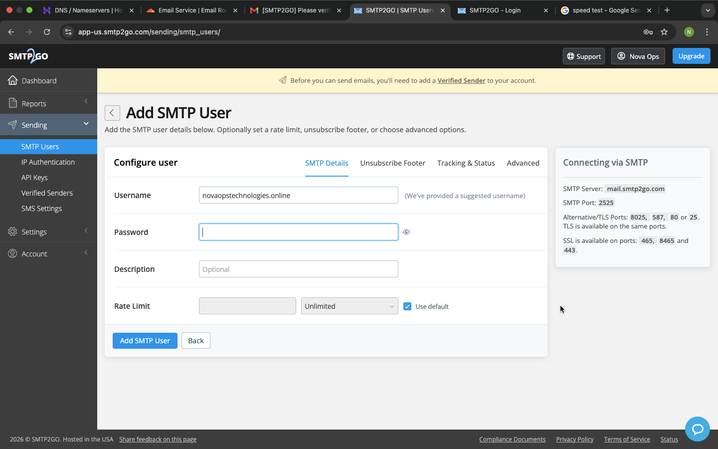
Step 6 — Create ONE SMTP user
9
The same SMTP username/password can be used for all custom addresses
Example username: novaopstechnologies.online
Create a strong password and keep it private.
Add SMTP User form
NovaOps Technologies • Custom Domain Email Setup

Slide 10
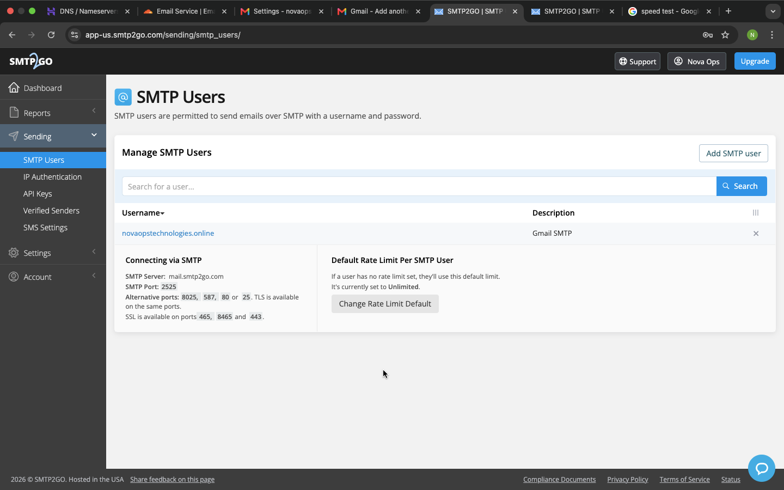
SMTP settings for Gmail
10
Use SMTP2GO's outgoing SMTP server, not Cloudflare MX hosts
SMTP Server
mail.smtp2go.com
Port
587
Username
Your SMTP2GO SMTP user
Password
Your SMTP2GO SMTP-user password
Security
TLS
Do not use route3.mx.cloudflare.net as the outgoing SMTP server.
SMTP Users page
NovaOps Technologies • Custom Domain Email Setup

Slide 11
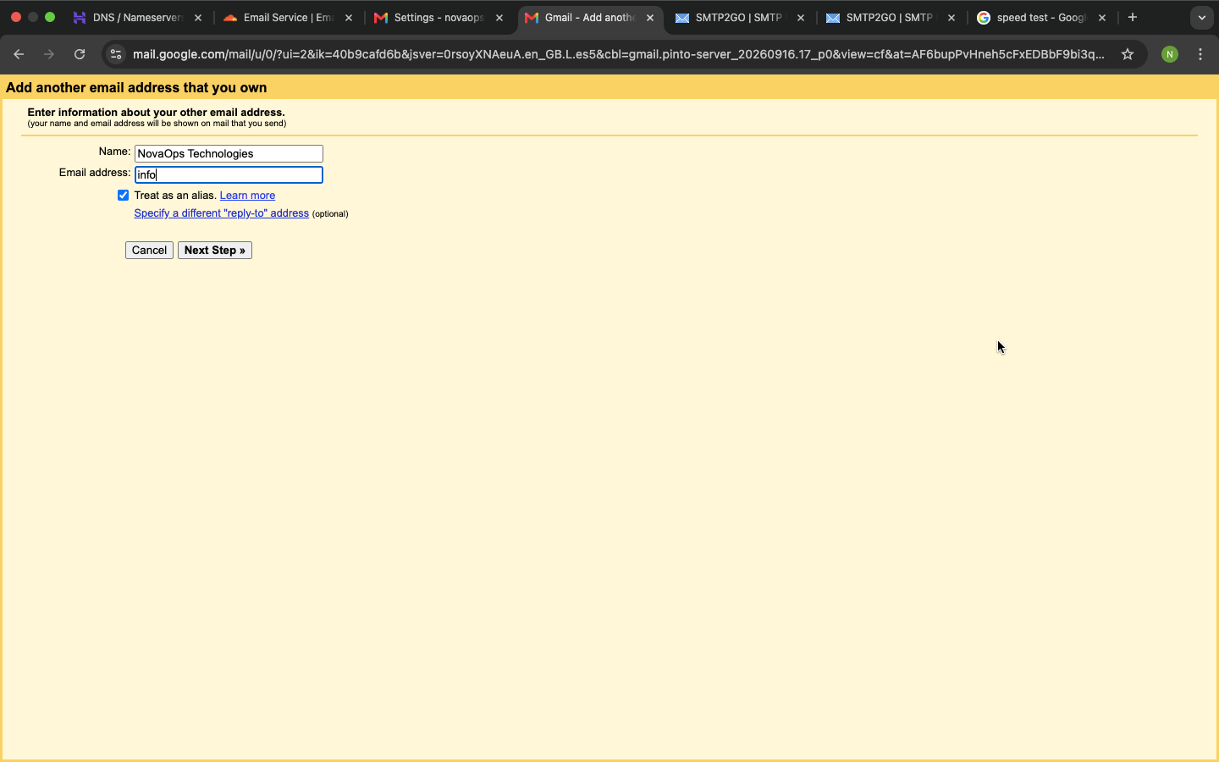
Step 7 — Add info@ to Gmail
11
Gmail → Settings → Accounts and Import → Send mail as
Email: info@novaopstechnologies.online • Treat as an alias: checked • SMTP: mail.smtp2go.com • Port: 587 • TLS
Gmail SMTP configuration screen
NovaOps Technologies • Custom Domain Email Setup

Slide 12
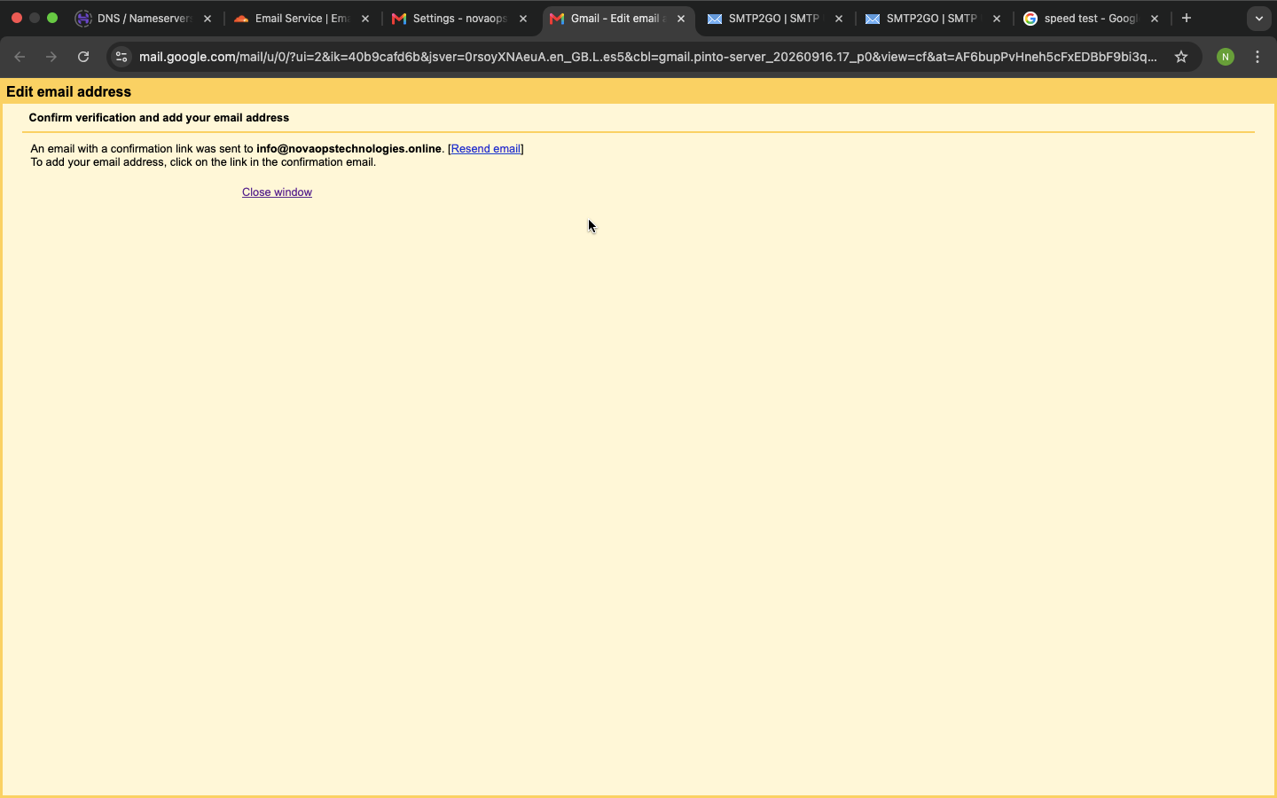
Step 8 — Verify the custom address
12
Gmail sends a confirmation message to info@
Gmail confirmation screen
Open the verification email delivered through Cloudflare and click the confirmation link. The address should show as Verified.
NovaOps Technologies • Custom Domain Email Setup

Slide 13
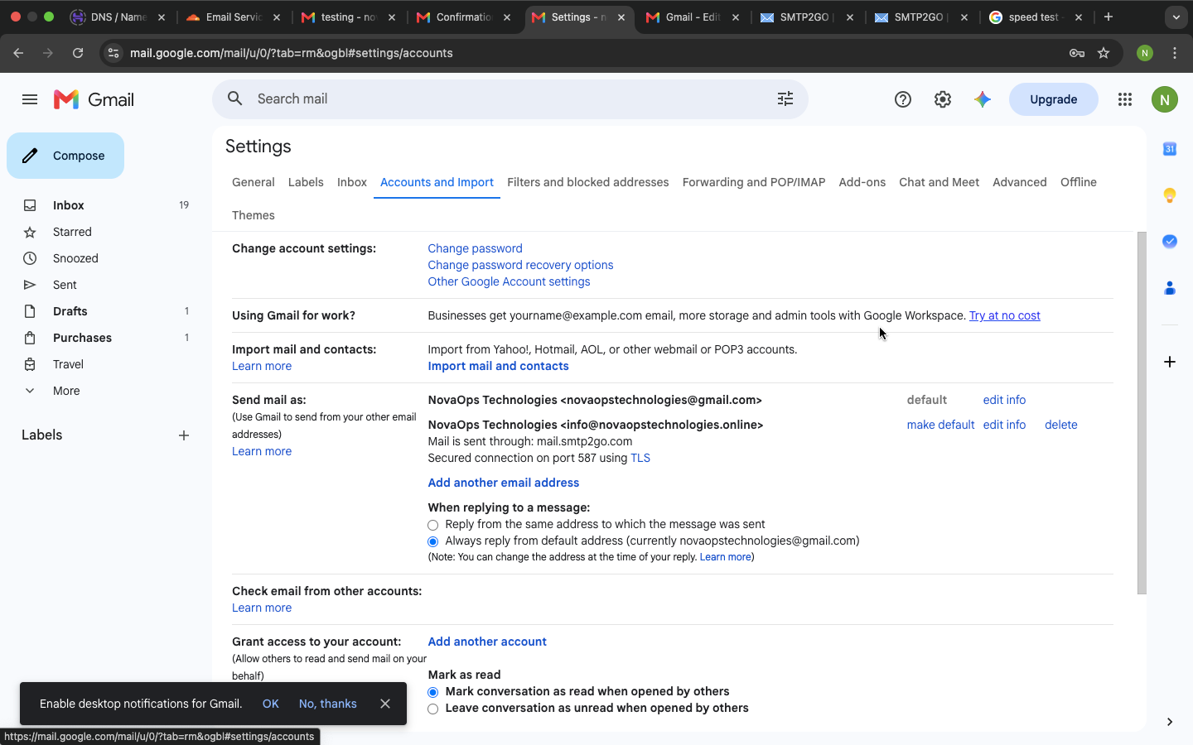
Step 9 — Make replies use the custom address
13
This setting controls the From address used for replies
Select: “Reply from the same address to which the message was sent.”
Gmail Accounts and Import — Send mail as / reply setting
NovaOps Technologies • Custom Domain Email Setup

Slide 14
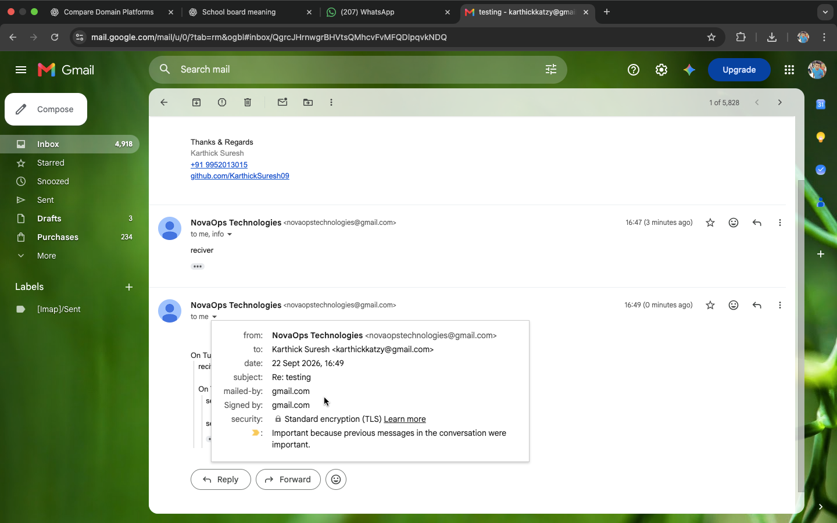
Step 10 — Test outgoing mail
14
Test from an external mailbox, then reply from Gmail
Send from an external email to info@novaopstechnologies.online.
Open the forwarded message in Gmail.
Click Reply and check the From field before sending.
Expected From: info@novaopstechnologies.online.
If the original message was sent from novaopstechnologies@gmail.com itself, Cloudflare may show a duplicate/missing-email warning. Use an external mailbox for the real test.
Gmail test conversation
NovaOps Technologies • Custom Domain Email Setup

Slide 15
Step 11 — Add the remaining addresses
15
Repeat the Gmail Send mail as process using the same SMTP2GO user
Support
support@novaopstechnologies.online
Use the same SMTP2GO server, username and password; verify the address in Gmail.
Admin
admin@novaopstechnologies.online
Use the same SMTP2GO server, username and password; verify the address in Gmail.
Karthick Suresh
karthicksuresh@novaopstechnologies.online
Use the same SMTP2GO server, username and password; verify the address in Gmail.
Cloudflare routing must exist for each address so Gmail can receive its verification email.
NovaOps Technologies • Custom Domain Email Setup

Slide 16
Final configuration
16
One Gmail mailbox + one SMTP2GO SMTP user + four custom addresses
INCOMING
Custom address
↓
Cloudflare Email Routing
↓
novaopstechnologies@gmail.com
OUTGOING
Gmail
↓
SMTP2GO
↓
Recipient
From = selected custom address
Addresses
info@novaopstechnologies.online
support@novaopstechnologies.online
admin@novaopstechnologies.online
karthicksuresh@novaopstechnologies.online
NovaOps Technologies • Custom Domain Email Setup

Slide 17
Troubleshooting checklist
17
Quick fixes for the issues encountered during setup
Gmail cannot connect
Use mail.smtp2go.com, port 587, TLS, and the SMTP2GO SMTP-user credentials.
Address is unverified
Open the Gmail confirmation email delivered through Cloudflare and click the verification link.
Reply uses Gmail
Select “Reply from the same address to which the message was sent.”
Cloudflare duplicate warning
Test from a different external mailbox, not the same Gmail destination.
Wrong SMTP server
Do not use route3.mx.cloudflare.net as the SMTP2GO outgoing server.
NovaOps Technologies • Custom Domain Email Setup

Slide 18
Custom Domain Email Setup
Cloudflare
Receiving & forwarding
Gmail
Mailbox & Send-as
SMTP2GO
Outgoing SMTP
NovaOps Technologies • info@ • support@ • admin@ • karthicksuresh@

