Slide 1
E-Commerce Product Analysis
Capstone Project | Data Analytics
Karthick .T| July 2025

Slide 2
Project Overview
Objective: Analyze laptop data from Amazon using Python ,Sql and Power BI
Steps: Web Scraping, Data Cleaning, EDA, SQL Storage, Power BI
Tools: Python, Pandas, MySQL, Power BI

Slide 3
Web Scraping
Tool: Python, SerpAPI
Target: Laptop product listings on Amazon.com
Steps:
Use SerpAPI to query laptops from Amazon (pages 1 to 50)
Extract relevant fields:
Product Name
Price
Rating
Number of Reviews
ASIN
Link
Add logic to parse extra info like:
Brand (from title using keyword matching)
RAM Size
Processor Type
Store all records in a CSV file

Slide 4
Data Cleaning
Removed:
Duplicates
Null values
Irrelevant entries (e.g., "Laptop,", "15.6", "180W" in brand column)
Normalized:
Brand names (auto-detected brands like HP, Dell, Lenovo)
Processor types (grouped similar names like Intel i7, i5)
RAM sizes standardized (e.g., "8GB", "16GB")
Converted reviews & prices to numeric formats for analysis.

Slide 5
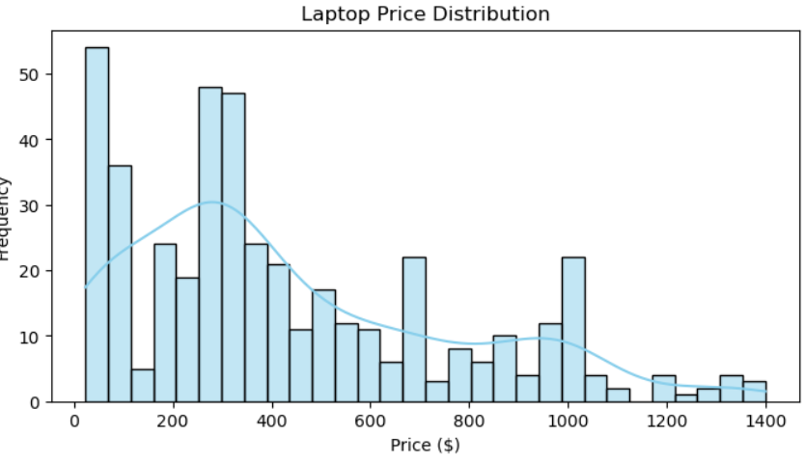
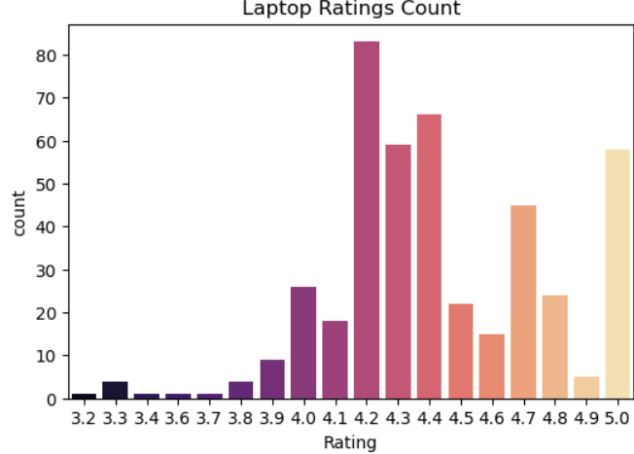
Exploratory Data Analysis (EDA)
Price Distribution
The price distribution is right-skewed.
Ratings Count Distribution
Most laptops have ratings between 4.1 and 4.5.

Slide 6
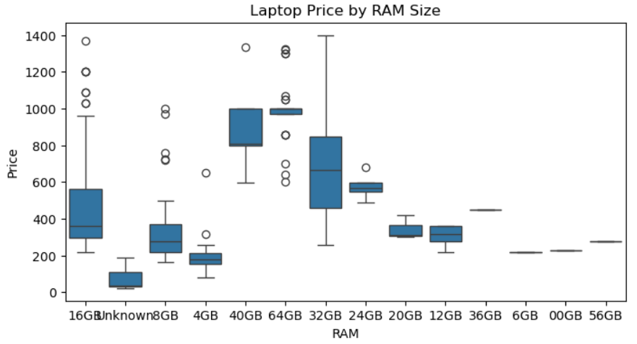
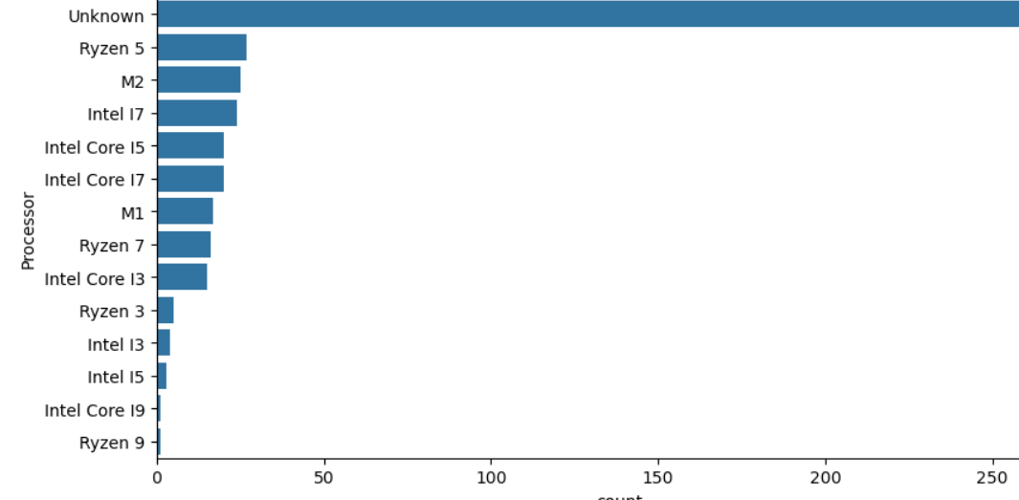
Exploratory Data Analysis (EDA)
Price by RAM Size
Laptops with higher RAM (64GB, 40GB, 32GB) tend to have higher price variance and median prices.
Processer Count
Ryzen 5, Intel i7, Intel Core i5 are common.

Slide 7
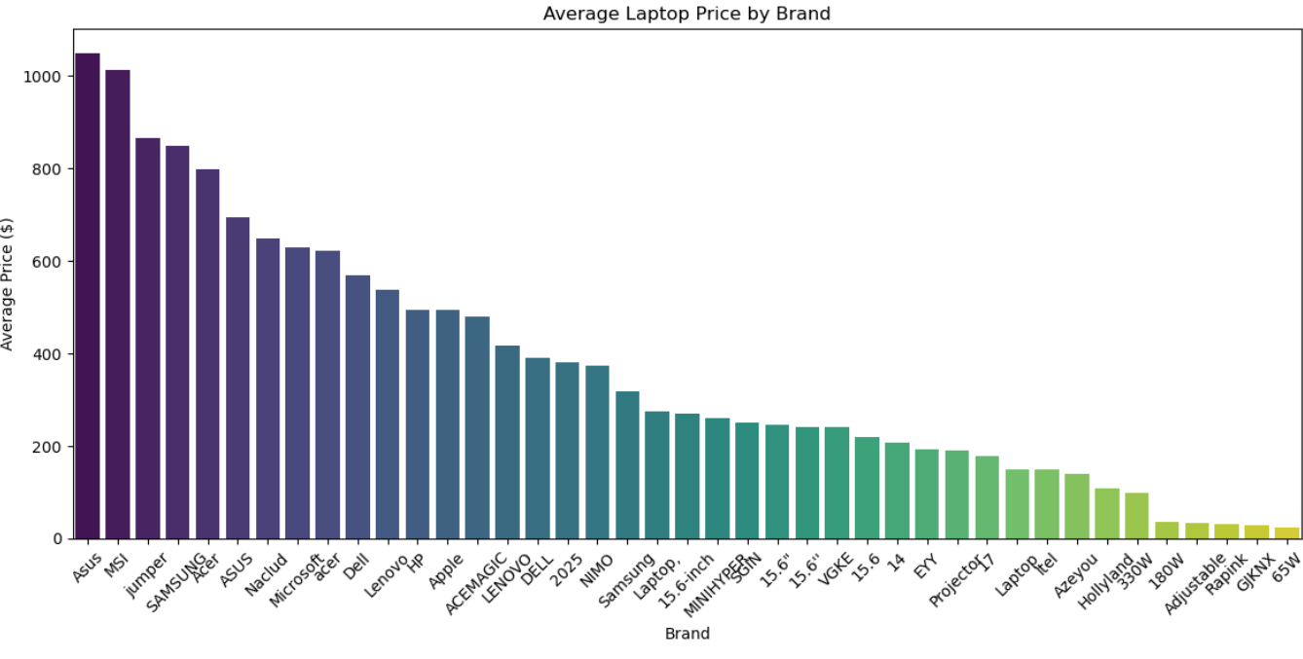
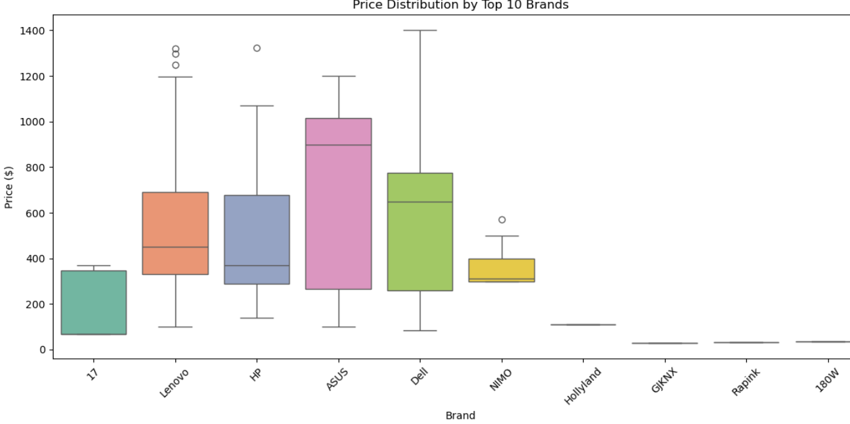
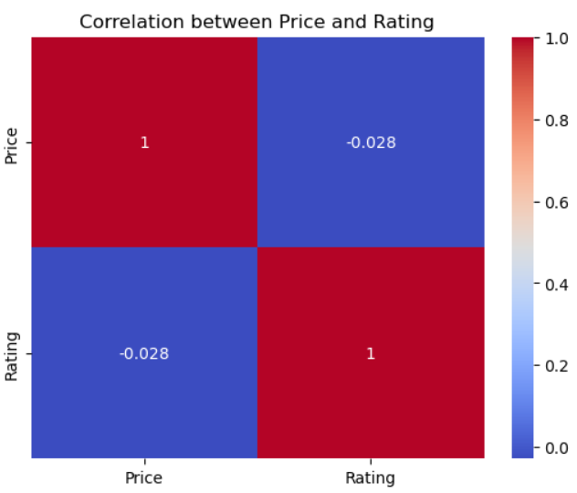
Average Laptop Price by Brand
Asus and MSI have the highest average
Acer, Lenovo, Dell, HP fall in the mid-price range.
Price Distribution by Top 10 Brands
ASUS and Dell have a wide price range.
Correlation Between Price and Rating
The correlation coefficient is -0.028, which is very weak and negative.

Slide 8
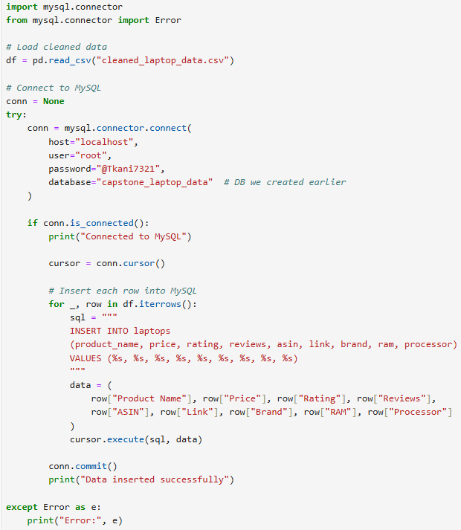
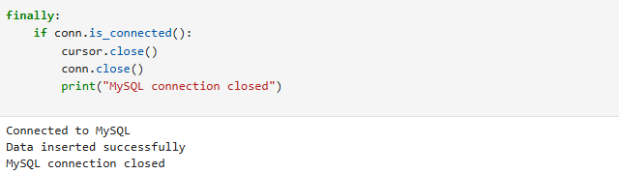
Storing Cleaned Data in MySQL
Tool: MySQL, MySQL Connector for Python
Design MySQL table schema
Connect to MySQL server using Python
Created database and table
Import cleaned CSV data into MySQL using insert queries
Test successful insertion with SELECT queries

Slide 9
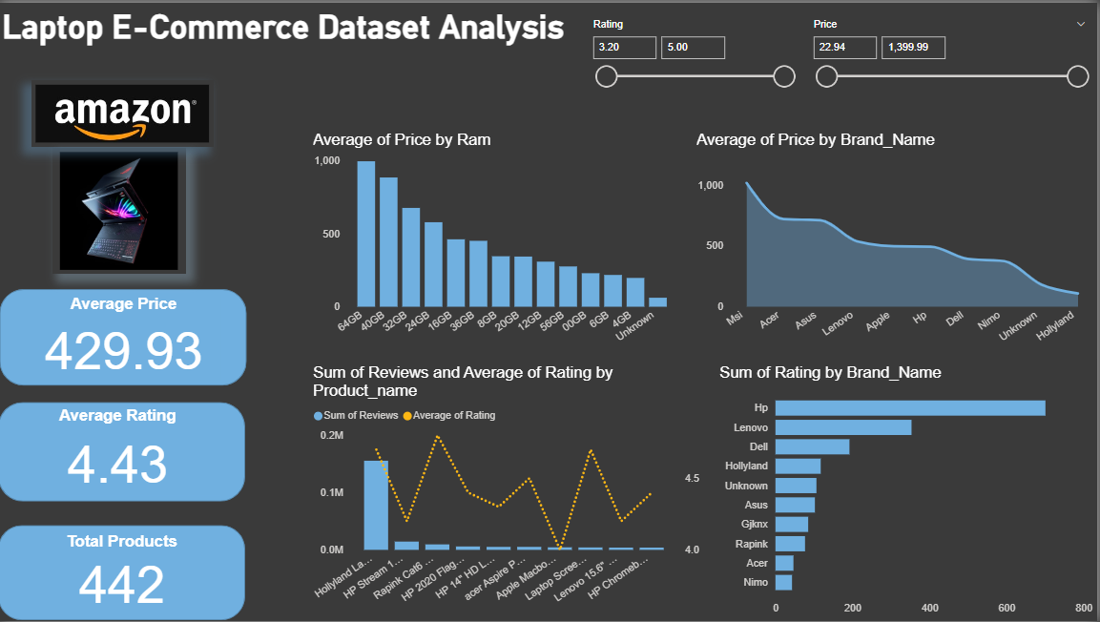
Power BI Dashboard

Slide 10
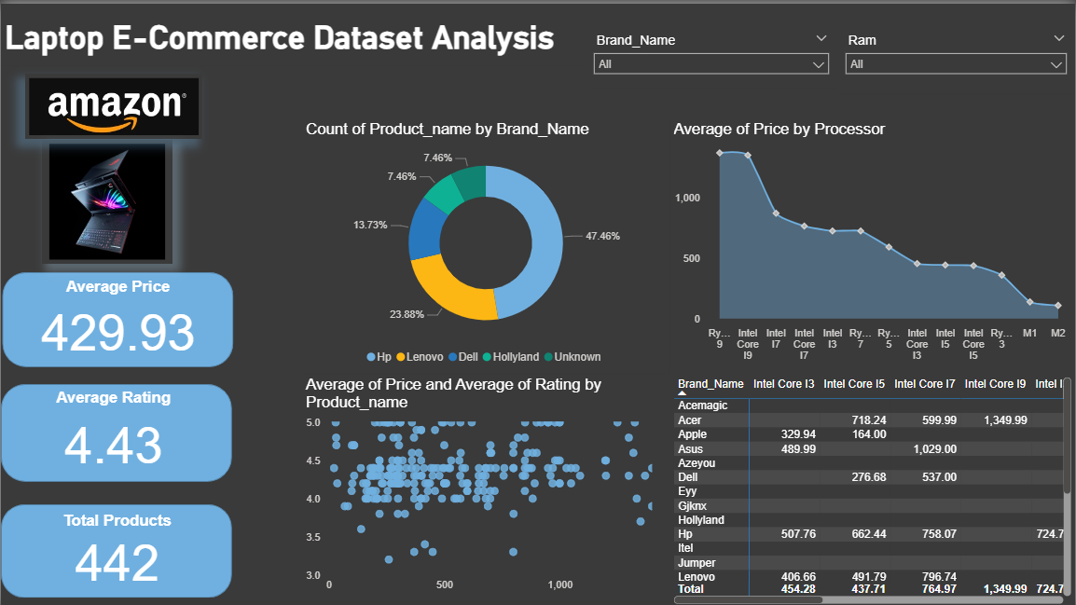
Power BI Dashboard

Slide 11
Key Insights Summary
Most laptops are priced below $500.
Price distribution is right-skewed with few high-end models above $1000.
Majority of laptops are rated between 4.1 and 4.5.
Average rating is 4.43, showing overall high customer satisfaction.
Higher RAM (32GB, 64GB) leads to higher prices.
8GB and 16GB are the most common and affordable RAM configurations.
Popular processors: Ryzen 5, Intel i7, Intel i5.
Correlation = -0.028 → No strong relationship.
Expensive laptops don’t always have higher ratings.
Asus, MSI, Apple have highest average laptop prices.
Lenovo, HP, Dell are dominant mid-range brands.
Several budget brands like Rapink, GJKNX offer low-cost options.
HP and Lenovo lead in review count and rating sum.
These brands have both affordability and customer trust.

Slide 12
Conclusion
This project successfully built a complete data pipeline—from web scraping to dashboard visualization—revealing key insights about laptop pricing, brand performance, and customer preferences on Amazon. The process is scalable and can be applied to other ecommerce product categories for impactful business analysis.

Slide 13
Thank You

