Slide 1
Data types
Double data type
S.ARUN KARTHICK
190013

Slide 2
WHAT IS DOUBLE?
THE DOUBLE DATA TYPE IS USED TO STORE AND PERFORM ARITHMETIC OPERATIONS ON THE FRACTIONAL NUMBERS. IT is used to hold floating point values.

Slide 3

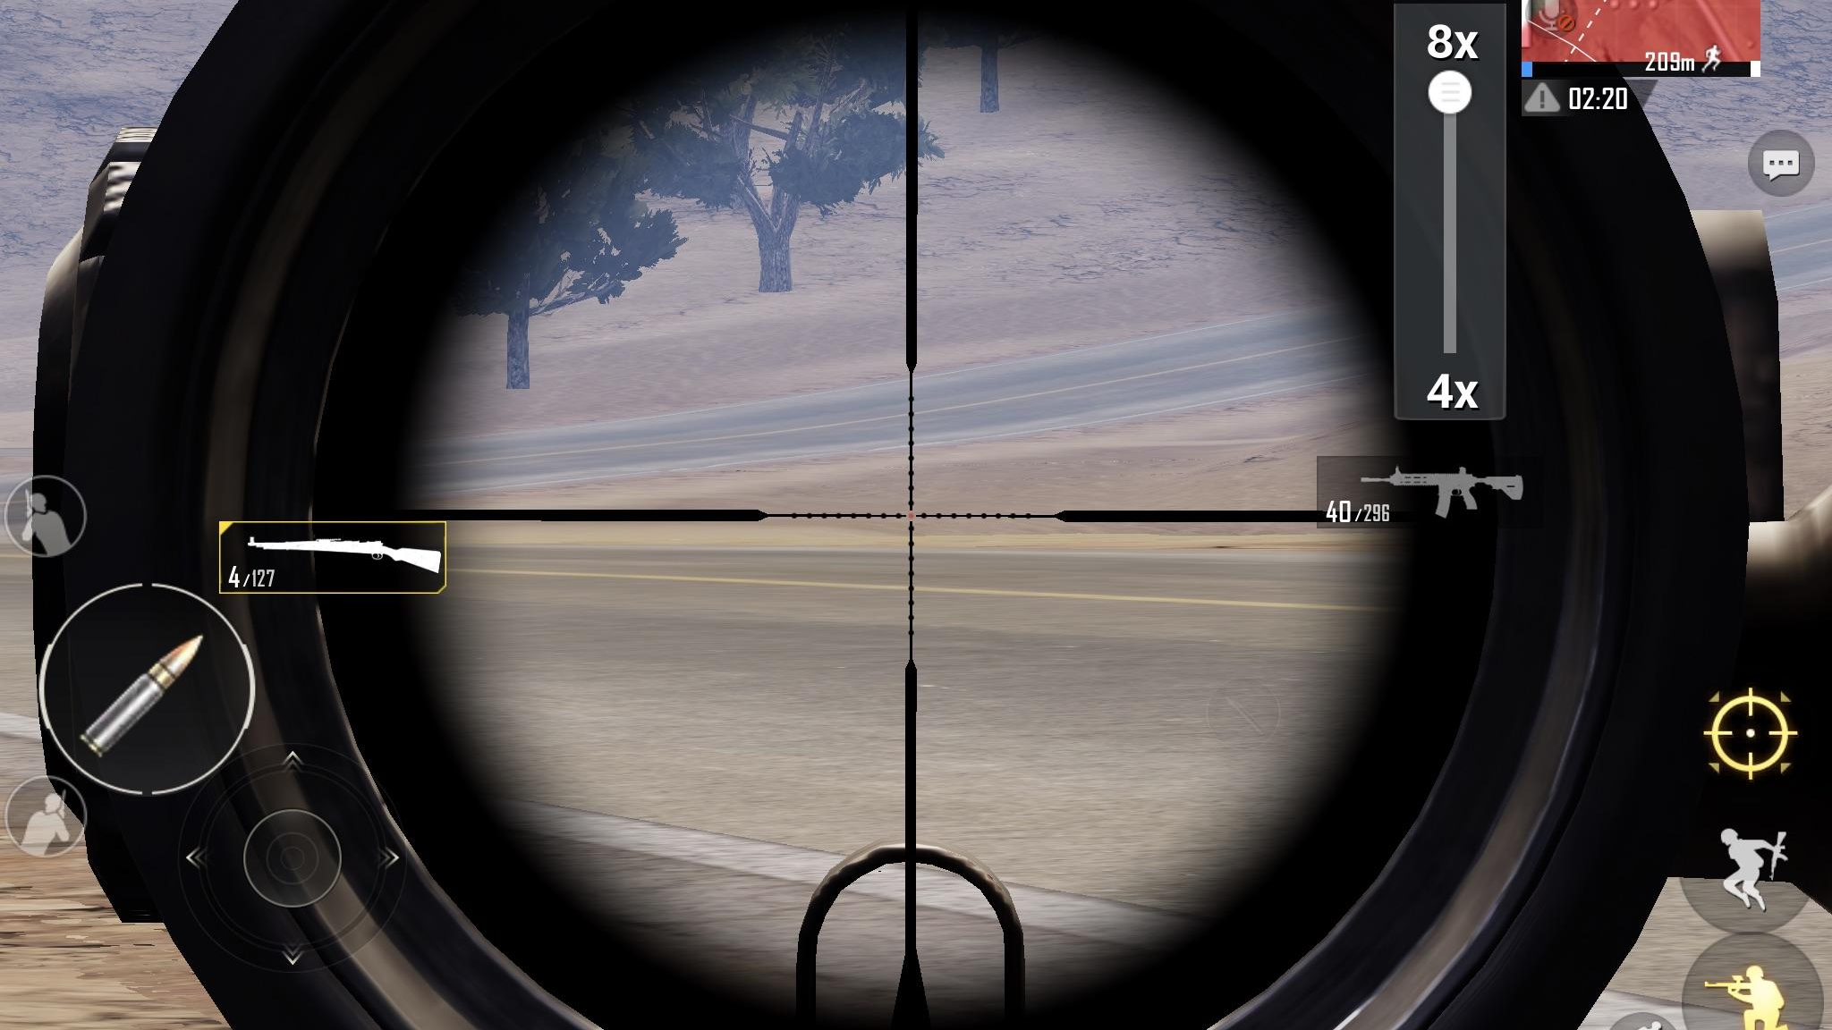
size of double
8 bytes

Slide 4


RANGE OF DOUBLE
±1.79769313486231570E+308 (15 SIGNIFICANT DECIMAL DIGITS)

Slide 5
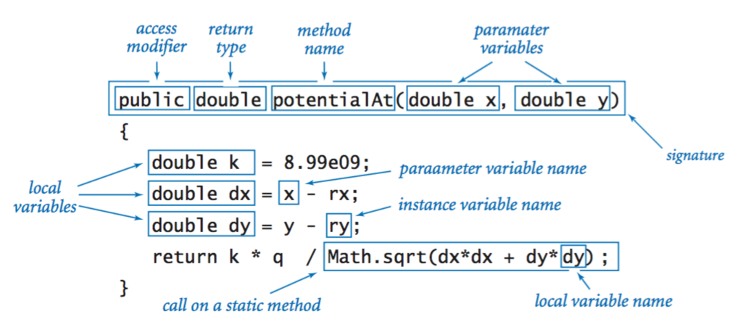
Double declaration

Slide 6
Class declaration
Public final class double
Extends number
Implements comparable<double>

Slide 7
summary
The double variable is used to hold floating point values.
The maximum and minimum values are 17 followed by 307 zeros.
SIZE OF THE DOUBLE IS 8 BYTES.

Slide 8
THANK YOU

