Slide 1
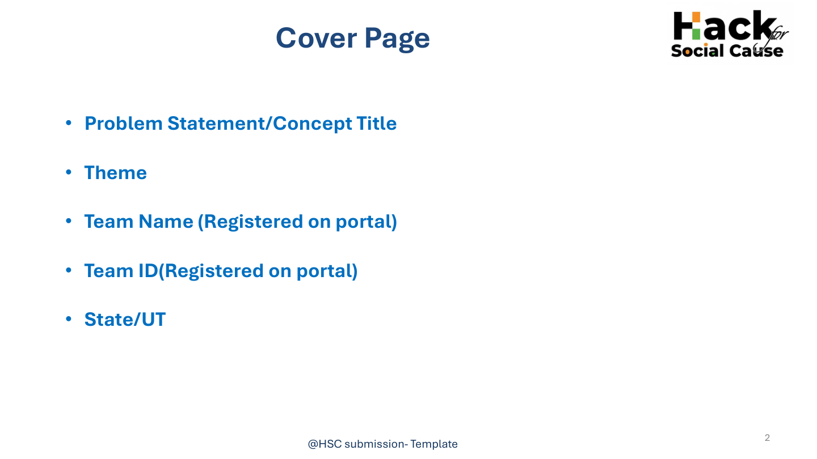



• Problem Statement / Concept Title
Agriculture and Wildlife Deterrent System (AWDS)
• Theme
Rural Developments and livelihood
AWDS21
• Team Name (Registered on portal)
AWDS21
IoT-Based Smart Crop Protection
and Wildlife Monitoring
• Team ID (Registered on portal)
HSC|TN|00811
TEAM AWDS21
Karthiga M • Keerthana I • Jothi M
Mentor: Dr. R. Valarmathi
• State/UT
Tamil Nadu

Slide 2
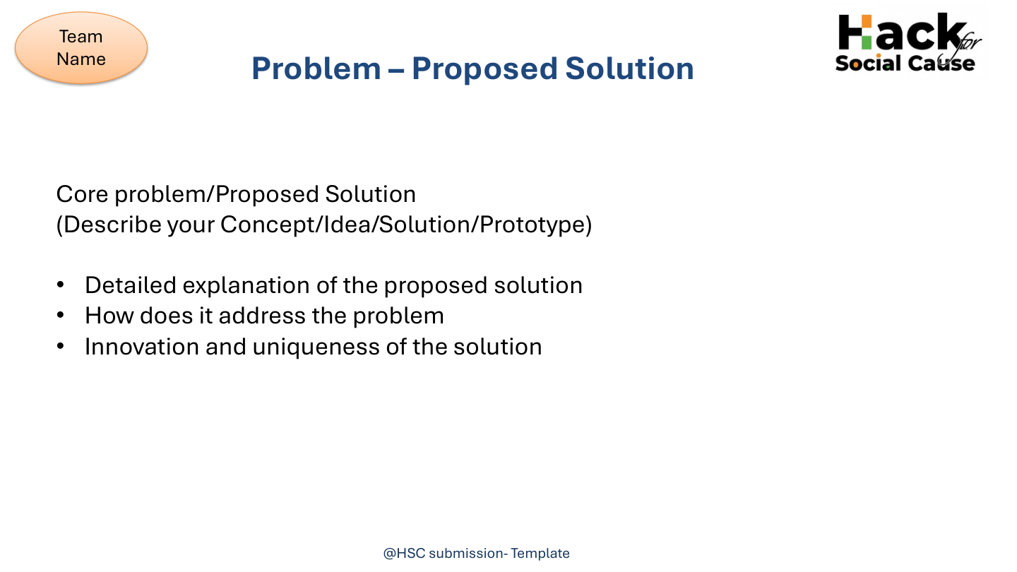
AWDS21
CORE PROBLEM
• Farmers near forests and wildlife corridors face crop losses from animal intrusion.
• Crop damage creates financial hardship and increases human–wildlife conflict.
• Manual guarding, fencing and standalone scare devices can be costly, labour-intensive or ineffective.
PROPOSED SOLUTION
• AWDS detects wildlife intrusion using motion sensors and camera monitoring.
• An embedded controller processes the detected event.
• Non-lethal ultrasonic deterrence is activated automatically.
• Real-time GSM/Wi-Fi alerts reach the farmer.
INNOVATION & UNIQUENESS
• Combines detection, automated deterrence and instant notification in one IoT platform.
• Continuous detection-to-action workflow reduces dependence on manual response.
• Modular architecture can support future AI recognition and cloud monitoring.

Slide 3
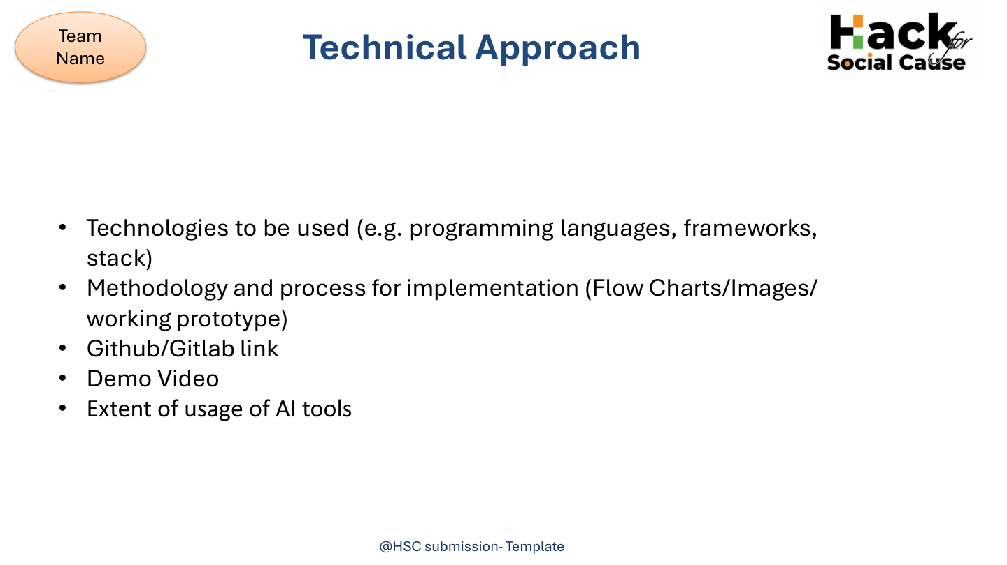
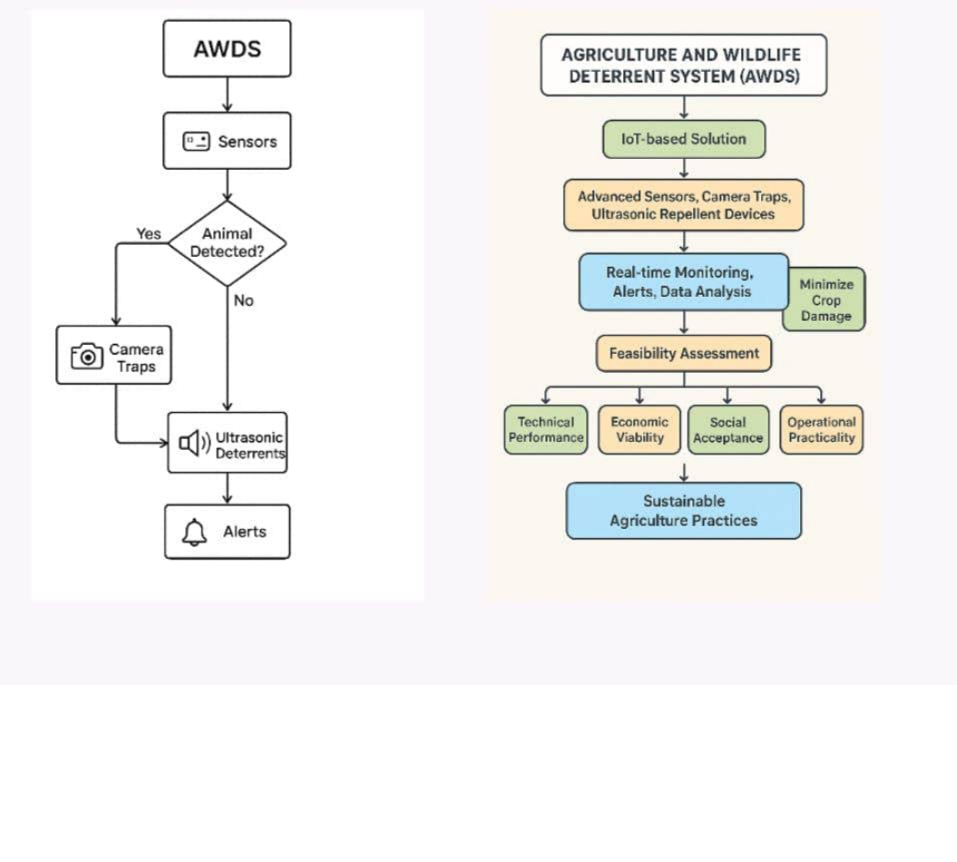
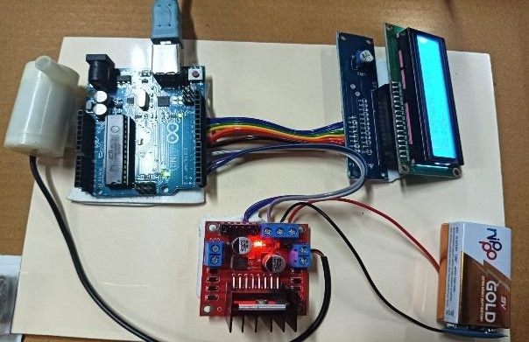
AWDS21
TECHNOLOGIES / COMPONENTS
• Arduino UNO embedded controller
• PIR motion sensing + camera monitoring
• GSM / Wi-Fi wireless communication
• Ultrasonic repellent + buzzer
• Threshold-based event processing
AWDS WORKFLOW / BLOCK DIAGRAM
IMPLEMENTATION METHOD
• Need → Detection → Processing → Wireless Command → Deterrence + Alert
• Detect movement → verify/monitor → process → trigger response → notify farmer
GitHub/GitLab: Not provided
AI: Future enhancement; current prototype uses threshold processing

Slide 4
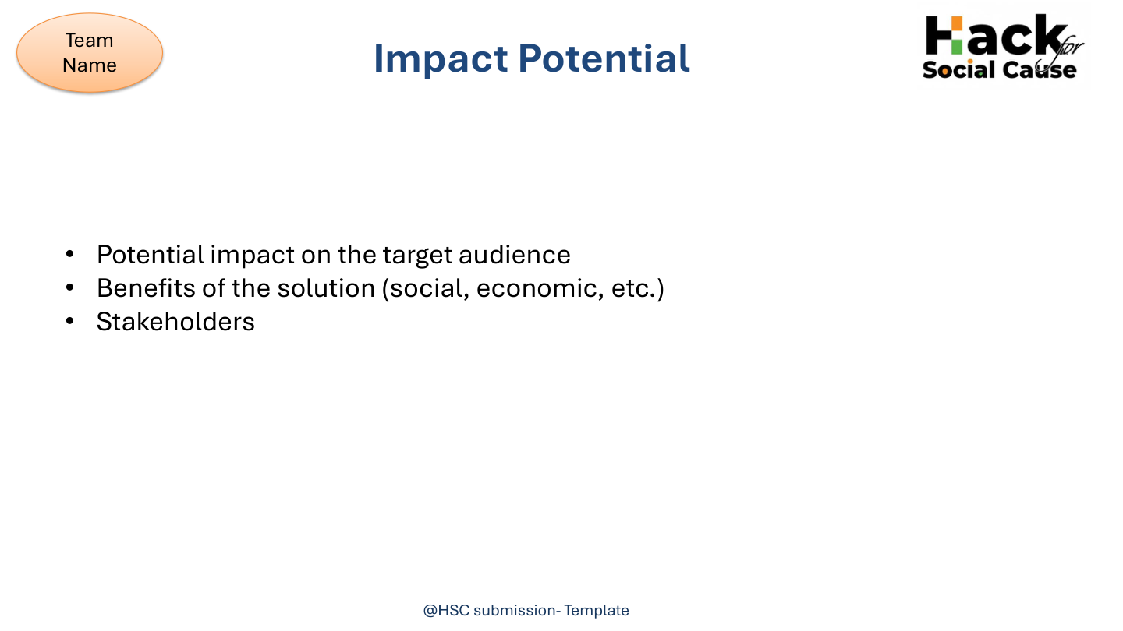
AWDS21
TARGET AUDIENCE
• Farmers and plantation owners
• Agricultural cooperatives / FPOs
• Horticulture and forest-edge communities
• Government agriculture and wildlife agencies
BENEFITS
• Economic: reduce crop damage and manual guarding
• Social: reduce human–wildlife conflict
• Environmental: non-lethal wildlife deterrence
• Supports sustainable and climate-resilient agriculture
STAKEHOLDERS
• Farmers and farming communities
• Agricultural departments
• Wildlife / conservation agencies
• Cooperatives, FPOs and future institutional partners
Impact potential: crop protection + safer coexistence + scalable smart farming

Slide 5
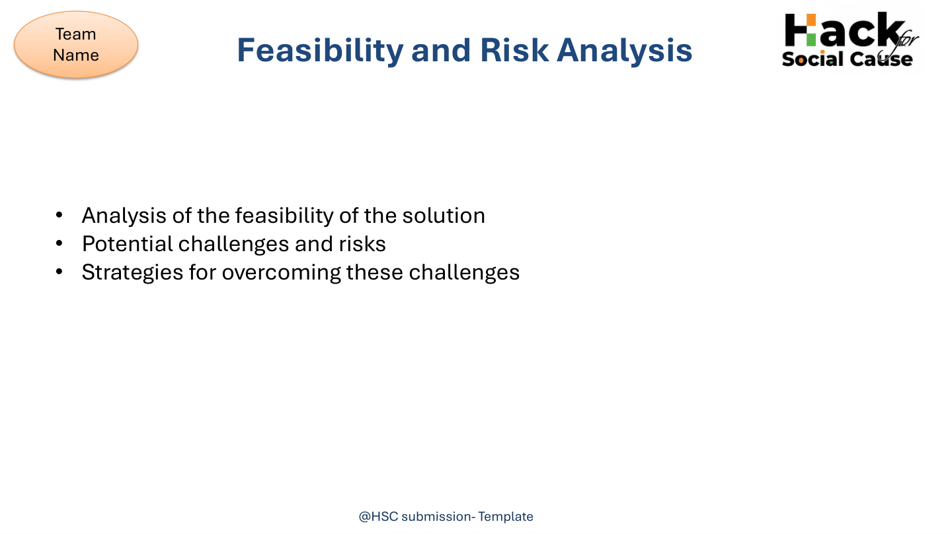
AWDS21
FEASIBILITY
• Uses readily available IoT hardware and embedded technologies.
• Prototype integrates sensing, processing, communication and deterrence.
• Installation/calibration require technical expertise; long-term operation is straightforward.
• Suitable for extended field validation and pilot deployment.
KEY RISKS / CHALLENGES
• Environmental conditions can affect performance.
• Sensor accuracy and sensitivity require calibration.
• Network availability can be limited in remote locations.
• Extended field validation is still required.
MITIGATION STRATEGIES
• Periodic calibration and maintenance
• Weather-resistant enclosures
• Optimize sensor placement and validate under diverse conditions
• Use reliable communication options for remote deployments
Overall feasibility: straightforward to moderate; major work is field validation and optimization

Slide 6
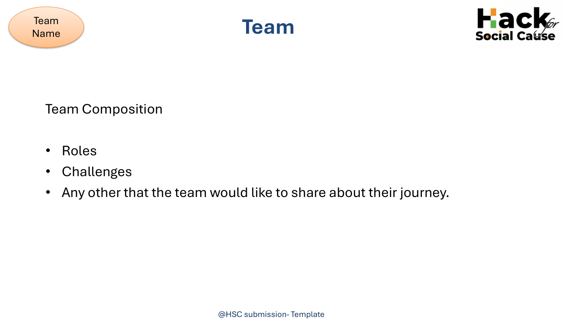
AWDS21
TEAM COMPOSITION
• Karthiga M
• Keerthana I
• Jothi M
• Mentor: Dr. R. Valarmathi, Associate Professor
ROLES / CONTRIBUTION
• Project development
• Research and documentation
• Prototype testing and refinement
• Presentation and project submission
CHALLENGES & JOURNEY
• Integrating sensing, deterrence and communication
• Validating the prototype under practical conditions
• Refining the system for wider field use
• Moving from prototype toward pilot deployment
Team focus: build → test → validate → improve AWDS for real agricultural use

Slide 7
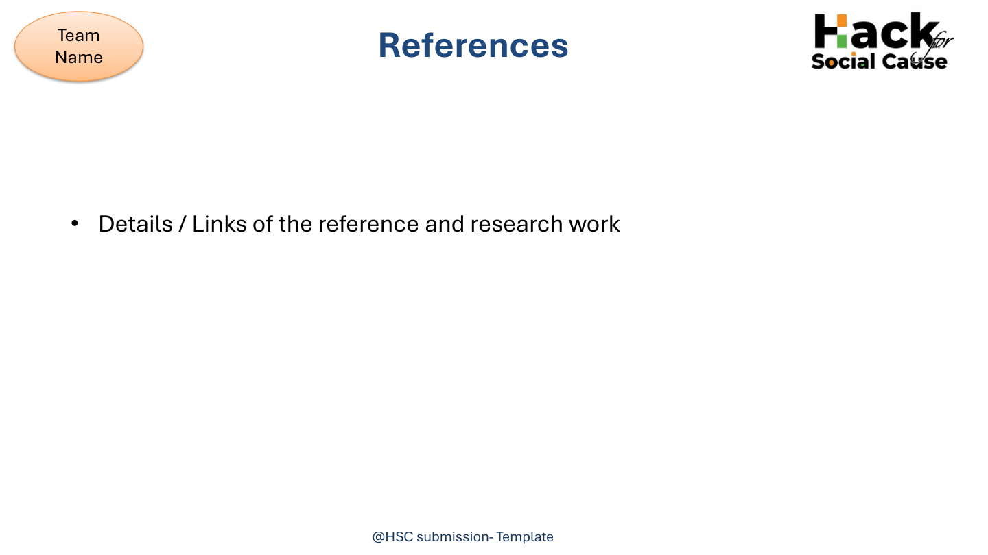
AWDS21
REFERENCE & RESEARCH WORK
[1]
P. S. Rathore, R. Gupta & A. Sharma, “IoT-Based Animal Detection and Alert System for Farm Fields,” IC3IoT, 2024.
researchgate.net/publication/381357336_IoT_Based_Animal_Detection_and_Alert_System_for_Farm_Fields
[2]
N. Alhassan et al., “IoT-Based Object-Detection System to Safeguard Endangered Animals on Farms,” Future Internet, 2023.
mdpi.com/1999-5903/15/12/372
[3]
S. Ramesh & V. Kumar, “Animal Detection Based Smart Farming in Animal Repellent Using AI and Deep Learning,” 2025.
irjweb.com
[4]
A. Y. Patel, R. Mehta & A. Pandey, “IoT-Based Real-Time Wildlife Intrusion Vigilance System,” 2025.
researchgate.net
[5]
F. B. Ahmed, R. F. Babatunde & K. C. Chang, “Real-Time Farm Surveillance Using IoT and YOLOv8 for Animal Intrusion Detection,” Future Internet, 2025.
mdpi.com/1999-5903/17/2/70
Source basis: AWDS research / IEEE material and project documentation supplied for this presentation.

