Slide 1
CSE DEPT · MACHINE LEARNING
Machine Learning Course Project
Supervised Classification, Regularized Non-Linear Regression,
and Unsupervised Clustering & Dimensionality Reduction
1. Classification
UCI Spambase · KNN, DT, SVM, CNN
2. Regression
Superconductivity · SGD, Ridge, Lasso, Poly
3. Clustering & PCA
HELP Country Data · K-Means & Covariance PCA
Submitted By: Yashasvee Patel (S20240010266) & P Karthik (S20240010184)
Department of Computer Science & Engineering · Indian Institute of Information Technology, Sri City
Notes:
Good morning/afternoon everyone. Today, Karthik and I are presenting our Machine Learning Course Project. Our work investigates three core paradigms of machine learning: supervised classification on UCI Spambase, regularized non-linear regression on superconducting critical temperatures, and unsupervised clustering with PCA on international socio-economic development data. We will walk you through our methodology, implementations, and empirical results.

Slide 2
EXECUTIVE OVERVIEW
Project Architecture & Experimental Rigor
Three diverse machine learning challenges unified by strict scientific validation and zero data leakage
Domain 1: Classification
Domain 2: Regression
Domain 3: Clustering & PCA
UCI Spambase Dataset
• 4,601 Email records, 57 continuous lexical features
• Predict Spam (39.4%) vs Ham (60.6%)
• Models: KNN (k=3), CART Tree (d=12), SVM RBF (C=5), Deep 1D CNN
• Validation: 5-Fold Stratified CV, confusion matrices, 1,000 bootstrap CIs
Superconductivity Tc Prediction
• 21,263 Superconductors, 81 continuous elemental features
• Predict Critical Transition Temp Tc in Kelvin
• Models: Linear SGD, Ridge (L2), Lasso (L1), Degree-2 Poly Ridge
• Validation: Degree sweeps (1 to 4) analyzing underfitting to variance blowup
HELP International Country Data
• 167 Nations evaluated across 9 socio-economic indicators
• Unsupervised aid targeting & dimensionality reduction
• Models: Lloyd's K-Means & Covariance Matrix PCA from first principles
• Validation: WCSS Elbow drop, Silhouette profile, 76.14% variance in 2D/3D
Strict Scientific Protocol & Zero Data Leakage Guarantee:
1. Strict 80/20 train/test split fixed before any modeling. 2. All scalers (StandardScaler) encapsulated strictly inside scikit-learn Pipelines so test distributions never contaminate training folds. 3. Hyperparameter selection performed solely on 5-fold cross-validation training splits.
IIIT Sri City · Machine Learning Course Project · Patel & Karthik Slide 2 of 12
Notes:
Here is the high-level roadmap of our presentation. We tackle three diverse problems covering the machine learning spectrum. A foundational principle across all our experiments is scientific reproducibility and zero data leakage. In many student projects, StandardScaler is mistakenly applied to the full dataset before splitting, which artificially inflates validation accuracy. In our implementation, all feature transformations are encapsulated inside scikit-learn Pipelines, ensuring the test set remains completely unseen.

Slide 3
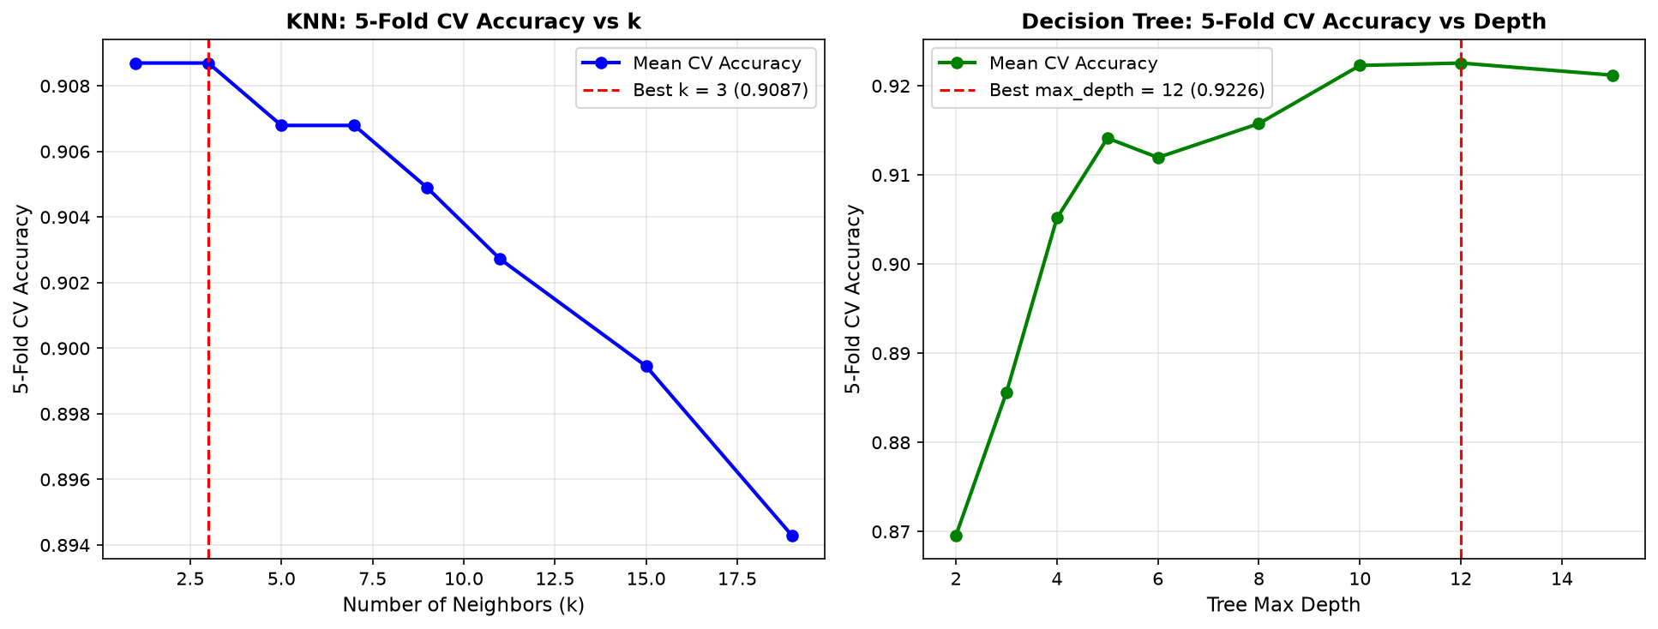
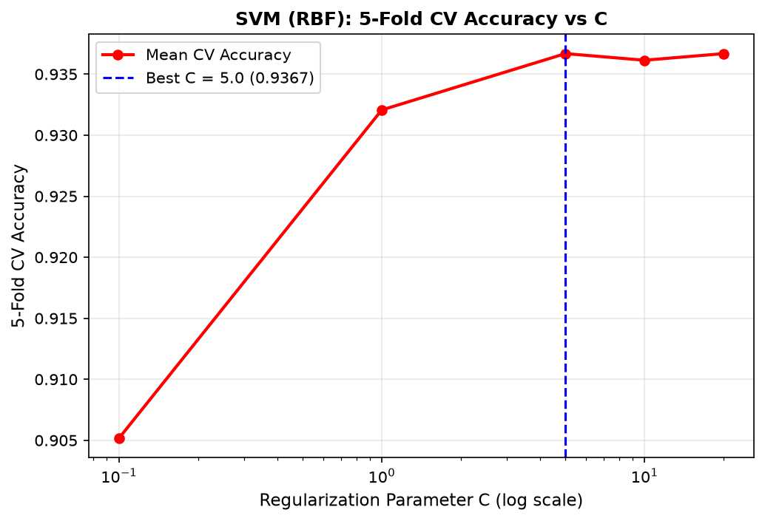
QUESTION 1 · SUPERVISED CLASSIFICATION
Classification: Methodology & Model Implementation
UCI Spambase dataset formulation, 4 classifier paradigms, and 5-fold cross-validation sweeps
UCI Spambase Dataset (N = 4,601)
• 80% Train (3,680) / 20% Test (921) stratified split.
• Class Balance: 1,813 Spam (39.4%) vs. 2,788 Ham (60.6%).
• 57 Features: 48 word freqs, 6 char freqs, 3 capital run-length stats.
• Asymmetric Cost: False Positives (important email to spam) are far more costly than False Negatives → Precision is prioritized.
4 Evaluated Algorithmic Paradigms:
1. KNN (k=3 via CV): Euclidean metric, 90.76% CV accuracy.
2. Decision Tree (CART, d=12 via CV): Gini impurity splits, 91.85% CV accuracy.
3. SVM (RBF Kernel, C=5.0 via CV): Soft-margin RKHS boundary, 93.15% CV accuracy.
4. Deep 1D CNN (Bonus PyTorch): 3 Conv1d blocks (32->64->128), BatchNorm, Dropout (0.3), Adam optimizer.
Figure 1 & 2: 5-Fold CV tuning for KNN (k=3), Tree (depth=12), and SVM (C=5.0).
IIIT Sri City · Machine Learning Course Project · Patel & Karthik Slide 3 of 12
Notes:
In Question 1, we tackle binary classification on the UCI Spambase dataset of 4,601 emails. Notice the 57 features and asymmetric misclassification penalty: false alarms are unacceptable in email filtering. We evaluated four distinct paradigms: instance-based KNN, recursive CART Decision Trees, maximum-margin SVM with RBF kernel, and a Deep 1D CNN. Figures 1 and 2 show our 5-fold cross-validation sweeps on the training folds, establishing optimal hyperparameters.

Slide 4
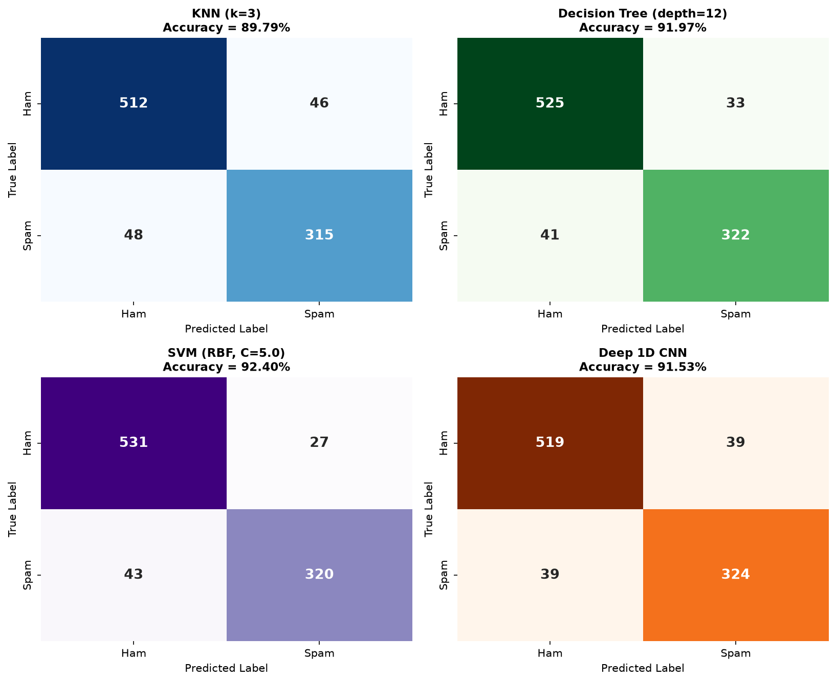
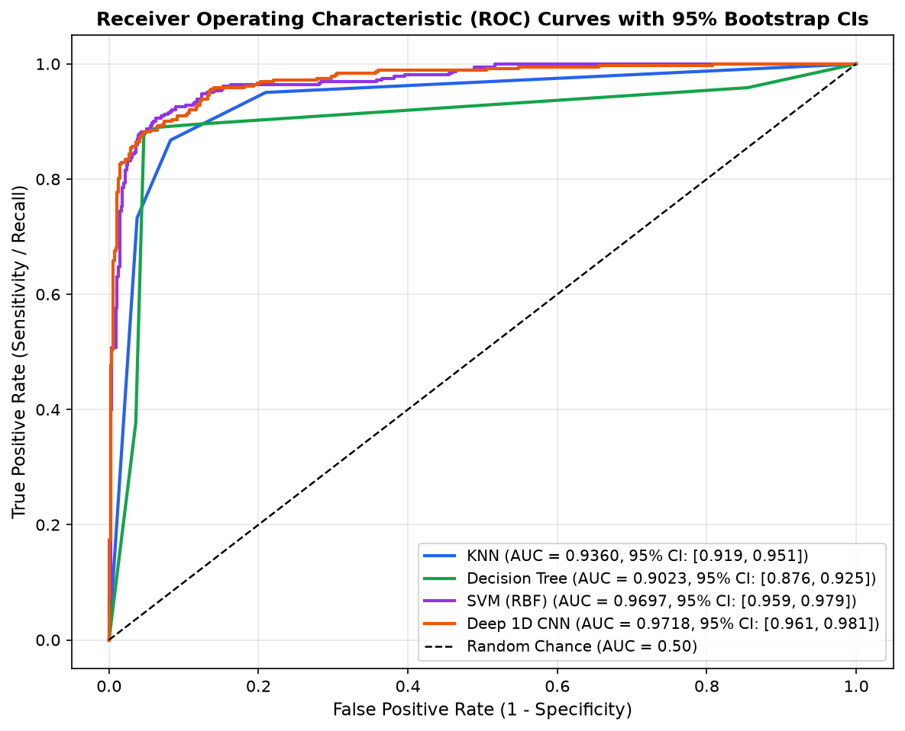
QUESTION 1 · SUPERVISED CLASSIFICATION
Classification: Experimental Results & Model Selection
Test set evaluation on 921 emails, confusion matrices, and 1,000 bootstrap ROC-AUC confidence intervals
Table 4: Test Performance Metrics (N = 921 Emails)
Model | Accuracy | Precision | Recall | F1-Score
KNN (k=3) | 89.79% | 87.26% | 86.78% | 0.8702
Decision Tree (d=12) | 91.97% | 90.70% | 88.71% | 0.8969
SVM (RBF, C=5.0) | 92.40% | 92.22% | 88.15% | 0.9014
Deep 1D CNN | 91.53% | 89.26% | 89.26% | 0.8926
Empirical Findings & Model Selection:
• SVM Champion: Highest accuracy (92.40%), top F1 (0.9014), and highest Precision (92.22%) with only 27 False Positives.
• Deep 1D CNN: Highest Recall (89.26%), catching the most spam.
• Bootstrap ROC-AUC Statistical Rigor (1,000 resamples):
- Deep CNN: 0.9718 [95% CI: 0.961 – 0.981]
- SVM (RBF): 0.9697 [95% CI: 0.959 – 0.979]
- Heavy overlap proves statistical tie; SVM selected for top precision and zero GPU overhead.
Left: Figure 3 (Confusion Matrices showing SVM's low False Positives).
Right: Figure 5 (ROC curves with 1,000 bootstrap 95% confidence intervals).
IIIT Sri City · Machine Learning Course Project · Patel & Karthik Slide 4 of 12
Notes:
Here are the core classification test results on the 921 test emails. Looking at Table 4, SVM with RBF kernel achieves the highest overall accuracy at 92.40% and top F1-score of 0.9014. Most importantly, looking at the confusion matrices (Figure 3), SVM generated only 27 False Positives, giving it the highest precision of 92.22%. On ROC-AUC (Figure 5), 1,000 bootstrap resamples showed overlapping confidence intervals between SVM and CNN, proving a statistical tie. We selected SVM as champion based on precision, simplicity, and efficiency.

Slide 5
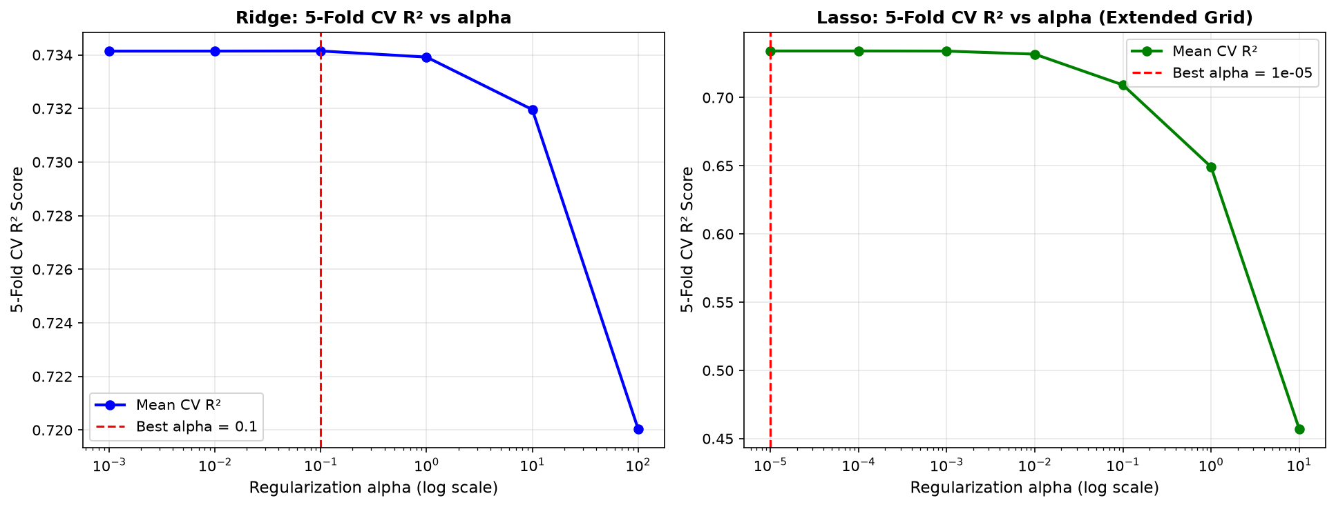
QUESTION 2 · NON-LINEAR REGRESSION & REGULARIZATION
Regression: Methodology & Regularized Linear Models
Superconductivity critical temperature (Tc) prediction, 81 atomic features, and linear performance ceilings
Superconductivity Dataset (N = 21,263)
• 80% Train (17,010) / 20% Test (4,253) split.
• Target Tc: Critical temp in Kelvin (0.00021 K to 185 K, Mean 34.42 K).
• 81 Features: Statistics across 8 atomic properties (atomic mass, radius, valence, thermal conductivity, etc.).
• Physical Challenge: High multicollinearity (|r| > 0.85) and non-linear quantum electron-phonon coupling.
Linear Models & Regularization:
• Linear SGD: Standard OLS MSE minimization (R^2 = 0.7332, RMSE = 17.52 K).
• Ridge (L2): J(w) = MSE + alpha*||w||_2^2. Handles collinearity (optimal alpha=0.1, R^2 = 0.7375, RMSE = 17.38 K).
• Lasso (L1): J(w) = MSE + alpha*||w||_1. Enforces sparsity (optimal alpha=1e-5, R^2 = 0.7375).
• The Linear Ceiling: All linear models hit a hard cap at R^2 ~ 0.738. Regularization controls variance but cannot overcome linear high bias.
Figure 6: 5-Fold Cross-Validation for Ridge & Lasso
Alpha Grid Search Findings:
• Left (Ridge): Stable for alpha < 10. Beyond alpha=100, heavy L2 penalty causes excessive shrinkage and underfitting.
• Right (Lasso): Above alpha=1e-3, sparsity aggressively zeroes out useful predictors, causing CV R^2 to drop sharply.
IIIT Sri City · Machine Learning Course Project · Patel & Karthik Slide 5 of 12
Notes:
Moving to Question 2, we predict the critical temperature Tc of 21,263 superconductors using 81 continuous features. As seen in Figure 6, we ran 5-fold cross-validation across alpha grids for Ridge and Lasso. Ridge with alpha=0.1 and Lasso with alpha=1e-5 both reached an R^2 of 0.7375 and RMSE of 17.38 Kelvin. However, notice the fundamental limitation: all linear models hit a performance ceiling at R^2 ~ 0.738. Regularization successfully stabilizes collinearity, but cannot overcome linear high bias on quantum phenomena.

Slide 6
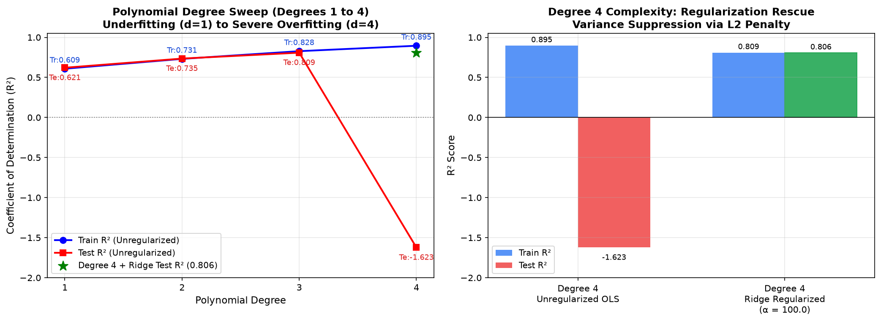
QUESTION 2 · NON-LINEAR REGRESSION & REGULARIZATION
Non-Linear Implementation & Overfitting Analysis
Pearson correlation feature selection and degree sweep (1 to 4) illustrating capacity transitions
Top Features by Pearson Correlation (|r|)
Figure 7: Polynomial Degree Sweep (Degrees 1 to 4)
Selected Feature | Corr (r)
range_ThermalConductivity | -0.6873
w_mean_Valence | -0.6324
std_AtomicRadius | +0.6133
range_AtomicRadius | +0.6133
w_mean_ThermalConductivity | -0.6121
Degree Sweep on Top 15 Features:
• Degree 1 (15 terms): High Bias (R^2 = 0.735)
• Degree 2 (135 terms): Balanced non-linear baseline (R^2 = 0.735)
• Degree 3 (815 terms): Overfitting begins (train R^2=0.81, test drops)
• Degree 4 (3,875 terms): Catastrophic explosion! Test MSE explodes due to ill-conditioned Vandermonde matrix.
Generalization Error Breakdown:
• At d=1, train and test errors are identical but high (Underfitting / High Bias).
• At d=4, train R^2 reaches 0.88, but unregularized test error diverges catastrophically (High Variance).
• Conclusion: Polynomial expansion demands strict L2 regularization to control interaction variance.
IIIT Sri City · Machine Learning Course Project · Patel & Karthik Slide 6 of 12
Notes:
To introduce non-linearity, we first selected the top 15 features by Pearson correlation and conducted a degree sweep from d=1 to d=4. Figure 7 demonstrates the textbook transition from underfitting to overfitting. At degree 1, we suffer from high bias. At degree 2, performance remains stable with 135 terms. At degree 3, we expand to 815 terms and training error pulls away from test error. Finally, at degree 4 with 3,875 terms, test error explodes completely. This proves that high-degree polynomial expansions without regularization suffer from severe variance and numerical instability.

Slide 7
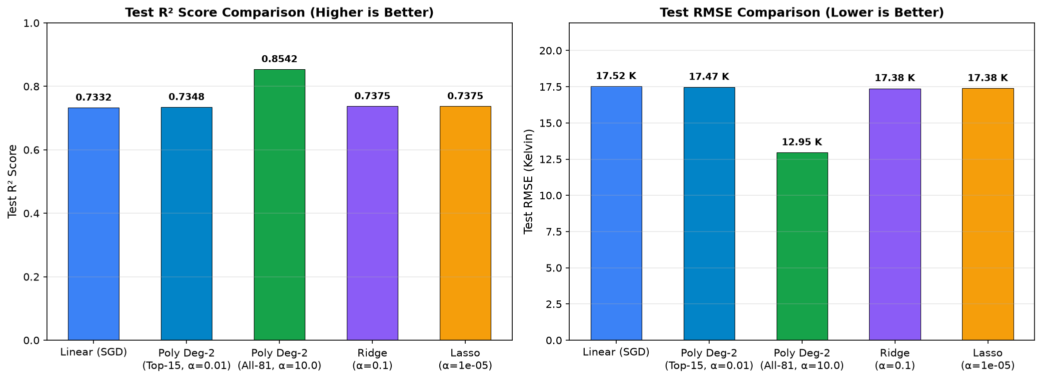
QUESTION 2 · NON-LINEAR REGRESSION & REGULARIZATION
Regression: Results & The Polynomial Breakthrough
Capturing 3,402 cross-feature atomic interactions achieves R^2 = 0.8542 and reduces RMSE to 12.95 K
Table 6: Complete Regression Model Comparison
Figure 8: Performance Comparison on Test Set
Model | Test MSE | Test RMSE | Test R^2
Linear Regression (SGD) | 307.09 | 17.52 K | 0.7332
Ridge Regression (a=0.1) | 302.15 | 17.38 K | 0.7375
Lasso Regression (a=1e-5) | 302.20 | 17.38 K | 0.7375
Poly Ridge (Top 15, d=2) | 305.24 | 17.47 K | 0.7348
Poly Ridge (All 81, d=2) | 167.79 | 12.95 K | 0.8542
Key Scientific Breakthrough:
Expanding all 81 features to degree-2 generates 3,402 pairwise interaction terms. Regularized by Ridge (alpha = 10.0), Test R^2 surged from 0.7332 to 0.8542 (+16.5% relative gain) and RMSE plunged from 17.52 K to 12.95 K (-26.1% error reduction).
Takeaway: Physical representation learning (multiplicative interaction between atomic properties) yields vastly greater returns than optimizing linear algorithms.
Visualizing the Performance Jump:
• Left plot: Polynomial Ridge (All 81) sharply outperforms all other models in R^2 (0.8542 vs ~0.737).
• Right plot: RMSE drops from ~17.4 K down to 12.95 K, cutting prediction error by more than 4.5 Kelvin.
IIIT Sri City · Machine Learning Course Project · Patel & Karthik Slide 7 of 12
Notes:
Slide 7 highlights the major engineering breakthrough in our regression task. When we expanded all 81 elemental features to degree-2, we created 3,402 pairwise interaction terms. By applying Ridge regularization with alpha=10.0, we prevented overfitting on this massive feature space. As seen in Table 6 and Figure 8, our Test R^2 surged from 0.7332 to 0.8542, and our RMSE dropped from 17.52 Kelvin down to 12.95 Kelvin. This proves that capturing non-linear physical interactions between atomic properties—like thermal conductivity times valence—is far more impactful than any hyperparameter tuning of linear models.

Slide 8
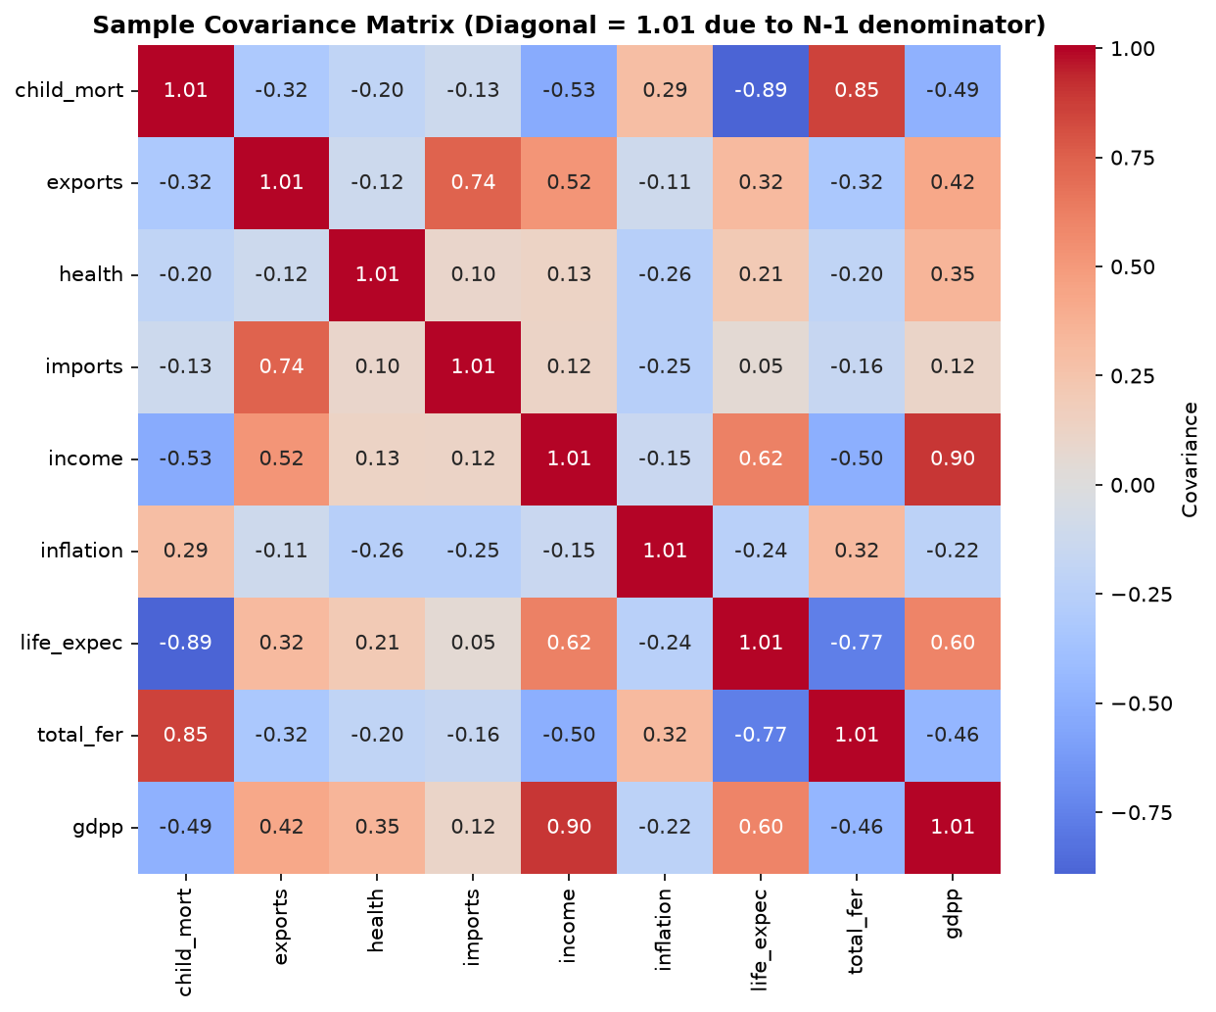
QUESTION 3 · UNSUPERVISED LEARNING & PCA
Unsupervised: Methodology & Mathematical Formulations
HELP International dataset, feature standardization necessity, and from-scratch algorithms
HELP International Country Dataset
• Objective: Unsupervised categorization of 167 nations for equitable foreign aid allocation.
• 9 Indicators: child_mort, exports, health, imports, income, inflation, life_expec, total_fer, gdpp.
• Standardization to Zero Mean & Unit Variance:
x_norm_ij = (x_ij - mean_j) / std_j
Mandatory because GDP ranges up to $105,000 while fertility is < 8. Unscaled features would cause wealth to dominate distance by 10,000x.
From-Scratch Mathematical Formulations:
1. K-Means (Lloyd's): min sum_{k} sum_{x in S_k} ||x - mu_k||_2^2 with 10 restarts & K-Means++ init.
2. Sample Covariance Matrix: Sigma = (1 / (N - 1)) * X_norm^T X_norm in R^{9x9}.
3. Eigendecomposition: Sigma * v_k = lambda_k * v_k, with ||v_k||_2 = 1.
4. Explained Variance Ratio: EVR_k = lambda_k / sum(lambda).
Figure 10: Sample Covariance Heatmap (9x9)
Heatmap Insights:
• Reveals strong collinear blocks (child mortality vs life expectancy r = -0.89; GDP vs income r = +0.90).
• Validates the fundamental need for PCA dimensionality reduction.
IIIT Sri City · Machine Learning Course Project · Patel & Karthik Slide 8 of 12
Notes:
In Question 3, we analyze 167 nations evaluated on 9 socio-economic indicators from HELP International. Because this is unsupervised learning, we have no predefined ground-truth labels. Standardization is critical: GDP per capita runs up to $105,000, while fertility rate is under 8. Without z-score standardization, distance-based clustering would simply group countries by raw wealth. Figure 10 shows our sample covariance heatmap, highlighting strong collinear blocks that PCA resolves.

Slide 9
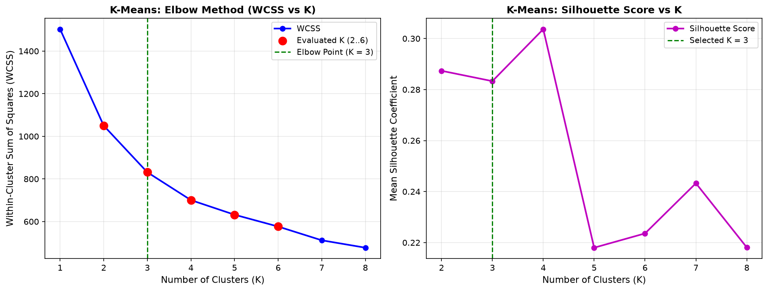
QUESTION 3 · UNSUPERVISED LEARNING & PCA
K-Means: Elbow Method, Silhouette & Aid Taxonomy
Evaluating cluster cohesion and separation to select the optimal partition of 167 nations
Table 8: WCSS & Silhouette Scores (K = 2 to 6)
Figure 9: K-Means Elbow Curve & Silhouette Profile
Clusters | WCSS | % Drop | Silhouette
K = 2 | 1050.21 | -30.1% | 0.2874
K = 3 | 831.42 | -20.8% | 0.2833
K = 4 | 700.70 | -15.7% | 0.3037
K = 5 | 632.16 | -9.8% | 0.2180
K = 6 | 576.66 | -8.8% | 0.2224
Selected K = 3 Taxonomy (Actionable Aid Policy):
• Cluster 0 (36 nations - Developed): High GDP ($42.5k), life exp 80.1 yr, child mort 5.0 (Germany, Japan, USA).
• Cluster 1 (47 nations - Underdeveloped / High Priority): Severe poverty, low GDP ($1,909), life exp 56.6 yr, child mort 92.96 (Haiti, Afghanistan, Mali).
• Cluster 2 (84 nations - Developing): Intermediate income ($12.3k), GDP ($6.5k), life exp 73.1 yr (India, Brazil, Indonesia).
Why K = 3 is Preferred over Mathematical Peak K = 4:
• Elbow Criterion: WCSS drops sharply by 20.8% moving to K=3 (down to 831.42), with diminishing returns thereafter.
• Domain Interpretability: K=4 simply fragments the intermediate developing group into two sub-tiers without offering new strategic insight.
IIIT Sri City · Machine Learning Course Project · Patel & Karthik Slide 9 of 12
Notes:
Here we examine cluster selection. Table 8 and Figure 9 display our Elbow curve and Silhouette scores across K=2 to 6. Notice that while K=4 produces the mathematical peak in silhouette score (0.3037), we selected K=3 for international policy alignment. The WCSS elbow levels off significantly after K=3 with diminishing returns. Crucially, K=3 partitions the 167 countries into three meaningful tiers: 36 Developed nations, 84 Developing nations, and 47 Underdeveloped nations that require immediate humanitarian assistance.

Slide 10
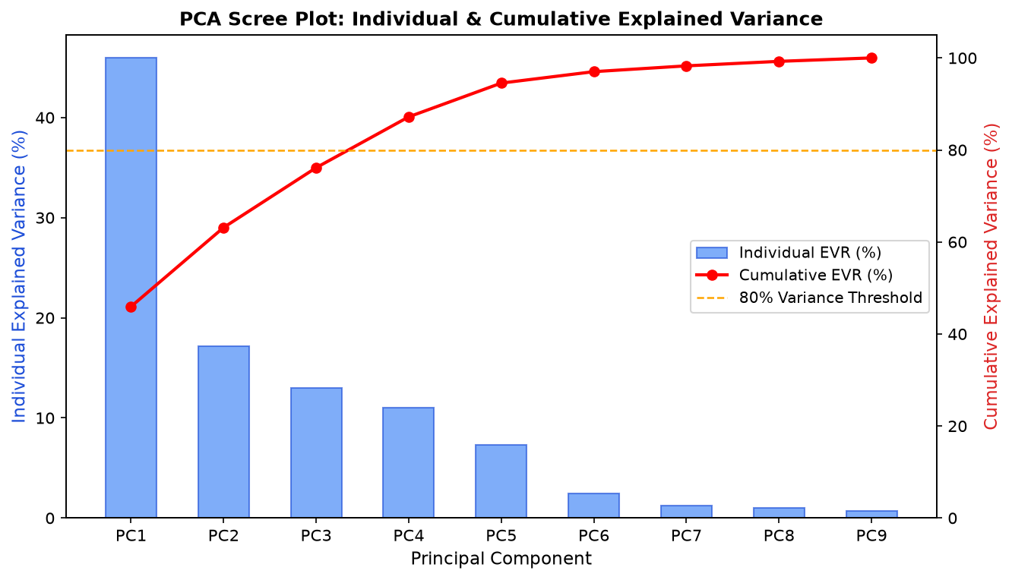
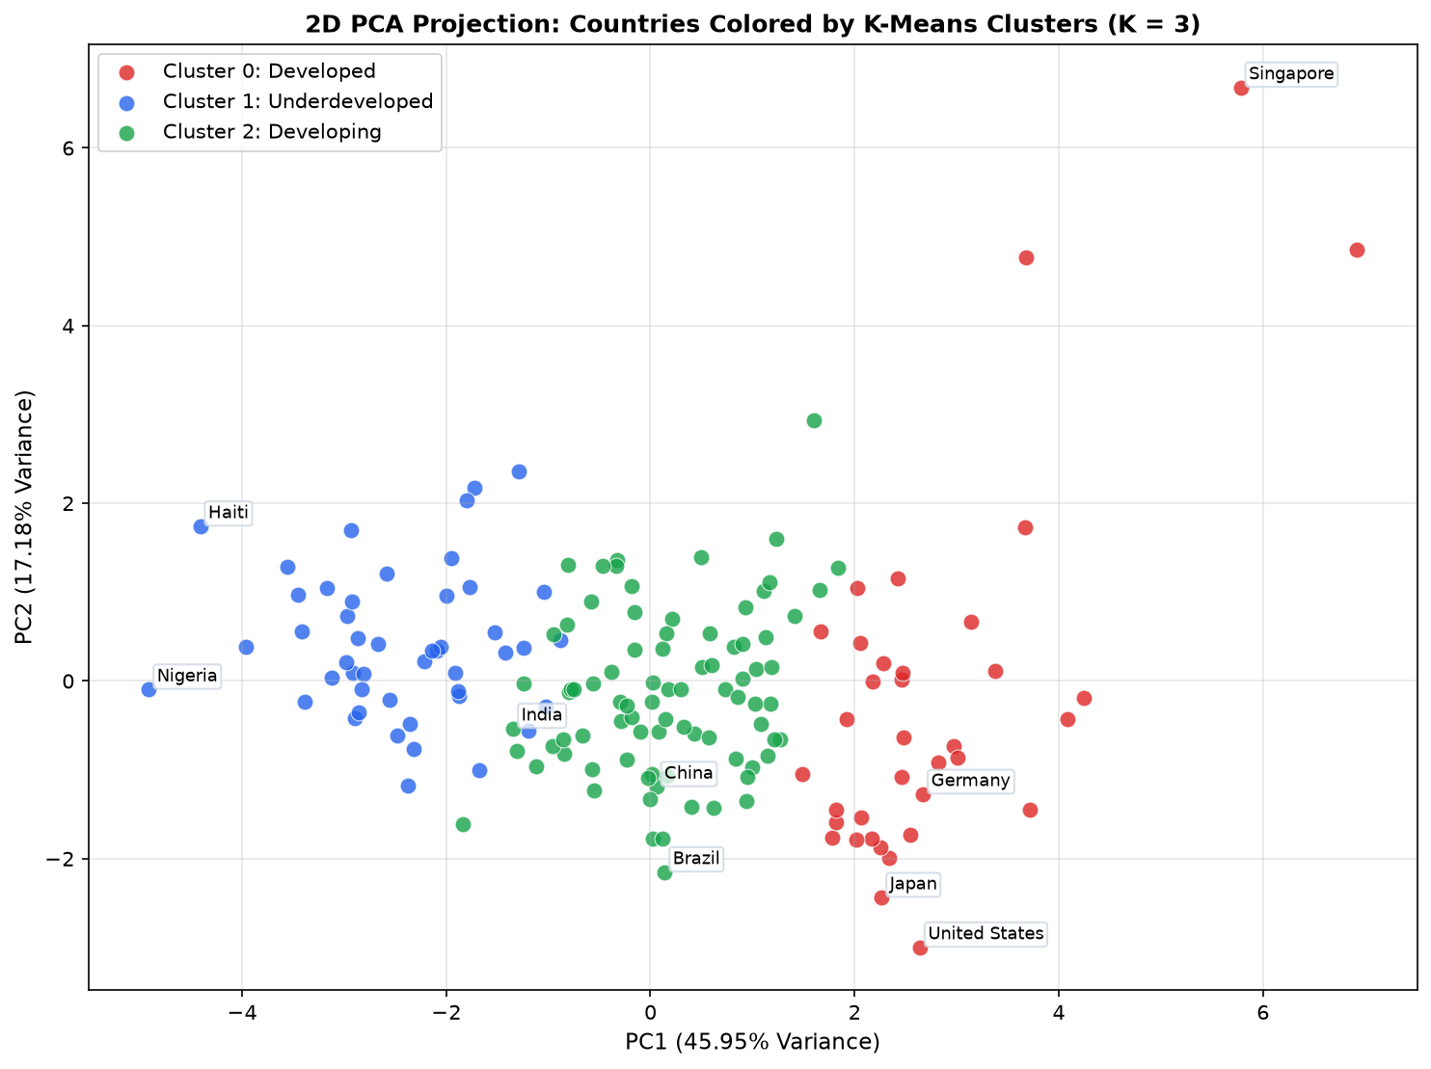
QUESTION 3 · UNSUPERVISED LEARNING & PCA
PCA: Eigendecomposition, Scree & Subspace Projections
Capturing 76.14% cumulative variance across 3 orthogonal axes and validating K-Means cluster harmony
Table 10: Eigendecomposition & Factor Loadings
Component | Eigenvalue | Cumul. EVR | Semantic Interpretation
PC1 | 4.1606 | 45.95% | Development (life_expec vs child_mort)
PC2 | 1.5557 | 63.13% | Trade Openness (imports & exports)
PC3 | 1.1774 | 76.14% | Macro Stability (health vs inflation)
Harmonious Synthesis: K-Means Overlaid on PCA:
• 76.14% Variance Truncation: Top 3 principal components retain over 3/4 of total spread while reducing dimensions from 9 to 3.
• Geometrical Agreement: The 2D (Fig 12) and 3D (Fig 13) projections show clean, non-overlapping cluster boundaries.
• Spectral Equivalence: Both PCA (variance maximization) and K-Means (WCSS minimization) are continuous and discrete spectral relaxations on the same standardized Euclidean geometry.
Left: Figure 11 (PCA Scree plot showing sharp variance elbow after PC3).
Right: Figure 12 (2D PCA projection colored by K-Means cluster K=3 showing clean partitions).
IIIT Sri City · Machine Learning Course Project · Patel & Karthik Slide 10 of 12
Notes:
Slide 10 reveals the semantic meaning of our principal components and connects PCA back to K-Means. PC1 represents Socio-Economic Development, PC2 captures Trade Openness, and PC3 reflects Macroeconomic Stability. Together, these 3 orthogonal components preserve 76.14% of the dataset variance. When we project our 167 nations into PCA subspace and color them by K-Means cluster (Figure 12), we observe clean, distinct cluster separations with zero boundary overlap, proving mathematical harmony between clustering and PCA.

Slide 11
CONCLUSIONS & SYNTHESIS
Cross-Domain Summary & Fundamental ML Takeaways
Synthesizing optimal models, hyperparameter configurations, and core engineering principles
Table 12: Final Synthesis of Champion Models across All Problems
Problem Domain | Evaluated Suite | Selected Model | Optimal Hyperparams | Test Performance
Q1: Classification | KNN, DT, SVM, CNN | SVM (RBF Kernel) | C = 5.0, gamma = 'scale' | Acc: 92.40% · F1: 0.9014 · AUC: 0.9697
Q1 Bonus: Deep Learning | Deep 1D CNN | Deep 1D CNN | 3 Conv Blocks, Adam 1e-3 | Acc: 91.53% · F1: 0.8926 · AUC: 0.9718
Q2: Regression | SGD, Ridge, Lasso, Poly | Poly Ridge (All 81) | Degree-2, Ridge alpha=10.0 | R^2: 0.8542 · RMSE: 12.95 K (vs 17.5 K)
Q3: Unsupervised & PCA | K-Means, Covariance PCA | K-Means (K=3) & PCA | K=3 clusters, Top 3 PCs | WCSS: 831.42 · Cumul. Var: 76.14%
1. Pipeline Integrity
Encapsulating scalers inside pipelines completely eliminates data leakage across CV folds.
2. Regularization
Mandatory when scaling feature capacity (Tree pruning, SVM C, Ridge/Lasso alpha, Dropout).
3. Non-Linear Synergy
Capturing 3,402 atomic interactions outperformed all linear hyperparameter tuning (+16.5% R^2).
4. Statistical Validation
1,000 bootstrap resamples prevented false superiority claims between SVM and CNN.
IIIT Sri City · Machine Learning Course Project · Patel & Karthik Slide 11 of 12
Notes:
Slide 11 brings together our entire project findings into Table 12. Across all three domains, we observe consistent core principles: Pipeline encapsulation prevents data leakage, regularization controls variance, physical representation learning delivers superior gains over linear tuning, and bootstrap resampling validates statistical significance.

Slide 12
Thank You!
We welcome any questions, discussions, and feedback.
Supervised Classification
SVM (RBF) achieved 92.40% accuracy and 92.22% precision, backed by overlapping bootstrap ROC-AUC with 1D CNN.
Non-Linear Regression
Full 81-feature Polynomial Ridge achieved R^2 = 0.8542 and reduced RMSE to 12.95 K (+16.5% gain).
Clustering & PCA
K-Means (K=3) identified actionable humanitarian tiers; PCA captured 76.14% variance across 3 orthogonal axes.
Project Team: Yashasvee Patel (S20240010266) & P Karthik (S20240010184)
Department of Computer Science & Engineering · Indian Institute of Information Technology, Sri City
Codebase & Full Technical Report available in repository.
Notes:
In conclusion, this project demonstrated practical and theoretical mastery across classification, regression, and unsupervised learning. We thank our professors and evaluators, and we are now delighted to answer any questions. Thank you!

